Slide 1

SMART INDIA HACKATHON 2026
TITLE PAGE
Problem Statement ID – SIH26167
Problem Statement Title- SatQuery AI – An Interactive Vision-Language Assistant for Multimodal Remote Sensing Image Analysis through Text Queries
Theme- Space Technology
PS Category- Software
Team ID- [fill after portal registration]
Team Name (Registered on portal)- [fill after portal registration]

Slide 2
IDEA TITLE
SatQuery AI
Proposed Solution (Describe your Idea/Solution/Prototype)
Problem: analysts manually interpret ISRO imagery today for agri-insurance, land records, and mining compliance – today’s workflow is Search → Select → Analyse → Interpret: slow, expertise-heavy, no natural-language access
Solution: ask in plain language, get an answer grounded in real ISRO evidence – fills the gap between structured dashboards (SatSure) and ungrounded global search (Google Earth AI)
Plain-Language Query
Agent Routing
Retrieve + Analyze (ISRO Archive)
Validated, Grounded Answer
Platform capabilities: semantic retrieval • VQA & visual grounding • confidence scoring — change detection & optical+SAR fusion (roadmap, after MVP validation)

Slide 3
TECHNICAL APPROACH
SatQuery AI
Stack: Python, PyTorch, RemoteCLIP-family dual encoder (image + text), fine-tuned on BigEarthNet-MM, evaluated on VRSBench
Pipeline: Query → Text Encoder → Vector Search → Top-k Retrieval → Grounded Answer (flow below), sourced from the ISRO archive
offline ingestion → Image Encoder
ISRO Bhuvan / NRSC Archive (Bhoonidhi)
NL Query
Text Encoder
Vector Search / Retrieval Index
Top-k Retrieved Tiles
Grounded Answer
MVP path shown in full; the same agent layer routes to change-detection and optical+SAR specialist models post-validation

Slide 4
FEASIBILITY AND VIABILITY
SatQuery AI
FEASIBILITY
Pretrained encoders + open datasets (BigEarthNet, VRSBench) → fine-tuning, not new invention. Main risk: retrieval accuracy on Indian-specific terrain classes.
RISK
Indian Domain Gap: training data may not fully represent Indian terrain
Multimodal Complexity: optical, SAR & temporal data need different analysis
AI Reliability: plausible answers can still be incorrect
MITIGATION
MVP proves retrieval + grounded VQA end-to-end on one region first – change detection & SAR fusion phased in after validation
Trust: every answer ships with evidence, a confidence score, and an execution trace
BUSINESS MODEL (UNIT ECONOMICS)
Usage-based per-query/report API to agri-insurance, land-record & mining-compliance verticals – priced below enterprise GEOINT contracts (SatSure, Google Cloud), since ISRO archive access is the cost base.

Slide 5
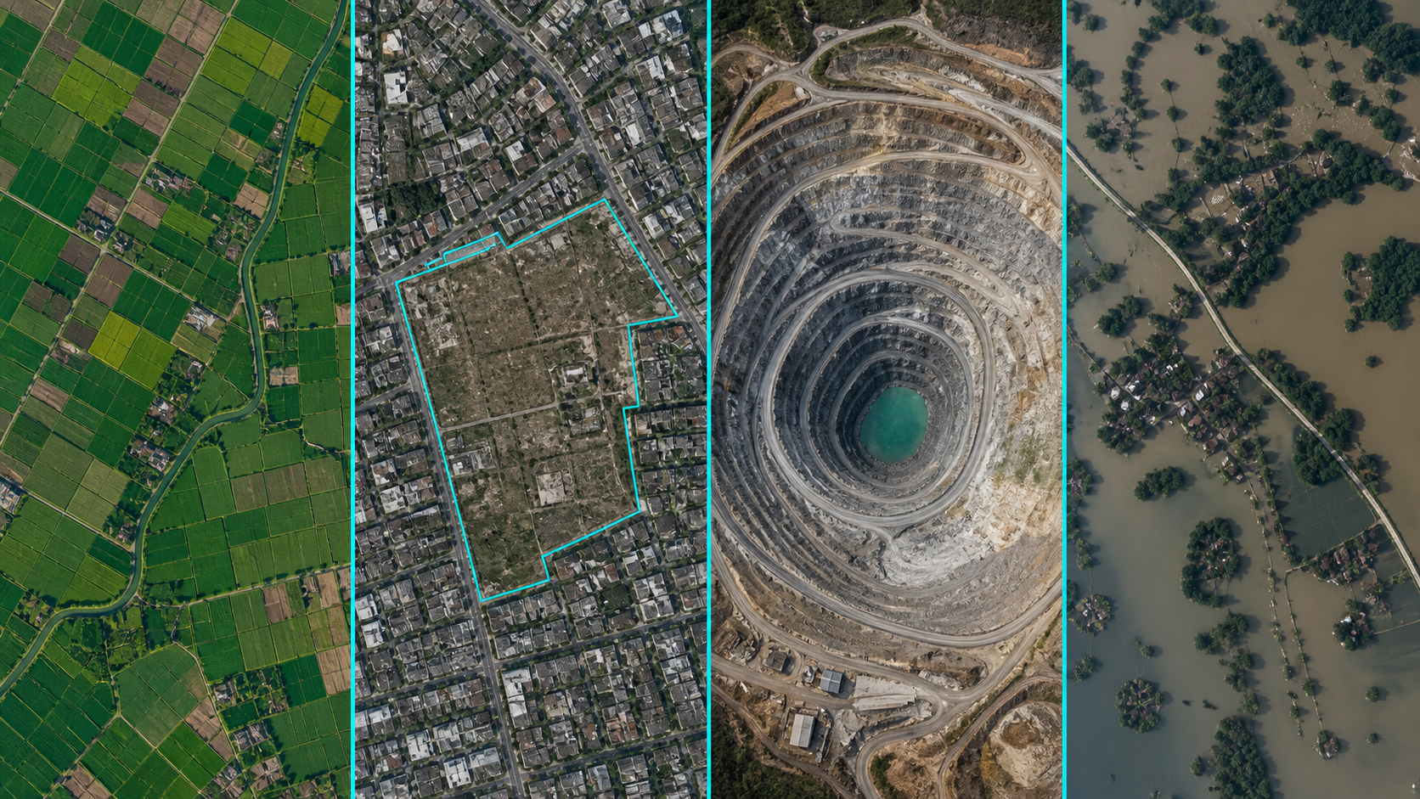
IMPACT AND BENEFITS
SatQuery AI
What this solves: turns a static satellite archive into a decision-ready answer, in plain language
AGRI-INSURANCE
“Does this field show crop damage?”
Impact: Faster claim assessment
LAND RECORDS
“Show construction beyond this boundary.”
Impact: Accessible geospatial analysis
MINING & ENVIRONMENT
“What changed around this mining lease?”
Impact: Faster compliance screening
DISASTER RESPONSE
“Which areas changed after the flood?”
Impact: Faster satellite-to-decision
Bottom line: AI doesn’t replace experts — it accelerates their analysis.

Slide 6
RESEARCH AND REFERENCES
SatQuery AI
BigEarthNet-MM dataset (arXiv:2603.29630) – primary fine-tuning corpus (Sentinel-1 SAR + Sentinel-2 multispectral, co-registered)
VRSBench – public evaluation benchmark for remote-sensing vision-language tasks
Prior art (open research, acknowledged directly): RemoteCLIP, GeoChat, TEOChat – remote-sensing vision-language architectures this design builds on
Adjacent commercial/global tools (differentiation, not duplication): SatSure SatScore (structured analytics, not conversational); Google Maps Platform Aerial & Satellite Insights (global zero-shot search, no ISRO archive integration)
Data source: ISRO Bhuvan / NRSC data portal, accessed via Bhoonidhi (Department of Space)

