Slide 1




Safe Space
An AI-powered app that analyses real-time data from various sources to predict and alert users about potential safety threats in their vicinity. It uses natural language processing to scan news, social media, and other data points for threat detection.
Pranjal Yadav – Backend Systems
Pushkar Modi – AI/NLP Pipelines
Pawankumar Navinchandra – Data Creation & Model Training
Parth Raninga – Presentation & Frontend Systems

Slide 2

Identified Gap in Distributed Safety Intelligence
Core Challenges :-
Absence of a federated threat aggregation system for heterogeneous geographies.
Fragmentation in public hazard awareness due to disjointed data silos (e.g., media, civic alerts, atmospheric sensors).
Legacy safety platforms operate on static rule sets, lacking contextual NLP or spatiotemporal analysis.
No converged intelligence layer exists to correlate civic risk with user mobility and behavioral context.

Slide 3

<Dev> Engers
Unified Threat Intelligence via Real-Time Multimodal AI
Deployment of an NLP-first threat detection pipeline ingesting structured (Gov APIs) and unstructured (social chatter, news) data streams.
Scalable inference engines with geolocation-bound alerting and contextual threat scoring.
Visual cognition layer (heatmaps) + predictive routing to dynamically guide users.
Bridging situational awareness with user-centric adaptive risk communication.

Slide 4
<Dev> Engers
Systems Architecture & Codebase Structure
Frontend: ReactJS + TailwindCSS + Framer Motion
APIs & Auth: Node.js + Express + JWT + Role-Based Access (in Future)
ML Inference Layer: FastAPI + Transformers + ONNX-compiled SVM models
Asynchronous Queueing: Redis + BullMQ for job orchestration
Data Persistence: MongoDB with geo-indexed threat logs
WebSockets: Real-time alert push and location pings

Slide 5
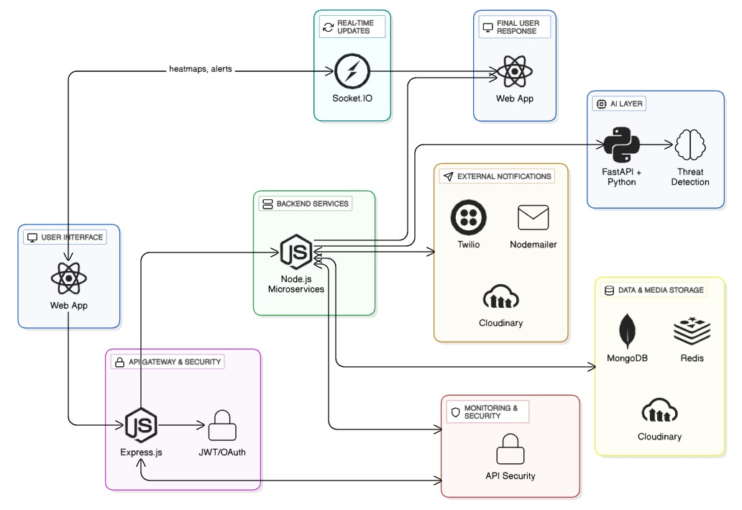
<Dev> Engers
Architecture Flow Diagram

Slide 6
<Dev> Engers
Key Functional Modules
Geospatial Threat Detection
Dynamic Heatmap Generation
Context-Aware AI Classification Engine
Personalized Notification Preferences
User State Management (JWT Auth, Alert Logs)
Semantic Ingestion from Live Feeds (NLP over News & Social)

Slide 7
<Dev> Engers
Future Scope
Multilingual NLP Expansion
Disinformation & Botnet Filtering
Integration with National Protocols
AI-Powered Navigation
Native Mobile Apps (Flutter/Kotlin)

Slide 8
<Dev> Engers
Thank You
For Your Time and Attention
Present by <Dev> Engers

