Slide 1
FORMATIVE ASSESSMENT 2 · DISTRIBUTED SYSTEMS · UNIT III & UNIT IV
Distributed Real-Time Traffic Incident
Detection, Coordination and Response System
FA-2: synchronization (clocks, logical time, global state, election, mutual exclusion, beacons) and emerging paradigms (objects, web, DFS, serverless, ledger) added to the FA-1 system.
Presented by
[TEAM MEMBER 1] - [ROLL NUMBER]
[TEAM MEMBER 2] - [ROLL NUMBER]
College
[COLLEGE NAME]
[DEPARTMENT] · [CLASS / YEAR]

Slide 2
FA-2 OVERVIEW
From FA-1 to FA-2: Extending, Not Rebuilding
FA-1 gave us three independent regional nodes (Pune, Mumbai, Nashik) that communicate by RPC, messages, streams and P2P. FA-2 adds the algorithms that make such nodes agree - on time, order, a leader and access to shared resources - and the newer ways of building distributed applications.
Unit III — Synchronization
• Clock synchronization: Cristian (+NTP), Berkeley
• Logical clocks: Lamport's algorithm, vector clocks
• Causal ordering of broadcasts
• Global state: Chandy–Lamport snapshot
• Election: Bully and Ring
• Mutual exclusion: Lamport, Ricart–Agrawala
• Beacon protocol
• Self-study: Lodha–Kshemkalyani, Knapp's classification
Unit IV — Emerging Paradigms
• Distributed object-based system (proxy, skeleton, naming)
• Distributed web-based system (HTTP caching, ETag/304)
• Distributed file system (chunks, replicas, checksums)
• Serverless architecture (local FaaS)
• Self-study: blockchain / distributed ledger
• Case studies: Megaport, Cloudflare, AWS, Hadoop, Kubernetes
Rule followed: FA-1 code, APIs and UI kept intact - FA-2 is a new package, a second gRPC service and a new dashboard section. FA-1's 40-assertion test still passes.
2

Slide 3
ARCHITECTURE
How FA-2 Plugs Into the FA-1 System
Dashboard
FA-1 panels + FA-2 section (fa2.js)
Second gRPC service, same port
proto/fa2_sync.proto: Deliver, GetTime, Command, Invoke, StoreChunk, ReadChunk. FA-1's traffic.proto is unchanged.
Gateway (FastAPI)
FA-1 coordinator · FA-2: /api/fa2, DFS master, naming, FaaS, ledger service
Message-passing algorithms
Each algorithm is written as 'on receiving X do ...' handlers that run one at a time (atomic).
FIFO channels
One send queue per peer keeps send order - needed by Lamport ME, Lodha–Kshemkalyani and Chandy–Lamport.
Pune Node
TrafficNode + SyncNode :5001
Mumbai Node
TrafficNode + SyncNode :5002
Nashik Node
TrafficNode + SyncNode :5003
Same failure model as FA-1
'Fail Node' makes a node refuse every FA-2 RPC too - peers see a crash.
FA-2 runtime
clocks · inbox · algorithms
*.db + *_ledger.db + dfs/
FA-2 runtime
clocks · inbox · algorithms
*.db + *_ledger.db + dfs/
FA-2 runtime
clocks · inbox · algorithms
*.db + *_ledger.db + dfs/
Gateway triggers, nodes decide
The dashboard starts an election or a CS request; the nodes exchange the messages.
Orange: SyncNode.Deliver - FIFO channels between all pairs of nodes; every message carries the sender's Lamport and vector clock.
Integration
Every FA-1 incident create/update is timestamped and causally broadcast; FA-2 events appear in the FA-1 log.
3

Slide 4
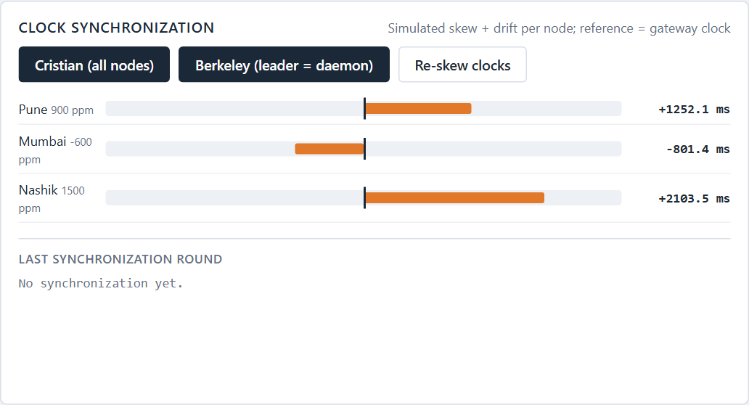
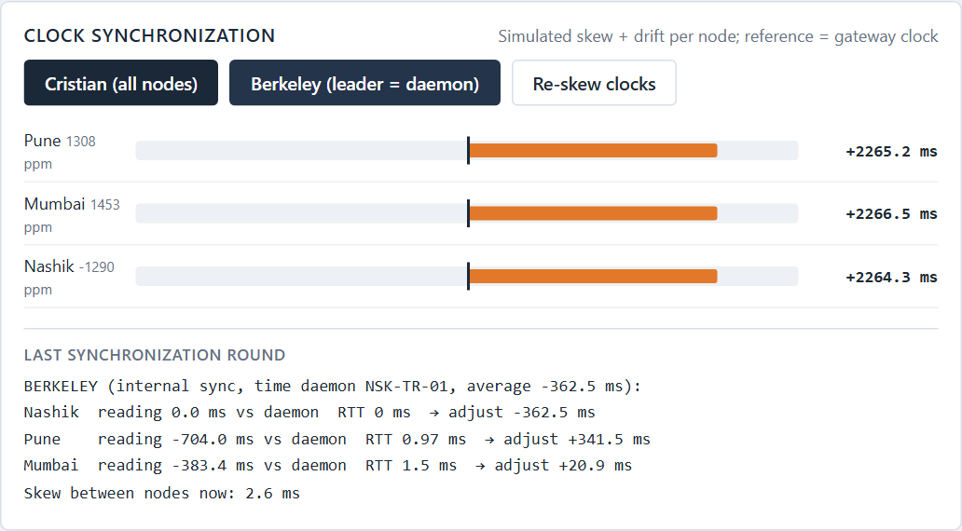
UNIT III
Clock Synchronization: Cristian and Berkeley
There is no global clock: each node's clock has an offset and drifts. Each node runs a software clock with a deliberate offset and drift (simulated - one laptop has one OS clock); the algorithms that correct it are real.
1
Cristian's algorithm (external)
Ask the time server (gateway = reference clock): new time = t3 + RTT/2. Four samples, the smallest RTT is used. NTP offset θ and delay δ are computed from the same four timestamps.
2
Berkeley algorithm (internal)
The elected leader is the time daemon: polls every clock (GetTime), removes outliers, averages, and sends each node its own adjustment (CLOCK_ADJUST).
Before: skewed node clocks
Measured
Cristian: clock errors of 0.8-2.1 s reduced to < 1 ms (first sample: ~265 ms RTT of connection set-up - discarded).
Berkeley: spread between the three clocks 2.1 s → about 1 ms.
After a Berkeley round led by the leader
4

Slide 5
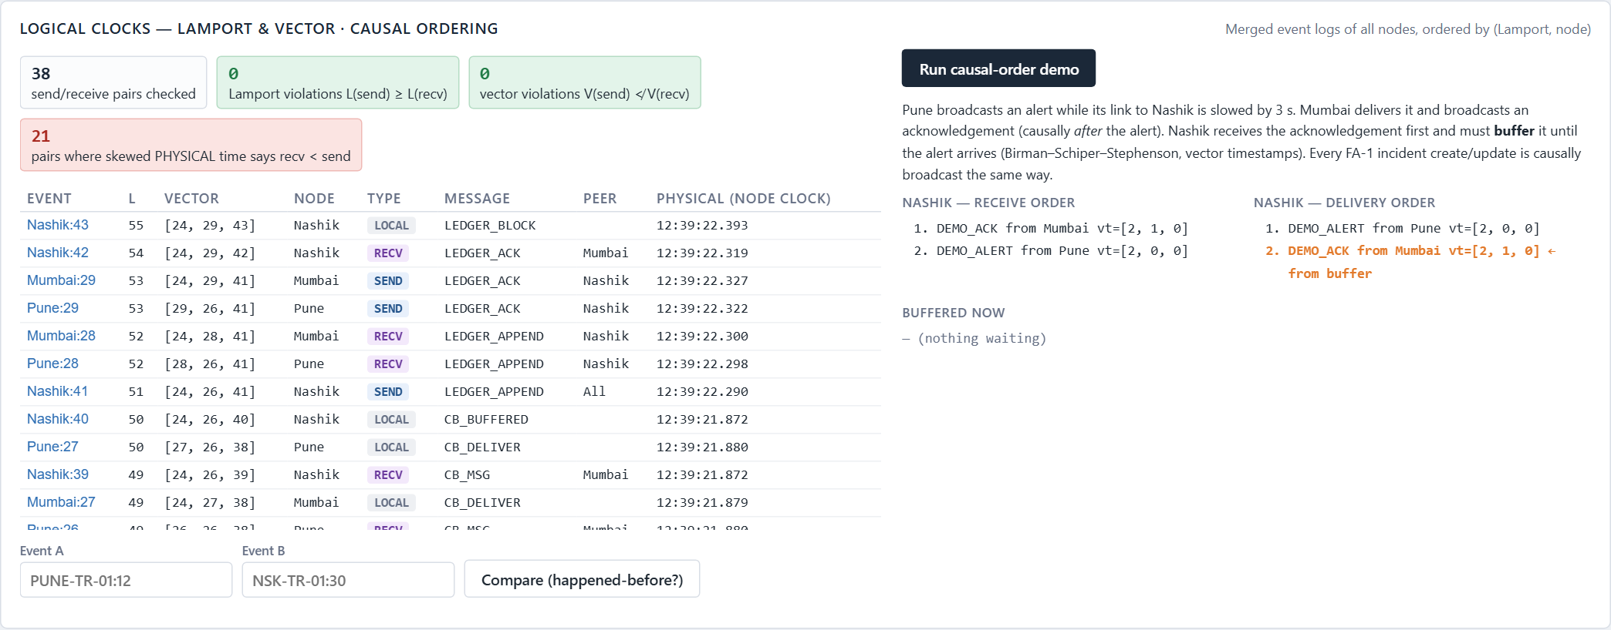
UNIT III
Logical Clocks: Lamport, Vector and Causal Ordering
Lamport's algorithm
L = L + 1 before every event; on receive L = max(L, L_msg) + 1. a → b ⇒ L(a) < L(b).
Vector algorithm
V[i] += 1 per event; on receive V = max(V, V_msg), V[i] += 1. a → b ⇔ V(a) < V(b); incomparable = concurrent.
Causal broadcast (Birman–Schiper–Stephenson)
Deliver a message from j only if it is j's next one and everything j had seen is already delivered; otherwise buffer it.
Real event log ordered by (Lamport, node) · Nashik receive vs delivery order
Applied in our project
Every FA-2 message carries both clocks; the gateway merges the three event logs and checks every send/receive pair: 0 Lamport and 0 vector violations, while the skewed physical times put the receive before the send in many pairs.
Demo: Pune→Nashik slowed 3 s; Nashik receives Mumbai's ACK first, buffers it, delivers ALERT then ACK.
5

Slide 6
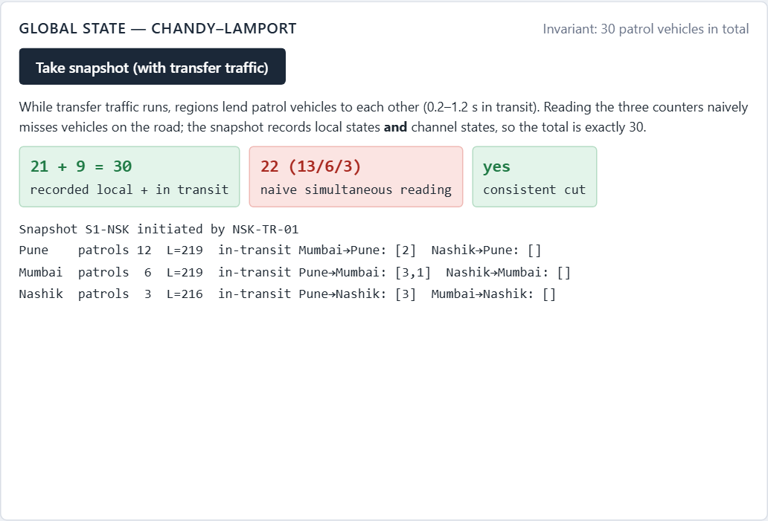
UNIT III
Global State: Chandy–Lamport Snapshot
A global state = the local state of every node + the messages still travelling in the channels. It must be a consistent cut: no message received in the cut without its send also being in the cut.
1
Initiator
records its state, sends MARKER on every channel, starts recording incoming channels.
2
First MARKER at a node
record own state, that channel is empty, forward MARKERs, record the other channels.
3
Later MARKER
stop recording that channel - what was recorded is 'in transit'.
4
FIFO channels
guarantee a marker separates messages sent before / after the cut.
Snapshot recorded by the Nashik leader
Application: 30 standby patrol vehicles are lent between regions (0.2-1.2 s in transit). Snapshot: local + in transit = 30 every time; a naive reading of the three counters does not add up.
6

Slide 7
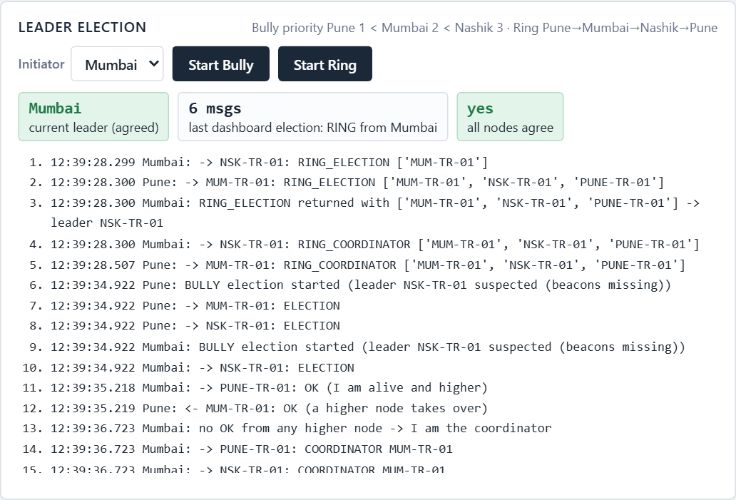
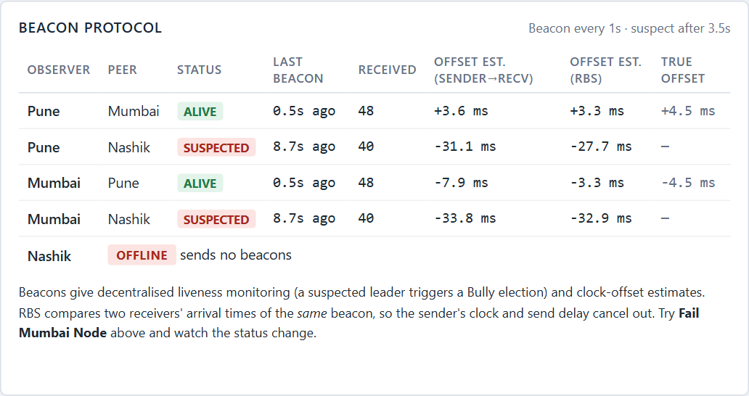
UNIT III
Election Algorithms and the Beacon Protocol
Bully
Priority Pune 1 < Mumbai 2 < Nashik 3. ELECTION to higher nodes; OK stops lower ones; the highest live node sends COORDINATOR. Timeouts detect dead nodes.
Ring
RING_ELECTION collects live ids around Pune→Mumbai→Nashik (dead successor skipped), then RING_COORDINATOR circulates once: 2n = 6 messages.
Beacon protocol
Every node sends a timestamped beacon to every peer each second: liveness (no beacon for 3.5 s → SUSPECTED) and clock-offset estimates (sender→receiver and reference-broadcast).
Demo with FA-1's Fail button
1. Fail Nashik (the leader) → Pune and Mumbai stop hearing its beacons → SUSPECTED.
2. Suspected leader triggers Bully → Mumbai becomes coordinator (Berkeley daemon, ledger proposer).
3. Recover Nashik → it starts an election and bullies its way back.
Bully triggered by missing beacons → Mumbai elected
Beacon table: Nashik SUSPECTED
7

Slide 8
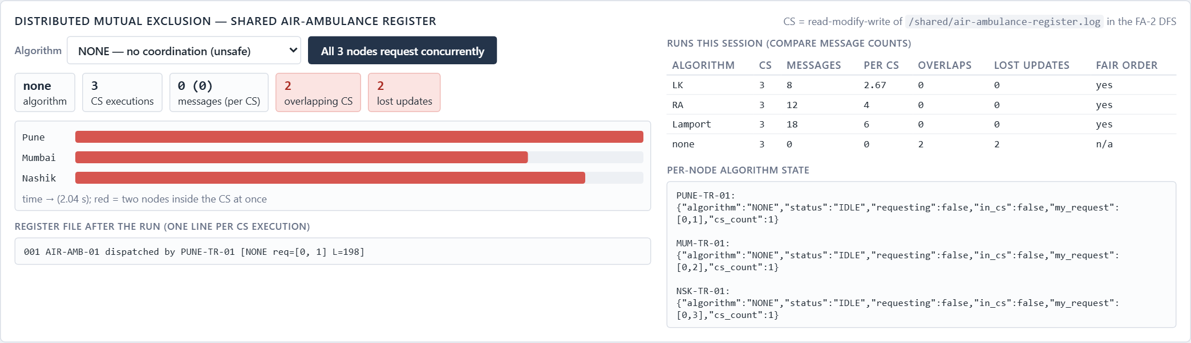
UNIT III
Distributed Mutual Exclusion on a Shared Resource
Shared resource: the regional air-ambulance register, a file in our DFS. The critical section reads it, works 0.6 s, appends a line and writes it back - if two nodes overlap, an update is lost.
Algorithm | Messages / CS | Measured (3 concurrent) | Lost updates
Lamport | 3(N-1) | 18 | 0
Ricart–Agrawala | 2(N-1) | 12 | 0
Lodha–Kshemkalyani | N-1 … 2(N-1) | 8 | 0
None | 0 | 0 | 2 (overlap!)
• Lamport: request queue + REPLY + RELEASE; enter when own request is first and a later-stamped message came from everyone.
• Ricart–Agrawala: reply at once unless own request has priority - then defer the reply until exit.
• All three grant the CS in timestamp order (fair); the 'None' run proves why an algorithm is needed.
Runs table + timeline of the unsafe 'None' run
8

Slide 9
SELF-STUDY
Lodha & Kshemkalyani's Fair Mutual Exclusion Algorithm
IEEE TPDS 11(6), 2000 - implemented exactly as Fig. 2 of the paper (backend/fa2/mutex.py, class LodhaKshemkalyani).
1
Request
SN = highest seen + 1; LRQ = [own request]; REQUEST to all; RV = 0 except own.
Messages per CS (paper §4.1)
2N − |CSet| if a lower-priority concurrent request exists
2N − 1 − |CSet| otherwise
2(N − 1) when requests are serialised
Our run, N = 3, all concurrent
3 + 3 + 2 = 8 messages (6 REQUEST + 2 FLUSH)
vs 12 for Ricart–Agrawala, 18 for Lamport
Assumptions
FIFO channels, no crashes - our demo refuses to run with a node offline.
2
On REQUEST (while requesting)
RV[j] = 0 → concurrent: insert in LRQ, RV[j] = 1 - the request itself is the reply. RV[j] = 1 → defer.
3
On REQUEST (not requesting)
send REPLY(last satisfied request).
4
On REPLY / FLUSH(Rj)
RV[j] = 1; remove every LRQ entry with priority ≥ Rj (a collective reply).
5
Enter CS
all RV = 1 and own request at the head of LRQ.
6
Exit CS
one FLUSH to the next request in LRQ + REPLY to deferred requests.
9

Slide 10
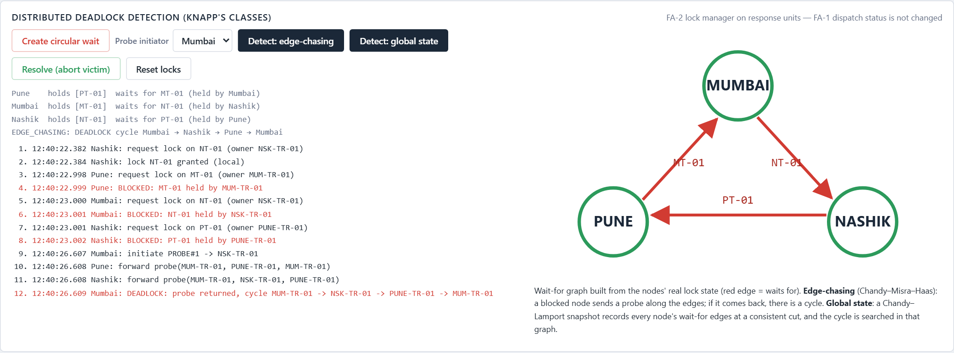
SELF-STUDY
Knapp's Classification of Distributed Deadlock Detection
Class | Idea | In our project
Path-pushing | sites forward wait-for paths until a cycle is visible (Obermarck) | documented
Edge-chasing | a probe follows wait-for edges; back at the initiator = deadlock (Chandy–Misra–Haas) | implemented
Diffusing computation | query/reply diffusion over the graph, OR model (CMH) | documented
Global state | consistent snapshot of all wait-for edges, then search a cycle | implemented
Demo
Each node locks its own unit, then requests the next region's: Pune → Mumbai → Nashik → Pune. No single node can see the cycle. A probe from Mumbai returns (MUM → NSK → PUNE → MUM); the snapshot method finds the same cycle; aborting the victim (Pune) breaks it. The lock table is FA-2 only - FA-1 unit data is untouched.
Real wait-for graph and probe trace
10

Slide 11
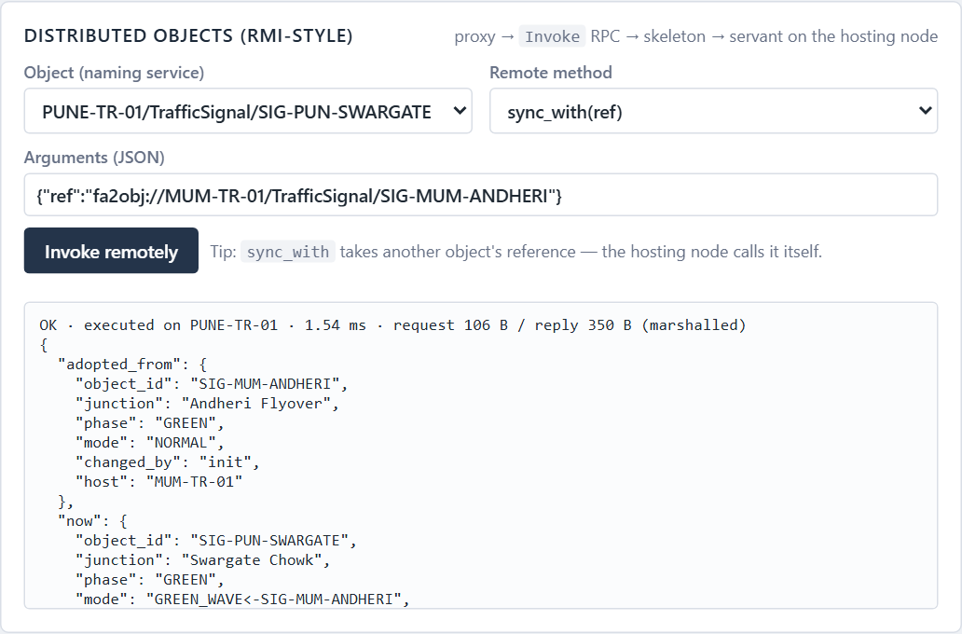
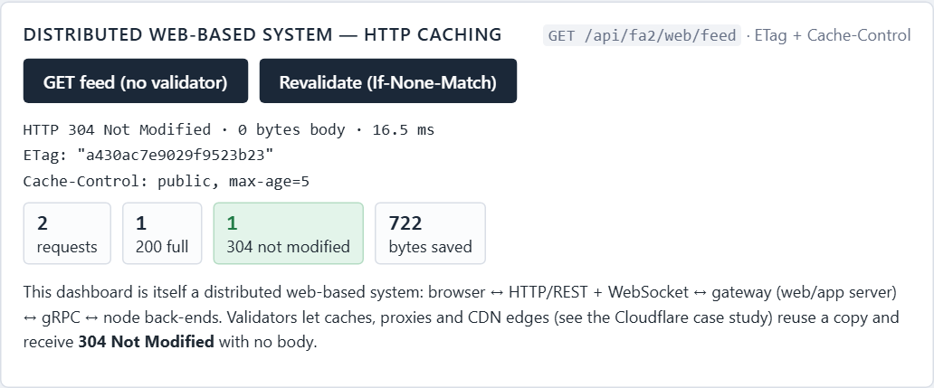
UNIT IV
Distributed Objects · Distributed Web-Based Systems
Distributed Object-Based System
Distributed Web-Based System
Objects live on one node and are invoked remotely through an object reference, as in Java RMI / CORBA.
Browser ↔ HTTP/REST + WebSocket ↔ web/app server ↔ back-end services. Caches use validators.
Applied in our project
Reference fa2obj://node/interface/id; naming service in the gateway.
Proxy marshals the call → Invoke RPC → skeleton → TrafficSignal / ResponseUnit servant.
sync_with(ref): a remote reference passed as a parameter; the hosting node calls the other object.
Applied in our project
The dashboard itself is the web client of a multi-tier distributed system.
GET /api/fa2/web/feed returns ETag + Cache-Control: max-age=5.
Revalidation with If-None-Match → 304 Not Modified, empty body (bytes saved).
11

Slide 12
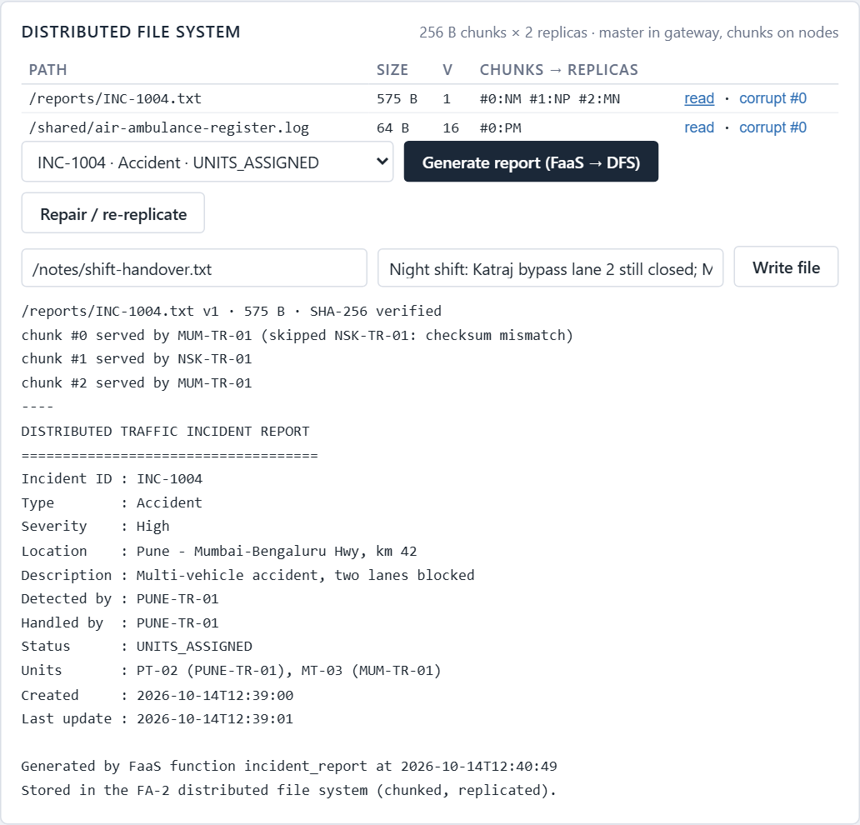
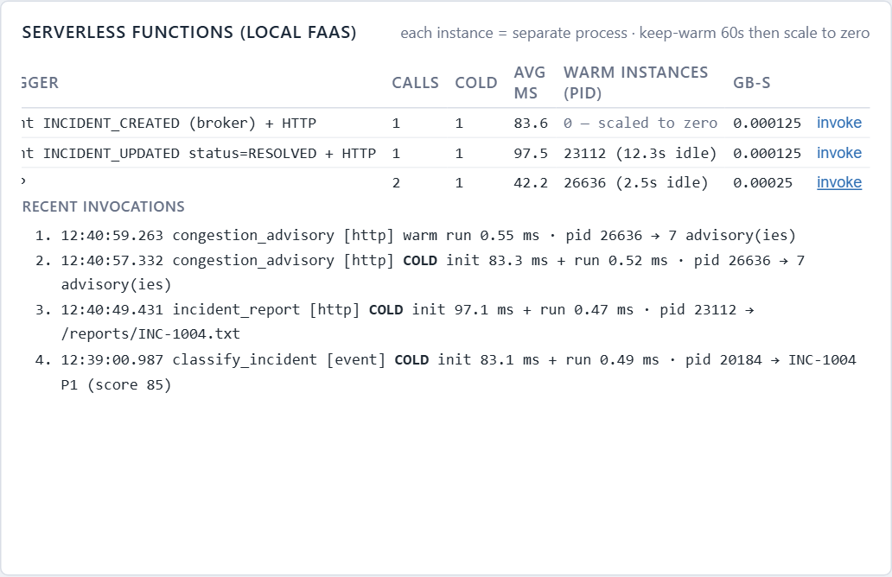
UNIT IV
Distributed File System · Serverless Architecture
Distributed File System (HDFS / GFS style)
Serverless (Function-as-a-Service)
A master keeps metadata; chunk servers keep replicated chunks with checksums.
Developers deploy stateless functions; the platform creates, reuses and destroys instances on demand.
Applied in our project
Gateway = master: path → chunks → replica nodes. Nodes store 256 B chunks + SHA-256.
2 replicas, least-loaded placement; a read skips offline or corrupted replicas.
Repair re-replicates (also automatically after a node recovers).
Applied in our project
Local FaaS emulation: each instance is a separate process.
Cold start (new process, ~80-100 ms) vs warm start (same PID, < 1 ms); idle 60 s → scale to zero.
Triggers: INCIDENT_CREATED → classify_incident; RESOLVED → incident_report → stored in the DFS.
Corrupted replica skipped - chunk served by another node
Cold and warm invocations
12

Slide 13
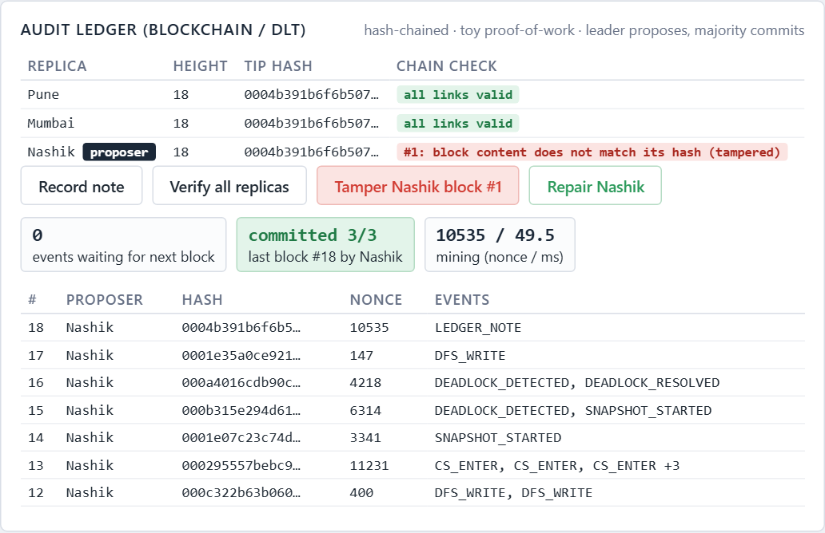
SELF-STUDY
Blockchain / Distributed Ledger: Append-Only Audit Ledger
1
Hash chain
block = index, time, proposer, previous hash, nonce, events; hash = SHA-256 of all of them.
2
Toy proof-of-work
the proposer searches a nonce so the hash starts with 000 (illustrates mining).
3
Leader ordering, majority commit
the elected leader proposes; committed when 2 of 3 replicas stored it.
4
Replication & catch-up
each node has its own SQLite replica; a node that was down fetches missing blocks.
5
Tamper evidence
editing an old block breaks its hash link - detected, then repaired from a valid peer.
Nashik replica tampered → broken at block #1
Recorded events: incidents, node failures/recoveries, leader elections, CS entries, deadlocks, clock syncs, DFS writes - batched into a block every 4 s.
6
Honest limits
crash-fault tolerant like a permissioned ledger - not Byzantine-fault tolerant.
13

Slide 14
UNIT IV
Industry Case Studies
System | What it is | Key distributed-systems ideas | Same idea in our project
Megaport | Network-as-a-Service | Private software-defined backbone; Virtual Cross Connects on demand; Megaport Cloud Router | Node↔node P2P links as a private regional interconnect
Cloudflare | Global anycast edge network | Nearest-edge routing, edge caching, Workers (V8 isolates), Durable Objects | ETag/304 caching, FaaS runtime, single-host remote objects
AWS | Public cloud | Regions + Availability Zones, replicated S3/DynamoDB, Lambda; Dynamo paper: consistent hashing, vector clocks | Vector clocks, replicated DFS, majority-commit ledger, FaaS metering
Apache Hadoop | Big-data storage & processing | HDFS NameNode + DataNodes, 3× block replication, checksums; MapReduce / YARN | DFS master = NameNode, nodes = DataNodes, re-replication
Kubernetes | Container orchestration | etcd (Raft) state store, reconciliation controllers, leader election, Services | Bully/Ring election, beacon health checks, names vs addresses
Case studies are documented only - no cloud infrastructure was added to the project.
14

Slide 15
VERIFICATION
Testing, Results and What Is Simulated
Test | Result
FA-1 regression (tools/test_system.py) | 40 / 40 passed
FA-2 end-to-end (tools/test_fa2.py) | 69 / 69 passed
Lamport / vector clock violations | 0
Snapshot invariant (30 vehicles) | holds
Mutex lost updates with LK / RA / Lamport | 0
Leader failure → re-election → recovery | passed
Dashboard click-through (headless Chromium) | 0 console errors
Real | Simulated / injected
Messages between 3 OS processes over gRPC | Clock offset and drift per node
Lamport/vector clocks, markers, probes, timeouts | Channel delays in two demos
DFS files, checksums, replicas | Node failure = refuse-all mode
FaaS processes, cold/warm starts | Patrol vehicles, FA-2 lock table
Ledger hashes, replication, tamper check | Case studies (documentation)
Note: one FA-1 check ('traffic density changes over time') is timing-dependent in the original FA-1 code as well (3 s sensor tick vs 2 s heartbeat vs 3.5 s wait) - measured on the unmodified code and documented, not weakened.
15

Slide 16
CONCLUSION
Limitations and Conclusion
1
Reliable-process assumption
Mutual exclusion and snapshot need all nodes up (demo refuses with a node down).
2
Gateway as single point
DFS master and ledger service live in the gateway, like an HDFS NameNode without HA.
3
Clock steps
Clocks are stepped, not slewed; skew is simulated on one host.
4
No Byzantine tolerance
The ledger tolerates crashes, not malicious nodes.
The same three traffic nodes now synchronise clocks, order events, elect a leader, share a resource safely, detect deadlocks, store replicated files, run serverless functions and keep a tamper-evident audit trail.
Thank You
16

