Slide 1
FORMATIVE ASSESSMENT 1 · DISTRIBUTED SYSTEMS
Distributed Real-Time Traffic Incident
Detection, Coordination and Response System
A Distributed Systems approach to real-time traffic incident communication and emergency response coordination.
Presented by
[TEAM MEMBER 1] - [ROLL NUMBER]
[TEAM MEMBER 2] - [ROLL NUMBER]
College
[COLLEGE NAME]
[DEPARTMENT] · [CLASS / YEAR]

Slide 2
PROBLEM STATEMENT
Traffic Incidents Need Faster Distributed Coordination
Accidents, road blockages and signal failures happen without warning. Each traffic control point keeps its own information, so a neighbouring region often learns about an incident late, response units are arranged by phone calls, and when one control point goes down the others lose visibility along with it.
!
Isolated Control Points
Incident and unit data of one region is not visible to the next region.
!
Slow Response Coordination
Borrowing an ambulance or patrol unit from a neighbour is a manual process.
Proposed Approach
A network of independent regional traffic nodes (Pune, Mumbai, Nashik) that each own their incident data and talk to each other through RPC, asynchronous messages, live streams and direct peer-to-peer calls - so incidents are detected, shared and answered in real time, even when a node fails.
!
Single Point of Failure
If one control point is down, nobody else can record or serve its incidents.
2

Slide 3
MOTIVATION
Why This Problem Matters
1
Time-Critical
Traffic incidents need a quick response; minutes spent finding a free unit matter.
2
Distributed Information
Pune, Mumbai and Nashik each maintain their own local incident and unit data.
3
Node Failure
One unavailable traffic node should not stop the whole network.
4
Regional Coordination
Nearby traffic nodes should be able to cooperate and share response units.
3

Slide 4
OBJECTIVES
What the Project Sets Out to Do
1
Detect and report traffic incidents in real time.
2
Enable communication between geographically distributed traffic nodes.
3
Coordinate response resources across nodes.
4
Demonstrate RPC and message-oriented communication.
5
Demonstrate stream-oriented and P2P communication.
6
Build a foundation for advanced FA-2 distributed algorithms.
4

Slide 5
UNIT 1
Definition, Goals & Types of Distributed Systems
Definition: A distributed system consists of independent computing nodes that communicate over a network and cooperate to provide a unified service. Here, three traffic nodes run as separate processes with separate databases, and the dashboard sees one coordinated network.
Goals:
✓ Resource Sharing
One region's response units can be reserved by another region (Pune uses Mumbai's MT-03).
✓ Transparency
The operator reports an incident; which node stores it and lends units stays hidden.
✓ Scalability
A new region is one more node process and one registry entry.
✓ Openness
Every node follows the same gRPC contract (traffic.proto) and message types.
✓ Fault Handling
Failed nodes are detected by heartbeats and requests are redirected.
Types of DS applied: a Distributed Information System (incident, unit and traffic records owned by each regional node) with Distributed Real-Time / Pervasive characteristics (traffic density streamed every few seconds, nodes leaving and rejoining the network).
5

Slide 6
ARCHITECTURE
System Architecture
Traffic Control Dashboard
browser - HTML / CSS / JS
1. Traffic Dashboard
Operator reports incidents and watches the network live.
REST + WebSocket
2. Coordination Middleware
Allocates incident ids, calls nodes by RPC, broadcasts incidents, detects failures and redirects requests.
Coordination Middleware
gateway - FastAPI, message broker, failure detector
RPC (gRPC)
3. Regional Traffic Nodes
Independent processes for Pune, Mumbai and Nashik; each keeps its own incidents, units and traffic status.
Pune Node
gRPC server :5001
P2P
Mumbai Node
gRPC server :5002
P2P
Nashik Node
gRPC server :5003
4. P2P Communication
When local units are insufficient a node asks its nearest peer directly.
5. Message + Stream Layer
Broker messages (INCIDENT_CREATED, NODE_FAILED ...) and a WebSocket stream to the dashboard.
pune.db
mumbai.db
nashik.db
Local SQLite databases - one per node, never shared. WebRTC: browser tab ↔ browser tab (signalling over the WebSocket).
6. Emergency Communication
WebRTC data channel and optional audio/video between control room and response team.
6

Slide 7
UNIT 1
Design Issues & Middleware
Design Issue | How Our System Addresses It
Heterogeneity | All nodes communicate through one common gRPC interface and one message format.
Openness | A new regional node joins by implementing the same contract and registering its id and address.
Scalability | Regions are independent processes with their own database; more regions can be added independently.
Failure Handling | Heartbeats detect a failed node; its requests are redirected to the nearest available node.
Concurrency | Nodes handle requests asynchronously; a unit is reserved with one atomic database update.
Transparency | The operator never needs to know which node holds a record or which node lent a unit.
Middleware: the layer between the network and the application that hides the differences between nodes. In this project the Coordination Service plays that role - it resolves node ids to addresses, makes the gRPC calls, runs the message broker and applies the failover rule, so the dashboard only calls one API.
7

Slide 8
UNIT 1
Distributed Multimedia · Model of Computation · Virtualization
Distributed Multimedia Systems
Model of Distributed Computation
Role of Virtualization
Concept
Transmission of continuous media (audio / video / data) between distributed endpoints in real time.
Concept
Independent processes with no shared memory and no global clock, interacting only by exchanging messages.
Concept
Running each service in its own isolated container or VM so it can be deployed and restarted independently.
Applied in our project
The Emergency Communication panel opens a WebRTC peer connection between the Traffic Control Center and the Emergency Response Team (two browser tabs). A data channel carries messages directly browser-to-browser; audio/video can be added with one button (optional).
Applied in our project
Each traffic node is a separate process with its own database. Nodes interact only through gRPC calls, broker messages and P2P calls - there is no shared state.
Applied in our project
Each regional node can be deployed as an independent Docker container (docker-compose with three node containers and one gateway). The same code also runs as plain Python processes with run.py.
8

Slide 9
UNIT 2
Communication Fundamentals & Remote Procedure Call
Fundamentals: distributed nodes communicate by sending messages over the network. Communication can be synchronous (the caller waits - our gRPC calls) or asynchronous (fire-and-forget - our broker messages).
RPC lets the Coordination Service call a procedure on a remote traffic node as if it were local:
1
Client
The Coordination Service calls search_response_units("Pune", "High") - in code: RequestResponseSupport(INC-1004) - like a normal function.
RPC flow
Dashboard
POST /api/incidents
2
Client stub
The stub generated from traffic.proto packs the parameters (protobuf) and sends them to the Pune node at localhost:5001.
Coordination Service
allocates INC-1004
3
Remote procedure
The server stub on the Pune node unpacks the call and runs the local procedure: search own units, then ask peers.
Pune Node localhost:5001
records + searches units
4
Response
The result (incident, assigned units, trace) is returned to the caller - or a gRPC error such as UNAVAILABLE if the node is down.
Response
back to the dashboard
search_response_units( "Pune", "High" ) → RPC → Pune Node
9

Slide 10
UNIT 2
Message-Oriented & Stream-Oriented Communication
Message-Oriented Communication
Stream-Oriented Communication
Asynchronous, queue-based communication: the sender publishes a message and continues; receivers pick it up from the queue. Sender and receiver do not wait for each other.
A continuous, time-ordered flow of data where timing matters - receivers get updates as they happen instead of asking again and again.
Used for
Used for
• Incident notifications (INCIDENT_CREATED, INCIDENT_UPDATED)
• Response requests and replies (RESPONSE_REQUESTED, RESPONSE_AVAILABLE)
• Node failure events (NODE_FAILED, NODE_RECOVERED)
• Traffic density of each region
• Node heartbeat / health status
• Live incident updates and the communication log
In our project: a small publish/subscribe message broker written in Python (queue + worker + subscribers). Nodes publish, the coordinator and the dashboard subscribe. Broadcasts for a node that is offline are queued and delivered when it recovers.
In our project: a WebSocket (/ws) from the gateway to the dashboard. Every broker message and a status snapshot every 2 seconds are pushed to the browser, so the page never needs a refresh.
10

Slide 11
UNIT 2
Peer-to-Peer Messaging & WebRTC
P2P Messaging
WebRTC
Nodes communicate directly with one another, without going through a central server or a shared database - so there is no single point of failure for that exchange.
An open browser standard for direct, low-latency peer connections carrying audio, video and data. A server is only needed to exchange the connection details (signalling).
request units
data channel
Pune Node
localhost:5001
Mumbai Node
localhost:5002
Traffic Control Center
browser tab 1
Emergency Response Team
browser tab 2
MT-03 available
+ audio / video
Applied in our project
When Pune's own units are not enough, the Pune node itself calls the Mumbai node's SearchResponseUnits and ReserveUnit procedures - nearest peer first, next peer if that one is down or empty. The exchange is shown live in the dashboard log as PUNE → MUMBAI / MUMBAI → PUNE.
Applied in our project
Two dashboard tabs connect with "Connect Peer": the offer, answer and ICE candidates travel over our WebSocket, then messages flow directly between the browsers through a data channel. "Start Audio/Video" adds camera and microphone (optional, needs a device).
11

Slide 12
UNIT 2
Names, Identifiers & Addresses · Fault Tolerance
Names, Identifiers & Addresses
Fault Tolerance
A name or identifier says what an entity is; an address says where to find it. Good distributed design keeps the two separate.
The ability of the system to keep working - possibly at reduced capacity - when some of its components fail.
Node ID | Node Name | Address
PUNE-TR-01 | Pune Traffic Node | localhost:5001
MUM-TR-01 | Mumbai Traffic Node | localhost:5002
NSK-TR-01 | Nashik Traffic Node | localhost:5003
Pune OFFLINE
heartbeat fails → NODE_FAILED
Request redirected
to the nearest online node
Applied in our project
Every message and record refers to a node by its id, never by host:port; a registry resolves the id to an address (in Docker the same ids map to different addresses). Incidents get unique ids INC-1001, INC-1002 ... and units PT-01, MT-03, NT-02 carry their owner node.
Mumbai responds
records the incident, borrows units from Nashik by P2P
Simulation note: "Fail Pune Node" makes the node refuse every RPC with gRPC status UNAVAILABLE, which is what a crashed node looks like to callers. Killing the process is detected the same way. "Recover" brings it back and it receives the broadcasts it missed.
12

Slide 13
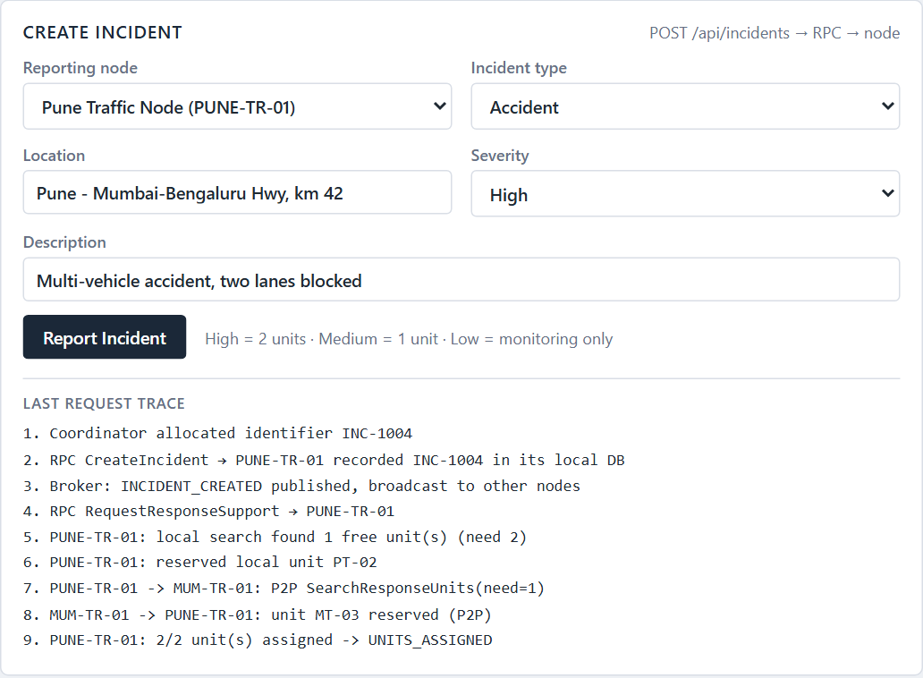
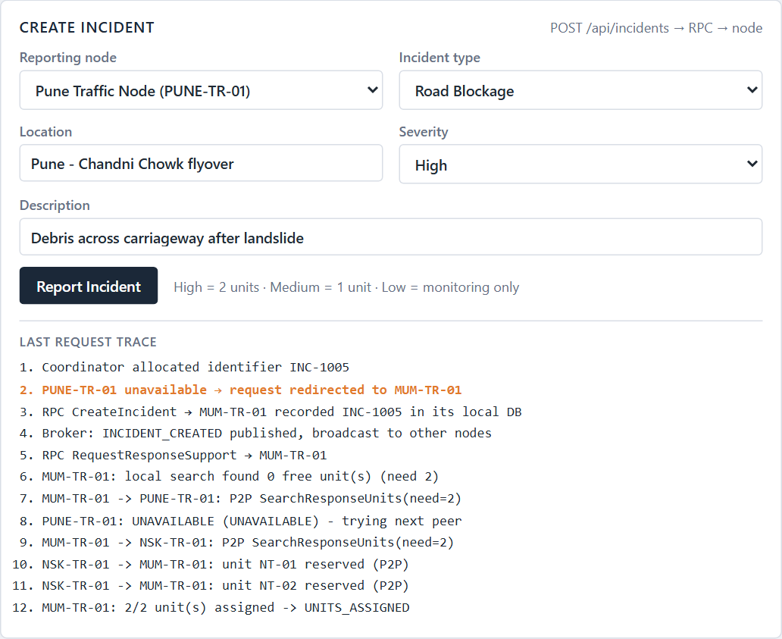
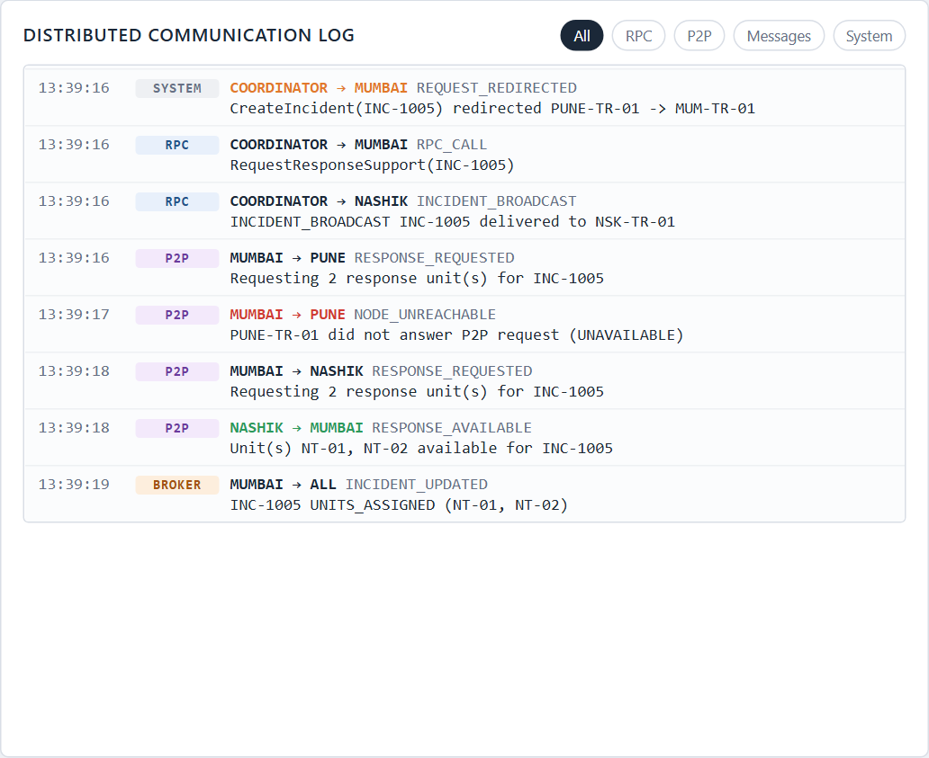
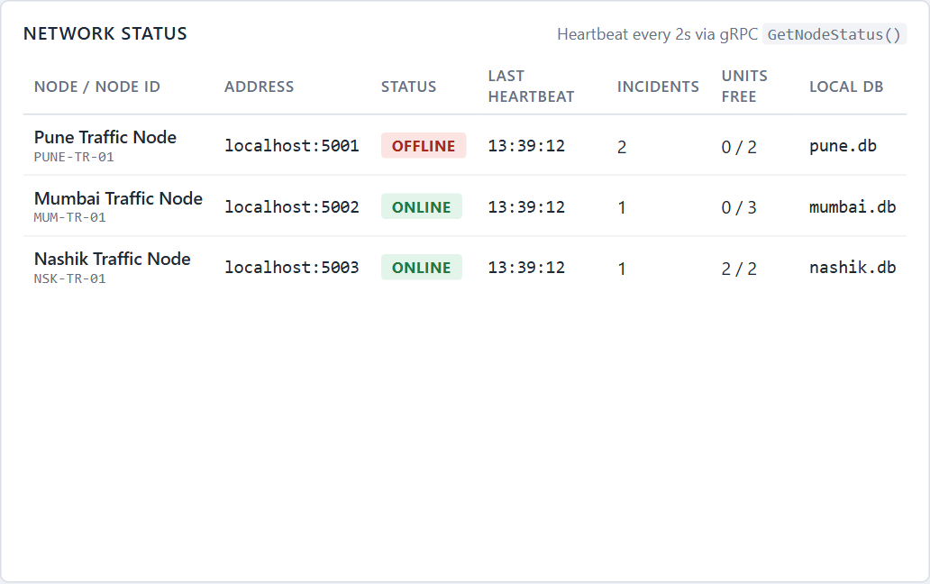
DEMONSTRATION
Working Demo Flow
1
Report accident in Pune Accident · Pune · High from the dashboard form
2
Pune node receives incident coordinator allocates INC-1004, RPC CreateIncident → stored in pune.db
3
Incident is broadcast INCIDENT_CREATED → Mumbai and Nashik store a copy
4
Pune searches locally High needs 2 units, Pune has only PT-02 free
5
Pune requests another node P2P SearchResponseUnits to Mumbai
Steps 1-6: request trace
Steps 8-9: redirected after failure
6
Mumbai responds MT-03 available → reserved; status UNITS ASSIGNED
7
Dashboard updates live table, units and log refresh over the WebSocket
8
Simulate Pune failure "Fail Pune Node" → heartbeat fails → OFFLINE
9
Request continues new Pune incident redirected to Mumbai, units borrowed from Nashik
Network status: Pune OFFLINE
Communication log during failover
13

Slide 14
IMPLEMENTATION
Technology Stack
Frontend
HTML + CSS + JavaScript
Single dashboard page, network diagram, live tables and log
Backend
Python + FastAPI
REST API, coordination middleware, message broker, WebSocket
RPC
Python gRPC
traffic.proto contract; each node is a gRPC server
Real-Time Stream
WebSocket
Pushes events and status snapshots to the dashboard
Messaging
Lightweight Python message layer
Publish/subscribe broker (RabbitMQ not used)
P2P
Python node-to-node gRPC
Direct SearchResponseUnits / ReserveUnit between nodes
WebRTC
Browser WebRTC
Data channel + optional audio/video between two tabs
Database
SQLite
One database file per node: pune.db, mumbai.db, nashik.db
Virtualization
Docker
One container per node + gateway (docker-compose)
All of the above is implemented and runs on one laptop: pip install -r requirements.txt → python run.py
14

Slide 15
FUTURE SCOPE
FA-2 Extension Roadmap
1
Mutual Exclusion
Avoid conflicting allocation of the same response unit by two nodes.
2
Clock Synchronization
Order events coming from different traffic nodes consistently.
3
Election Algorithms
Select the coordinator dynamically instead of a fixed gateway.
4
Replication & Recovery
Keep a region's data available while its node is down.
5
Distributed Consistency
Keep incident copies synchronized across nodes.
These are planned extensions - not part of the FA-1 implementation.
Thank You
15

