Slide 1
Bank Loan Approval Prediction
Week 4 Major Project — Option 2
Machine Learning & AI

Slide 2
Project Objective
Build a classification model for bank loan approval prediction.
Use the supplied Loan Prediction Dataset.
Follow the Week 4 workflow: cleaning, Random Forest, confusion matrix, prediction.

Slide 3
Dataset
614 application records and 13 columns.
Target variable: Loan_Status.
Y = approved; N = rejected.
Features include Gender, Married, Dependents, Education, Income, Credit_History and Property_Area.

Slide 4
Data Cleaning & Preprocessing
Remove Loan_ID from predictive features because it is an identifier.
Median imputation for numerical missing values.
Most-frequent imputation for categorical missing values.
One-hot encoding for categorical variables.
Preprocessing is integrated into the model pipeline.

Slide 5
Model
Algorithm: Random Forest Classifier.
Number of trees: 300.
Random state: 42.
Balanced class weights are used.
Training/testing split: 80% / 20%, stratified.

Slide 6
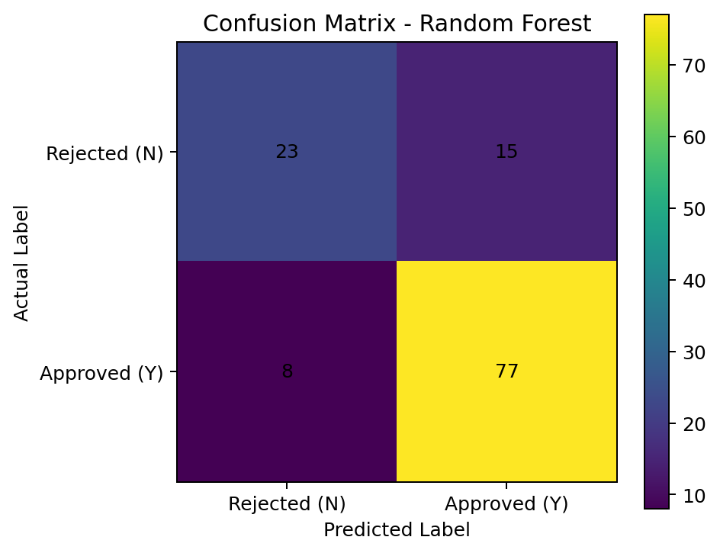
Confusion Matrix

Slide 7
Evaluation Results
Accuracy: 0.8130
Precision: 0.8370
Recall: 0.9059
Confusion matrix: [[23, 15], [8, 77]]

Slide 8
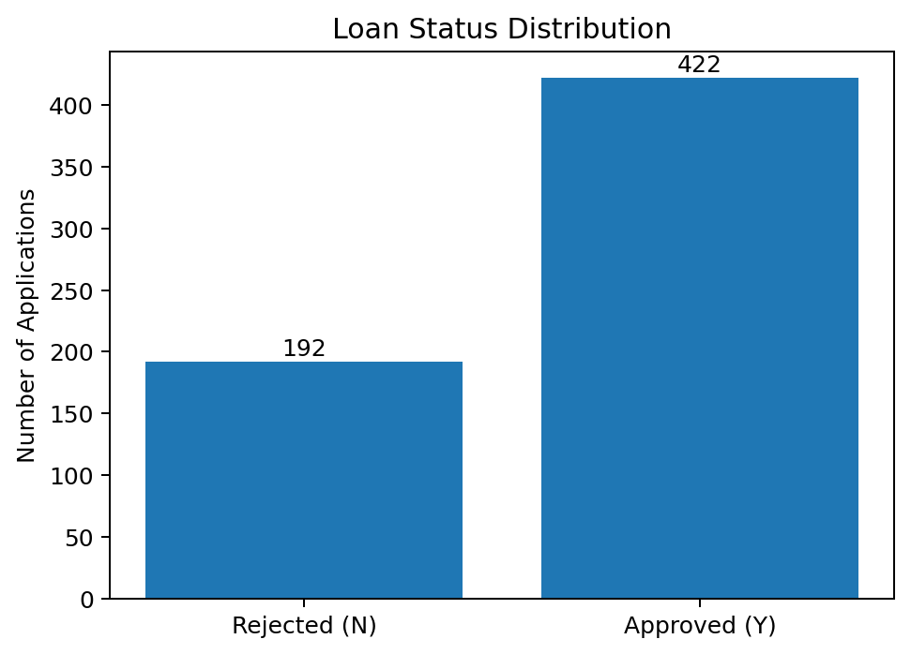
Loan Status Distribution

Slide 9
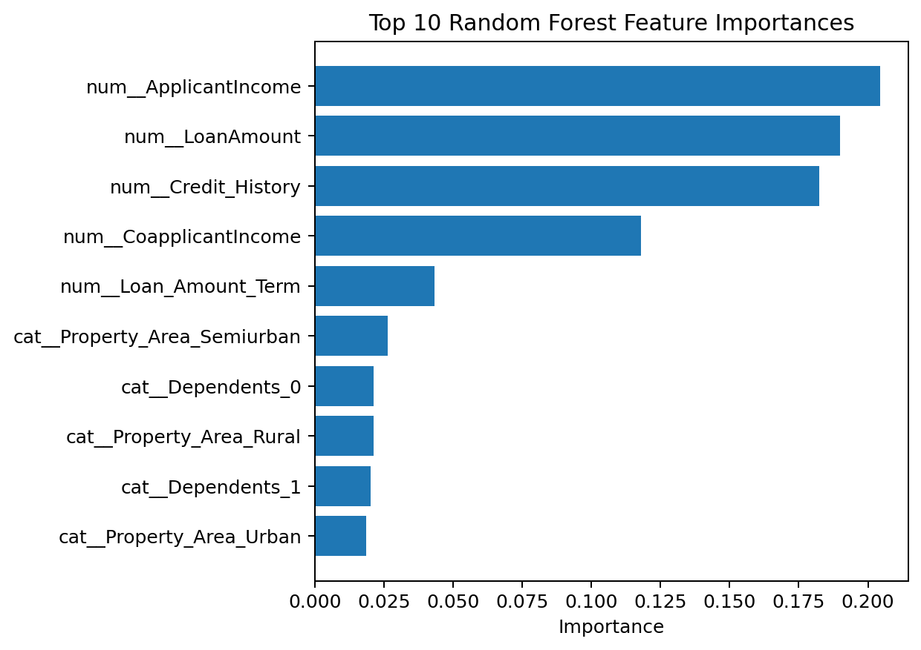
Top Feature Importances

Slide 10
Conclusion
A complete ML classification pipeline was implemented.
The model cleans and encodes the supplied data before training.
Performance is evaluated using accuracy, precision, recall and a confusion matrix.
The included script makes the workflow reproducible.

