Slide 1



7th Semester, Major Project Phase-2 (BCS705),
Review ‘1’ Presentation on
Travel Yantra — AI Based Personalized Travel Itinerary Planner and Virtual Tour Guide with Multilingual Support
Nithin G (1BY23IS140)
Pushkar Reddy S (1BY23IS167)
Rishab Paul (1BY23IS175)
Rohan Balu (1BY23IS177)
VII SEMESTER DEGREE OF BACHELOR OF ENGINEERING IN
Information Science and Engineering
UNDER THE GUIDANCE OF
Prof. Shwetha T
Assistant Professor, Dept. of ISE
DEPT. OF ISE
BMSIT&M

Slide 2
CONTENT
Abstract
Introduction
Problem statement
Objectives of the work
Methodology
Implementation of project Execution
Experimental Setup, Expected Results & Analysis
Project Status, Conclusion
Publication
References(IEEE format)

Slide 3
ABSTRACT
Context: Planning a trip in India means a dozen browser tabs, almost all in English, and a chat answer that may be confidently wrong about when a place closes. At the site itself there is no guide that can be trusted on a date or a fee.
Problem Identified: Generic large language models are fluent but unreliable planners — GPT-4 passes 0.6 percent of multi-constraint plans on the TravelPlanner benchmark — and free-form generation invents opening hours, fees and history that a traveller cannot check.
Objective: This review demonstrates two of the six project objectives in working software: Objective 1, AI-Powered Personalised Itinerary Generation, and Objective 5, Virtual Cultural Tour Guide, delivered as the feature named Katha.
Methods: Our own solver computes the itinerary — candidate selection, grouping places by part of the city, nearest-next ordering then untangling under opening hours, a checklist, and a repair loop that rebuilds one day. The language model reads the traveller's words into the form, drafts places for a city we have never seen (labelled unverified), writes the finished plan up and reads the guide aloud; every paragraph it speaks is checked against its source.
Results: On the demonstration trip the routed itinerary is 30.9 km against 34.98 km for the same stops in list order, with 37 of 37 checks passed in 4 ms. Retrieval reaches Recall@5 of 0.867 on written questions and 0.900 on name lookups; 17 of 18 narrated segments passed the fact-check; 144 automated tests pass.

Slide 4
INTRODUCTION
Travel Yantra is an AI-based personalised itinerary planner and virtual tour guide for the Indian tourism context, built for travellers who currently plan across several disconnected platforms and who are more comfortable in an Indian language than in English.
Phase 1 established the problem, surveyed twenty-two papers and set six measurable objectives. Phase 2 is implementation. This review presents working software for two of those six objectives, evaluated on real data rather than described as intent.
Scope of this review — Objective 1: the planner is an India-wide architecture; nothing in the solver is specific to one state. It is demonstrated on Karnataka data because that is where our verified data exists; a city outside it is drafted by the model on first request and labelled unverified until a source confirms it.
Scope of this review — Objective 5: the Katha guide is scoped to Karnataka, since every paragraph it can speak has to be written and sourced before it can be retrieved.
Related work in one line: TravelPlanner (Xie et al., ICML 2024) showed that a single language model fails multi-constraint travel planning; Hao et al. (NAACL 2025) recovered the accuracy on that same benchmark by handing the constraints to a solver; and ChinaTravel (Shao et al., ICLR 2026) reproduced the effect on a second, harder benchmark. Our architecture follows that finding rather than restating the problem.

Slide 5
PROBLEM STATEMENT
A traveller assembling a three-day trip must reconcile opening hours, weekly closing days, entry fees, road time between stops, a midday meal, a budget and how far the oldest member of the group can walk. These are hard constraints and they interact: fixing one breaks another.
Booking and review platforms each solve one slice — flights, hotels, reviews, maps — and leave the traveller to be the integration layer. Not one of them sequences a day against opening hours.
General-purpose chat models are fluent, but measured at a 0.6 percent pass rate on multi-constraint travel plans, and they state fees and timings with a confidence they have not earned.
Both classes of tool are English-first, which excludes the traveller who would rather read and listen in Kannada or Hindi.
On site, there is no grounded, source-cited guide. This is exactly where a fabricated date or fee is least detectable by the listener and most damaging to trust.
Stated as an engineering problem: an itinerary must be computed against its constraints and be able to show the working — not generated and hoped for.

Slide 6
OBJECTIVES OF THE WORK
Demonstrated in this review
Objective 1 — AI-Powered Personalised Itinerary Generation: “Design and implement a multi-agent AI system that generates day-by-day itineraries from user preferences, budget, dates and group composition, targeting a user satisfaction rate of ninety percent or higher.”
Objective 5 — Virtual Cultural Tour Guide: “Build a Retrieval-Augmented Generation based interactive guide for history, food, cultural significance and emergency information, with sub-three-second response latency.” Delivered as the feature named Katha.
Scope: Objective 1 is an India-wide architecture demonstrated on Karnataka; Objective 5 is scoped to Karnataka.
Deferred to Review 2
Objective 2 — Multilingual Natural Language Support across Hindi, Tamil, Telugu, Kannada and Bengali. English and Kannada are working today; the full five-language pipeline is Review-2 work.
Objective 3 — Multi-Channel Deployment and Accessibility across web, WhatsApp and voice. The web channel is built; WhatsApp and telephony are Review-2 work.
Objective 4 — Real-Time Booking and Route Optimisation against live booking and routing APIs.
Objective 6 — Privacy and Cost Constraints is a standing constraint, not a milestone: the stack is open-source-first and the measured model spend for the whole project to date is under one US dollar.

Slide 7
METHODOLOGY
The plan is computed by our own solver. The AI reads, drafts data when we have none, and narrates. It never decides the plan.
Stages 3 to 7 are ordinary code following fixed rules with a fixed random seed, so the same request always gives the same plan.
1 Your words
the model reads them into
a form you check
2 Unknown city?
the model drafts its places,
labelled unverified
3 Candidates
SQL + your interests +
pairing edges (our code)
4 Days and route
group by part of the city;
nearest-next, then untangle
5 Checklist
hours, closures, day end,
meal, travel, budget
6 Repair
drop one flexible stop,
rebuild that day only
7 Reasons
one plain sentence per
stop, from templates
8 Narrate
writes the plan up, reads
Katha aloud, fact-checked
Our code — fixed rules, seeded
Language model — reads, drafts, narrates
The model also turns a chat edit into a strict instruction, and one day is rebuilt while the others stay untouched. Anything it drafts is labelled on screen until a source confirms it; anything it narrates is checked against its source, and a message it cannot read becomes one question, not a guess.

Slide 8
METHODOLOGY (contd.)
The validator is the contract. A plan is only returned once every check passes, or the request is refused with the arithmetic shown.
Repair loop (maximum eight iterations)
Why a solver and not the model alone
Build the day
TravelPlanner (Xie et al., ICML 2024) — final pass rate [1]
GPT-4-Turbo
0.6%
LLM + solver [2]
93.9%
Validate: 6 checks per day
ChinaTravel (Shao et al., ICLR 2026) — constraint satisfaction [3]
Purely neural
about a tenth
Any violation?
no
Plan returned
Neuro-symbolic
37%
Pure language-model agents score in the low single digits on both benchmarks. Pairing the model with a solver raises that to 93.9 percent on TravelPlanner (Hao et al.) and tenfold on ChinaTravel, the papers' own comparison. These are published figures, not ours, and they are why the plan here is computed by a solver and the model is kept out of the decision.
yes
Drop the lowest-scoring flexible
stop of the least-repaired day
The fixed-time anchor of a day is never dropped. Only the day named by the violation is rebuilt; every other day is left byte-for-byte identical.
Our own result on the demonstration trip — 37 of 37 checks passed — is on the results slide.

Slide 9
METHODOLOGY (contd.)
Katha, the guide: the model speaks only from paragraphs we have written and stored, and every paragraph carries its source.
City Katha — a fixed portrait
Place and Day Kathas, and questions — retrieval
What the city is · how it began · who ruled here · the city today · what it eats · festivals · worth your time · before you come
Each paragraph sits at a tier — 2, 5 or 10 minutes — so a longer Katha is a superset of a shorter one. More minutes means more of the city, never more of the inside of one monument; that lives in the Place Katha behind “Go deeper”.
No retrieval and no randomness on this path: the same city and the same minutes always tell the same story, in the same order. A city we have never seen gets its portrait drafted by the model and labelled.
Every paragraph is turned into a list of numbers that captures its meaning, so a question asked in Kannada lands near an answer written in English. A second search matches exact words, for names. The two rankings are merged; below 0.81 similarity with no exact match the guide refuses rather than answers.
After the model writes a paragraph, every date, number and name is checked against the source it was given. Anything of its own is thrown away and the model tries once more; if that fails too, the source text is spoken as it is.
Speech is Sarvam, served from our own cache for the demo.
For the record: pgvector HNSW for the meaning search, tsvector for the exact words, reciprocal rank fusion (k = 60), multilingual-e5-small (384 dimensions), google/gemini-3.1-flash-lite for narration.
Rhythm rules for a Place or Day Katha: a paragraph never repeats; it opens on a hook or a story when there is one; five minutes or more carries at least one story.

Slide 10
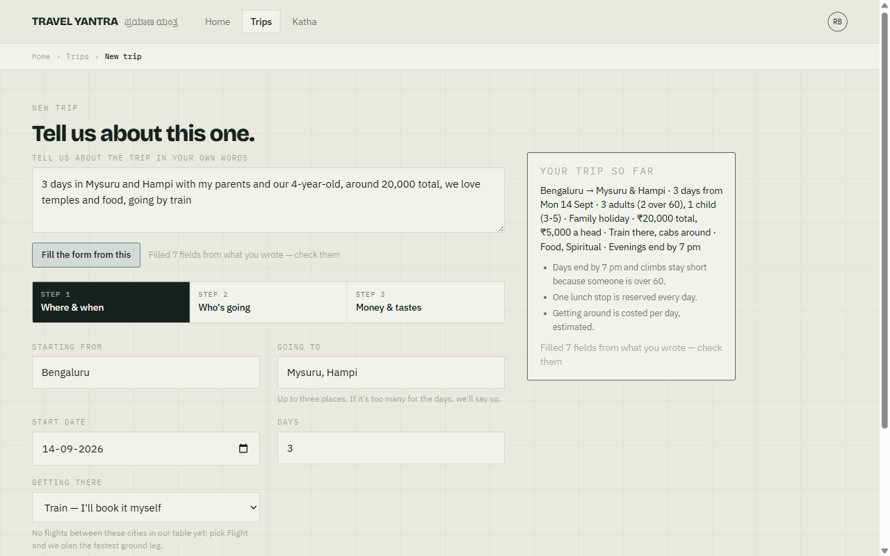
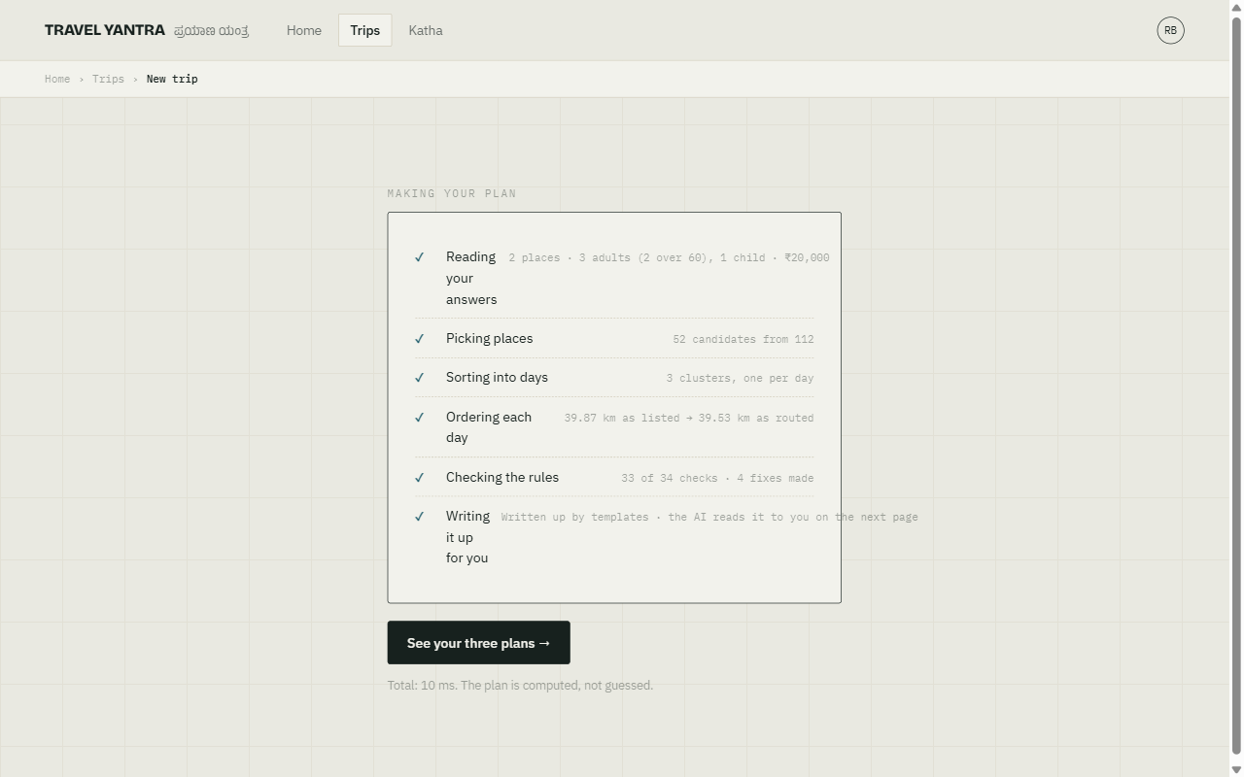
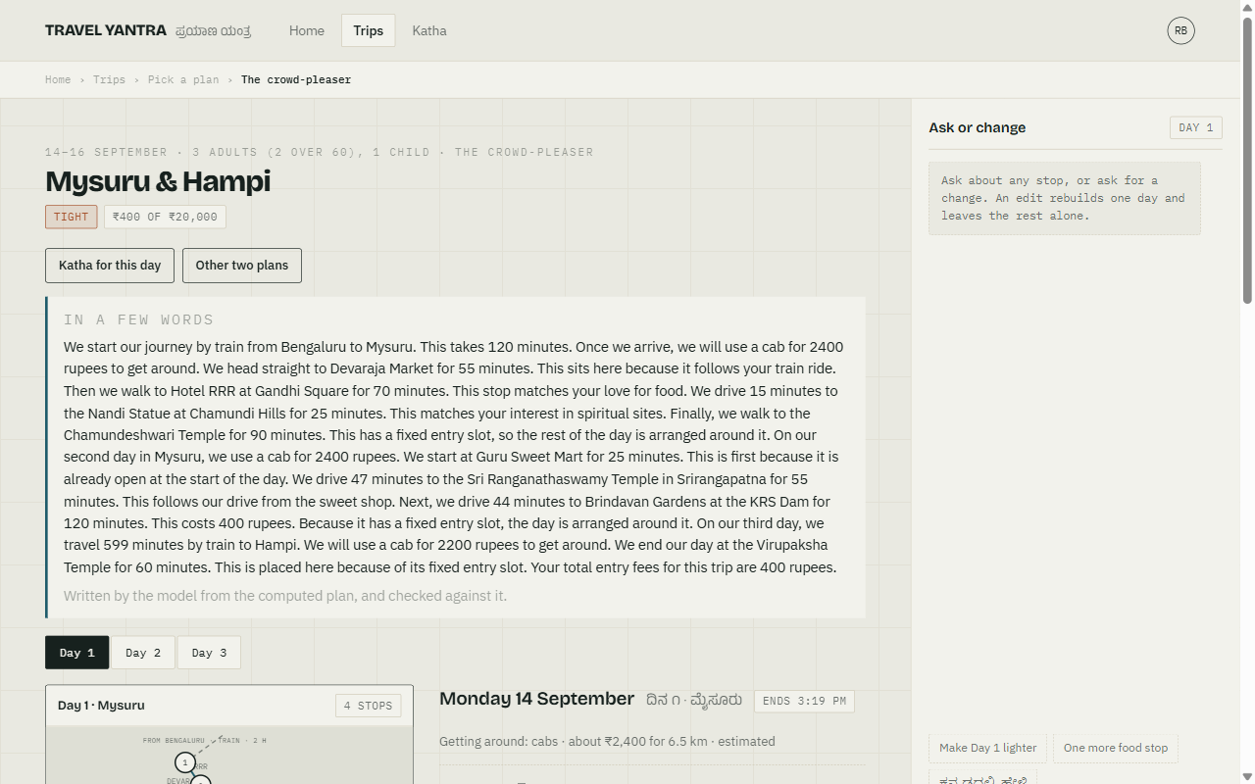
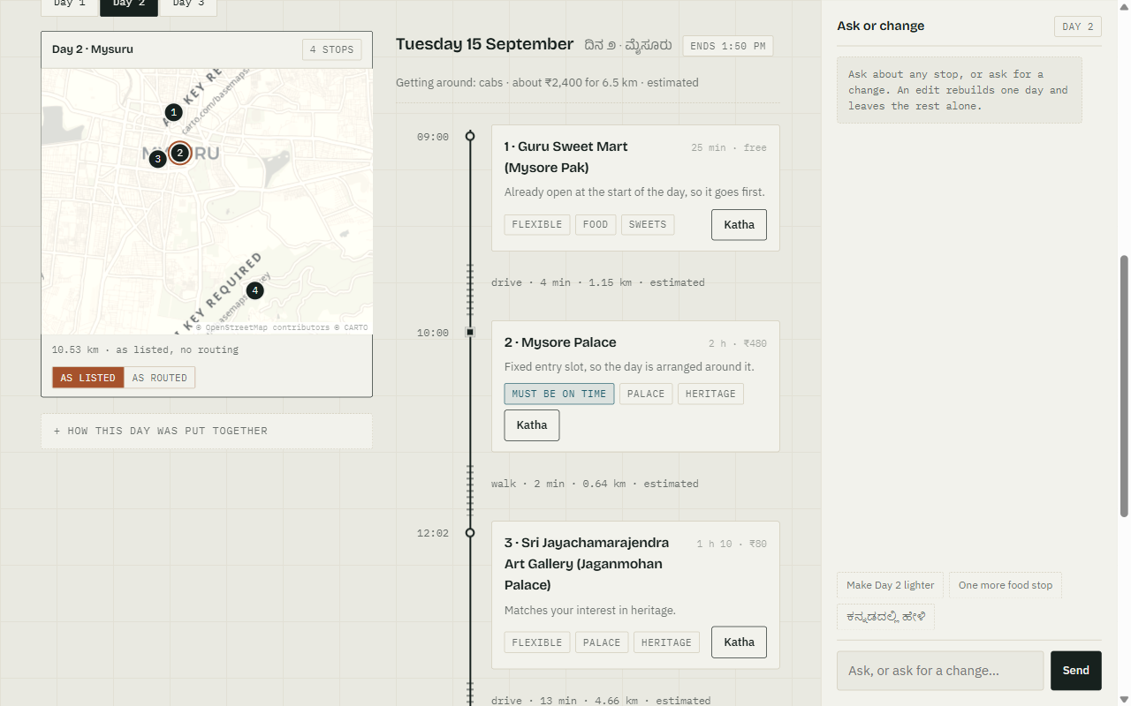
DEMONSTRATION OF PROJECT EXECUTION
The form, filled by the model from one pasted sentence; the traveller checks it.
Build trace from PlanMetrics: 27 of 135 candidates, 34.98 → 30.9 km, 37/37 checks.
Plan page: “In a few words”, written by the model and checked; the getting-around line.
Day 2 as listed, on real tiles: 10.53 km in list order against 6.45 km routed.

Slide 11
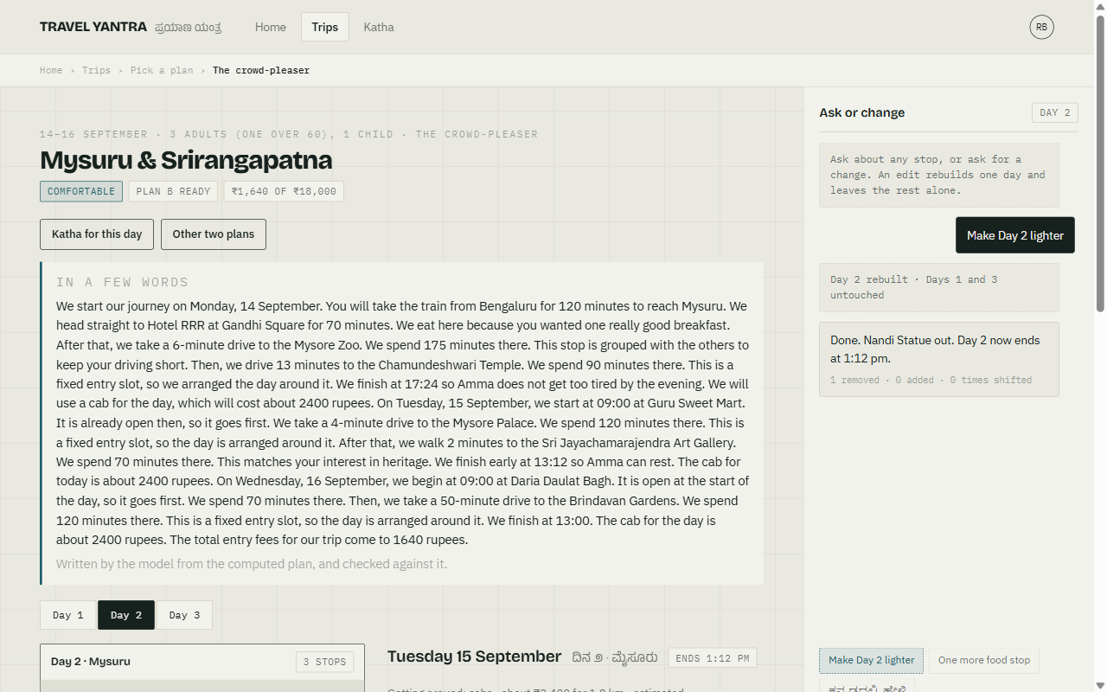
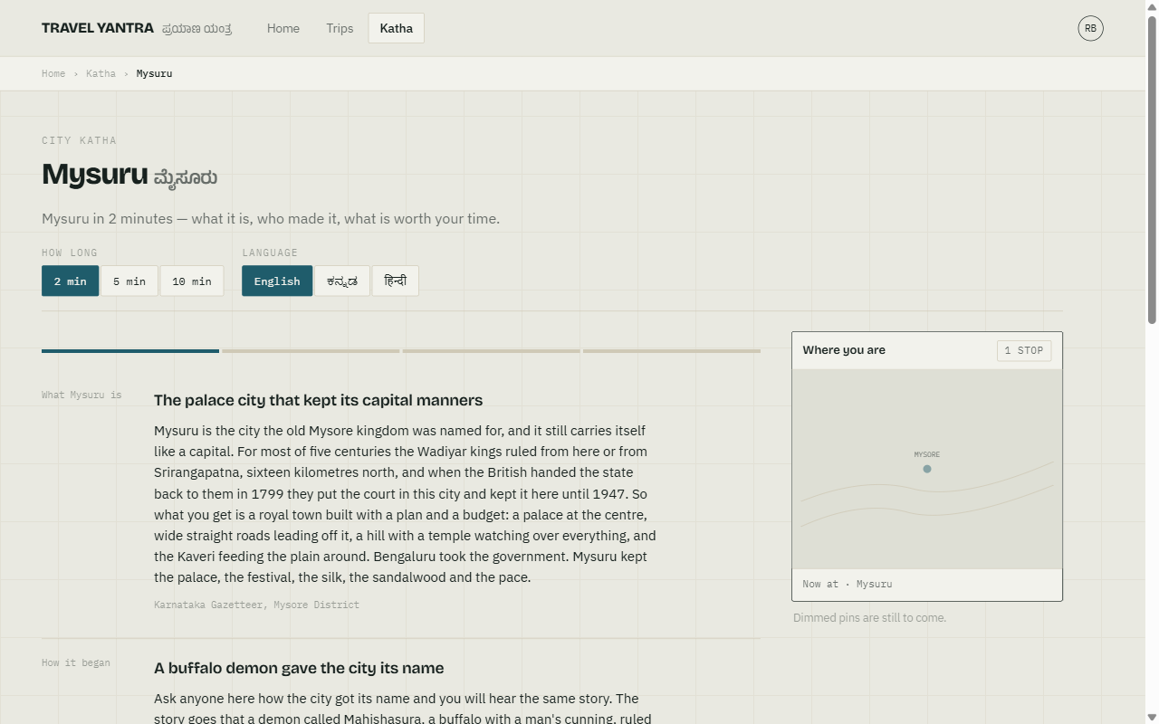
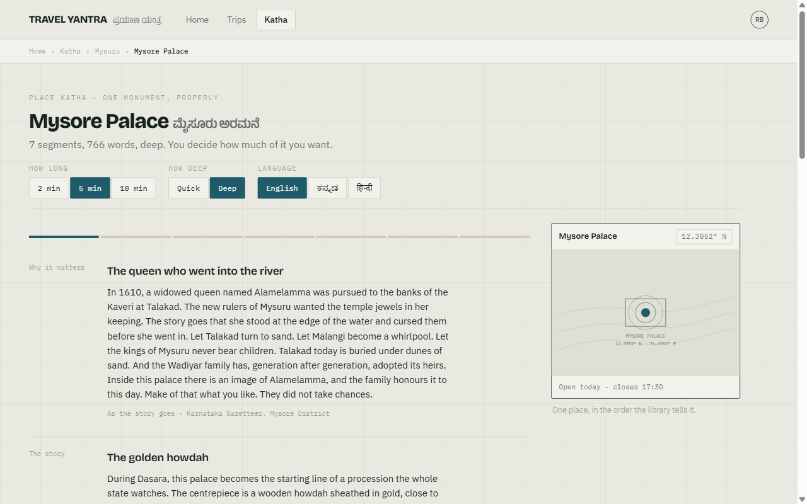
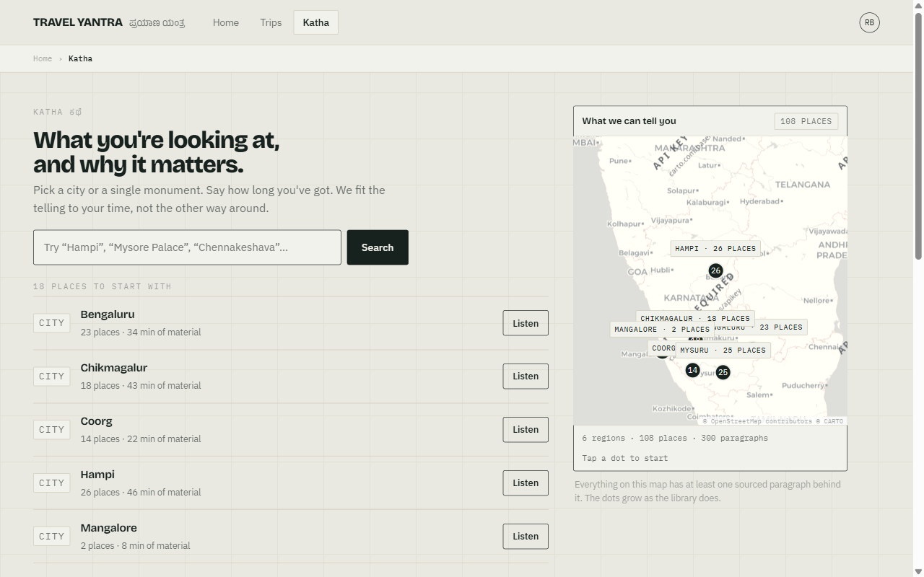
DEMONSTRATION OF PROJECT EXECUTION (contd. 2/3)
A chat edit rebuilds Day 2 only; Days 1 and 3 untouched, and the reply says so.
Mysuru city Katha at 2 minutes: a fixed portrait, no type labels, a source per paragraph.
Place Katha for Mysore Palace, with the depth picker; monument interiors live here.
Katha home: one pin per region with its place count, on real tiles.

Slide 12
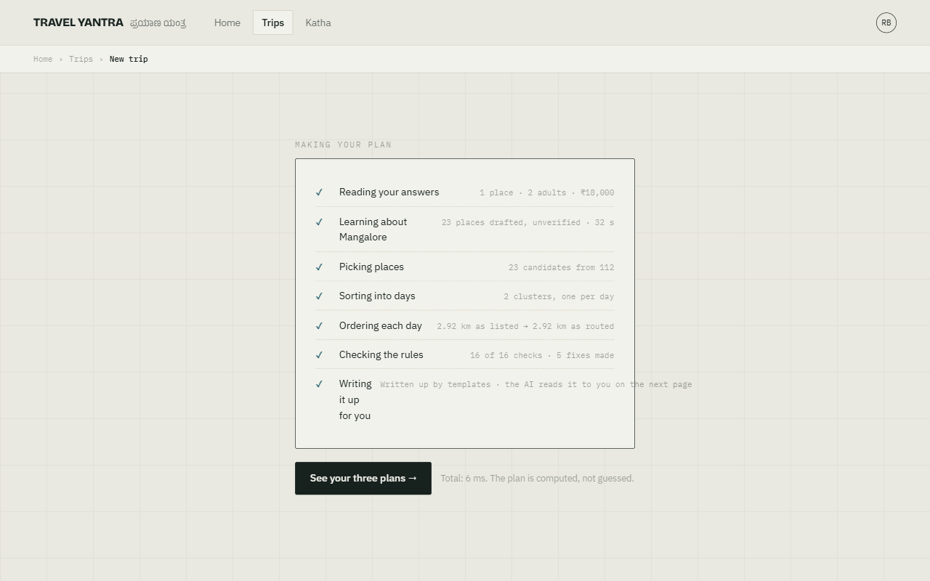
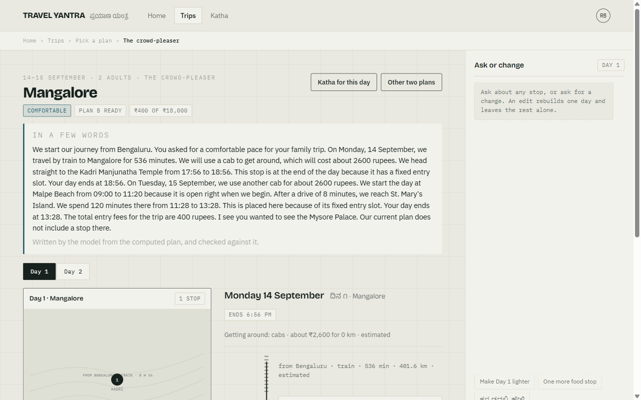
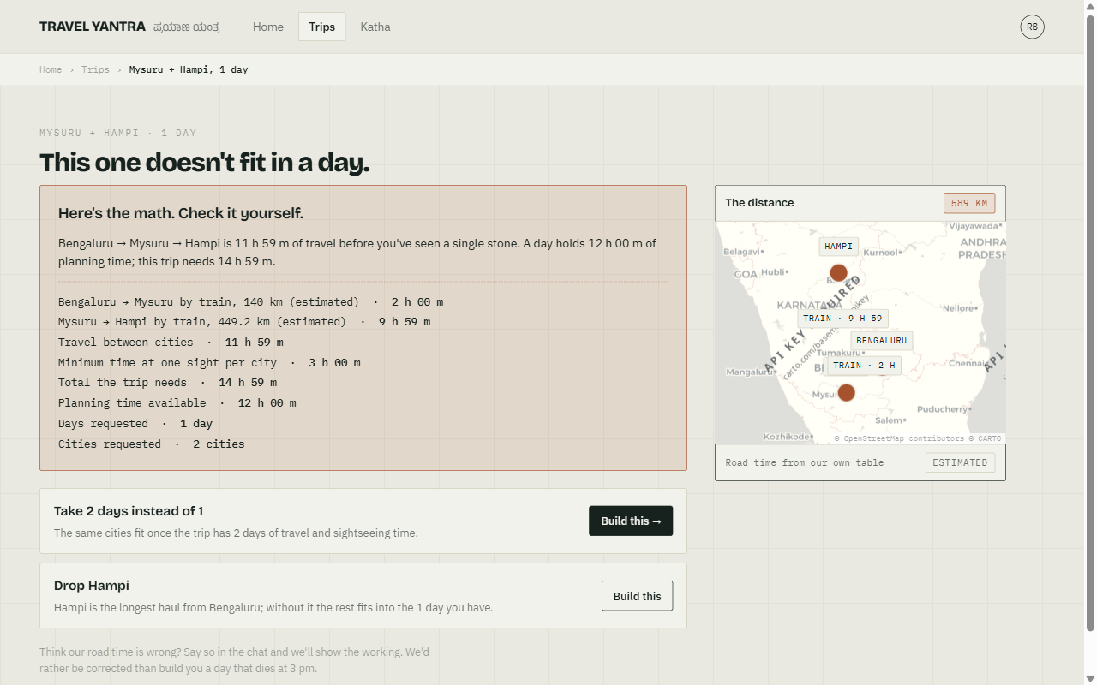
DEMONSTRATION OF PROJECT EXECUTION (contd. 3/3)
Mangalore, never seen before: 23 places drafted in 32 s, labelled unverified.
The Mangalore plan: our solver scheduled the draft; each stop says “AI-drafted · unverified”.
Mysuru and Hampi in one day: refused with the arithmetic and two buildable alternatives.

Slide 13
Experimental Setup, Results & Analysis
Setup: Python 3.12 and FastAPI against Supabase PostgreSQL 17 with pgvector and pg_trgm; embeddings computed locally with multilingual-e5-small; models through OpenRouter; speech from Sarvam bulbul:v3. Planner and retrieval are measured by their own harnesses, offline where they can be, so the numbers are reproducible.
Data the system was built on
Planner, on the seeded demonstration trip
Dataset | Count
Places in the table | 135
Verified against a live source | 20
Of those, corrected by verification | 16
Drafted by the model, unverified | 23
Live corpus paragraphs | 300
Of which the city portrait layer | 82
Whole trip, as listed
34.98 km
Whole trip, as routed
30.9 km
Day 2, as listed
10.53 km
Day 2, as routed
6.45 km
16 of the 20 verified entries were wrong before we checked them. That ratio is the argument for verifying rather than trusting, and for labelling what is not yet verified.
Same scale for all four bars.
Planner measure | Result
Constraint checks passed | 37 / 37
Repairs applied | 3
Candidates considered | 27 of 135
Build time | 4 ms
Module-wise status
Module | State
Intake parser and cold start | Working
Planner (cluster, route, validate, repair) | Working
Retrieval; city, place and day Kathas | Working
Narration with fact-check | Working
Speech (Sarvam, cached) | Working
Web application, maps and chat | Working
“As listed” is the same stops visited in candidate order — what an itinerary that never routes produces. It is the honest baseline, because nearest-next was already optimal here.

Slide 14
Experimental Setup, Results & Analysis (contd.)
Retrieval — Recall@5, re-measured today (eval_run 10)
Grounding, refusal, tests
Method | 30 questions | 10 name lookups | Kannada | p50
Dense (pgvector, e5) | 0.867 | 0.900 | 0.833 | 69 ms
Lexical (tsvector) | 0.600 | 0.900 | 0.167 | 57 ms
Hybrid + RRF | 0.867 | 0.900 | 0.833 | 129 ms
Measure | Result
Narrated segments passing the check | 17 / 18
Refusal gate | 6 / 6
Automated tests | 144
Reported honestly: hybrid retrieval tied dense rather than beating it, at nearly twice the latency. We keep it for one measured reason — on exact names the word search is as good as the meaning search (0.900 against 0.900) at less than half the time, which is how a traveller actually looks for a monument — and the meaning search carries Kannada (0.833 against 0.167), where the English index has almost nothing to match.
Cold start — a city never seen
City | Places | Paragraphs | Time | Cost
Mangalore | 23 | 12 | 32 s | $0.009
Every narrated segment is checked after generation against the paragraphs it was given: any date, number or English name not in the source fails, the segment is retried, then replaced by the source text itself.
The refusal gate is the opposite test — six questions the corpus cannot answer, all six refused.
Also reported: Recall@5 fell from 0.933 to 0.867 when the hand-written corpus was merged in, and was not tuned back. Re-measured after today's city portrait layer: Recall@5 unchanged, MRR 0.772 → 0.753, p50 110 → 129 ms. The numbers stand as measured.
Analysis: the planner result is a checklist result, not an opinion — 37 of 37 checks on a trip with an elder, a child, a fixed-time palace slot and a 7 pm evening. The retrieval result is reported as measured, including the regression, because a benchmark that only moves upward is not a benchmark.

Slide 15
PROJECT STATUS, CONCLUSION
Completed
In progress
Not started — Review 2
Intake: your words read into a form
Cold start for an unseen city
Deterministic planner
Hybrid retrieval
City, Place and Day Kathas
Narration with fact-check
Sarvam speech, cached
Chat repair, one day
Web app on real map tiles
Verifying the model-drafted places
Counting getting-around cost
against the budget
OpenStreetMap as the place source
for new cities
Objective 2: full five-
language support
Objective 3: WhatsApp and
voice channels
Objective 4: live booking
and routing APIs
A dedicated vector database
for the five-language corpus
Known limits, stated plainly
23 places drafted by the model for Mangalore are unverified; every one is labelled “AI-drafted · unverified” on screen until a source confirms it.
The getting-around cost is shown per day, estimated, and not yet counted against the budget or checked by the planner.
92 of the seeded places are still unverified draft data; the interface labels them as estimated rather than hiding it.
Routes are drawn as straight segments between stops, on real tiles or on the sketch; the kilometres use a detour factor and are honest, the drawing is not.
The system runs on localhost for this review; deployment is a post-review decision recorded in the project log.
Conclusion: two of six objectives are demonstrated in working software, measured rather than asserted. Beyond Karnataka, a city we have never seen is drafted by the model on first request, labelled, and still scheduled by our solver; OpenStreetMap is the intended place source for Review 2.

Slide 16
PUBLICATION
Planned contribution: IndiaTravel — the first India-specific benchmark for travel-planning AI agents.
Modelled on ChinaTravel (Shao et al., ICLR 2026), the equivalent open-ended benchmark for Chinese travel, on which neuro-symbolic agents reach 37.0 percent constraint satisfaction against 2.6 percent for purely neural ones — roughly a tenfold gap.
The novelty is the constraint set. India-specific constraints have no counterpart in the existing benchmarks: temple darshan windows and midday closures, weekly closing days, festival and Dasara crowding, monsoon access to hill roads, vegetarian and Jain food requirements, multi-generational parties with an elder's walking limit, and state-boundary transport changes.
Our planner, its validator and the 135-place dataset (20 verified against live sources) are the working reference implementation the benchmark would be released alongside.
Target: a Scopus-indexed conference or journal. Drafting begins after Review 2, once the multilingual and multi-channel objectives provide the second half of the evaluation.
The report will be prepared in LaTeX and checked through Turnitin, to remain under the fifteen percent similarity requirement.

Slide 17
REFERENCES (IEEE FORMAT)
[1] J. Xie, K. Zhang, J. Chen, T. Zhu, R. Lou, Y. Tian, Y. Xiao and Y. Su, “TravelPlanner: A Benchmark for Real-World Planning with Language Agents,” in Proc. 41st Int. Conf. Machine Learning (ICML), 2024.
[2] Y. Hao, Y. Chen, Y. Zhang and C. Fan, “Large Language Models Can Solve Real-World Planning Rigorously with Formal Verification Tools,” in Proc. 2025 Conf. North American Chapter of the ACL (NAACL), 2025, pp. 3499–3557.
[3] J.-J. Shao, B.-W. Zhang, X.-W. Yang, B. Chen, L.-Z. Guo and Y.-F. Li, “ChinaTravel: An Open-Ended Travel Planning Benchmark with Compositional Constraint Validation for Language Agents,” in Proc. Int. Conf. Learning Representations (ICLR), 2026.
[4] P. Lewis et al., “Retrieval-Augmented Generation for Knowledge-Intensive NLP Tasks,” in Adv. Neural Inf. Process. Syst. (NeurIPS), vol. 33, 2020, pp. 9459–9474.
[5] L. Wang, N. Yang, X. Huang, L. Yang, R. Majumder and F. Wei, “Multilingual E5 Text Embeddings: A Technical Report,” arXiv:2402.05672, 2024.
[6] G. V. Cormack, C. L. A. Clarke and S. Buettcher, “Reciprocal Rank Fusion Outperforms Condorcet and Individual Rank Learning Methods,” in Proc. 32nd Int. ACM SIGIR Conf., 2009, pp. 758–759.
[7] G. A. Croes, “A Method for Solving Traveling-Salesman Problems,” Operations Research, vol. 6, no. 6, pp. 791–812, 1958.
[8] D. Arthur and S. Vassilvitskii, “k-means++: The Advantages of Careful Seeding,” in Proc. 18th ACM-SIAM Symp. Discrete Algorithms (SODA), 2007, pp. 1027–1035.
[9] S. P. Lloyd, “Least Squares Quantization in PCM,” IEEE Trans. Information Theory, vol. 28, no. 2, pp. 129–137, 1982.

