Slide 1



The trusted campus marketplace for students to buy and sell academic essentials — textbooks, electronics, and study materials — within our campus community.
STUDENT-TO-STUDENT MARKETPLACE
PHP · MYSQL
Presented By-
Om Sandeep Bagde
Karn Sandeep Ghorpade﻿
Pranav Shivaji Janjal
T.Y.B.C.A.(Science)-VI﻿
Notes:
1

Slide 2
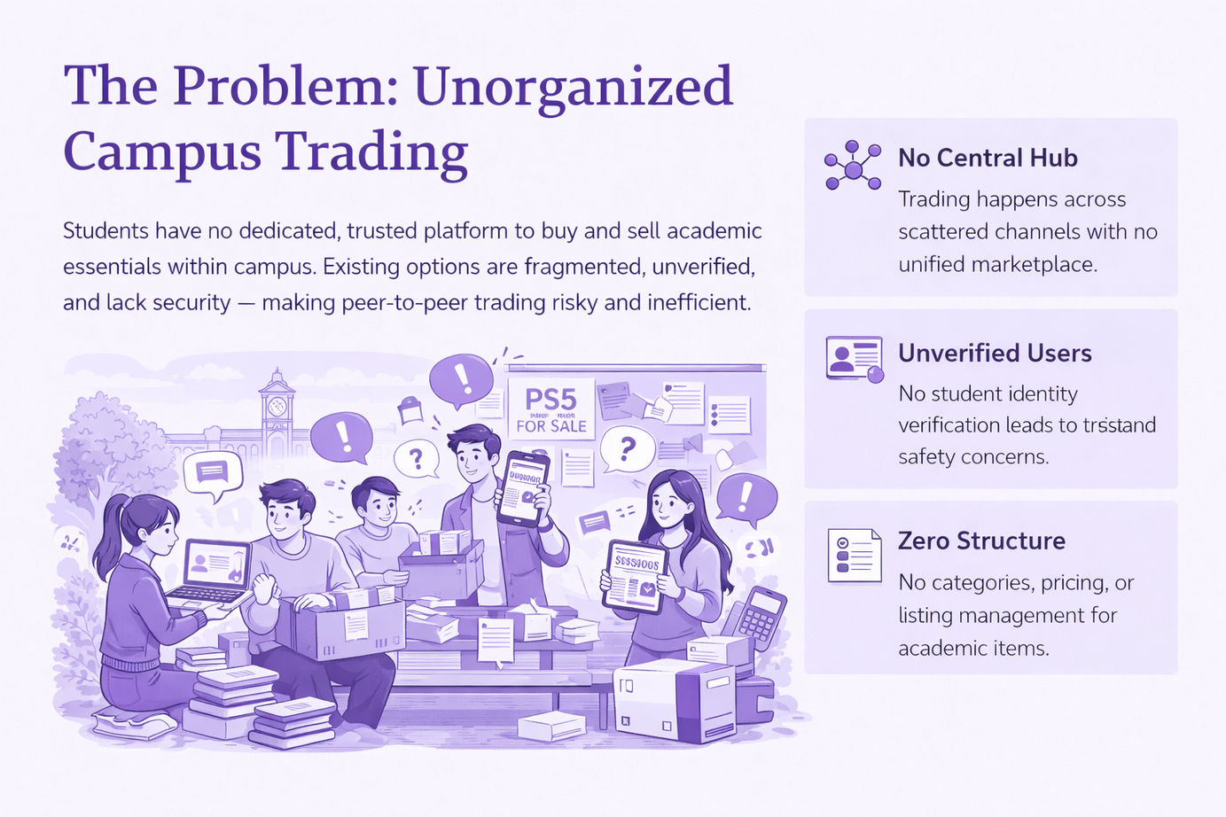
The Problem: Unorganized Campus Trading
Students have no dedicated, trusted platform to buy and sell academic essentials within campus. Existing options are fragmented, unverified, and lack security — making peer-to-peer trading risky and inefficient.
No Central Hub
Unverified Users
Trading happens across scattered channels with no unified marketplace.
No student identity verification leads to trust and safety concerns.
Zero Structure
No categories, pricing, or listing management for academic items.
Notes:
2

Slide 3

The Solution: campXchange
A purpose-built, student-exclusive marketplace powered by PHP and MySQL — enabling secure, verified, and organized campus commerce.
Verified Community
Only verified student accounts can transact, ensuring safety for everyone.
Save Money
Get quality academic essentials at a fraction of the original price from fellow students.
Sell Easily
Turn your used textbooks and gadgets into cash quickly within your campus circle.
Notes:
3

Slide 4
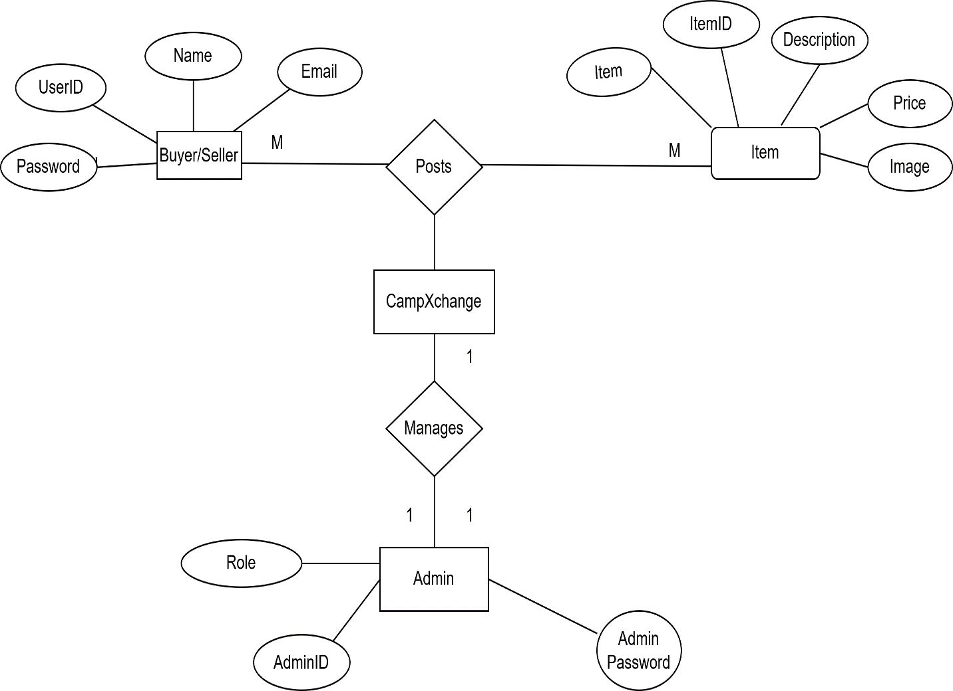
. ER Diagram (Entity Relationship)
Entities:
User
Product
Transaction
Relationship:
One user can add multiple products
One product belongs to one user

Slide 5
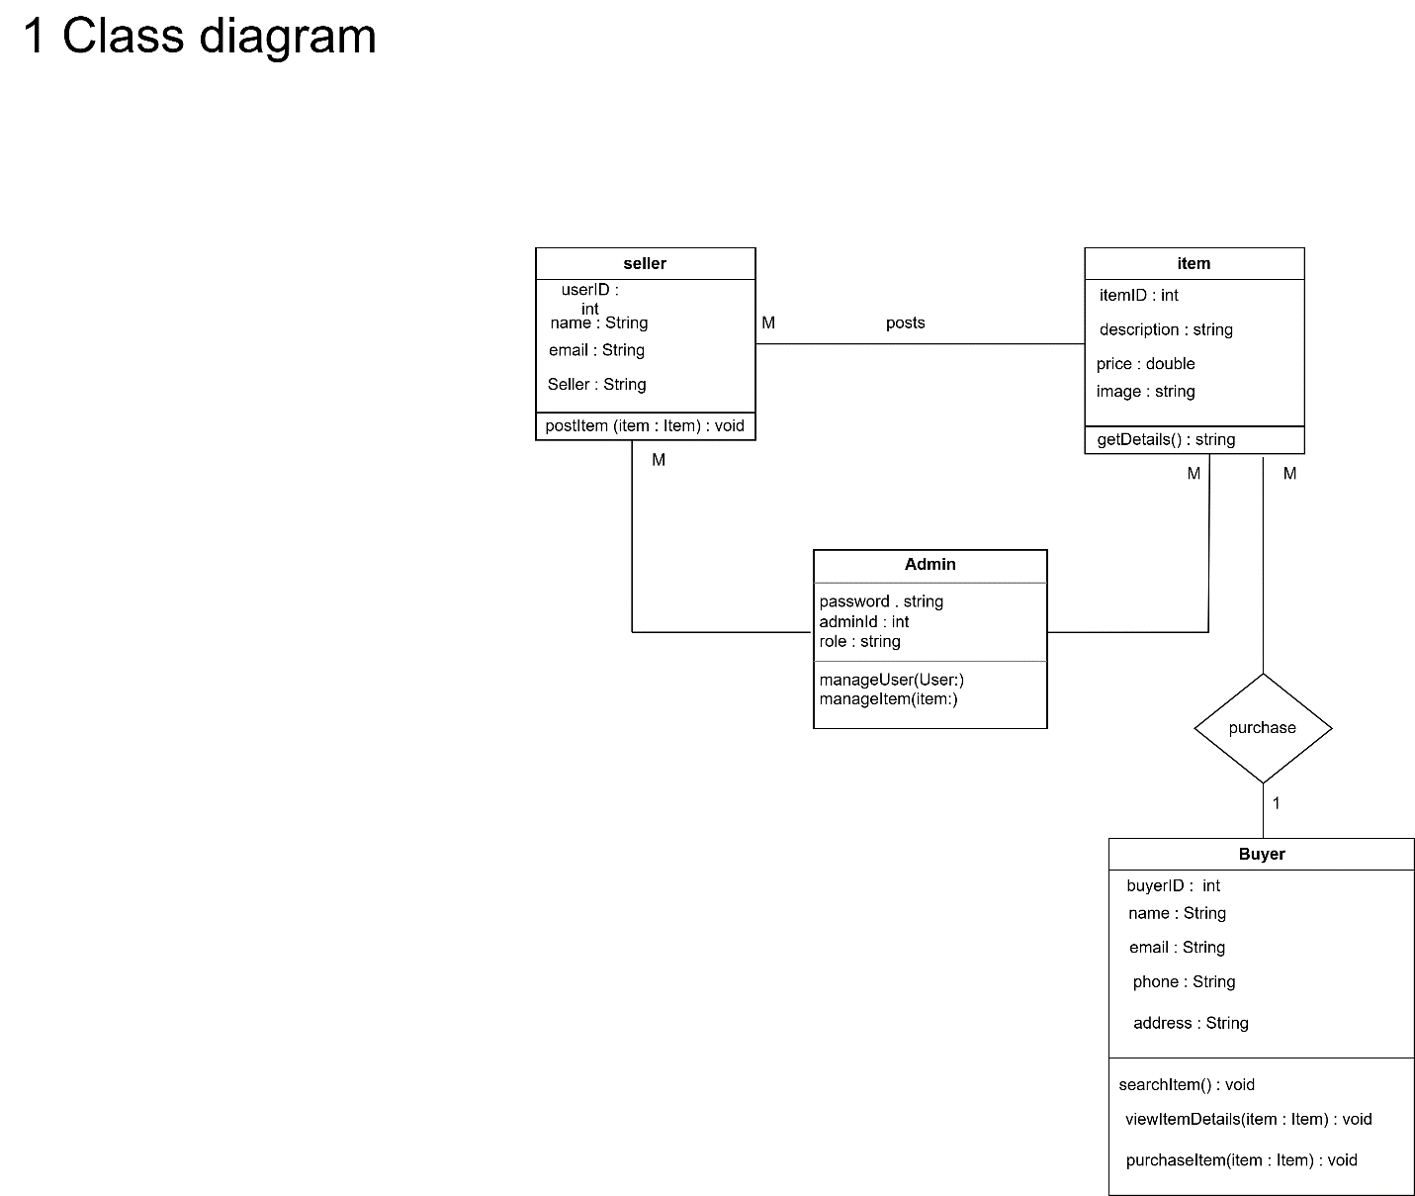
Class Diagram
Classes:
User
Product
Admin
Each class contains:
Attributes (data)
Methods (functions)

Slide 6
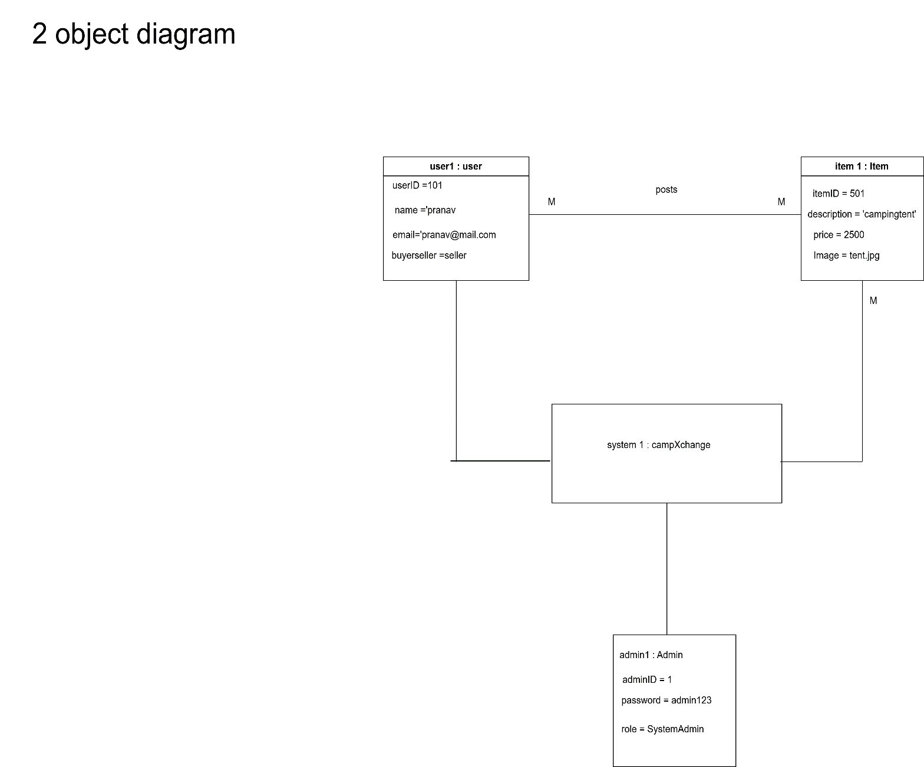
Object Diagram
Shows real-time instances of classes.
Example:
User: OMII
Product: Laptop

Slide 7
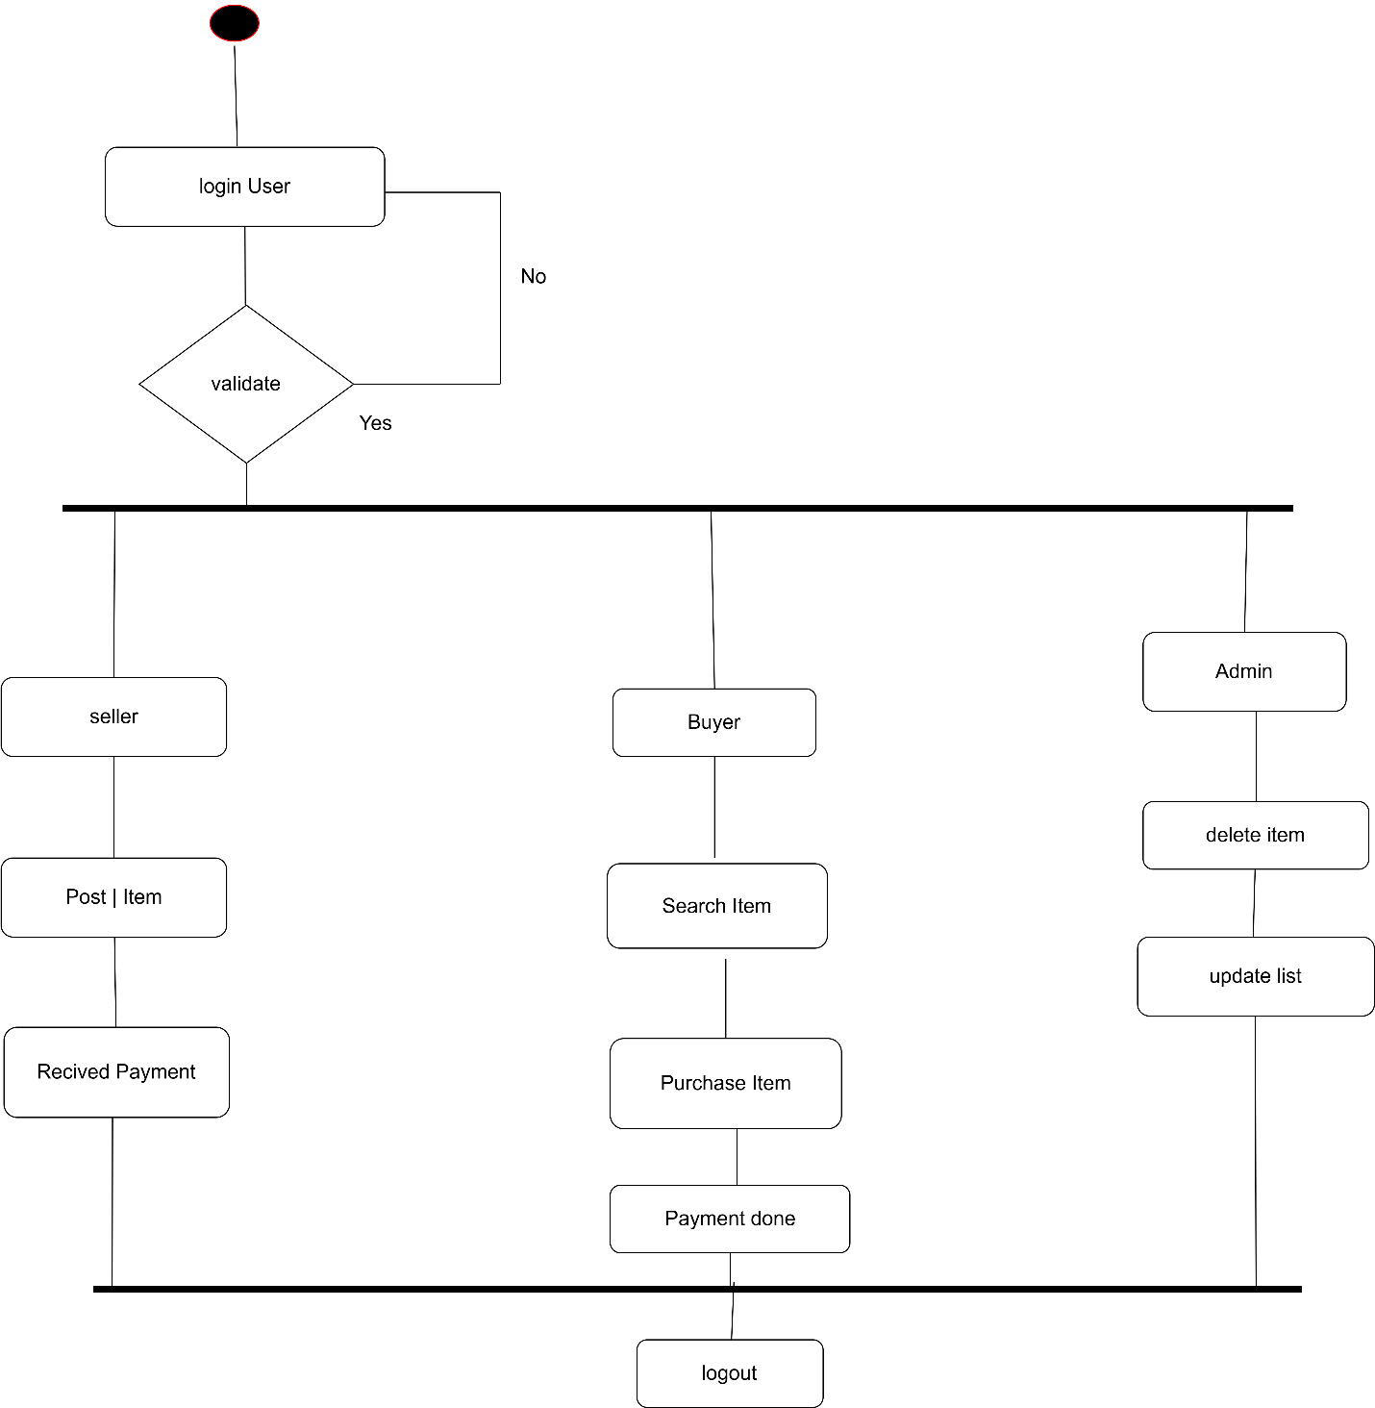
Activity Diagram
Flow:
Login → Add Product → View Product → Buy Product

Slide 8
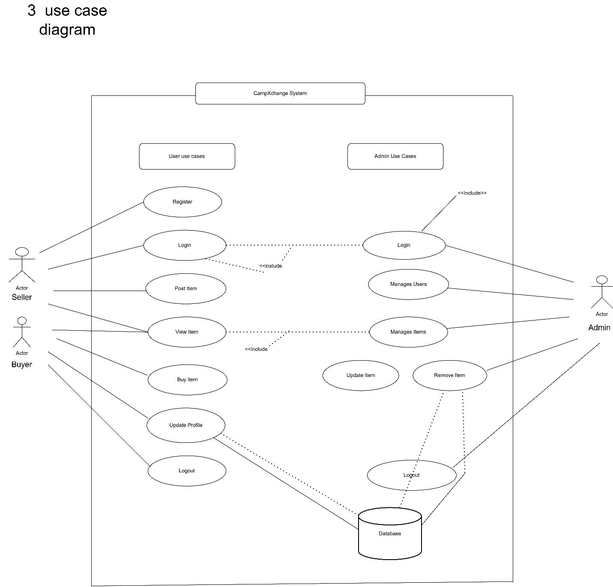
Use Case Diagram
Actors:
User
Admin
User can:
Login
Add product
Buy product
Admin can:
Manage users
Delete products

Slide 9
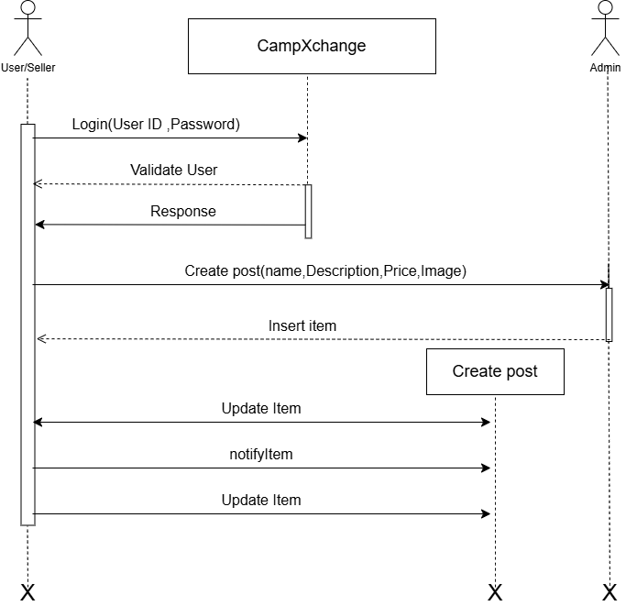
Sequence Diagram
Shows step-by-step interaction:
User → System → Database → Response

Slide 10
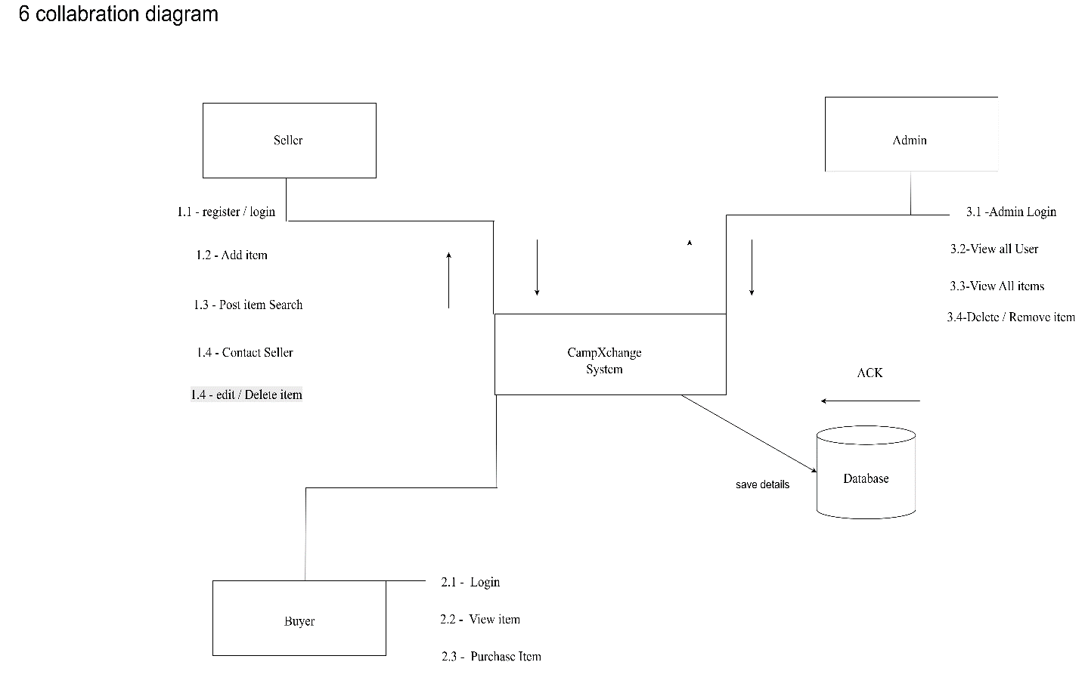
Collaboration Diagram
Shows communication between system components

Slide 11
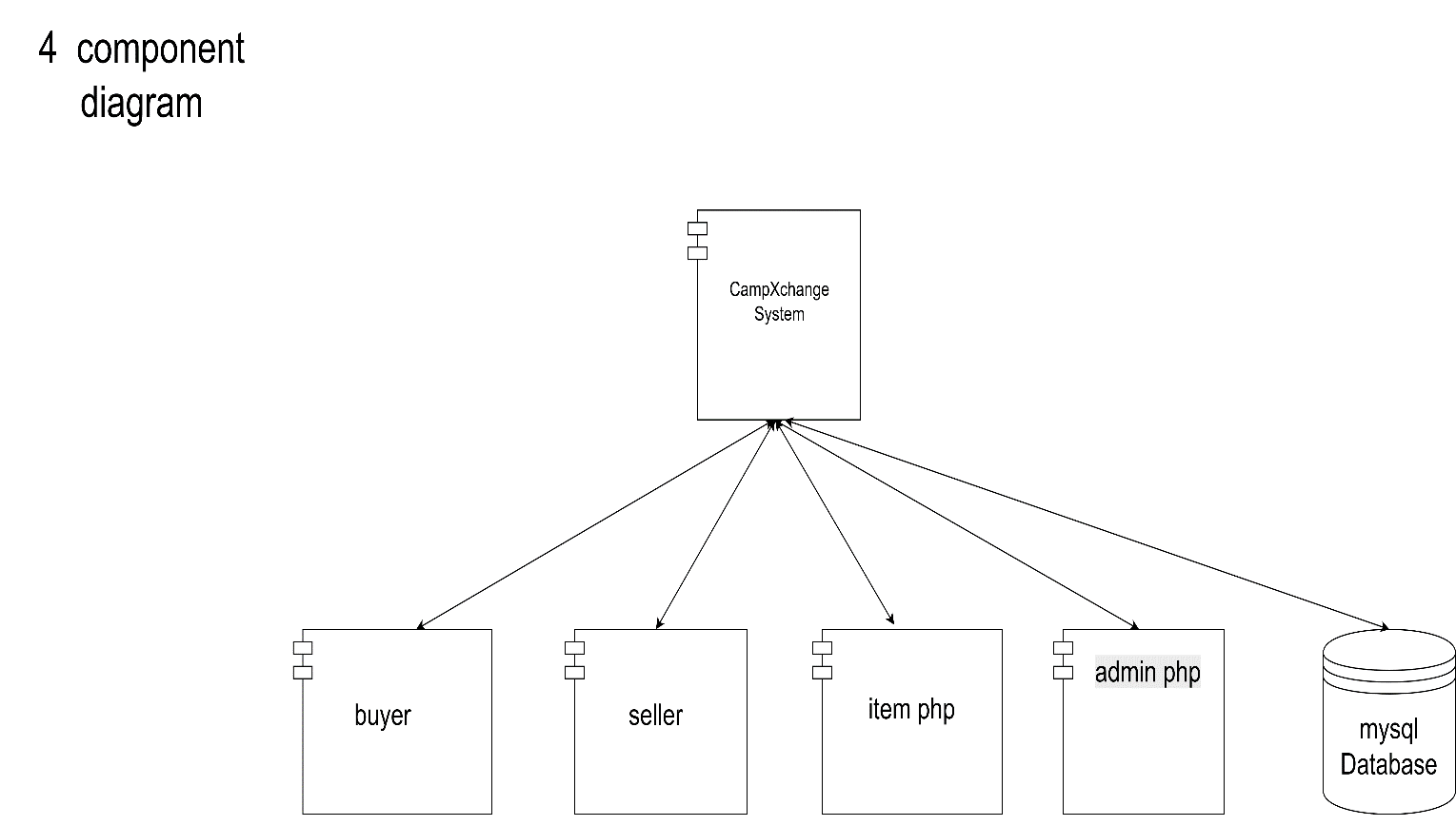
Component Diagram
Modules:
User Interface
Backend
Database

Slide 12
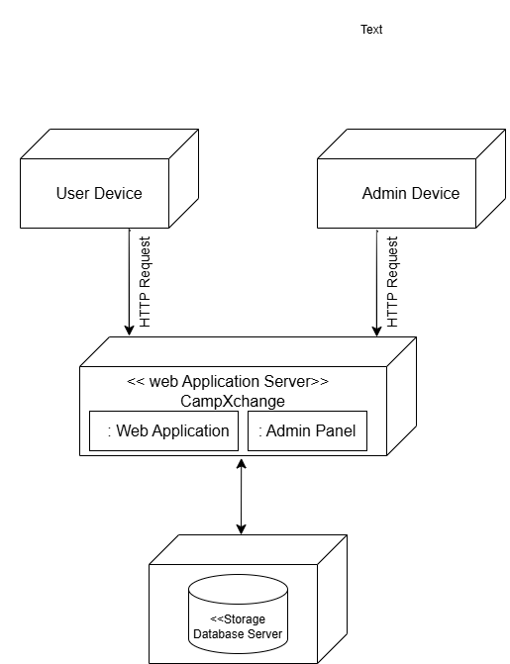
Deployment Diagram
Architecture:
Client (User device)
Server
Database

Slide 13
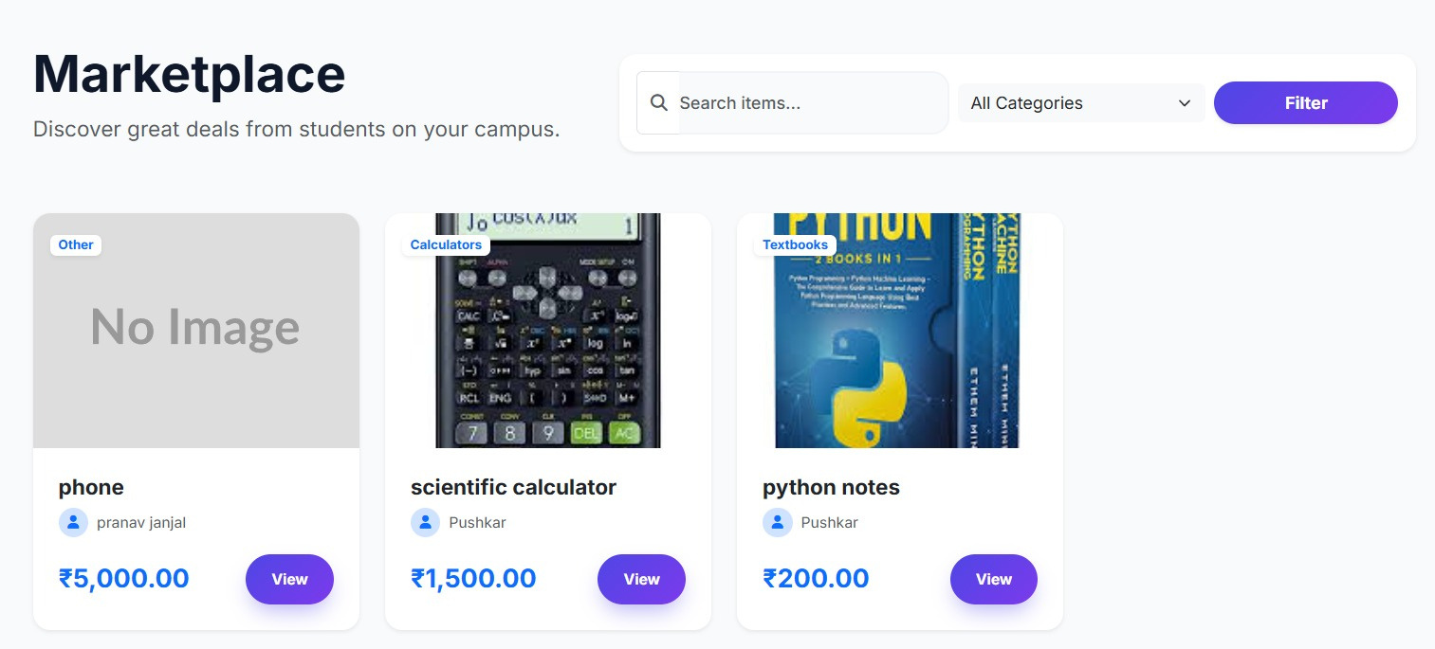


Landing Page & Browse Experience
Key Features
  Category browsing: Textbooks, Electronics, Stationery, Calculators
  Live listings with seller info, price, and condition
  Quick links: Home, Browse Items, Register
  Contact support and social media integration
Sample listings include a phone at ₹5,000, scientific calculator at ₹1,500, and python notes at ₹200 — all from verified campus sellers.
Notes:
4

Slide 14
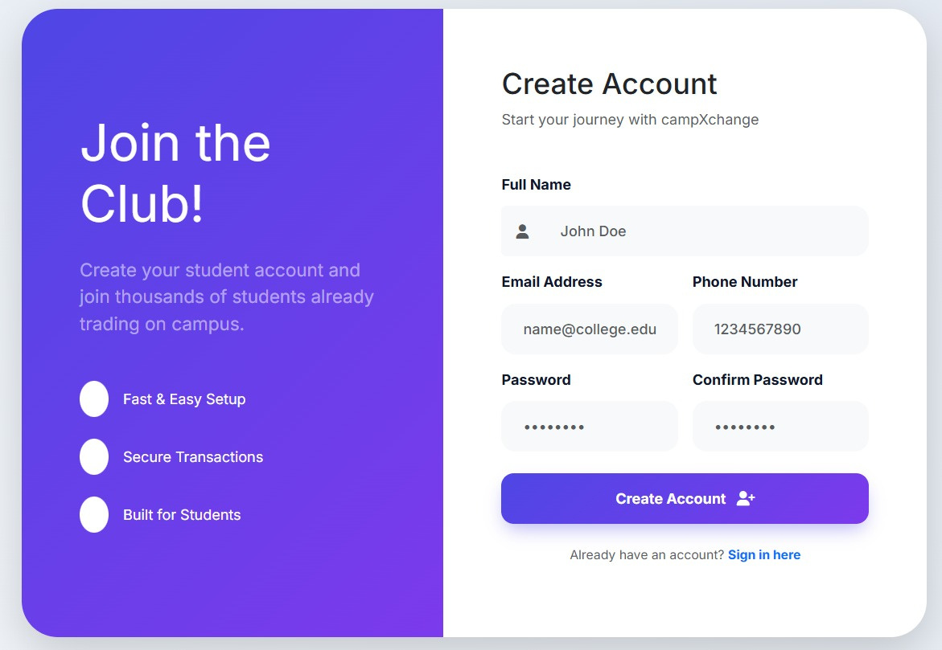
Authentication: Sign In & Registration
Sign In
Students log in with their college email and password. Forgot-password support included. Secure session management via PHP.
Create Account
Fast setup with full name, email, phone number, and password confirmation. Built exclusively for students.
Verified Access
Real-time messaging and secure transactions unlock upon verified student account creation.
Notes:
5

Slide 15
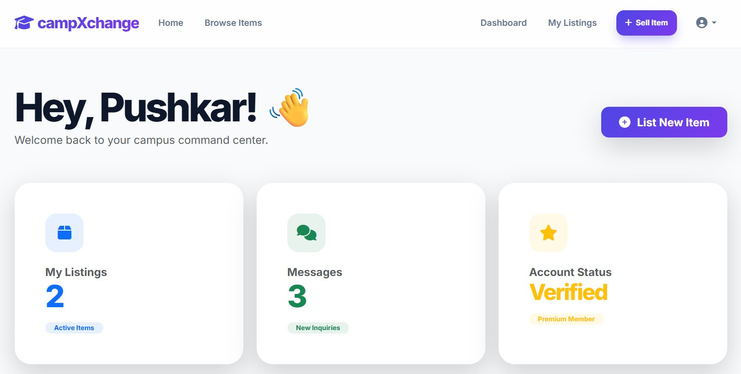

User Dashboard: Campus Command Center
Dashboard Overview
  My Listings: Manage all posted items with View, Edit, Delete actions
  Messages: Real-time inquiries from potential buyers
  Account Status: Verified badge and Premium Member access
  Quick Actions: + List New Item from the dashboard
Recent listings display item name, category, price, and live status — e.g., scientific calculator (₹1,500) and python notes (₹200), both posted Mar 19, 2026.
Notes:
6

Slide 16
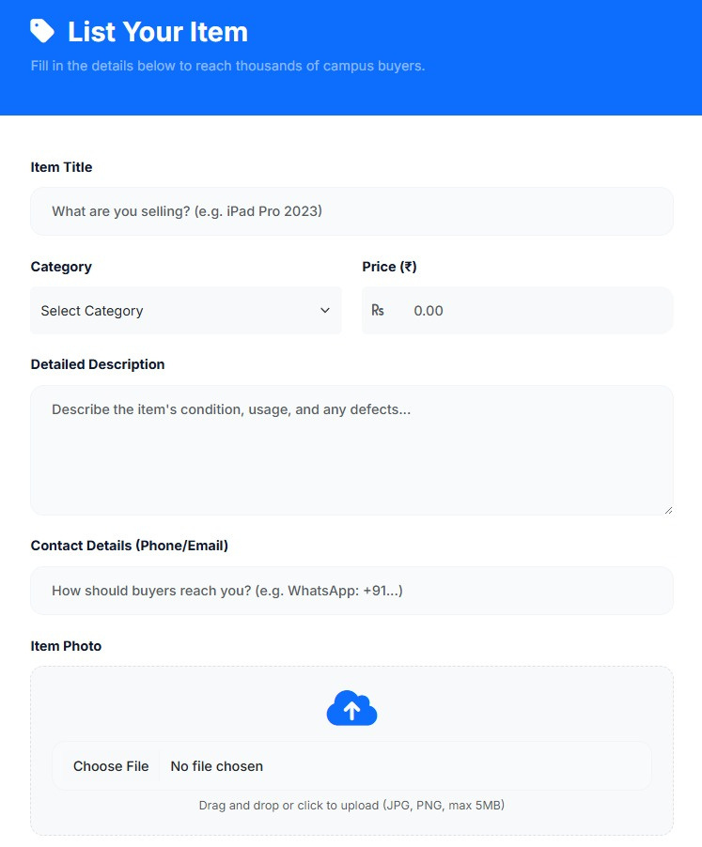
List Your Item
Students fill in item details to reach thousands of campus buyers. Listings include title, category, price, condition description, and contact info.
Enter Title
Set Price
Add item title and category
Enter price (₹) and brief description
Post Listing
Upload Photos
Publish live with contact details
Add JPG/PNG images (max 5MB)
Contact details (phone/email or WhatsApp) are included so buyers can reach the seller directly. Drag-and-drop image upload supports JPG and PNG formats up to 5MB.
Notes:
7

Slide 17
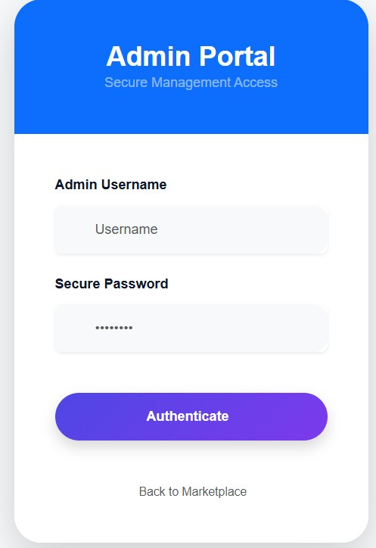
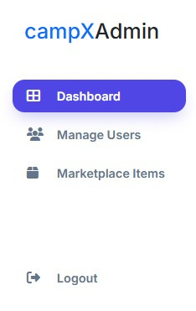
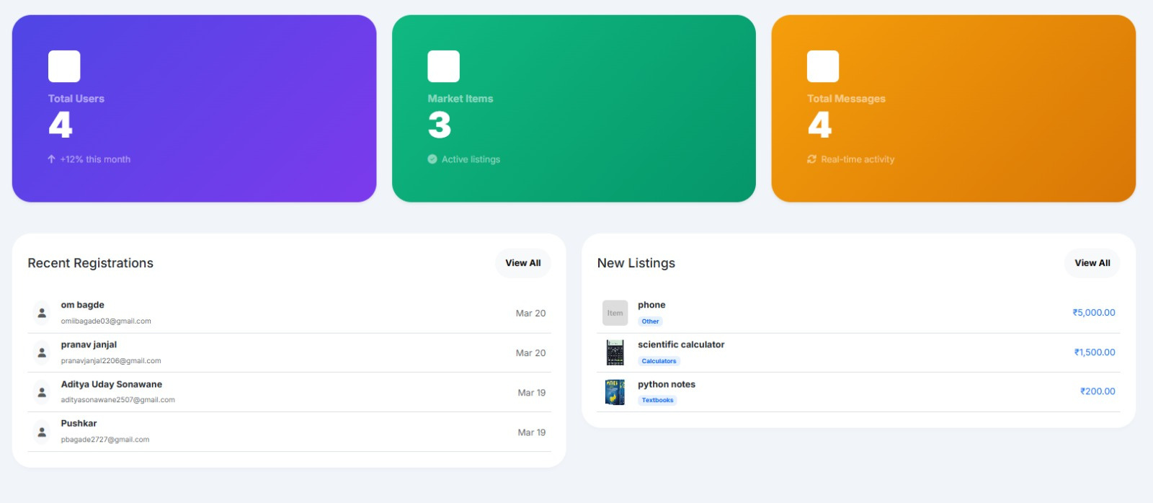
Admin Portal
Super Admin Dashboard
Secure management access for platform oversight. Tracks platform health and user activity in real time.
  Total Users: 4 (↑ +12% this month)
  Market Items: 3 active listings
  Total Messages: 4 real-time activity
  Recent Registrations with email and date
  New Listings overview with category and price
OM BAGADE — SUPER ADMIN
Notes:
8

Slide 18
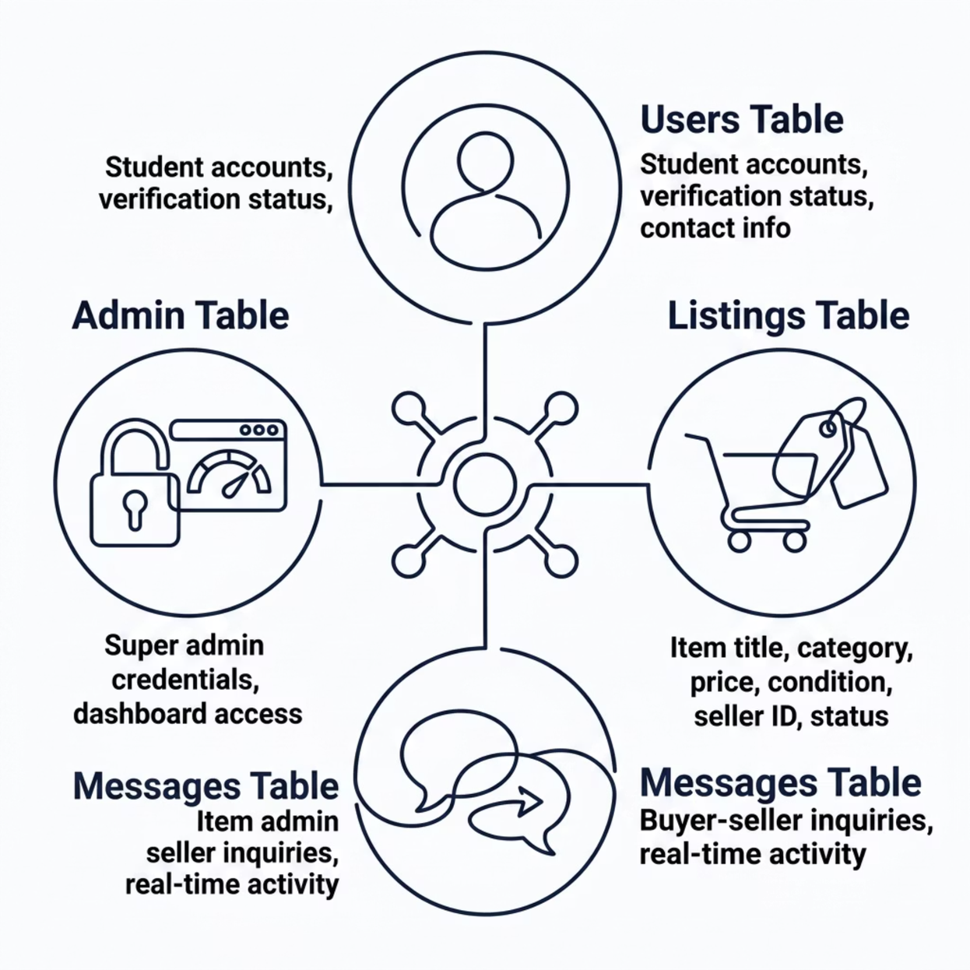
Database Architecture
CampXchange is built on a structured MySQL database supporting all core marketplace operations — from user authentication to live listings and messaging.
Core Tables
  Users — Student profiles with verification status and contact details
  Listings — Item title, category, price, condition, and live status
  Messages — Buyer-seller inquiry threads
  Admin — Super admin credentials and portal access
All transactions are tied to verified student accounts, ensuring a
secure and accountable campus marketplace.
Notes:
9

Slide 19




Why campXchange Works
Trusted Community
Verified student accounts ensure safe and secure transactions for everyone on campus.
Fast & Easy Setup
Students can register, list items, and start trading within minutes of signing up.
Real-Time Messaging
Built-in messaging connects buyers and sellers instantly for seamless campus commerce.
Built for Students
Every feature — from categories to pricing — is designed specifically for the campus community.
Notes:
10

Slide 20
Conclusion
campXchange is a simple and secure platform built to help students buy and sell academic items easily within the campus. It replaces unorganized methods like WhatsApp groups with a professional system, making campus life more affordable and efficient for everyone.
Thank You!
​Project Name: campXchange
Academic Year: 2025-2026
​Presented By
  Om Sandeep Bagde
  Karan Sandeep Ghorpade
  Pranav Shivaji Janjal
Notes:
10

