Slide 1
MBA 652A Statistical Modelling for Business Analytics
Analysis of the Factors Affecting Sales Price of Houses in King County, USA
Project 1 – Multiple Linear Regression
Submitted By: (GROUP 11)
Abhishek Sahu (20114002)
Pushkar Awasthi (21114014)
Saurabh Sachan (20114018)
Sumit Tripathi (20114022)
Submitted To:
Prof. Devlina Chatterjee
IME, IIT KANPUR

Slide 2
Contents
Problem statement
Methodology
Data Description
Exploratory data analysis
Linear Regression model with One Variable
Linear Regression model with Multiple Variable
Conclusions

Slide 3
PROBLEM STATEMENT
In this project, we will be examining data from house sales in King County, Washington in order to study the various factors affecting the Sales Price of House using various Regression Techniques and to formulate a multiple regression depicting the effects of these factors.
This dataset included 21,597 observations on the housing market in King County, WA, for homes sold between May 2014 and May 2015.
The analysis may used to determine what a potential seller may be able to do in order to increase the final sale price of their home. While there are many factors at play when it comes to home value, we will attempt to figure out key features that drive sale price using data scrubbing and linear regression models.

Slide 4
METHODOLOGY
We looked at the Summary of data and did some Exploratory Data Analysis & Data Visualization.
Start building model using uni-variate Linear Regression model, and then using multi-variate Linear. Regression model.
We then tried to evaluate all the possible combination of variables that explains the variation in price of House.
Then we tried to conclude the best possible combination on the basis of threshold p-values and VIF(Variance Inflation Factor) , by performing backward elimination and eliminating insignificant variables.

Slide 5
DATA DESCRIPTION
The dataset we have chosen is historical dataset of houses at King County, USA from year 2014-2015 from the Kaggle source.
This dataset offers 21 house features including the price and the id columns, along with 21613 observations.
We have the dependent variable (Y) price, which is the prediction target.
We have the 20 independent variables (X), list is provided below:
Id, date, bedrooms, bathrooms, sqft_living, sqft_lot, floors, waterfront, view, condition, grade, sqft_above, sqft_basement, yr_built, yr_renovated, zipcode, lat, long, age

Slide 6
Exploratory data analysis
Correlation plot between variables: ( shown in the next slide)
From the plot this have concluded that there is no perfect multicollinearity among variables; but there is imperfect multi collinearity between sqft_living and sqft_above,grade and sqft_above , bathrooms and sqft_living,& grade and sqft_living .
We decided to drop the “sqft_above” , “zipcode” and “age” features as they are highly correlated with the other variables.

Slide 7
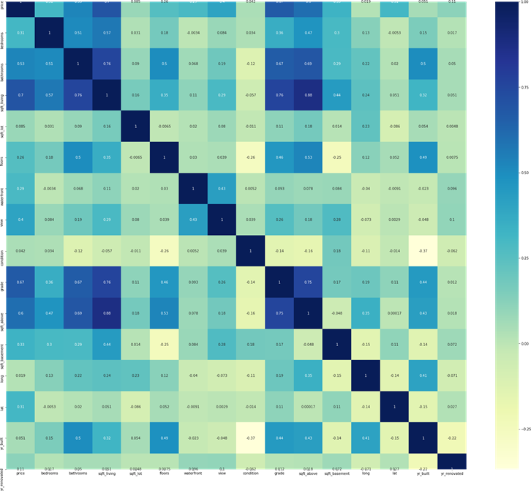

Slide 8
Exploratory data analysis
Data Visualization : We created
Boxplots: We detected outliers for the “bathroom” feature, while majority of the houses having 6-7 bathroom, very few were found to have 33 bathrooms. We then consequently decided to remove the outliers.
Scatter Plot: Through scatter plot we were able to detect high collinearity between dependent variable “price” and independent variables “sqft_living” and “grade”.

Slide 9
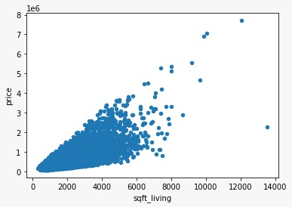
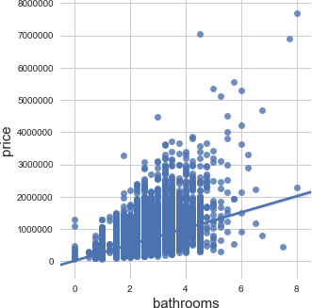
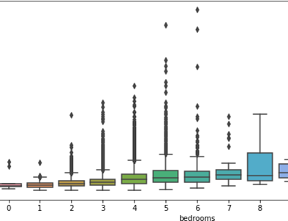

Slide 10
LINEAR REGRESSION MODEL WITH ONE VARIABLE
We formulated model for each of the remaining independent features (15) with dependent feature “price” to calculate the important role of each feature in predicting the price value.
We use Hypothesis rule for 95% Confidence Interval, for analyzing whether the feature is important or not.
We modelled it against each of the 15 features, showing the OLS Summary of only those which had lesser R-squared value signifying those features that are not impacting the price that much.

Slide 11
FEATURE | R SQUARED VALUE
long | 0.000
condition | 0.001
sqft_lot15 | 0.007
sqft_lot | 0.008
updated_age | 0.014
waterfront | 0.072
floors | 0.082
lat | 0.098
bedrooms | 0.1
sqft_basement | 0.13
view | 0.158
bathrooms | 0.28
sqft_living15 | 0.345
grade | 0.449
sqft_living | 0.494

Slide 12
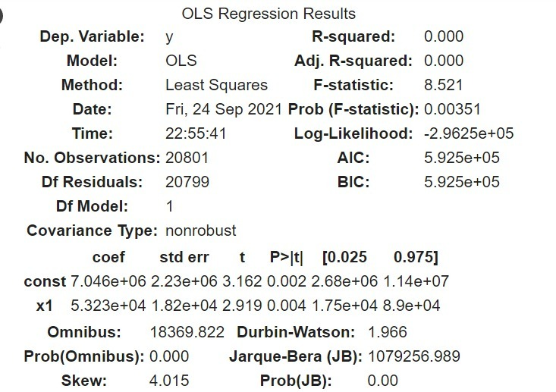

Slide 13
SUMMARY OF SLOPE AND INTERCEPTS
 |  | Model 1 | Model 2 | Model 3 | Model 4 | Model 5 | Model 6 | Model 7 | Model 8
intercept | Estimate | -50660*** | - 15058000*** | 59740*** | 255700*** | 495500*** | 462800*** | 97770*** | 480100***
Sqft_living | Estimate | 282.147***
grade | Estimate |  | 209200*** |  |  |  |  | -
Sqft_above | Estimate |  |  | 268.443***
bathrooms | Estimate |  |  |  | 255700***
view | Estimate |  |  |  |  | 191100***
Sqft_basement | Estimate |  |  |  |  |  | 266**
bedrooms | Estimate |  |  |  |  |  |  | 130900***
condition | Estimate |  |  |  |  |  |  |  | 17760***

Slide 14
LINEAR REGRESSION MODEL WITH MULTIPLE VARIABLE
We formulated model for all the independent feature at once.
We then used Back-propagation elimination process, we define best combination of independent variable using p-value, VIF, less R-square value for single variable.
We found a reasonable change in R-square value, when we eliminated “waterfront” feature, thus we settled for 10 significant features, responsible for predicting the house prices.

Slide 15
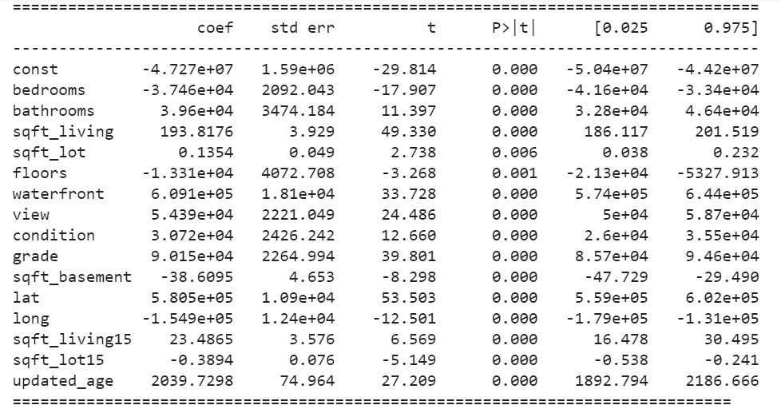
Here, we didn’t find any significant p-value for any feature, thus we couldn’t eliminate any feature based on this.

Slide 16
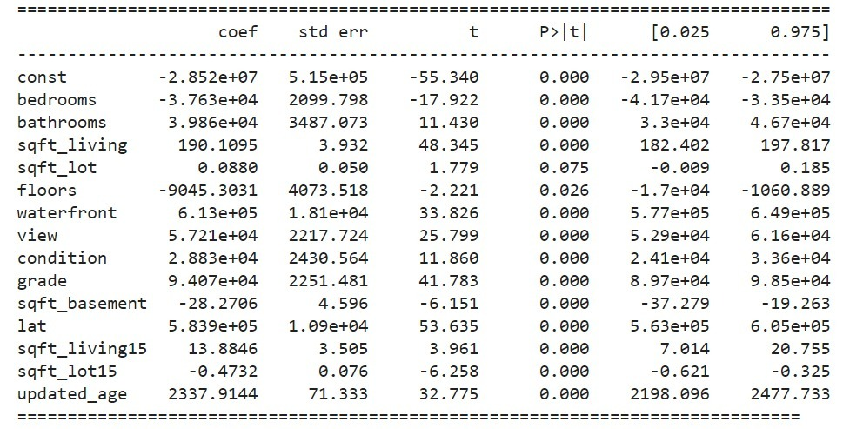

Removed the “long” feature as per R-square value and found significant change in the p-value of “sqft_lot” feature and thus, decided to remove it in the next model.

Slide 17
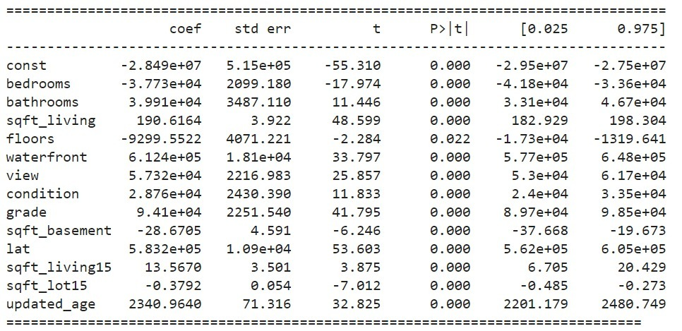
Here we found that there is no significant change in p-value and VIF, so we decided to remove the “condition” feature as per low R square value.

Slide 18
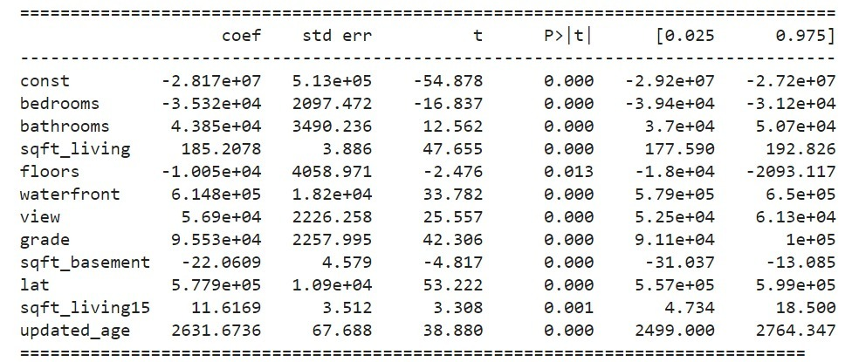
Here we removed sqft_lot15 as it has low R square value and low significance change in R square value of multiple regression model.

Slide 19
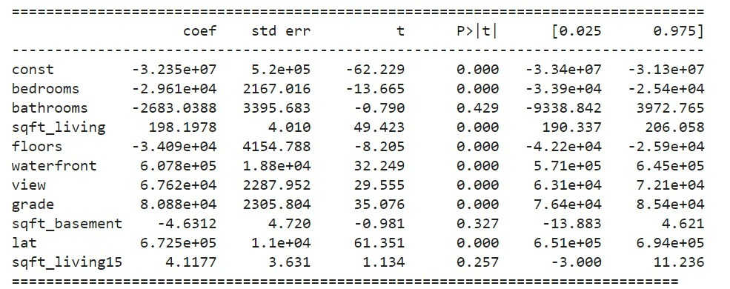
Now we decided to remove the feature updated_age which had significant change in R squared for multiple regression model.

Slide 20
CONCLUSION
Independent variable which affects the price of the house most are
bedrooms
Bathrooms
sqft_living
Floors
Waterfront
View
Grade
Updated_age
Sqft_basement
We have encountered one omitted variable bias, ie. sqft_above, that has higher correlation with sqft_living.
Having a Grade of 9, would help the house to sell at a higher price.

Slide 21

THANK YOU

