Slide 1











TaskBoard: from laptop to monitored Kubernetes
Session 21 DevOps Capstone | React, FastAPI and PostgreSQL delivered to AWS EKS
Pushkar Desai | github.com/PushkarDesai-06/taskboard-devops-capstone
React
FastAPI
PostgreSQL
Docker
Actions
Terraform
AWS
Kubernetes
Helm
Prometheus
Grafana
Notes:
Hi everyone. This is my capstone for Session 21. The goal was not to learn tools one at a time, it was to take one real application from my laptop all the way to a monitored Kubernetes cluster on AWS, and prove every step along the way. The application is TaskBoard, a small task manager. Around it I built the complete delivery path: tests, containers, a security scan, a registry, Terraform infrastructure, Kubernetes with Helm, ingress, autoscaling, monitoring, and some deliberate failures to troubleshoot. I'll walk through the architecture, then the workflow every commit goes through, and then what happened when the system was running live under load.

Slide 2
What was built and proven
4 / 4
63
2 → 6
9 → 0
pipeline stages green
AWS resources
backend pods
HIGH vulnerabilities
test, build + scan, push, deploy
created by one terraform apply
scaled by the HPA under load
found by Trivy, then fixed
Agenda
1
The application
2
Architecture
3
Delivery workflow
4
Operations
5
Toward production
All 15 demo items from the brief are covered, with screenshots in SCREENSHOTS.md.
Notes:
Here is the whole project in four numbers. Four pipeline stages, test, build and scan, push, and deploy, all green on the final run. Sixty three AWS resources created by Terraform, from the VPC to the EKS node group. Under load, the backend scaled itself from two pods to six, and back down when the load stopped. And zero high or critical vulnerabilities in the images I ship, after Trivy found nine on the very first scan. All fifteen demo items from the brief are covered, with a screenshot for each one in the repository. The agenda follows the same path a change takes: the application, the architecture, the workflow, operations, and what I would change for production.

Slide 3
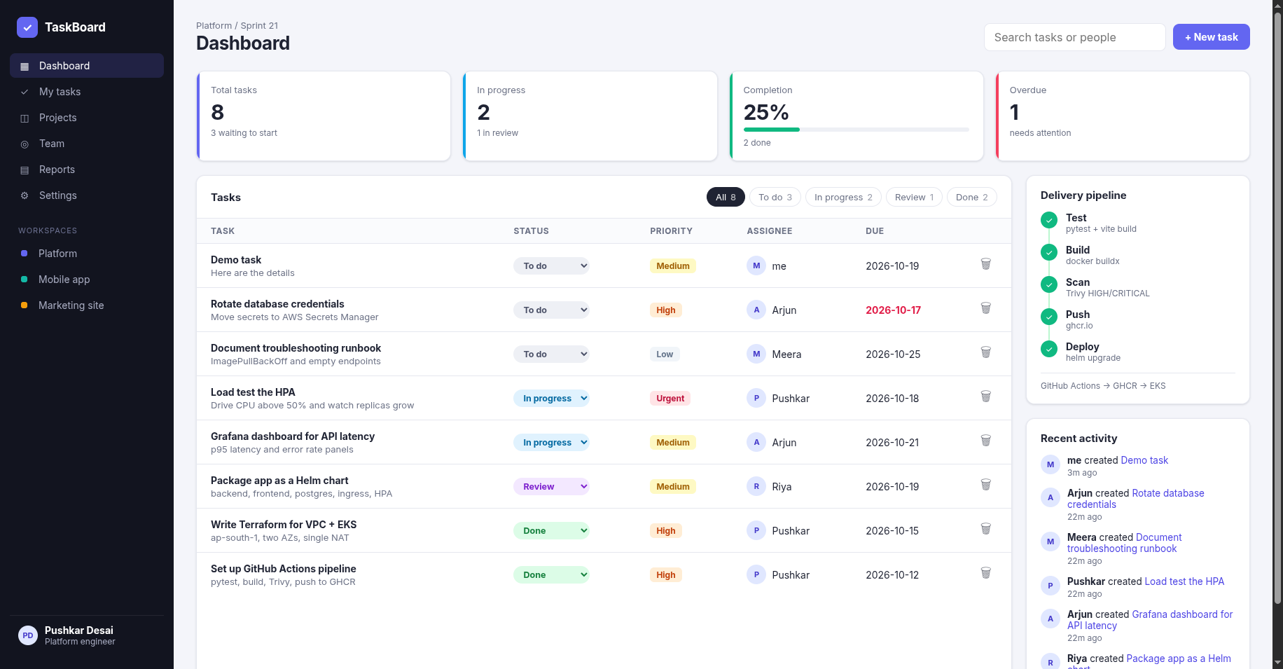

The application
React + Vite frontend
KPI cards, filters, task table, activity feed, create modal; responsive to phone width
FastAPI backend
6 task endpoints plus /health, /ready and /metrics, with Swagger docs
PostgreSQL + Alembic
SQLAlchemy models, versioned migrations, seeded demo data
TaskBoard running locally with Docker Compose
Key design choice: the browser only calls relative /api paths. Nginx (locally) or the Ingress (on EKS) decides where that traffic goes.
Notes:
TaskBoard is a SaaS style dashboard. The frontend is React with Vite: a sidebar, KPI cards, status filters, a task table with priority badges, an activity feed and a create task modal, and it is responsive down to phone width. The backend is FastAPI with six task endpoints plus health, readiness and metrics. Data lives in PostgreSQL through SQLAlchemy, and the schema is managed by Alembic migrations, which also seed demo data so the dashboard looks real on a fresh install. One design choice matters for everything that follows: the browser only ever calls relative paths like slash api slash tasks. It never needs to know where the backend lives. Nginx does the routing locally, and the Ingress does it in Kubernetes.

Slide 4
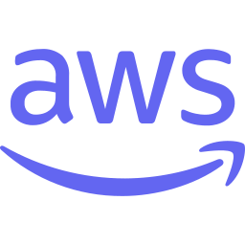








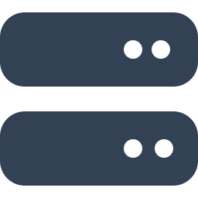
Architecture on AWS
AWS VPC | ap-south-1 | EKS 1.36
Frontend x2
Prometheus
Nginx serving React
+ Grafana dashboards
ingress-nginx
Browser
NLB
/api → backend
/ → frontend
scrapes /metrics
any user
public subnets
Backend x2 to 6
PostgreSQL
FastAPI, scaled by HPA
StatefulSet, EBS gp3
GHCR
3 × t3.medium worker nodes
private subnets in 2 AZs | images pulled through the NAT gateway | EBS CSI + metrics-server add-ons
app images
Notes:
This is how it runs on AWS. A user's browser reaches a Network Load Balancer, which the ingress-nginx controller created for me automatically. The Ingress rules then split traffic by path: anything under slash api goes straight to the FastAPI pods, everything else goes to the frontend pods running Nginx. The backend talks to PostgreSQL, which runs as a StatefulSet with its data on an encrypted EBS gp3 volume. Off to the side, Prometheus scrapes the metrics endpoint of every backend pod, and Grafana visualizes it. All of this runs on three t3.medium worker nodes in private subnets across two availability zones, and the nodes pull images from GitHub Container Registry through a NAT gateway.

Slide 5





A backend built to be operated
Method | Path | Purpose
GET | /api/tasks | List, filter by status or priority
GET | /api/tasks/{id} | One task
POST | /api/tasks | Create (validated, 201)
PUT | /api/tasks/{id} | Partial update
DELETE | /api/tasks/{id} | Delete (204)
GET | /api/tasks/stats | Numbers for the KPI cards
GET | /docs | Swagger UI
/health
/ready
Liveness
Readiness
Is the process alive? If not, Kubernetes restarts the container.
Queries the database. Returns 503 so the pod gets no traffic.
/metrics
Startup
Prometheus
Safe migrations
Request counts and latency histograms per endpoint.
Postgres advisory lock: replicas take turns, no races.
10 pytest tests on in-memory SQLite, so CI needs no database
Notes:
I designed the backend to be easy to operate, not just to use. On the left is the REST API, documented automatically in Swagger. On the right are the parts operations care about. Health is the liveness check: is the process alive, and if not, Kubernetes restarts it. Ready is the readiness check: it actually queries the database and returns 503 when it can't, so Kubernetes stops routing traffic to that pod. Metrics exposes request counts and latency histograms for Prometheus. And migrations run at startup behind a Postgres advisory lock, so when two or six replicas start together they take turns instead of racing. The ten pytest tests run against in-memory SQLite, so CI doesn't need a database at all.

Slide 6




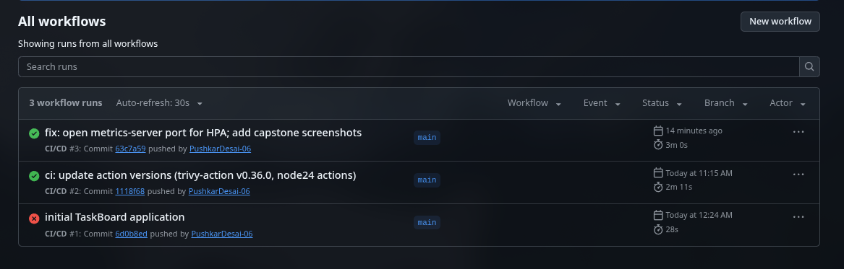

CI/CD: one road for every commit
1
2
3
4
5
Test
Build
Scan
Push
Deploy
pytest: 10 tests
Vite build
Fail = stop
Multi-stage
buildx cache
Both images
Trivy
Fails on CRITICAL
SARIF report
GHCR
Tag = commit SHA
Only from main
helm upgrade
Same SHA
Repo toggle
Run #1 failed in the build stage
so no image was pushed. The gate worked.
Runs #2 and #3 green
#3 deployed to EKS in 59 seconds.
Notes:
Every commit takes exactly the same road through GitHub Actions. One, test: pytest and a production build of the frontend. If that fails, nothing else runs. Two, build both images with multi stage Dockerfiles. Three, scan them with Trivy. Four, push them to GitHub Container Registry, tagged with the commit SHA. Five, deploy to EKS with helm upgrade, using that same SHA. The run history at the bottom tells a small story. Run one failed in the build stage because an action had renamed its version tags, and because of that, no image was pushed. That is the quality gate doing its job. Runs two and three are green, and run three deployed to the cluster in under a minute.

Slide 7


Containers and the security gate
Multi-stage builds
Trivy: first scan vs fixed
node:22 build
Nginx unprivileged
9
0
npm ci, vite build
static files only, port 8080
Frontend
fixable HIGH, first scan
HIGH or CRITICAL now
Python builder
python:3.12-slim
deps into /opt/venv
venv only, no pip, uid 10001
No pip in the runtime image (it vendored urllib3, msgpack, setuptools)
Backend
Debian and Alpine security updates applied at build time
Build tools never reach the runtime image.
pytest and httpx moved out of the production image
In CI: the pipeline fails on any fixable CRITICAL, and the full report goes to GitHub's Security tab.
Notes:
Both images are multi stage builds. The frontend compiles in a Node stage and ships only the static files on an unprivileged Nginx image. The backend installs its dependencies into a virtual environment in a builder stage and ships only that venv, on a slim Python runtime that runs as a non-root user. The security part is my favourite story. The first Trivy scan found nine fixable high severity vulnerabilities, and most of them were not in my code. They were in Debian packages, and in libraries vendored inside pip itself. The app never needs pip at runtime, so I removed it from the image, applied OS security updates, and moved the test libraries out of production. The result is zero. In CI the scan fails the pipeline on any fixable critical, and the full report goes to GitHub's security tab.

Slide 8


Infrastructure as Code
VPC 10.0.0.0/16
Internet gateway
63
resources planned and created
ap-south-1a
ap-south-1b
~15 min
to create (EKS control plane ~10)
Public 10.0.101.0/24
Public 10.0.102.0/24
NAT gateway, NLB node
NLB node
64
destroyed at teardown, incl. the SG fix
Private 10.0.1.0/24
Private 10.0.2.0/24
EKS node 10.0.1.60
EKS node 10.0.2.140
Community modules
terraform-aws-modules/vpc
terraform-aws-modules/eks + add-ons (VPC CNI, CoreDNS, EBS CSI, metrics-server)
terraform-aws-modules/iam (IRSA role for EBS CSI)
EKS node 10.0.2.196
Notes:
Kubernetes runs workloads, but something has to create the network and the cluster. That is Terraform. One plan created sixty three resources: a VPC across two availability zones, public subnets for the load balancer and the NAT gateway, private subnets for the worker nodes, the EKS control plane, a managed node group, and the add-ons, including the EBS CSI driver for volumes and metrics server for the autoscaler. I used the community modules for VPC, EKS and IAM instead of hand writing every resource. To keep the bill low there is a single NAT gateway; production would use one per zone. The apply took about fifteen minutes, and at the end terraform destroy removed sixty four resources, one more than planned, because I added a security group rule as a fix along the way.

Slide 9






Packaged with Helm
Deployment: backend
Deployment: frontend
StatefulSet: postgres
Services
FastAPI with probes and CPU requests for the HPA
Nginx serving React, proxies /api
1 Gi gp3 EBS volume through a PVC
Stable names for backend, frontend, postgres
Ingress
HPA
ServiceMonitor
Dashboard ConfigMap
/api to backend, / to frontend
2 to 6 backend replicas at 50% CPU
Prometheus scrapes /metrics every 15 s
Grafana sidecar loads it automatically
values.yaml
defaults for every environment
values-dev.yaml
local cluster, host taskboard.local
values-eks.yaml
gp3, ingress, monitoring on
Notes:
Instead of a folder of hand edited YAML files, the whole application is one Helm chart. It contains the backend and frontend Deployments, PostgreSQL as a StatefulSet with a volume claim, the Services, the Ingress, the autoscaler, a ServiceMonitor that tells Prometheus what to scrape, and even the Grafana dashboard, shipped as a ConfigMap that Grafana loads automatically. The differences between environments live in values files: the defaults, a dev file for a local cluster, and an EKS file that turns on ingress, gp3 storage and monitoring. Before spending money on EKS, I installed the same chart on a throwaway kind cluster, which caught problems for free.

Slide 10


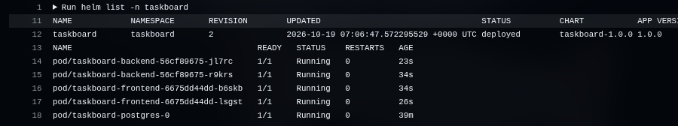
One commit, traced to the pod
Commit
CI run
Image
Helm
Pods
63c7a59
#3
:63c7a59…
revision 2
4 replaced
pushed to main
4 of 4 jobs green
pushed to GHCR
deployed by CI
running that image
CI's own rollout log (run #3): Helm revision 2 deployed, backend and frontend pods replaced seconds ago, database untouched
Bad release?
helm rollback taskboard 1
back to the previous revision
Notes:
This is the traceability the brief asks for. I pushed commit 63c7a59. CI run number three tested it, built it, scanned it, and pushed images tagged with that exact SHA. The deploy job ran helm upgrade with the same tag, which became Helm revision two, and the log at the bottom is CI itself printing the rollout: revision two deployed, and the four application pods freshly replaced. The database pod kept running, because nothing about it changed. So for anything running in the cluster I can answer: which commit is this, did it pass the tests, was it scanned. And if a release is bad, helm rollback returns to the previous revision in one command.

Slide 11
Autoscaling under real load
407%
peak CPU of the backend's request, against a 50% target
2 → 6
replicas within about a minute (the configured maximum)
2 min
scale-down stabilization, then back to 2 replicas
Notes:
To test autoscaling I started six small load generator pods that call the API in a loop. The HPA targets fifty percent of the CPU each backend pod requests. Within a minute CPU jumped to about four hundred percent of that request, and the HPA scaled the backend from two replicas to six, the maximum I configured. When I stopped the load, it waited out a two minute stabilization window, so it does not flap, and then scaled back down to two. These are the actual readings from kubectl get hpa with the watch flag. There was a real problem before this worked, which I will come back to in troubleshooting.

Slide 12
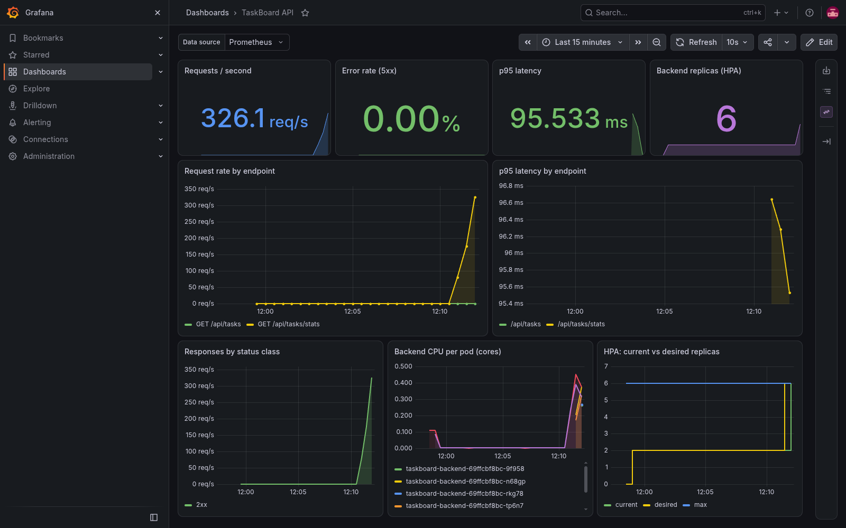
Monitoring the live system
326
requests per second at peak
0.00%
5xx error rate under load
95 ms
p95 latency at peak
6 / 6
backend pods scraped by Prometheus
Custom TaskBoard dashboard in Grafana, captured during the load test
Notes:
This is the dashboard I built, captured while the load test was running. Prometheus discovered all six backend pods through the ServiceMonitor, six out of six up, including the four new ones the autoscaler had just created. Grafana shows about 326 requests per second, an error rate of zero, and p95 latency around 95 milliseconds even at peak. The bottom row shows per pod CPU spiking and the replica count stepping from two to six. These panels answer the questions from the brief: is traffic arriving, which endpoint is slow, are errors increasing, and is the autoscaler working.

Slide 13

Troubleshooting like an operator
Broken image
Broken Service
HPA shows <unknown>
Planned lab
Planned lab
Found live on EKS
SYMPTOM
SYMPTOM
SYMPTOM
Pod stuck in ImagePullBackOff
ENDPOINTS <none>, no traffic
TARGETS cpu: <unknown>/50%
INVESTIGATE
INVESTIGATE
INVESTIGATE
describe pod: tag not found
Compare selector with pod labels
apiservice: FailedDiscoveryCheck
ROOT CAUSE
ROOT CAUSE
ROOT CAUSE
Tag v9.9.9 does not exist
Selector says taskboard-api
Port 10251 blocked by node SG
FIX
FIX
FIX
kubectl set image to a real tag
Patch selector to taskboard-backend
One SG rule in Terraform
Method: symptom → describe and read events → compare desired vs actual → fix it in code
Notes:
I troubleshot three failures with the same method: look at the symptom, describe the object and read the events, compare what you wanted with what you got, and fix it in code. First, a Deployment with an image tag that does not exist: ImagePullBackOff, the events say the tag is not found, and setting a real image fixes it. Second, a Service whose selector matches no pod labels: no endpoints, so no traffic, and patching the selector fixes it. The third one was not planned. On EKS the autoscaler showed unknown. Describing it said the metrics API was unavailable, and the API service showed timeouts to port 10251. The EKS metrics server add-on listens on that port, and the node security group did not allow it. I fixed it with one rule in Terraform, not by clicking in the console, so the fix is versioned with everything else.

Slide 14






Toward production
What I would change
Cost and teardown
Amazon RDS for PostgreSQL instead of an in-cluster StatefulSet
~$0.30/hr
GitHub OIDC role instead of static AWS keys in secrets
EKS, NAT gateway, 3 nodes and the NLB while running
Terraform state in S3 with locking, shared by the team
Teardown order matters
App secrets in AWS Secrets Manager via External Secrets
1
helm uninstall the app, delete the PVC (EBS volume)
TLS on a real domain with cert-manager
2
uninstall ingress-nginx (deletes the NLB)
3
terraform destroy: 64 resources, verified empty
One NAT gateway per AZ, and the Trivy gate on HIGH too
Notes:
This was a classroom setup, so some choices were deliberately simple. For production I would move PostgreSQL to Amazon RDS, replace the static AWS keys in GitHub with an OIDC role so there are no long lived credentials, keep Terraform state in S3 with locking, store secrets in AWS Secrets Manager, add TLS on a real domain, use one NAT gateway per zone, and tighten the Trivy gate to block high findings too. On cost: the running stack was roughly thirty cents an hour. Teardown order matters. Uninstall the app and the ingress first, so the load balancer and the database volume are actually deleted, then run terraform destroy. I checked afterwards that nothing was left billing.

Slide 15

Thank you
Questions?
github.com/PushkarDesai-06/taskboard-devops-capstone
Automated
Proven
Operable
commit to running pod
evidence for all 15 demo items
probes, metrics, autoscaling
Notes:
To sum up: one application, one pipeline, and every step from a commit to monitored, autoscaling pods is automated and backed by evidence in the repository. The code, the pipeline and all the screenshots are at the link on this slide. Thank you, I am happy to take questions.

