Slide 1

Write a program to display "Welcome " if a number entered by user is a multiple of five otherwise print "Bye“.
Code
Output
num=int(input("Enter a number: "))
if num%5==0:
print("Welcome")
else:
print("Bye")

Slide 2
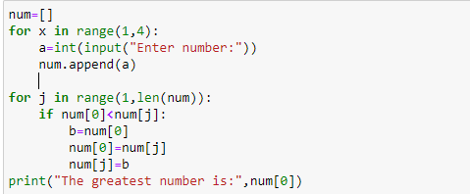

Write a program to find the largest number out of three numbers excepted from user.
Code
Output

Slide 3
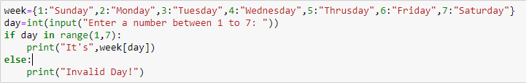

Write a program to accept a number from 1 to 7 and display the name of the day like 1 for Sunday , 2 for Monday and so on.
Code
Output

Slide 4
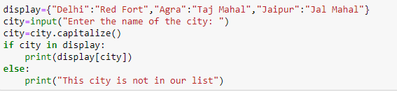

Accept any city from the user and display monument of that city
City | Monument
Delhi | Red Fort
Agra | Taj Mahal
Jaipur | Jal Mahal
Code
Output

Slide 5
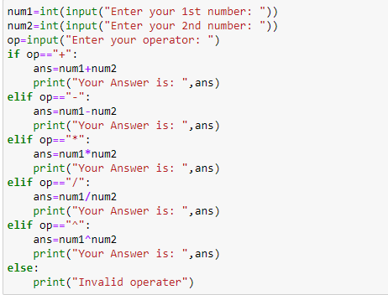

Write a program to accept two numbers and mathematical operators and perform operation accordingly. Like: Enter First Number: 7 Enter Second Number : 9 Enter operator : + (you can use different operators as well) Your Answer is : 16
Code
Output

Slide 6


Check if the input is Leap Year , write a function We add a Leap Day on February 29, almost every four years. The leap day is an extra, or intercalary day and we add it to the shortest month of the year, February. In the Gregorian calendar three criteria must be taken into account to identify leap years: 1. The year can be evenly divided by 4, is a leap year, unless: 2. The year can be evenly divided by 100, it is NOT a leap year, unless: 3. The year is also evenly divisible by 400. Then it is a leap year. Examples : This means that in the Gregorian calendar, the years 2000 and 2400 are leap years, while 1800, 1900, 2100, 2200, 2300 and 2500 are NOT leap years. What you have to do? You are given the year, and you have to write a function to check if the year is leap or not. Note that you have to complete the function and remaining code is given as template. You can use a variable as input with a fix value of user input
Code
Ouput

Slide 7

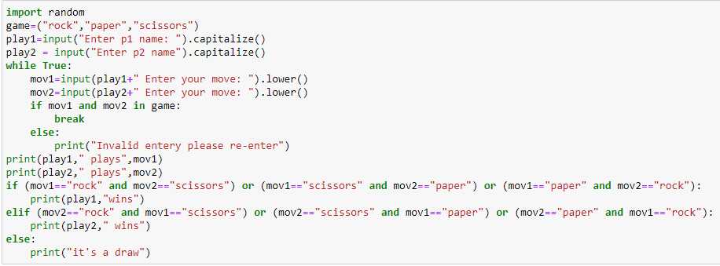
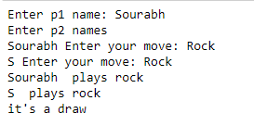
6. Check if the input is Leap Year , write a function We add a Leap Day on February 29, almost every four years. The leap day is an extra, or intercalary day and we add it to the shortest month of the year, February. In the Gregorian calendar three criteria must be taken into account to identify leap years: 1. The year can be evenly divided by 4, is a leap year, unless: 2. The year can be evenly divided by 100, it is NOT a leap year, unless: 3. The year is also evenly divisible by 400. Then it is a leap year. Examples : This means that in the Gregorian calendar, the years 2000 and 2400 are leap years, while 1800, 1900, 2100, 2200, 2300 and 2500 are NOT leap years. What you have to do? You are given the year, and you have to write a function to check if the year is leap or not. Note that you have to complete the function and remaining code is given as template. You can use a variable as input with a fix value of user input
OUTPUT:

Slide 8
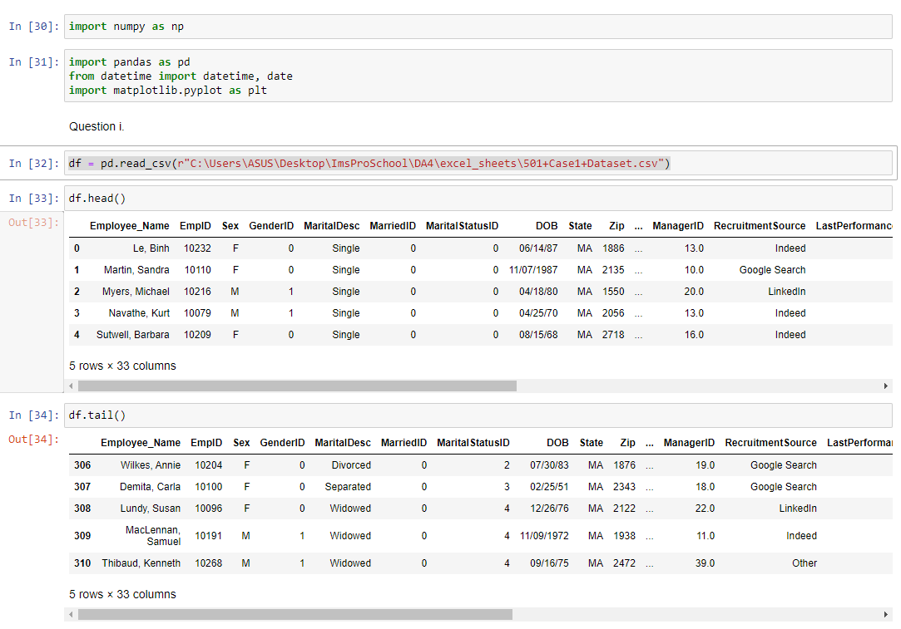
PART-2
Suppose you are a data analyst in a company & You have been provided with the HR dataset, now they want you to find certain insights in the organization. Now your task is to do data exploration, data preprocessing & find out the necessary insights they are looking for, the questions are as follows:
I) Import the data & check the head, tail for it.
Code and Output:

Slide 9
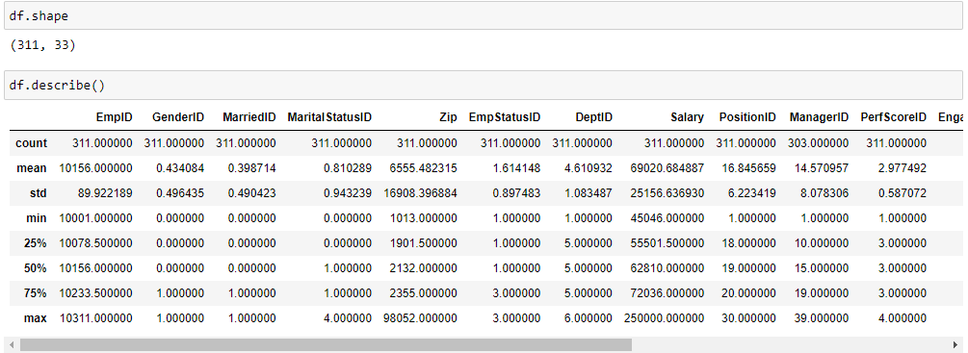
II) Check the shape, size of the data.

Slide 10
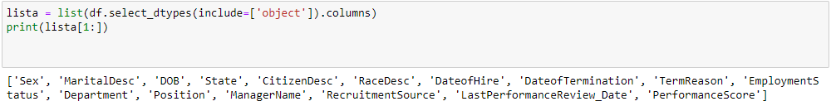
III) How many columns have categorical features?

Slide 11
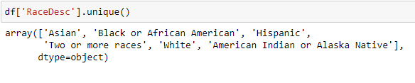
IV) How many unique values are present in RaceDesc column?

Slide 12
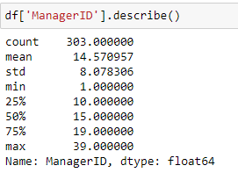
V) Check for mean, max .value, min .value, count, standard deviation of ManagerID column.

Slide 13
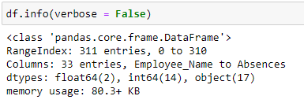
VI) Count the no of categorical , numerical columns .

Slide 14
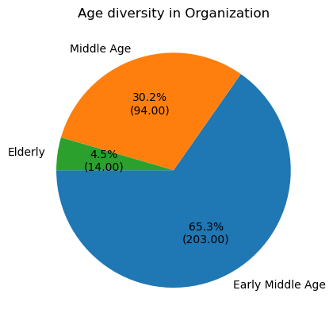
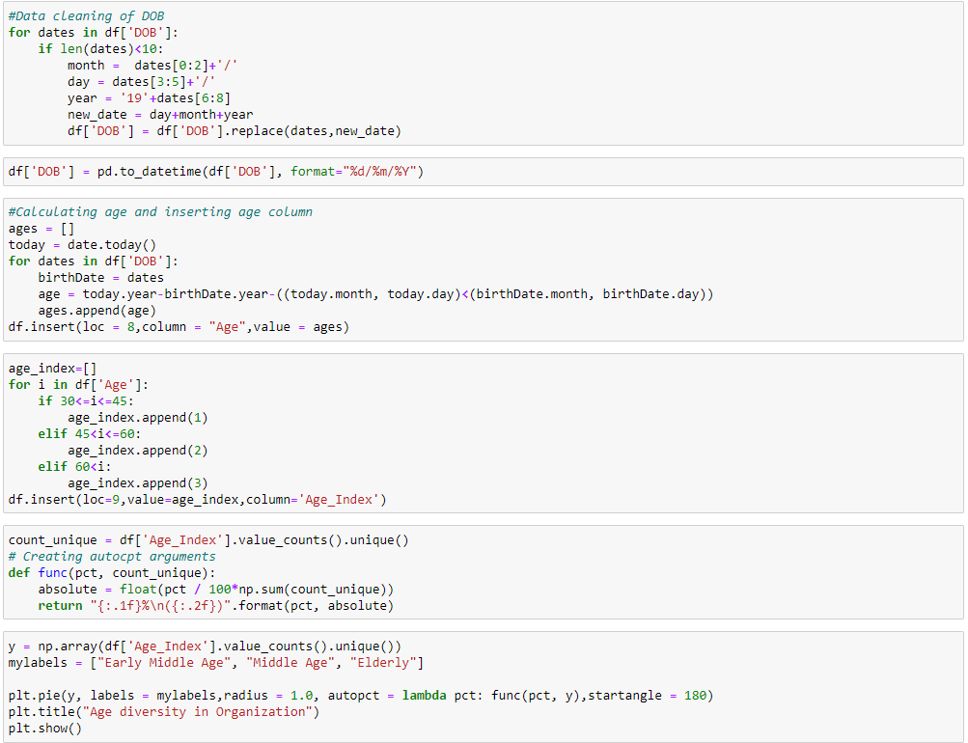
VII) Make a diversity report about the dataset.

Slide 15
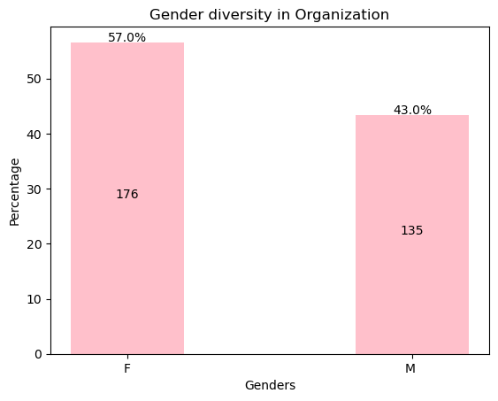
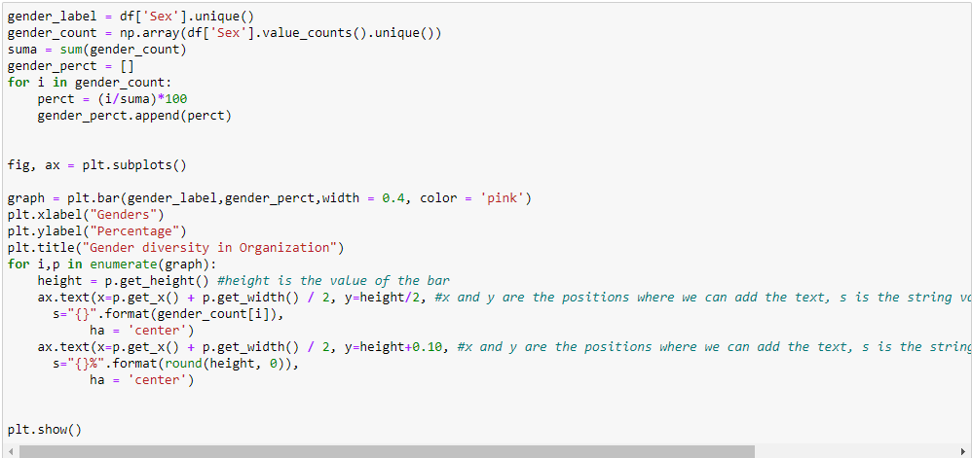
VII) Make a diversity report about the dataset.

Slide 16
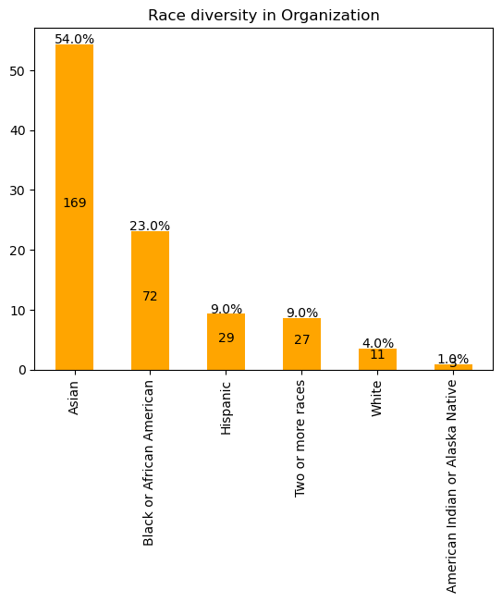
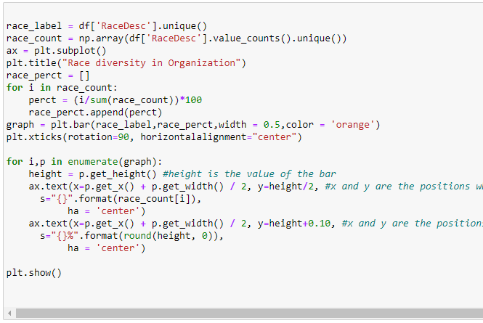
VII) Make a diversity report about the dataset.

Slide 17
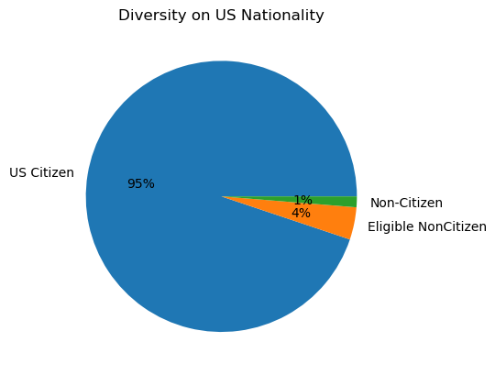
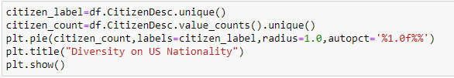
VII) Make a diversity report about the dataset.

Slide 18
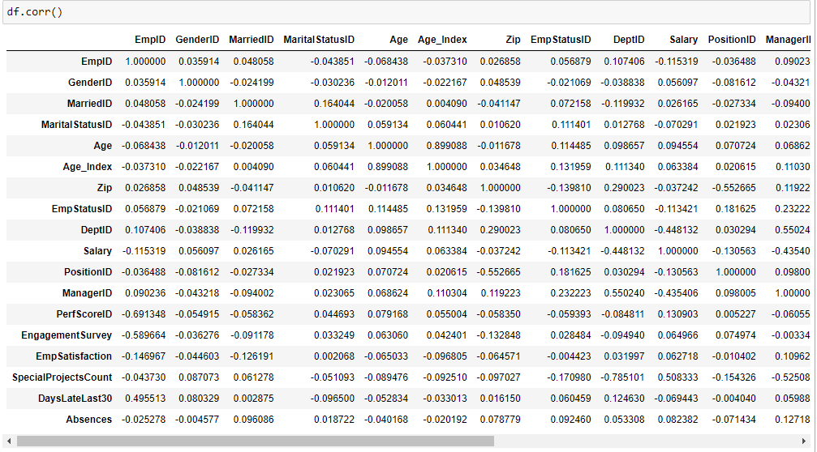
VIII) Which columns have correlation with each other, what will you interpret from it.
OUTPUT:

Slide 19
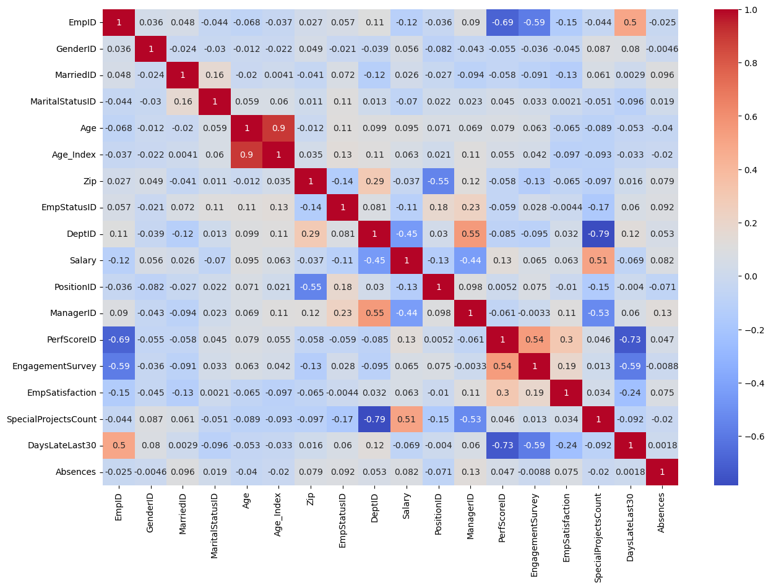

VIII) Which columns have correlation with each other, what will you interpret from it.
OUTPUT:

Slide 20
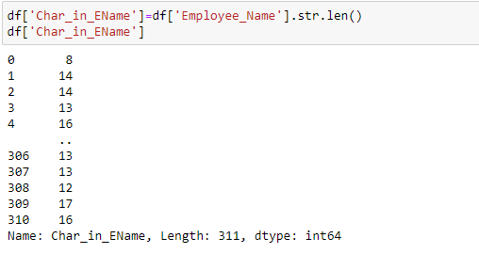
IX) Add a new column which specifies the number of characters in Employee_Name column.
OUTPUT:

Slide 21
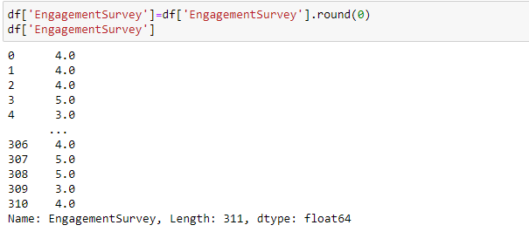
X) Round up the values in Engagement Survey column
OUTPUT:

Slide 22

XI) Check for a. Does marital status have any impact on salary? b. Does Race Desc have any impact on Emp Satisfaction? c. Is there any correlation between Engagement Survey and Emp Satisfaction.
OUTPUT:

Slide 23
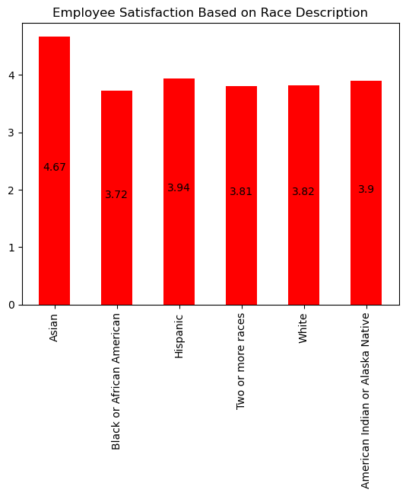
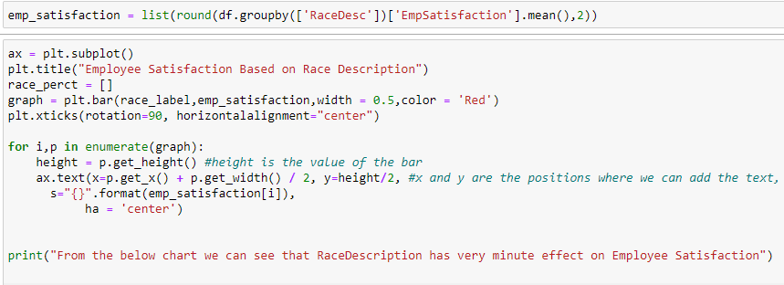
XI) Check for a. Does marital status have any impact on salary? b. Does Race Desc have any impact on Emp Satisfaction? c. Is there any correlation between Engagement Survey and Emp Satisfaction.
OUTPUT:

Slide 24
XI) Check for a. Does marital status have any impact on salary? b. Does Race Desc have any impact on Emp Satisfaction? c. Is there any correlation between Engagement Survey and Emp Satisfaction.
OUTPUT:

Slide 25
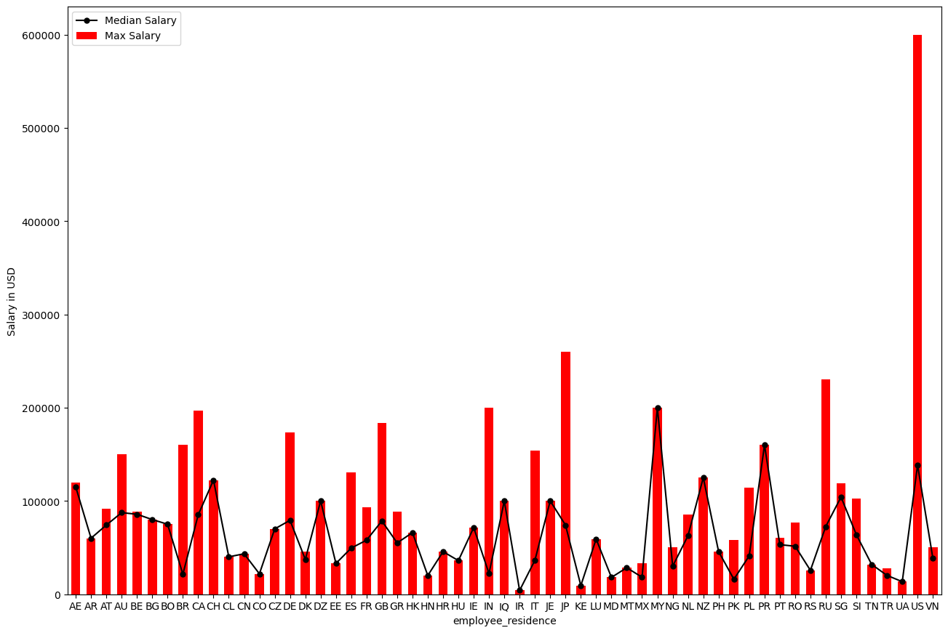
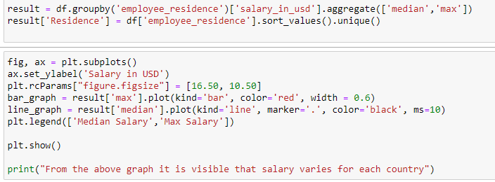
1. How does where you live affect your salary?
OUTPUT:

Slide 26
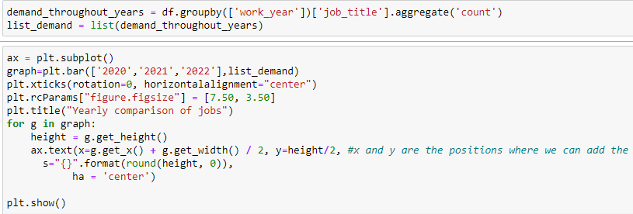
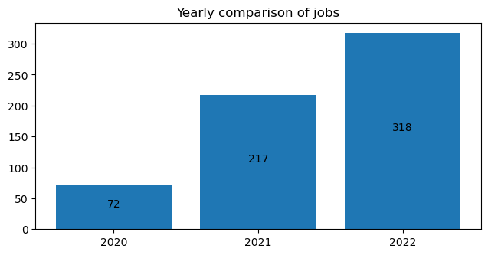
2. How has the demand of the jobs been throughout the years?
OUTPUT:

Slide 27
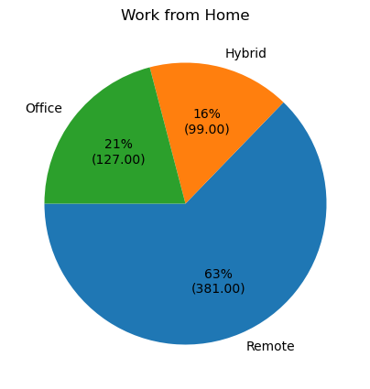
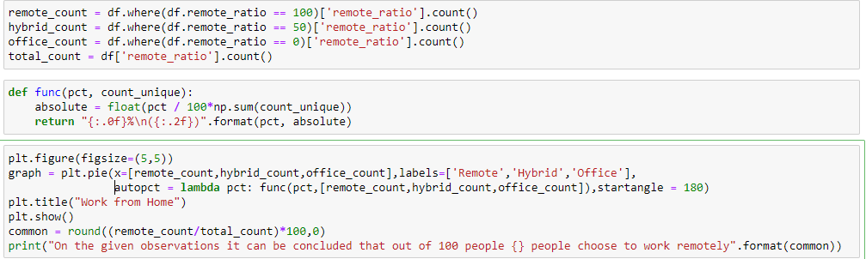
3. How common is to work remote?
OUTPUT:

Slide 28
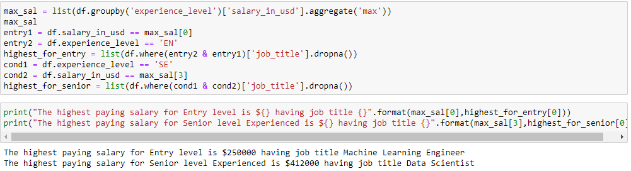
4. What the highest paying jobs with entry level as well as for senior level experienced?
OUTPUT:

Slide 29
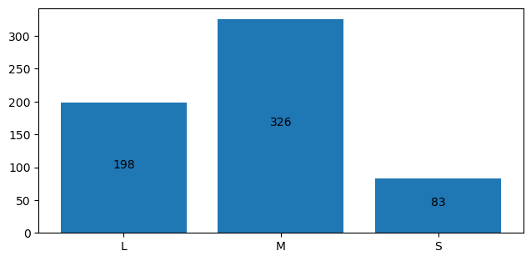
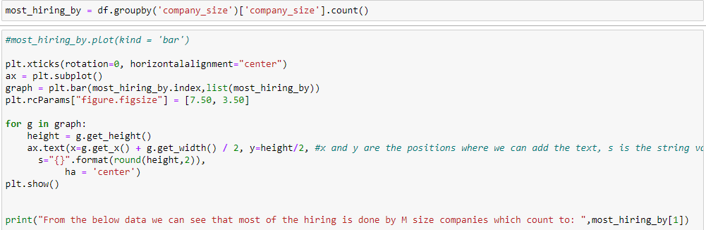
5. What company size hire the most?
Code:
OUTPUT:

Slide 30
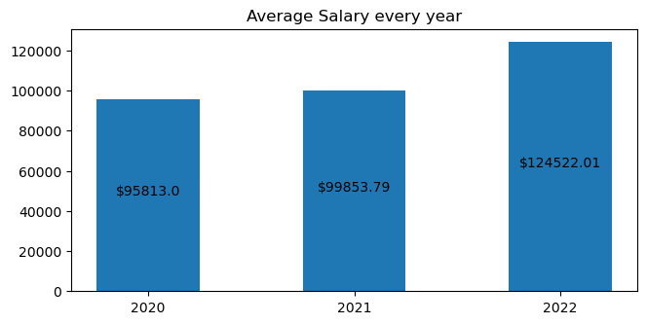
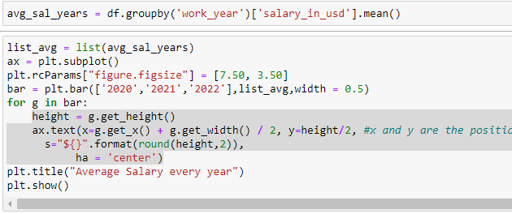
6. How has average salary changed throughout the years?
OUTPUT:

Slide 31
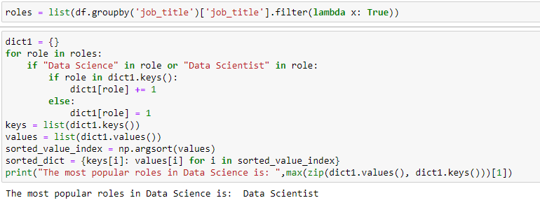
7. What are most popular roles in Data Science ?
OUTPUT:

Slide 32
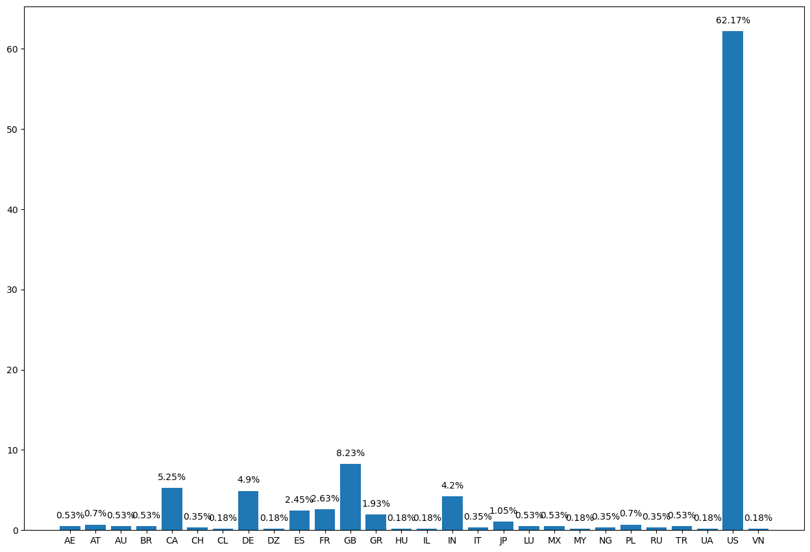
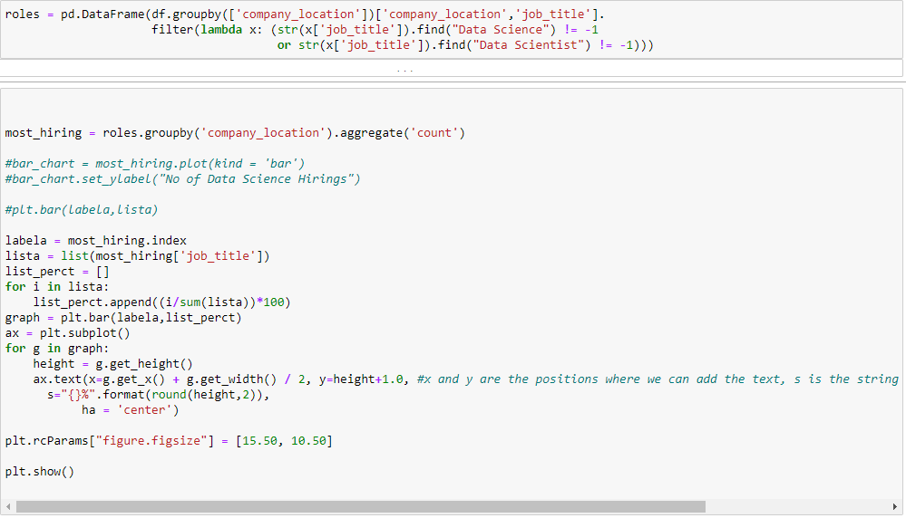
8. Which country hire the most people in Data Science?
OUTPUT:

Slide 33
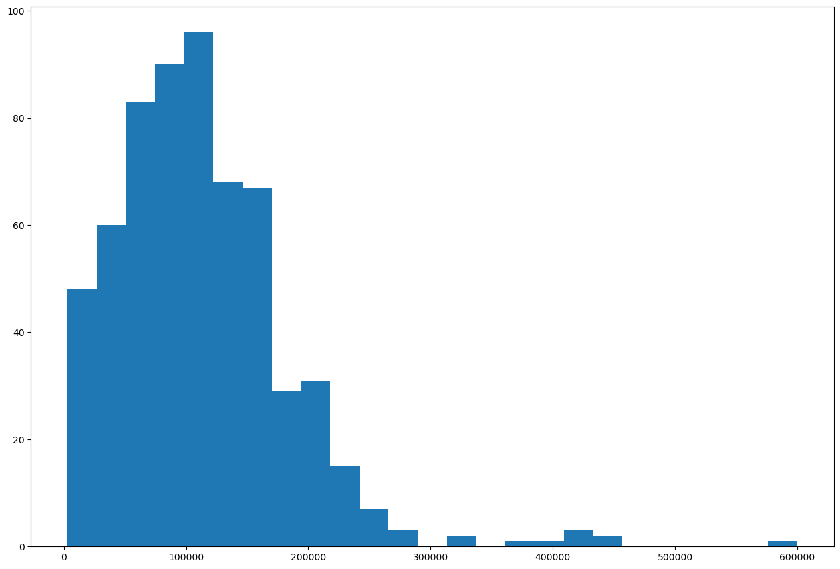
9. What is the distribution of Salaries?
OUTPUT:

Slide 34
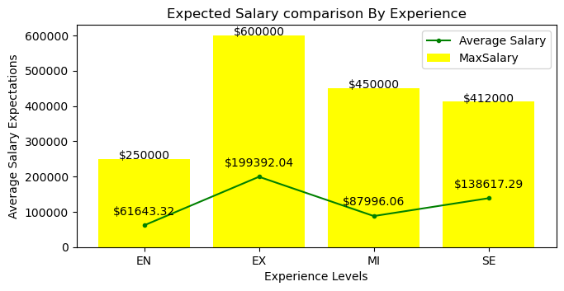
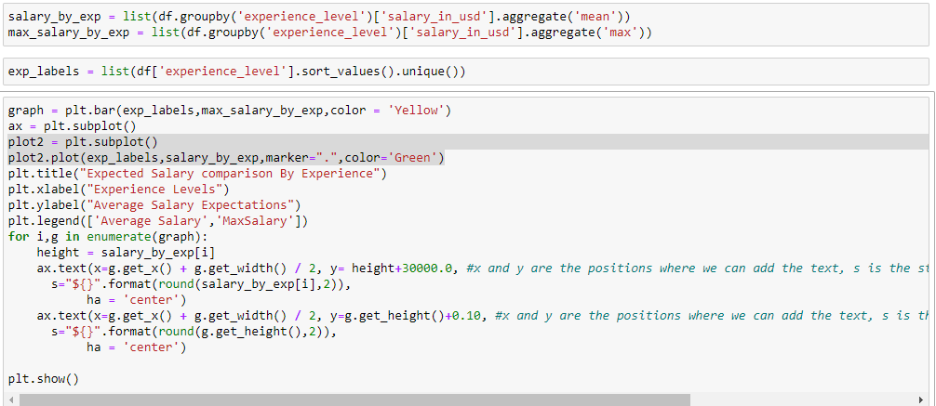
10. How much can you expect depending on your years of experience?
OUTPUT:

Slide 35
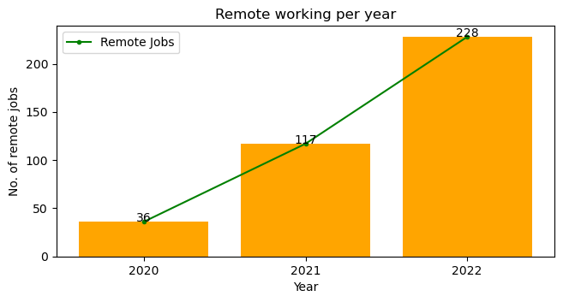
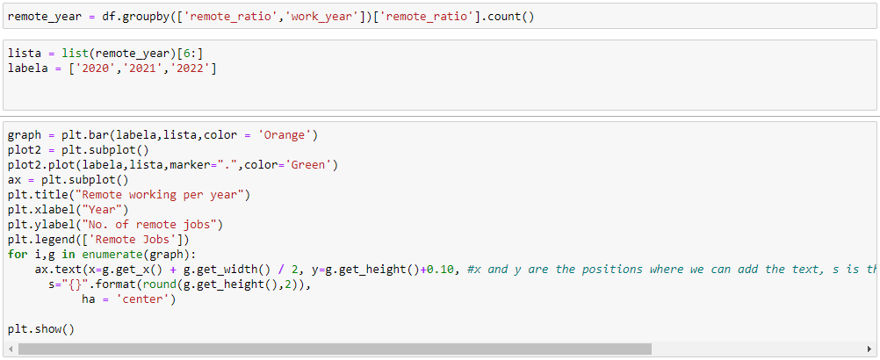
11. Which year do people prefer to stay at home the most?
OUTPUT:

Slide 36
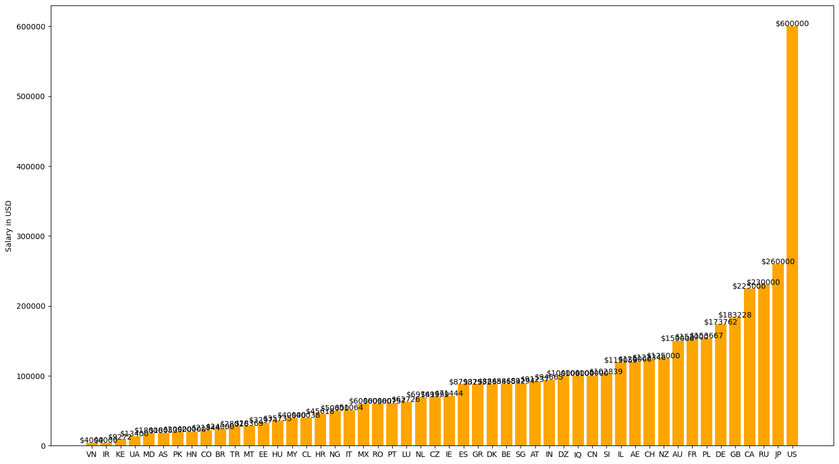
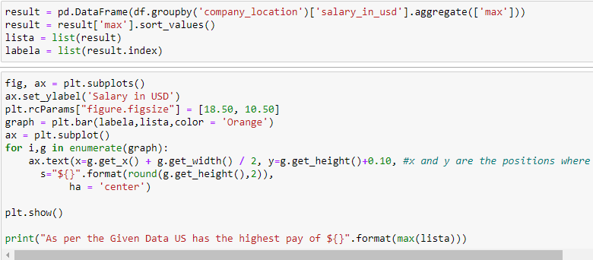
12. Which country has the highest pay?
OUTPUT:

Slide 37
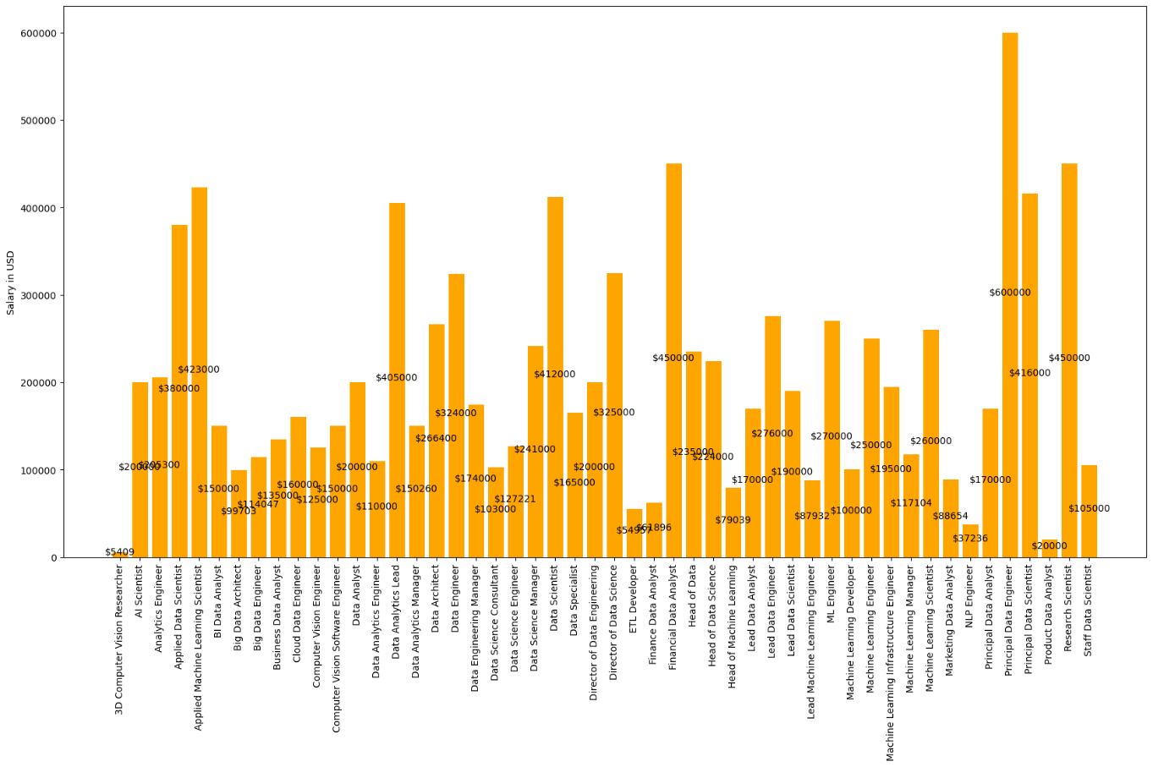
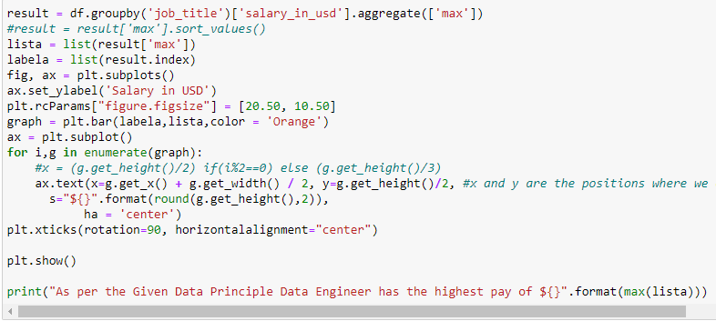
13. Which job title has the highest pay?
OUTPUT:

Slide 38
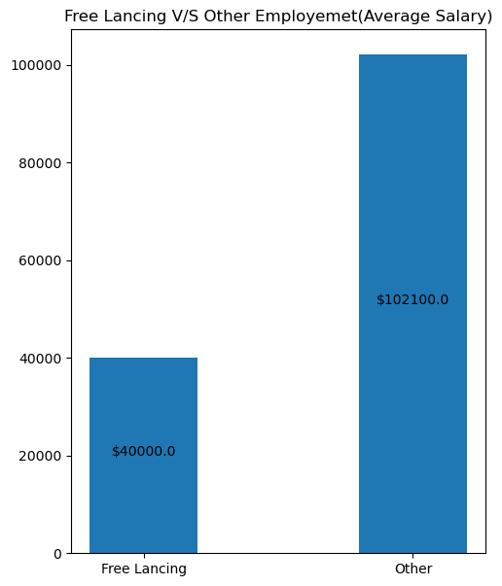

14. Is freelancing is worth or not?
OUTPUT:

