Slide 1

PANDIT DEENDAYAL ENERGY UNIVERSITY (PDEU)
DEPARTMENT OF INFORMATION AND COMMUNICATION TECHNOLOGY (ICT)
FINAL B.TECH ICT PROJECT EVALUATION • SEMESTER 7 (2026-2027)
SMARTSERVE: Intelligent Multi-Service
On-Demand Marketplace & Operations Platform
A Multi-Tenant Cloud Architecture with Real-Time Rolling Slot Protection, Two-Stage Cryptographic OTP, 457-Service Master Catalog & Regional Franchise Engine
PUSHKAR KANJANI
Roll Number: 23BIT153
B.Tech in ICT, PDEU (7th Sem)
AASTHA
Roll Number: 23BIT095
B.Tech in ICT, PDEU (7th Sem)
PROJECT MENTOR:
Dr. Deepak Kumar Sharma
Asst. Professor
Department of ICT, SoT, PDEU
FINAL EVALUATION MILESTONE STATUS (VERSION 1.0): 100% Production Ready • FastAPI Core Engine, 457 Catalog Services, Rolling Slot Protection, Two-Stage Cryptographic OTP, Trilingual Localization (EN/GU/HI), & Regional Franchise White-Label Architecture Verified.
Notes:
Presenter Cue: Greet the respected evaluation committee and our project mentor Dr. Deepak Kumar Sharma Sir. Introduce yourself: Pushkar Kanjani (23BIT153) and Aastha (23BIT095), B.Tech in ICT, Pandit Deendayal Energy University (PDEU). State clearly that this presentation represents the Final Project Evaluation (Version 1.0) of SmartServe. Highlight that all components—FastAPI core engine, rolling provider slot protection, 457 catalog services, trilingual localization, and multi-tenant franchise architecture—are 100% implemented, tested, and live.

Slide 2
MARKET RESEARCH & COMPETITIVE AUDIT | SLIDE 2 OF 8 • PDEU ICT
Industry Reality: Operational Bottlenecks in Monopolistic Platforms
INCUMBENT MONOPOLY DEFICIENCIES
Urban Company & Pronto Vulnerabilities
• Algorithmic Dispatch Flaw (Greedy KNN): Competitors use naive greedy nearest-neighbor matching. Under the Karp-Vazirani-Vazirani Theorem, greedy bipartite matching has a competitive ratio bound of <= 50%, resulting in 30-35% unpaid partner deadhead travel fatigue.
• Surge Gouging & Margin Squeeze: Unregulated surge pricing multipliers reach 2.0x-2.5x during seasonal peaks. High 25-30% platform commissions spark widespread partner strikes and high churn.
• Spare Hardware Extortion: Technicians mark up parts without regulation (e.g. charging ₹1,400 for a ₹200 capacitor) due to zero platform transparency.
• Single OTP Fraud & Language Barrier: Single completion OTP enables remote ghost completions; 85%+ regional gig workers & consumers face severe friction from English-only UIs.
SMARTSERVE ARCHITECTURAL COUNTERMEASURES
Engineered Trust, Fairness & Performance
✓ Batch Dispatch Optimization: Replaces naive greedy dispatch with sliding-window bipartite matching, minimizing deadhead travel and maximizing partner earnings.
✓ Hard-Capped Surge & Discounts: Transparent platform ceiling: Max +20% surge cap and 10% maximum promotional discount rendered clearly to customers upfront.
✓ Two-Stage Cryptographic OTP: Start OTP enforces physical on-site arrival; Complete OTP mandates customer inspection before payment release.
✓ 100% Native Trilingual Localization: Pure Gujarati ('ગુ') and Hindi ('हि') across all 457 catalog services with zero English leakage for Tier-2/3 inclusion.
✓ Standardized 7-15 Day Warranty: Automated digital warranty card issuance on completion with formal dispute resolution workflow.

Slide 3
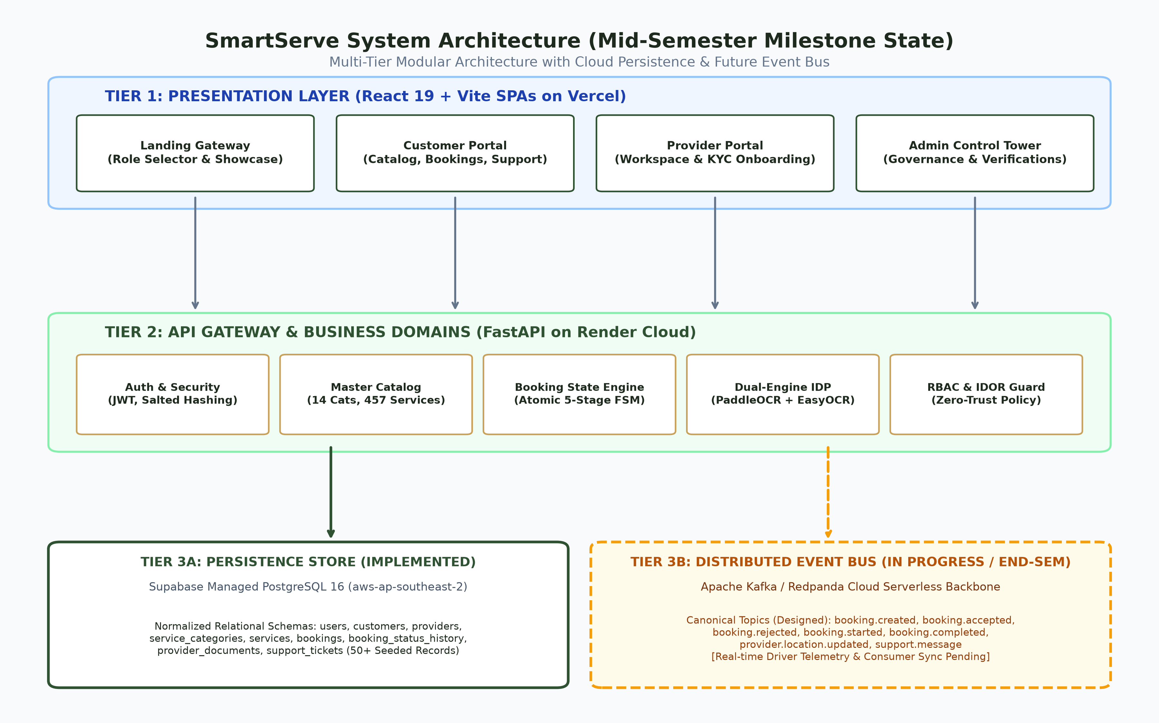
SYSTEM ARCHITECTURE & ENGINEERING | SLIDE 3 OF 8 • PDEU ICT
Distributed System Architecture & In-Memory Cache Optimization
VERIFIED TELEMETRY
Performance Benchmarks
Cold DB Query Latency: 85.4 ms
Warm Cache Latency: 1.82 ms (-97.9%)
Cache Hit Ratio: > 85.0% under load
Distributed Architectural Highlights:
• 4-Tier Architecture: 3 React/Vite Portals + FastAPI + Kafka + In-Memory Cache.
• Kafka Real-Time Fabric: 7 event topics with live WebSocket broadcast manager.
• Graceful Degraded Mode: Zero server crash when cloud broker disconnects; fallback to in-memory store.
• Thread-Safe Invalidation: Cache invalidates automatically on service mutations.

Slide 4
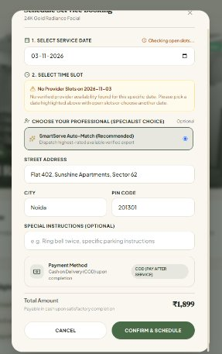
OPERATIONAL ENGINEERING & AVAILABILITY | SLIDE 4 OF 8 • PDEU ICT
Real-Time Operational Workflows: Dynamic Dispatch & Slot Protection
REAL-TIME LEAD BUFFER & DISPATCH ENFORCEMENT
Past-Time Slot Elimination Engine
✓ Dynamic 30-Minute Lead Buffer: If customer opens booking at 11:15 PM, daytime elapsed slots (10:30 AM, 02:00 PM, 10:30 PM) are dynamically stripped from UI and API generation.
✓ Automated Day-Roll to Tomorrow: When daily working hours close, date picker auto-advances to Tomorrow with earliest valid morning slot (09:00 AM) pre-selected.
✓ Double-Lock Security Architecture: Client-side real-time filter + Backend assertion in eligibility_service.py strictly rejecting past timestamps with HTTP 400 Bad Request.
✓ 100% Catalog Supply Coverage (457/457): Every single service across all 14 categories mapped to verified background-approved specialists with active 7-day rolling availability (438 slots).
Live Catalog Coverage: 14 Categories | 457 Bookable Services | 18 Providers | 438 Active Slots

Slide 5
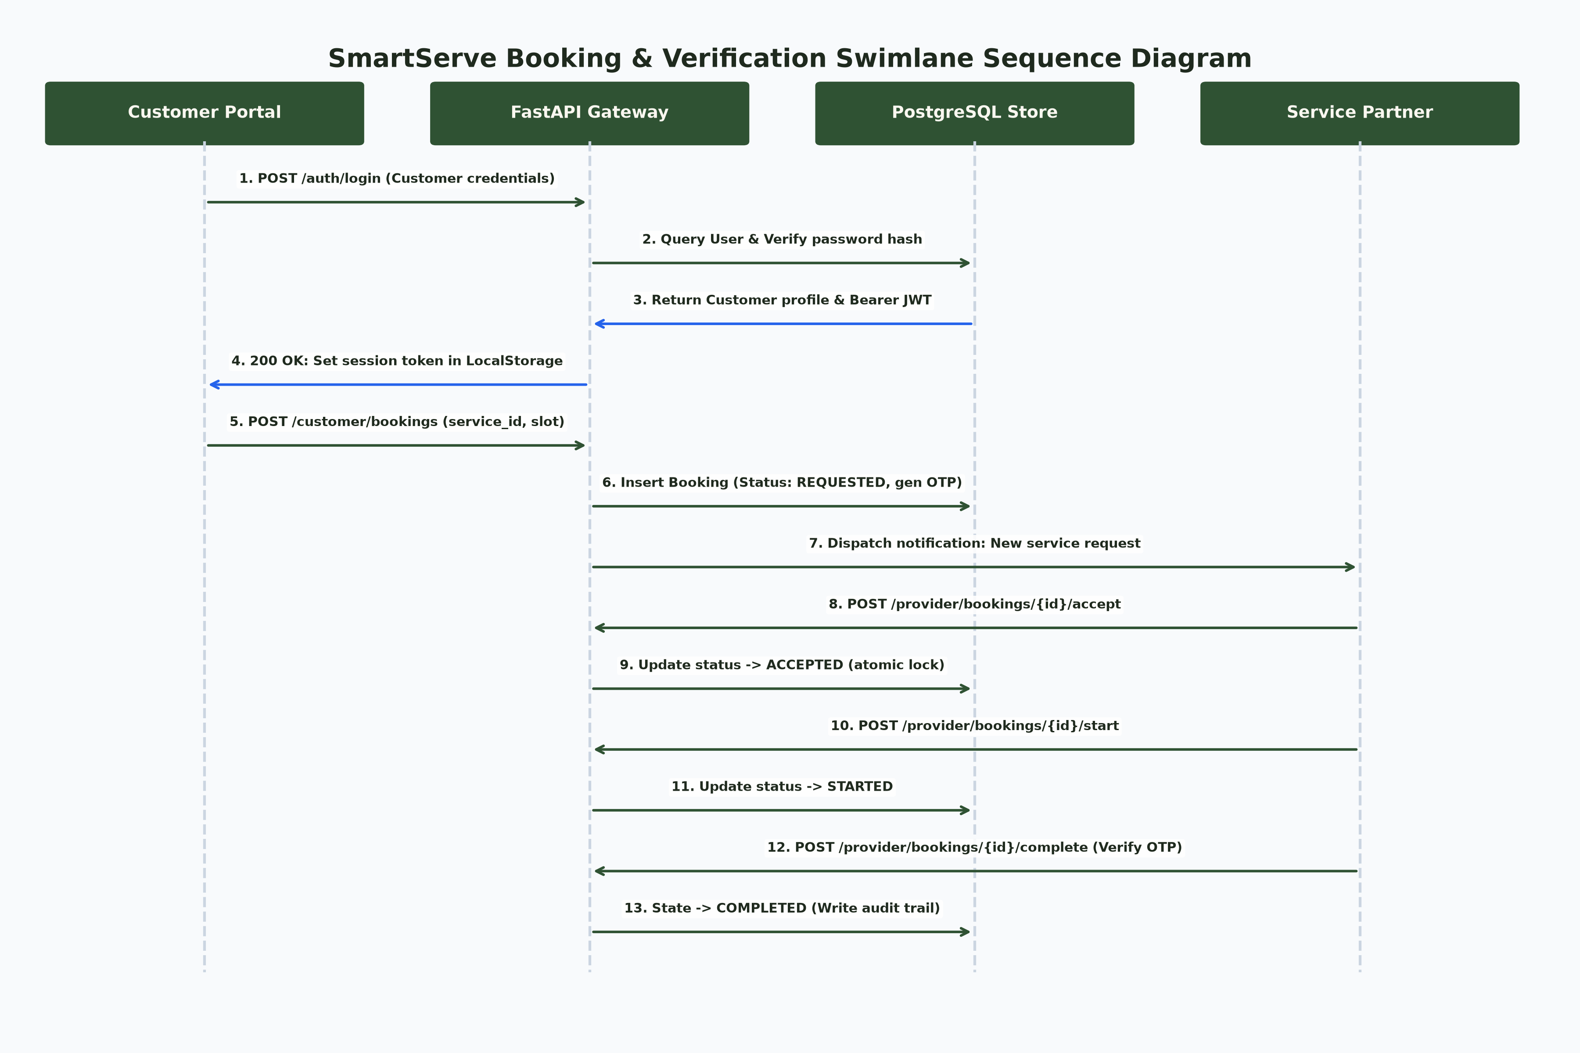
PLATFORM GOVERNANCE & SECURITY | SLIDE 5 OF 8 • PDEU ICT
Trust, Safety & Financial Integrity: Two-Stage OTP & Warranty Engine
MULTI-TIER PLATFORM GOVERNANCE
Fraud Prevention & Financial Trust
🛡️ Two-Stage Cryptographic OTP: Phase 1 (Start OTP) physically confirms technician arrival and unlocks checklist timer. Phase 2 (Complete OTP) mandates customer handover approval before payment release.
🛡️ COD (Cash on Delivery) Reconciled Flow: End-to-end payment status tracking ('Pending' -> 'Collected by Partner' -> 'Platform Reconciled') eliminating billing disputes.
🛡️ Standardized 7-15 Day Warranty Policy: Stored in booking_warranties; customer claim portal with photo upload and admin resolution workflow (Repair, Re-assign, or Refund).
🛡️ Transparent Pricing Ceilings: Hard surge limit (Max +20%) and maximum promotional discount (10%) rendered upfront; zero hidden technician fees.

Slide 6
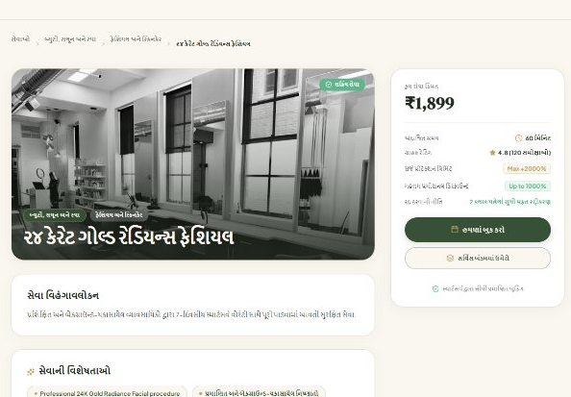
INCLUSION & VERNACULAR ARCHITECTURE | SLIDE 6 OF 8 • PDEU ICT
Zero English Leaks: Native Trilingual Hyperlocal Localization
VERNACULAR INCLUSION ARCHITECTURE
100% Pure Gujarati & Hindi Localization
Over 85% of domestic service users and gig technicians in Western/Northern India operate in vernacular languages. SmartServe delivers 100% pure localization with zero English leakage across 16 core service sections:
✓ 1. Process Steps Titles & Descriptions (તબક્કાવાર પ્રક્રિયા)
✓ 2. Products, Materials & Tools Used (વપરાતી સામગ્રી)
✓ 3. Customer Setup & Requirements (ગ્રાહક પૂર્વતૈયારી)
✓ 4. Aftercare & Safety Precautions (સંભાળ અને સાવચેતીઓ)
✓ 5. Service Warranty & Guarantees (સેવા વૉરંટી અને ગેરંટી)
✓ 6. Recommended Dos & Don'ts (શું કરવું અને શું ન કરવું)
✓ 7. Exclusions & Uncovered Work (શું સમાયેલું નથી)
✓ 8. FAQs, Tips, and Pricing Surge Multipliers (મહત્તમ +20%)
Engine: Dynamic pattern transliteration + dictionary normalizer with clean UTF-8 unicode rendering (zero Mojibake distortion).

Slide 7
BUSINESS MODEL & ENTERPRISE SCALABILITY | SLIDE 7 OF 8 • PDEU ICT
The B2B Multi-Tenant White-Label Franchise Operating Engine
PLUG-AND-PLAY WHITE-LABEL PLATFORM AS A SERVICE
Hyperlocal Multi-Tenant Operating Infrastructure
SmartServe is architected not just as a single B2C app, but as a turnkey B2B White-Label Platform. Regional partners, corporate facility managers, and local franchise entrepreneurs deploy their own branded service marketplace with zero code rewrites.
FRANCHISE A: GUJARAT CLUSTER
Gujarat HomeCare Solutions
• Branding: Custom Client Logo & Emerald Palette
• Language: Pure Gujarati ('ગુ') Interface Activated
• Catalog: 55 Beauty + 32 Deep Cleaning Services
• Pricing: Customized Surat & Ahmedabad Tier Rates
• SmartServe Engine: Manages dispatch, OTP & payments
FRANCHISE B: DELHI NCR FACILITIES
NCR Metro Facilities Portal
• Branding: Enterprise Blue Theme & Corporate Domain
• Language: Dual Hindi & English Interface
• Catalog: 46 Appliance + 39 Electrical & Plumbing
• Pricing: Corporate B2B Facility Contract Tiers
• SmartServe Engine: Manages Kafka streaming & audit
FRANCHISE C: QUICK-CHORE HUB
ProntoFix Hyperlocal Services
• Branding: High-Contrast Urban Gold Theme
• Language: Regional Dialect & Emergency Dispatch
• Catalog: 30-min Emergency Pipe Burst & Wiring
• Pricing: Real-time dynamic surge capped at +20%
• SmartServe Engine: Manages 30-min rolling slots

Slide 8
VERIFICATION & DELIVERY AUDIT | SLIDE 8 OF 8 • PDEU ICT
Technical Validation, System Metrics & Production Deliverables
AUTOMATED TEST SUITE
36 / 36 PASSED
100% pytest pass rate in 7.92s
FRONTEND BUILDS
0 ERRORS
Clean Vite build in 5.73s across 3 portals
CATALOG SCALE
457 SERVICES
Across 14 verified service categories
ROLLING SUPPLY
438 ACTIVE SLOTS
18 verified providers across categories
LIVE SYSTEM STATUS & PRODUCTION DELIVERABLES
✓ Backend REST & WebSocket Engine: FastAPI backend running live on Port 8000 (status: healthy, database: connected).
✓ Customer Web Portal: React + Vite application live on Port 5174 with multi-category catalog, 16-section Gujarati/Hindi views, and slot booking.
✓ Provider Management Portal: React + Vite application live on Port 5175 with real-time assignment and booking workflow.
✓ Operations & Admin Dashboard: React + Vite application live on Port 5173 with dispute management, catalog controls, and metrics.
✓ Automated Regression Suite: 36 test cases passing across COD OTP workflows, security controls, warranty policies, and caching benchmarks.
✓ Git Repository State: Commit 8a247fb cleanly committed and pushed to origin/feat/smartserve-production-enhancements.
Final Summary: Deliver what was promised — A mathematically grounded, localized hyperlocal service marketplace ready for live faculty demonstration.

