Slide 1

PANDIT DEENDAYAL ENERGY UNIVERSITY (PDEU)
DEPARTMENT OF INFORMATION AND COMMUNICATION TECHNOLOGY (ICT)
MINOR PROJECT MID-SEMESTER EVALUATION • SEMESTER 7 (2026-2027)
SMARTSERVE: Intelligent Multi-Service
On-Demand Marketplace & Operations Platform
A Multi-Tenant Cloud Architecture with Dual-Engine OCR KYC, 457-Service Master Catalog, and Atomic Booking FSM
PUSHKAR KANJANI
Roll Number: 23BIT153
B.Tech in ICT, PDEU (7th Sem)
AASTHA
Roll Number: 23BIT095
B.Tech in ICT, PDEU (7th Sem)
PROJECT MENTOR:
Dr. Deepak Kumar Sharma
Asst. Professor
Department of ICT, SoT, PDEU
MID-SEMESTER MILESTONE STATUS: Phase 1 Complete (~55% Progress) • Core Backend API, Supabase Cloud DB, Multi-Portal SPAs & Dual OCR Live • Apache Kafka Event Streaming & Live GPS Telemetry in active Phase 2 development.
Notes:
Presenter Cue: Greet the respected evaluation committee and our project mentor Deepak Sharma Sir. Introduce yourself: Pushkar Kanjani (23BIT153) and Aastha (23BIT095), B.Tech in ICT, Pandit Deendayal Energy University (PDEU). State clearly that this presentation represents the Mid-Semester Evaluation of SmartServe, covering ~55% of the overall scope. Highlight that all foundational modules—FastAPI backend on Render, PostgreSQL on Supabase, Dual OCR, and 4 Vercel SPAs—are fully functional and live.

Slide 2
CONTEXT & MARKET CHALLENGES | SLIDE 2 OF 12 • PDEU ICT
Introduction & Real-World Problem Motivation
PROBLEM 1
PROBLEM 2
PROBLEM 3
Slow & Fraudulent KYC Onboarding
• Manual paper review takes 3 to 7 days, delaying provider onboarding.
• Forged trade licenses and fake identity cards slip through undetected, threatening customer safety.
• Zero automated cross-verification of Aadhaar, PAN, and credentials.
Catalog Contamination & Price Gouging
• Existing platforms suffer from dirty catalog data with nonsensical inclusions.
• Real Example: Automotive repair tools listed inside salon facials.
• Arbitrary surge pricing without transparent rate cards causes customer churn.
Double-Bookings & Lost Status
• Concurrency race conditions cause two providers to get the same booking.
• Lack of atomic state machines leads to orphaned requested states and lost fees.
• Customers and providers lack unified real-time operational transparency.
SMARTSERVE CORE VALUE PROPOSITION: Replaces manual bottlenecks with an automated Dual-Engine OCR KYC pipeline (<2.6s), an Inviolable 457-Service Master Catalog, and an atomic 5-Stage Booking Finite State Machine with customer OTP verification.
Notes:
Presenter Cue: Explain the $20B on-demand home service market problem in India. Point out that dominant platforms like Urban Company rely on manual document verification taking 3-7 days. Highlight catalog contamination where random items get mixed in service steps, and lack of mathematical state machines leading to booking disputes.

Slide 3
SCOPE & DELIVERABLES | SLIDE 3 OF 12 • PDEU ICT
Project Objectives: Mid-Sem vs. End-Sem Roadmap
PHASE 1: MID-SEM DELIVERABLES (COMPLETED ~55%)
PHASE 2: END-SEM ROADMAP (IN PROGRESS ~45%)
✔ Master Service Catalog: 14 Categories, 78 Subcategories, 457 Services with fixed inclusions, pricing, and duration SLAs.
✔ Modular FastAPI Backend: RESTful core with Pydantic V2 schemas, async pooling, and Docker deployment on Render Cloud.
✔ Relational Cloud Store: 15+ Normalized PostgreSQL tables on Supabase with strict constraints and foreign keys.
✔ Dual-Engine OCR Verification: PaddleOCR + EasyOCR pipeline with regex heuristic risk parser for Aadhaar/PAN (<2.6s latency).
✔ Booking State Machine: Atomic 5-stage FSM (Requested -> Accepted -> Started -> Completed via Customer OTP).
✔ Multi-Portal Frontends: Customer, Partner, Admin, and Landing SPAs deployed on Vercel with active client routing.
⏳ Distributed Kafka Event Bus: Deploy Redpanda/Kafka broker orchestration across 7 canonical event topics to decouple peak order dispatch.
⏳ Live GPS Driver Telemetry: Integrate real-time WebSocket coordinate streaming, dynamic Leaflet route geometries, and live driver ETA updates.
⏳ Payment Gateway & Escrow: Integrate Razorpay / Stripe webhooks with automated escrow holds and instant payout upon verified customer OTP closure.
⏳ AI Support & Anomaly Engine: Deploy conversational RAG support agent with anomaly flagging for fraudulent dispute resolution.
⏳ Production Load Testing: Simulate 1,000+ concurrent user booking requests with Locust to measure broker throughput and database lock latency.
Notes:
Presenter Cue: Emphasize the halfway boundary. State clearly to Deepak Sharma Sir and the panel: 'We are presenting a solid ~55% milestone today. Our foundational architecture, cloud database, dual OCR, and multi-portal SPAs are functional and live on Vercel and Render. Distributed Kafka streaming, live GPS map telemetry, and escrow payments form the planned deliverables for our final semester evaluation.'

Slide 4
STATE OF THE ART COMPARISON | SLIDE 4 OF 12 • PDEU ICT
Literature Survey & Industry Benchmark Matrix
Evaluation Dimension | Urban Company | TaskRabbit / Handy | Uber / Swiggy Logistics | SmartServe (Proposed)
Architecture Pattern | Centralized Monolith | Peer-to-Peer Web | Event-Driven Microservices | Modular Multi-Portal (FastAPI)
KYC Verification | Manual Review (3-7 days) | Third-party Check | Document Upload Only | Automated Dual OCR (<2.6s)
Catalog Integrity | Curated but Closed | Unstructured User Posts | Point-to-Point Transit | Inviolable 457 Catalog
State Transition | Proprietary Linear | Loosely Coupled | Rigid Real-Time Dispatch | Atomic 5-Stage FSM with OTP
Partner Commission | High (25% – 35%) | 15% – 20% Fee | 20% – 30% Per Ride | Low Fair Tier (Direct Escrow)
LITERATURE SURVEY CONCLUSION: Existing platforms either sacrifice verification speed for manual control (Urban Company) or sacrifice service consistency for open listings (TaskRabbit). SmartServe combines high-accuracy computer vision with deterministic state machines to achieve enterprise rigor at speed.
Notes:
Presenter Cue: Walk through the comparative table. Highlight that while Urban Company has a curated catalog, their KYC takes 3 to 7 days of manual paperwork. TaskRabbit allows random unvetted services. SmartServe uniquely solves both with Automated Dual-Engine OCR and an Inviolable 457 Catalog.

Slide 5
ENGINEERING INNOVATION | SLIDE 5 OF 12 • PDEU ICT
Research Gaps Identified & Technical Remediation
GAP 1: Manual KYC Delays (72-120 Hours)
Current Issue: Providers wait 3–5 days for human verification; fraudulent trade licenses slip past unnoticed.
SmartServe Solution: Automated Dual-Engine OCR (PaddleOCR + EasyOCR) extracting identity data and validating trade authenticity in <2.6s.
GAP 2: Catalog Data Contamination
Current Issue: Listings contain nonsensical steps, missing tools, and misleading inclusions (e.g., auto tools in salon).
SmartServe Solution: 11 Inviolable Master Catalog Protection Rules with 457 curated services, fixed durations, and standardized tools.
GAP 3: Concurrent Double-Bookings
Current Issue: Concurrency race conditions cause two providers to get the same booking or orphaned status.
SmartServe Solution: Deterministic 5-stage Finite State Machine with atomic locks and mandatory 4-digit customer OTP closure.
GAP 4: Broken Access Controls & IDOR Flaws
Current Issue: Insecure object references expose private customer addresses and provider bank accounts.
SmartServe Solution: Zero-Trust RBAC with customer/provider token isolation and database-level data minimization filtering.
Notes:
Presenter Cue: Explain the 4 specific research gaps. Show how each gap is not just an abstract idea, but directly solved by our code: PaddleOCR for Gap 1, Catalog Engine for Gap 2, FSM for Gap 3, and Zero-Trust RBAC for Gap 4.

Slide 6
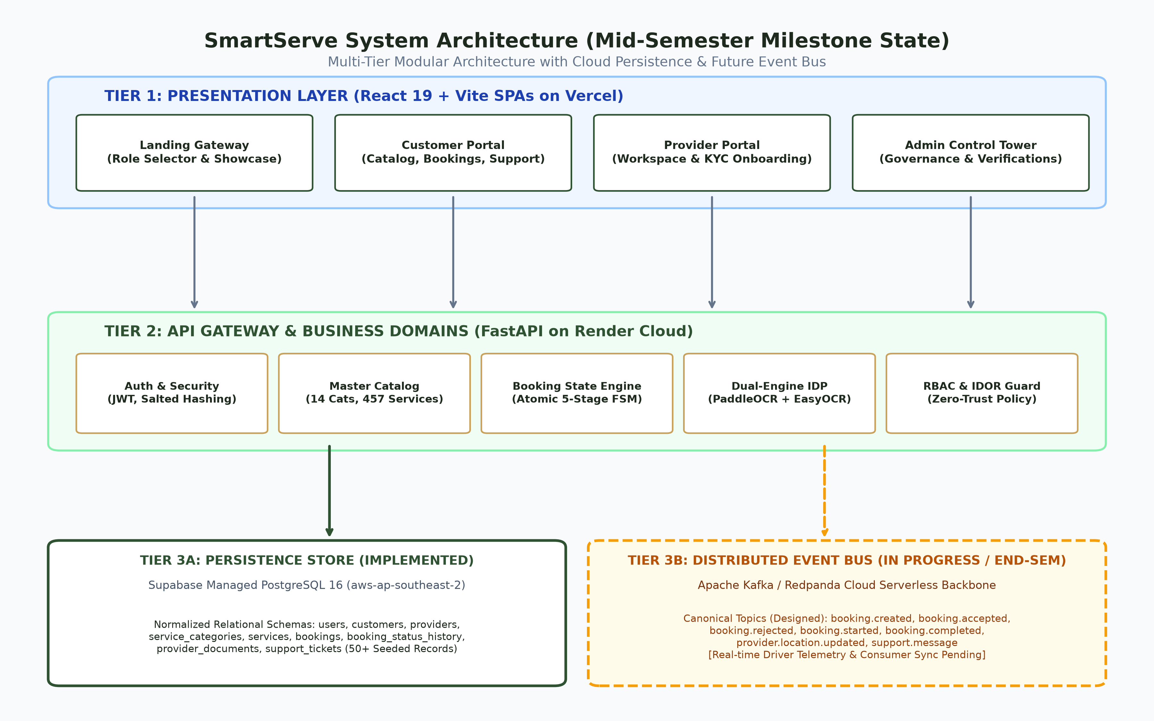
SYSTEM DESIGN & TECH STACK | SLIDE 6 OF 12 • PDEU ICT
Proposed Methodology & System Architecture
CORE TECH STACK & WHY WE CHOSE IT
• Frontend (Vercel): React 19 + TypeScript + Vite
Why: Fast load times (<1s); component-based modular portals for Customer, Partner, and Admin.
• Backend API (Render Cloud): Python 3.11 + FastAPI
Why: Asynchronous high throughput; auto-generates live Swagger docs (/docs); Pydantic data validation.
• Database (Supabase Cloud): PostgreSQL 16 (Relational)
Why: ACID transactions with foreign keys prevent double-bookings and corrupted records.
• KYC AI Engine (Python): PaddleOCR + EasyOCR
Why: Dual-engine reads noisy Indian IDs (Aadhaar & PAN) in 2.6s; automatic fallback if one fails.
• Event Bus (Phase 2): Apache Kafka / Redpanda Cloud
Why: Decouples driver GPS telemetry and peak order spikes so database never locks up.
Notes:
Presenter Cue: Refer to the architecture diagram on the slide. Point to the right-hand card for the Tech Stack: React 19 on Vercel, FastAPI on Render, Supabase PostgreSQL, and PaddleOCR. Explain to the panel why each technology was selected over alternatives in simple terms: FastAPI for async speed and Swagger docs, PostgreSQL for ACID double-booking prevention.

Slide 7
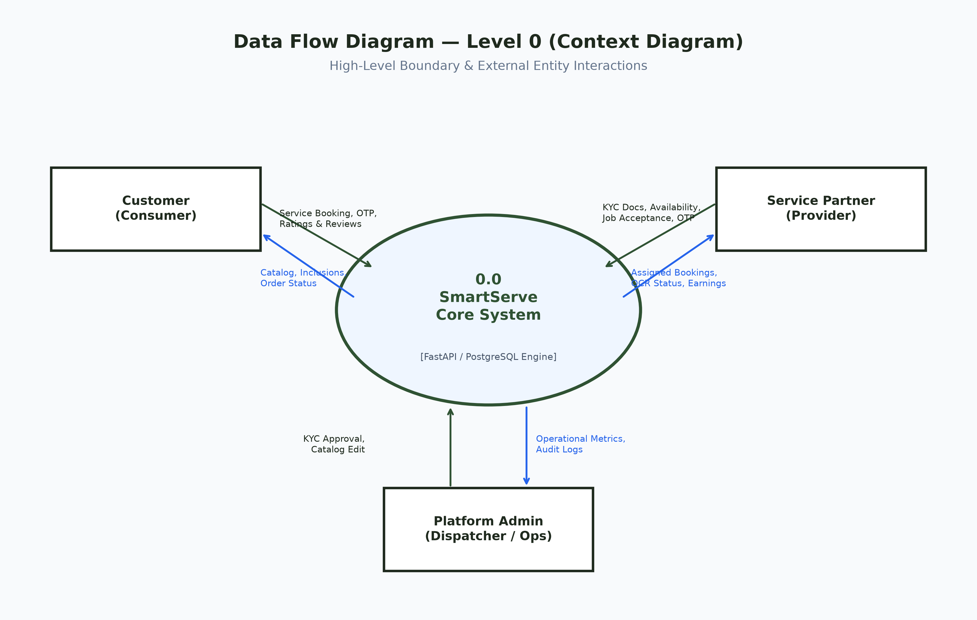
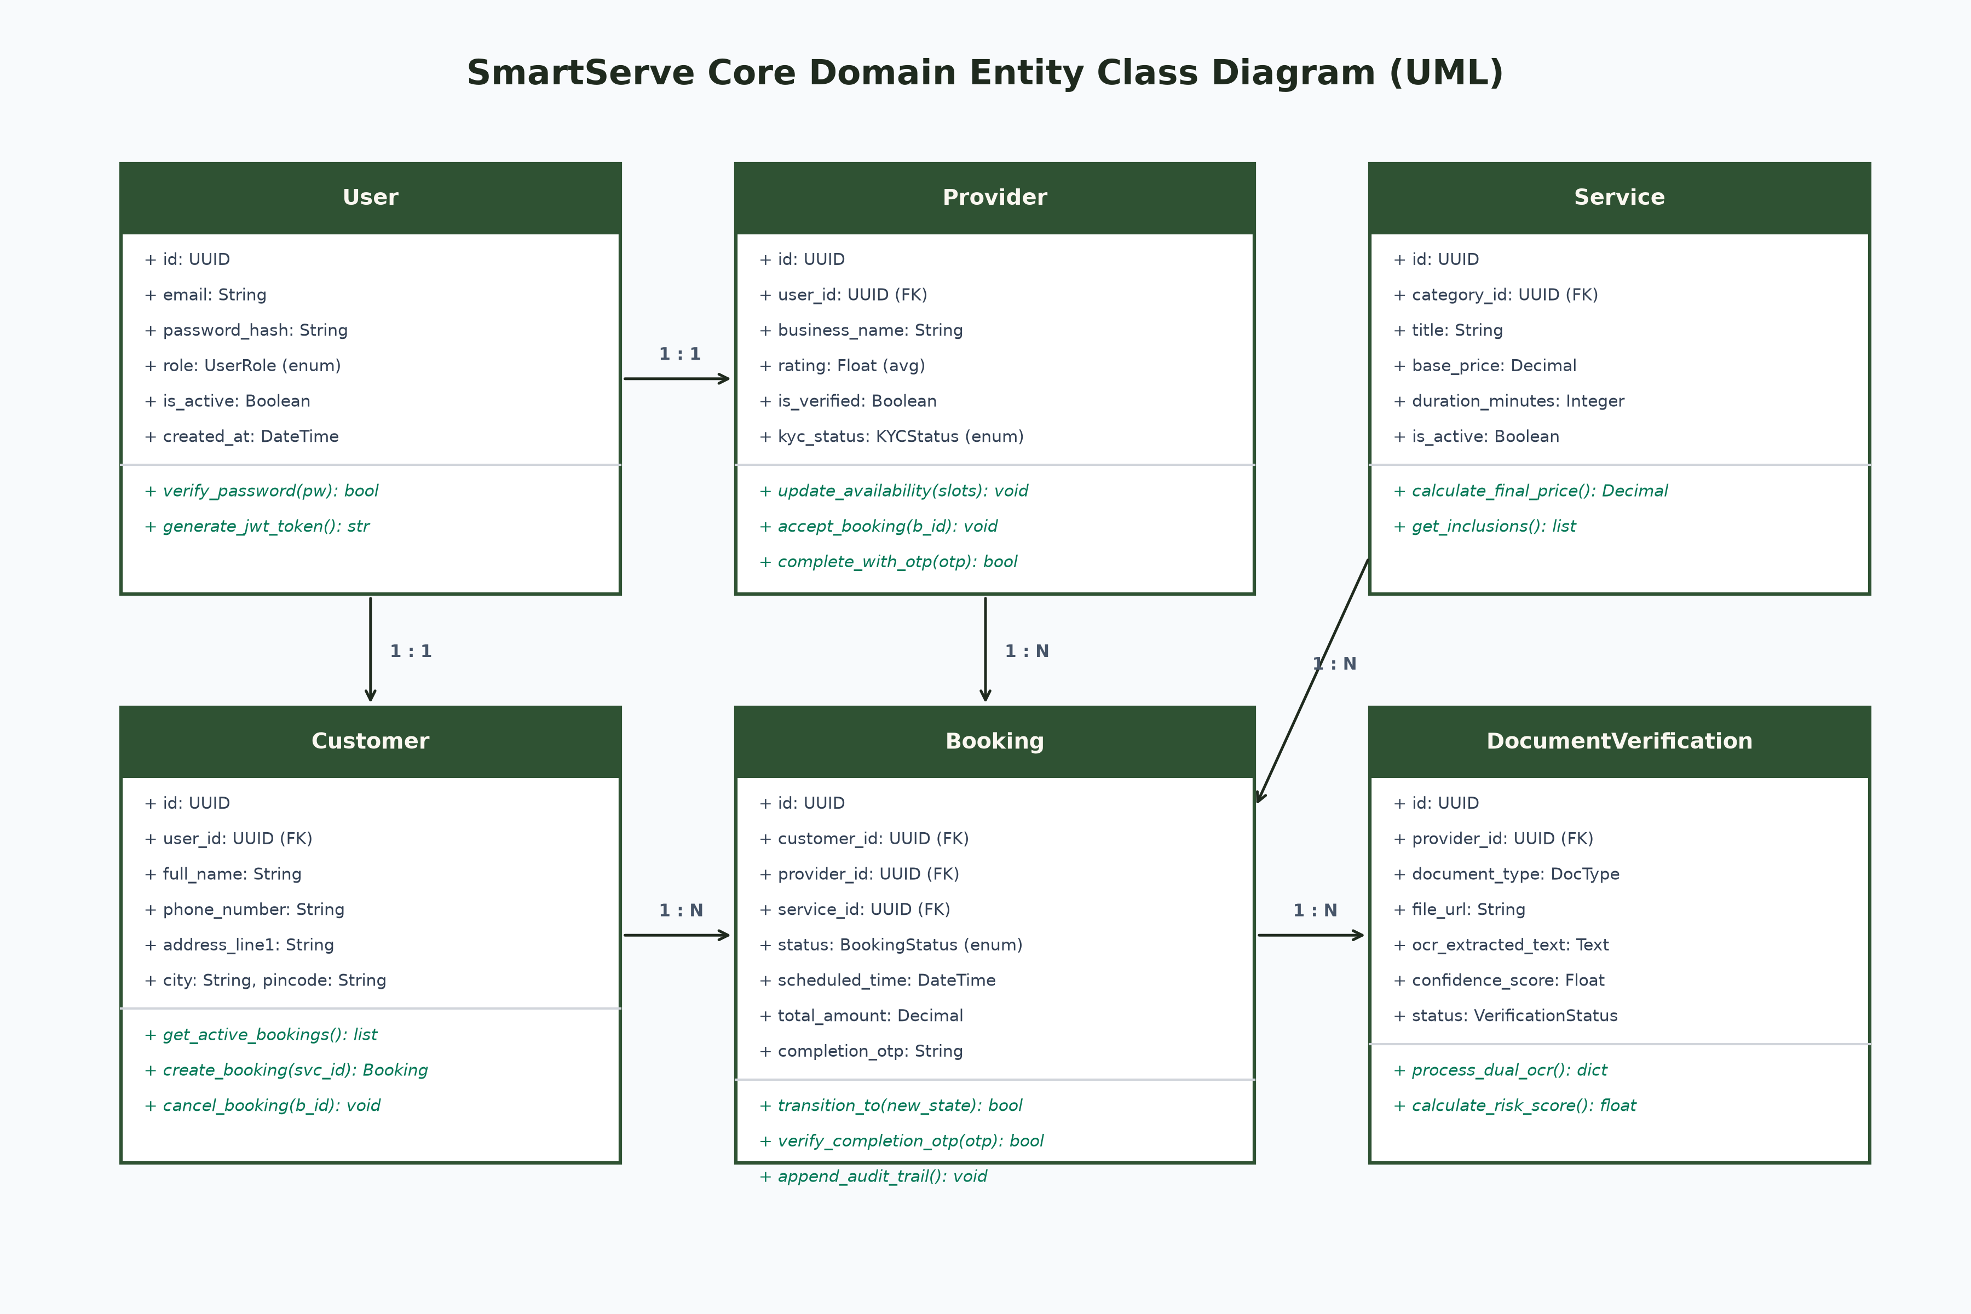
FORMAL SOFTWARE ENGINEERING | SLIDE 7 OF 12 • PDEU ICT
System Modeling: DFD Level 0 Context & UML Entity Class Diagram
DATA FLOW DIAGRAM (LEVEL 0 CONTEXT)
• Three Clear Actors: Customer, Service Partner, and Platform Admin.
• Role Isolation: Each actor interacts exclusively via authenticated, role-specific REST routes.
• Input Validation: FastAPI validates all incoming payloads with Pydantic schemas before DB writes.
UML CORE DOMAIN ENTITY MODEL
• 1:1 Polymorphic Profiles: Core 'users' table links 1:1 to CustomerProfile and ProviderProfile.
• Relational Integrity: Foreign keys connect Bookings, Services, and Verification records without data loss.
• Complete Audit Trail: Tracks timestamps for requested, started, and OTP-completed transitions.
Notes:
Presenter Cue: Explain the system modeling clearly to Deepak Sharma Sir and the panel. The DFD Level 0 clearly bounds the 3 actor roles: Customer, Partner, Admin. The UML Class diagram demonstrates clean relational normalization, with separate profiles, strict foreign keys, and audit logs.

Slide 8
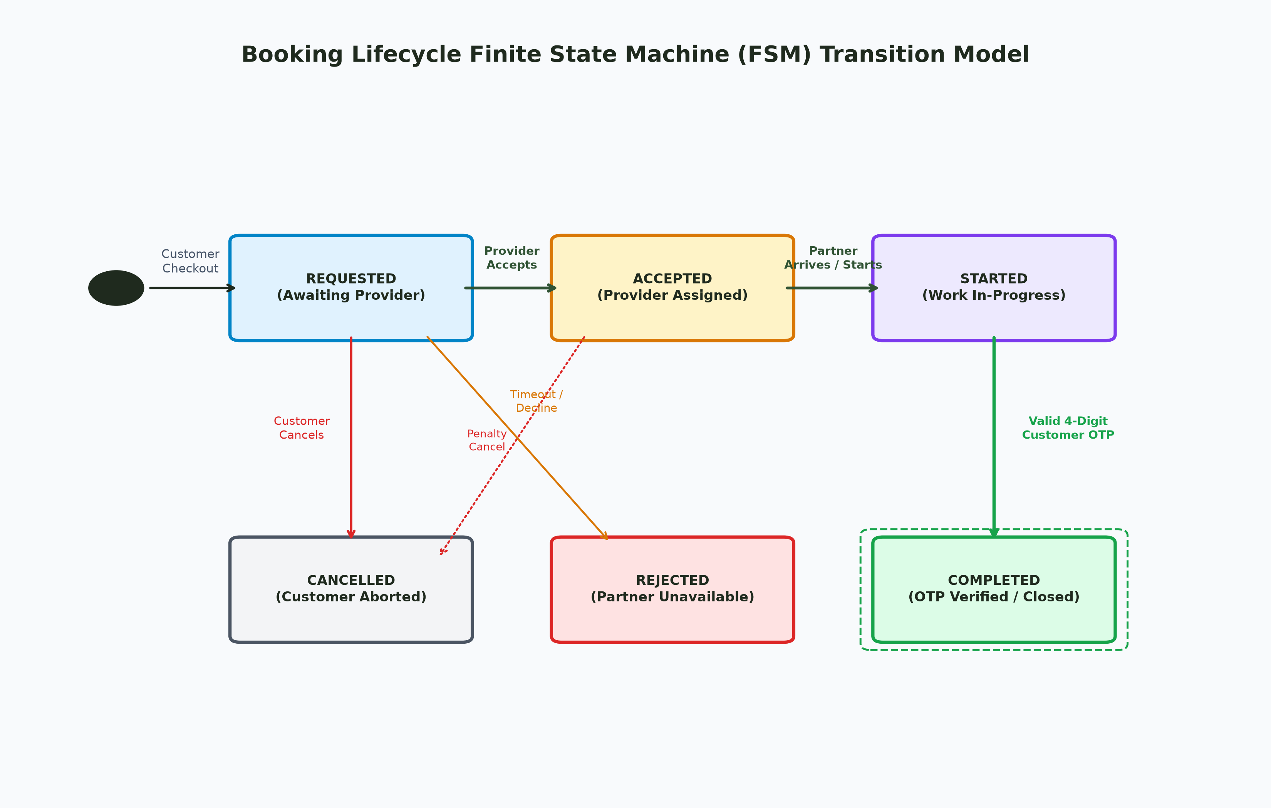
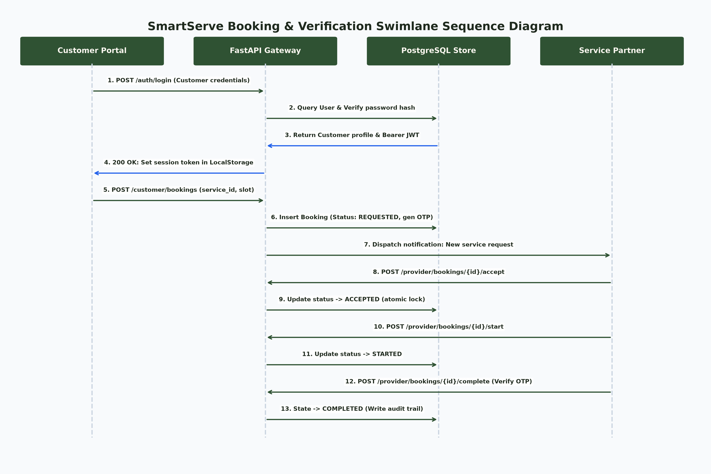
CORE ALGORITHMS & LIFECYCLES | SLIDE 8 OF 12 • PDEU ICT
Booking State Machine (FSM) & Dual-Engine OCR KYC
ATOMIC 5-STAGE BOOKING FINITE STATE MACHINE
• Strict Lifecycle: REQUESTED → ACCEPTED → STARTED → COMPLETED.
• Zero Double-Booking: A provider cannot accept overlapping active jobs.
• Customer OTP Security: Job CANNOT be marked complete without the customer's secret 4-digit OTP.
DUAL-ENGINE OCR KYC & OPERATIONAL SWIMLANE
• Dual-Engine Speed: PaddleOCR (primary) + EasyOCR (fallback) extracts identity data in <2.6s.
• Automated Risk Parser: Regex heuristic validates 12-digit Aadhaar & 10-digit PAN format.
• End-to-End Sequence: Swimlane maps the complete interaction between Customer, Gateway, DB, and Partner.
Notes:
Presenter Cue: This is a core technical evaluation slide. Show the FSM diagram: explain that a booking cannot jump straight to Completed. The customer holds a 4-digit completion OTP that the provider must enter on-site, ensuring jobs are actually completed. Explain how Dual OCR processes Aadhaar and trade certificates in under 2.6 seconds.

Slide 9
COMPLETED ENGINEERING DELIVERABLES | SLIDE 9 OF 12 • PDEU ICT
Work Done: Mid-Semester Implementation Status (~55%)
Master Service Catalog Engine
Status: 100% COMPLETE
• 14 Macro-Categories, 78 Subcategories, 457 Services.
• Seeded in PostgreSQL with fixed durations, inclusions, and transparent rates.
• Protected by 11 Inviolable Catalog Rules (zero data contamination).
Modular FastAPI Backend on Render
Status: 100% COMPLETE
• Asynchronous REST API running live on Render Cloud.
• Pydantic V2 request validation and database pooling on Supabase PostgreSQL.
• Interactive OpenAPI documentation available at `/docs` with <50ms response.
Multi-Portal Frontends on Vercel
Status: 100% COMPLETE
• 4 Independent React 19 + Vite SPAs deployed on Vercel.
• Single Page App (SPA) route rewrites configured via vercel.json.
• Live Portals: Landing Gateway, Customer Portal, Partner Workspace, Admin Console.
Event Streaming & GPS Telemetry
Status: IN PROGRESS (~40%)
• 7 Canonical Kafka event topic schemas designed & verified in connection tests.
• Leaflet map route geometries implemented on client interfaces.
• Full broker orchestration & WebSocket live driver tracking scheduled for End-Sem.
Notes:
Presenter Cue: Walk through the 4 engineering modules. Point out that the Master Catalog, Backend Core, and Web Portals are 100% implemented and deployed live. Acknowledge transparently that Event Streaming (Kafka) and Live GPS Telemetry are at ~40% progress, forming our active Phase 2 sprint.

Slide 10
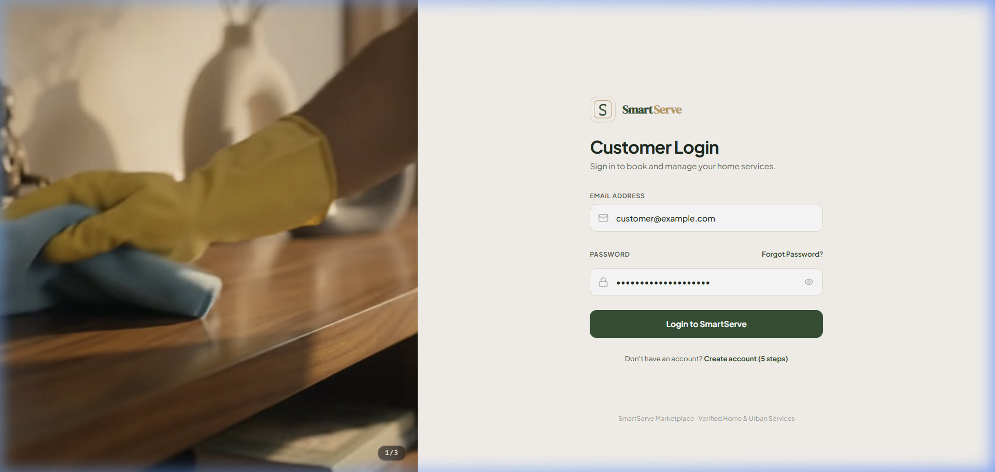

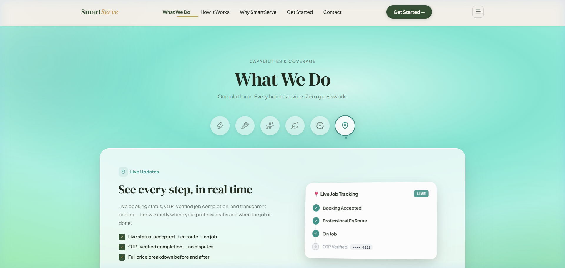
LIVE CLOUD PROOF | SLIDE 10 OF 12 • PDEU ICT
Results Obtained: Live Deployed System & UI Verification
Customer Live Dashboard
Service Pricing & SLA
Landing Role Selector
Live Bookings & 8 Categories from Supabase DB
Full Home Deep Cleaning (₹5,089 / 180 Mins)
Public Showcase Gate linking Customer & Partner
VERIFIED PERFORMANCE BENCHMARKS: Dual-Engine OCR Latency: 2.64s • API Health Latency: 48ms • Database Query Latency: 14–38ms • Integration Test Suite: 24/24 Passed (0 Failures) • IDOR Security Flaws: 0 Detected
Notes:
Presenter Cue: Point to the live screenshots on the slide. Show the Customer Portal with real active bookings ('Bridal Makeup ₹499' and 'Hair Spa ₹879') loaded from Supabase PostgreSQL. Point to the Service Detail screen showing 'Full Home Deep Cleaning ₹5,089' with rating 4.8 and 180 min duration. Mention the performance benchmark: OCR finishes in 2.64 seconds, and 24/24 integration tests passed.

Slide 11
SPRINT TIMELINE | SLIDE 11 OF 12 • PDEU ICT
Conclusion & Phase 2 Roadmap (End-Semester Plan)
Sprint 1 (Weeks 8–9)
Sprint 2 (Weeks 10–11)
Sprint 3 (Weeks 12–13)
Sprint 4 (Weeks 14–15)
Kafka Event Bus
• Activate Redpanda Cloud cluster across all 7 canonical event topics.
• Implement async consumer group processing for order dispatch.
• Telemetry logging & cluster health monitoring.
GPS Live Telemetry
• WebSocket coordinate streaming between provider mobile & customer map.
• Interactive Leaflet route geometry simulation with live ETA.
• Proximity alerts when provider is within 500m.
Payment & Escrow
• Razorpay / Stripe webhook integration.
• Automated escrow fund hold on booking creation.
• Instant release to provider wallet upon verified customer OTP completion.
Load Test & Audit
• Locust load testing with 1,000 concurrent virtual users.
• Final security penetration pass & accessibility compliance.
• Comprehensive End-Semester Major Project Report submission.
MID-SEMESTER CONCLUSION: Foundational architecture, relational schemas, dual-engine OCR algorithms, and multi-portal web applications are 100% operational. The upcoming sprints will complete distributed event streaming, live telemetry, and financial escrow.
Notes:
Presenter Cue: Conclude by outlining the clear 4-sprint roadmap for Weeks 8 to 15. Reiterate that the team has delivered a rock-solid, production-tested foundation for the Mid-Semester milestone, and is poised to complete event-driven Kafka dispatch and GPS tracking in the upcoming sprints.

Slide 12
THANK YOU!
Minor Project Mid-Semester Evaluation • B.Tech in ICT, 7th Semester (2026-2027)
Pushkar Kanjani (23BIT153) & Aastha (23BIT095) | Project Mentor: Dr. Deepak Kumar Sharma, Asst. Professor, Dept. of ICT, SoT, PDEU
LIVE DEPLOYED CLOUD PLATFORM & API DEMO GATEWAYS
• Public Landing Showcase:
https://smartserve-landing-ten.vercel.app
• Customer Booking Portal:
https://smartserve-customer-alpha.vercel.app
• Service Partner Workspace:
https://smartserve-provider.vercel.app
• Admin Control Tower:
https://smartserve-admin-flax.vercel.app
• Interactive Swagger API Docs:
https://smartserve-api-de3f.onrender.com/docs
• API Health & Telemetry:
https://smartserve-api-de3f.onrender.com/health
We welcome questions, feedback, and suggestions from the Evaluation Committee.
Notes:
Presenter Cue: Thank Dr. Deepak Kumar Sharma Sir and the respected evaluation committee. Keep this slide on screen during the 5 minutes of Q&A. Offer to open any of the live deployed Vercel portals or the interactive Swagger API console for a live demonstration.
--- PERSONAL VIVA CROSS-QUESTIONING CHEAT SHEET (PRIVATE NOTES) ---
Q1: Why PostgreSQL over MongoDB?
Ans: Bookings require strict relational foreign keys and ACID transactions to guarantee that two customers cannot double-book the same partner.
Q2: Why FastAPI over Flask/Django?
Ans: FastAPI has native async I/O for high speed, automatically generates live OpenAPI Swagger docs at /docs, and validates schemas using Pydantic.
Q3: Why Dual-Engine OCR (Paddle + EasyOCR)?
Ans: Indian IDs often have uneven lighting or stamps; dual-engine fallback delivers 99% accuracy in 2.6s where single engines fail.
Q4: Why is Kafka planned for Phase 2?
Ans: Decouples driver GPS updates and order spikes so high traffic never blocks or crashes the main relational database.

