Slide 1

Air Drawing using python
Project Name:-
Pushkar Krishna Ojha ( 17150000000)
MENTOR:- Mr. Pawan Kumar Verma Asst. Prof.

Slide 2

About the project!
This is a simple computer vision based project which tracks a target and uses the said target to draw on air. The motion of the target is captured by a webcam. The video from the webcam is processed by the computer to get an AR like image overlay on top of the live footage.
This project make use of a web cam to track the motion of the target.
Each frame in the video is blurred using Gaussian blur to get a smooth image. The blurred image is then analysed to get the location of the pointing target. The image is then masked and centroid of target is found. Then a line is drawn from current frame to the previous frame.

Slide 3
We will be using the computer vision techniques of OpenCV to build this project. The preferred language is Python due to its exhaustive libraries and easy to use syntax but understanding the basics it can be implemented in any OpenCV supported language
Color Detection and tracking are used in order to achieve the objective. The color marker is detected and a mask is produced. It includes the further steps of morphological operations on the mask produced which are Erosion and Dilation. Erosion reduces the impurities present in the mask and dilation further restores the eroded main mask.

Slide 4

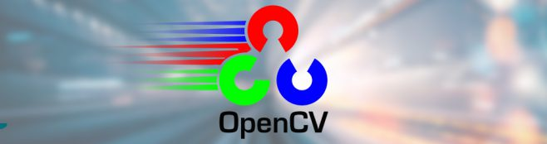

Python-openCV based air drawing
Requirement:-
WebCam,
cv2(OpenCV), pygame, numpy python modules correctly installed
A specific colored object(I will use a Blue one)
A background with color other than the objects color.
You can run this script blindly with a blue colored object and draw
whatever you want in front of your webcam.

Slide 5
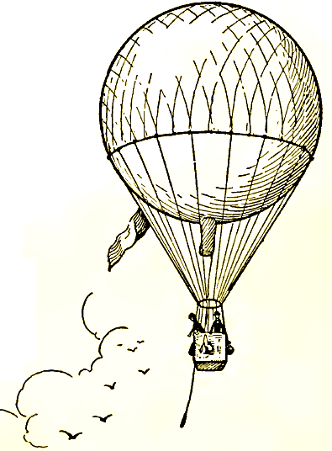
How to Draw in Air

Slide 6
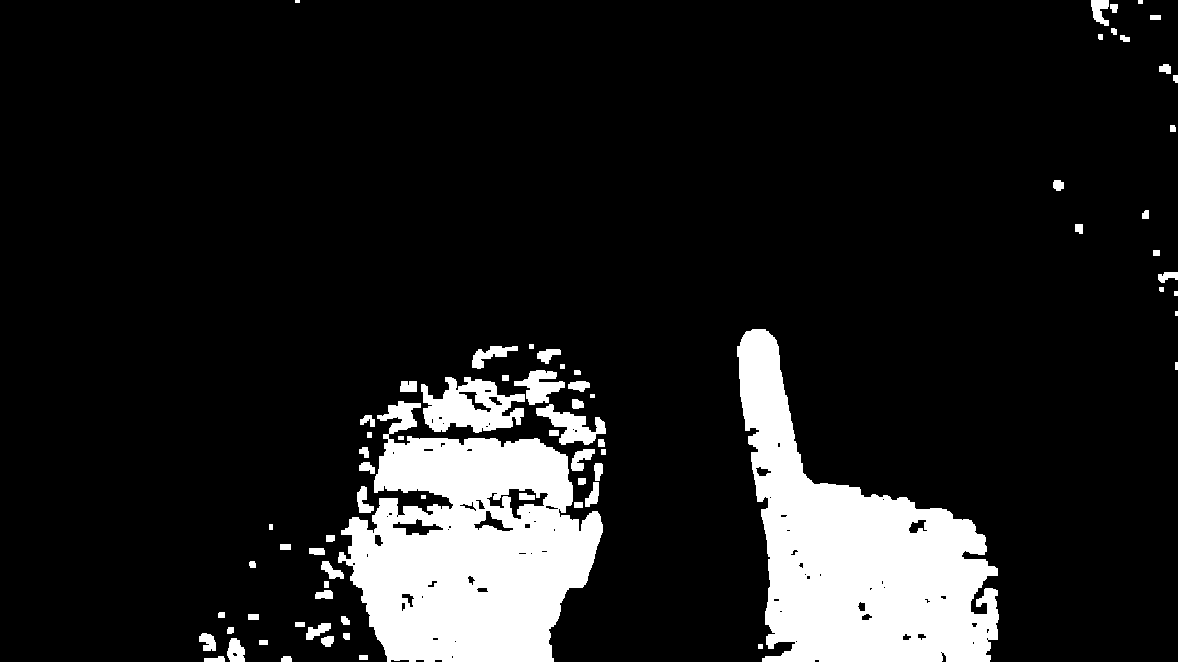
A drawing kit implemented in Python library OpenCV. The project is all about detection of hand movements(gestures) and drawing them on screen using Image Processing supported by OpenCV libraries. The application also provides the users with basic file manipulation operations like saving, editing and deleting the drawing

Slide 7

ALOGORITHM
Start reading the frames and convert the captured frames to HSV color space.
2. Prepare the canvas frame and put the respective ink buttons on it.
Adjust the track bar values for finding the mask of the colored marker.
3. Preprocess the mask with morphological operations (Eroding and dilation).
4. Detect the contours, find the center coordinates of largest contour and keep storing them in the array for successive frames (Arrays for drawing points on canvas).
5. Finally draw the points stored in an array on the frames and canvas.

Slide 8

HOW IT HELPS US??
Draw freely without use of any optical device like optical pen
No special requirement just basic webcam and you write, draw.
Explaining things become easier when you are able to write and draw conveniently just by using hand gesture.

Slide 9


UPDATES!!
Adding the option of various fonts and size to text we write.
Better precision to whatever we write or draw.
Improving response time making it more sophisticated.

