Slide 1
New framework for supply chain decision making under uncertainty: An analysis of the computational effort
(All IP patent pending under PCT)
Abhilasha Aswal
Infosys Technologies Limited,
Bangalore, India
Email: abhilasha_aswal@infosys.com
G.N. Srinivasa Prasanna
International Institute of Information Technology,
Bangalore, India
Email: gnsprasanna@iiitb.ac.in

Slide 2
Outline
Introduction
Models for handling uncertainty
Our model: Extension of robust optimization
  Capabilities (simple to input specifications, quantify it, and see its relations to other possible specifications)
Problem formulation
Computational Results
Conclusions

Slide 3



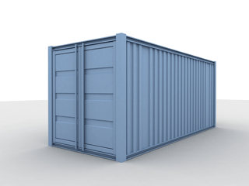
Introduction
Suppliers
Factories
Warehouses
Markets
A typical Supply Chain

Slide 4
Introduction
Major Issue in Supply Chains: Uncertainty
  A supply chain necessarily involves decisions about future operations.
    Coordination of production, inventory, location, transportation to achieve the best mix of responsiveness and efficiency.
  Decisions made using typically uncertain information.
    Uncertain Demand, supplier capacity, prices.. etc
    Forecasting demand for a large number of commodities is difficult, especially for new products.

Slide 5
Models for handling uncertainty in supply chains
Deterministic Model
  A-priori knowledge of parameters
  Does not address uncertainty
Stochastic / Dynamic Programming
  Uncertain data represented as random variables with a known distribution.
  Information required to estimate:
  All possible outcomes: usually exponential or infinite
  Probability of an outcome
  How to estimate?
Robust Optimization
  Uncertain data represented as uncertainty sets.
  Less information required.
  How to choose the right uncertainty set?

Slide 6
Our model: Extension of robust optimization

Slide 7
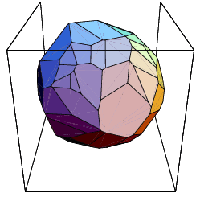
Convex polyhedral formulation
Uncertain parameters bounded by polyhedral uncertainty sets (extendible to convex polyhedral sets).
  Linear constraints that model microeconomic behavior
  Parameter estimates based on ad-hoc assumptions avoided, constraints used as is.
  Aggregates, Substitutive and Complementary behavior.
A hierarchy of scenarios sets
  A set of linear constraints specify
  a scenario set.
  Scenario sets can each have an
  infinity of scenarios
    Intuitive Scenario Hierarchy
    Based on Aggregate Bounds
    Underlying Economic Behavior

Slide 8
Representation of uncertainty
Information easily provided by Economically Meaningful Constraints
  Economic behavior is easily captured in terms of types of goods, complements and substitutes.
    Substitutive goods
      10 <= d₁ + d₂ + d₃ <= 20
      d₁, d₂ and d₃ are demands for 3 substitutive goods.
    Complementary/competitive goods
      -10 <= d₁ - d₂ <= 10
      d₁ and d₂ are demands for 2 complementary goods.
    Profit/Revenue Constraints
      20 <= 6.1 d₁ + 3.8 d₃ <= 40
      Price of a product times its demand ➔ revenue. This constraint puts limits on the total revenue.

Slide 9
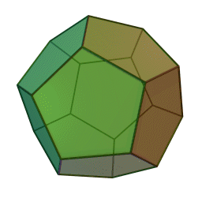
Quantification of Information content
Information is provided in the form of constraint sets.
These constraint sets form a polytope, of Volume V₁
The volume measures the total number of scenarios being considered.
No of bits = log₂ (V_{REF}/V₁)
Quantitative comparison of different
Scenario sets
  Quantitative Estimate of Uncertainty.
  Generation of equivalent information.
  Both input and output information.
Img source: http://en.wikipedia.org/wiki/File:Dodecahedron.gif

Slide 10
Uncertainty and amount of information
dem1
dem2

Slide 11
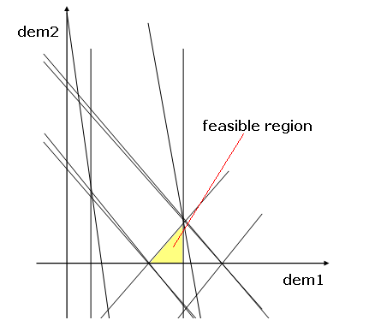
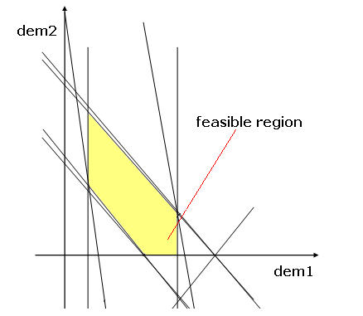
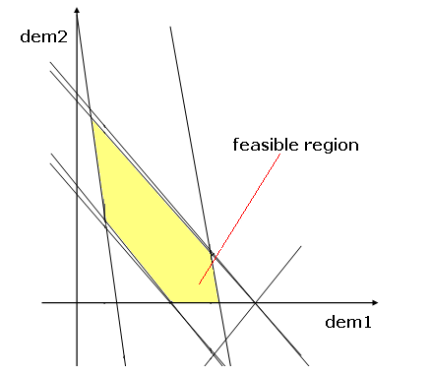
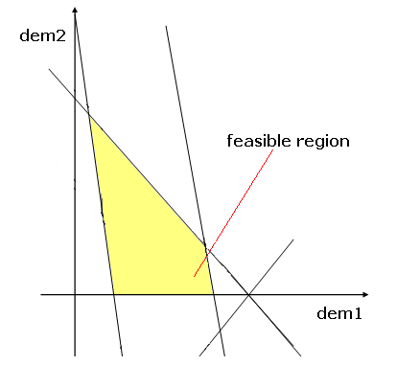
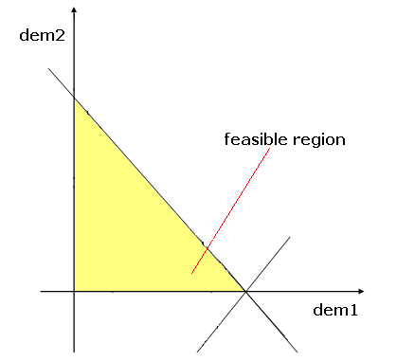
Uncertainty and amount of information

Slide 12
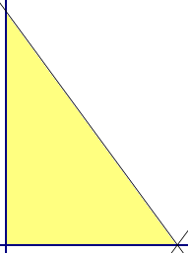
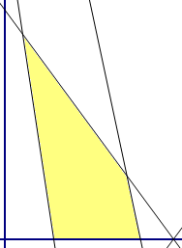
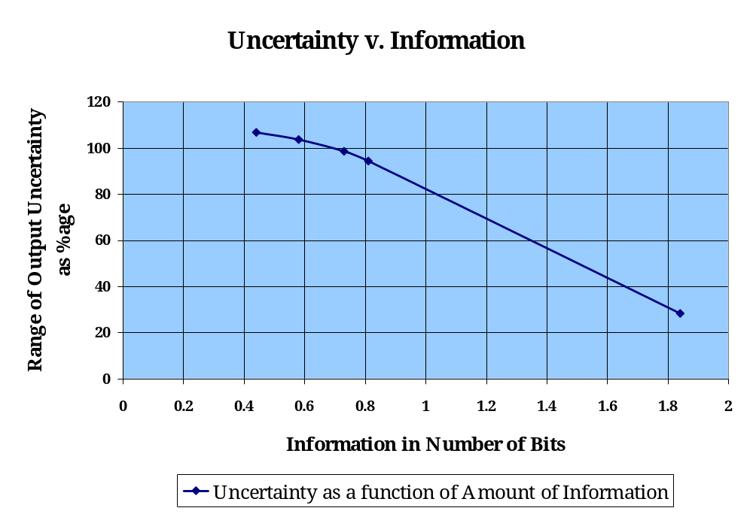
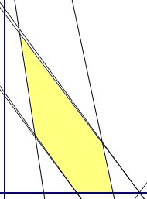
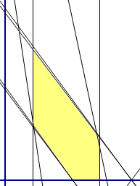
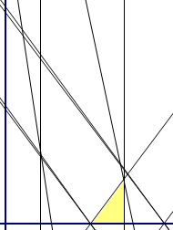
Uncertainty and amount of information

Slide 13
Relational algebra of polytopes
Relationships between different scenario sets using the relational algebra of polytopes
  One set is a sub-set of the other
  Two constraint sets intersect
  The two constraint sets are disjoint
A general query based on the set-theoretic relations above can also be given, e.g. -
  “A Subset (B Intersection C)?”: checks if the intersection of B and C encloses A.
Subset
Intersection
Disjointed-ness

Slide 14
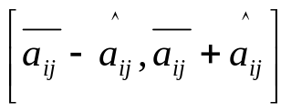
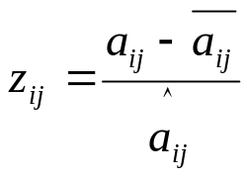
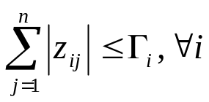
Related work
Bertsimas, Sim, Thiele - “Budget of uncertainty” (amongst Nemirovksi/Ben Tal/Shapiro/El Ghaoui/Lebret)
  Uncertainty:
  Normalized deviation for a parameter:
  Sum of all normalized deviations limited:
  N uncertain parameters ➔ polytope with 2^{N} sides
  In contrast, our polyhedral uncertainty sets:
    More general
    Much fewer sides

Slide 15
Problem formulation
Static capacity planning (simplified)

Slide 16
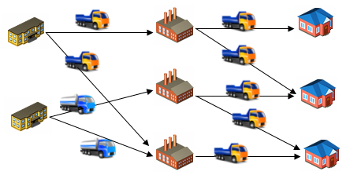
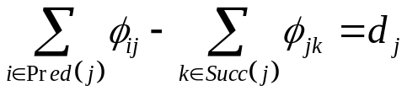
Optimization problem
The formulation results in tractable models
  Classical MCF: natural formulation.
  Flow conservation equations are linear:

Slide 17
Optimization problem
Matrix form of flow equations: AΦ ≤ d
  A: unimodular flow conservation matrix
  d: source/sink values
  Φ: flow vector [Φ_{S}, Φ_{D}, Φ_{I}]
  Φ_{S}: flow vector from the suppliers
  Φ_{D}: (variable) demand
  Φ_{I}: inventory
Hence, a generic supply chain optimization:
      Min C^{T}Φ
        AΦ ≤ d
        Φ ≥ 0

Slide 18

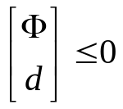
Optimization problem
Uncertainty in the right hand side
  When uncertainty is introduced, right hand side B becomes a variable (and moves to the l.h.s), yielding the formal LP:
Min C^{T}Φ
(CP)^{T} d ≤ E
        Φ ≥ 0
  The (CP)^{T} d ≤ E represents the linear uncertainty constraints of our specification.

Slide 19
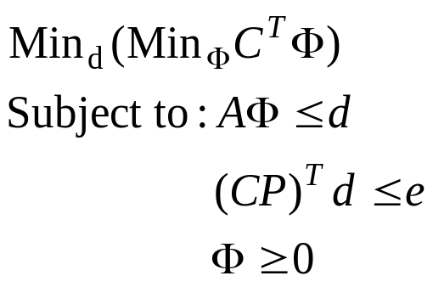
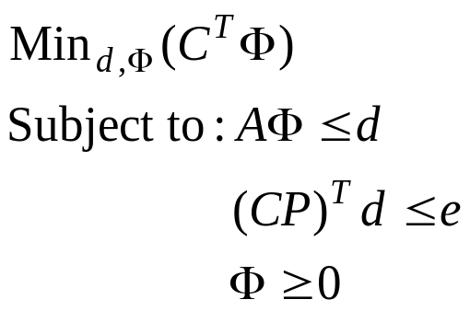
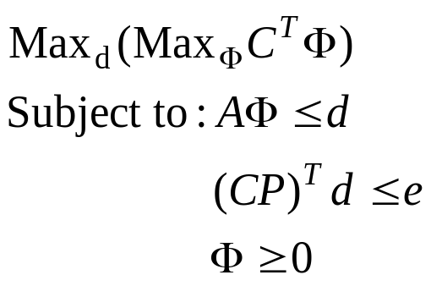
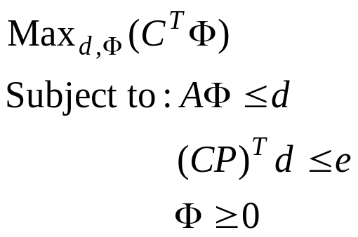
Finding absolute bounds
Absolute bounds on performance quickly found
  Best performance in best case of the uncertain parameters
  Worst performance in worst case of the uncertain parameters
LP
LP

Slide 20
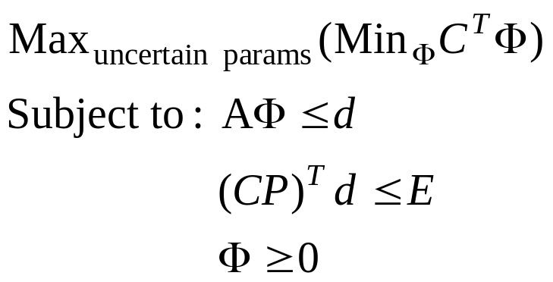
Finding optimal solutions
Optimal flow ➔ Φ
  Minimizes the cost in the worst case of the uncertain parameters.
min-max optimization ➔ not an LP.

Slide 21
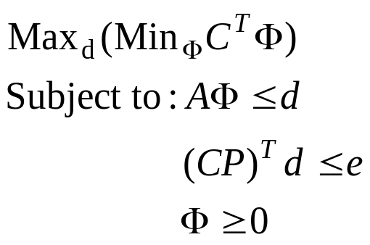
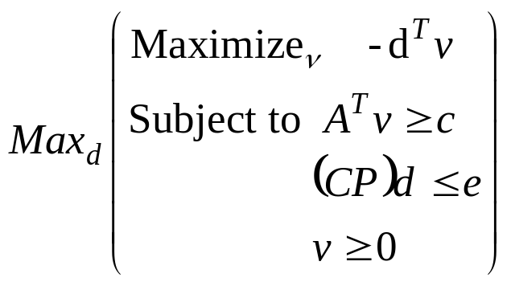
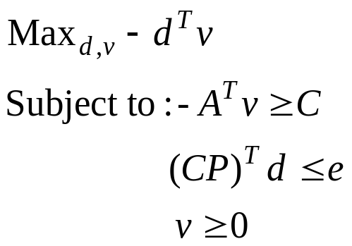
Finding optimal solutions
Duality??
  No breakpoints or fixed costs: min-max optimization ➔ QP
QP

Slide 22
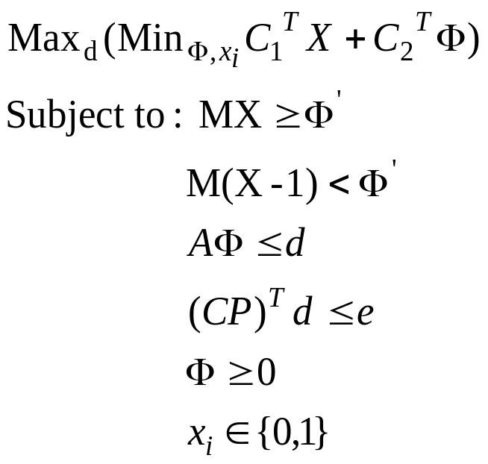
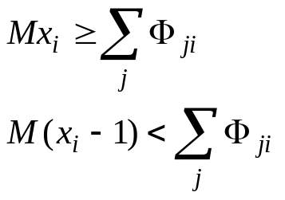
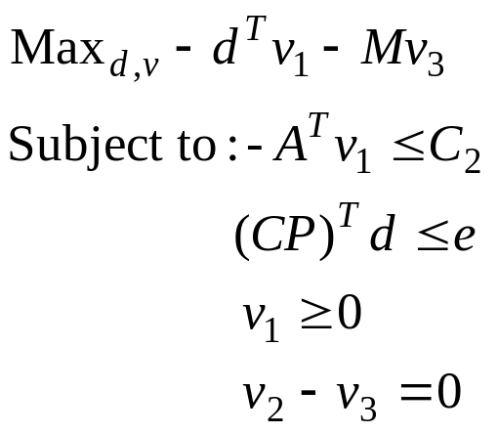
Finding optimal solutions
Duality??
  Linear costs and variable locations ➔ QP
QP
}

Slide 23
Finding optimal solutions
Duality??
  Fixed costs and breakpoints: non-convexities that preclude strong-duality from being achieved.
Finding absolute bounds is relatively easy using state-of-art solvers
Min-max bound tightening heuristics have to be used in general
Cost
B₁
B₂
Quantity

Slide 24
The statistical sampling heuristic
First, the performance is bounded by finding absolute bounds (min-min and max-max solutions)
  These can be found directly by min/max ILP)
A number of demand samples are chosen at random and optimal policies for each is computed.
  The problem of finding the optimal policy for a deterministic demand sample is an LP/ILP.
The one having the lowest worst case cost is selected.

Slide 25
The statistical sampling heuristic
LP
CP
Max cost
Min-Max
Min cost

Slide 26
Experimental Results
All problems solved using
  A typical laptop:
    Intel Celeron 1.60 GHz processor, with a 512 MB RAM
  ILOG CPLEX 11.0 solver

Slide 27
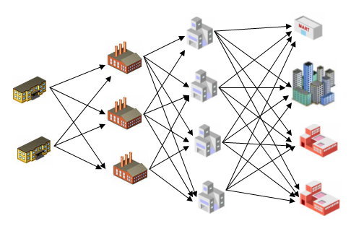

Example: Facility Location and Capacity Planning
100 ≤ dem_p1 + dem_p2 ≤ 250
500 ≤ dem_p1 + dem_p2 ≤ 700
200 ≤ dem_p1 + dem_p2 ≤ 400
dem_M3_p1
200 ≤ dem_p1 + dem_p2 ≤ 400
dem_M4_p1
25 ≤ - ≤ 65

Slide 28
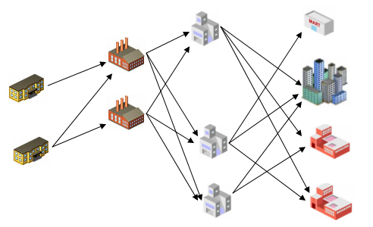
Example: Facility Location and Capacity Planning
Optimum chain if demand takes minimum values
Total cost: 81200

Slide 29
Example: Facility Location and Capacity Planning
Worst case chain if demand takes maximum values
Total cost: 1058500

Slide 30
Experimental Results
Nodes | Products | Breakpoints | Variables | Time taken (seconds)
8 | 2 | 1 | 120 | 0.6
40 | 2 | 1 | 1640 | 1.27
170 | 2 | 1 | 28470 | 3179.41
205 | 2 | 1 | 46680 | 885.74
8 | 2000 | 0 | 119746 | 0.77
20 | 2000 | 0 | 260015 | 18.66
170 | 20 | 1 | 284070 | 26957.20 (aborted at integrality gap 2%)
40 | 2000 | 0 | 970030 | 600.77
Integrality gap of
10% in 600 s

Slide 31
Conclusions
Convenient and intuitive specification to handle uncertainty in supply chains.
Specification meaningful in economic terms and avoids ad-hoc assumptions about demand variations.
Correlations between different products incorporated, while retaining computational tractability.
Realistic costs with breakpoints lead to ILPs that are NP-hard. However, a large number of medium scale problems with tens of thousands of variables are solvable in minutes on typical laptops.

Slide 32
Thank you
Contact:
Abhilasha Aswal: abhilasha_aswal@infosys.com
G. N. Srinivasa Prasanna: gnsprasanna@iiitb.ac.in

