Slide 1
Estimating Correlated Constraint Boundaries from timeseries data: The multi-dimensional German Tank Problem
Abhilasha Aswal
G N S Prasanna
IIIT-B
EURO XXIV Lisbon

Slide 2
The German Tank Problem
Biased estimators
  Maximum likelihood
Unbiased estimators
  Minimum Variance unbiased estimator (UMVU)
  Maximum Spacing estimator
  Bias-corrected maximum likelihood estimator
EURO XXIV Lisbon

Slide 3
Maximum Spacing Estimator
Cheng, R.C.H.; Amin, N.A.K. (1983). "Estimating parameters in continuous univariate distributions with a shifted origin". Journal of the Royal Statistical Society, Series B 45 (3): 394–403.
Ranneby, Bo (1984). "The maximum spacing method. An estimation method related to the maximum likelihood method". Scandinavian Journal of Statistics 11 (2): 93–112.
EURO XXIV Lisbon

Slide 4
The General Problem
Given correlated data samples, drawn from a uniform distribution- estimating the bounded region formed by correlated constraints enclosing the samples.
Estimating the constraints without bias and with minimum variance.
EURO XXIV Lisbon

Slide 5


A new UMVU for the general problem
Generate the convex hull for the given samples.
The convex hull has a very large number of facets, hence the generated convex hull facets are clustered using the following approach –
  Every N-dimensional facet is mapped to a point in N+1 D space as follows:
  All such points are K-means clustered into M clusters.
  The points in a cluster are replaced by a single point by taking average of all the elements.
  The averaged points are mapped back to the facet space forming a constrained region with fewer number of facets, approximating the convex hull.
EURO XXIV Lisbon

Slide 6
A new UMVU for the general problem
Advantages -
  Asymptotically consistent and unbiased.
  Fast convergence.
  Model independent.
A model dependent approach can be based on linear programming.
EURO XXIV Lisbon

Slide 7
Convergence Analysis
V_{K} – volume of the k^{th} estimate of the convex hull.
V – real volume.
V
V_{K}
EURO XXIV Lisbon

Slide 8
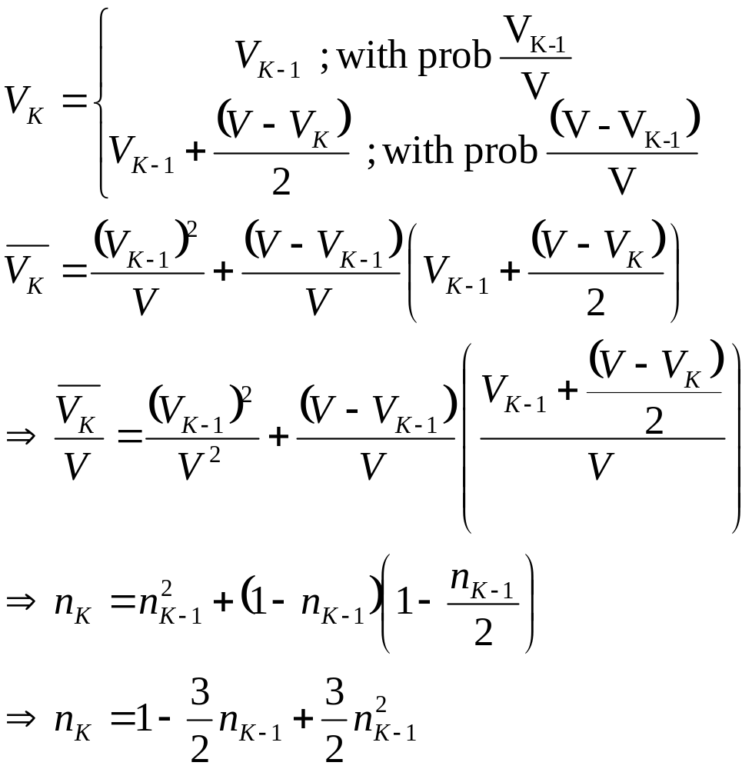
Convergence Analysis
EURO XXIV Lisbon

Slide 9
Examples
EURO XXIV Lisbon

Slide 10
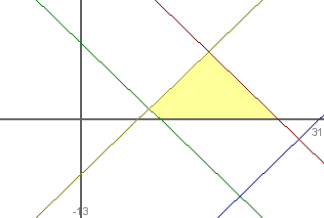
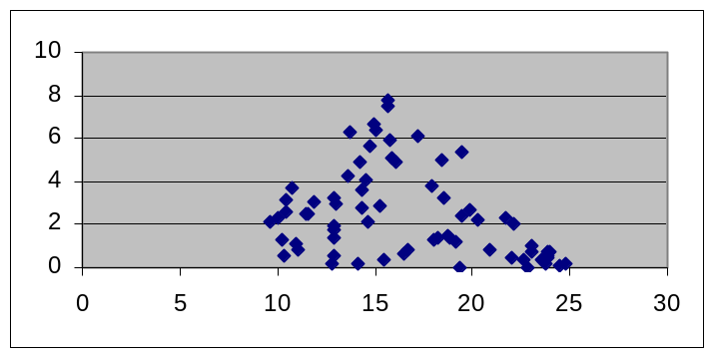
Example 1 - A 2D example
Constraints:
  x + y <= 25
  x + y >= 10
  x - y <= 30
  x - y >= 7
70 samples uniformly taken
EURO XXIV Lisbon

Slide 11
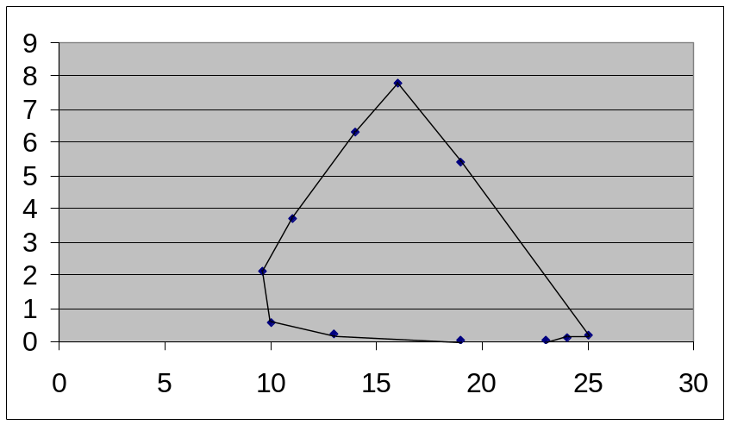
Example 1 - A 2D example
Convex Hull – 11 facets
EURO XXIV Lisbon

Slide 12
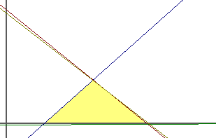
Example 1 - A 2D example
x1 + 2 x2 <= 130
x1 + 2 x2 >= 50
x2 >= 10
x2 <= 35
x1 + 2 x2 <= 130
x1 + 2 x2 >= 50
x2 >= 10
x2 <= 35
Convex hull faces K-means clustered into four clusters
  0.835 x + y = 21.235
  -0.0057 x + y = -0.33
  -0.92 x + y = -6.3
  0.8 x + y = 20.6
Original region
EURO XXIV Lisbon

Slide 13
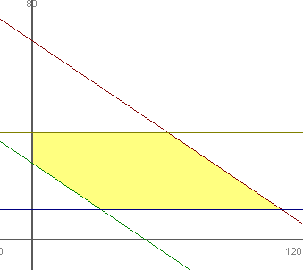
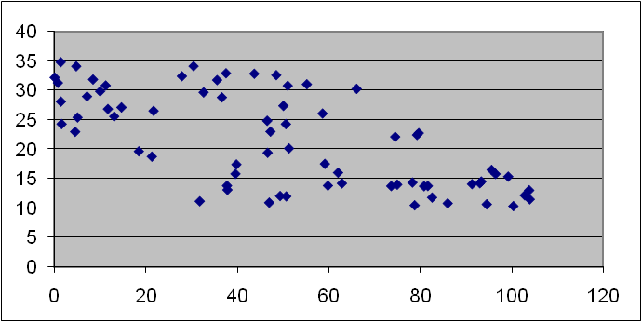
Example 2 - A 2D example
Constraints:
  x + 2 y <= 130
  x + 2 y >= 50
  y >= 10
  y <= 35
70 samples uniformly taken
EURO XXIV Lisbon

Slide 14
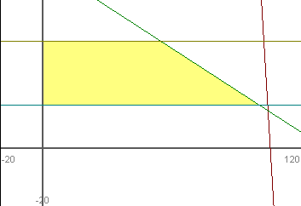
Example 2 - A 2D example
Convex Hull – 14 facets
Convex hull faces K-means clustered into four clusters
EURO XXIV Lisbon

Slide 15
Example 3 - A 5D example
Constraints
  x1 + x2 + x3 + x4 + x5 <= 800
  x1 + x2 + x3 + x4 + x5 >= 500
  x1 - x2 - x3 >= 50
  x1 - x2 - x3 <= 100
  x4 - x5 >= 30
  x4 - x5 <= 70
Convex hull – 1918 facets
EURO XXIV Lisbon

Slide 16
Conclusions
A new approach to multi-dimensional generalization of the German Tank problem with convergence time, polynomial in accuracy, is presented.
This can be used to estimate constraints in a robust optimization approach and is applicable to a wide variety of applications such as robust optimizations in a supply chain.
EURO XXIV Lisbon

Slide 17
Thank you
EURO XXIV Lisbon

