Slide 1
New Vistas in Inventory Optimization under Uncertainty
Abhilasha Aswal
Infosys Technologies Limited,
Bangalore, India
G.N. Srinivasa Prasanna
International Institute of Information Technology - Bangalore,
Bangalore, India
IAENG International Conference on Operations Research (ICOR'09)
Hong Kong, 18-20 March, 2009

Slide 2
Outline
Introduction
Representation of Uncertainty
Optimization Algorithms
Comparison with the EOQ model
Conclusions

Slide 3
Introduction
Major Issue in Supply Chains: Uncertainty
  A supply chain necessarily involves decisions about future operations.
    Coordination of production, inventory, location, transportation to achieve the best mix of responsiveness and efficiency.
  Decisions made using typically uncertain information.
    Uncertain Demand, supplier capacity, prices.. etc
    Forecasting demand for a large number of commodities is difficult, especially for new products.

Slide 4
Introduction
Models for handling uncertainty in supply chains
  Deterministic Model
    A-priori knowledge of parameters
    Does not address uncertainty
  Stochastic / Dynamic Programming
    Uncertain data represented as random variables with a known distribution.
    Information required to estimate:
    All possible outcomes: usually exponential or infinite
    Probability of an outcome
    How to estimate?
  Robust Optimization
    Uncertain data represented as uncertainty sets.
    Less information required.
    How to choose the right uncertainty set?

Slide 5
Introduction
Models for handling uncertainty in supply chains
  “…stochastic programming has established itself as a powerful modeling tool when an accurate probabilistic description of the randomness is available; however, in many real-life applications the decision-maker does not have this information, for instance when it comes to assessing customer demand for a product.”
  [Bertsimas and Thiele 2006]

Slide 6
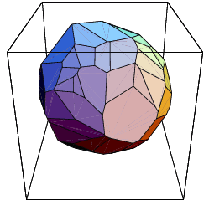
Introduction
Our Model: Extension of Robust Optimization
  Uncertain parameters bounded by polyhedral uncertainty sets.
    Linear constraints that model microeconomic behavior
    Parameter estimates based on ad-hoc assumptions avoided, constraints used as is.
    Aggregates, Substitutive and Complementary behavior.
  A hierarchy of scenarios sets
    A set of linear constraints specify
    a scenario.
    Scenario sets can each have an
    infinity of scenarios
    Intuitive Scenario Hierarchy
    Based on Aggregate Bounds
    Underlying Economic Behavior

Slide 7
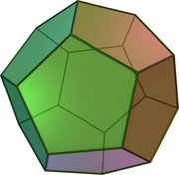
Introduction
Our Model: Uncertainty is identified with Information ➔ Information theory and Optimization
  Information is provided in the form of constraint sets.
  These constraint sets form a polytope, of Volume V1
  No of bits = log V_{REF}/V₁
  Quantitative comparison of different
  Scenario sets
    Quantitative Estimate of Uncertainty
    Generation of equivalent information.
    Both input and output information.

Slide 8
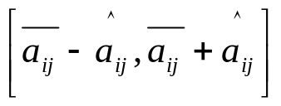
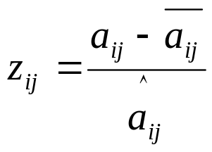
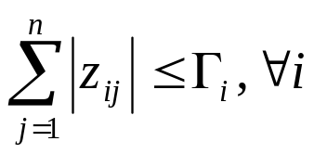
Introduction
Related Work
  Bertsimas, Sim, Thiele - “Budget of uncertainty”
    Uncertainty:
    Normalized deviation for a parameter:
    Sum of all normalized deviations limited:
    N uncertain parameters ➔ polytope with 2^{N} sides
    In contrast, our polyhedral uncertainty sets:
      More general
      Much fewer sides

Slide 9
Outline
Introduction
Representation of Uncertainty
Optimization Algorithms
Comparison with the EOQ model
Conclusions

Slide 10
Representation of Uncertainty
Information easily provided by Economically Meaningful Constraints
  Economic behavior is easily captured in terms of types of goods, complements and substitutes.
    Substitutive goods
      10 <= d₁ + d₂ + d₃ <= 20
      d₁, d₂ and d₃ are demands for 3 substitutive goods.
    Complementary/competitive goods
      -10 <= d₁ - d₂ <= 10
      d₁ and d₂ are demands for 2 complementary goods.
    Profit/Revenue Constraints
      20 <= 6.1 d₁ + 3.8 d₃ <= 40
      Price of a product times its demand ➔ revenue. This constraint puts limits on the total revenue.

Slide 11
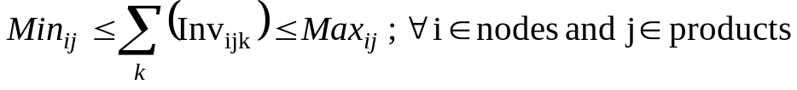
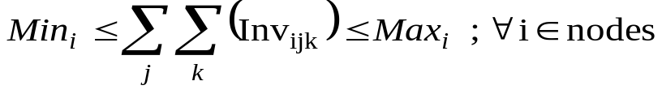

Representation of Uncertainty
Many kinds of future uncertainty can be easily specified
  Constraints on inventory
    Bounds on total inventory at a node for a particular product at a particular time period
    Bounds on total inventory for a particular product at a particular node over all the time periods
    Bounds on total inventory for all the products at a particular node over all the time periods
    Bounds on total inventory for all the products at all the nodes that may ever be stored

Slide 12


Representation of Uncertainty
  Inventory tracking demand
  The total inventory may be limited by total purchases. For example,
  Total inventory for a product over all the nodes, over all time periods may be no more than 50% of the total purchases and no less than 30 % of the total purchases.

Slide 13
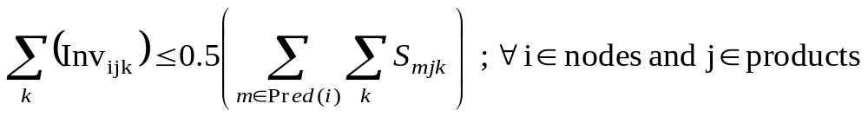
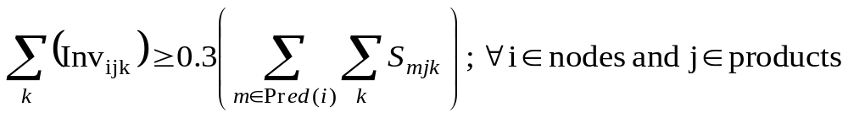
Representation of Uncertainty
  Inventory tracking supplies
  Total inventory may be limited by the total supplies. For example,
  Total inventory for a product at a node over all time periods may be no more than 50% of the total supply to that node and no less than 30 % of the total supply to that node

Slide 14
Representation of Uncertainty
  Inventory tracking each other
Similarly sums, differences, and weighted sums of demands, supplies, inventory variables, etc, indexed by commodity, time and location can all be intermixed to create various types of constraints on future behavior.

Slide 15
Outline
Introduction
Representation of Uncertainty
Optimization Algorithms
Comparison with the EOQ model
Conclusions

Slide 16
Optimization Algorithms
The formulation results in tractable models
  Classical MCF: natural formulation.
  Flow conservation equations are linear:
  Matrix form of flow equations: AΦ ≤ B
    A: unimodular flow conservation matrix
    B: source/sink values
    Φ: flow vector [Φ_{S}, Φ_{D}, Φ_{I}]
    Φ_{S}: flow vector from the suppliers
    Φ_{D}: (variable) demand
    Φ_{I}: inventory
  Hence, a generic supply chain optimization:
        Min C^{T}
        AΦ ≤ B

Slide 17
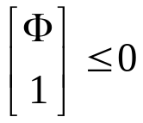

Optimization Algorithms
Uncertainty in the right hand side
  When uncertainty is introduced, right hand side B becomes a variable (and moves to the l.h.s), yielding the LP:
Min C^{T}Φ
D^{T} B ≤ E
  The D^{T} B ≤ E represents the linear uncertainty constraints of our specification.

Slide 18
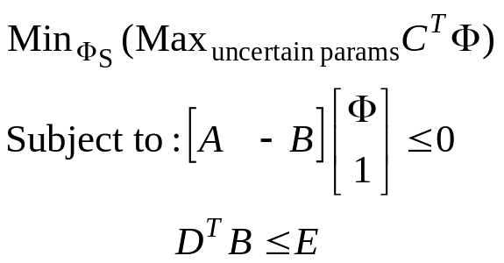
Optimization Algorithms
Finding optimal policy
  Optimal policy ➔ ordering policy (Φ_{S})
    minimizes the cost in the worst case of the uncertain parameters.
  This is a min-max optimization, and is not an LP.
  Duality??
    Fixed costs and breakpoints: non-convexities that preclude strong-duality from being achieved.
    No breakpoints or fixed costs: min-max optimization ➔ QP
  Heuristics have to be used in general.

Slide 19
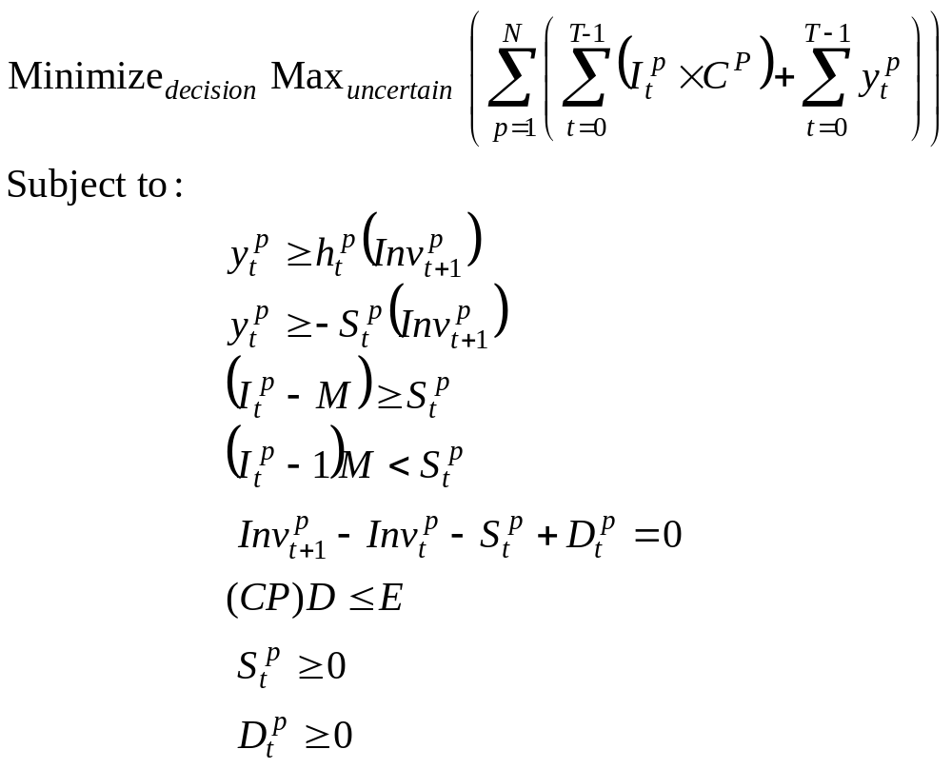
Optimization Algorithms
Finding optimal policy

Slide 20
Optimization Algorithms
The statistical sampling heuristic
  First, the performance is bounded by finding absolute bounds (min-min and max-max solutions)
    These can be found directly by min/max ILP)
  A number of demand samples are chosen at random and optimal policies for each is computed.
    The problem of finding the optimal policy for a deterministic demand sample is an LP/ILP.
  The one having the lowest worst case cost is selected.

Slide 21
Optimization Algorithms
The statistical sampling heuristic
Begin
for i = 1 to maxIteration
{
parameterSample = getParameterSample(i, constraint Set)
bestPolicy = getBestPolicy(i, parameterSample)
findCostBounds(i, betPolicy)
}
chooseBestSolution()
End

Slide 22
Outline
Introduction
Representation of Uncertainty
Optimization Algorithms
Comparison with the EOQ model
Conclusions

Slide 23
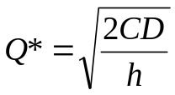
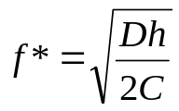
Comparison with the EOQ model
The EOQ model
    C: fixed ordering cost per order
    h: per unit holding cost
    D: demand rate
    Q*: optimal order quantity
    f*: optimal order frequency
Q*

Slide 24










Comparison with the EOQ model
Inventory optimization example
Car type I
Car type II
Automobile
store
Car type III
Tyre type I
Supplies
Tyre type II
Petrol
Drivers

Slide 25
Comparison with the EOQ model
Ordering and holding costs
Product | Ordering Cost in Rs. (per order) | Holding Cost in Rs. (per unit)
Car Type I | 1000 | 50
Car Type II | 1000 | 80
Car Type III | 1000 | 10
Tyre Type I | 250 | 0.5
Tyre Type II | 500 (intl shipment) | 0.5
Petrol | 600 | 1
Drivers | 750 | 300

Slide 26
Comparison with the EOQ model
Exactly Known Demands, no uncertainty
  EOQ solution and Constrained Optimization solution match exactly:
  But…
Product | Demand per month | EOQ Solution |  |  | Constrained Optimization Solution
 |  | Order Frequency | Order Quantity | Cost | Order Frequency | Order Quantity | Cost
Car Type I | 40 | 1 | 40 | 2000 | 1 | 40 | 2000
Car Type II | 25 | 1 | 25 | 2000 | 1 | 25 | 2000
Car Type III | 50 | 0.5 | 100 | 1000 | 0.5 | 100 | 1000
Tyre Type I | 250 | 0.5 | 500 | 250 | 0.5 | 500 | 250
Tyre Type II | 125 | 0.25 | 500 | 250 | 0.25 | 500 | 250
Petrol | 300 | 0.5 | 600 | 600 | 0.5 | 600 | 600
Drivers | 5 | 1 | 5 | 1500 | 1 | 5 | 1500
Total |  |  |  | 7600 |  |  | 7600
UNREALISTIC!!!
We cannot know the future demands exactly.

Slide 27
Comparison with the EOQ model
Bounded Uncorrelated Uncertainty
  Assuming the range of variation of the demands is known, we can get bounds on the performance by optimizing for both the min value and the max value of the demands.
  EOQ solution and Constrained Optimization solution are almost the same.
Product | EOQ solution |  |  |  | Constrained Optimization
 | Order Frequency |  | Order Quantity |  | Order Frequency |  | Order Quantity
 | Min | Max | Min | Max | Min | Max | Min | Max
Car Type I | 0.5 | 1 | 20 | 40 | 0.5 | 1 | 20 | 40
Car Type II | 0 | 1 | 0 | 25 | 0 | 1 | 0 | 25
Car Type III | 0.5 | 1 | 100 | 200 | 0.5 | 1 | 100 | 200
Tyre Type I | 0.25 | 0.5 | 248.99 | 500 | 0.25 | 0.5 | 248 | 500
Tyre Type II | 0.25 | 0.5 | 500 | 1000 | 0.25 | 0.5 | 500 | 1000
Petrol | 0.25 | 0.5 | 300 | 600 | 0.25 | 0.5 | 300 | 600
Drivers | 0.45 | 1 | 2.24 | 5 | 0.5 | 1 | 2 | 5

Slide 28
Comparison with the EOQ model
Beyond EOQ: Correlated Uncertainty in Demand
  Considering the substitutive effects between a class of products (cars, tyres etc.)
  200 ≤ dem_tyre_1 + dem_tyre_2 ≤ 700
  65 ≤ dem_car_1 + dem_car_2 + dem_car_3 ≤ 250
  Considering the complementary effects between products that track each other
5 ≤ (dem_car_1 + dem_car_2 + dem_car_3) – dem_petrol ≤ 20
  5 ≤ dem_car_2 – dem_drivers ≤ 20
EOQ cannot incorporate such forms of uncertainty.

Slide 29
Comparison with the EOQ model
Beyond EOQ: Correlated Uncertainty in Demand
  Min-Max solution for different scenarios:
Products | With Substitutive Constraints |  | With Complementary Constraints |  | With both Substitutive and Complementary constraints
 | Order Frequency | Order Quantity | Order Frequency | Order Quantity | Order Frequency | Order Quantity
Car Type I | 0.75 | 25 | 0.5 | 38 | 0.5 | 40
Car Type II | 0.5 | 13 | 0.5 | 22 | 1 | 10
Car Type III | 0.75 | 125 | 0.75 | 121 | 0.5 | 180
Tyre Type I | 0.25 | 362 | 0.75 | 250 | 0.75 | 200
Tyre Type II | 0.75 | 500 | 0.75 | 373 | 0.5 | 400
Petrol | 0.5 | 400 | 0.5 | 208 | 0.5 | 222.5
Drivers | 0.5 | 5 | 0.5 | 2 | 0.5 | 3
Cost (Rs.) | 4590.438 |  | 4593.688 |  | 4654.188
EOQ
Order Frequency | Order Quantity
1 | 40
1 | 25
0.5 | 100
0.5 | 500
0.25 | 500
0.5 | 600
1 | 5
7600

Slide 30
Comparison with the EOQ model
Beyond EOQ: Correlated Uncertainty in Demand
  Comparison of different uncertainty sets
Scenario sets | Absolute Minimum Cost | Absolute Maximum Cost
Bounds only | 3349.5 | 9187.5
Bounds and Substitutive constraints | 3412.5 | 9100
Bounds and Complementary constraints | 4469.5 | 8972.5
Bounds, Substitutive and Complementary constraints | 4482.5 | 8910

Slide 31
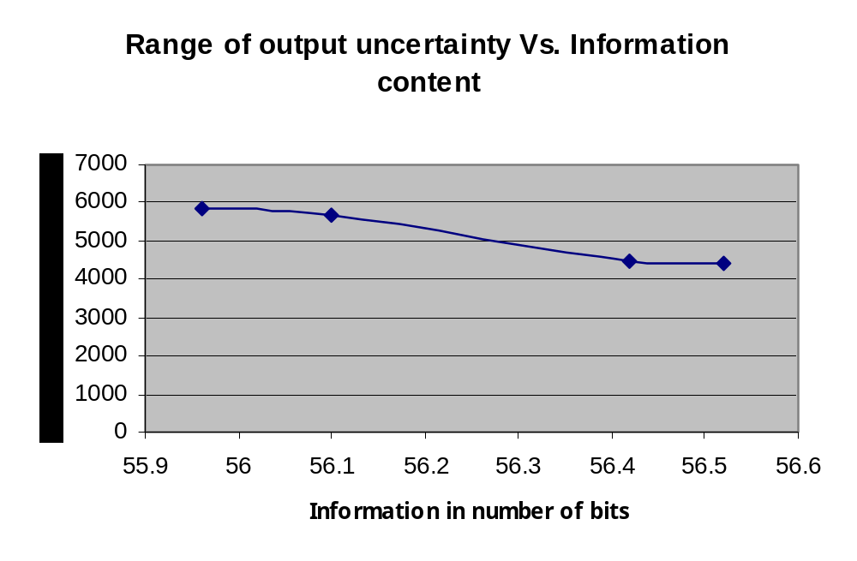
Comparison with the EOQ model
Beyond EOQ: Correlated Uncertainty in Demand

Slide 32
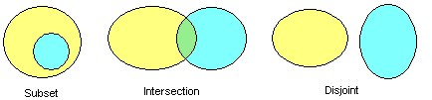
Comparison with the EOQ model
Beyond EOQ: Correlated Uncertainty in Demand
  Relationships between different scenario sets using the relational algebra of polytopes
    One set is a sub-set of the other
    Two constraint sets intersect
    The two constraint sets are disjoint
  A general query based on the set-theoretic relations above can also be given, e.g. -
    “A Subset (B Intersection C)?”: checks if the intersection of B and C encloses A.

Slide 33
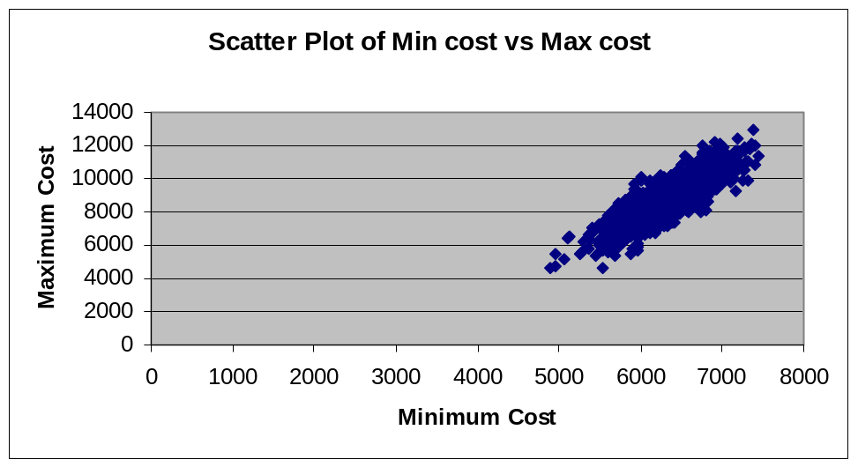
Comparison with the EOQ model
Computational procedure
  The Min-Max for the scenario set with substitutive constraints using “statistical sampling heuristic”
  From the graph, the solution has a cost not exceeding Rs. 4590.
  Number of samples: 1000
  Min-Min cost = Rs. 3412.5
  Max-Max cost = Rs. 9100

Slide 34
Comparison with the EOQ model
Correlated Inventory Constraints
Inv_tyre_1 + Inv_tyre_2 ≤ 120
Inv_car_1 + Inv_car_2 + Inv_car_3 ≤ 68
  The total cost in the absolute best case ➔ Rs. 5195.5
  Rs. 713 greater than when there are no inventory constraints.

Slide 35
Conclusions
Convenient and intuitive specification to handle uncertainty in supply chains.
Specification meaningful in economic terms and avoids ad-hoc assumptions about demand variations.
Correlations between different products incorporated, while retaining computational tractability.
Semi-industrial scale problems with realistic costs with many breakpoints and complicated constraints successfully solved.

Slide 36
Thank you
Questions?

