Slide 1

A New, Intuitive and Industrial Scale Approach towards Uncertainty in Supply Chains
Abhilasha Aswal
Infosys Technologies Limited,
Bangalore, India
Email: abhilasha_aswal@infosys.com
G.N. Srinivasa Prasanna
International Institute of Information Technology,
Bangalore, India
Email: gnsprasanna@iiitb.ac.in

Slide 2
Outline
Introduction
Our model: Extension of robust optimization
Optimization under our model
Illustrative Example
Conclusions

Slide 3
Introduction

Slide 4
Introduction
Major Issue in Supply Chains: Uncertainty
  A supply chain necessarily involves decisions about future operations.
    Coordination of production, inventory, location, transportation to achieve the best mix of responsiveness and efficiency.
  Decisions made using typically uncertain information.
    Uncertain Demand, supplier capacity, prices.. etc
    Forecasting demand for a large number of commodities is difficult, especially for new products.

Slide 5
Models for handling uncertainty in supply chains
Deterministic Model
  A-priori knowledge of parameters
  Does not address uncertainty
Stochastic / Dynamic Programming
  Uncertain data represented as random variables with a known distribution.
  Information required to estimate:
  All possible outcomes: usually exponential or infinite
  Probability of an outcome
  How to estimate?
Robust Optimization
  Uncertain data represented as uncertainty sets.
  Less information required.
  How to choose the right uncertainty set?

Slide 6
Our model: Extension of robust optimization

Slide 7
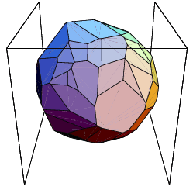
Convex polyhedral formulation
Uncertain parameters bounded by polyhedral uncertainty sets (extendible to convex polyhedral sets).
  Linear constraints that model microeconomic behavior
  Parameter estimates based on ad-hoc assumptions avoided, constraints used as is.
  Aggregates, Substitutive and Complementary behavior.
A hierarchy of scenarios sets
  A set of linear constraints specify
  a scenario set.
  Scenario sets can each have an
  infinity of scenarios
    Intuitive Scenario Hierarchy
    Based on Aggregate Bounds
    Underlying Economic Behavior

Slide 8
Representation of uncertainty
Information easily provided by Economically Meaningful Constraints
  Economic behavior is easily captured in terms of types of goods, complements and substitutes.
    Substitutive goods
      10 <= d₁ + d₂ + d₃ <= 20
      d₁, d₂ and d₃ are demands for 3 substitutive goods.
    Complementary/competitive goods
      -10 <= d₁ - d₂ <= 10
      d₁ and d₂ are demands for 2 complementary goods.
    Profit/Revenue Constraints
      20 <= 6.1 d₁ + 3.8 d₃ <= 40
      Price of a product times its demand ➔ revenue. This constraint puts limits on the total revenue.

Slide 9
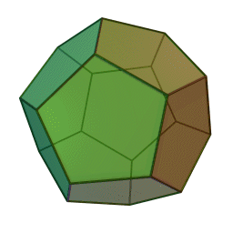
Quantification of Information content
Information is provided in the form of constraint sets.
These constraint sets form a polytope, of Volume V₁
The volume measures the total number of scenarios being considered.
No of bits = log₂ (V_{REF}/V₁)
Quantitative comparison of different
Scenario sets
  Quantitative Estimate of Uncertainty.
  Generation of equivalent information.
  Both input and output information.
Img source: http://en.wikipedia.org/wiki/File:Dodecahedron.gif

Slide 10
Uncertainty and amount of information
dem1
dem2

Slide 11
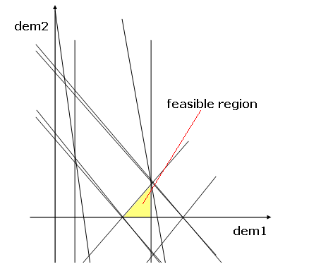
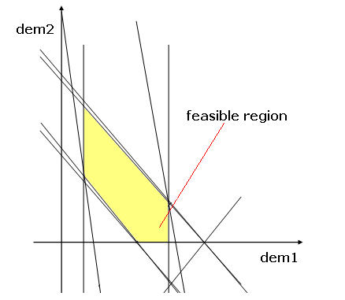
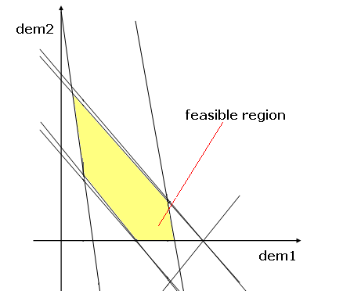
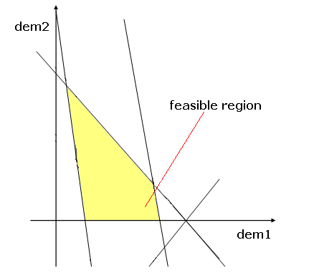
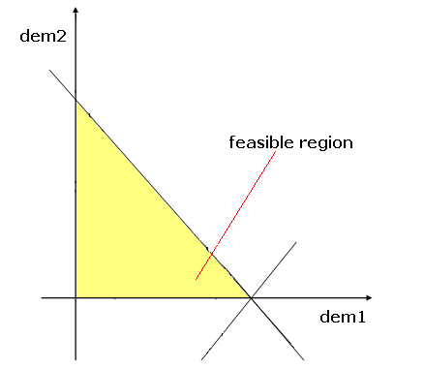
Uncertainty and amount of information

Slide 12
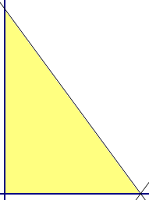
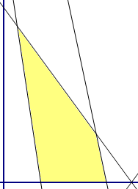
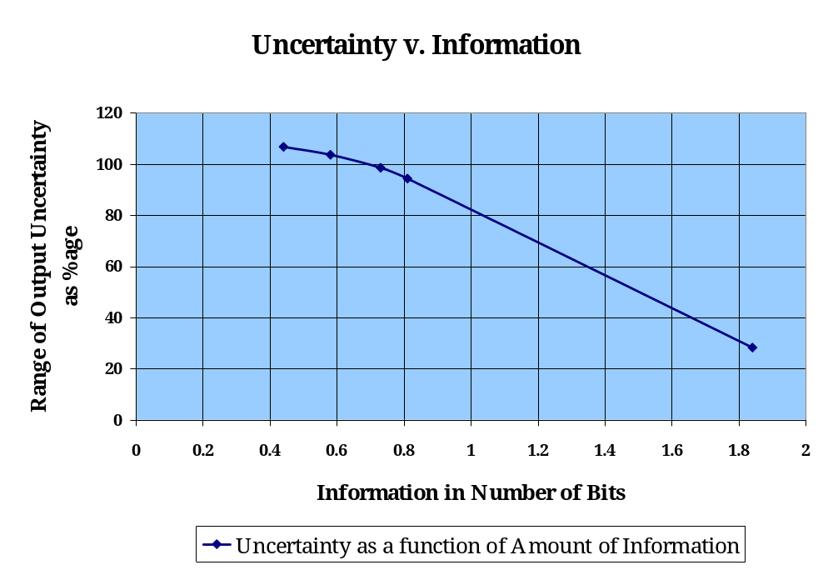
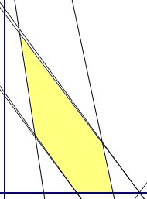
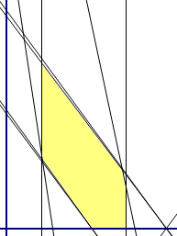
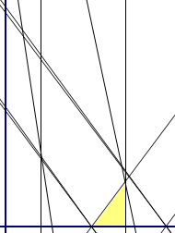
Uncertainty and amount of information

Slide 13
Relational algebra of polytopes
Relationships between different scenario sets using the relational algebra of polytopes
  One set is a sub-set of the other
  Two constraint sets intersect
  The two constraint sets are disjoint
A general query based on the set-theoretic relations above can also be given, e.g. -
  “A Subset (B Intersection C)?”: checks if the intersection of B and C encloses A.
Subset
Intersection
Disjoint

Slide 14
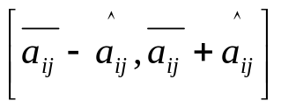
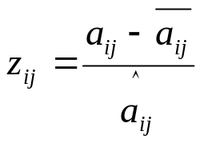
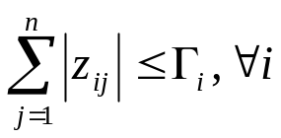
Related work
Bertsimas, Sim, Thiele - “Budget of uncertainty” (amongst Nemirovksi/Ben Tal/Shapiro/El Ghaoui/Lebret)
  Uncertainty:
  Normalized deviation for a parameter:
  Sum of all normalized deviations limited:
  N uncertain parameters ➔ polytope with 2^{N} sides
  In contrast, our polyhedral uncertainty sets:
    More general
    Much fewer sides

Slide 15
Optimization under our model

Slide 16
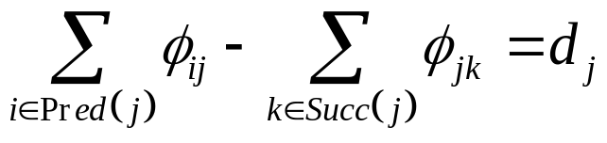
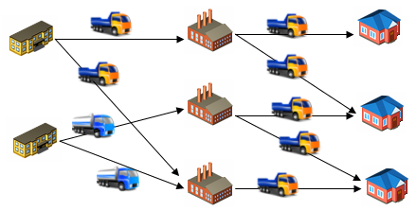
MCF model
Classical multi-commodity flow model a natural formulation

Slide 17
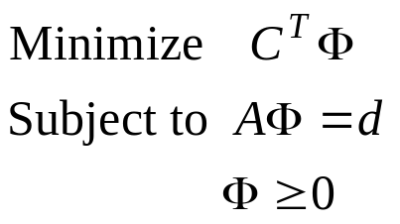
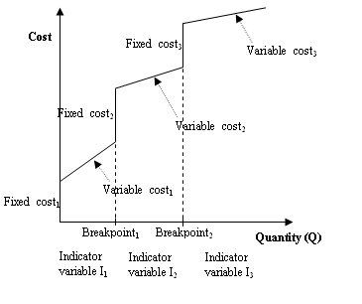
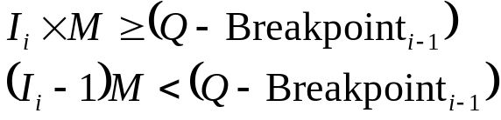


Deterministic problem
Fixed demands and fixed locations with linear costs
Fixed demands and fixed locations with breakpoints and multiple fixed and variable costs

Slide 18
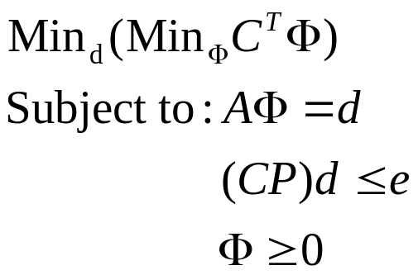
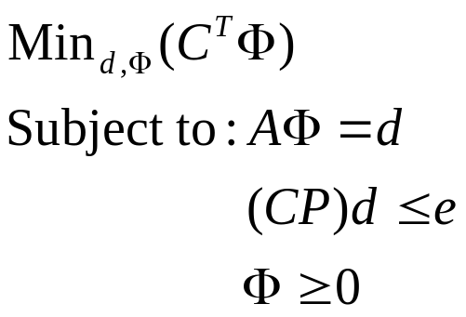
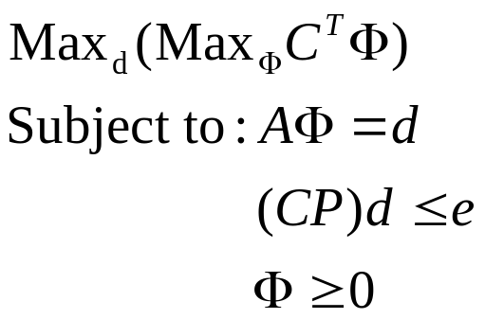
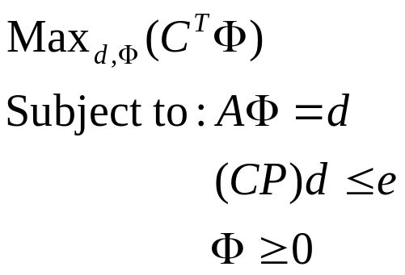
Uncertain Problem: Finding absolute bounds
Absolute bounds on performance quickly found
  Best performance in best case of the uncertain parameters
  Worst performance in worst case of the uncertain parameters

Slide 19
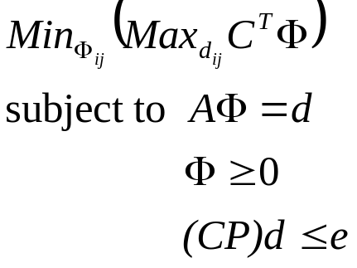
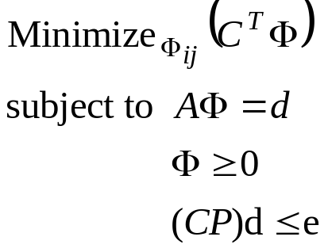
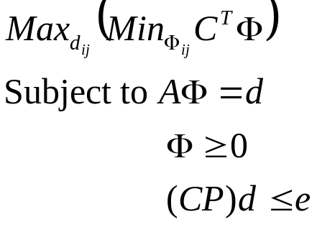
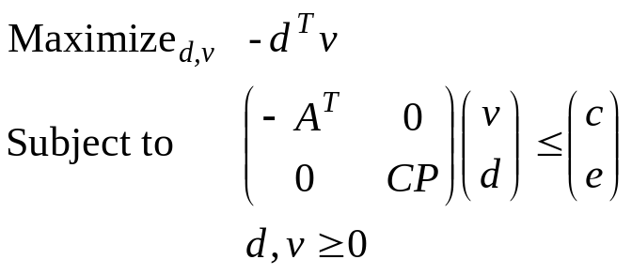
Uncertain Problem: Finding optimal solution
Variable polyhedral demand and fixed locations with linear costs
  The routing that minimizes the worst case cost
  The demand whose optimal routing costs the most
Linear Programs
dual

Slide 20
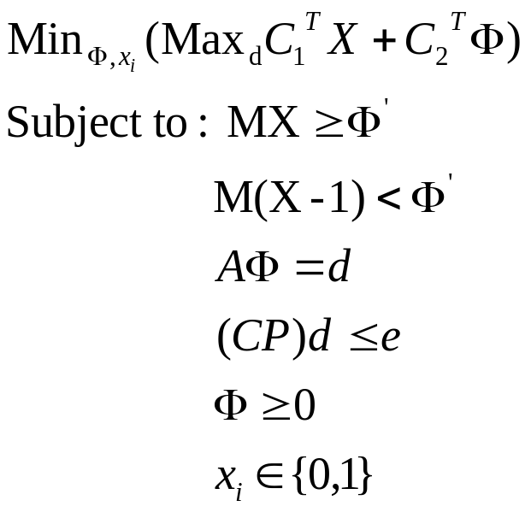
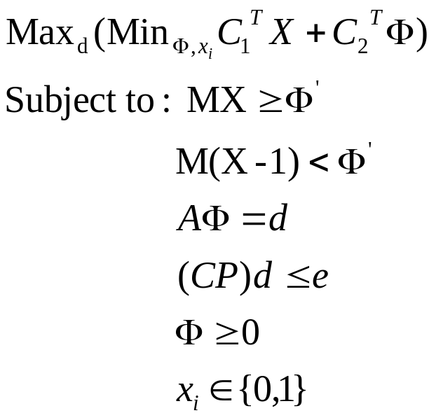
Uncertain Problem: Finding optimal solution
Variable polyhedral demand and variable locations with linear costs
The routing that minimizes the worst case cost
The demand whose optimal routing costs the most
Duality?

Slide 21
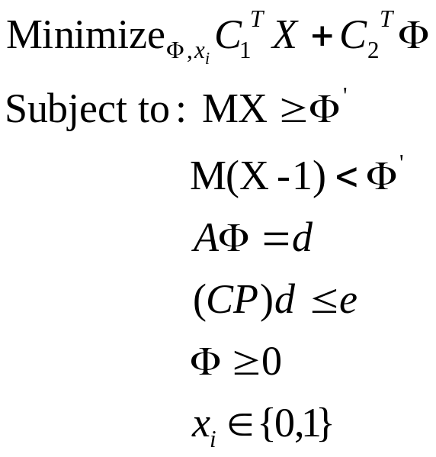
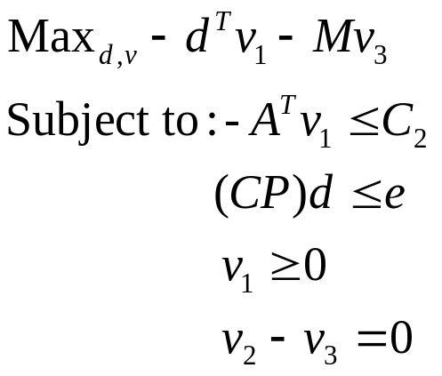
Uncertain Problem: Finding optimal solution
Variable polyhedral demand and variable locations with linear costs
The routing that minimizes the worst case cost
The demand whose optimal routing costs the most
Integer Programs – NP hard

Slide 22
Uncertain Problem: Finding optimal solution
Variable polyhedral demand and variable locations with breakpoints and multiple fixed and variable costs
  Fixed costs and breakpoints: non-convexities that preclude strong-duality from being achieved
  Finding absolute bounds is relatively easy using state-of-art solvers
  Min-max bound tightening heuristics have to be used in general

Slide 23
Illustrative Example

Slide 24
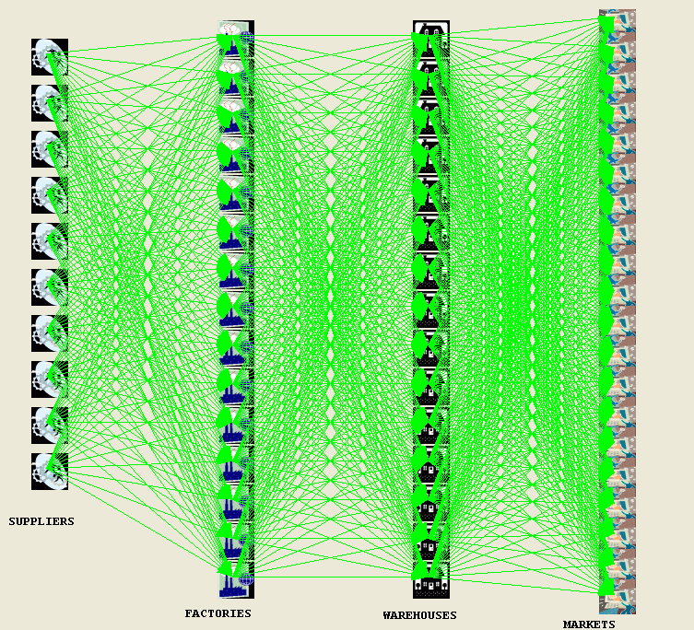
Example: 60 node supply chain
Locations – variable
Cost – non-linear (fixed + variable)

Slide 25
Alternative Assumption (constraint) sets
Constraint Set 4
Constraint Set 2
Constraint Set 1
Constraint Set 3

Slide 26
Information content in Constraint sets
Normalized information content
Constraint Set 1 | Constraint Set 2 | Constraint Set 3 | Constraint Set 4
12.56 bits | 8.37 bits | 11.18 bits | 5.85 bits

Slide 27
Absolute Cost bounds
Constraint Set | Min Cost | Max Cost | Range of Cost Uncertainty | Information Content
Set 1 | 3900 (52.55s) | 83793.67 (18.20s) | 79893.67 | 12.56 bits
Set 2 | 3500 (2.81s) | 103000 (0.08s) | 99500 | 8.37 bits
Set 3 | 3900 (1.73s) | 84467.24 (3.75s) | 80567.24 | 11.18 bits
Set 4 | 7400 (50.27s) | 107400 (0.08s) | 100000 | 5.85 bits
Constraint set 1 is a subset of Constraint set 2.
Constraint set 4 is totally disjoint from Constraint set 1, Constraint set 2 and Constraint set 3.
Constraint set 3 intersects with Constraint set 1 and Constraint set 2.

Slide 28
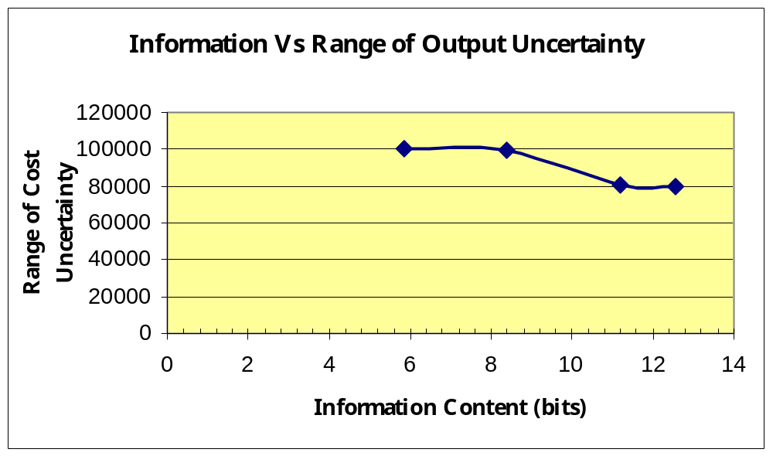
Information Vs Uncertainty tradeoff
Constraint set 2
Constraint set 1
Constraint set 4
Constraint set 3

Slide 29
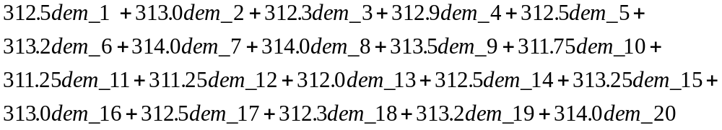
What-if Analysis for Constraint set 2 and its derivatives based on Information content
Total revenue from the sales:
Bounds on revenue computed for increasing degrees of uncertainty

Slide 30
What-if Analysis for Constraint set 2 and its derivatives based on Information content
Number of equations | Number of successes | Number of Bits | Relative volume | Minimum Revenue | Maximum Revenue | Range of Revenue
20 | 1092 | 8.37 | 0 | 31195.42 | 117983.77 | 86788.35
18 | 1099 | 8.36 | 0 | 30054.35 | 117983.77 | 87929.42
16 | 1308 | 6.25 | 1 | 30054.35 | 140832.45 | 110778.1
14 | 1387 | 6.03 | 2 | 16291.3 | 140832.45 | 124541.15
12 | 1417 | 5.75 | 2 | 16291.3 | 140874.62 | 124583.32
10 | 1502 | 4.35 | 5 | 14030.1 | 141284.22 | 127254.12
8 | 1821 | 3.58 | 8 | 14030.1 | 141285.39 | 127255.29
6 | 5846 | 1.62 | 33 | 14030.1 | 141285.39 | 127255.29
4 | 0 | 0 | 100 | 11362.74 | unbounded | unbounded
2 | 0 | 0 | 100 | 10945.68 | unbounded | unbounded

Slide 31
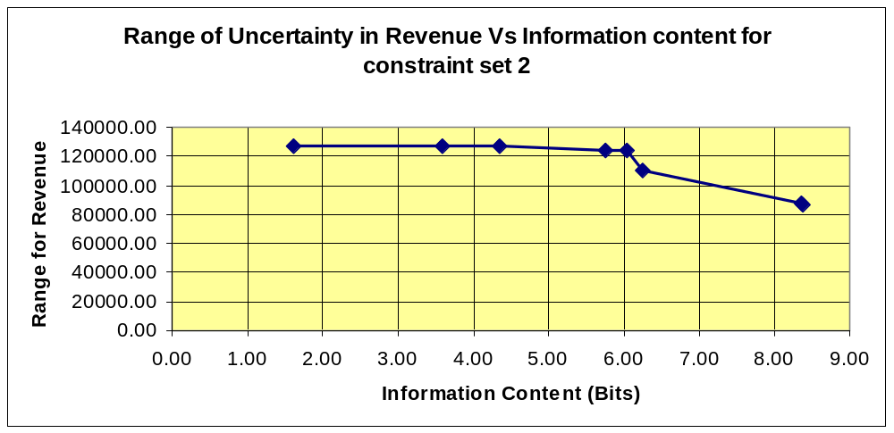
What-if Analysis for Constraint set 2 and its derivatives: Information Vs Uncertainty tradeoff

Slide 32
Experimental results for varied supply chains
Nodes | Products | Breakpoints | Variables | Time taken (seconds)
8 | 2 | 1 | 120 | 0.6
40 | 2 | 1 | 1640 | 1.27
170 | 2 | 1 | 28470 | 3179.41
205 | 2 | 1 | 46680 | 885.74
8 | 2000 | 0 | 119746 | 0.77
20 | 2000 | 0 | 260015 | 18.66
170 | 20 | 1 | 284070 | 26957.20 (aborted at integrality gap 2%)
40 | 2000 | 0 | 970030 | 600.77
Integrality gap of
10% in 600 s

Slide 33
Conclusions
Convenient and intuitive specification to handle uncertainty in supply chains.
Specification meaningful in economic terms and avoids ad-hoc assumptions about demand variations.
Correlations between different products incorporated, while retaining computational tractability.
Realistic costs with breakpoints lead to ILPs that are NP-hard. However, a large number of medium scale problems with tens of thousands of variables are solvable in minutes on typical laptops.

Slide 34
Thank you
Contact:
Abhilasha Aswal: abhilasha_aswal@infosys.com
G. N. Srinivasa Prasanna: gnsprasanna@iiitb.ac.in

