Slide 1
N-Dimensional Volume Estimation of Convex Bodies: Algorithms and Applications
Mamta Sharma
G. N. Srinivasa Prasanna
Abhilasha Aswal
IIIT-Bangalore
India

Slide 2
MAJOR ISSUE IN SUPPLY CHAINS: UNCERTAINTY
A supply chain necessarily involves decisions about future operations (about demand, supply, prices etc.)
Forecasting demand for a large number of commodities is difficult, especially for new products.

Slide 3
A NEW ROBUST APPROACH TO HANDLING UNCERTAINTY IN SUPPLY CHAINS
Uncertain parameters bounded by polyhedral uncertainty sets.
Uncertainty sets as convex polyhedron.
  Linear constraints that model microeconomic behavior
  Capture relation between uncertain parameters
A hierarchy of scenarios sets
    A set of linear constraints specify a scenario.
    Scenario sets can each have an infinity of scenarios
    Intuitive Scenario Hierarchy
    Based on Aggregate Bounds
    Underlying Economic Behavior

Slide 4
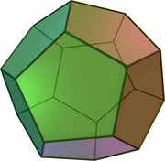
OUR MODEL: UNCERTAINTY IS IDENTIFIED WITH INFORMATION➔ INFORMATION THEORY AND OPTIMIZATION
Information is provided in the form of constraint sets and represents total possibilities in the future
These constraint sets form a polytope, of Volume V₁
No of bits = log V_{REF}/V₁
Quantitative comparison of
different Scenario sets
    Quantitative Estimate of Uncertainty
    Generation of equivalent information.
    Helps in what-if analysis

Slide 5
OUR MODEL: INFORMATION THEORY AND OPTIMIZATION (CONTD..)
Quantification of change in underlying assumptions ⬄ Quantification of change in polyhedral volume as the constraints are changed.
V₁
V₂
_{Vmax}
_{Vmax}

Slide 6
A SMALL SUPPLY CHAIN EXAMPLE
2 suppliers: S0 and S1
2 factories: F0 and F1
2 warehouses: W0 and W1
2 markets: M0 and M1
1 finished product: p0
Demand at market M0: dem_M0_p0
Demand at market M1: dem_M1_p0
r0
p0
p0
S0
F0
W0
M0
dem_M0_p0
S1
F1
W1
M1
dem_M1_p0

Slide 7
INFORMATION EASILY PROVIDED BY ECONOMICALLY MEANINGFUL CONSTRAINTS
Economic behavior is easily captured in terms of types of complements , substitutes , revenues.
  Substitutive goods
  Min1 <= d1 + d2 <= Max1
      d1, d2 are demands for 2 substitutive goods.
  Complementary/competitive goods
  Min2 <= d1 - d2 <= Max2
      d1 and d2 are demands for 2 complementary goods.
  Profit/Revenue Constraints
  Min3 <= a d1 + b d2 <= Max3
      Price of a product times its demand ➔ revenue. This constraint puts limits on the total revenue.
  Bounds
  Min2<=d1<=Max2
        Demand d1 is unknown but it lies in a range.

Slide 8
PREDICTION OF DEMAND CONSTRAINTS
171.43 dem_M0_p0 + 128.57 dem_M1_p0 <= 79285.71
171.43 dem_M0_p0 + 128.57 dem_M1_p0 >= 42857.14
57.14 dem_M0_p0 + 42.86 dem_M1_p0 <= 26428.57
57.14 dem_M0_p0 + 42.86 dem_M1_p0 >= 14285.71
175.0 dem_M0_p0 + 25.0 dem_M1_p0 <= 65000.0
175.0 dem_M0_p0 + 25.0 dem_M1_p0 >= 22500.0
0.51 dem_M0_p0 - 0.39 dem_M1_p0 <= 237.86
0.51 dem_M0_p0 - 0.39 dem_M1_p0 >= 128.57
300.0 dem_M0_p0 <= 105000.0
300.0 dem_M0_p0 >= 30000.0
Revenue
constraints
Complementary
constraints
Bounds

Slide 9
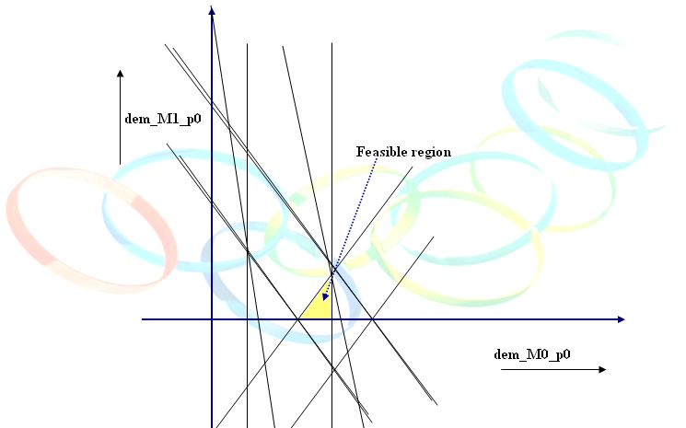
DECISION SUPPORT: ALL ASSUMPTIONS ABOUT FUTURE ARE VALID ➔10 DEMAND CONSTRAINTS
Revenue
constraints
valid in a
competitive
market

Slide 10
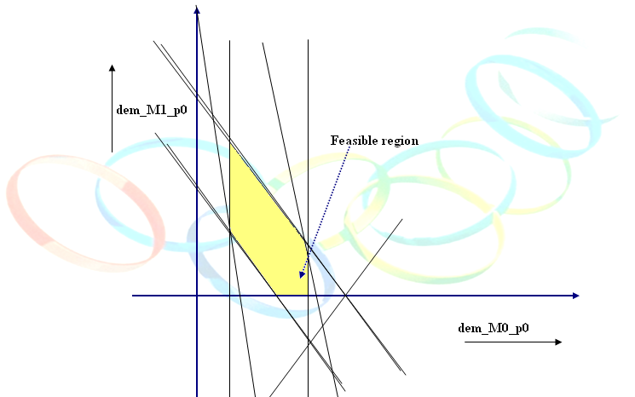
9 DEMAND CONSTRAINTS
One
complementary
constraint
removed

Slide 11
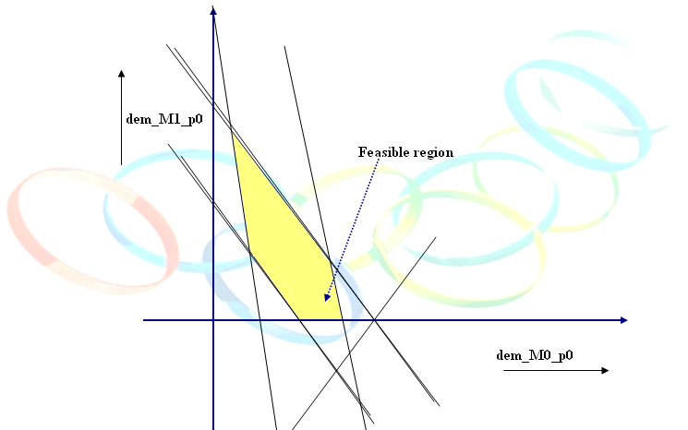
7 DEMAND CONSTRAINTS
Bounds on
dem_M0_p0
removed.
Only revenue
constraints
valid

Slide 12
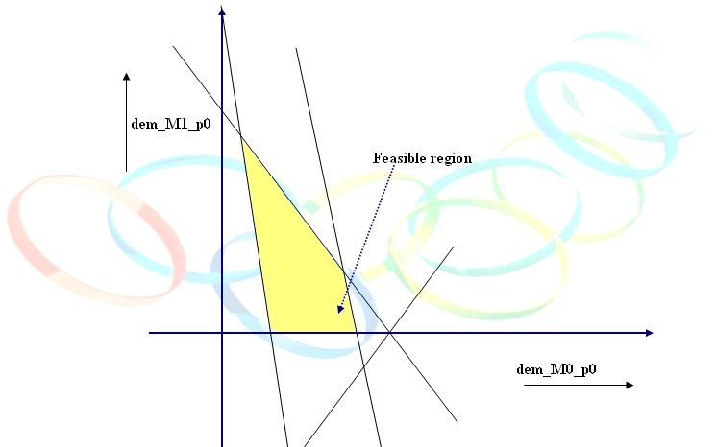
FUZZY FUTURE ➔ 4 DEMAND CONSTRAINTS
Fewer
revenue
constraints
valid

Slide 13
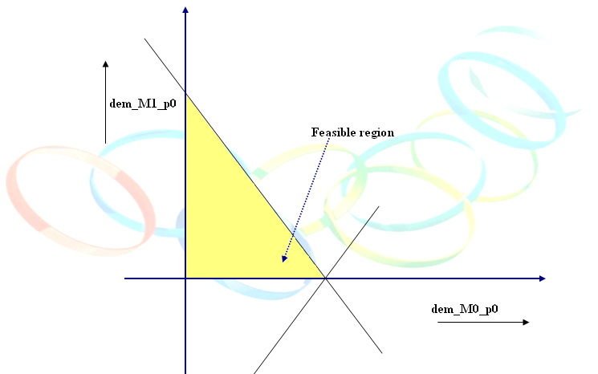
FUZZIEST FUTURE ➔ 2 DEMAND CONSTRAINTS
Only one
revenue
constraint
valid

Slide 14
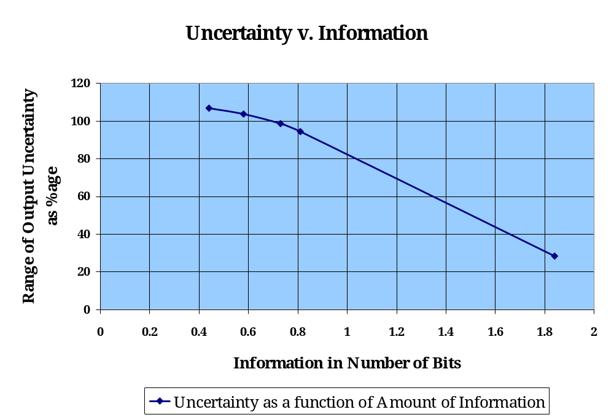
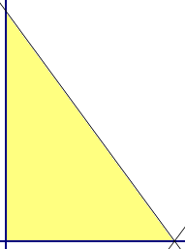
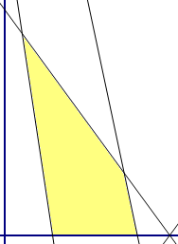
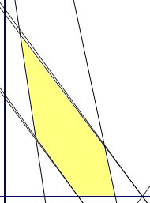
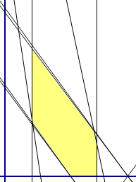
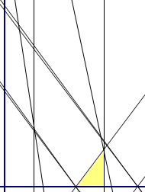
UNCERTAINTY AND AMOUNT OF INFORMATION

Slide 15
RESULTS FOR ALL SCENARIOS
Number of constraints that are valid | Condition number | Approximate Volume | Actual volume | % error | Information in number of bits | Minimization |  |  | Maximization
 |  |  |  |  |  | Minimum cost | dem_M0_p0 | dem_M1_p0 | Maximum cost | dem_M0_p0 | dem_M1_p0
10 constraints | 3.4928 | 10706.39 | 12900 | 17.00% | 1.84 | 100% | 326.5 | 102 | 128.38% | 350 | 133.33
9 constraints | 3.4929 | 63713.38 | 70800 | 10% | 0.81 | 60.06% | 173.49 | 102 | 154.50% | 99.99 | 483.33
7 constraints | 4.0373 | 73522.29 | 83300 | 11.73% | 0.73 | 60.06% | 173.49 | 102 | 158.72% | 49.99 | 550
4 constraints | 7.7426 | 115712.18 | 143000 | 19.08% | 0.58 | 54.99% | 107.66 | 146.33 | 158.72% | 49.99 | 550
2 constraints | 115.5282 | inf | inf | - | - | - | - | - | - | - | -

Slide 16
VOLUME ESTIMATION

Slide 17
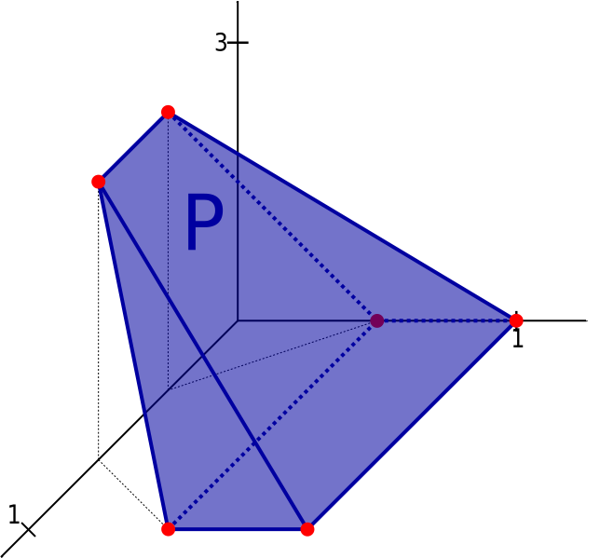


N-DIMENSIONAL VOLUME ESTIMATION OF CONVEX BODIES
A convex Polytope is a convex hull of finite set of points in
or bounded subset of which is the intersection of finite set of half spaces.
Let P= {x ε Rⁿ: Ax <= b} be a polyhedron bounded by n linear inequalities
P is convex.
V and H representations
Exact and approximate methods are known
3-dim Convex polytope

Slide 18
EXACT VOLUME COMPUTATION
Triangulation Methods
Signed Decomposition Methods

Slide 19
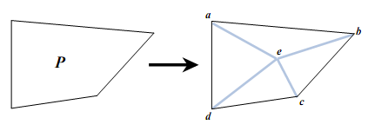
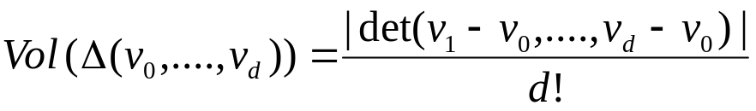
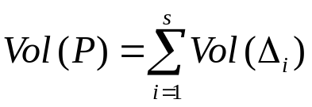
TRIANGULATION METHODS
Decompose the polytope into simplices and the volume of the polytope is simply the sum of the simplices.
volume if a simplex=
Volume of the polytope =

Slide 20
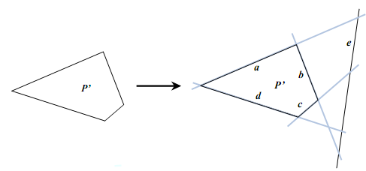
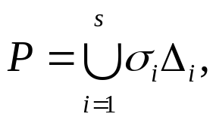
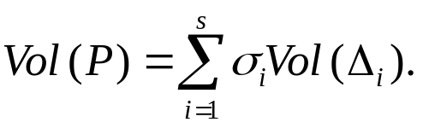
SIGNED DECOMPOSITION METHODS
Decompose the given polytope into signed simplices such that the signed sum of their volume is the volume of polytope.
P=signed union of simplices

Slide 21
PROBLEMS IN EXACT METHODS
Requires combination of V and H representations
    V←→H conversion is costly
Works differently for simple and simplical polytopes.
Difficult to construct triangulations and calculate coordinate of all vertices as dimensions increases.
No of simplices are exponential in n dimensions

Slide 22
APPROXIMATE VOLUME COMPUTATION METHODS
Deterministic algorithms:
  Brute force - Fine Grid method:
  Enclose the body k in a box, put a fine grid on k
  Count the grid points in k
  Number of points can be exponentially high w.r.t dimension
  Thus deterministic methods are computationally expensive.

Slide 23
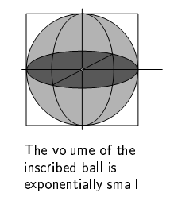
RANDOMIZED ALGORITHM – DIRECT MONTE CARLO
Enclose k in a retangular box Q whose volume is known
Generate uniformly distributed points x1,x2,…….xn ε Q
Count how often xi ε k =S
Vol(k)= S/N vol(Q)
As the dimension increases, the ratio of inscribed body becomes exponentially small
We need to generate more points to hit the body

Slide 24
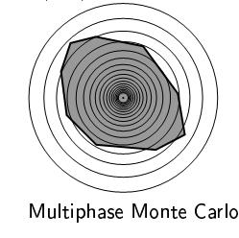

RANDOMIZED ALGORITHM – MULTI-PHASE MONTE CARLO
Construct a sequence of convex bodies
where k0 is the body whose volume is easily constructed
Estimate vol(ki-1)/vol(ki) by generating uniformly distributed random points in ki and count what fraction fall in ki-1.

Slide 25
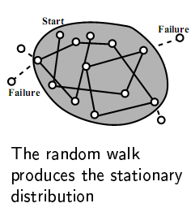
GENERATION OF UNIFORMLY DISTRIBUTED RANDOM POINTS : RANDOM WALK
Walking on truncated grid (lattice walk)
Ball-walk
Hit and run

Slide 26
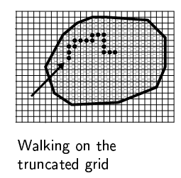
LATTICE WALK
Define a fine grid of d steps
Move to any one of the 2n directions

Slide 27
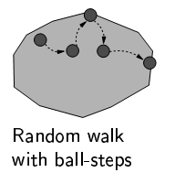
BALL WALK
A fine grid is not defined, we can move in any direction v.

Slide 28
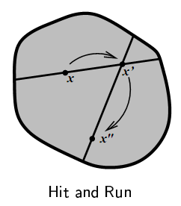
HIT AND RUN
Generate a uniform random vector v
Determine intersection segment of line x+tv and k
Move to a randomly located point on this segment
Repeat the process

Slide 29
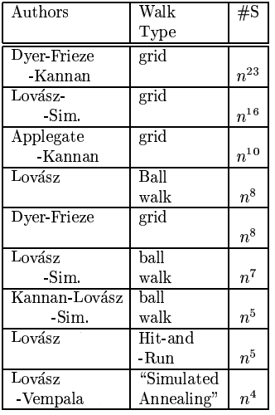
HISTORICAL DEVELOPMENTS

Slide 30
UNIFORM SAMPLING
  Construct a hypercuboid around the convex body
  Choose number of samples p
  Volume=q/p*volume of hypercube
  p=sample size
  q=number of points falling within the polyhedron

Slide 31
FAST SAMPLING
Faster version of uniform sampling
Step1: if nth sample ε k,
check if (n+k)th sample ε k
if yes, mark all points between n+1 and n+k as success
if no, check all the samples from n+1 until failure is encountered.
Step2: If nth sample does not ε k, jump by k to check if n+k ε k
if yes, repeat step1
if no, mark all n+1 to n+k as failure and repeat step2
v

Slide 32
IMPORTANCE SAMPLING
Non-uniform sampling
Calculate the centre of polyhedron
Draw a hypersphere around the polyhedron with the centre calculated
Generate points by spiraling around the centre
Points farther away from the centre are weighted up to give more importance than the points near the centre

Slide 33
EXPERIMENTAL RESULTS
Dimension | Constraints |  |  | Figure | Condition number | Actual Volume | uniform sampling | Fast Sampling | Importance sampling
2 | d1>=0 d2>=0 |  | d1<=100 d2<=100 | Square | 1 | 1000 | 1000 | 9873.393 | 8795.786
2 | d2-d1<=70.72 d1+d2>=70.72 d2-0.99d1>=-69.26 d2+0.99d1<=210.7 |  |  | Square rotated by 45 deg and translated | 1.3952 | 9946.7 | 10093.367 | 10503.738 | 9855.433
3 | d1>=0 d2>=0 d3>=0 |  | d1<=10 d2<=10 d3<=10 | Cube | 1 | 1000 | 999.901 | 9945.253 | 8439.240
3 | d1+d2>=200 d2-d1>=0 d3>=100 d1+d2<=214.14 d2-d1<=14.14 d3<=110 |  |  | Cube rotated 45 deg around z axis and translated | 1.414 | 999.698 | 1005.285 | 9803.674 | 9001.893
4 | d1>=0 d2>=0 d3>=0 d4>=0 | d1<=10 d2<=10 d3<=10 d4<=10 |  | 4-d square | 1 | 10000 | 9999.990 | 10220.309 | 9981.168
5 | d1>=0 d2>=0 d3>=0 d4>=0 d5>=0 | d1<=10 d2<=10 d3<=10 d4<=10 d5<=10 |  | 5-d square | 1 | 100000 | 99999.832

Slide 34
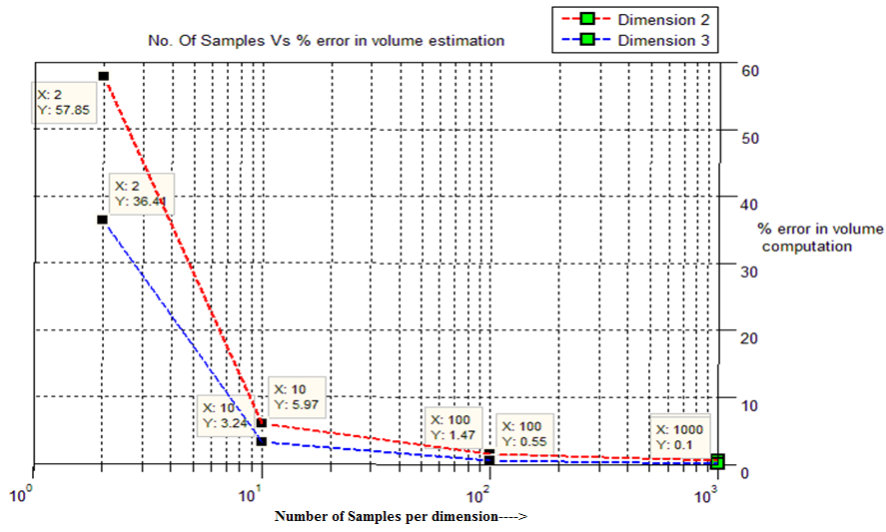
NO. OF SAMPLES PER DIMENSION VS % ERROR IN VOLUME ESTIMATION

Slide 35
SUMMARY OF WORK IN VOLUME ESTIMATION MODULE
  Study of practical volume computation methods.
  Experimental study for dimensions up to 5
    Uniform sampling,
    Importance sampling and
    Fast sampling methods
  Comparison of results obtained from actual and approximate volume computation.
    Validation of results for upto 5 dimensions.

Slide 36
PROJECT STATUS
Implementation and experimental study.
Complete package to exercise decision support system in this paradigm.
  Flexible problem specification
  Meaningful constraint prediction
  Quantification of uncertainty
  Practical volume computation methods
  Application to major industrial segment

Slide 37
FUTURE WORK
  Evaluation of numerical accuracy for Polytopes with different condition numbers.
  Optimization of sampling methods for higher dimensions.
  Tight integration into overall project
  SOA Architecture
  Extend the quantification of information to medium/large industrial scale problems.

Slide 38
REFERENCES
G. N. Srinivasa Prasanna, Traffic Constraints instead of Traffic Matrices: A New Approach to Traffic Characterization, Proceedings ITC, 2003.
Dimitris Bertsimas, Aurelie Thiele, Robust and Data-Driven Optimization: Modern Decision-Making Under Uncertainty, Optimization Online, Entry accepted May 2006.
Lovász, L. and Vempala, S. 2003. Simulated Annealing in Convex Bodies and an 0*(n4) Volume Algorithm. In Proceedings of the 44th Annual IEEE Symposium on Foundations of Computer Science (October 11 - 14, 2003). FOCS. IEEE Computer Society.
Dyer, M., Frieze, A., and Kannan, R. 1991. A random polynomial-time algorithm for approximating the volume of convex bodies. J. ACM 38, 1 (Jan. 1991),
Lasserre, J. B. and Zeron, E. S. 2001. A Laplace transform algorithm for the volume of a convex polytope. J. ACM 48, 6 (Nov. 2001), 1126-1140.
Exact Volume Computation for Polytopes: A Practical Study : Benno Bueler, Andreas Enge ,Komei Fukuda, 1998
Volume Computation Using a Direct Monte Carlo Method , Sheng Liu^{1, 2} , Jian Zhang¹ and Binhai Zh u^{3,} 2007 .
Finding the exact volume of a polyhedron , H.L Ong,H.C Huang,W.M Huin, Feb 2003
A new Algorithm for volume of a convex Polytope,Jean.B.Lasserre, Eduardo S. Zeron,June 2001

Slide 39
THANK YOU

