Slide 1
Inventory Optimization under Correlated Uncertainty
Abhilasha Aswal
G N S Prasanna,
International Institute of Information Technology – Bangalore

Slide 2
Outline
Motivation
Optimizing with correlated demands
Generalized EOQ
Related work
Some Extensions:
  Generalized base stock
  Geman Tank
  Relational Algebra
Conclusions

Slide 3
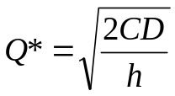
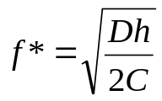
The EOQ model
The EOQ model (Classical – Harris 1913)
    C: fixed ordering cost per order
    h: per unit holding cost
    D: demand rate
    Q*: optimal order quantity
    f*: optimal order frequency
Q*

Slide 4
Inventory optimization for multiple products
EOQ(K)?

Slide 5










Motivation
Inventory optimization example
Car type I
Car type II
Car type III
Automobile
store
Tyre type I
Supplies
Tyre type II
Petrol
Drivers

Slide 6
Motivation
Ordering and holding costs
Product | Ordering Cost in Rs. (per order) | Holding Cost in Rs. (per unit)
Car Type I | 1000 | 50
Car Type II | 1000 | 80
Car Type III | 1000 | 10
Tyre Type I | 250 | 0.5
Tyre Type II | 500 (intl shipment) | 0.5
Petrol | 600 | 1
Drivers | 750 | 300

Slide 7
1 product versus 7 products
Exactly Known Demands, no uncertainty
  EOQ solution and Constrained Optimization solution match exactly:
  But…
Product | Demand per month | EOQ Solution |  |  | Constrained Optimization Solution
 |  | Order Frequency | Order Quantity | Cost | Order Frequency | Order Quantity | Cost
Car Type I | 40 | 1 | 40 | 2000 | 1 | 40 | 2000
Car Type II | 25 | 1 | 25 | 2000 | 1 | 25 | 2000
Car Type III | 50 | 0.5 | 100 | 1000 | 0.5 | 100 | 1000
Tyre Type I | 250 | 0.5 | 500 | 250 | 0.5 | 500 | 250
Tyre Type II | 125 | 0.25 | 500 | 250 | 0.25 | 500 | 250
Petrol | 300 | 0.5 | 600 | 600 | 0.5 | 600 | 600
Drivers | 5 | 1 | 5 | 1500 | 1 | 5 | 1500
Total |  |  |  | 7600 |  |  | 7600
UNREALISTIC!!!
We cannot know the future demands exactly.

Slide 8
1 product versus 7 products
Bounded Uncorrelated Uncertainty
  Assuming the range of variation of the demands is known, we can get bounds on the performance by optimizing for both the min value and the max value of the demands.
  EOQ solution and Constrained Optimization solution are almost the same.
Product | EOQ solution |  |  |  | Constrained Optimization
 | Order Frequency |  | Order Quantity |  | Order Frequency |  | Order Quantity
 | Min | Max | Min | Max | Min | Max | Min | Max
Car Type I | 0.5 | 1 | 20 | 40 | 0.5 | 1 | 20 | 40
Car Type II | 0 | 1 | 0 | 25 | 0 | 1 | 0 | 25
Car Type III | 0.5 | 1 | 100 | 200 | 0.5 | 1 | 100 | 200
Tyre Type I | 0.25 | 0.5 | 248.99 | 500 | 0.25 | 0.5 | 248 | 500
Tyre Type II | 0.25 | 0.5 | 500 | 1000 | 0.25 | 0.5 | 500 | 1000
Petrol | 0.25 | 0.5 | 300 | 600 | 0.25 | 0.5 | 300 | 600
Drivers | 0.45 | 1 | 2.24 | 5 | 0.5 | 1 | 2 | 5

Slide 9
1 product versus 7 products
Beyond EOQ: Correlated Uncertainty in Demand
  Considering the substitutive effects between a class of products (cars, tyres etc.)
  200 ≤ dem_tyre_1 + dem_tyre_2 ≤ 700
  65 ≤ dem_car_1 + dem_car_2 + dem_car_3 ≤ 250
  Considering the complementary effects between products that track each other
5 ≤ (dem_car_1 + dem_car_2 + dem_car_3) – dem_petrol ≤ 20
  5 ≤ dem_car_2 – dem_drivers ≤ 20
EOQ cannot incorporate such forms of uncertainty.

Slide 10
1 product versus 7 products
Beyond EOQ: Correlated Uncertainty in Demand
  Min-Max solution for different scenarios:
Products | With Substitutive Constraints |  | With Complementary Constraints |  | With both Substitutive and Complementary constraints
 | Order Frequency | Order Quantity | Order Frequency | Order Quantity | Order Frequency | Order Quantity
Car Type I | 0.75 | 25 | 0.5 | 38 | 0.5 | 40
Car Type II | 0.5 | 13 | 0.5 | 22 | 1 | 10
Car Type III | 0.75 | 125 | 0.75 | 121 | 0.5 | 180
Tyre Type I | 0.25 | 362 | 0.75 | 250 | 0.75 | 200
Tyre Type II | 0.75 | 500 | 0.75 | 373 | 0.5 | 400
Petrol | 0.5 | 400 | 0.5 | 208 | 0.5 | 222.5
Drivers | 0.5 | 5 | 0.5 | 2 | 0.5 | 3
Cost (Rs.) | 4590.438 |  | 4593.688 |  | 4654.188
EOQ
Order Frequency | Order Quantity
1 | 40
1 | 25
0.5 | 100
0.5 | 500
0.25 | 500
0.5 | 600
1 | 5
7600

Slide 11
1 product versus 7 products
Beyond EOQ: Correlated Uncertainty in Demand
  Comparison of different uncertainty sets
Scenario sets | Absolute Minimum Cost | Absolute Maximum Cost
Bounds only | 3349.5 | 9187.5
Bounds and Substitutive constraints | 3412.5 | 9100
Bounds and Complementary constraints | 4469.5 | 8972.5
Bounds, Substitutive and Complementary constraints | 4482.5 | 8910

Slide 12
Optimizing with Correlated Demands
Mathematical Programming Formalism

Slide 13
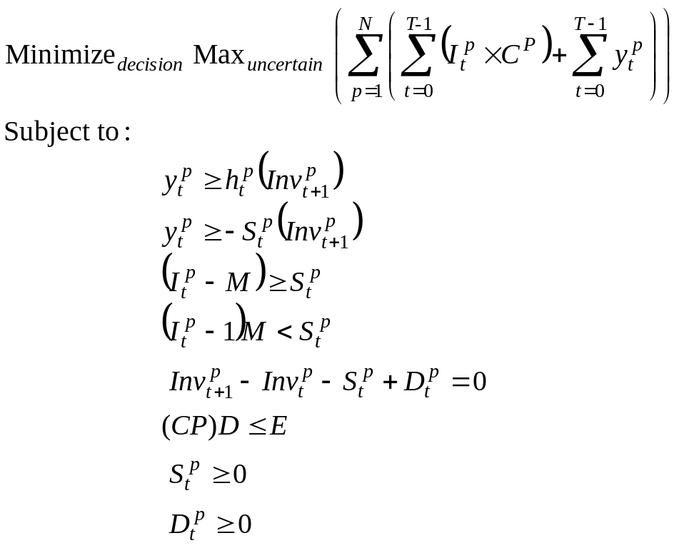
Optimal Inventory policy using “ILP”
Min-max optimization, not an LP.
Duality??
  Fixed costs and breakpoints: non-convexities that preclude strong-duality from being achieved.
  No breakpoints or fixed costs: min-max optimization ➔ QP
Heuristics have to be used in general.

Slide 14
Optimal Inventory policy by Sampling
A simple statistical sampling heuristic
Begin
for i = 1 to maxIteration
{
parameterSample = getParameterSample(constraint Set)
bestPolicy = getBestPolicy(parameterSample)
findCostBounds(bestPolicy)
}
chooseBestSolution()
End

Slide 15
Optimizing with Correlated Demands:
Analytical Formulation: Generalized EOQ(K)

Slide 16
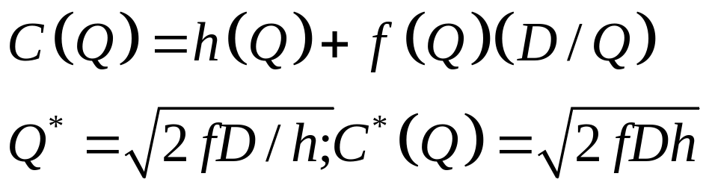
Classical EOQ model
Per order fixed cost = f(Q)
holding cost per unit time = h(Q)

Slide 17
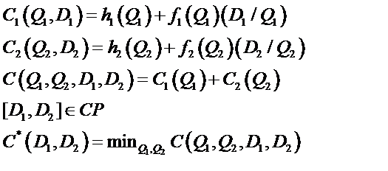
EOQ(K) with multiple products, uncertain demands
Additive SKU costs
Case with 2 commodities, generalized to n commodities

Slide 18
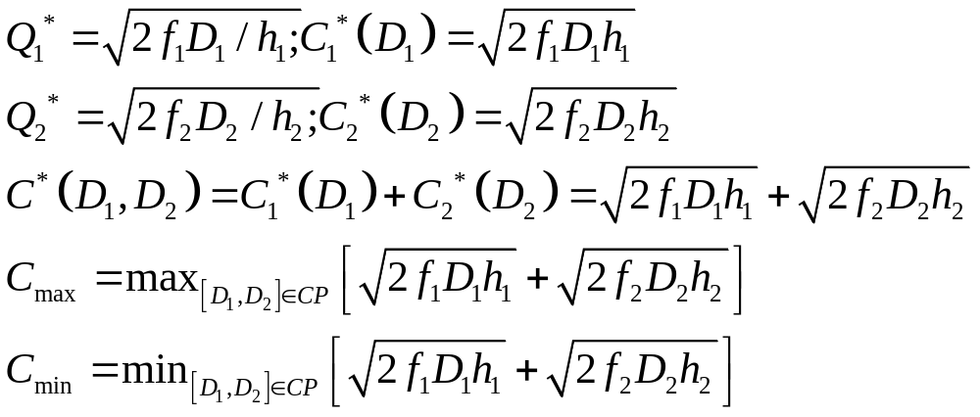
EOQ(K) with multiple products, uncertain demands
Holding cost linear, ordering cost fixed

Slide 19
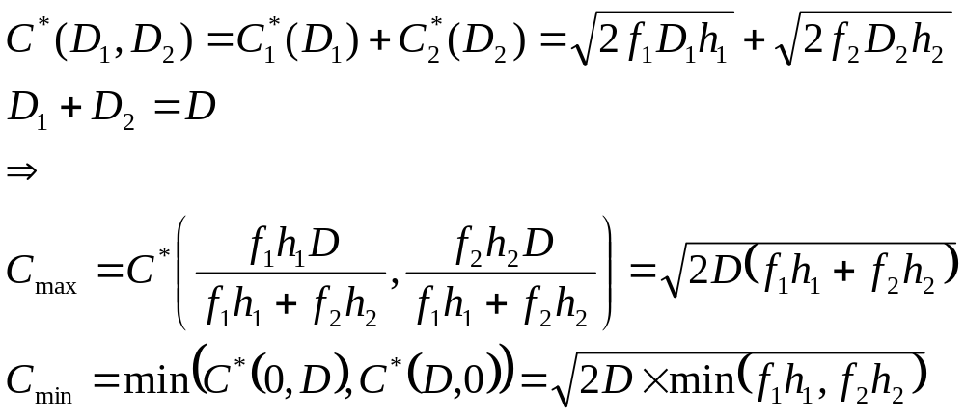
Analytical solution: Substitutive constraints
Holding cost linear, ordering cost fixed
Under a substitutive constraint D₁ + D₂ <= D

Slide 20
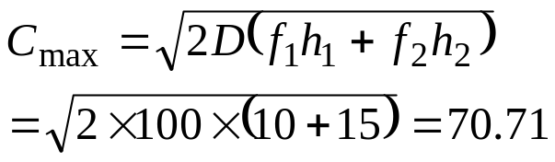
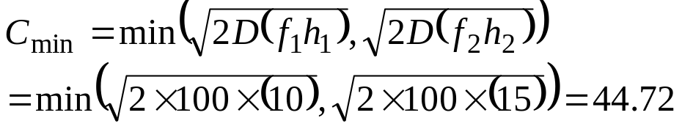
Analytical solution: Substitutive constraints - Example
2 products, demands D₁ & D₂
  Costs:
      h₁ = 2/unit
      h₂ = 3/unit
      f₁ = 5/order
      f₂ = 5/order
  D₁ + D₂ = D = 100
Maximum cost
Minimum cost

Slide 21
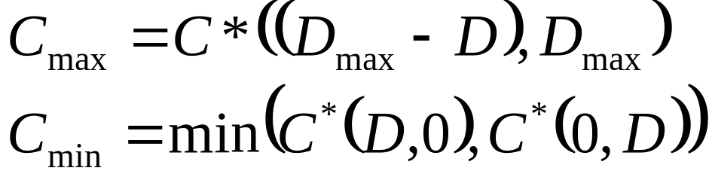
Analytical solution: Complementary constraints
Holding cost linear, ordering cost fixed
Under a complementary constraint D₁ – D₂ <= D, with D₁ and D₂ limited to D_{max}

Slide 22
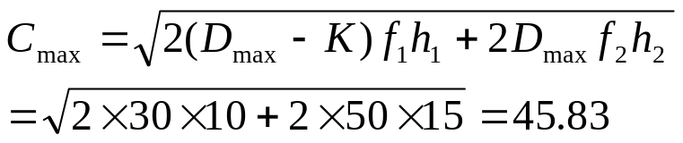
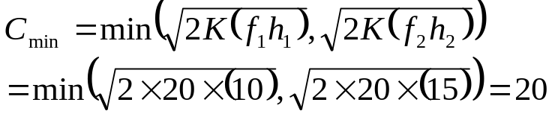
Analytical solution: Complementary constraints - Example
2 products, demands D₁ & D₂
  Costs:
      h₁ = 2/unit
      h₂ = 3/unit
      f₁ = 5/order
      f₂ = 5/order
  Demand constraints:
      D₁ - D₂ = K = 20
      D₁ <= D_{max} = 50
      D₂ <= D_{max} = 50
Maximum cost
Minimum cost

Slide 23
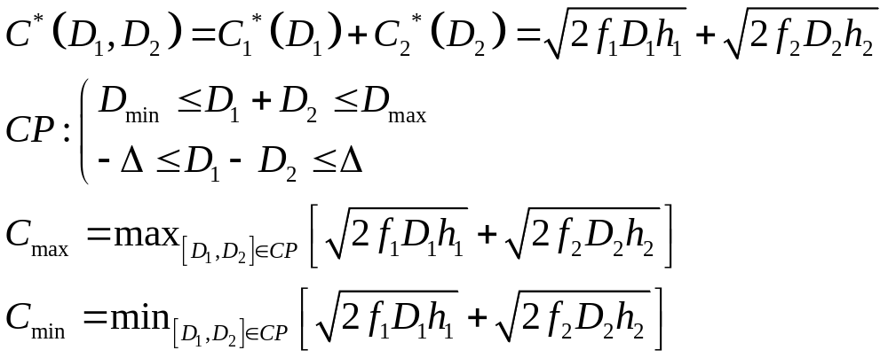
Both substitutive & complementary constraints
Holding cost linear, ordering cost fixed
Under both substitutive and complementary constraints
Convex optimization techniques are required for this optimization.

Slide 24
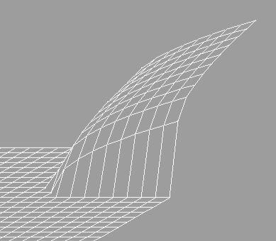
Both substitutive & complementary constraints - Optimization
Objective function: concave
  Minimization: HARD!
  Envelope based bounding schemes
Heuristics to find upper bound.
  Simulated annealing based

Slide 25
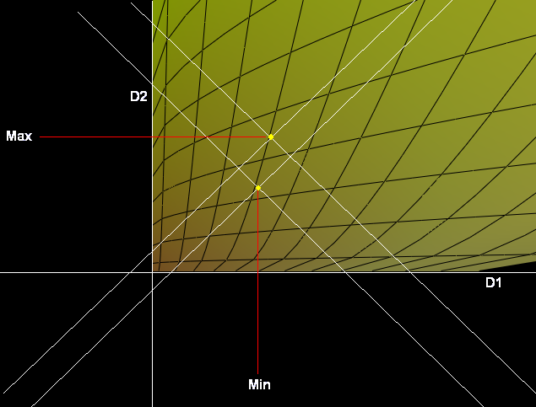
Both substitutive & complementary constraints - Example
2 products, demands D₁ & D₂
  Costs:
      h₁ = 2/unit
      h₂ = 3/unit
      f₁ = 5/order
      f₂ = 5/order
  Demand constraints:
      150 <= D₁ + D₂ <= 200
      -20 <= D₁ – D₂ <= 20
Maximum cost: 99.88
Minimum cost
  Enumerating all vertices (exact)
      85.39
  Simulated annealing heuristic
      85.48499
  Error: 0.111247 %

Slide 26
Both substitutive & complementary constraints – Example (contd)
5 products, demands D₁, D₂, D₃, D₄ & D₅
  Costs:
      h₁ = 2/unit
      h₂ = 3/unit
      h₃ = 4/unit
      h₄ = 5/unit
      h₅ = 6/unit
      f₁, f₂, f₃, f₄, f₅ = 5/order
Demand constraints:
  D₁ + D₂ + D₃ + D₄ + D₅ <= 1000
  D₁ + D₂ + D₃ + D₄ + D₅ >= 500
  2 D₁ - D₂ <= 400
  2 D₁ - D₂ >= 100
  5 D₅ - 2 D₄ <= 900
  5 D₅ - 2 D₄ >= 150
  D₂ + D₄ <= 400
  D₂ + D₄ >= 250
  D₁ <= 350
  D₁ >= 100
  D₃ >= 150
  D₃ <= 300
  D₄ >= 75
  D₄ <= 200

Slide 27
Both substitutive & complementary constraints – Example (contd)
Maximum cost: 436.6448
Minimum cost:
  Enumerating all vertices (exact)
      323.5942
  Simulated annealing heuristic
      324.4728
  Error: 0.271505 %

Slide 28
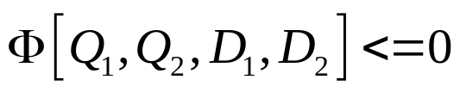
Inventory constraints
Constrained Inventory Levels
  If the inventory levels Qi and demands Di, are constrained as
  The vector constraint above can incorporate constraints like
    Limits on total inventory capacity (Q1+Q2 <= Q_{tot})
    Balanced inventories across SKUs (Q1-Q2) <= ∆
    Inventories tracking demand (Q1-D1<=D_{max})

Slide 29
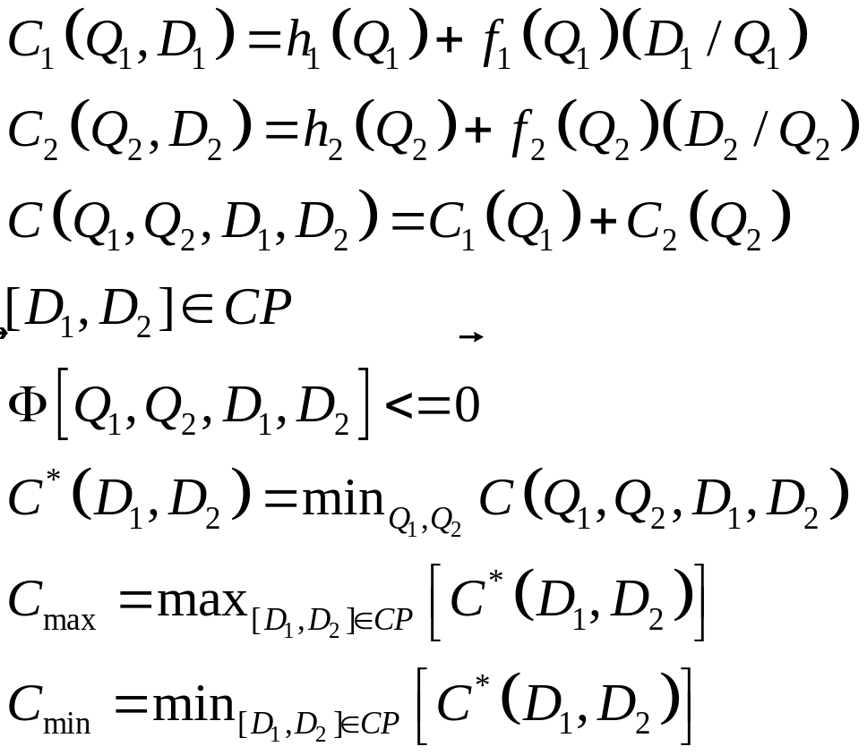
Inventory constraints
Constrained Inventory Levels

Slide 30
Related Work
McGill (1995)
Inderfurth (1995)
Dong & Lee (2003)
Stefanescu et. al. (2004)
Bertsimas, Sim, Thiele et. al.

Slide 31
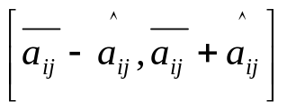
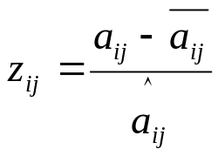
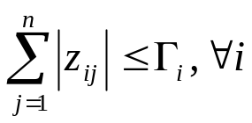
Related work
Bertsimas, Sim, Thiele - “Budget of uncertainty”
  Uncertainty:
  Normalized deviation for a parameter:
  Sum of all normalized deviations limited:
  N uncertain parameters ➔ polytope with 2^{N} sides
  In contrast, our polyhedral uncertainty sets:
    More general
    Much fewer sides

Slide 32
Extensions:
Generalized basestock
German Tank

Slide 33

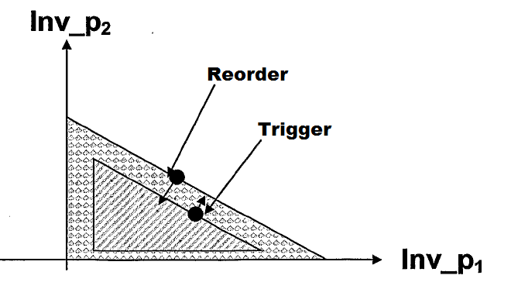
Basestock with correlated inventory

Slide 34
The German Tank Problem
Classical German Tank
Generalization
Biased estimators
  Maximum likelihood
Unbiased estimators
  Minimum Variance unbiased estimator (UMVU)
  Maximum Spacing estimator
  Bias-corrected maximum likelihood estimator
Given correlated data samples, drawn from a uniform distribution- estimating the bounded region formed by correlated constraints enclosing the samples.
Estimating the constraints without bias and with minimum variance.

Slide 35
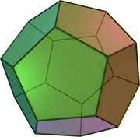
Information Theory and Relational Algebra
Uncertainty can be identified with Information.
Information ⬅➔ polyhedral volume
Relational algebra between alternative
constraint polyhedra

Slide 36
Conclusions
Generalized EOQ to Correlated Demands
  Analytical Solutions
  Computational Solutions
    Enumerative versus Simulated Annealing
Extensions of formulations
  Generalized Basestock
  German Tank
  Information Theory and Relational Algebra

Slide 37
Thank you

