Slide 1

Presented by,
Shyno Annie Jacob
MT2011149

Slide 2
CAPTCHA
Developed by Carnegie Mellon University
"Completely Automated Public Turing test to tell Computers and Humans Apart“
To prevent abuse from “bots” or automated programs written to generate spam.

Slide 3
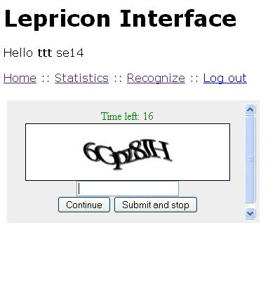

Slide 4
Contd..
200 million captchas are solved a day.
Roughly 10 secs of spent for each.
150,000 hrs of work on each day
Why cant make it useful?

Slide 5

RE-CAPTCHA
To archive human knowledge and to make information more accessible to the world.
Digitize books that were written before the computer age.

Slide 6
Contd..
Photographically scanned
Transformed into text using “OCR”(Optical Character Recognition”)
Cant store as images itself because difficult to store, expensive to download and cannot search.

Slide 7
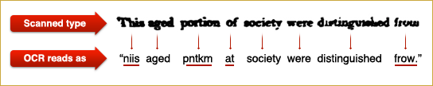
Contd..
OCR is not perfect

Slide 8
Contd..
Send these words in form of captcha to decipher.
Each word is given with a word for which answer is already known.
If solves 1st word correctly, system assumes second one is right.

Slide 9
Contd..
2 OCR programs and English dictionary
If different answers, then CAPTCHA
CAPTCHA with control word
Captain Infernet to Captain Internet

Slide 10
Contd..
Identification of OCR-0.5 points
By human -1 point
If 2.5 points, the word is considered call.
Consistently given words as control words

Slide 11
99.5 % accuracy at word level.
Security with wraps and random lines
Adaptive security
IP address security

Slide 12
References:
http://www.google.com/recaptcha/
http://en.wikipedia.org/wiki/ReCAPTCHA
http://www.captcha.net/

Slide 13
Thank You!!

