Slide 1
Cryptography

Slide 2
Why Cryptography?

Slide 3



BRUCE
STARK
https://www.youtube.com/watch?v=MK0SrxBC1xs

Slide 4
Reasons for using Cryptography
Integrity
Authenticity
Confidentiality.

Slide 5
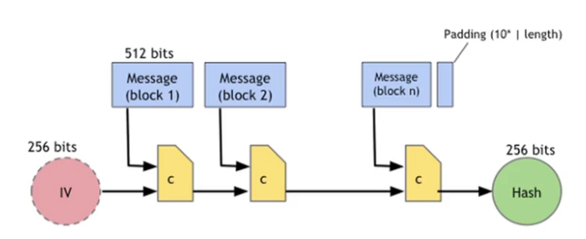
Algorithms suggested by AUTOSAR
Hashing Functions : A Hash function is a algorithm that takes an arbitrary amount of data input and produces a fixed size output of enciphered text called a hash value.
1. SHA-1
2. SHA-2
* Length: 256, 384 and 512 bits
3. SHA-3
* Length: 256, 384 and 512 bits
SHA 256

Slide 6
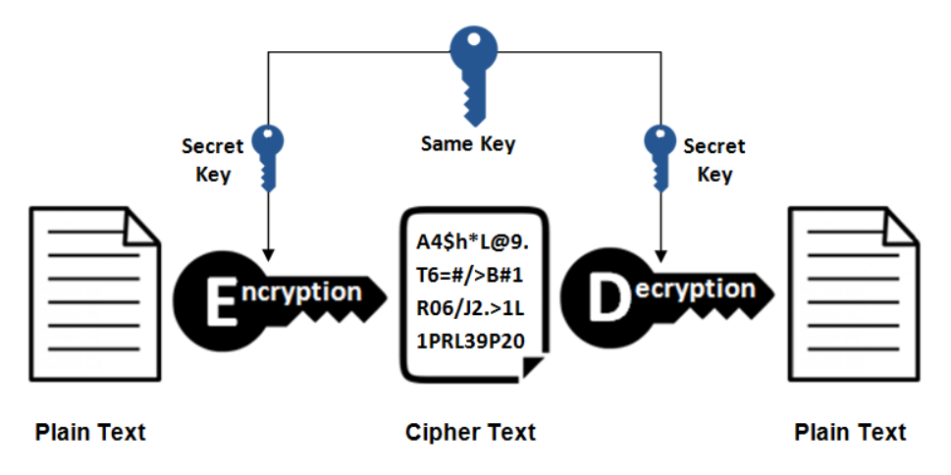
Algorithms suggested by AUTOSAR
2. Symmetric Ciphers : A Symmetric cipher is one that uses same key for encryption and decryption.
1. AES
* Key Length: 128, 192 and 256 bits
2. Camellia
* Key Length: 128, 192 and 256 bits
3. ChaCha20

Slide 7
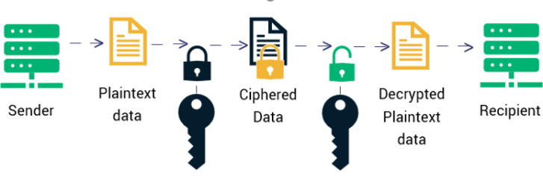
Algorithms suggested by AUTOSAR
3. Asymmetric Encryption/Decryption and Signature Handling : Asymmetric cipher is the one which use two different keys to encrypt and decrypt the data.
1. RSA
* Key Length: 2048, 3072 and 4096 bits
* Padding: PKCS#1 v2.2
2. Curve25519/Ed25519
3. NIST curves P256, P384 and P521 / ECDSA
Private Key
Public Key

Slide 8
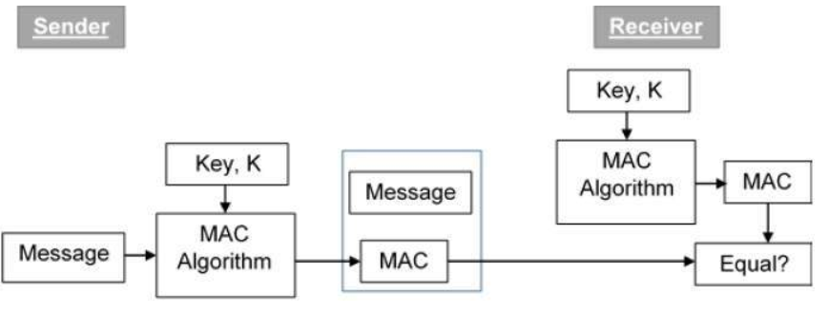
Algorithms suggested by AUTOSAR
4. Message Authentication Code (MAC) : MAC Algorithm is a symmetric key cryptographic technique to provide message authentication. For establishing MAC process, the sender and receiver share a symmetric key K.
1. CBC – MAC
2. CMAC
3. GMAC
4. HMAC

Slide 9
Algorithms suggested by AUTOSAR
5. Random Number Generation : A Random number generator is a mathematical construct, either computational or a hardware device that is designed to generate a random set of numbers.
1. Deterministic Random Number Generator(DRNG)
2. True Random Number Generator(TRNG)

Slide 10
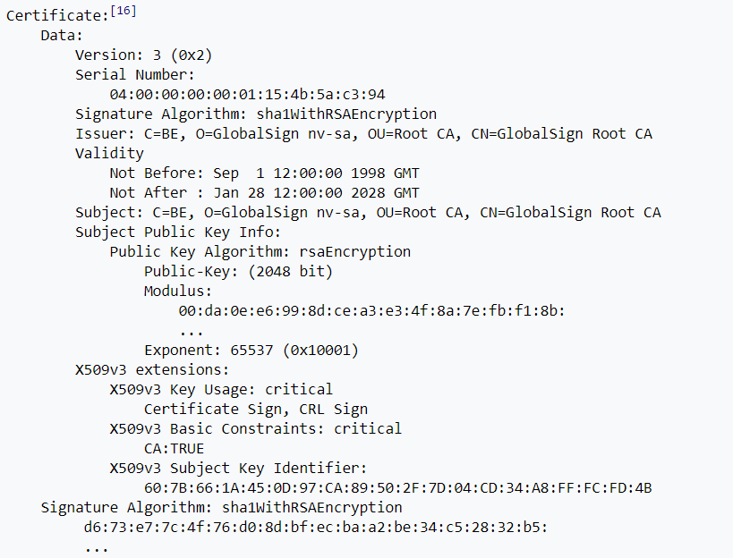
Certificates handling
5. Certificates : A Public key certificate is a digitally signed document that serves to validate the sender’s authorization and name.
The certificate consists of a specially formatted block of data that contains name of the certificate holder and holder’s public key as well as the digital signature.
1. User Certificate
2. Intermediate Certificate
3. Root Certificate
X.509 Ref : https://en.wikipedia.org/wiki/X.509

Slide 11
Cybersecurity Mechanism Variants:
1. Software Based
2. Hardware Based

Slide 12

Secure Flashing:
Software Package Signing with Private Key
Software Package
Software Package
Hashing
(SHA 256)
Encryption
(RSA 2048)
Encrypted Hash
Private Key
Software Package Verification using Public key
Software Package
Hashing
(SHA 256)
If Hash Value is Equal – Verification Passed
Else if Hash Value is Not Equal – Verification Failed
Decryption
(RSA 2048)
Hashing
(SHA 256)
Encrypted Hash
Public Key

Slide 13
Secure Flashing: Certificate Usage : Variant 1
Software Package Signing with Private Key
Software Package
Software Package
Hashing
(SHA 256)
Encryption
(RSA 2048)
Encrypted Hash
Private Key
User Certificate.
Software Package Verification using Public key
Software Package
Hashing
(SHA 256)
If Hash Value is Equal – Verification Passed
Else if Hash Value is Not Equal – Verification Failed
Hashing
(SHA 256)
Encrypted Hash
If User Certificate Verification Passed
Decryption
(RSA 2048)
User Certificate.
User Certificate Verification
Public Key

Slide 14
Secure Flashing: Certificate Usage : Variant 2
Software Package Signing with Private Key
Software Package
Software Package
Hashing
(SHA 256)
Encryption
(RSA 2048)
Encrypted Hash
Private Key
Software Package Verification using Public key
Software Package
Hashing
(SHA 256)
If Hash Value is Equal – Verification Passed
Else if Hash Value is Not Equal – Verification Failed
Hashing
(SHA 256)
Encrypted Hash
If Certstore COT Verification Passed
Decryption
(RSA 2048)
CertStore.
Certstore COT Verification
Issuer Public Key

Slide 15

AUTOSAR Adaptive Platform Cryptography

Slide 16


Agenda
Overview – Crypto Stack
Overview – Reference Architecture
Overview – Crypto Service Manager
Overview – Crypto Driver
Supported Features – Crypto Stack
API Overview – TBD..
1.
2.
3.
4.
5.
6.
7.
8.
9.
10.
11.
12.
© ZF Friedrichshafen AG

Slide 17
Overview – Crypto Stack
Functional Cluster which is responsible for construction and supervision of cryptographic primitives and offers interfaces to Adaptive Applications.
Provides multiple implementations of cryptographic algorithms, key management, dynamic generation of key, etc.
Provides key storage - keys may be stored internally in the crypto backend (Crypto Driver) or
externally and imported/exported on demand.
Supports both hardware and software implementation of cryptographic primitives
(selectable during runtime).
Protection of keys and key usage can be provided by constraining keys to particular usages
(e.g. decrypt-only).
Limitation of the availability of keys to individual applications as reported by IAM.

Slide 18
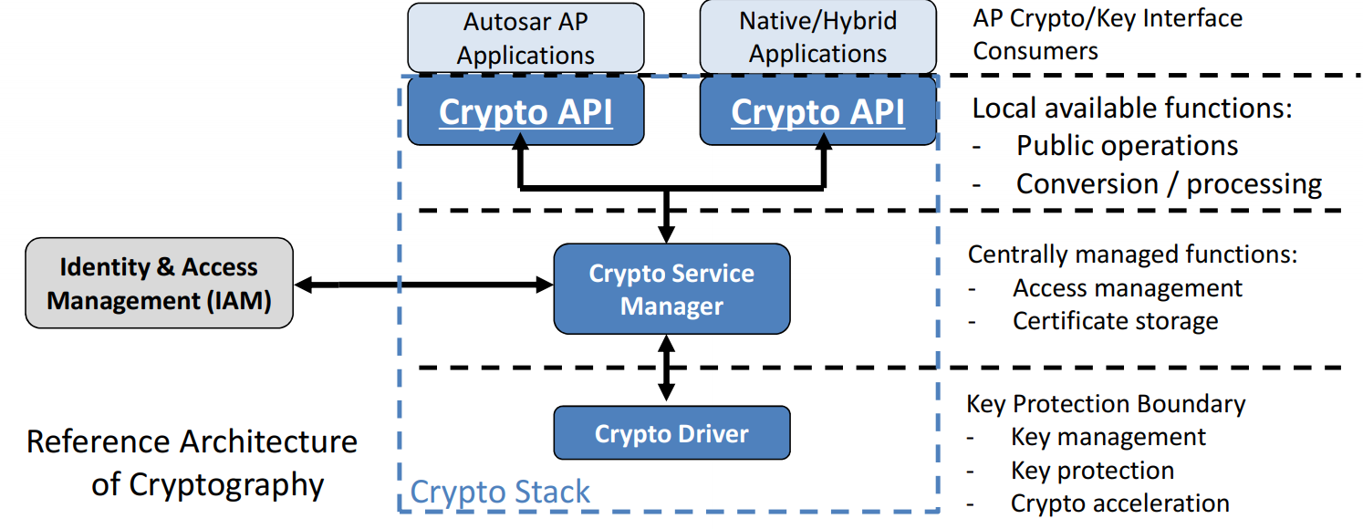
Overview – Reference Architecture
AUTOSAR AP only defines the high-level Crypto Stack API exposed to applications.
The API is designed to support encapsulation of security-sensitive operations and decisions in a separate component, such as a Hardware Security Module (HSM).
The API can also be used to protect session keys and intermediate secrets when processing cryptographic protocols such as TLS and SecOC.

Slide 19
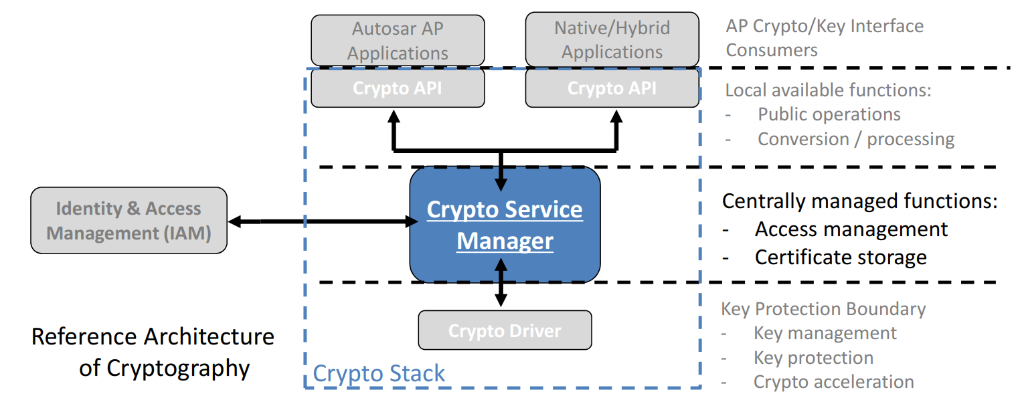
Overview – Crypto Service Manager
Implements platform-level tasks consistently across applications
(access control, certificate storage, etc.)
Coordinates the offloading of functionality to a Crypto Driver (Library/HSM)

Slide 20
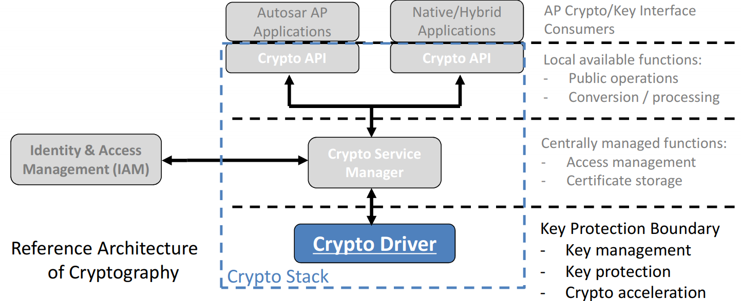
Overview – Crypto Driver
Can be software library or hardware (HSM)
When both are available, selection is done during run-time
Typically complete set of key management and crypto functions are implemented to accelerate crypto operations and protect managed keys from malicious applications
(permission needs to be granted for operations)

Slide 21
Supported Features – Crypto Stack
Symmetric and asymmetric encryption and decryption.
Hash algorithms (to identify data manipulation).
Generation, importing, and storing of public/private keys in a secured manner.
Random number generation
Support of PKI systems (incl. CSR and CRT)
❐ X.509 certificats
❐ PKCS#7
❐ Attestation

Slide 22
Thank you

