Slide 1

Platform Health Management(PHM)

Slide 2


Agenda
1.
Introduction
Supervised Entity
Alive Supervision
Deadline Supervision
Logical Supervision
Local Supervision Status
Global Supervision Status
Health Channel
Arbitration
Action List
Recovery Actions
APIs
2.
3.
4.
5.
6.
7.
8.
9.
10.
11.
12.
© ZF Friedrichshafen AG

Slide 3
Introduction
Health Monitoring is required by ISO 26262 (under the terms control flow monitoring, external monitoring facility, watchdog, logical monitoring, temporal monitoring, program sequence monitoring).
The Health Monitoring supervises the execution of a configurable number of Supervised Entities and it also supervises their Health Status.
When it detects a violation of the configured temporal and/or logical constraints on program execution or a violation of the configured health constraints, it triggers the appropriate error handlers or Watchdogs correspondingly.

Slide 4
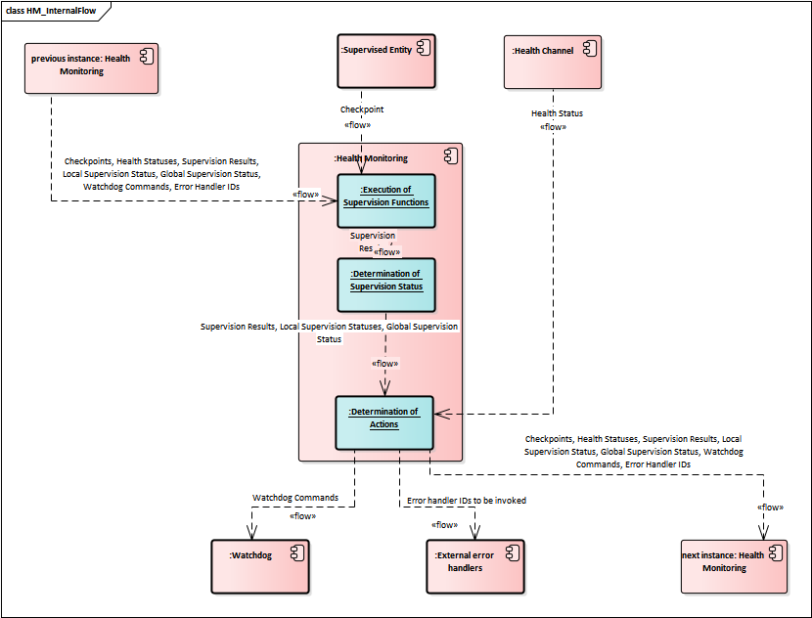
Introduction

Slide 5
Supervised Entity
A Supervised Entity is a collection of Checkpoints that can occur during the runtime of a software.

Slide 6
Alive Supervision
Alive Supervision offers a mechanism to periodically check the execution reliability of one or several Supervised Entities.

Slide 7
Deadline Supervision
Deadline Supervision checks the timing constraints of non-cyclic Supervised Entities. In these Supervised Entities, a certain event happens and a following event happens within a given time span. This time span can have a maximum and minimum deadline (time window).

Slide 8
Logical Supervision
Logical Supervision checks if the code of Supervised Entities is executed in the correct sequence.

Slide 9
Local Supervision Status
Status that represents the current result of Alive Supervision, Deadline Supervision and Logical Supervision of a single Supervised Entity.

Slide 10
Global Supervision Status
Status that summarizes the Local Supervision Status
of all Supervised Entities of a software subsystem.

Slide 11
Global Supervision Status
SupervisionCycle: at which cycle the Global Supervision and its contained LocalSupervisions are executed (i.e. at which cycle the new state is determined)
ExpiredSupervisionCyclesTolerance: maximum acceptable amount of Supervision Cycles in the global state GLOBAL_STATUS_EXPIRED before it is Considered GLOBAL_STATUS_STOPPED.
FailedSupervisionCyclesTolerance: maximum acceptable amount of Supervision Cycles in the local state LOCAL_STATUS_FAILED before it is considered LOCAL_STATUS_EXPIRED.

Slide 12
Health Channel
Health Channels is an information that is being monitored or that has already been determined by the supplier and classified according to the possible health status values.
Health Status represents a possible value of the Health Channel.

Slide 13
Arbitration
The Phm Arbitration defines the expressions and rules to calculate a logical statement from a set of input Health Channels. The results of these calculations are used to define the triggering of specific actions by the Platform Health Management

Slide 14
Arbitration

Slide 15
Action List
The Action List collects an ordered list of Action Items to be executed when the Action List is executed.
Restart Application/Process
Reset Platform Software
Hardware Watchdog Reset
Recovery Via Application

Slide 16
Recovery Actions

Slide 17
APIs
void ReportCheckpoint(Enum t);
LocalSupervisionStatus GetLocalSupervisionStatus();
GlobalSupervisionStatus GetGlobalSupervisionStatus();
void ReportHealthStatus(Enum t);

Slide 18

Thank you
ZF Friedrichshafen AG behält sich sämtliche Rechte an den gezeigten technischen Informationen einschließlich der Rechte zur Hinterlegung von Schutzrechtsanmeldungen und an daraus entstehenden Schutzrechten im In- und Ausland vor.
ZF Friedrichshafen AG reserves all rights regarding the shown technical information including the right to file industrial property right applications and the industrial property rights resulting from these in Germany and abroad.
© ZF Friedrichshafen AG

