Slide 1
Requirements Engineering

Slide 2
Agenda
Introduction
Requirements Elicitation
Requirements Documentation
Requirements Validation
Requirements Negotiation
Requirements Management

Slide 3
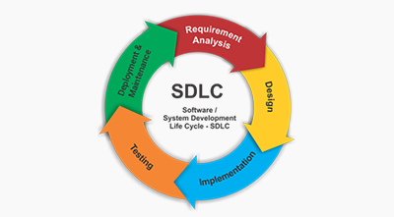
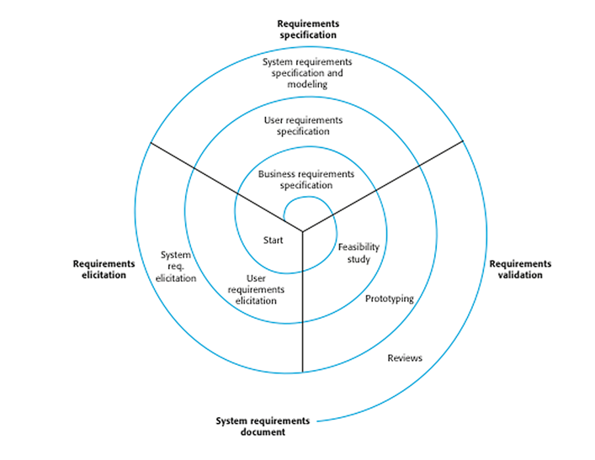
Requirements Engineering
Requirements engineering is the discipline that involves establishing and documenting requirements.
Requirements engineering techniques offer ways of dealing with complexity, by systematically breaking down complex problems into simpler ones, so that we can understand them better.
In practice, requirements engineering isn't sequential process, it's an iterative process in which activities are interleaved.

Slide 4
Causes and Symptoms of Inadequate RE
Cause | Description
Incorrect Assumption | The wrong assumption of the stakeholders that much is self-evident and does not need to be stated explicitly
Communication Problems | Problems due to differences in experience and knowledge of the communicating stakeholders or team members
Project Pressure | Project pressure from the client to build a productive system rapidly, without allowing sufficient time for requirements engineering activities
Symptoms/Effects of Inadequate RE
Symptom | Description
Missing requirements | Requirements do not reflect customer needs precisely, that might result in a system that does not meet stakeholder expectations
Unclear Requirements | Requirements are ambiguous and hence follow for multiple interpretations, that might in a system that does not meet stakeholder expectations

Slide 5
The Necessary Capabilities of a Requirement Engineer
Capability | Description
Analytical Thinking | Since stakeholders often discuss problematic requirements by means of concrete examples and (suboptimal) solutions, the RE must be able to abstract from the concrete statements of the stakeholder.
Empathy | Able to identify the actual needs of a stakeholder the RE to have a good intuition and empathy for people
Communication Skills | Good communication skills are necessary to elicit requirements from stakeholders and to interpret them correctly
Conflict Resolution (Negotiation) | The RE must identify conflicts, mediate between the parties involved, and apply techniques suitable to resolve the conflict
Moderation skills (Facilitation Skills) | The RE must be able to mediate between different opinions and lead discussions during individual conversations as well as group workshops
Self-confidence | The RE needs to have a high level of self-confidence to be able to defend herself, should be open to strong criticism or objections to her opinions if arises, without taking criticism personally
Persuasiveness | The RE needs to be persuasive in order to be able to facilitate a decision in case of a disagreement and bring about consensus among stakeholders

Slide 6
Requirements Elicitation

Slide 7
Requirements Elicitation Techniques Obtain requirements from requirement sources (people, processes, systems in operation, documents, events) using a combination of techniques
Document-Centric Techniques
System Archeology
Perspective-Based Reading
Observation Techniques
Field Observation
Apprenticing
Survey Techniques
Interview
Questionnaire
Creativity Techniques
Support Techniques
Brainstorming
Brainstorming Paradox
Reuse of requirements
6-3-5 or Brain wiring (Written form of Brainstorming)
Mind Mapping
Requirements Workshop
CRC (Class, Responsibility, Collaboration) Cards
Audio and Video Recordings
Use case Modelling
Prototyping
Change of perspective
Analogy Techniques

Slide 8
Requirements Documentation

Slide 9
Constructing Requirements using a Template
Step 5
Step 1
Step 2
Step 3
Step 4
Conditions | Subject | Modal verb | Process verb | Object & object details
a) When <Conditions> - To be avoided | the system <System Name> | a) shall – Legally binding | <Process verb> Autonomous system activity | <object> and <details about the object>
b) If <Conditions> - Logical condition |  | b) should – Strongly recommended | b) Provide <whom> with the ability to <process verb> - User interaction
c) As soon as <Conditions> - Temporal condition |  | c) will – Future requirement | c) Be able to <process verb> - Interface requirement
If the customer data is already present in the Customer Relationship Management system, (Logical condition) | the system | shall | display | the error message “Customer already exists”
If the customer is not yet registered on the library system, (Logical condition) | the system | shall | provide the librarian with the ability to register (user interaction) | the customer with it
As long as the library system is in operation, (temporal condition) | the library system | shall | be able to receive | system updates from the central administration server, via a LAN

Slide 10
Quality Aspects and Quality Criteria for Requirements
Quality Criteria for Requirements
Correct
Complete
Consistent (without contradictions)
Unambiguous (clear)
Verifiable (testable)
Traceable (necessity)
Ranked (Prioritized)
Agreed
Valid & Up-to-date
Realizable (Feasible/Implementable)
Understandable
No premature design decisions
Includes only what the stakeholder needs, nothing more or less
Used during requirements validation
Quality Aspects of Requirements
Content
Documentation
Agreement
Quality Criteria for Requirements documents
Clear Structure
Complete
Consistent
Unambiguous
Traceable
Modifiable (No Duplication) & Extensible
Promotes selective reading of a document
2 types of completeness
The document must contain all relevant requirements
Each requirement must be complete, with it’s associated details
Fundamental Principles of Understandability
Short sentences and short paragraphs (concise)
Only one requirement (main process verb) per sentence (also called atomic)
Formulate requirements using only active voice
Glossary

Slide 11
Example 1 - Atomic
Self-contained
Capable of being understood independently of other requirements or designs
Has been decomposed to its lowest level and cannot be decomposed any further
One requirement contains one and only one requirement (main process verb)
Consider the following requirements:
The administrator shall be able to add, edit and delete customer accounts.
The above requirement is not atomic because it comprises of 3 different requirements in a single requirements, separated by conjunction “and”.
The above requirement can be rewritten as follows:
Req 1: The administrator shall be able to add customer accounts.
Req 2: The administrator shall be able to edit customer accounts.
Req 3: The administrator shall be able to delete customer accounts.

Slide 12
Example 2 - Concise
Separate supporting details for a requirement from the requirement itself
Look for and remove “subordinate clauses” from requirement statements
Because, in order to, in order that, so that etc.
The justification for a requirement I certainly important, but it is not a part of the requirement and hence must be separated out from the requirement into supporting details
Consider the following requirements:
To assist in positioning items on a diagram, the user may enable a grid via an option on a control panel. A grid helps the user to create a neat diagram with well spaced entries.
The above requirement has a subordinate clause “To assist in … “ and also has information related to the requirement, that is not part of the requirement (”A grid helps … “).
The above requirement can be rewritten as follows:
The user shall be capable of enabling a grid via an option on the control panel.
Supporting details:
This capability assists the user in positioning items on a diagram
A grid helps the user to create a neat diagram with well-spaced entries.

Slide 13
Example 3 - Correct
Most incorrect requirements are the result of incorrect assumptions made
Hence, one or more subject matter experts would need to identify and challenge the assumptions related to a requirement, in order to test the requirement for correctness
Consider the following requirement:
The system shall allow only employees at the ZF TCI office to access the system configuration data.
The requirement was documented for the system Administration team that operated only from the ZF TCI office.
Two incorrect assumptions:
All employees at the ZF TCI office belong to the System Administration team
The system Administration team would operate only from the TCI office.
The requirement could have been specified access based on role, rather than location.
The above requirement can be rewritten in its “correct” form as follows:
The system shall not allow any user other than a member of the system Administration team to access the system configuration data.

Slide 14
Example 4 - Complete
Enough to guide further work and at the appropriate level of detail for work to continue
Must contain all the information (and only the information) necessary for the reader to understand it
An incomplete requirement can also make it unambiguous (unclear)
Consider the following requirement:
The system shall comply with the organizational policies applicable to it
The above requirement is incomplete because it misses information about the specific policies with which the system must comply, without which, the requirement cannot possibly be implemented.
The missing information may not necessarily be included in the requirement statement itself. The requirement may make a reference to another source that provides the necessary information
The above requirement can be rewritten in its “complete” form as follows:
The system shall comply with the organizational policies POL 001 to 015, as listed in the Policy Manual V3.0.

Slide 15
Example 5 - Consistent
The requirement does not conflict with other requirements of the same type or with higher level requirements of there types
The requirements use consistent terminology .i.e., they do not use different terms to mean the same thing
This is primarily applicable to a set of 2 or more requirements, rather than a single requirement
Consider the following requirements:
Req1: The CRM system shall send customer satisfaction data on a daily basis
Req1: The CRM system shall generate and process customer satisfaction data on a weekly basis
The above requirements are inconsistent because if customer satisfaction data is generated on a weekly basis, it cannot possibly sent to any system on a daily basis.
Some of the reasons that might make it difficult to discover the above inconsistency are:
Requirements articulated by two different stakeholders
Requirements articulated by stakeholders at two different times
Requirements documented by two different authors on different pages of the requirement specification, rather than one after the other.
Grouping all related requirements into a single section makes it easy to discover inconsistencies.

Slide 16
Example 6 - Unambiguous
The requirement must be subject to one and only one interpretation
There are 2 types of ambiguity: Linguistic and domain specific
Linguistic ambiguity is related to the English Language and can be easily reduces to a great extent by avoiding
Adjectives - user friendly, robust, fast, easy to use, efficient etc.
adverbs – accordingly, almost, approximately, commonly, efficiently, frequently etc.
Pronouns – he, she, it, they, this, that, these, those, who etc.
The + noun – such nouns must be defined completely by adding details to it.
Domain specific ambiguity is associated with the context of the business domain.
Consider the following requirements:
Placing an order should be quick and easy
The above requirement makes use of adjectives (quick and easy)
The above requirement can be rewritten as follows:
The user shall be able to successfully place an order, with up to 3 unique items, in not more than 15 seconds.
Supporting details: The 15 seconds time is measured from the time the user adds the first item to his/her shopping cart until the successful order confirmation message is displayed to him/her

Slide 17
Example 7 - Testable
A requirement is testable if it is possible to clearly define test cases and expect results for them, to verify that the requirement has been met.
A Requirement that is ambiguous and non-feasible will certainly be non-testable
A Requirement that is incomplete and inconsistent will likely be non-testable
Getting experienced Testers to review requirements is a quick way to examine the testability of the requirements
Consider the following requirements:
The system shall be user-friendly
“user friendly” is an adjective, that makes the requirement ambiguous.
Eliminating ambiguity from a requirement significantly enhance its testability.

Slide 18
Example 8 - Realizable
Some of the ways to effectively assess feasibility of the requirements are:
Engage cross- functional stakeholders especially Project Managers (for project constraints) and technical representatives (for technology constraints), in the review of requirements and design
Use POC (Proof-Of-concept) prototyping
Use an iterative, incremental initiation life cycle approach such as agile
Consider the following requirements:
The system shall be compatible with all web browsers.
The word ‘all’ makes the requirement non-feasible.
“All’ implies that the system must be compatible with all web browsers (and all versions of those browsers) that have been in use in the past, those that are current; in use, as well as those that will be in use in the future.
It is obviously not feasible to test this compatibility within a reasonable amount of time and effort.
The above requirement can be rewritten as follows:
The e-commerce system shall be compatible with the following browsers:
Mozilla Firefox, versions 18 to 22
Microsoft Internet Explorer, versions 9 to 11

Slide 19
Requirements Validation

Slide 20
Requirements Validation (checking)
Requirement Validation must be performed throughout the RE lifecycle
The goal of validation is to discover errors in the documented requirements
An error is a deviation between the defined requirements and the stakeholder’s actual needs
The benefits of effective Requirements Validation are that it:
Significantly reduces overall project costs due to reduced rework
Mitigates legal and other risks that might arise due to non-fulfilment of contractual agreements, as a result of errors
Performed on the basis of pre-determined acceptance criteria
3 Quality Aspects of requirements
Content
Documentation
6 Principles of requirement Validation
Involvement of the correct stakeholders
Separation of the identification from the correction of errors
Requirement Validation Technique
Commenting (Peer Review)
Inspection (technical Review)
Agreement
Validation from different views
Adequate change of documentation type
Construction of development artifacts
Repeated Validation
Walkthrough (Lightweight Review)
Perspective-Based Reading
Prototyping
Throw-away
Evolutionary
Checklists

Slide 21
Requirements Negotiation

Slide 22
Requirements Negotiation
Requirement Negotiation must be performed throughout the RE lifecycle
The goal of requirements negotiation is to gain a common and agreed upon understanding of the system requirements among all the stakeholders
The benefits of Requirements negotiation are that it:
Increases the likelihood of system acceptance by stakeholders
Facilitates creativity and innovation, since conflicts between stakeholders require a solution, that can potentially help discover new ideas for development and can illustrate different options
Conflict Management Tasks
Conflict Identification
Types of Conflict
Requirements related conflicts
Conflict resolution Techniques
Agreement
Compromise
Voting
Overruling (Forcing)
Conflict between requirements
Conflict between stakeholders
Conflict Analysis
Conflict Resolution
Conflict Documentation
Subject conflict
Conflict of Interest
Conflict of Value
Stakeholder related conflicts
Relationship Conflict
Structural Conflict

Slide 23
Requirements Management

Slide 24
Requirements Management Activities
Supports the other RE activities over the system lifecycle
Assigning requirements Attributes
Defining Requirements Views
Prioritizing Requirements
Requirements Traceability
Requirements Versioning
Requirements Change Management

