Slide 1
College Management System
Submitted to AKTU for partial fulfillment of the requirements for qualifying degree of
Session 2019-2022
Submitted By:
Pushkar kumar
Roll NO:- 1900380140009

Slide 2
Objective:-
Best Fee Management System to manage all tasks related to enrollment and fees collection
Reduced workload
Smooth Communication
Data Security
Real-time information

Slide 3
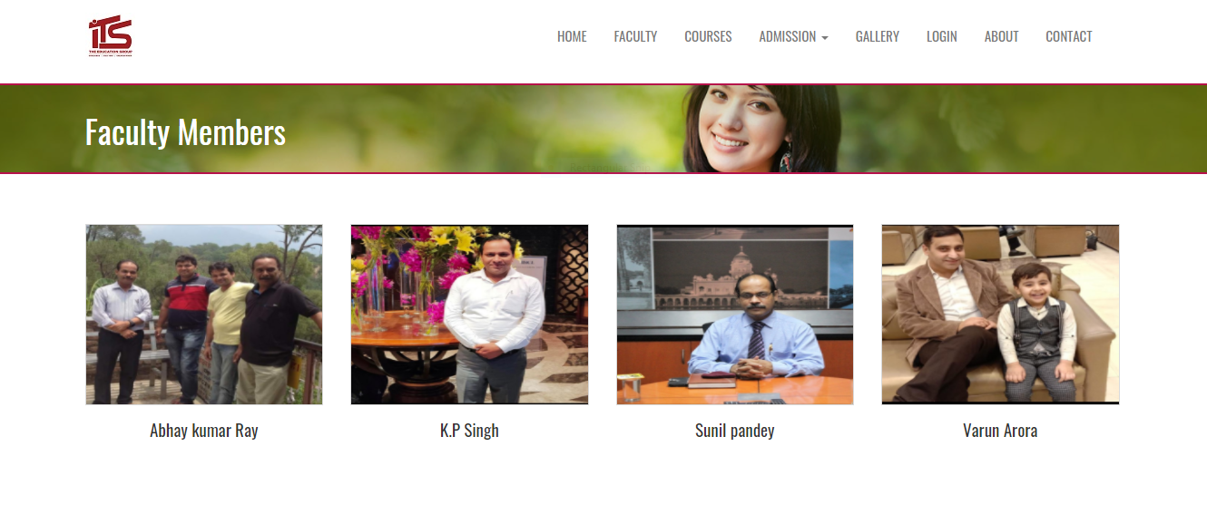

Slide 4
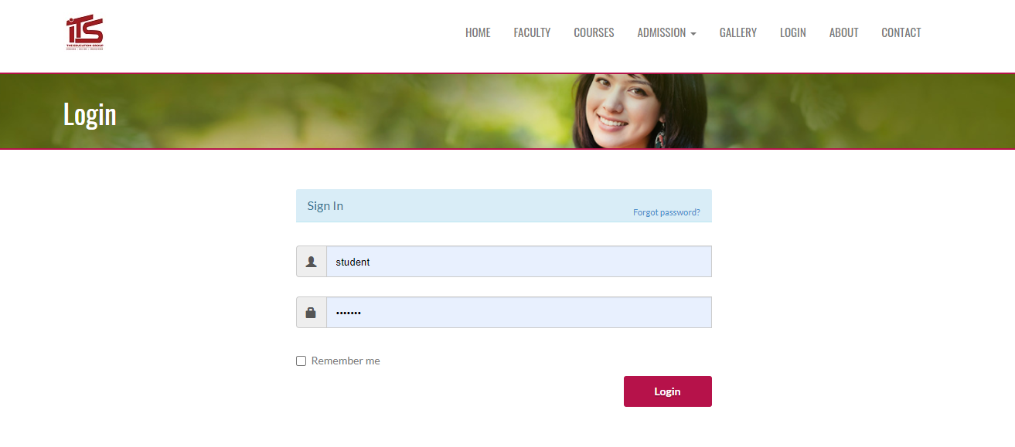



Teacher
Student
Admin

Slide 5
Project function
Admin Show data (student,teache,add program)
Teacher add student marks
Student adminsion,show college’s webside,and program

Slide 6
Software used
Vs code
Wamps server
Chrome
Database phpmyadmin

Slide 7
Language use
Html:-Page Layout has been designed
Css :-Css has been used for all the designing part
JavaScript:-All the validation
PHP:-All the business loges
MySql:-Phpmyadmin database
Apache2:-Project will be run(WAMP)

Slide 8
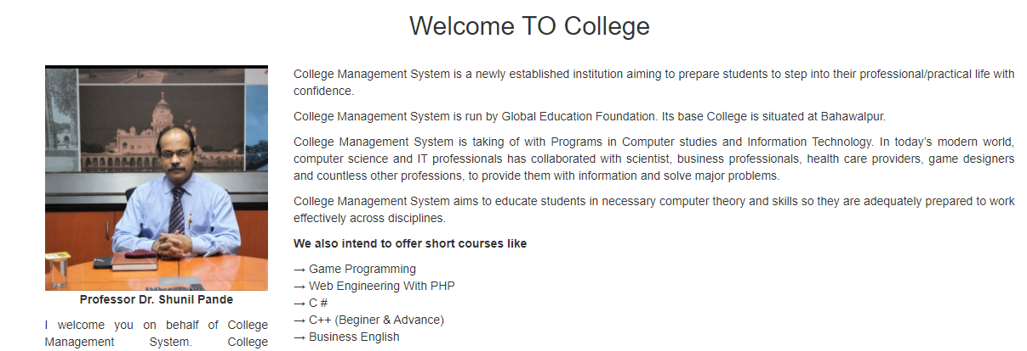
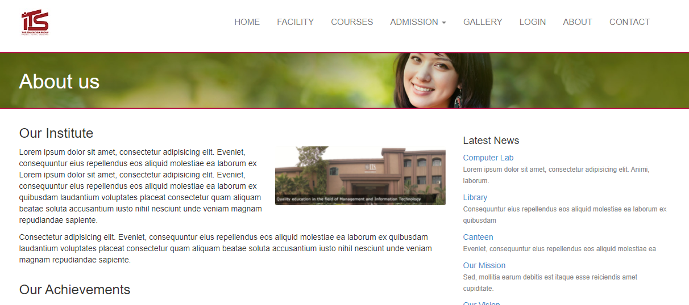
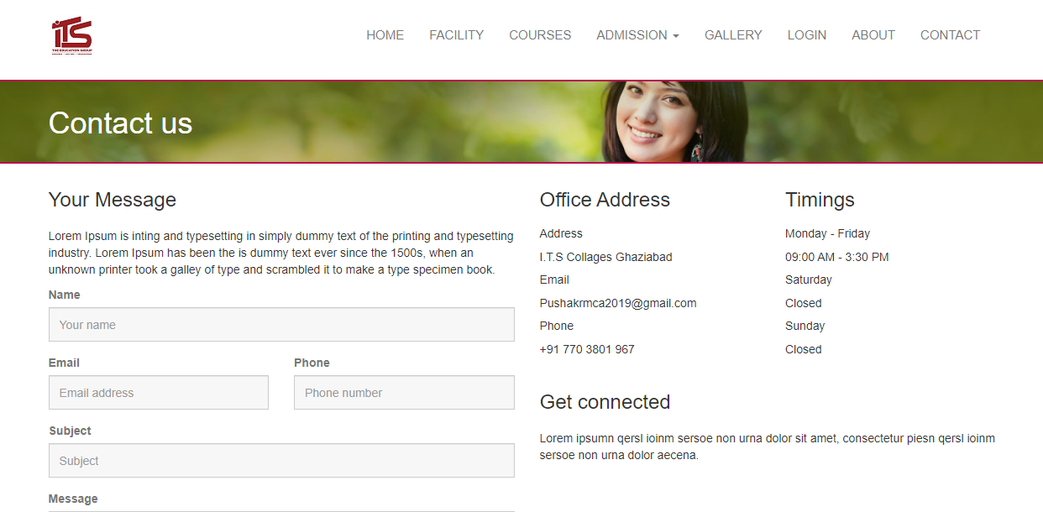

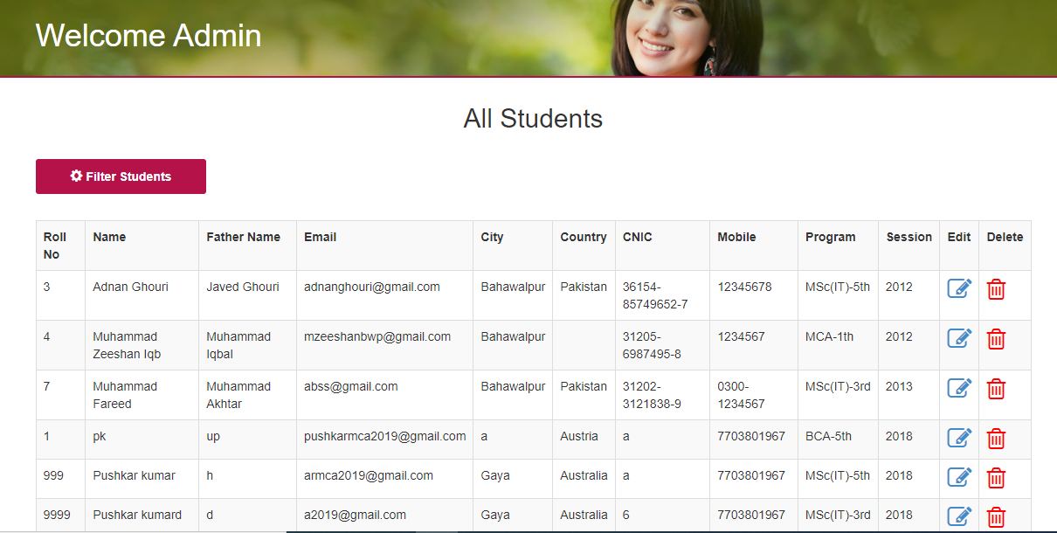
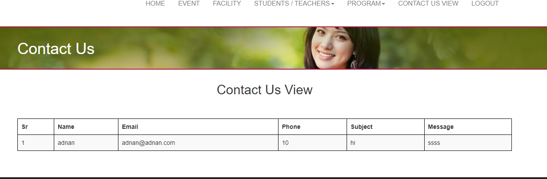
College Teacher
Contact Us
About Us

Slide 9
Project url
https://pstudys.com/its/

Slide 10
Thank you

