Slide 1
Claim Sach
Evidence-backed, interactive health-insurance coverage simulator
Coverage Twin · Track 2: AI-Powered Financial Journeys
Know what your policy might leave you paying before admission.
Pushkar Mondal · Paytm Build for India AI Hackathon, Bengaluru · October 2026
A working prototype: deterministic engine, 180 tests, a real IRDAI-hosted wording encoded and measured, runs offline. github.com/Pushkarmondal/paytm-hackathon
Notes:
Claim Sach, Coverage Twin, Track 2. One sentence: know what your policy might leave you paying before admission. It is a working prototype, not a concept: a deterministic rules engine with a trace on every number, tested, and it runs offline.

Slide 2
The policy's cost shows up at the hospital
PROBLEM STATEMENT
Room-rent limits, proportionate deductions, sub-limits and exclusions surface at admission, not at purchase.
The room-rent clause is the sharpest. Pick a room above the eligible rate and many policies pay the surgeon, anaesthetist, nursing and operation-theatre charges only in the proportion eligible ÷ actual rate. It is not about the room.
Which items are touched depends on the policy's own definition. General explainers stop at the concept; the gap we are testing is applying your own wording to your own bill.
₹2,500 a day
the room-rent gap in our worked example: ₹7,500 chosen against ₹5,000 eligible
₹48,000
potential deductions from that one choice, ₹38,000 of it on items that are not the room
4 of 11 lines
affected under the policy's definition; 3 excluded by it; 2 the wording never classifies
Worked example on a synthetic policy and estimate, computed by the prototype. Not a market statistic.
Notes:
The problem is well known in general and unknown in particular. Everyone has heard of room-rent limits; almost nobody can say which lines of their own bill the deduction touches, under their own wording. The numbers on the right are from the prototype's synthetic case: a ₹2,500 a day room gap becomes ₹48,000 of potential deductions, most of it on the surgery itself.

Slide 3
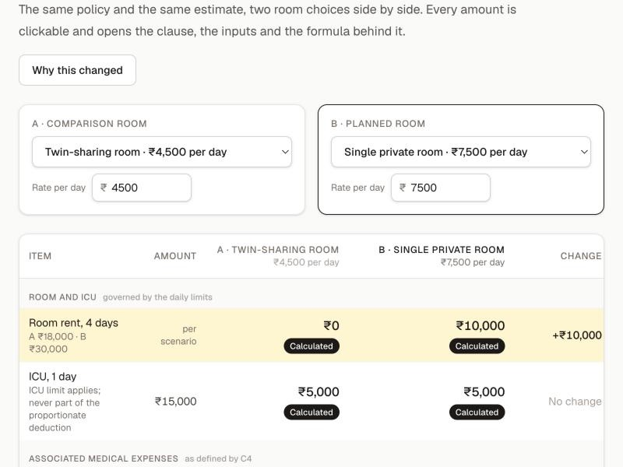
Coverage Twin: your wording, your bill, live
PROPOSED SOLUTION
1 Policy documents
2 Structured rules
3 Scenario simulation
4 Itemised potential deductions
5 Source clause
6 Explicit uncertainty
What a judge does in three minutes
Open the example policy and estimate.
Change the room category or rate; the itemised breakdown updates at once.
Click any amount: its clause, page, inputs with provenance, formula.
Open the uncertainty panel: what could not be established, and who can settle it.
Not a chatbot. Not a payout guarantee. A scenario estimate of the deductions it covers, with its unknowns on screen.
Notes:
The workflow is six steps and the product is built around all six: documents become structured rules with the clause kept beside each rule, a scenario is simulated, the deductions are itemised, every number points at its clause, and what cannot be determined is said out loud. The screenshot is the live Coverage Twin: two rooms, same policy, same estimate; the amber rows are what changed.

Slide 4
Deterministic engine, AI only with human review
TECHNOLOGY / TECH STACK
Frontend
TypeScript, strict. Next.js 16 (App Router), React 19, Tailwind 4.
Five screens on a tested screen model; no business logic in components.
Rules engine
Pure TypeScript, no I/O, no model. Integer paise, exact ratios, one half-up rounding.
A trace on every amount: rule, inputs, clause, formula, output, open assumptions.
Two wordings
Synthetic demo policy, plus Arogya Sanjeevani (New India, irdai.gov.in): ten clauses verbatim, checksum shown.
Partially encoded, labelled so.
AI, in its place
Ruleset builder: a model proposes rules with quotes; the engine verifies each quote verbatim; a person confirms.
Cached in this build; adapter off.
Quality
Vitest, 180 tests, test first. GitHub Actions on every PR.
Evaluation harness: six measures over two wordings, results committed and checked for staleness.
Runs anywhere
One command, offline on localhost; fonts bundled; Vercel-ready.
Nothing the user enters leaves the browser. No key, no account, no analytics.
Notes:
The calculation is deterministic on purpose: an insurance number you cannot trace is worthless. AI is placed where it belongs, extracting candidate clauses from public wordings for a person to confirm, through an adapter that is off by default. The engine is pure TypeScript with integer-paise arithmetic, 124 tests written before the code, and an evaluation harness that keeps four measures separate.

Slide 5
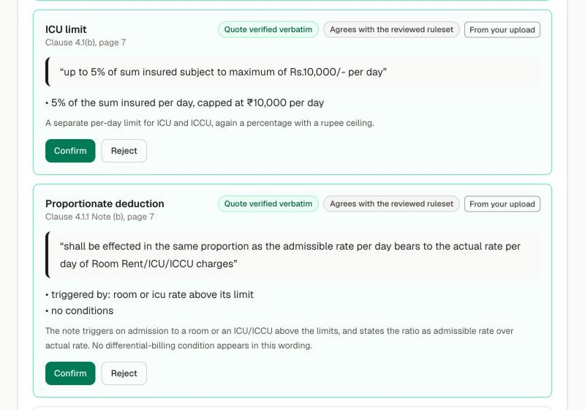
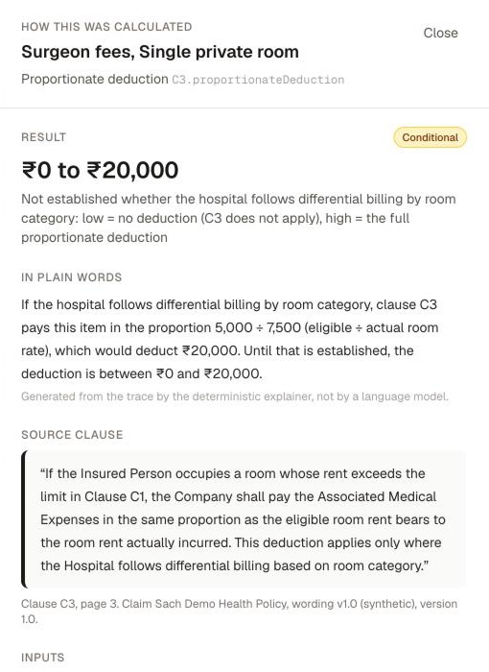
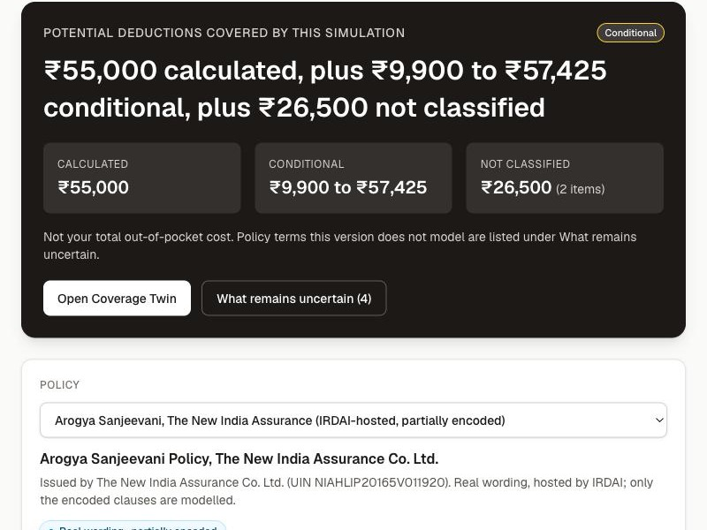
Item-level, clause-cited, honest about unknowns
USP
1
Every number is clickable
Clause and page, inputs with where they came from, the formula, the operation. Tampered traces fail validation.
2
Unknown is never zero
Items the wording does not classify stay out of every total. A conditional amount shows both bounds and the condition.
3
Change your room, see the difference
Two rooms side by side, the rule behind every changed row; the room ladder and the question sheet turn it into a decision and a call script.
4
Proven on a real wording, honestly
Arogya Sanjeevani, ten clauses verbatim with a checksum; where the 2019-20 text conflicts with IRDAI's 2020 norms, the engine says so.
Bounded review of nine public sources: none did this. We do not claim nobody does; we claim we looked.
Notes:
The differentiator is not the room-rent formula, which is public; it is that every statement is pinned to a clause, every unknown stays visible, and the comparison is live. The competitor claim is deliberately narrow: nine public sources, read on 24 October, none did this. We do not say nobody does.

Slide 6
The room decision, made before admission
IMPACT & BENEFITS
For the policyholder
The room decision with its deductions visible before admission, not after.
Questions for the hospital and the insurer written out: what to ask, and what it is worth.
Measured, not claimed
Measure | Synthetic | Real wording
Clause retrieval, top-1 | 11 of 12 | 10 of 12
Rule extraction, field-level | 10 of 10 | 10 of 12
Calculations, exact paise | 9 of 9 (46 amounts) | 3 of 3 (21 amounts)
Uncertainty and refusal | 6 of 6 | 3 of 3
Model proposals: quotes verbatim (cached) | n/a | 6 of 6
Model proposals: agree with reviewer (cached) | n/a | 11 of 13
For a broker's claim-assistance agent
The clause on screen during the call.
The uncertainty list is the call script; the trace is the written answer.
Measured on the synthetic wording and on ten encoded clauses of one real wording; the model proposals are cached, not a live run. The product shows no accuracy figure anywhere. Figures on this slide are potential deductions covered by the simulation, never total out-of-pocket cost.
Notes:
Impact is stated as what the user gains, not as a market number we have not measured. The only figures are the evaluation results, with their dataset sizes, on the synthetic wording. That honesty is part of the product: the UI itself never shows an accuracy score.

Slide 7
Where it fits Paytm, and what must be tested
BUSINESS MODEL
Verified facts
Hypotheses, each with its test
Paytm Insurance Broking Pvt Ltd is a Direct (Life & General) broker: IRDAI Reg. No. 700, renewed 9 Feb 2026, valid to 16 Feb 2029.
It distributes car, two-wheeler, health, life and term policies from 18+ insurers, including Niva Bupa and Aditya Birla Health. It does not underwrite.
It already offers claim assistance by phone. Arogya Sanjeevani is IRDAI's standard product on one wording; one verified encoding serves every insurer that sells it.
FY25 turnover ₹37.1 crore, loss ₹13.2 crore (Form AOC-1), inside a ₹2,593 crore financial-services line in FY26. Insurance is a small line for Paytm today; clarity is a wedge worth testing.
Hypothesis | Test
Fewer claim-time support contacts and disputes | Pilot cohort against a matched cohort
More eligible-room choices when the consequence is visible | Room-change rate in the simulator, then claims data
Panel insurers co-fund a coverage-clarity tool | Three conversations; one signed pilot letter is the pass
A coverage check lifts conversion or renewal on the policy page | A/B test, if Paytm chooses to run one
Revenue options depend on those tests: a broker-side feature (retention), an insurer-paid integration, or a premium claim-assistance tier. No Paytm integration is claimed or built. Bima Sugam is not live; it belongs in the future tense.
Notes:
The regulatory fit is real and verified: a licensed direct broker that distributes health policies from many insurers, does not underwrite, and already assists claims by phone. The business case is four hypotheses with the test that would kill each one. We say plainly that insurance is a small line for Paytm today.

Slide 8
Built, tested, runs offline
github.com/Pushkarmondal/paytm-hackathon · npm install && npm run dev
180 unit tests · two wordings, one of them real · six evaluation measures · a ruleset builder where a model proposes and a person confirms · a trace on every number
Next: a second real wording through the builder with the live adapter on; independent review of the evaluation fixtures; a four-week pilot at a broker's claim-assistance desk.
Notes:
Close on what exists today and the three next steps. Everything shown runs on a laptop with Wi-Fi off.

