Slide 1

A PROJECT PRESENTATION ON “ATM Machine System” GROUP NO: 2 Members names 1) 41_Pushkar Mhatre 2) 21_Aditya gawade 3) 22_Aryan Gawand UNDER THE GUIDANCE OF Prof. Sabrina Shaikh
Department of Computer Engineering Saraswati College of Engineering, Kharghar, Navi Mumbai University of Mumbai 2023-24

Slide 2
ATM Machine System
Using JAVA Swing

Slide 3
01
Table of Contents
02
03
05
Introduction & Literature Survey
Problem statement and scope & Proposed system
Methodologies
System flow diagram & Design Details
04
Hardware And Software Details
Expected outcomes & Results
06

Slide 4
01
Introduction

Slide 5
General Overview
The ATM Machine project is a software application that emulates the functionalities of an Automated Teller Machine (ATM). The goal of this project is to develop a user-friendly and efficient system that enables users to perform common banking operations such as cash withdrawal, balance inquiry, fund transfer, and account management. The ATM Machine project utilizes Java programming language and incorporates key concepts such as object-oriented programming, data structures, and database management. The system implements a secure authentication mechanism to ensure that only authorized users can access their bank accounts

Slide 6
Understanding the Problem Statement & Objective
Objective
Problem Statement
Our aim is to build a dependable ATM simulation through a Java Swing interface that accurately reflects physical transactions at an ATM. We'll adhere to coding best practices and utilize Java Swing features, ensuring user-friendly access to banking services.
To create a secure and user-friendly ATM system simulation using the Java Swing interface in line with physical ATM machines. We will utilize JAVA coding practices and Java Swing's features for accurate transaction processing.

Slide 7
02
METHODOLOGIES

Slide 8
Methodology
4 . Actions based on Menu Selection
1. Login options
Sign up to new account or login with previous account.
Withdraw- deducts amount if sufficient, else error. Deposit- adds amount to balance. Bank Details - shows current bank details. Change PIN- updates PIN.
3. Menu options
2. User authentication
Display available options like withdrawal, deposit, bank details, change PIN
Prompt for account number and PIN, validate against database, display error message if incorrect input.

Slide 9
03
System flow diagram & Design Details

Slide 10





New User ?
$2
Registered User
Save User Credentials
10%
45K
Make Deposit , Withdraw , Change Pin & Check Bank Info

Slide 11
Design Details
JAVA Swing
NetBeans IDE
We created an ATM machine using Java Swing's basic components. The GUI displayed account details and allowed for cash withdrawal, deposit, and balance inquiry. The project utilized JTextField, JFrame, JPanel, and JSpinner.
MySQL
We developed an ATM machine GUI using NetBeans drag-and-drop feature with Java Swing. To customize the pre-built components to the project's needs was easy and straightforward.
The database's configurability and scalability allowed our application to grow alongside user demands, with MySQL's optimized response time keeping our application running smoothly.

Slide 12
04
Hardware And Software Details

Slide 13
HARDWARE AND SOFTWARE REQUIREMENTS
01
02
HARDWARE
SOFTWARE
1. RAM: 1 GB RAM
2. Hard Drive: 4 GB Hard Drive
3. Processor: Intel Core-i3 Processor
1. Operating System
2. Java Development Kit (JDK 17)
3. MySQL
4. NetBeans IDE

Slide 14
05
Results

Slide 15
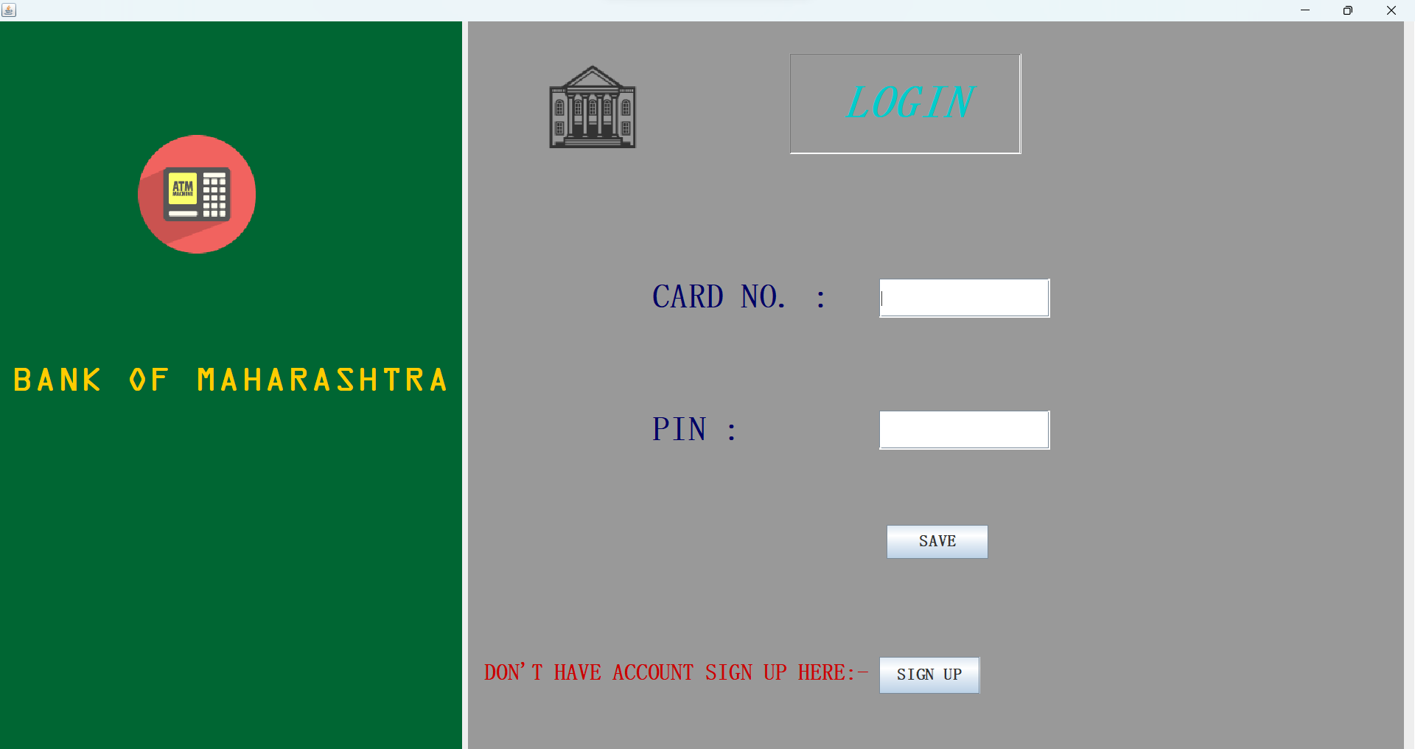
ATM INTERFACE – Login Page

Slide 16
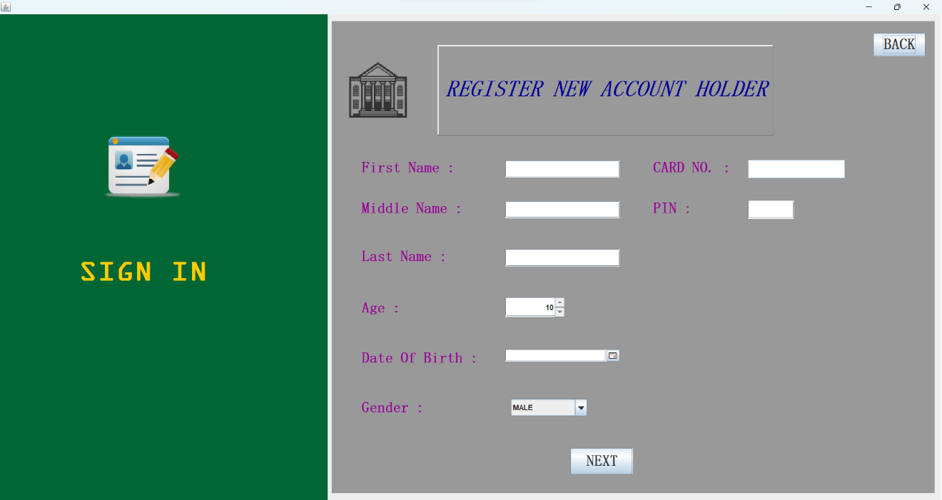
ATM INTERFACE – Sign-in Page

Slide 17
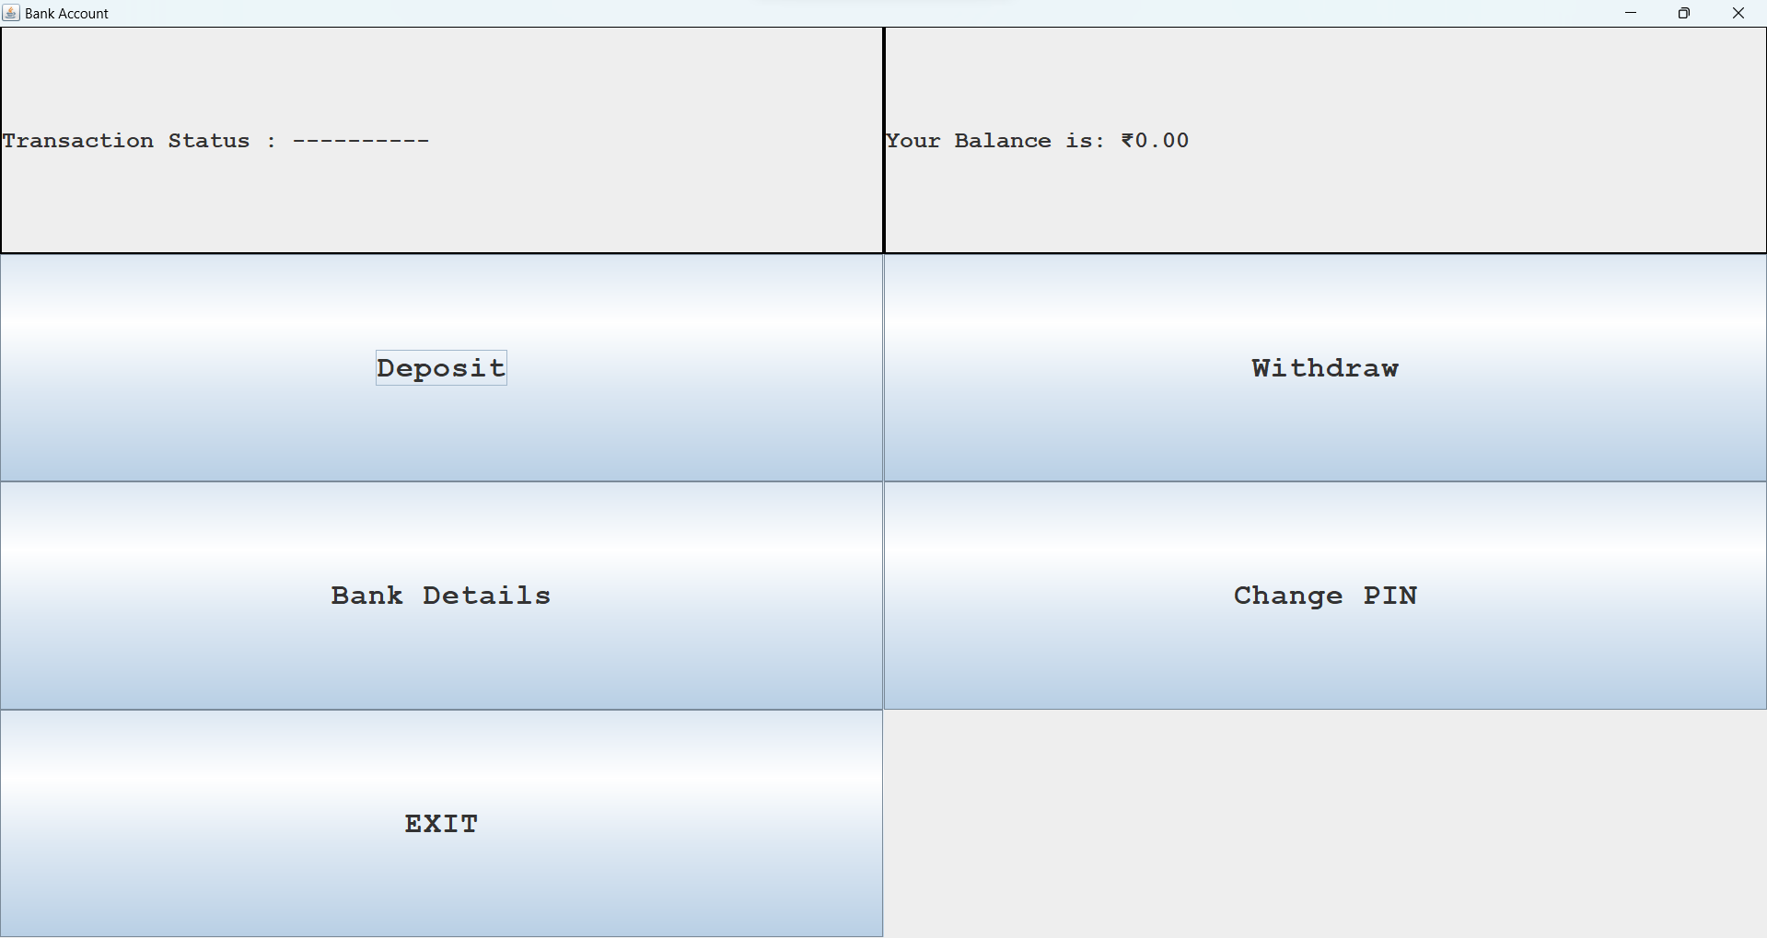
ATM INTERFACE – Transactions Page

Slide 18
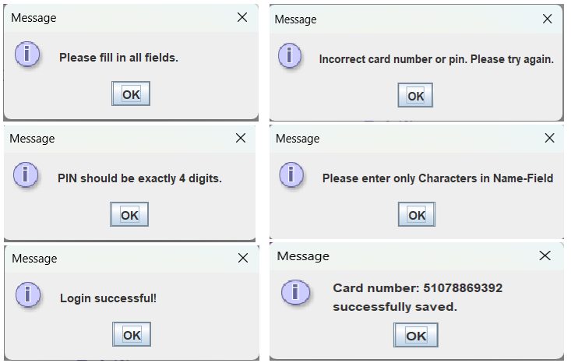
ATM INTERFACE – Messages & Warnings

Slide 19
Thank You

