Slide 1



FACE DETECTION SYSTEM
Using Python and Tkinter GUI

Slide 2


TABLE CONTENTS
01
Introduction
02
Problem statement and scope
03
Methodologies
04
System flow diagram & Design Details
05
Hardware and software details

Slide 3

INTRODUCTION

Slide 4


General Overview
The face detection system developed using VS code, tkinter GUI, and openCV. This system is designed to provide a user-friendly interface and offers multiple functionalities. It is capable of detecting faces, saving detected face samples into a database, adding new students, and adding teachers. The system can also detect faces and securely store them in the database
the project incorporates various aspects such as database management, object-oriented programming, data structures, and openCV concepts. The use of user authentication ensures the security of the system

Slide 5


Problem Statement and Objective
Objective
Problem statement
The face detection System, designed for student attendance, aims to provide an efficient, accurate, and user-friendly solution for managing and tracking attendance in educational institutions.
Develop an efficient, accurate, and user-friendly face detection System that automates student attendance tracking, ensures secure access control, and simplifies data management in educational institutions, utilizing advanced technologies such as OpenCV, database management, object-oriented programming, and data structures.

Slide 6
METHODOLOGIES

Slide 7


Requirements Gathering and Analysis:
Identify the stakeholders (students, teachers, administrators) and gather their requirements for the app.
Analyze the gathered requirements to understand the app's functional and non-functional aspects.
Design and Development :
Design the user interface and app architecture,including hardware and software components.Intigrate a face detection and recogonition algorithm using OpenCV and python with tkinter for the GUI this involve pre trained models such as haar cascade,LBHP or CNNs for the face detection
Testing and Validation:Perform unit testing on individual components, such as login, registration, and face recognition modules. Validate the app's performance, accuracy, and efficiency in real-world scenarios.
Deployment, Training, and Maintenance :Monitor the app's performance, address issues, and continuously update and improve it based on user feedback and technological advancements.

Slide 8
SYSTEM FLOW DIAGRAM AND DESIGN DETAILS

Slide 9










System Diagram
Register new student
Training And Register a Face
User
Login
Excel attendance
sheet
Take attendance
Face recognition
Save into folder
no
Register
Excel sheet as per the subject
View attendance
Excel
attendance
sheet

Slide 10

Design Details
Python
OpenCV
My SQL
Tkinter
The Face Detection System will utilize Python with the OpenCV library for robust face detection capabilities. Tkinter will be employed for the user interface, offering a user-friendly experience. The system will employ pre-trained models like Haar Cascades or Convolutional Neural Networks (CNNs) for accurate face detection.
Designing a face detection system using OpenCV involves setting up the development environment, processing input images, implementing face detection algorithms, and face landmark detection and recognition.
We have use my sql for the data base. efficient in data managing and easy to use interface. through witch we can manage large amount of data
Tkinter will serve as the graphical user interface toolkit for the Face Detection System, offering a cross-platform solution for GUI development in Python. It will provide widgets and tools for creating an intuitive user interface with features like buttons, labels, and input fields.

Slide 11
Hardware And Software Details
Software
1. VS code editor
2. Operating System
3. Python version 3.0 or above
4. OpenCV
5. My SQL
Hardware
1. RAM: 512 MB RAM
2. Hard Drive: 4 GB Hard Drive
3. Processor: Intel Core-i3 Processor

Slide 12
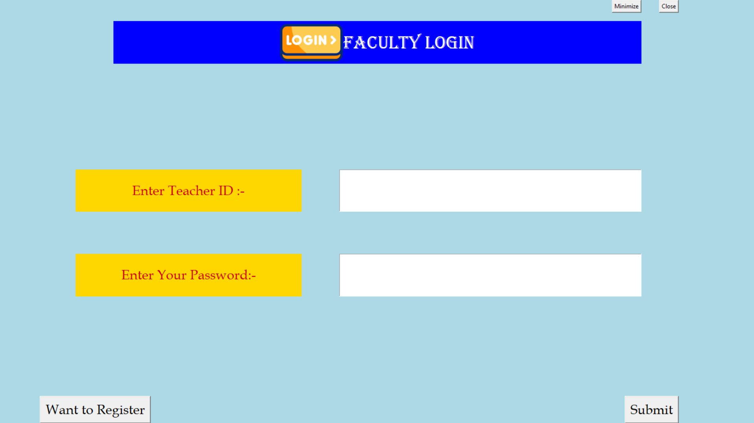
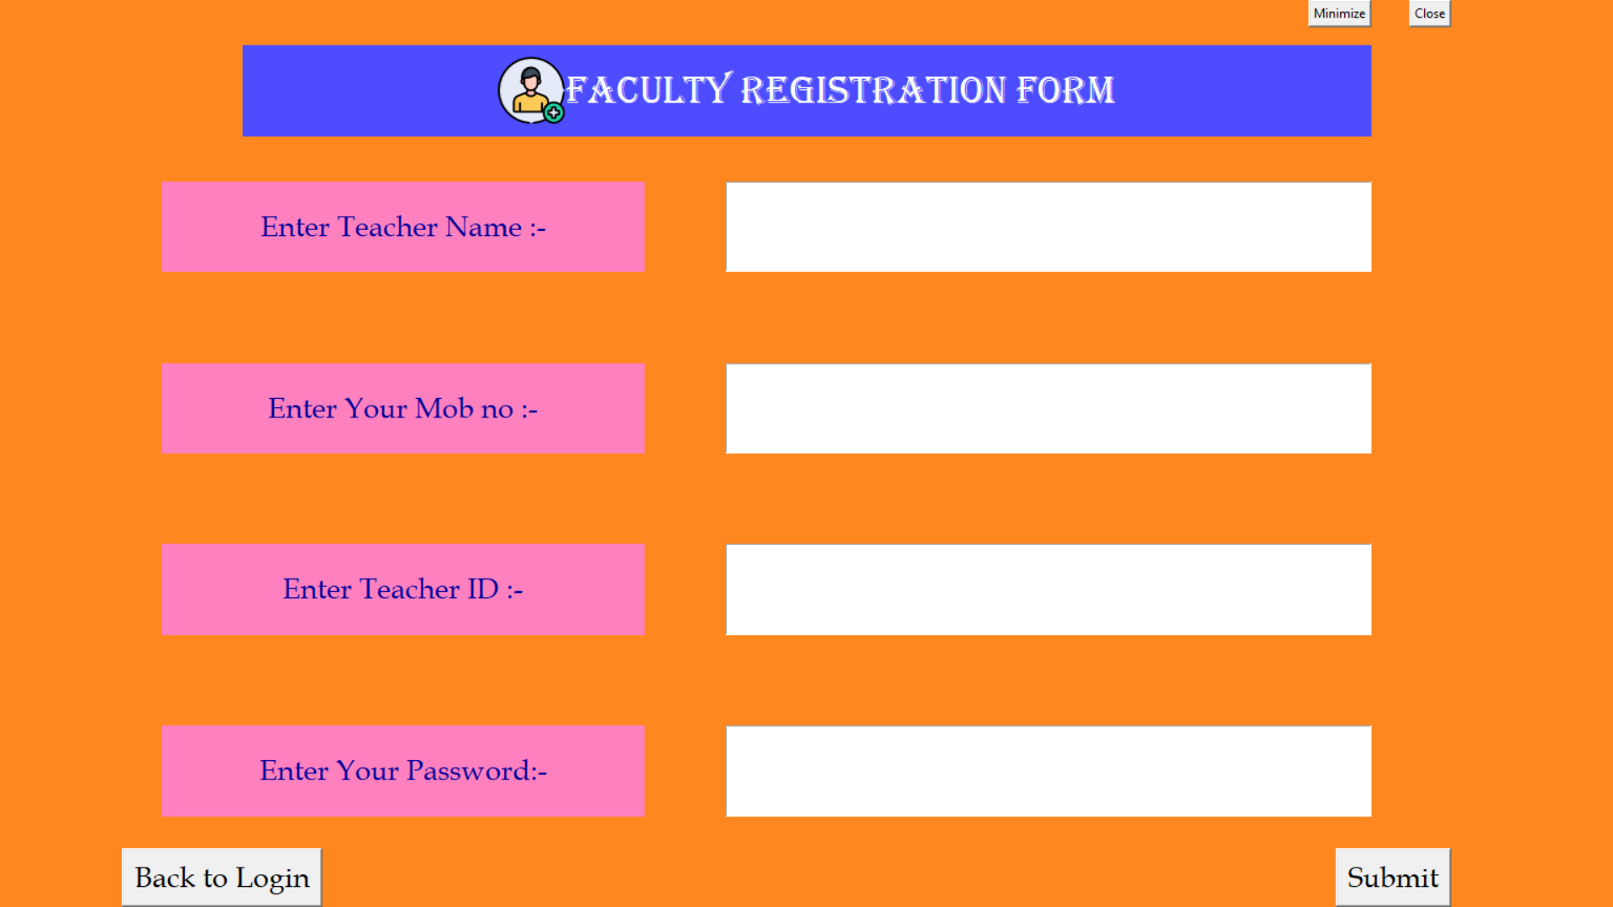
RESULT
Login Page
Registration Page

Slide 13
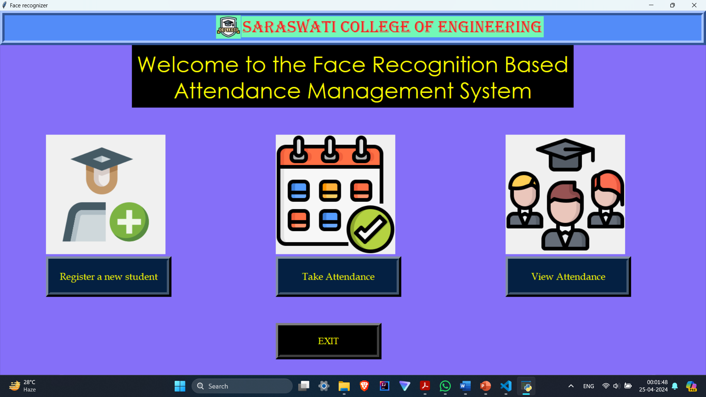
HomePage Interface for Faculty

Slide 14
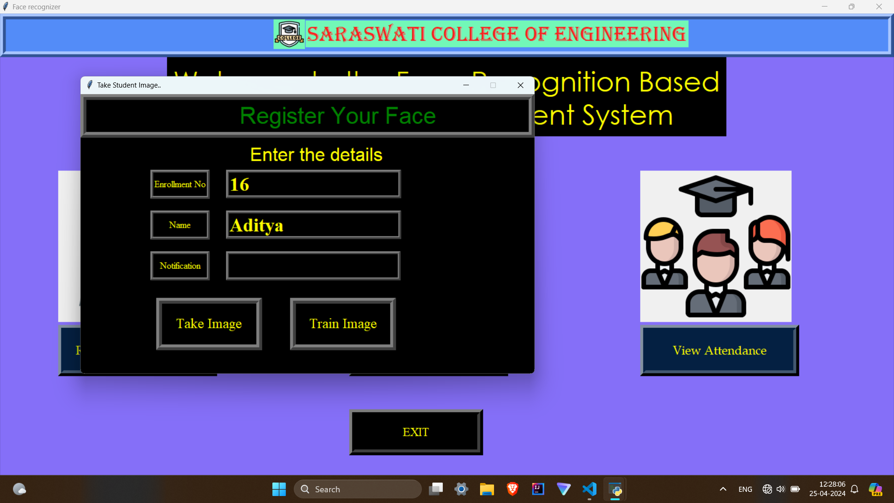
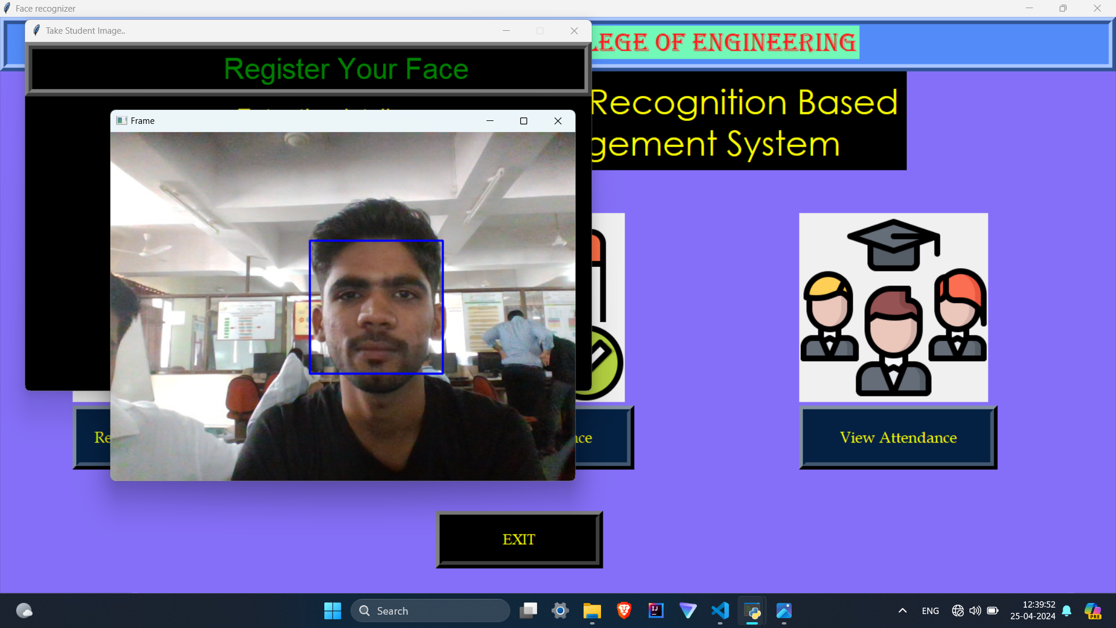
Registration of Student Face
← Entering Student Information
Training Student Faces →

Slide 15
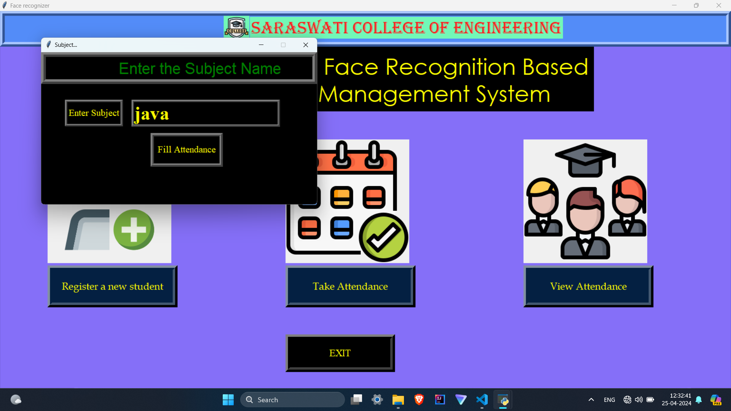
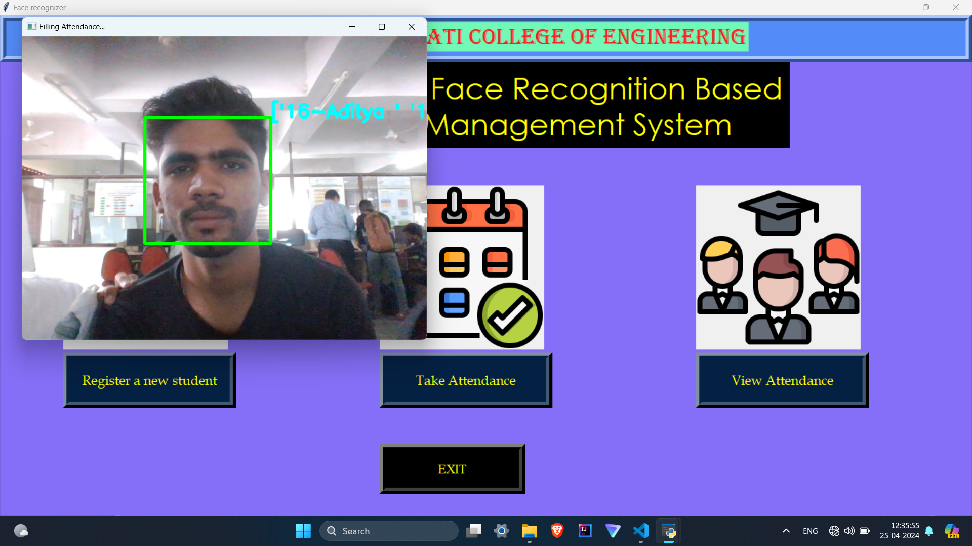
Taking Attendance
← Entering Subject Name
Recognizing Student Faces for attendance →

Slide 16

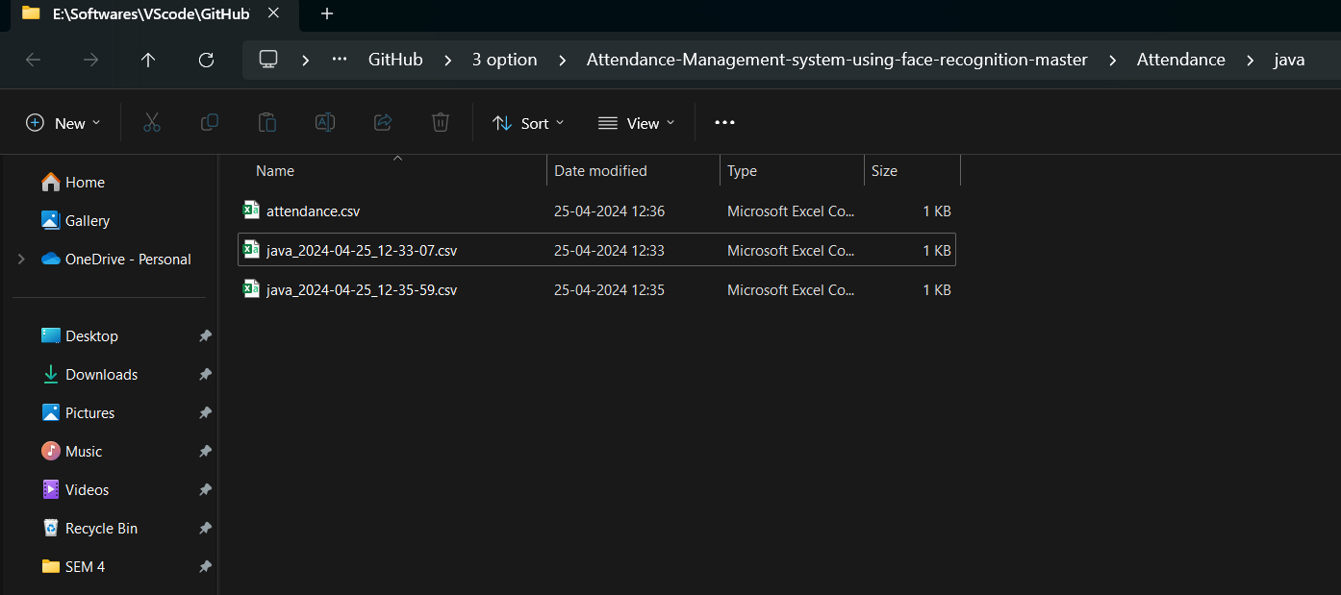
Checking Attendance Entry
← Student Entry in Excel Sheet
Attendance Excel Sheet Saved →

Slide 17
Conclusion
The Facial Detection Attendance System in Python has successfully demonstrated the potential of facial recognition technology in automating attendance processes. By utilizing advanced image processing and machine learning algorithms, the system has been able to accurately detect and identify individuals within a given environment. The implementation of this system has led to increased efficiency, reduced human error, and enhanced security in managing attendance records

Slide 18
Future Scope
Scalability: The system can be scaled to accommodate larger organizations or institutions, ensuring that it remains efficient and effective even as the number of users increases.
Multiple Face Detection: The future of multiple face detection involves optimizing algorithms for real-time processing, enabling applications to detect and track multiple faces instantaneously. This capability is crucial for security systems, surveillance, and interactive applications.
Artificial Intelligence (AI) integration: Incorporating AI technologies like deep learning and natural language processing can further improve the system's performance and introduce new functionalities, such as voice-based attendance or personalized recommendations for time management.

Slide 19
THANK YOU

