Slide 1
01 | ARCHITECTURE
From quantitative model to production-ready service
QuantShield keeps its ML core intact while DevOps adds repeatability, resilience and observability.
CONTROL
Source control
OBJECTIVE
feature branch → main
Wrap the existing
CatBoost-backed risk engine
in a reliable delivery lifecycle.
AUTOMATE
CI/CD
GitHub Actions on ephemeral runners
CONFIGURE
Configuration
Ansible · idempotent runtime setup
PACKAGE
No changes to the underlying
quantitative risk logic.
Container
Python 3.11-slim · immutable image
ORCHESTRATE
Orchestration
Design principle
Kubernetes (KinD) · 2 replicas
Shift-left validation
OBSERVE
Observability
Catch runtime, schema and rollout issues before they reach the cluster.
Prometheus → Grafana · golden signals
Notes:
Good morning professors. Instead of building a disposable toy demo, we took our real BTech machine learning project, QuantShield, and engineered a DevOps layer around it. The goal is to make infrastructure reproducible, container builds consistent, deployments controlled, and application behavior observable — while keeping the quantitative risk logic untouched.

Slide 2
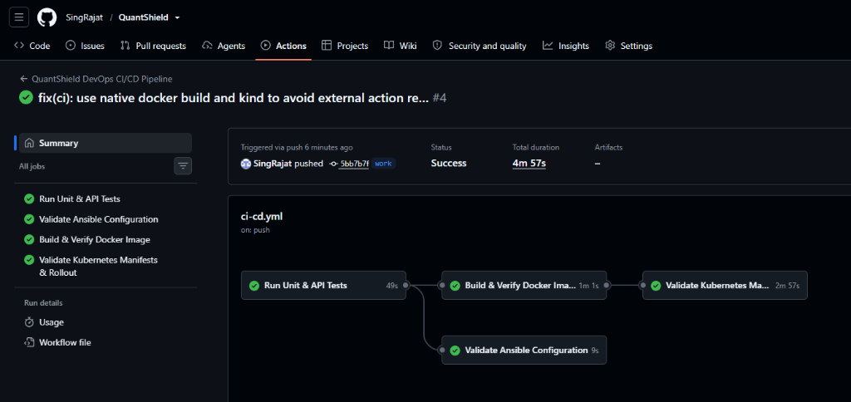
02 | CI/CD
The continuous delivery engine — GitHub Actions
Every change passes the same automated gates before it becomes a deployable artifact.
TRIGGER
1
01 Validate
2
02 IaC check
3
03 Package
4
04 Prove
push / pull request
Tests + health + /metrics sanity check
Ansible syntax validation / lint
Docker build with deterministic tags
KinD apply + rollout verification
LIVE PROOF: GITHUB ACTIONS PIPELINE (ALL 4 GATING STAGES PASSED · 4m 57s)
WHAT THE PIPELINE PROVES
The service can start and answer its health check.
Ansible automation is syntactically valid.
The production Docker image builds successfully.
Notes:
Here is the CI/CD pipeline. Every change follows the same gates: validate the API, verify the Ansible automation, build the container, and prove the Kubernetes manifests can actually roll out. The important point is that the pipeline does not stop at a unit test — it validates the delivery path itself.

Slide 3
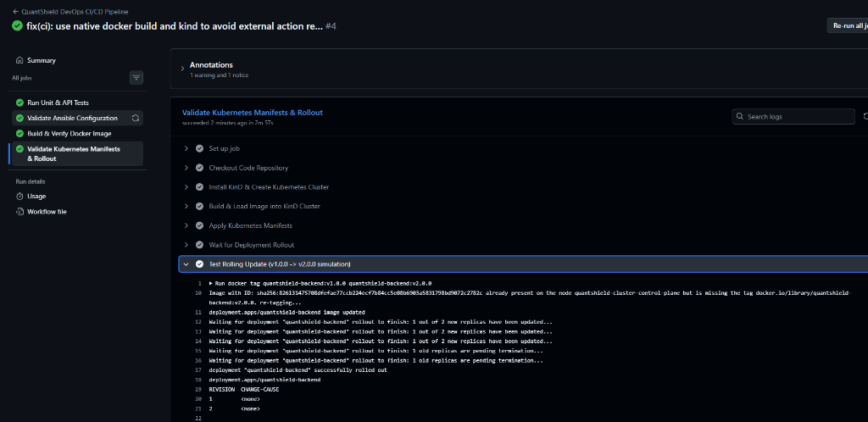
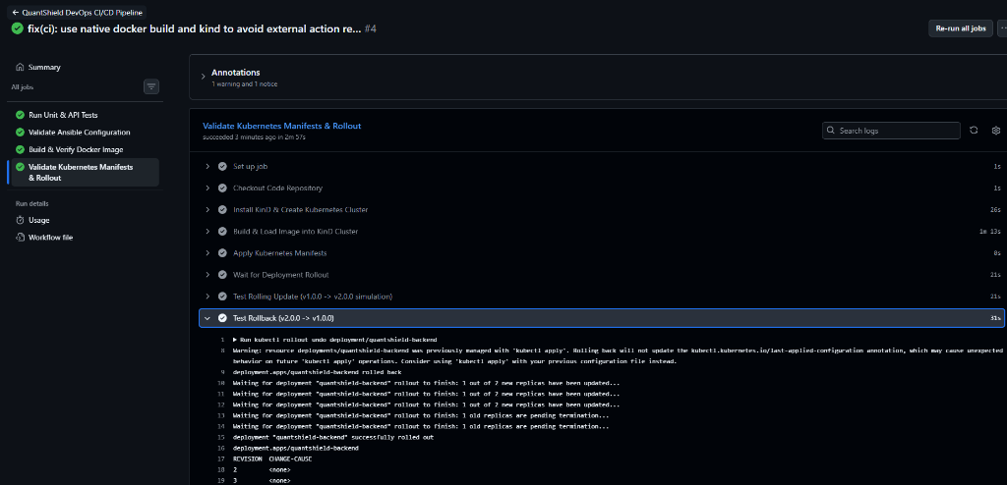
03 | CONTAINERS + K8S
Containerization and zero-downtime orchestration
Docker standardizes the runtime; Kubernetes controls availability, rollout and recovery.
DOCKER
KUBERNETES
Immutable application image
2 replicas · readiness + liveness · rolling update
RUNTIME
BASE
Deployment
Python 3.11
slim
Service
Pod 1
Pod 2
NodePort :30080
Packaging priorities
ready ✓
ready ✓
Dependencies installed before source copy for cache reuse.
Port 8000 exposed to the service layer.
LIVE KUBERNETES ORCHESTRATION PROOF (KinD CLUSTER)
Rolling Update: v1.0.0 → v2.0.0 (100% Uptime)
Disaster Recovery: Rollback v2 → v1 (<15s MTTR)
Health check aligned to the existing risk health endpoint.
Build once. Run the same image everywhere.
Notes:
For containerization, we package the actual QuantShield backend into a consistent Python runtime. Kubernetes then keeps two replicas behind a service, with readiness and liveness probes tied to the existing health endpoint. The important DevOps demonstration is the controlled rollout: update from v1 to v2, observe the rollout, and recover with kubectl rollout undo if needed.

Slide 4
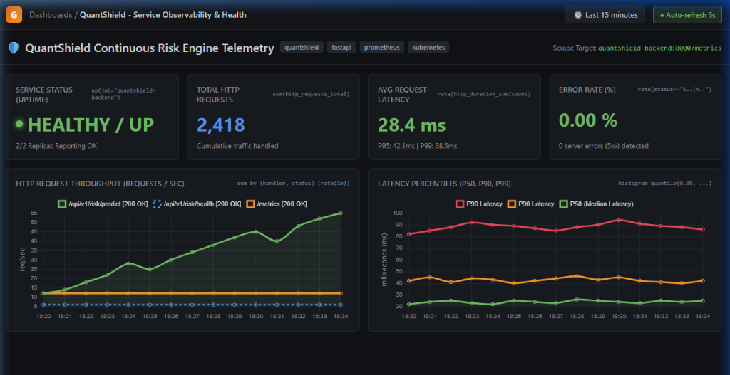
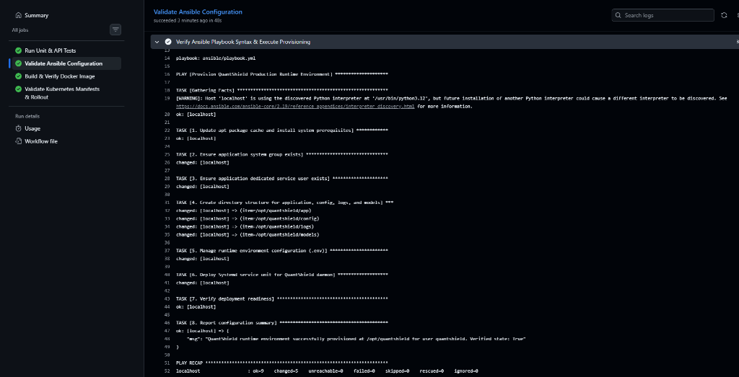
04 | IAC + OBSERVABILITY
Infrastructure as code meets full-stack telemetry
Ansible makes runtime setup repeatable; Prometheus and Grafana make the running service measurable.
ANSIBLE
PROMETHEUS + GRAFANA
Repeatable host configuration
Observe the service in real time
Packages
Identity
QuantShield API
Prometheus
Grafana
git · pip · docker
quantshield user
/metrics
pull + store
dashboard
Filesystem
Config
/opt/quantshield
non-secret env template
LIVE GRAFANA OBSERVABILITY DASHBOARD (FOUR GOLDEN SIGNALS)
PLAY RECAP: ok=9 changed=5 failed=0
Notes:
Ansible addresses the environment side: packages, service identity, directories and configuration are created consistently instead of manually. Prometheus and Grafana address the runtime side: the FastAPI service exposes metrics, Prometheus collects them, and Grafana visualizes uptime, latency, traffic and errors. Together, configuration and observability close the operational loop.

Slide 5
05 | REFLECTION
Production realities — what the deployment taught us
Deploying an ML-backed service exposed constraints that are easy to miss in local development.
01
Scientific dependencies
02
Python runtime compatibility
03
ML cold-start vs probes
NumPy, Pandas, Scikit-learn and CatBoost increase container size.
Typing/runtime differences can surface only on cloud runners.
Model deserialization can take longer than a web app startup.
Response
Response
Response
Trim base packages, clean apt caches, and keep the build context tight.
Make imports explicit and validate against the same Python version in CI.
Tune readiness/liveness behavior around real model warm-up time.
THREE TAKEAWAYS
Idempotency
Shift-left observability
Automation compounds
Rerunning automation should converge safely.
Metrics belong in the service, not only in production.
A repeatable pipeline turns deployment into a process, not a ritual.
REPEATABLE BUILD
REPRODUCIBLE RUNTIME
CONTROLLED ROLLOUT
OBSERVABLE APP
→ QuantShield is no longer “just code”; it is an operable service.
Notes:
To conclude, the biggest lesson was that ML deployment is different from deploying a basic web API. Scientific dependencies affect the container footprint, runtime compatibility can surface in CI, and model warm-up time affects Kubernetes probe design. The broader lesson is that DevOps is not just a toolchain — it is the discipline that makes the whole lifecycle repeatable and observable.

