Slide 1
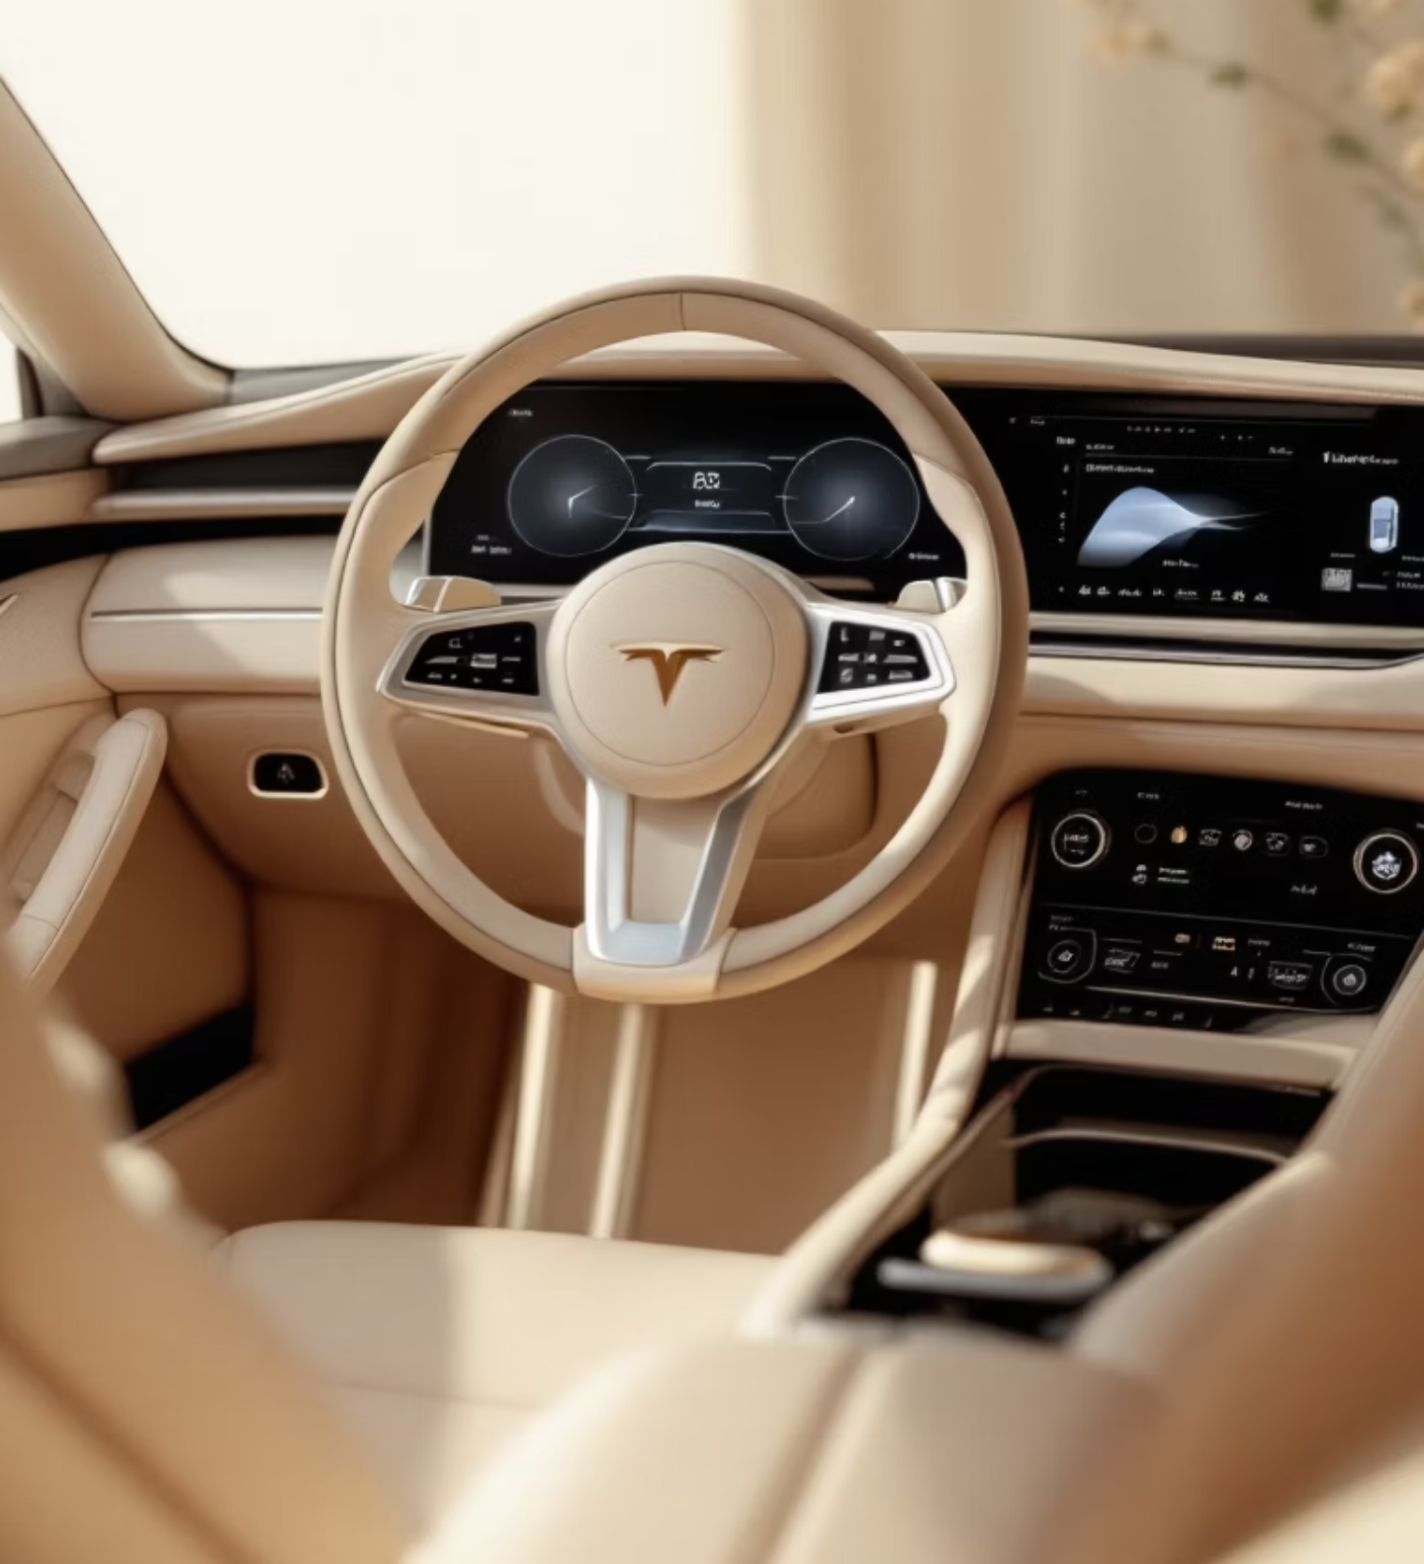

Intelligent Vehicle Sensor Dashboard System
Real-Time Multi-Process ADAS Implementation in C

Slide 2
Executive Summary
A sophisticated real-time multi-process vehicle monitoring and control system demonstrating advanced systems programming concepts. The implementation features an interactive ncurses - based dashboard that monitors multiple vehicle sensors simultaneously, providing intelligent alerts for safety-critical situations through inter-process communication, multi-threading, and network programming.
8+
2
Concurrent Modules
Shared Memory
Independent sensor processes
IPC segments (8108, 9999)

Slide 3
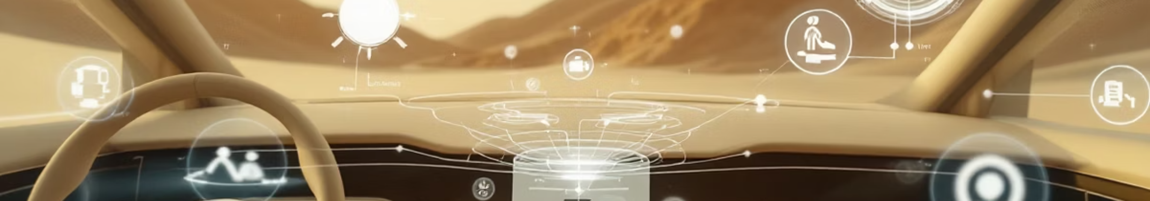
Problem Statement
Real-Time Monitoring
Driver Safety
Modern vehicles require simultaneous monitoring of multiple safety-critical systems with sub-second latency requirements
Immediate alerts for critical conditions are essential to prevent accidents and save lives
Complex Processing
System Integration
Sensor data requires intelligent analysis, fusion, and prioritized visualization
Need for cohesive ADAS architecture unifying disparate monitoring capabilities

Slide 4
Solution Architecture
1
2
3
Multi-Process Architecture
System V IPC
Interactive UI
Centralized dashboard coordinating independent sensor processes
Real-time data sharing via shared memory segments
Terminal-based ncurses interface with dynamic screen management
4
5
Alert Management
Remote Monitoring
Severity-based notification system with visual and auditory feedback
TCP/IP networking with HTTP web interface capability

Slide 5
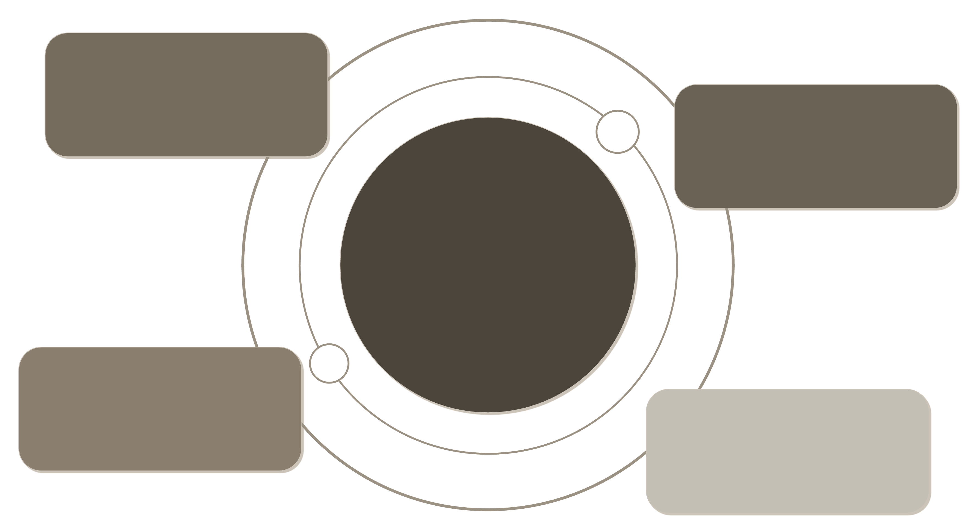
System Architecture Overview
Collision Avoidance
Bidirectional via shm 8108/9999
Lane Departure
Bidirectional via shm 8108/9999
Dashboard UI
Central node using
shm, FIFO, TCP
Driver Monitor
Bidirectional via shm
8108/9999
Blind Spot
Bidirectional via shm
8108/9999

Slide 6




Critical Safety Features
Collision Avoidance System
Lane Departure Warning
Distance monitoring (<30m trigger)
Real-time lane position tracking
Speed analysis (alerts >50 km/h)
Instant driver alerts
Automatic emergency braking (>80 km/h)
Continuous boundary detection
Driver Drowsiness Detection
Blind Spot Detection
Eye closure monitoring (75% threshold)
Left/right vehicle presence
Yawn detection (60% threshold)
Continuous monitoring during operation
Progressive fatigue alerts
Lane change warnings

Slide 7
Vehicle Health Monitoring
Tyre Pressure Monitoring
Fuel Level System
Real-time tracking with 25 PSI minimum threshold for all four wheels. Multi-threaded processing ensures immediate detection of pressure anomalies.
Continuous monitoring with critical alert triggering at <30% capacity. Provides range estimation based on consumption patterns.
Engine Temperature
Concurrent Processing
Warning system triggers at >100°C with graduated alert levels. Prevents thermal damage through early intervention.
Multi-threaded sensor architecture with mutex-protected shared memory ensuring data consistency across all health metrics.

Slide 8




Environmental Monitoring
Temperature & Humidity
Rain Intensity Detection
Cabin comfort tracking with automatic climate control recommendations. Maintains optimal driving conditions through continuous environmental assessment.
Multi-level precipitation monitoring for automated wiper control. Adjusts wiper speed dynamically based on detected rainfall intensity.
Fog Level Monitoring
Driving Recommendations
Visibility assessment with graduated warning levels. Provides driving recommendations and automatic lighting adjustments in reduced visibility conditions.
Intelligent suggestions based on current weather patterns. Integrates multiple environmental factors to provide actionable safety guidance.

Slide 9
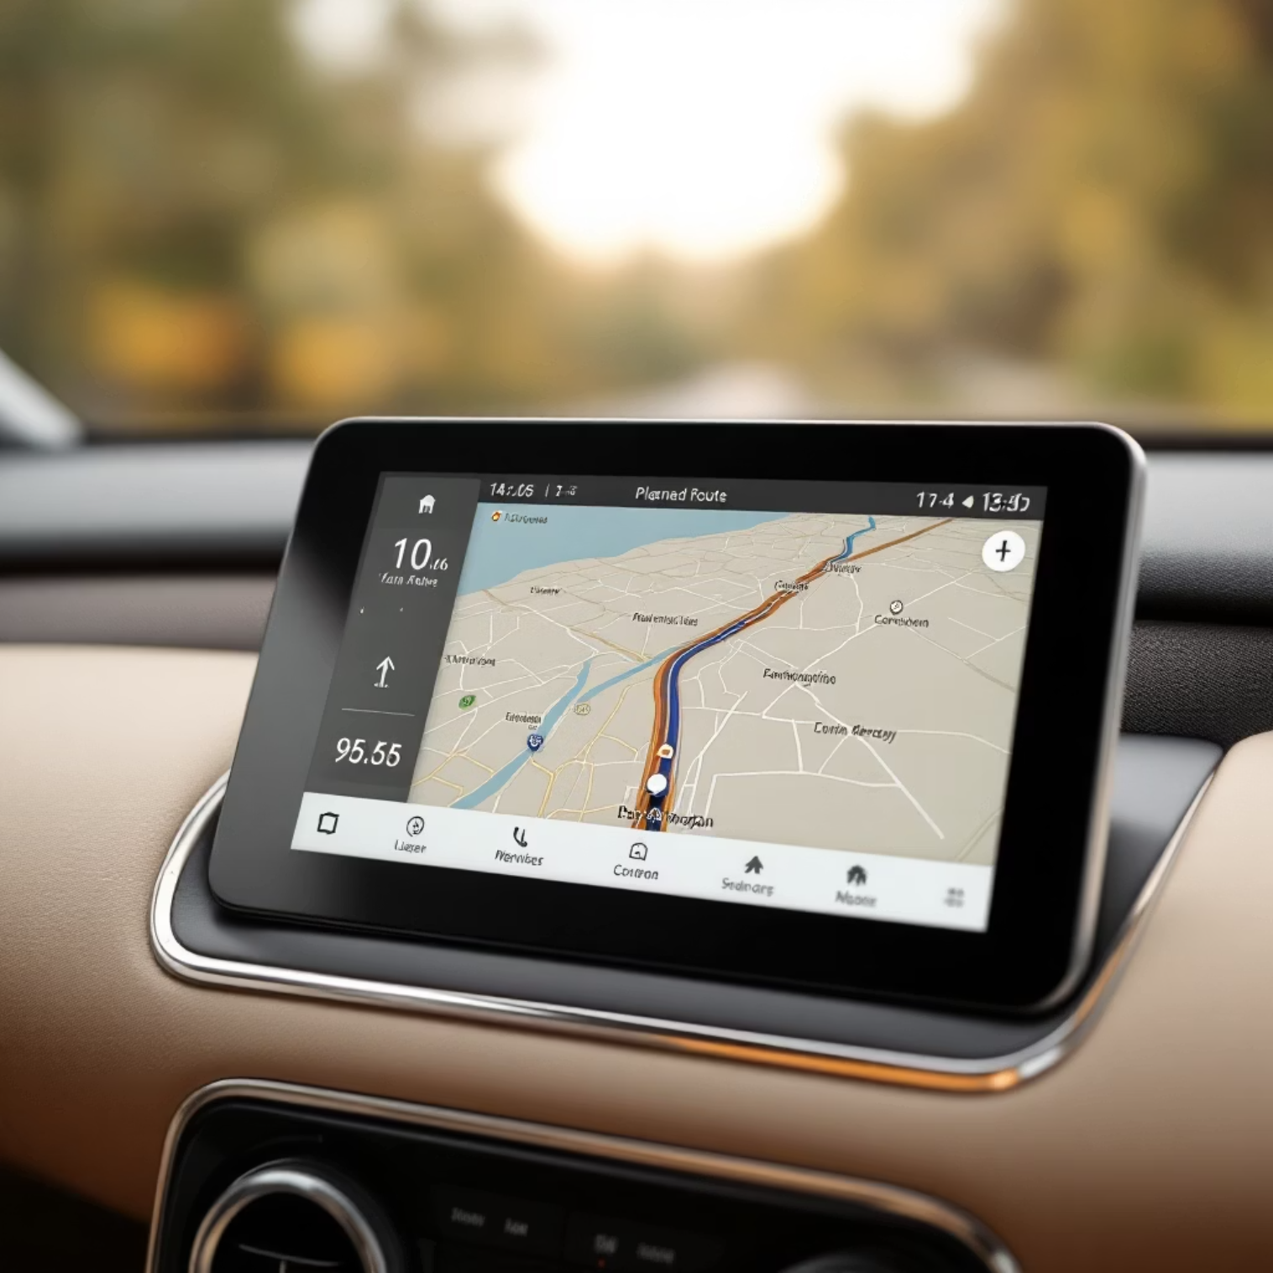
GPS Navigation System
Real-Time Location Tracking
High-precision coordinate monitoring with continuous position updates
Dynamic Distance Calculation
Continuous recalculation of distance to destination accounting for route
changes
Turn-by-Turn Guidance
Progressive navigation instructions with arrival notifications and waypoint management
Remote Integration
TCP streaming for location data sharing with external monitoring systems

Slide 10
Proximity Detection (Parking module)
Front and rear ultrasonic sensors provide comprehensive coverage during parking maneuvers with real-time distance measurement and visual feedback.
🟢 Safe Zone
🟡 Warning
>50cm clearance
20-50cm proximity
🟠 Caution
🔴 STOP
10-20cm critical
<10cm immediate

Slide 11
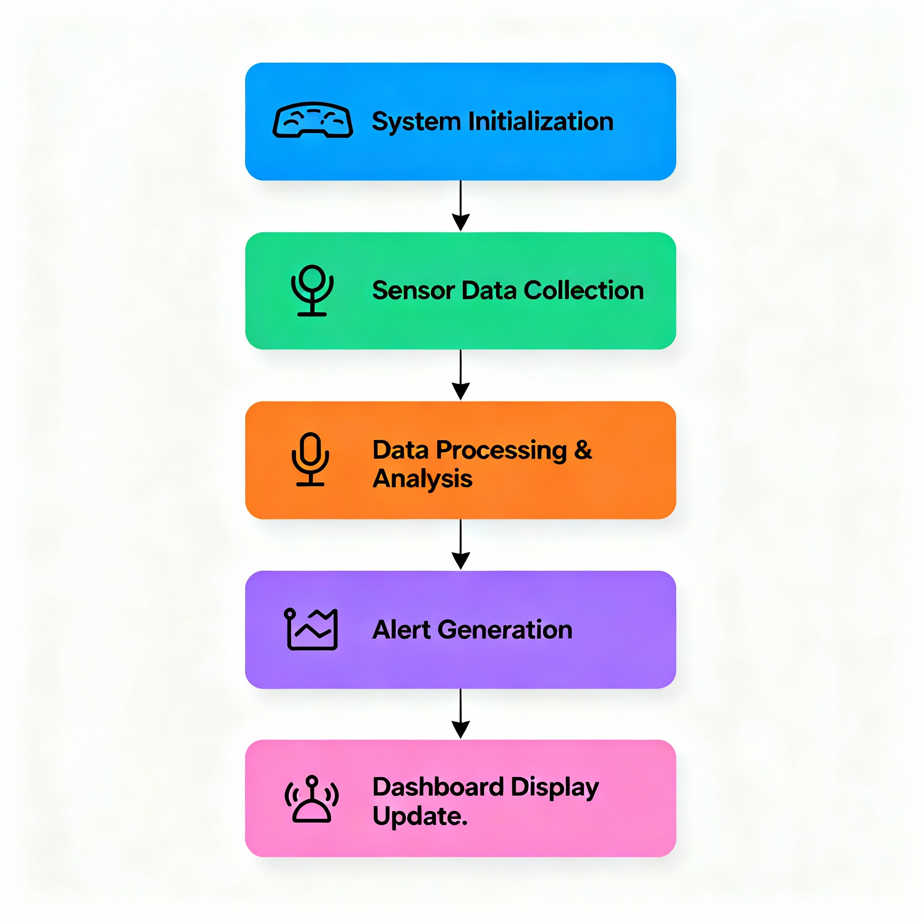
Flow Chart

Slide 12
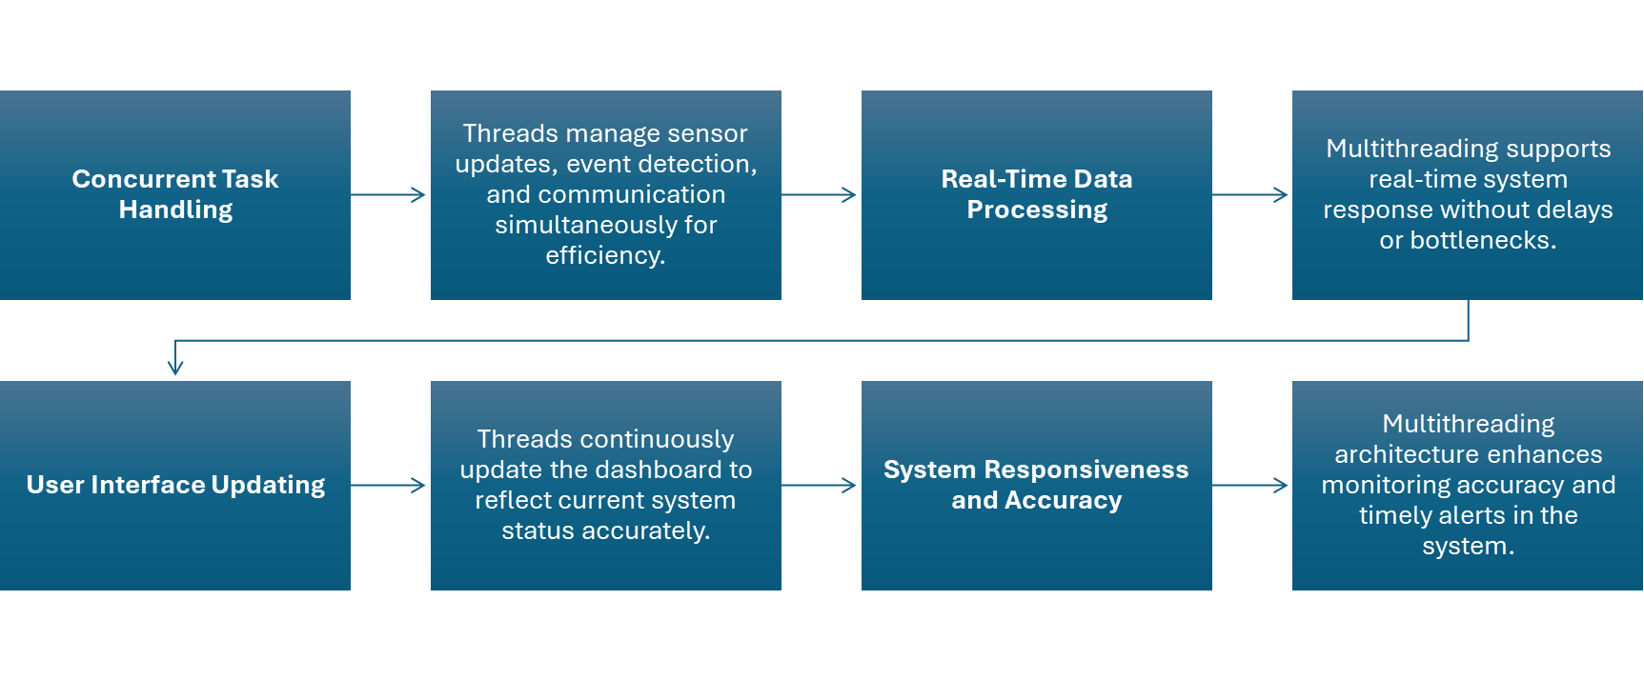
Multi-threading Architecture

Slide 13
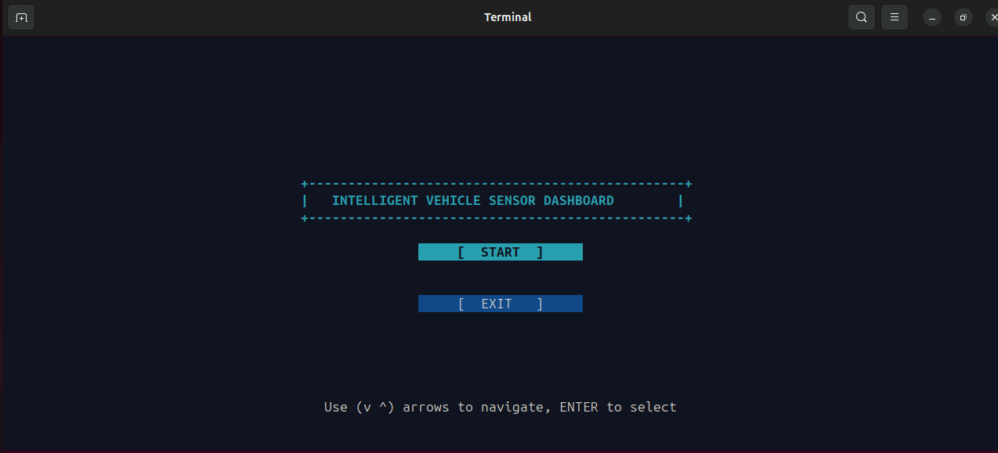
SCREEN-1

Slide 14
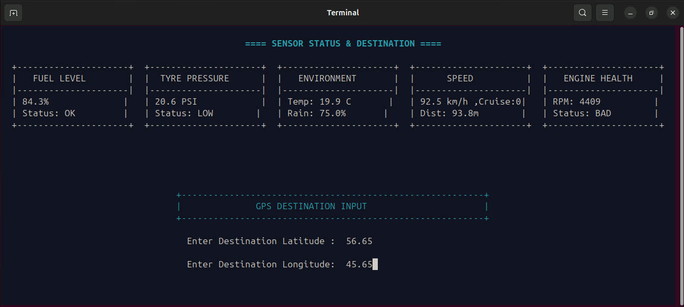
SCREEN-2

Slide 15
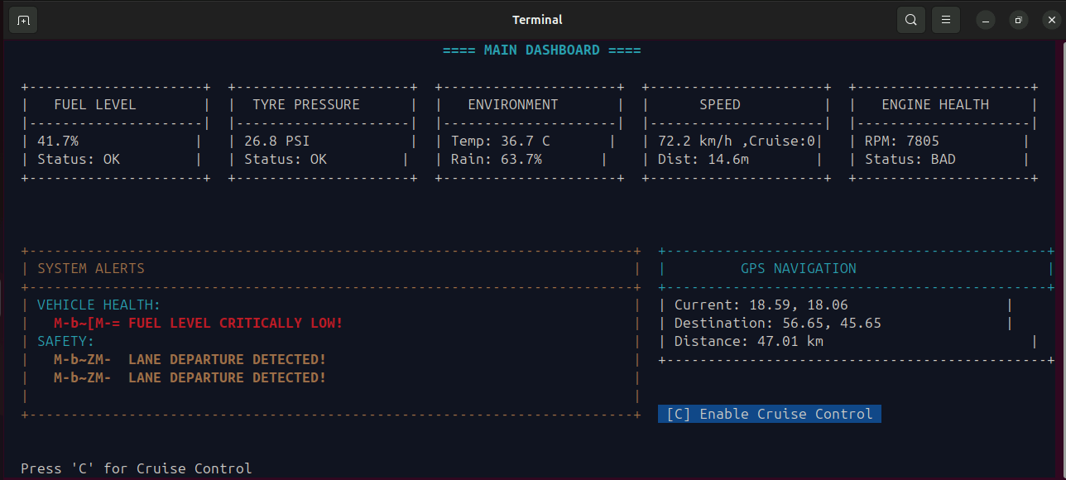
SCREEN-3

Slide 16
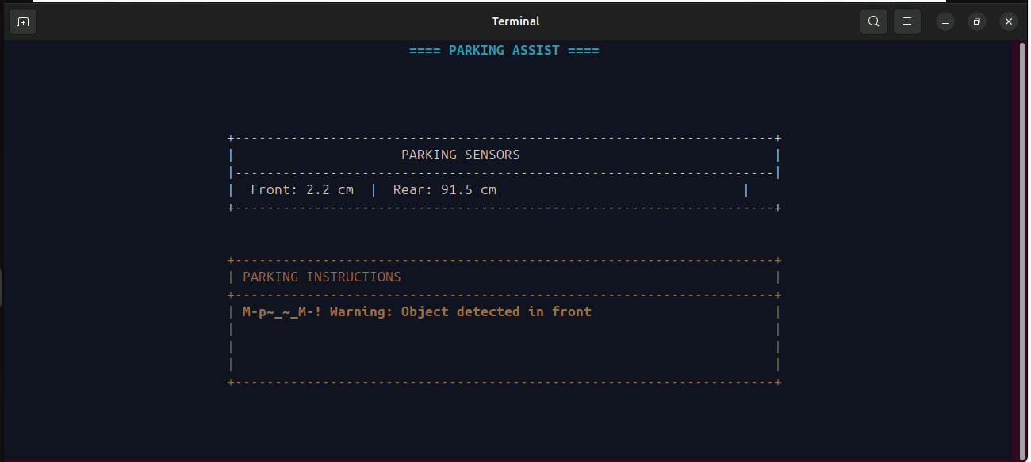
SCREEN-4

Slide 17
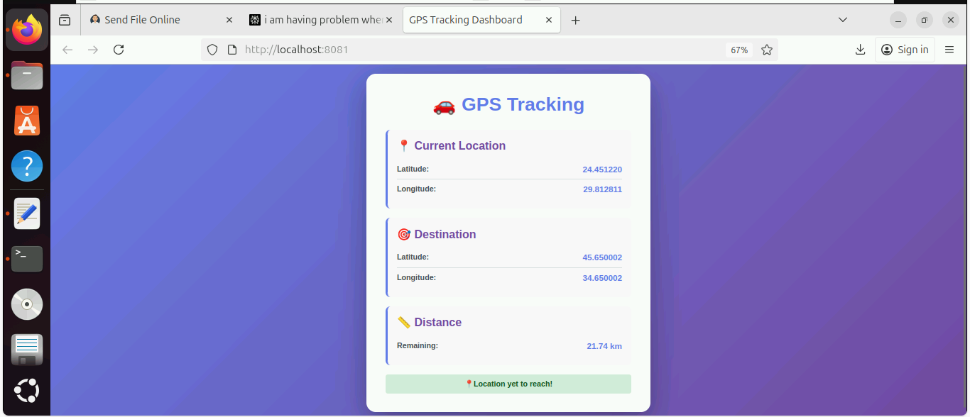
WEB UI (SERVER)

