Slide 1
AI-FITNESS TRAINEE
By
B.Pushpa Shree o190867
Under the Guidance of
Ms. Bheema Shireesha
Assistant Professor

Slide 2
CONTENTS IN THE PPT
INTERNSHIP CERTIFICATE
ABSTRACT
INTRODUCTION
EXISTING SYSTEM
PROPOSED SYSTEM
HARDWARE AND SOFTWARE REQUIREMENTS
TECHNOLOGIES USED
DESIGN
IMPLEMENTATION
SAMPLE OUTPUTS
ADVANTAGES AND DISADVANTAGES
FUTURE SCOPE
CONCLUSION

Slide 3

INTERNSHIP CERTIFICATE

Slide 4
ABSTRACT
Many people face health issues due to a lack of physical activity, increasing risks like obesity, high blood pressure, and heart disease. Our project aims to address this by using OpenCV and MediaPipe to track body movements via webcam and guide users on proper exercise or yoga form. MediaPipe detects 33 body landmarks in real-time, allowing us to assess posture and provide personalized feedback. This solution helps users improve their form from home, removing barriers like gym travel, trainer costs, and social anxiety.

Slide 5
INTRODUCTION
Exercise is vital for maintaining health and fitness, yet modern sedentary lifestyles limit daily activity, leading to various health issues. Regular physical activity helps control weight, boost mental health, reduce disease risk, and improve sleep. Despite 60% of people not exercising regularly due to time constraints, it's essential for a healthy lifestyle. Proper form and tracking sets and reps are key to preventing injuries and staying motivated.

Slide 6
EXISTING SYSTEM
There are numerous applications available in the market which guide the user about the exercises to be performed. All of the applications and services of fitness available to the public on play store and app store are focusing on describing the exercise routine to be followed and the number of repetitions for which it should be performed and the time duration in which you need to complete.

Slide 7
PROPOSED SYSTEM
This project aims to develop an AI-based personal fitness trainer that helps users exercise correctly at home using real-time pose estimation. With the help of OpenCV and MediaPipe, the system uses a webcam to detect and analyze the user's body posture during workouts. It tracks key points on the body, calculates joint angles, and validates whether each exercise repetition is performed correctly. The system counts reps, checks form, and provides real-time feedback through voice alerts to help users improve performance and avoid injury. It’s a convenient, cost-effective solution for people who prefer home workouts but still want guidance similar to a personal trainer.

Slide 8
SOFTWARE AND HARDWARE REQUIREMENTS
Operating System: Windows 10 or Linux
Programming Language: Python 3.7 or higher
Libraries and Frameworks: Mediapipe,OpenCV, Streamlit ,NumPy, Pandas, and Matplotlib
IDE/Text Editor: Visual Studio Code and Jupyter Notebook
Web Browser: Google Chrome
Processor: Intel i5 or higher, or equivalent AMD processor
RAM: Minimum 8 GB
Storage: At least 500 MB of free storage
Internet Connection: Required for downloading libraries, datasets, and running the Streamlit app if deployed online

Slide 9
TECHNOLOGIES USED
python3
numpy
pandas
matplotlib
Mediapipe
SMTP
streamlit

Slide 10
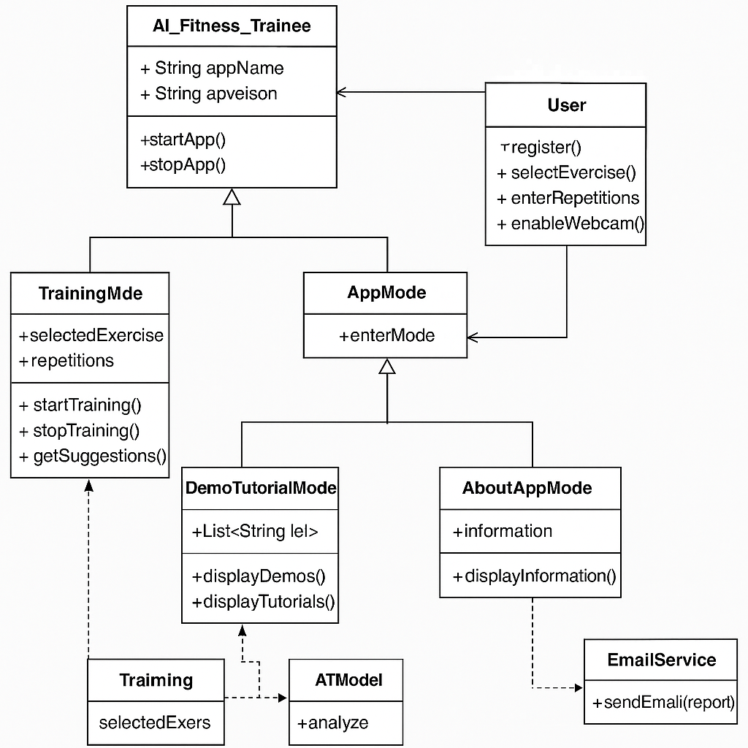
DESIGN
CLASS DIAGRAM

Slide 11
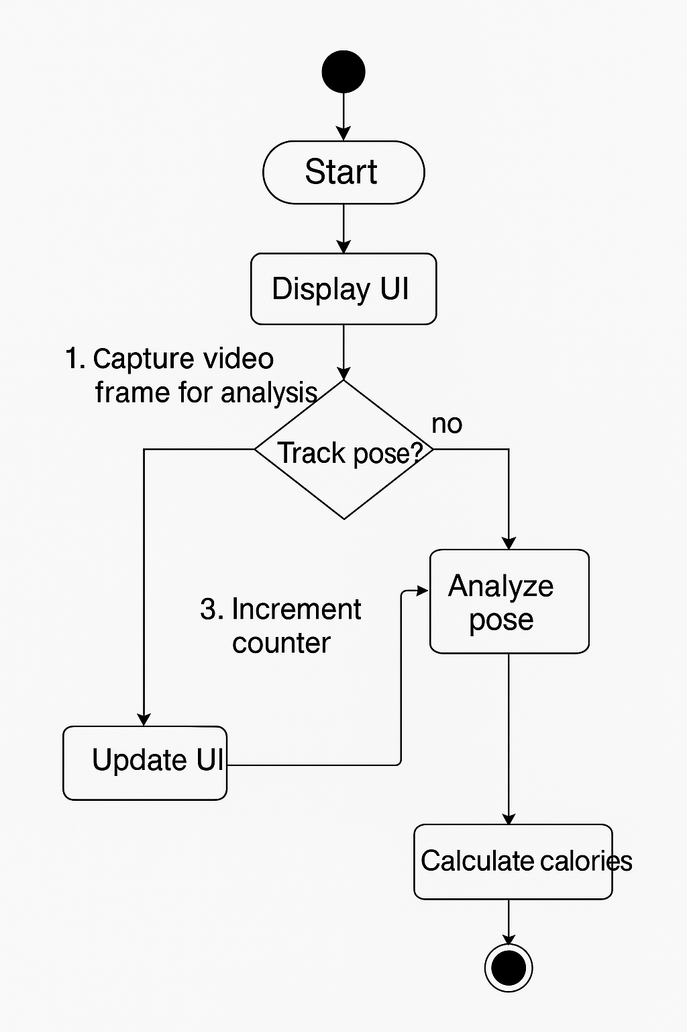
ACTIVITY DIAGRAM

Slide 12
IMPLEMENTATION
Main Streamlit Application with Webcam and UI
Module for Plotting Performance Graphs
Estimates Calories Burned Based on Exercise
Sends Email Summaries to Users

Slide 13
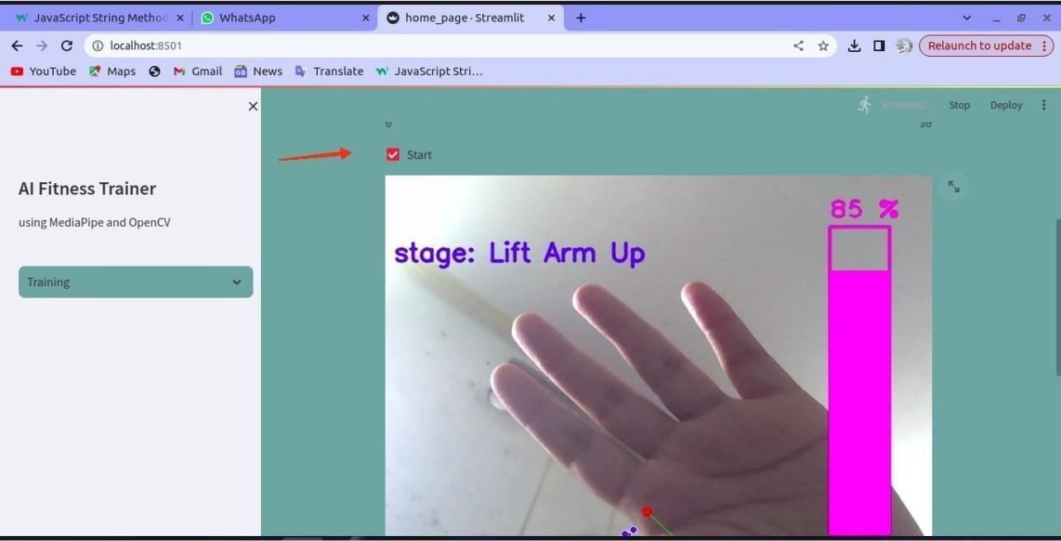
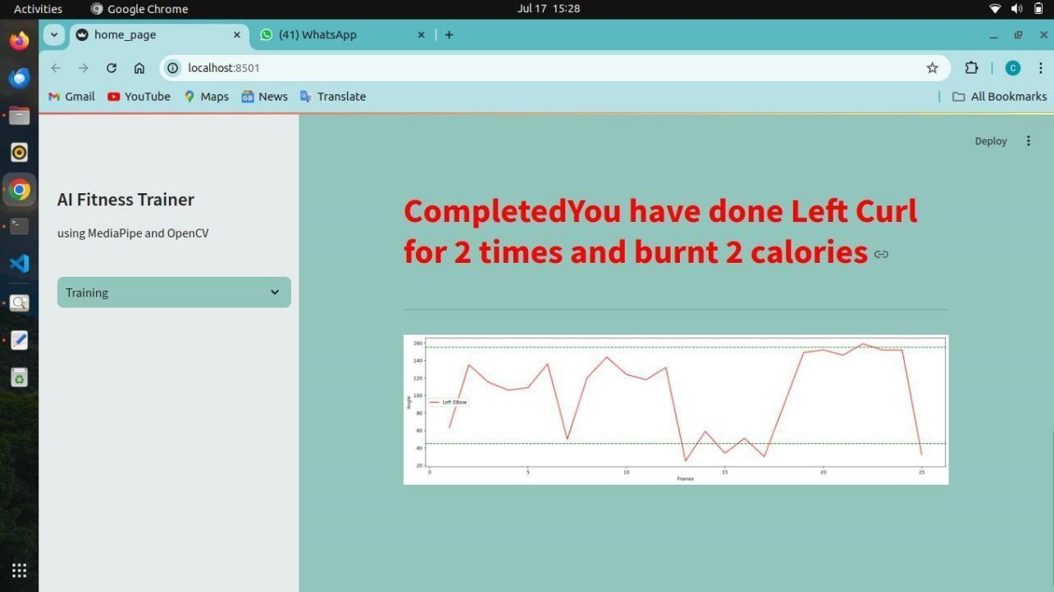
SAMPLE OUTPUTS

Slide 14
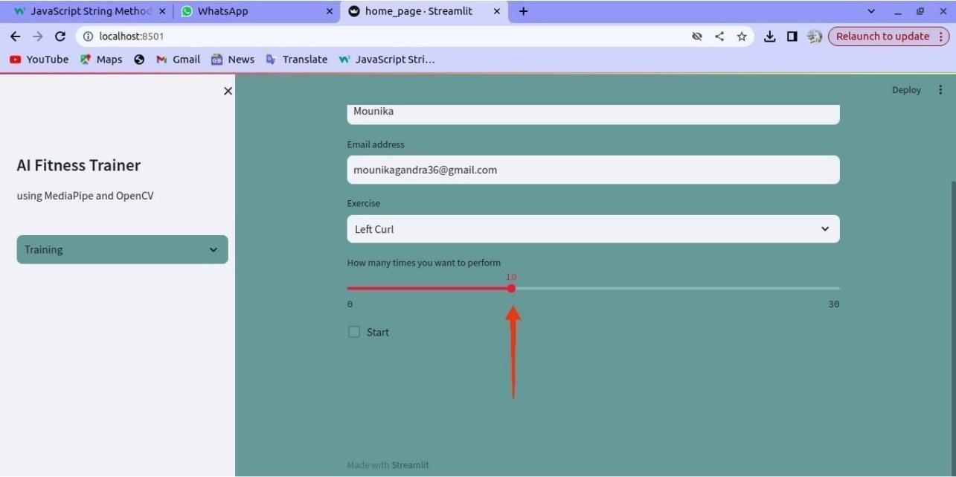
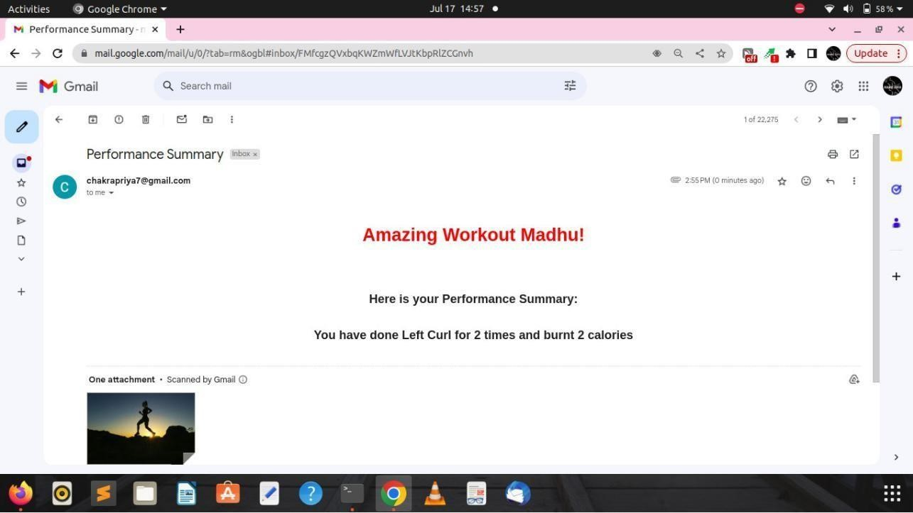

Slide 15
ADVANTAGES AND DISADVANTES
Accecebility
Smart Shceduling
Affordability
Proper Internet Connection
Lack of Personalisation
No Human Interaction
Limited Exercise Variety

Slide 16
FUTURE SCOPE
Real-Time Feedback and Corrections
AI-powered Personal Trainer Conversations

Slide 17
CONCLUSION
With increasingly busy lifestyles, many struggle to stay fit, leading to health issues. AI-powered fitness apps can help by providing personalized workout plans, tracking form, and offering feedback using pose estimation via camera. This reduces errors and makes home workouts more effective and accessible. The project aims to build an AI trainer that can guide users in real-time, replacing the need for constant human supervision.

Slide 18
THANK YOU
-BELLAMKONDA PUSHPA SHREE
O190867

