Slide 1
Course Navigator
It navigates you to the right path

Slide 2
BATCH - 67
J. Chandrika - O190019
B. Pushpa Sree - O190867
K.T.A Devi – O190101
V. Ramya Sri - O191082
G. Chandra Babu – O191100
Under the Guidance Of :
B. Shireesha ASST. PROF OF CSE DEPT.

Slide 3
CONTENTS
1. ABSTRACT
2. INTRODUCTION
3. EXISTING SYSTEM
4. PROPOSED SYSTEM
5. SOFTWARE AND HARDWARE REUIREMENTS
6. UML DIAGRAMS
7. DESIGN, IMPLEMENTATION AND OUTPUTS
8. ADVANTAGES
9. DISADVANTAGES
10. FUTURE SCOPE
11. CONCLUSION
12. REFERENCES

Slide 4
1.ABSTRACT
In today's fast-paced educational landscape, the abundance of available courses can overwhelm learners seeking to enhance their skills or acquire new knowledge. To address this challenge, a personalised course recommendation system is proposed. Leveraging advanced machine learning algorithms and user data, the system tailors recommendations to individual learners, taking into account their preferences and career goals. Through this approach, learners can discover courses aligned with their interests and objectives, facilitating continuous learning and professional development.

Slide 5
2.INTRODUCTION
Course Navigator is a machine learning model, it is trained
based on the dataset. If the user asked about any domain ,it suggests
all the paid and unpaid courses in different platforms. In this modern
world ,people find this very difficult to choose one among many, So
our Course Navigator overcomes this situation.

Slide 6
3.EXISTED SYSTEM
COURSERA Course Recommendation System:
Coursera course recommendation system utilizes various techniques to suggest courses to users based on their preferences, but it only recommends the courses in the coursera platform only.
UDEMY Course Recommendation System:
This is also same as the coursera recommendation system which only recommends the courses in their platform only.

Slide 7
4.PROPOSED SYSTEM
The proposed system "COURSE NAVIGATOR" contains courses
related to any field of Engineering. It suggests accordingly based on
the users requirement. Unlike the existed systems, it can cover both
paid and unpaid courses which is helpful to the students. It consists
numerous options based on their interests, budget, language
preference one can choose their needed course.

Slide 8
5.SOFTWARE AND HARDWARE REQUIREMENTS
Software Requirements: Harware Requirements:
Frontend Languages: Processor
1.HTML Memory
2.CSS Hard Disk
3.Python Keyboard
Backend Languages: RAM
1.Python Monitor
2.SQLite

Slide 9
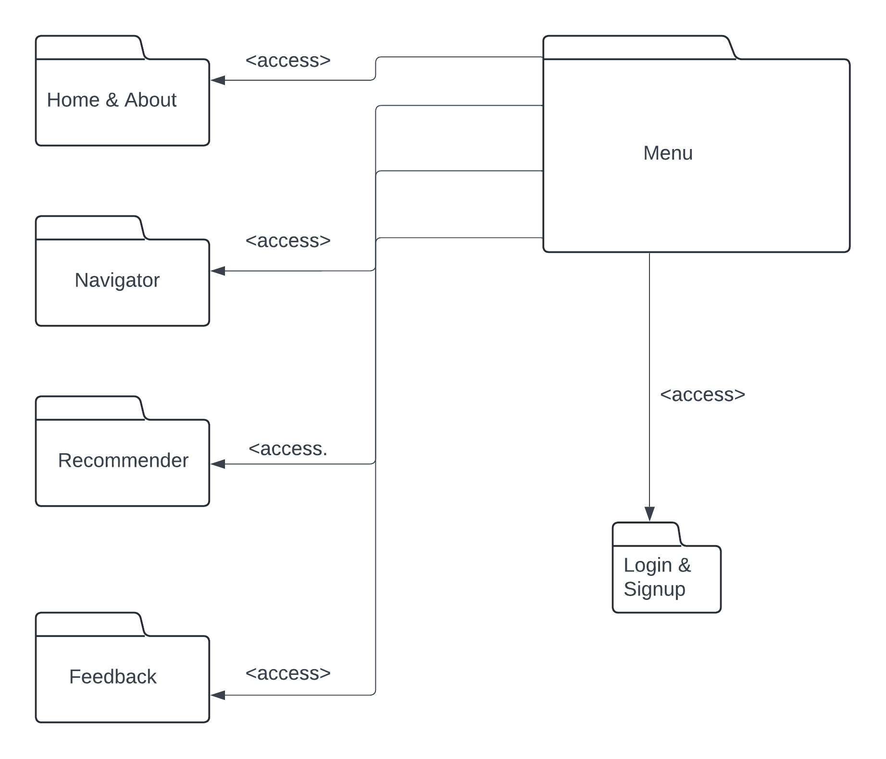
6.UML DIAGRAMS
Profile Diagram:

Slide 10
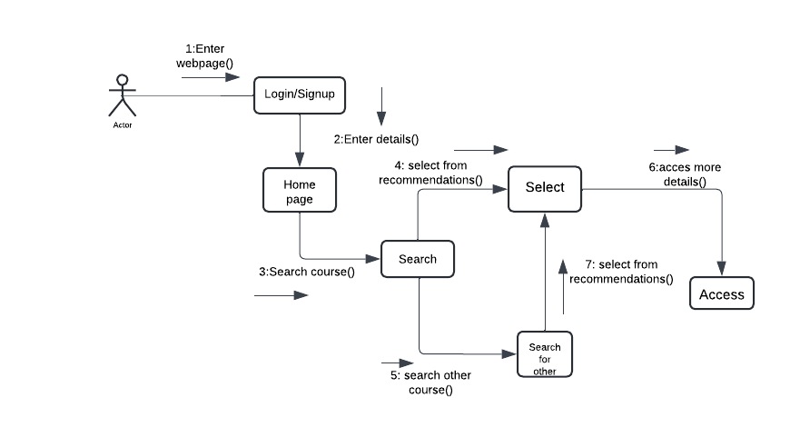
Communication Diagram:

Slide 11
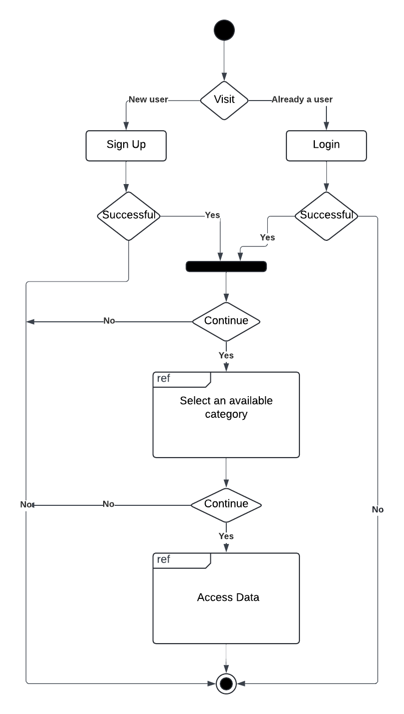
Interaction Overview Diagram:

Slide 12
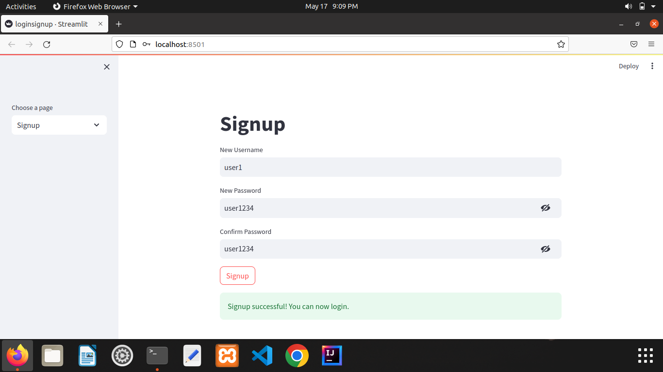
7.DESIGN, IMPLEMENTATION AND OUTPUTS

Slide 13
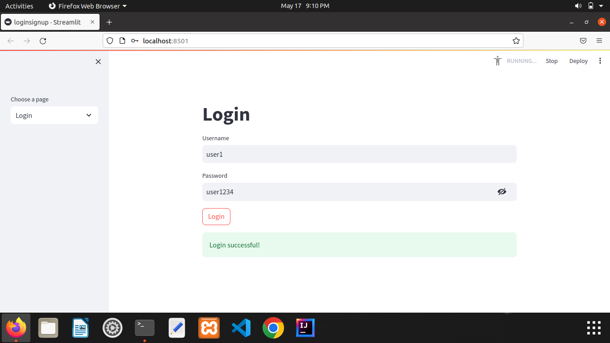

Slide 14
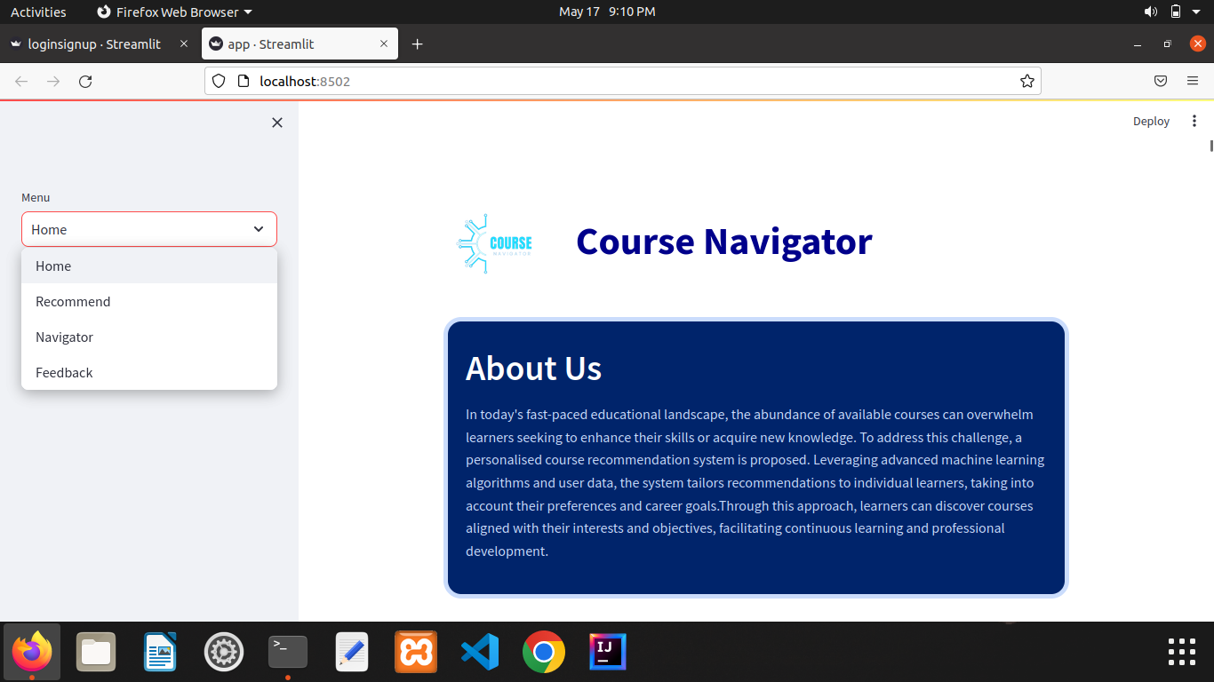

Slide 15
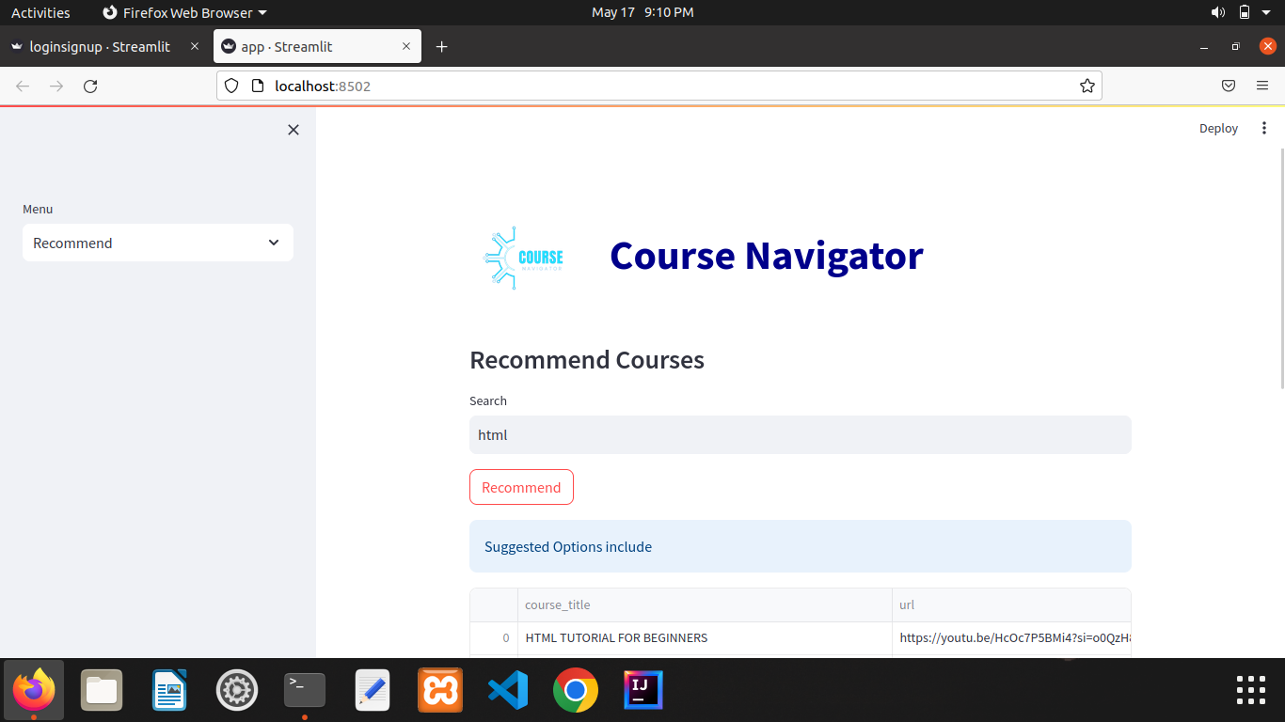

Slide 16
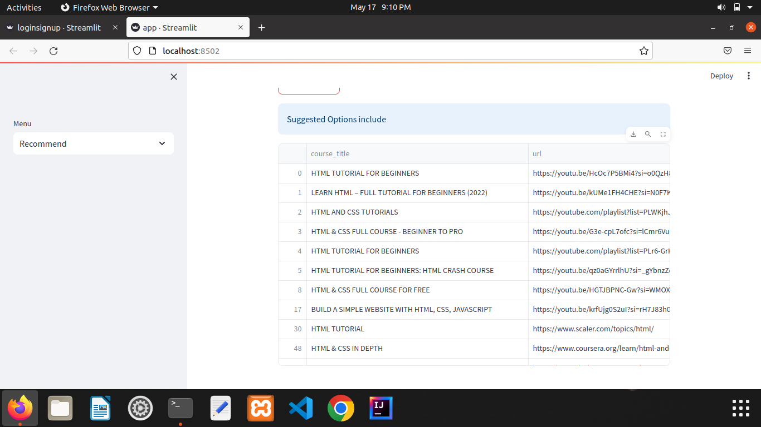

Slide 17
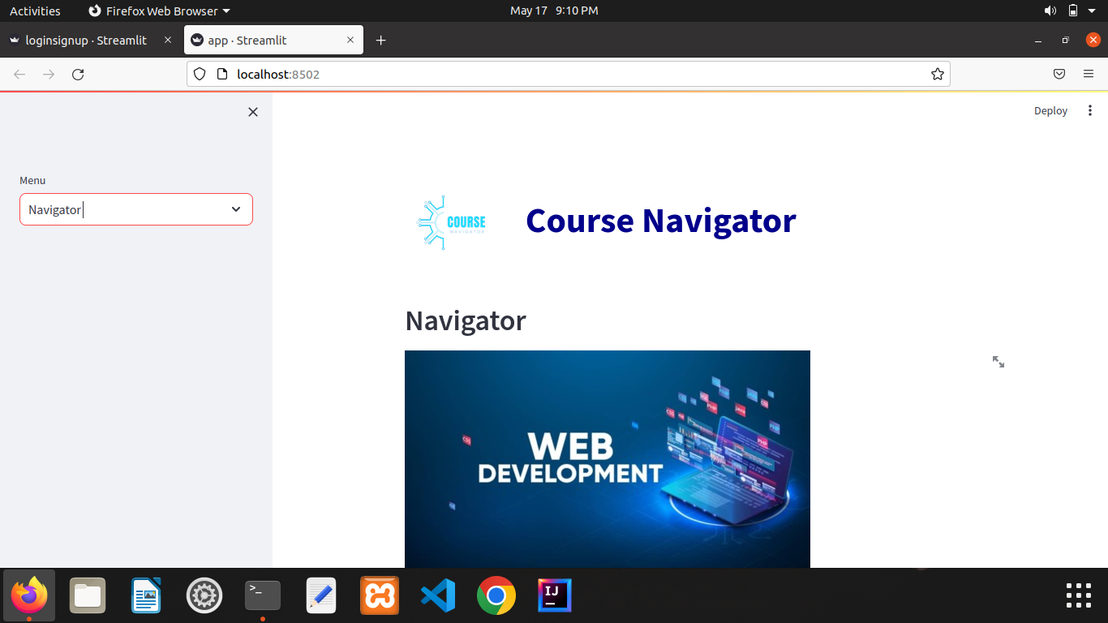

Slide 18
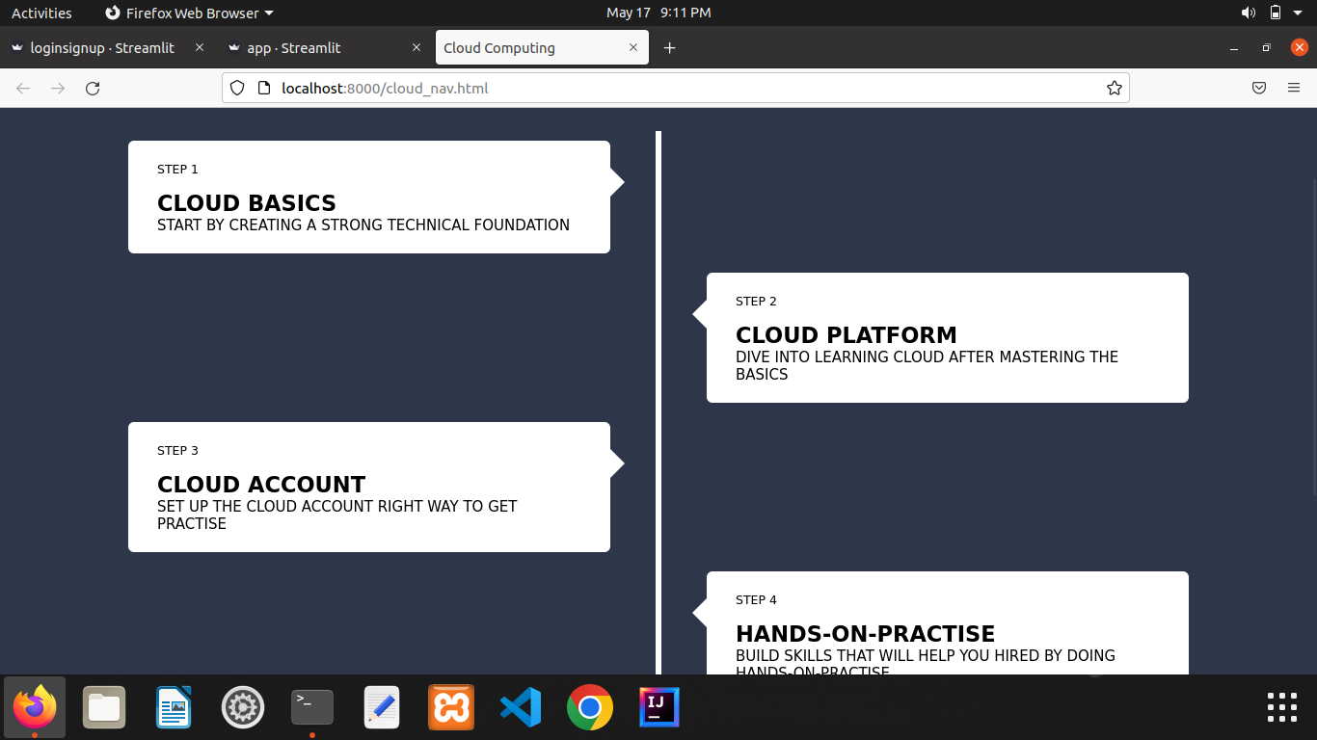

Slide 19
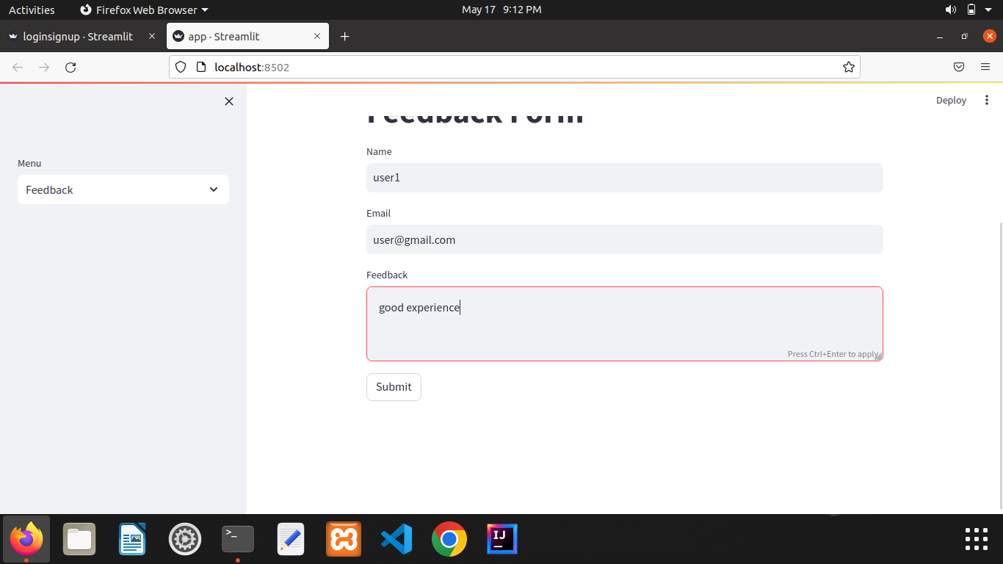

Slide 20
8.ADVANTAGES
Course Navigator covers all the platforms which provides numerous courses.
It suggests based on the users requirements.
It can be affordable by any class of people.

Slide 21
9.DISADVANTAGES
It can't provide any courses ,it just only suggests.
It can't cover all the fields of education except engineering.

Slide 22
10.FUTURE ENHANCEMENT
We will include the courses belong to every field of education.
We will profile mentorship to users.
We will also provide course materials

Slide 23
11.CONCLUSION
The course recommendation system presented encompasses a comprehensive array of courses spanning diverse fields of education, including both paid and unpaid options. By levaraging advanced algorithms, it effectively matches users with courses tailored to their interests and objectives. This system not only facilitates access to valuable educational resources but also enhances learning outcomes by providing personalized recommendations suited to individual preferences and needs.

Slide 24
12.REFERENCES
1. Adomavicius, G., & Tuzhilin, A. (2005). "Toward the Next Generation of Recommender Systems: A Survey of the State-of-the-Art and Possible Extensions." IEEE Transactions on Knowledge and Data Engineering,17(6), 734-749.
2. Koren, Y., Bell, R., & Volinsky, C. (2009). "Matrix Factorization Techniques for Recommender Systems." Computer, 42(8), 30-37.
3. Resnick, P., & Varian, H. R. (1997). "Recommender Systems." Communications of the ACM, 40(3), 56-58.
4. Tang, J., & McCalla, G. (2005). "Smart Recommendation for an Evolving E-Learning
System: Architecture and Experiment." International Journal on E-Learning, 4(1), 105-129.

Slide 25
THANK YOU

