Slide 1
TOOLS & TECHNOLOGIES

Slide 2
Streamlit:
Streamlit is a free and open-source framework for quickly creating and sharing visually appealing machine learning and data science web apps. It is a python-based library created primarily for machine learning developers.
As our project is ML, to deploy on streamlit, create a github repository which is containing all the files of ML. Now go to the Streamlit website and connect it with your ML github repository. Click on the new app button.

Slide 3
Pandas:
Pandas is a Python library used for working with datasets. It has functions for analyzing, cleaning, exploring and manipulating data. The name "Pandas" has a reference to both "Panel Data" and "Python Data Analysis" and was created by Wes McKinney in 2008.
In our project, we are working with the course related datasets, pandas can be used for exploring the datasets, analyzing respective to requirements and manipulate the data in the datasets.

Slide 4
CountVectorizer:
CountVectorizer converts a collection of text documents into a matrix where the rows represent the documents, and the columns represent the tokens(words or n-grams). It counts the occurences of each token in each token in each document, creating a "document-term matrix" with integer values representing the frequency of each token.
As per our project, the text documents can be converted into matrix form and it counts the occurences of each word in that matrix.

Slide 5
Cosine Similarity:
Scikit-learn offers simple and efficient tools for predictive data analysis and has a function to directly and efficiently compute cosine similarity.
Recommendation systems, to recommend similar items based on user preferences or to suggest similar users in social network applications. An example is to recommend the next page on product documentation based on the text similarity found.
If user searching for some course, for example user is searching for html, the similar suggestions will be recommend to the user using countvectorizer in our project.

Slide 6
Jupyter Notebook:
A Jupyter notebook has two components : a front-end webpage and back-end kernel. The front-end webpage allows data scientists to enter programming code or text in rectangular "cells". The browser then passes the code to the back-end kernel which runs the code and returns the results.
We are working with python to build our ML project. To run the python code we use jupyter notebook.

Slide 7
Python:
Python is a general-purpose, high-level programming language renowned for its readability, easy to use and extensive capabilities. These attributes make it a perfect choice for various domains, including machine learning.
Why to we use Python in Machine Learning Projects?
Easy to learn and use: Clear syntax makes coding and understanding code a breeze.
Powerful libraries: Numpy, Pandas, Scikit-learn, TensorFlow and pyTorch provide tools for all your machine learning needs.
Fast prototyping: Experiment quickly with different approaches.
Large community: Plenty of help and resources available.
Cross-platforms: Runs on different operating systems without hassle.

Slide 8
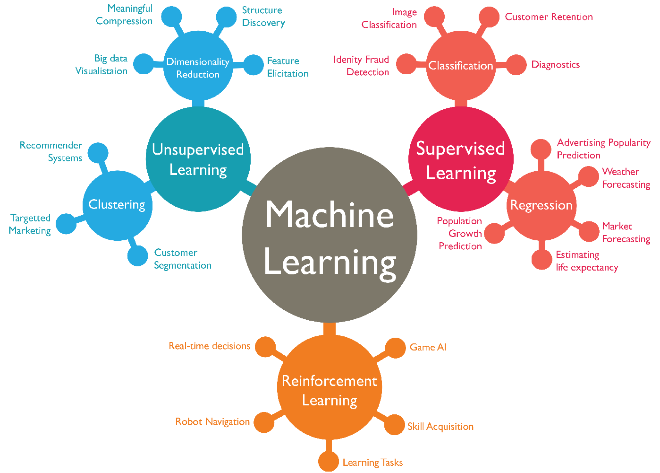
Machine Learning:
Machine learning is a subset of AI, which uses algorithms that learn from data to make predictions. These predictions can be generated through supervised learning, where algorithms learn patterns from existing data or unsupervised learning, where they discover general patterns in data.
Types of Machine Learning:
Supervised Learning
Unsupervised Learning
Reinforcement Learning

Slide 9
Supervised Learning: learns a mapping from inputs to desired outputs using labeled data (teacher showing student classified examples).
Unsupervised Learning: Finds hidden patterns or structures in unlabeled data (student grouping similar objects without labels).
Reinforcement Learning: Learns by interacting with an environment through trial and error to maximize rewards (animal learning through positive reinforcement).
Semi-supervised Learning: Combines labeled and unlabeled data for learning often to improve effieciency(student learning with some labeled and some unlabeled examples).

Slide 10
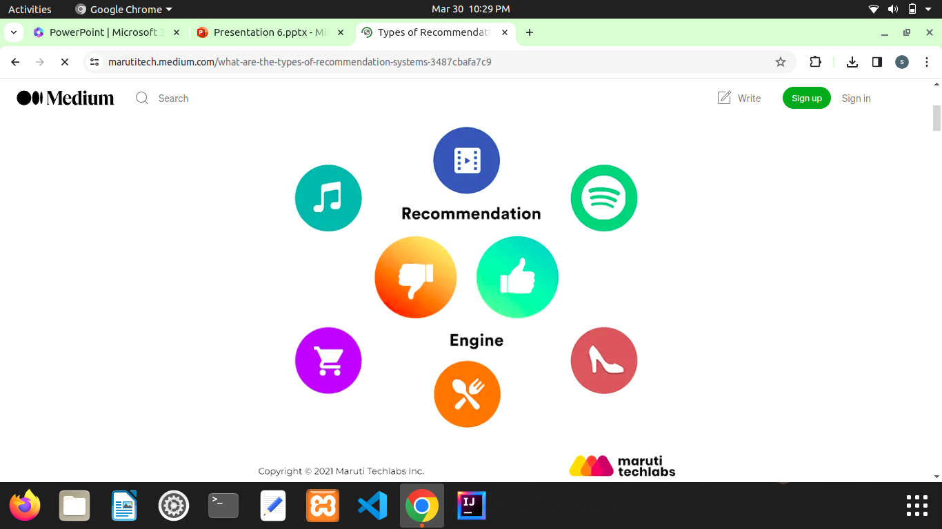
Recommendation System:
A recommendation system is a technology that suggests relevant items to users.
How does a Recommendation system work?
Collection
Storing
Analysing
Filtering

Slide 11
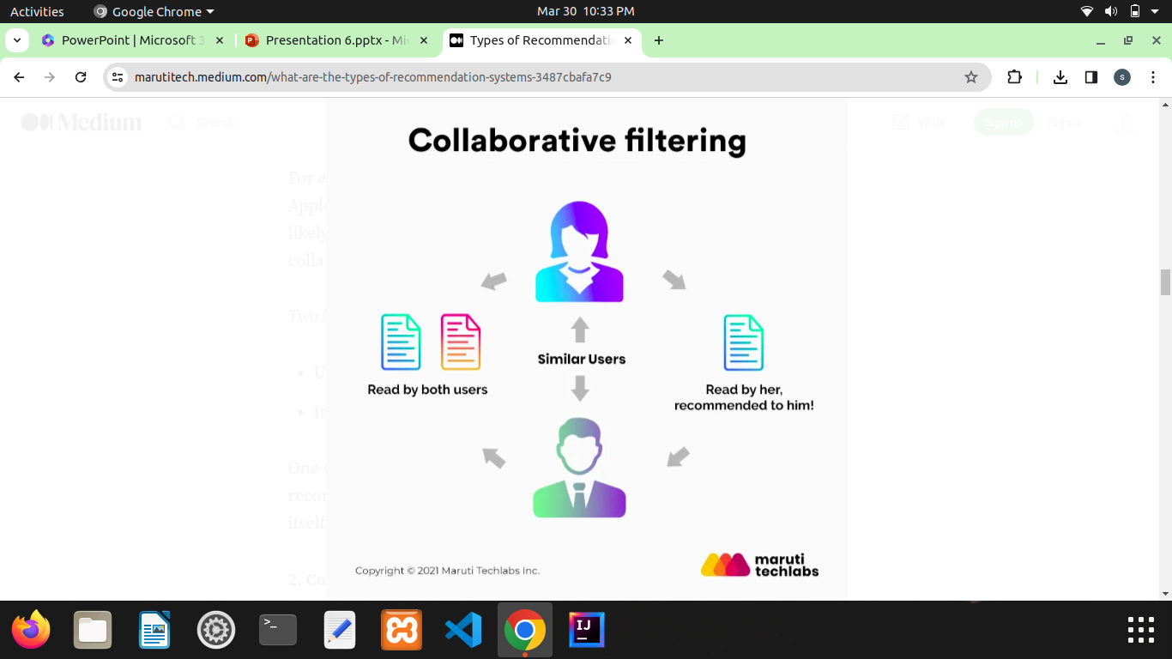
Types of Recommendation System:
Collaborative Filtering
The collaborative filtering method is based on gathering and analyzing data on user’s behavior. This includes the user’s online activities and predicting what they will like based on the similarity with other users.
Two kinds of collaborative filtering techniques used are:
User-User collaborative filtering
Item-Item collaborative filtering

Slide 12
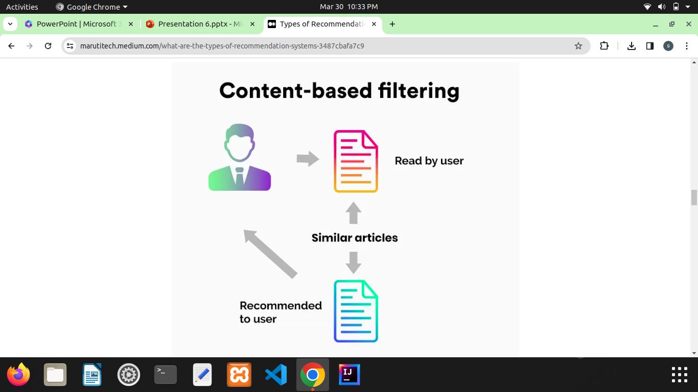
2. Content-Based Filtering
Content-based filtering methods are based on the description of a product and a profile of the user’s preferred choices. In this recommendation system, products are described using keywords, and a user profile is built to express the kind of item this user likes.

Slide 13
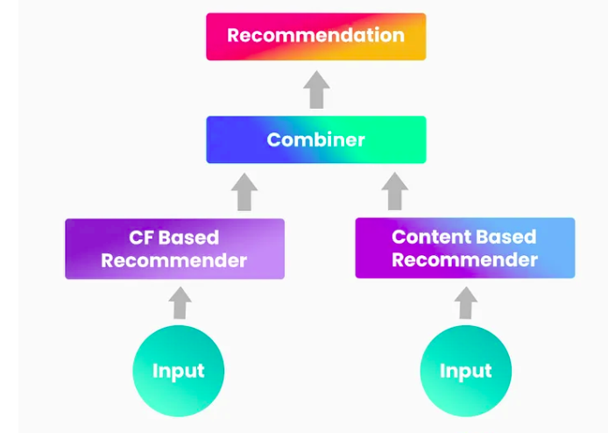
3.Hybrid Recommendation Systems
In hybrid recommendation systems, products are recommended using both content-based and collaborative filtering simultaneously to suggest a broader range of products to customers. This recommendation system is up-and-coming and is said to provide more accurate recommendations than other recommender systems.

Slide 14
THANK YOU

