Slide 1



||Jai Sri Gurudev || Adichunchanagiri Shikshana Trust(R.) SJC INSTITUTE OF TECHNOLOGY An Autonomous Institution under VTU from 2024-25 AICTE Approved, Accredited by NBA(CSE,ISE,ECE,ME,CV,AE) NAAC with A+ grade, QS I-Gauge Gold rated P.B. No. 20, B.B. Road, Chikkaballapur- 562101, Karnataka.
Major Project phase -II
On
“Autonomous Multi-Agent V2V Simulation with MetaDrive”
Presented by:
PRIYANSHU KUMAR 1SJ22CI040
PUSHPAK CHAKRABORTY 1SJ22CI042
RAJATH K M 1SJ22CI044
TRUPTI GARWAD 1SJ22CI057
DEPARTMENT OF ARTIFICIAL INTELLIGENCE & MACHINE LEARNING
Under the guidance of :
Asst. Prof Muniraju M
Dept. of AI & ML, SJCIT

Slide 2
.
TABLE OF CONTENTS
Abstract
Objective
Problem statement
Methodology
Algorithm
Flow chart
Errors
O/P

Slide 3
Introduction
Vehicle-to-Vehicle (V2V) communication allows vehicles to share data such as speed, position, and direction.
It helps autonomous vehicles detect and respond to nearby obstacles more efficiently.
Simulations like MetaDrive provide a safe and flexible platform to test obstacle detection systems.
Using V2V, vehicles can predict potential collisions and take preventive actions.
This improves road safety and reliability in autonomous multi-agent environments.

Slide 4
Abstract
The growth of autonomous vehicles has increased the need for safe and reliable V2V communication systems. This project, “Autonomous Multi-Agent V2V Simulation with MetaDrive,” focuses on simulating multiple vehicles that can communicate and coordinate effectively. Each vehicle acts as an intelligent agent, sharing real-time data such as position, speed, and obstacle information.
AES-based encryption ensures secure and private communication between vehicles. The system integrates MetaDrive’s multi-agent environment with Python modules for broadcasting, receiving, and processing messages. Simulation results show improved coordination, reduced collision risks, and faster decision-making. This work provides a foundation for developing secure and scalable V2V frameworks. It can also be extended to include V2I and V2X communications for real-world autonomous systems.

Slide 5
Objectives
Simulation Development: Develop a real-world environment for autonomous vehicles utilizing the MetaDrive framework.
Real-Time Data Sharing: Implement Vehicle-to-Vehicle (V2V) communication to enable seamless, real-time data exchange between vehicles.
Safety and Responsiveness: Ensure that each vehicle can accurately detect and efficiently respond to obstacles to maintain safety.
Security Implementation: Secure the V2V communication protocols through the application of AES-based encryption.
Collision Mitigation: Improve inter-vehicle coordination strategies to actively reduce and minimize the risk of collisions.
Performance Demonstration: Effectively demonstrate the practical benefits and effectiveness of V2V communication in improving traffic flow and safety within a controlled setting.
Scalable Architecture: Provide a foundational system that can be readily extended to support V2V communication architectures.

Slide 6
Problem Statement
Ensuring the safe operation of autonomous vehicles requires accurate awareness of surrounding vehicles and obstacles, yet poor inter-vehicle communication often leads to safety risks. This project leverages the MetaDrive simulation platform to develop a secure Vehicle-to-Vehicle (V2V) communication system, enhancing obstacle detection and coordination to reduce collisions and improve road safety.

Slide 7
Methodology
• Environment setup:
- MultiAgentMetaDrive (v0.4.x) with 10 autonomous agents and onscreen rendering.
- Procedural maps and seed-based reproducibility.
• Agent configuration:
- Sensors: Lidar, Side Detector, Lane Line Detector.
- IDMPolicy for human-like control.
• V2V Communication & Security:
- UDP-based broadcaster/receiver per vehicle.
- Encrypted JSON messages (AES + HMAC via Fernet).

Slide 8
Methodology
• Planning & Control:
- Hybrid A* for global paths, motion primitives for maneuvers.
- Response Planner ensures collision-free behavior.
• Execution & Evaluation:
- Parallel communication subprocesses with seed management.
- Metrics: collision rate, latency, headway, speed.
- Logs saved per tick for reproducibility and analysis.

Slide 9
System Architecture
Section | Module/File | Description
1. communication/ | broadcaster.py | Encrypts and transmits V2V messages.
 | receiver.py | Receives and decrypts incoming data.
 | encryption_utils.py | Key generation and Fernet encryption layer.
2. metadrive_env/ | env_manager.py | Multi-agent environment orchestration and simulation loop.
 | vehicle_manager.py | Individual vehicle state management and control interface.
3. decision_engine/ | planning_module.py | Trajectory planning algorithms.
 | decision_module.py | High-level behavioral decision-making using V2V data.
4. config/ & Launcher | config.yaml | System parameters and vehicle configurations.
 | run_all.py | Master orchestrator coordinating all system components.

Slide 10
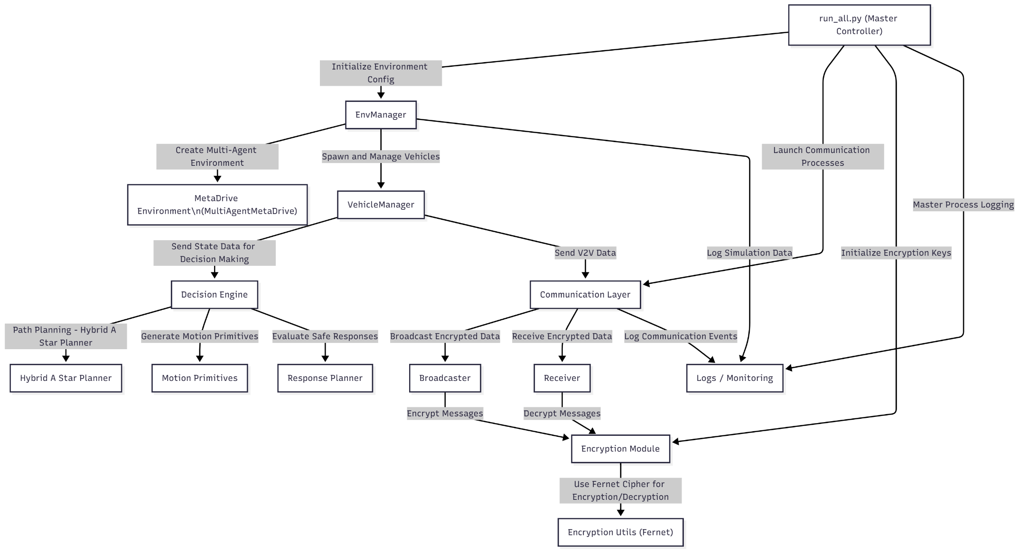
System Architecture

Slide 11
Algorithm Used
1. IDM – Intelligent Driver Model
Purpose: Controls longitudinal (forward–backward) motion of autonomous vehicles.
How it works: It computes each vehicle’s acceleration based on its current speed, desired speed, and the gap/time-headway to the vehicle in front.
Why used: Produces human-like car-following behavior in traffic simulations.
2. Hybrid A* Path Planning Algorithm
Purpose: Generates a smooth, collision-free path from the vehicle’s current pose to the goal.
How it works: Extends traditional A* by including continuous heading angles and vehicle kinematics, producing drivable, curvature-constrained trajectories.
Why used: Suitable for car-like robots that can’t turn instantaneously (non-holonomic vehicles).

Slide 12
Algorithm Used (Cont.)
3. Motion Primitives
Purpose: Defines a discrete set of feasible vehicle motions (e.g., straight, left-turn, right-turn arcs).
How it works: Each primitive encodes realistic steering and velocity commands that respect the vehicle’s turning radius.
Why used: Reduces computation time by searching only through feasible motions during planning.
4. Response Planning Algorithm
Purpose: Decides how an autonomous vehicle reacts to V2V messages or nearby obstacles.
How it works: Uses distance thresholds and predicted trajectories to trigger behaviors such as slow down, maintain lane, or reroute.
Why used: Ensures cooperative, safe maneuvers between vehicles in shared road scenarios.

Slide 13
Algorithm Used
5. Fernet Encryption Algorithm (Symmetric Key Crypto)
Purpose: Secures V2V messages during transmission.
How it works: Uses AES (Advanced Encryption Standard) (in CBC: Cipher Block Chaining mode) and HMAC (Hash Based Message Authentication Code) for authenticated encryption with a 32-byte base64 key.
Why used: Guarantees confidentiality, integrity, and authenticity of vehicle-to-vehicle data.
6. UDP(User Datagram Protocol) Broadcast/Receive Protocol
Purpose: Handles low-latency message passing between vehicles.
How it works: Each broadcaster sends encrypted packets via UDP to a shared or per-agent port; receivers decrypt and parse messages in real time.
Why used: Simulates real-world V2V wireless communication with minimal network overhead.

Slide 14
Algorithm Used
7. Multi-Agent Decision Loop
Purpose: Coordinates all autonomous vehicles simultaneously in the MetaDrive environment.
How it works: At every simulation tick, each agent observes environment data, receives V2V messages, updates its state through its policy (IDM + planner), and outputs new actions.
Why used: Enables decentralized yet coordinated behavior among multiple self-driving cars.

Slide 15
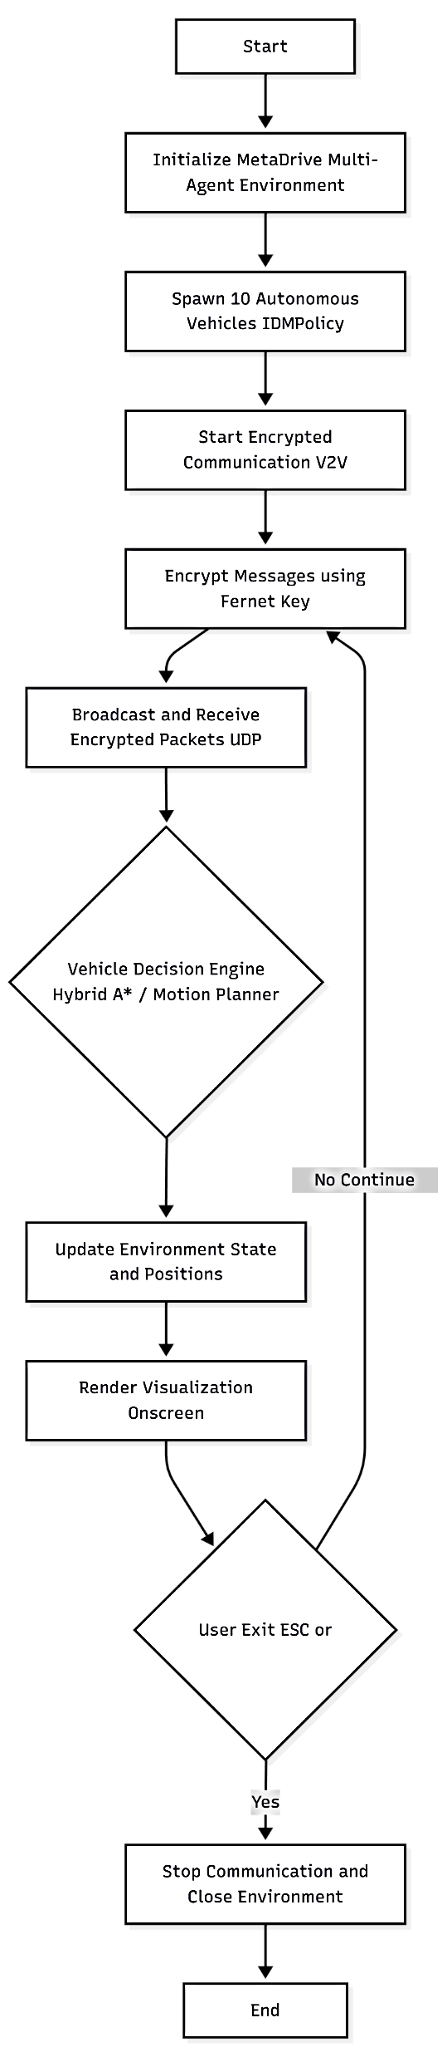
Flow Chart

Slide 16
Errors and Fixes
1. MetaDrive Environment Initialization Errors
Symptoms: Errors like TypeError: agent_policy: IDMPolicy and Agents
Cause: Incorrect configuration keys passed to MetaDriveEnv / MultiAgentMetaDrive. Some keys like policy, agent_policy, and num_agents were not supported or mismatched.
Fix: Cleaned up env_manager.py to only include valid parameters and switched to MultiAgentMetaDrive for multi-vehicle simulation.
2. Invalid Spawn Lane / No Valid Lanes Found
Symptoms: Runtime errors like RuntimeError: No valid lanes found in the current map!.
Cause: The chosen map had no drivable or spawnable lanes for autonomous vehicles.
Fix: Switched to procedural maps like 'S' or 5 and added fallback logic in env_manager.py to retry with alternate maps when spawn lanes are missing.

Slide 17
Errors and Fixes
3. Encryption Key Format Error
Symptoms: ValueError: Fernet key must be 32 url-safe base64-encoded bytes.
Cause: Old or manually created key file (secret.key) was not a valid Fernet key.
Fix: Implemented automatic key validation and regeneration in encryption_utils.py (via generate_key() and load_key()).
4. Communication Import & Structure Issues
Symptoms: ImportError: cannot import name 'start_broadcaster' or start_receiver.
Cause: Mismatch between module imports and function definitions in the communication folder.
Fix: In process

Slide 18
Errors and Fixes
5. Port Type & Network Binding Errors
Symptoms: TypeError: str, bytes or bytearray expected, not int during socket binding or broadcasting.
Cause: Port numbers and hostnames were being mixed up or passed as incorrect data types to the socket bind/send functions.
Fix: Ensured all ports were integers and hostnames were strings (host="127.0.0.1", port=int(port)).
6. Missing or Incorrect Agent Policy Attribute
Symptoms: 'MultiAgentMetaDrive' object has no attribute 'agent_policy'.
Cause: Attempt to access a non-existent agent_policy in MetaDrive 0.4.3 (policy is handled internally).
Fix: Removed direct policy access — agents now run autonomously under MultiAgentMetaDrive default behaviors (e.g., IDM).

Slide 19
Errors and Fixes
7. Rendering and Visualization Issues
Symptoms: No visual output or rendering crash when using onscreen.
Cause: Incompatible render mode or absence of display device.
Fix: Added runtime check for render_mode='onscreen' or 'none' depending on available resources.
8. Synchronization and Early Simulation Termination
Symptoms: Simulation started but crashed immediately with cleanup messages.
Cause: Multiprocessing race conditions — environment started before all communication subprocesses stabilized.
Fix: Added controlled startup order and short delays (time.sleep()) before launching main loop.

Slide 20
Errors and Fixes
9. MetaDrive Configuration Schema Mismatch
Symptoms: KeyError: '{'environment_num'}' does not exist in existing config.
Cause: Passing unsupported keys (legacy config format).
Fix: Updated configuration dictionary to match MetaDrive v0.4.3 schema (only valid keys like num_agents, agent_configs, map, etc.).
10. Process Cleanup and Signal Handling
Symptoms: Orphan processes or delayed shutdown after termination signal.
Cause: Communication and environment processes weren’t closing gracefully.
Fix: In process.

Slide 21
Output
Through Video (or by running we can show)

