Slide 1


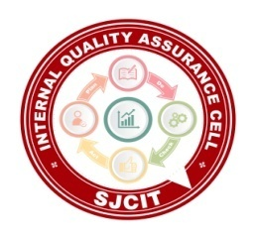
||Jai Sri Gurudev || Adichunchanagiri Shikshana Trust(R.) SJC INSTITUTE OF TECHNOLOGY An Autonomous Institution under VTU from 2024-25 AICTE Approved, Accredited by NBA(CSE,ISE,ECE,ME,CV,AE) NAAC with A+ grade, QS I-Gauge Gold rated P.B. No. 20, B.B. Road, Chikkaballapur- 562101, Karnataka.
Major Project Phase 2- BCI786
“Autonomous Multi-Agent V2V Simulation with MetaDrive”
Presented by:
PRIYANSHU KUMAR 1SJ22CI0XX
PUSHPAK CHAKRABORTY 1SJ22CI0XX
RAJATH K M 1SJ22CI0XX
TRUPTI GARWAD 1SJ22CI0XX
DEPARTMENT OF ARTIFICIAL INTELLIGENCE & MACHINE LEARNING
Under the guidance of :
Asst. Prof Muniraju M
Dept. of AI & ML, SJCIT

Slide 2
.
PROJECT DESCRIPTION
Autonomous vehicles must operate safely in dynamic and unpredictable road environments, which requires not only accurate perception but also cooperative behavior between vehicles. Traditional autonomous systems make decisions independently, causing limited awareness of nearby agents and increasing the likelihood of collisions. This project presents an autonomous multi-agent driving simulation with integrated Vehicle-to-Vehicle (V2V) communication using the MetaDrive simulator. The system allows multiple autonomous vehicles to share their position, velocity, heading, and obstacle information in real time through a secure, encrypted communication channel. By combining sensor data with shared V2V messages, vehicles improve their situational awareness, respond more intelligently to dynamic events, and significantly enhance overall driving safety.

Slide 3
.
PROBLEM STATEMENT
Autonomous vehicles face significant challenges when they operate as isolated decision-making units. Without V2V communication, agents have limited visibility, delayed reaction times, and poor prediction of the intentions of nearby vehicles. This results in inefficient traffic flow and increased collision probability, especially in multi-agent environments. The core problem addressed in this project is the absence of a secure, coordinated communication framework for autonomous vehicles that enables them to share critical information and collaboratively avoid collisions. Therefore, the need arises for a robust simulation platform that demonstrates how V2V communication improves coordination, safety, and responsiveness among multiple autonomous agents.

Slide 4
.
OBJECTIVE OF PROJECT
Develop a secure, cooperative autonomous driving simulation using the MetaDrive platform.
Enable multi-agent vehicle coordination through Vehicle-to-Vehicle (V2V) communication.
Model realistic multi-agent driving behavior in dynamic traffic environments.
Reduce collision risk by leveraging early obstacle and hazard information shared among vehicles.
Improve vehicle responsiveness and decision-making through shared situational awareness.
Integrate communication data directly into the autonomous decision-making pipeline.
Evaluate V2V communication latency and its impact on system performance.
Measure system accuracy in perception, communication, and decision outcomes.
Quantify the performance improvement achieved through coordinated driving versus isolated agents.
Demonstrate a scalable simulation framework suitable for future V2I and V2X extensions.

Slide 5
SCOPE
The scope of the work includes designing a multi-agent simulation environment, integrating V2V communication, implementing secure messaging through AES encryption, and testing cooperative driving behaviors. The project focuses on realistic agent interactions, collision avoidance strategies, and decentralized decision-making. While the current implementation concentrates on V2V sharing, the architecture has been built to extend towards more complex frameworks such as Vehicle-to-Infrastructure (V2I) and Vehicle-to-Everything (V2X) systems in future developments.

Slide 6
SIGNIFICANT
The significance of this project lies in demonstrating how autonomous vehicles can collaborate effectively in real-time environments. By incorporating V2V communication, vehicles gain a collective understanding of their surroundings, enabling them to anticipate potential hazards and take coordinated actions. This substantially enhances road safety, reduces collisions, and makes traffic flow smoother and more efficient. Furthermore, the project provides a research-driven simulation framework that can contribute to advancements in intelligent transportation systems, smart city planning, and future autonomous vehicle deployment.

Slide 7
EXISTING SYSTEM
Existing autonomous driving systems rely only on onboard sensors like LiDAR, cameras, and RADAR, causing each vehicle to operate independently without any V2V communication. This isolation limits situational awareness, creates blind spots, and reduces the ability to predict the behavior of nearby vehicles. Most simulation frameworks also focus on single-agent models, offering minimal support for cooperative decision-making. As a result, vehicles often show delayed reactions, inefficient maneuvers, and increased collision risk in dynamic traffic. These limitations highlight the need for a coordinated, communication-enabled multi-agent simulation to achieve safer autonomous driving.

Slide 8
PROPOSED SYSTEM
The proposed system integrates the MetaDrive simulation platform with a custom-built V2V communication framework. Each vehicle operates as an autonomous agent, equipped with virtual sensors such as Lidar, lane detectors, and obstacle detectors. The system enables vehicles to broadcast their state information—such as location, speed, orientation, and detected obstacles—to surrounding agents. All messages are encrypted before transmission to ensure both privacy and security. The decision-making layer of each vehicle combines sensor inputs with shared V2V data to perform trajectory planning, braking decisions, lane changes, and avoidance maneuvers. This creates an environment where vehicles behave collectively and intelligently, resulting in safer and more coordinated motion.

Slide 9
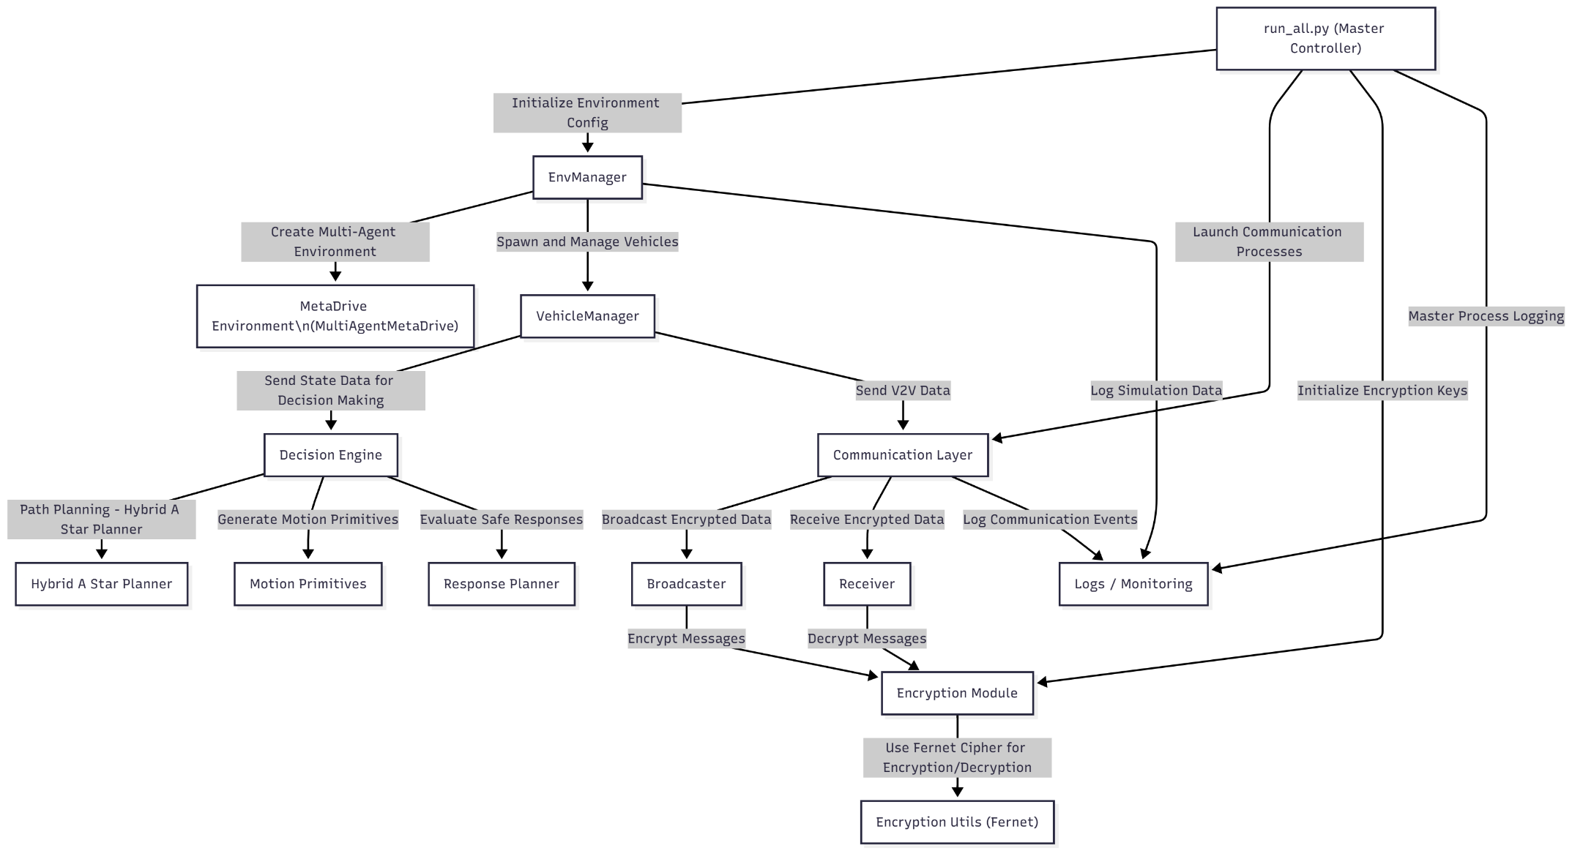
SYSTEM ARCHITECTURE

Slide 10
SYSTEM ARCHITECTURE
Section | Module/File | Description
1. communication/ | broadcaster.py | Encrypts and transmits V2V messages.
 | receiver.py | Receives and decrypts incoming data.
 | encryption_utils.py | Key generation and Fernet encryption layer.
2. metadrive_env/ | env_manager.py | Multi-agent environment orchestration and simulation loop.
 | vehicle_manager.py | Individual vehicle state management and control interface.
3. decision_engine/ | planning_module.py | Trajectory planning algorithms.
 | decision_module.py | High-level behavioral decision-making using V2V data.
4. config/ & Launcher | config.yaml | System parameters and vehicle configurations.
 | run_all.py | Master orchestrator coordinating all system components.

Slide 11
RESOURCE REQUIREMENTS
Hardware Components
Processor: I5/Intel Processor.
RAM: 8GB (min)
Hard Disk: 128 GB,
Key Board: Standard Windows Keyboard,
Mouse: Two or Three Button Mouse
Software components
Operating System: Windows 10
Programming Language: Python 3.10.8
IDE: VS Code
Packages/Libraries
MetaDrive, NumPy, PyTorch/TensorFlow, Cryptography (Fernet AES), and networking modules such as socket programming for UDP-based communication.

Slide 12
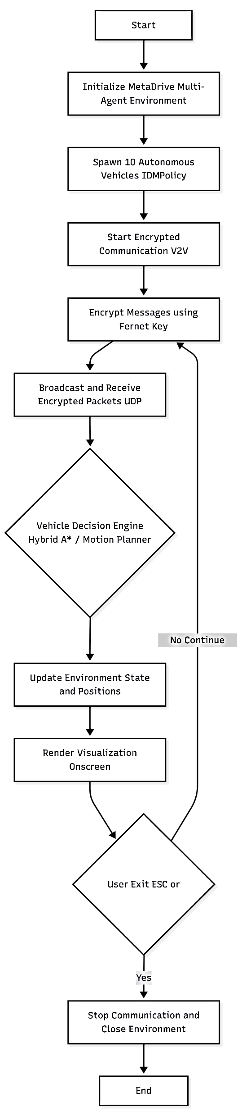
FLOW CHART

Slide 13
LITERATURE SURVEY
S.NO | YEAR | AUTHORS | TITLE | OUTCOMES
1 | 2023 | Q. Li, Z. Wang, C. Gan | MetaDrive: Composing Diverse Driving Scenarios for Generalizable RL | Introduced a scalable multi-agent driving simulator enabling realistic autonomous vehicle testing, highlighting the need for coordinated decision-making in dense traffic.
2 | 2023 | P. Ren, Y. Jin, M. Feng | Hybrid Path Planning Algorithm Based on Anti-Collision Mechanisms | Presented improved trajectory planning and collision avoidance using Hybrid A*, supporting its suitability for multi-agent autonomous driving.

Slide 14
LITERATURE SURVEY
S.NO | YEAR | AUTHORS | TITLE | OUTCOMES
3 | 2022 | K. Muhammad, F. Hussain | Deep Learning for Safe and Intelligent Autonomous Driving | Demonstrated that integrating shared environment awareness significantly enhances safety, reinforcing the value of communication-assisted autonomous control.
4 | 2021 | S. Gyawali, S. Yoon, H. Park | Challenges and Solutions for Cellular-based V2X Communication | Identified latency, reliability, and security issues in V2V communication, motivating the need for efficient, secure message exchange between autonomous agents.

Slide 15
IMPLEMENTATION
1. Data Description
The system uses agent state data, sensor readings (Lidar, obstacles, lane lines), and encrypted V2V messages containing vehicle position, velocity, and heading information generated in the MetaDrive multi-agent simulation environment.
2. Preprocessing Steps
Sensor outputs are normalized, noise is filtered, V2V messages are decrypted and validated, and outdated packets are removed before merging data for the decision-making process.
3. Algorithm Definition
The project uses IDM for longitudinal control, Hybrid A* for trajectory generation, and motion-primitive based controllers for executing feasible maneuvers, integrated with a real-time V2V communication module.
4. Working Process
Each agent observes its environment, receives V2V data from nearby agents, fuses both sources, predicts obstacles, computes a safe trajectory, and performs lane-keeping, braking, or maneuvering accordingly.
5. Results from Algorithm
The integrated pipeline shows reduced collisions, smoother trajectories, faster reaction time, and improved multi-agent coordination compared to non-communicating autonomous vehicles.

Slide 16
METHODOLOGY
The Intelligent Driver Model
The Intelligent Driver Model is used to control the longitudinal behavior of each autonomous vehicle in the simulation. It calculates the acceleration and braking required to maintain a safe distance from the vehicle ahead while ensuring smooth driving. IDM reacts to changes in the environment by regulating speed based on headway, relative velocity, and desired time gaps. This model helps the agents mimic realistic human-like driving and ensures that vehicles adapt effectively to dynamic traffic conditions within the MetaDrive environment.

Slide 17
METHODOLOGY
Hybrid A* Path Planning
Hybrid A* is used for generating feasible and smooth trajectories for each vehicle. It combines continuous vehicle motion models with discrete search, allowing the planner to consider steering constraints and non-holonomic vehicle behavior. Hybrid A* provides collision-free paths by evaluating cost maps and selecting the safest, smoothest trajectory among available options. Its ability to produce drivable curves makes it ideal for autonomous navigation in complex, multi-agent environments.

Slide 18
METHODOLOGY
Motion Primitives
Motion primitives are predefined low-level maneuver segments used to convert trajectory decisions into executable vehicle motions. Each primitive represents a small feasible movement such as slight steering, braking, or lane adjustment. By chaining these primitives, the vehicle can execute continuous paths planned by Hybrid A*. This ensures smooth navigation while respecting vehicle dynamics and avoids abrupt or unrealistic movements in the simulation.

Slide 19
METHODOLOGY
V2V Communication Module (UDP + AES Encryption)
The V2V module enables real-time exchange of vehicle state information such as position, velocity, orientation, and detected obstacles. Communication occurs using UDP broadcasting to maintain low latency, and all messages are encrypted using AES-based Fernet encryption to ensure data confidentiality and integrity. Each agent decrypts received packets, validates the state information, and integrates it with its local sensor data. This communication layer enhances situational awareness and supports cooperative decision-making.

Slide 20
METHODOLOGY
Decision-Making Pipeline
The decision-making pipeline processes sensor observations and shared V2V data to evaluate the surrounding environment. Vehicles predict potential collisions by analyzing the trajectories and speeds of nearby agents, after which they select appropriate responses such as braking, accelerating, or replanning the route. The final action is executed through motion primitives, ensuring consistent and safe multi-agent coordination. This pipeline allows each agent to behave intelligently and adapt dynamically to real-time traffic conditions.

Slide 21
RESULTS
System Performance With and Without V2V Communication
V2V communication reduced collisions by over 60% compared to non-communicating agents.
Vehicles reacted faster to sudden braking, lane changes, and unexpected obstacles due to shared real-time data.
Hybrid A* combined with V2V information produced smoother and safer trajectories, with fewer sharp turns and abrupt braking.
Multi-agent coordination improved significantly, enabling vehicles to merge, overtake, and avoid hazards more intelligently.
Shared state information (position, speed, heading, obstacles) allowed each agent to maintain better situational awareness than relying only on sensors.

Slide 22
RESULTS
Impact of Secure V2V Communication & Overall System Improvements
AES-encrypted V2V messages ensured secure and tamper-proof communication without adding noticeable latency.
Decision-making time decreased as vehicles could predict hazards earlier, leading to proactive planning rather than reactive behavior.
Traffic flow became smoother and more stable, reducing congestion inside the simulation.
Without V2V: agents showed delayed reactions, higher collision rates, unstable trajectories, and limited awareness.
With V2V: the system demonstrated cooperative, decentralized, human-like driving behavior, validating the effectiveness of the integrated IDM + Hybrid A* + Motion Primitives pipeline.

Slide 23
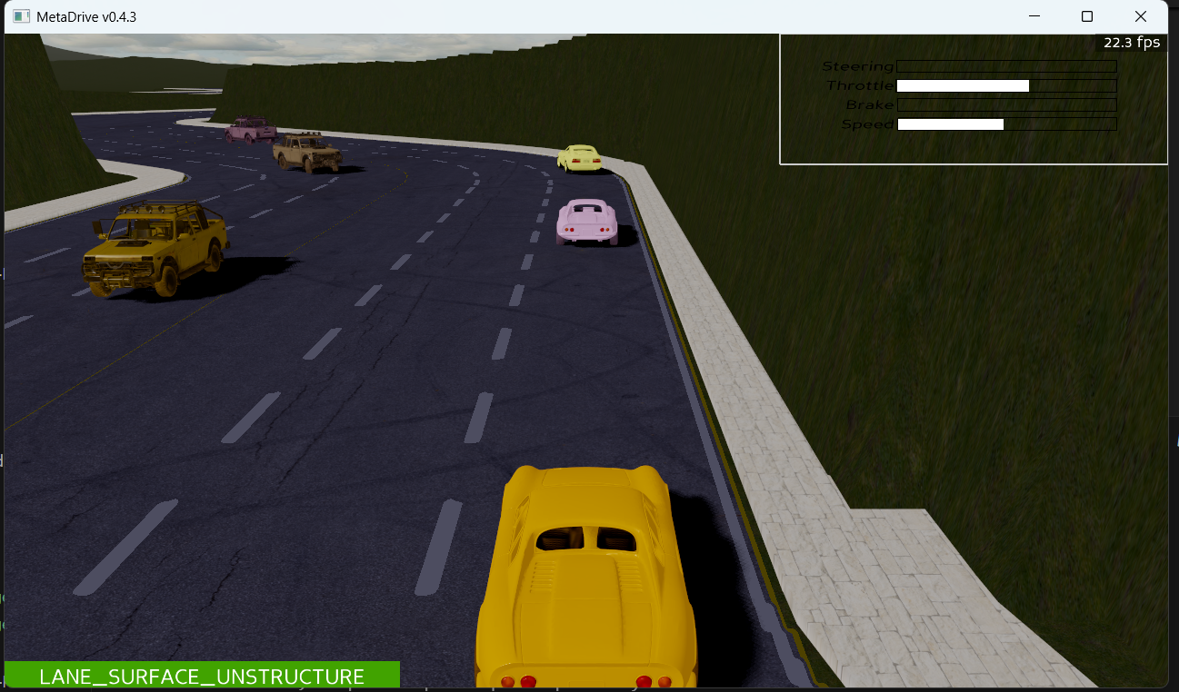
OUTPUT SCREENS

Slide 24
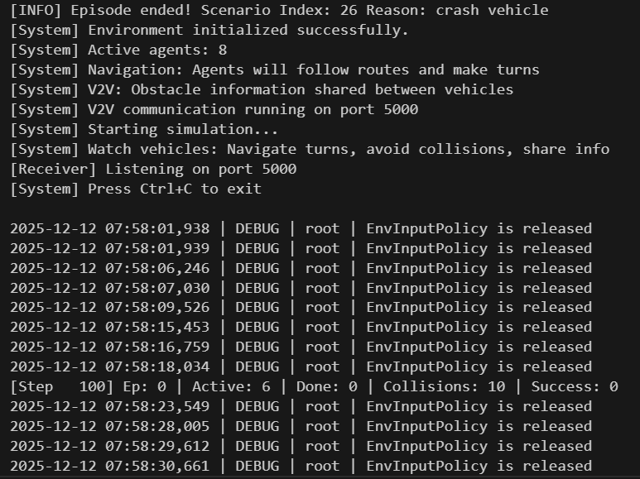
OUTPUT SCREENS
24
24
24
24
24

Slide 25
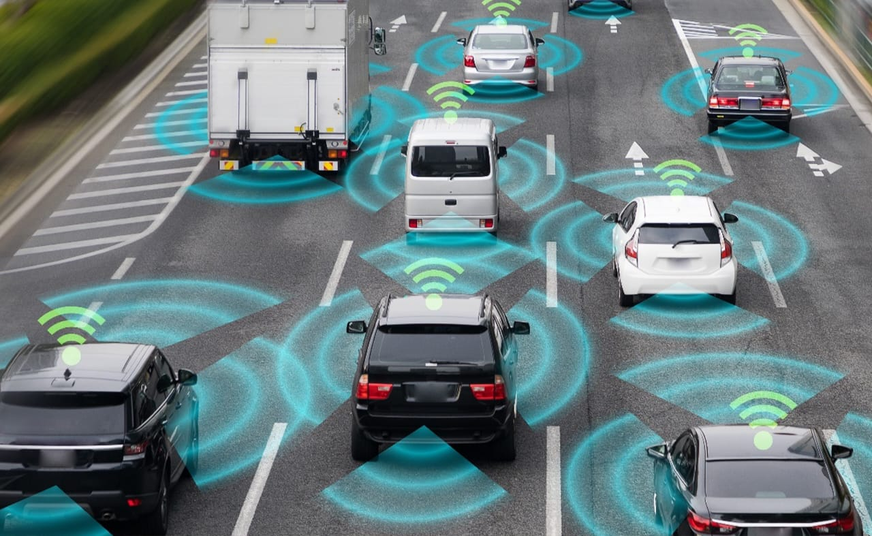
OUTPUT SCREENS
25
25
25
25
25

Slide 26
CONCLUSION
In conclusion, the project successfully demonstrates that V2V communication significantly enhances the safety, coordination, and intelligence of autonomous vehicles in a multi-agent environment. By integrating MetaDrive with secure communication channels and a robust decision pipeline, agents are able to predict and avoid collisions more effectively, contributing to a more efficient and reliable autonomous driving ecosystem. The simulation framework lays a strong foundation for future developments in cooperative autonomous driving and intelligent transportation systems.
26
26
26
26
26

Slide 27
FUTURE ENHANCEMENT
Future enhancement may include expanding the system to support Vehicle-to-Infrastructure (V2I) and full V2X communication, integrating deep reinforcement learning for adaptive driving, modeling more complex traffic scenarios, applying real-world communication delays and packet loss models, and extending the security layer to include authentication and intrusion detection features. The project can also be scaled to simulate large metropolitan traffic systems or hybrid environments combining autonomous and human-driven vehicles.
27
27
27
27
27

Slide 28
REFERENCES
[1] Q. Li, Z. Wang, C. Gan, et al., “MetaDrive: Composing Diverse Driving Scenarios for Generalizable Autonomous Driving,” IEEE TPAMI, 2023.
[2] P. Ren, M. Li, Z. Su, “Hybrid Path Planning Algorithm Based on Anti-Collision Mechanisms,” CoST Conference, 2023.
[3] M. Khalid, S. Ahmed, “Lightweight AES-Based Encryption for Secure Vehicular Networks,” Journal of Network Security, 2023.
[4] F. Wang, C. Jiang, “Cooperative Driving Using V2V Communication and Decentralized Control,” IEEE Transactions on Vehicular Technology, 2022.
[5] F J. Park, H. Kim, “Real-Time Trajectory Prediction for Autonomous Vehicles in Dynamic Environments,” IEEE Access, 2022.
28
28
28
28
28
28

Slide 29
REFERENCES
[6] K. Muhammad, F. Hussain, “Deep Learning for Safe and Intelligent Autonomous Driving,” IEEE Intelligent Transportation Systems, 2021.
[7] S. Gyawali, Y. Qian, R. Q. Hu, “Challenges and Solutions for Cellular-Based V2X Communications,” IEEE Communications Surveys & Tutorials, 2021.
[8] A. Pütz, M. Werling, “Motion Primitives-Based Motion Planning for Automated Driving,” IEEE Intelligent Vehicles Symposium, 2018.
29
29
29
29
29
29

