Slide 1

MEET UP
Submitted by
PUSHPAK GANAGONI

Slide 2

TABLE OF CONTENTS
Abstract
Introduction
Technologies used
Flowchart
Conclusion

Slide 3
ABSTRACT
Chat application is a feature or a program on the Internet to communicate directly among Internet users who are using the internet. Chat applications allow users to communicate even though from a great distance. Therefore, this chat application must be real-time and multi platform to be used by many users. In this chat application we can Select the Interest from the menu and find the person with the common interests and send him Hello. We can get so much information about our interests .The Technologies used to build this application are HTML, CSS , JS with Django framework and PostgreSQL database.

Slide 4
INTRODUCTION
Communication is a mean for people to exchange messages. It has started since the beginning of human creation. Distant communication began as early as 1800 century with the introduction of television, telegraph and then telephony. Interestingly enough, telephone communication stands out as the fastest growing technology, from fixed line to mobile wireless, from voice call to data transfer. The emergence of computer network and telecommunication technologies bears the same objective that is to allow people to communicate . All this while, much efforts has been drawn towards consolidating the device into one and therefore indiscriminate the services. Chatting is a method of using technology to bring people and ideas together despite of the geographical barriers. The technology has been available for years but the acceptance it was quite recent. Our project is an example of a chat server. It is an App based on the common interests. We can Select the Interest from the menu and find the person with the common interests and we can get so much information about our interests.

Slide 5
TECHNOLOGIES USED
HTML
CSS
JS
DJANGO
POSTGRESQL

Slide 6
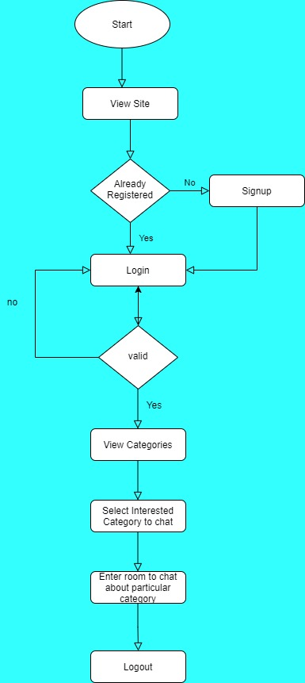
FLOW CHART

Slide 7
CONCLUSION
The main objective of the project is to develop a Chat Application. I had taken a wide range of literature review in order to achieve all the tasks, where I came to know about some of the products that are existing in the market. I made a detailed research in that path to cover the loop holes that existing systems are facing and to eradicate them in our application.
Meetup is a web based Application which helps users to chat with different people based on their interests.

Slide 8

THANK YOU

