Slide 1


SQL vs NO-SQL
Pushpak Sunil Rane
California State University Chico: Department of Mathematics and Statistics
MATH-608
DATA SCIENCE PROJECT

Slide 2
SQL vs NO-SQL
Pushpak Sunil Rane
California State University Chico: Department of Mathematics and Statistics
SQL – [Structured Query Language]
SQL
Oracle Database
PostgreSQL
IBM Db2
Microsoft SQL Server
MySQL
SQLite
MariaDB
NO-SQL – [ Not Only SQL]
CouchDB
MongoDB
Neo4j
Cassandra
Redis
Elasticsearch
Amazon DynamoDB

Slide 3
SQL vs NO-SQL
Pushpak Sunil Rane
California State University Chico: Department of Mathematics and Statistics
Feature | SQL | NoSQL
Data Model | Relational (tables) | Various (document, key-value, wide-column, etc.)
Schema | Fixed schema | Schema-less or dynamic schema
Scalability | Vertical scalability | Horizontal scalability
Query Language | Standardized (SQL) | Varies by database (e.g., MQL, CQL, etc)
Performance | Can be slower for large volumes of unstructured data | Optimized for fast read/write operations

Slide 4
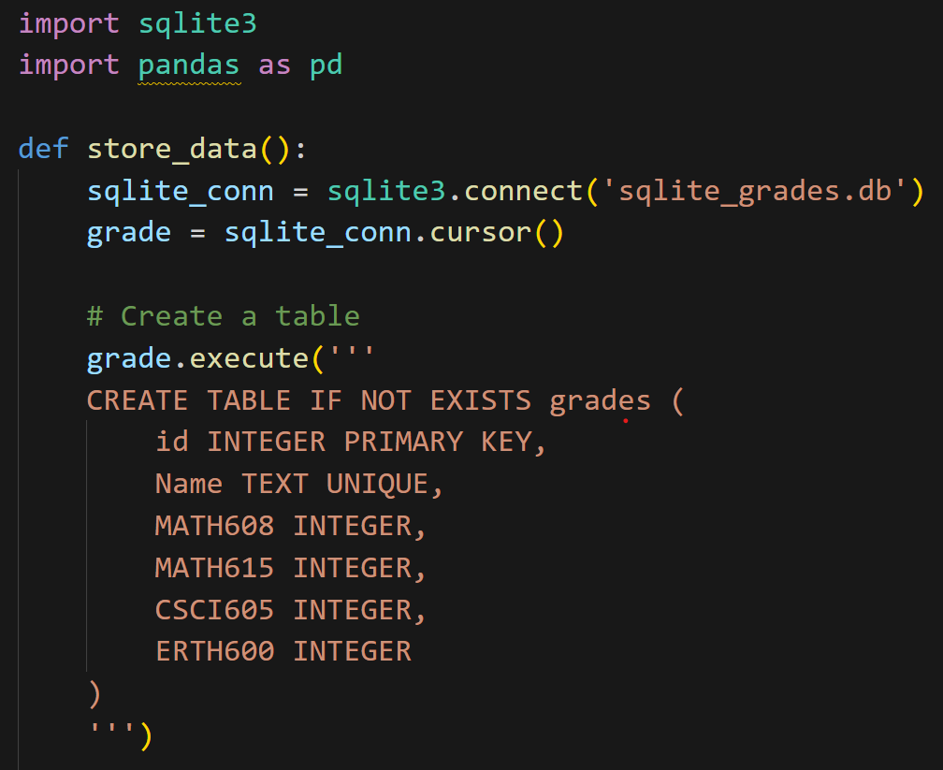
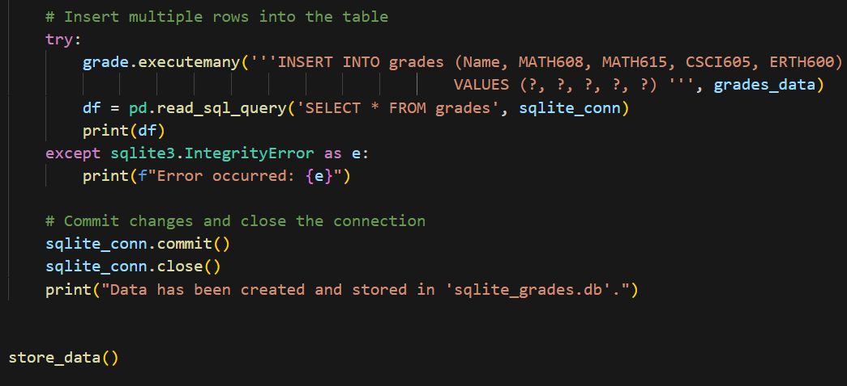
SQL vs NO-SQL
Pushpak Sunil Rane
California State University Chico: Department of Mathematics and Statistics
SQL – [SQLite]

Slide 5
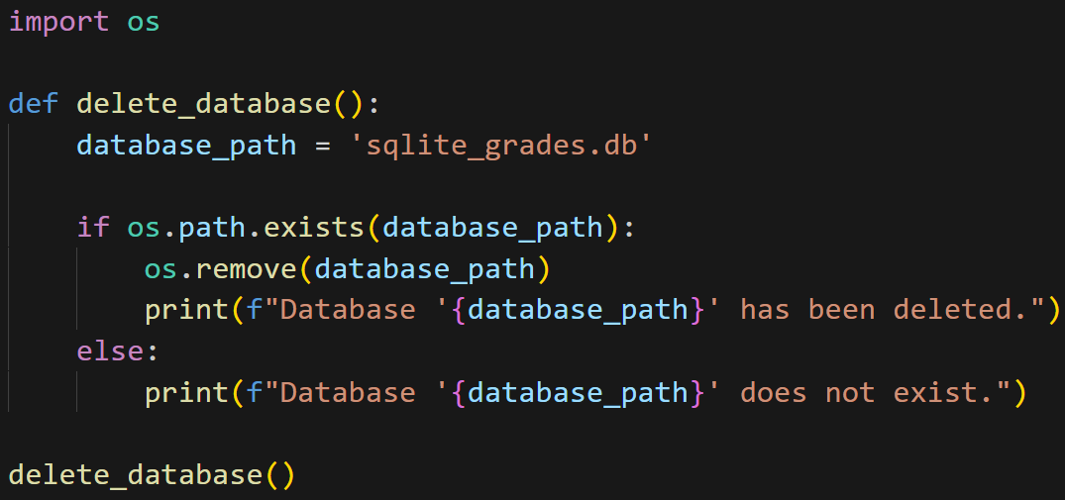
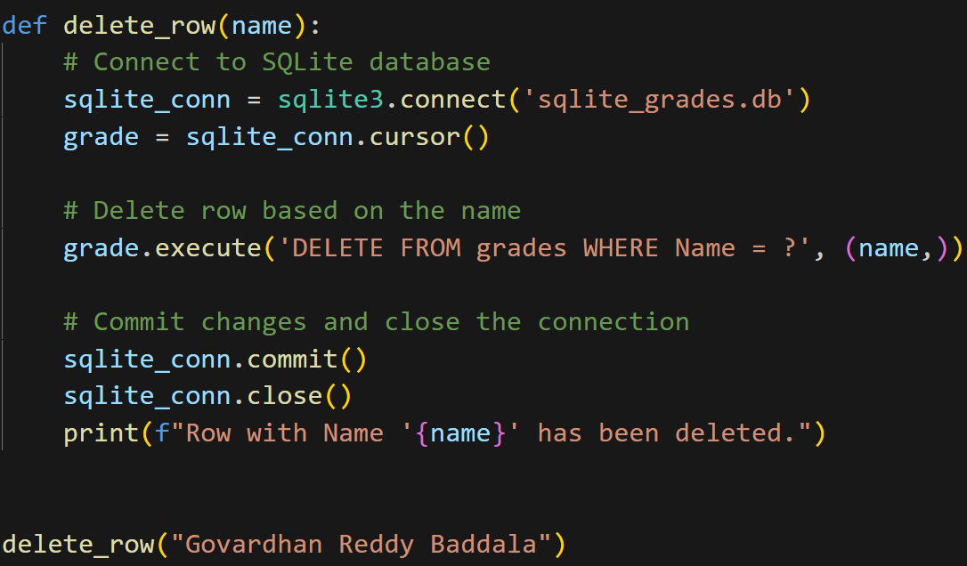
SQL vs NO-SQL
Pushpak Sunil Rane
California State University Chico: Department of Mathematics and Statistics
SQL – [SQLite]

Slide 6
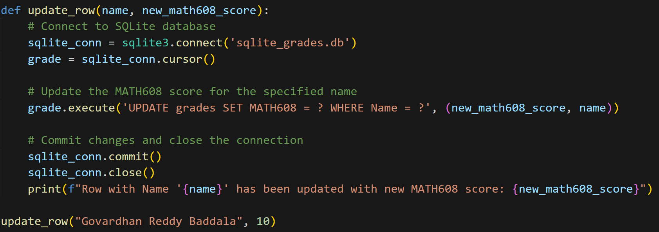
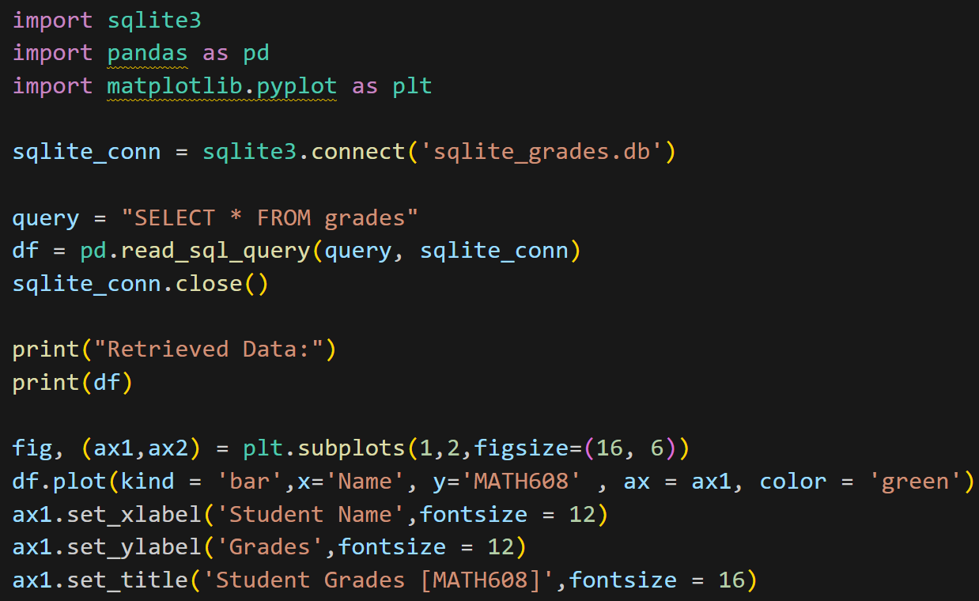
SQL vs NO-SQL
Pushpak Sunil Rane
California State University Chico: Department of Mathematics and Statistics
SQL – [SQLite]

Slide 7
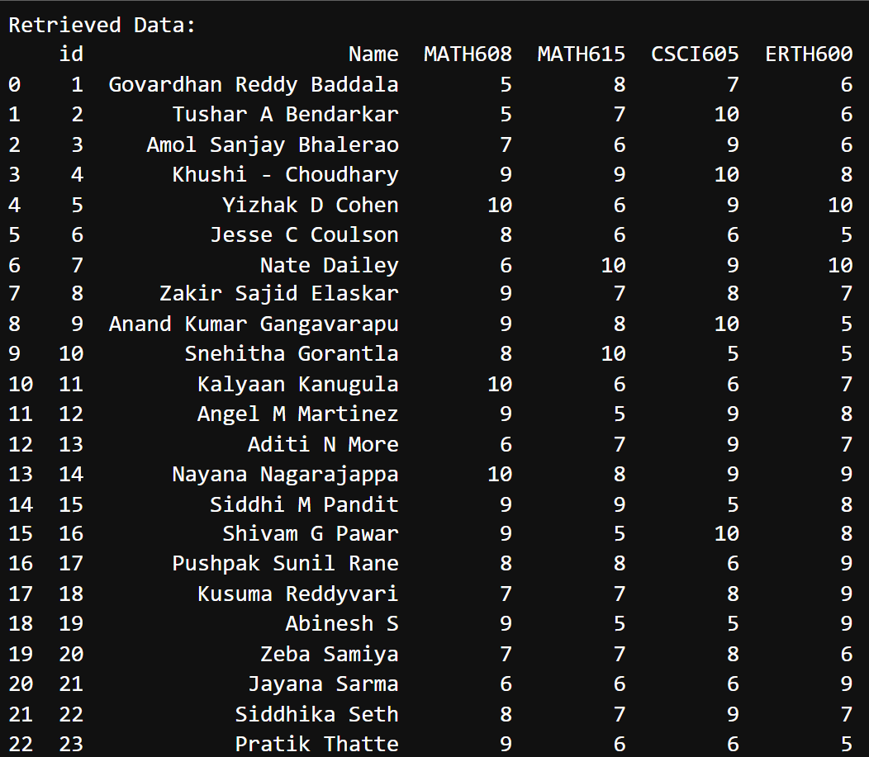
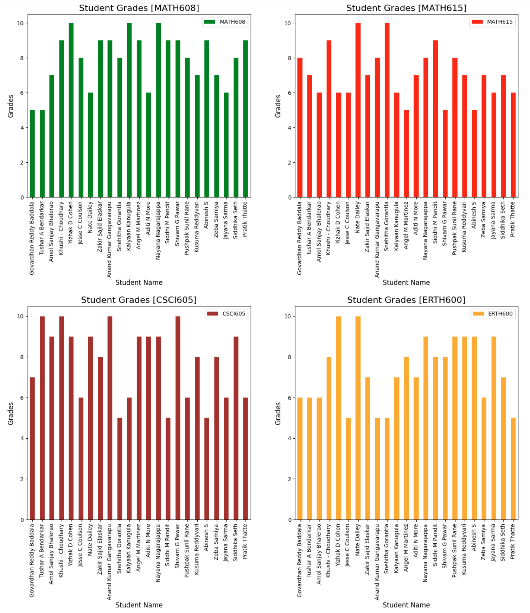
SQL vs NO-SQL
Pushpak Sunil Rane
California State University Chico: Department of Mathematics and Statistics
SQL – [SQLite]

Slide 8
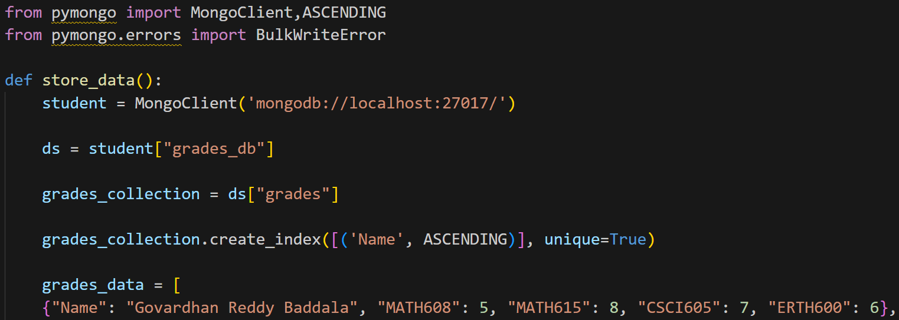
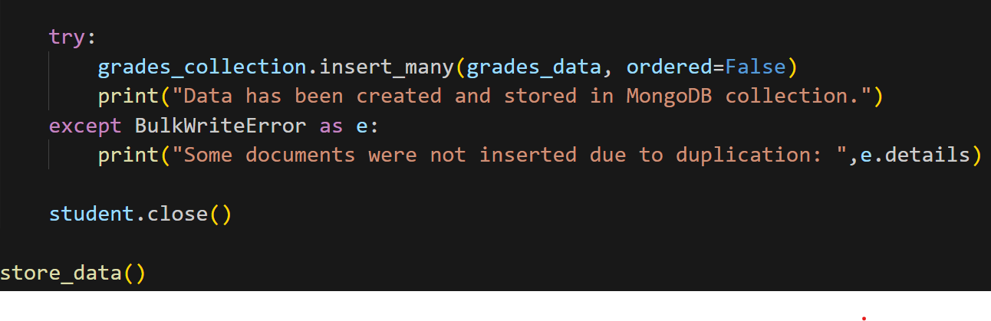
SQL vs NO-SQL
Pushpak Sunil Rane
California State University Chico: Department of Mathematics and Statistics
NO-SQL – [MongoDB]

Slide 9
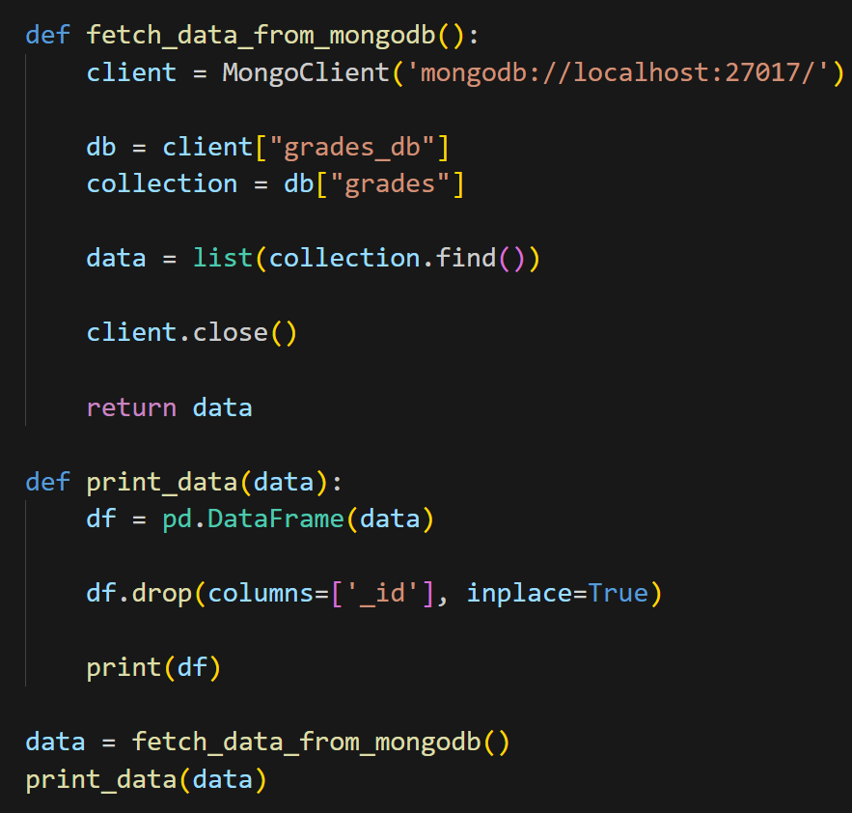
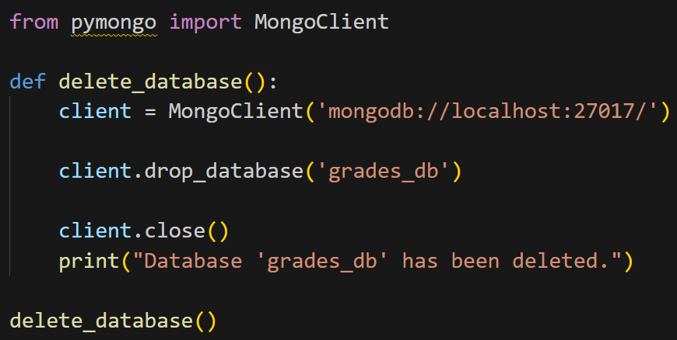
SQL vs NO-SQL
Pushpak Sunil Rane
California State University Chico: Department of Mathematics and Statistics
NO-SQL – [MongoDB]

Slide 10
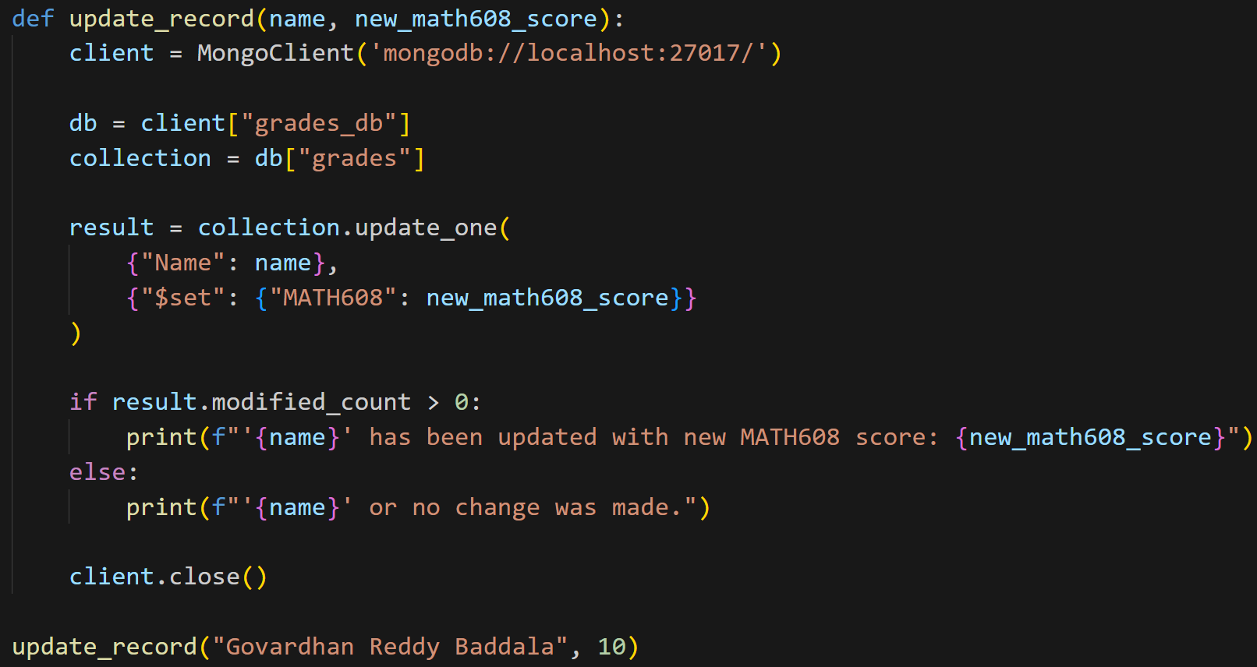
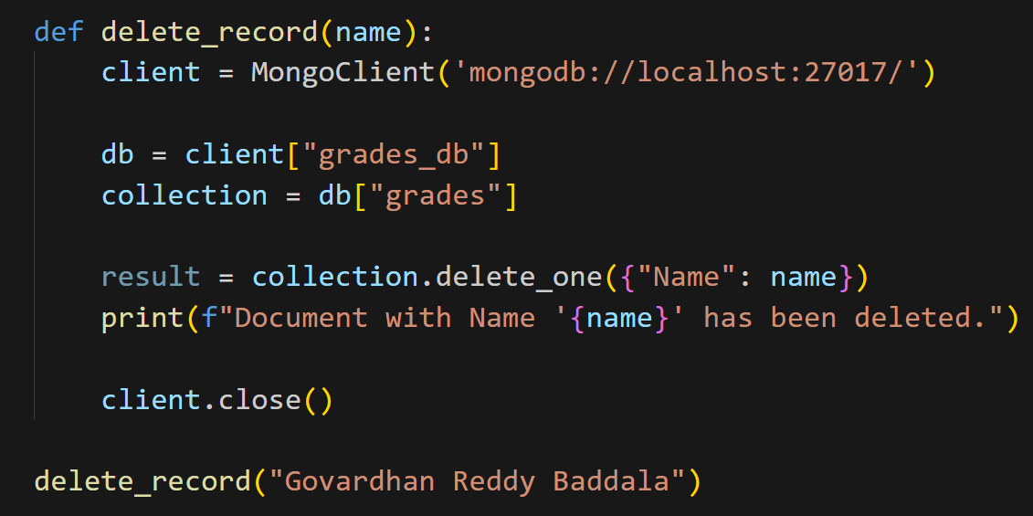
SQL vs NO-SQL
Pushpak Sunil Rane
California State University Chico: Department of Mathematics and Statistics
NO-SQL – [MongoDB]

Slide 11
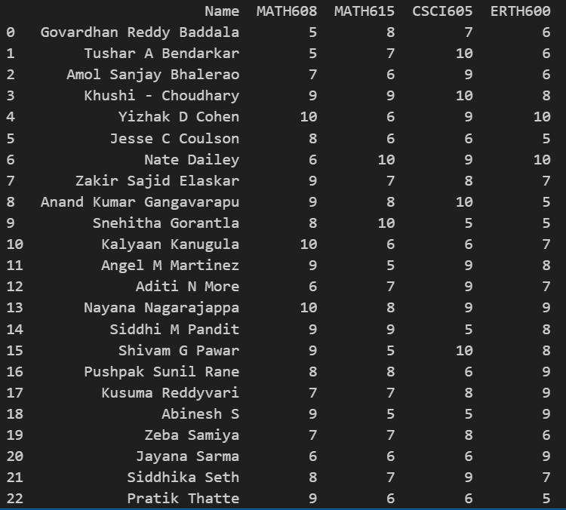
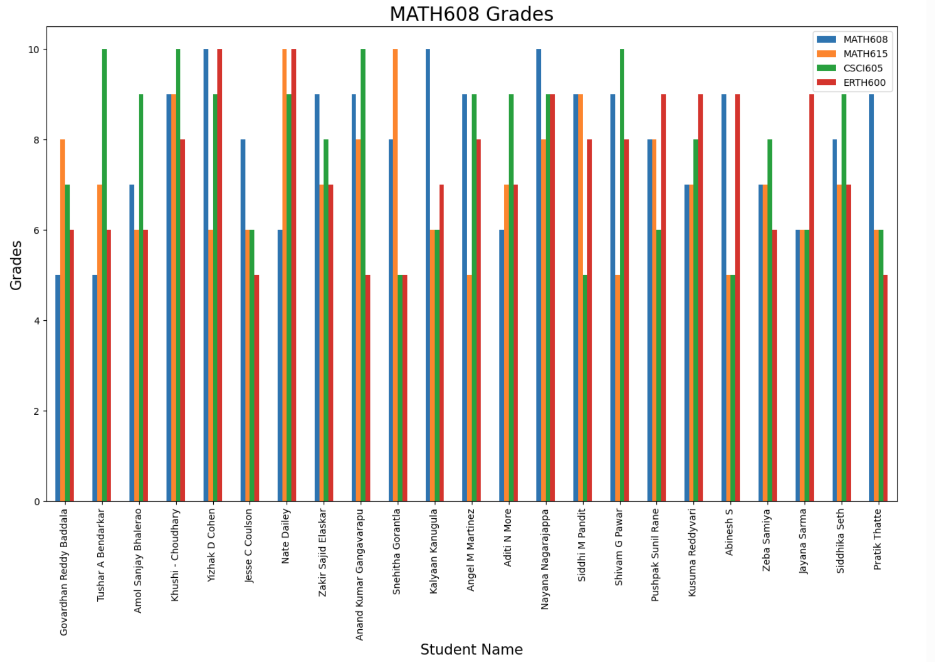
SQL vs NO-SQL
Pushpak Sunil Rane
California State University Chico: Department of Mathematics and Statistics
NO-SQL – [MongoDB]

Slide 12
SQL vs NO-SQL
Pushpak Sunil Rane
California State University Chico: Department of Mathematics and Statistics
THANK YOU

