Slide 1


SQL vs NO-SQL
Pushpak Sunil Rane
California State University Chico: Department of Mathematics and Statistics
SQL – [Structured Query Language]
SQL (1970)
Oracle Database (1979)
PostgreSQL (1982)
IBM Db2 (1983)
Microsoft SQL Server (1989)
MySQL (1995)
SQLite (2000)
MariaDB (2009)
NO-SQL – [ Not Only SQL]
CouchDB (2005)
MongoDB (2007)
Neo4j (2007)
Cassandra (2008)
Redis (2009)
Elasticsearch (2010)
Amazon DynamoDB (2012)

Slide 2
SQL vs NO-SQL
Pushpak Sunil Rane
California State University Chico: Department of Mathematics and Statistics
Feature | SQL | NoSQL
Data Model | Relational (tables) | Various (document, key-value, wide-column, etc.)
Schema | Fixed schema | Schema-less or dynamic schema
Scalability | Vertical scalability | Horizontal scalability
Query Language | Standardized (SQL) | Varies by database (e.g., MQL, CQL, etc)
Use Cases | Complex queries, transactions, data integrity | High performance, scalability, flexibility
Performance | Can be slower for large volumes of unstructured data | Optimized for fast read/write operations

Slide 3
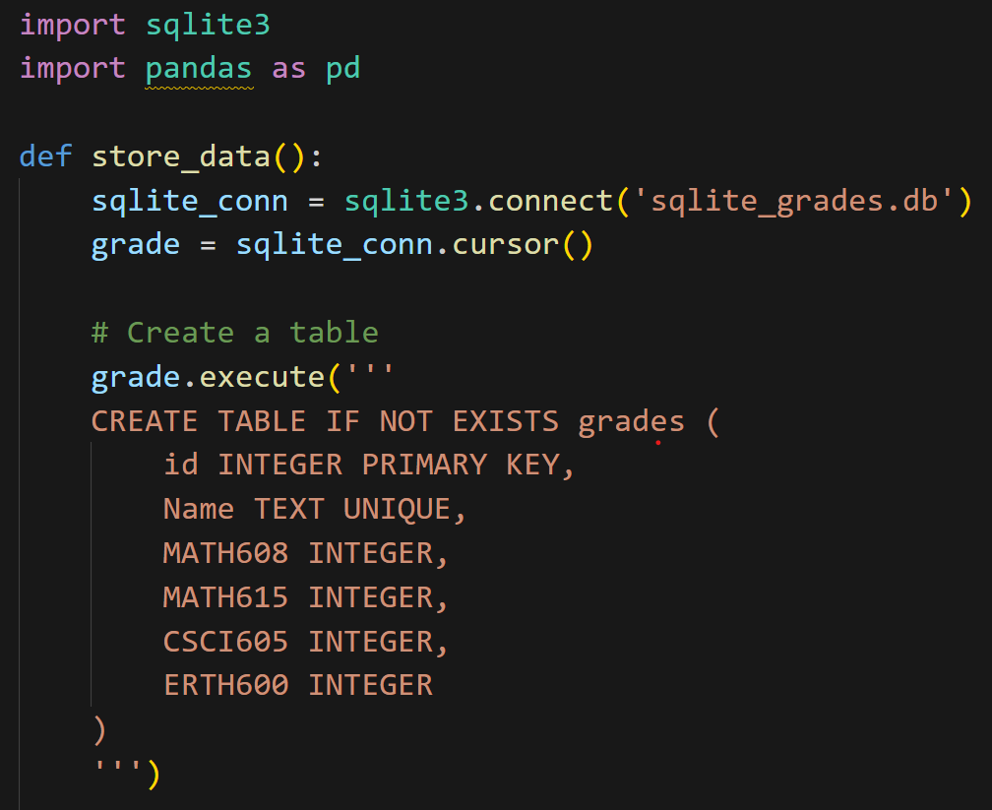
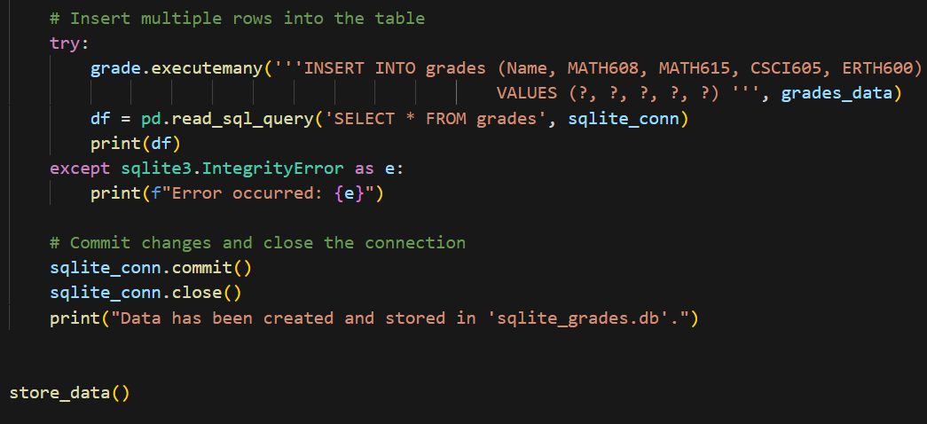
SQL vs NO-SQL
Pushpak Sunil Rane
California State University Chico: Department of Mathematics and Statistics
SQL – [SQLite]

Slide 4
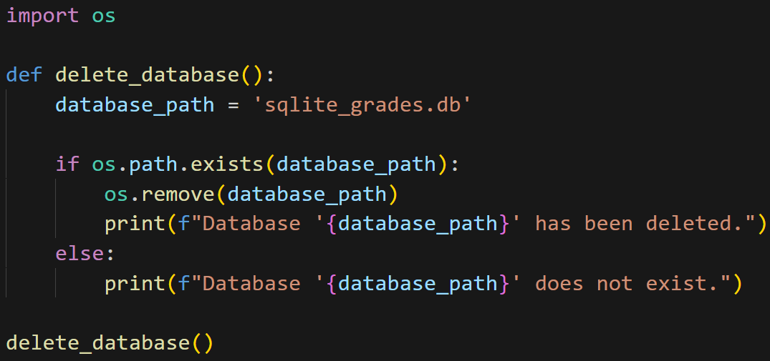
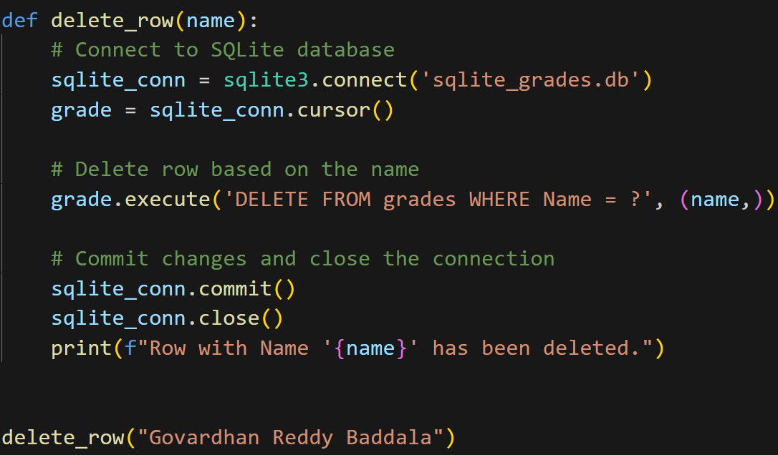
SQL vs NO-SQL
Pushpak Sunil Rane
California State University Chico: Department of Mathematics and Statistics
SQL – [SQLite]

Slide 5
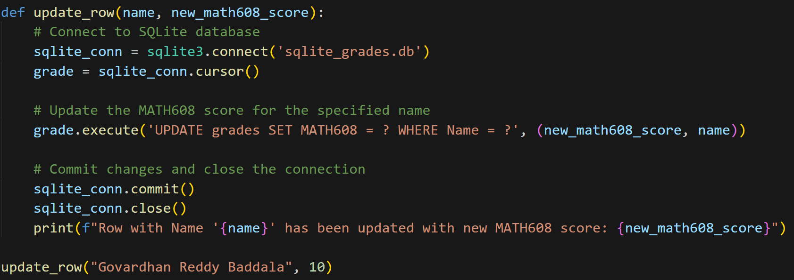
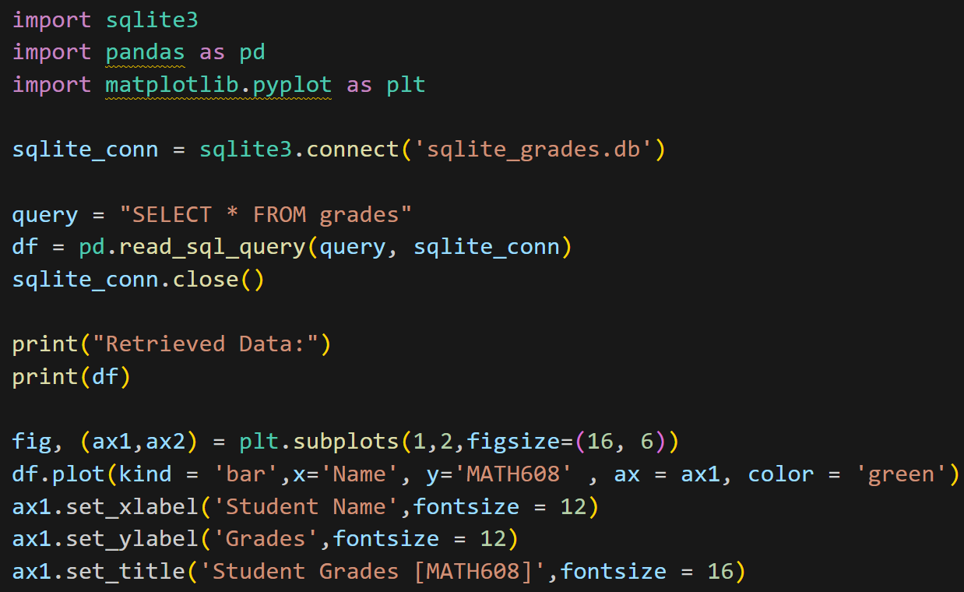
SQL vs NO-SQL
Pushpak Sunil Rane
California State University Chico: Department of Mathematics and Statistics
SQL – [SQLite]

Slide 6
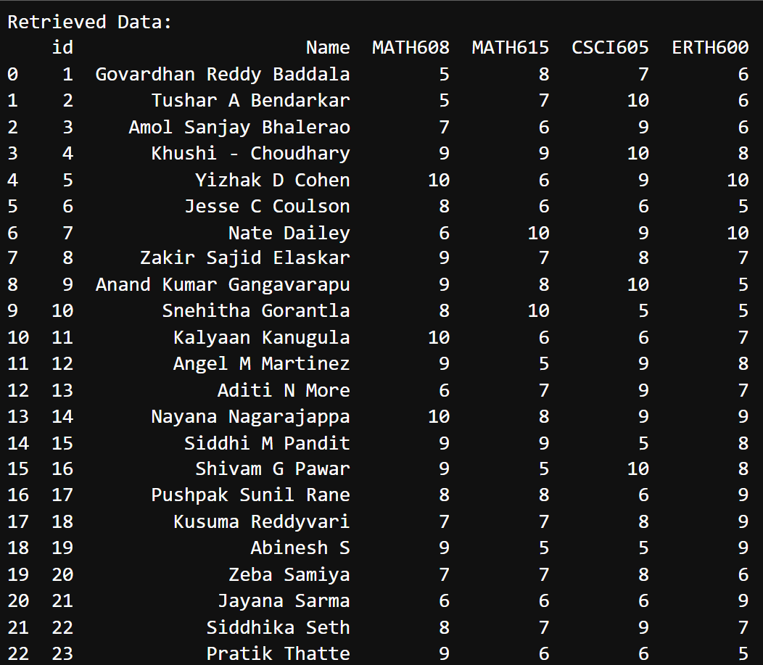
SQL vs NO-SQL
Pushpak Sunil Rane
California State University Chico: Department of Mathematics and Statistics
SQL – [SQLite]

Slide 7
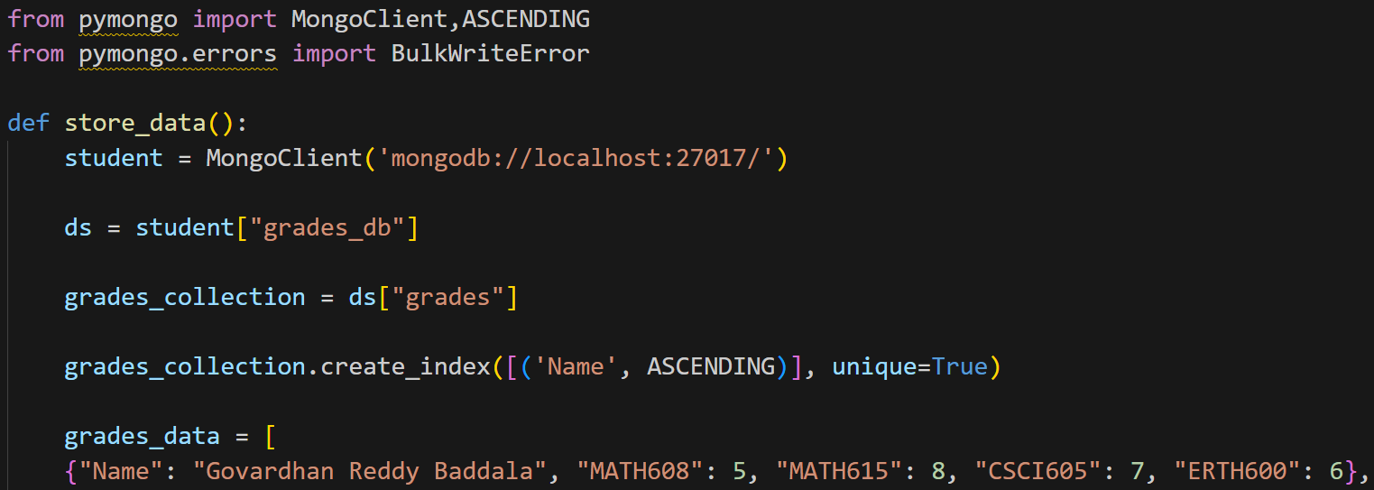
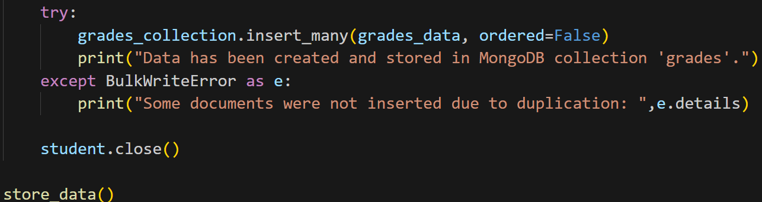
SQL vs NO-SQL
Pushpak Sunil Rane
California State University Chico: Department of Mathematics and Statistics
NO-SQL – [MongoDB]

Slide 8
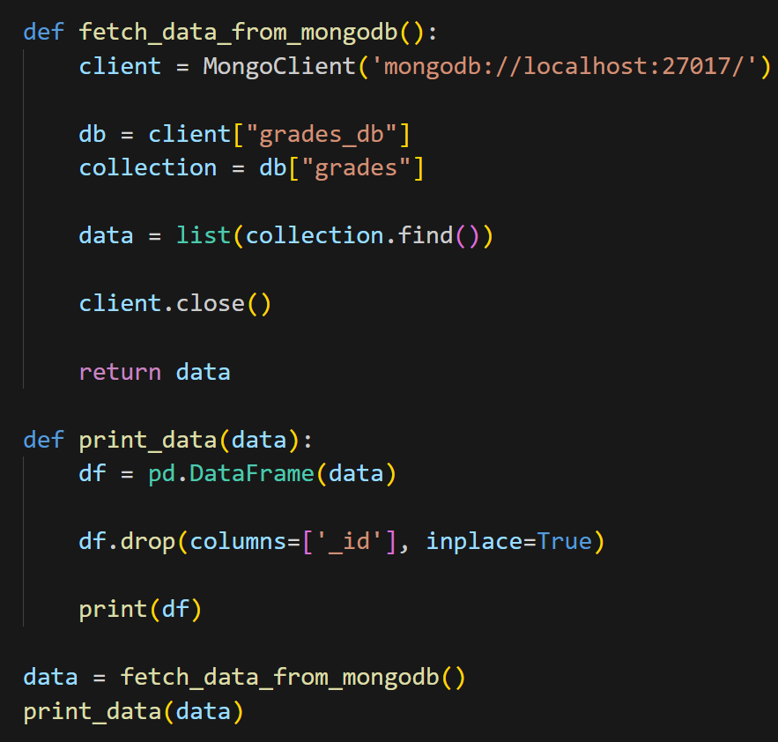
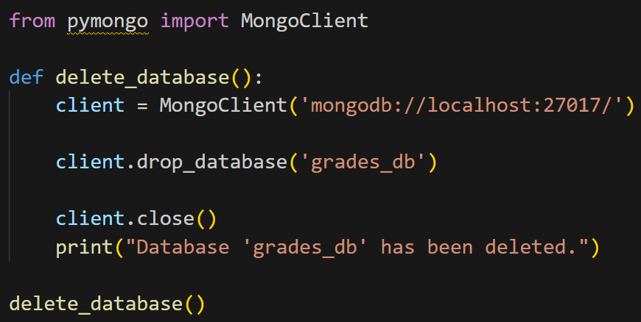
SQL vs NO-SQL
Pushpak Sunil Rane
California State University Chico: Department of Mathematics and Statistics
NO-SQL – [MongoDB]

Slide 9
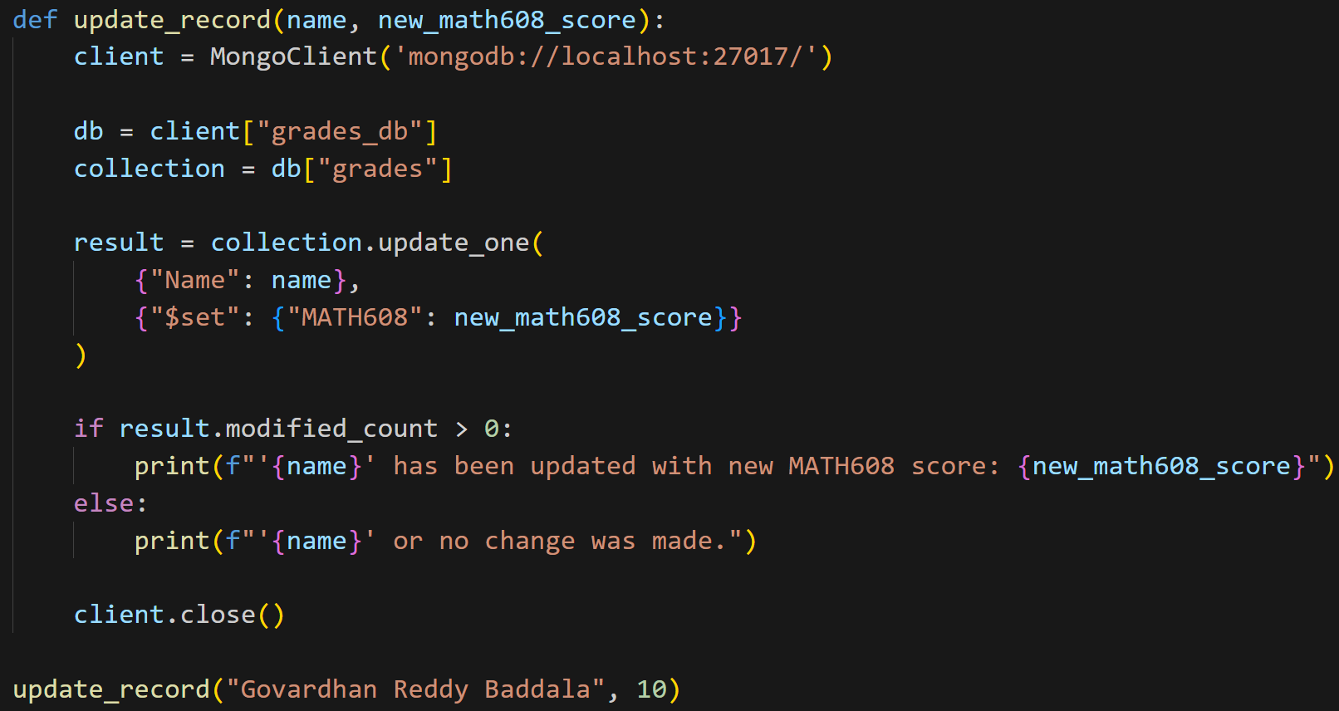
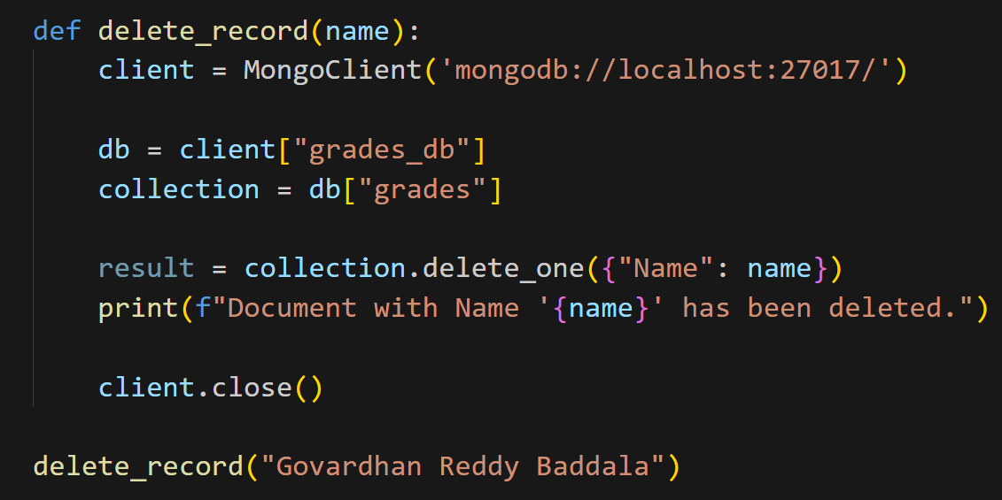
SQL vs NO-SQL
Pushpak Sunil Rane
California State University Chico: Department of Mathematics and Statistics
NO-SQL – [MongoDB]

Slide 10
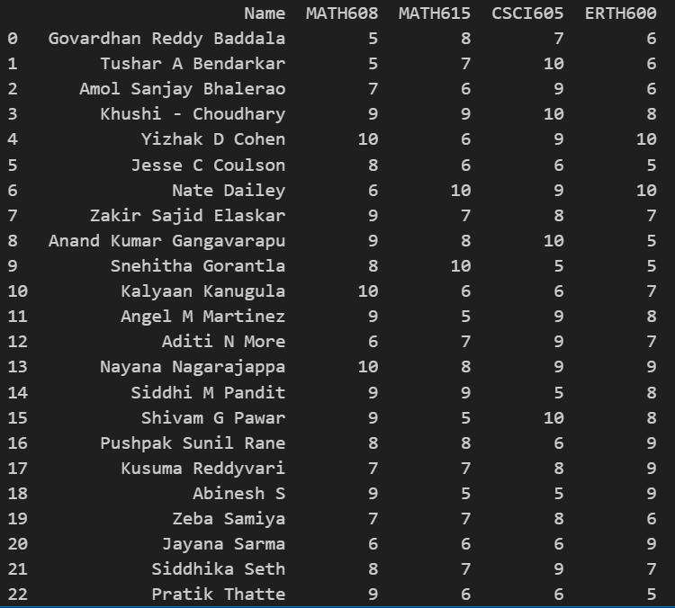
SQL vs NO-SQL
Pushpak Sunil Rane
California State University Chico: Department of Mathematics and Statistics
NO-SQL – [MongoDB]

Slide 11
SQL vs NO-SQL
Pushpak Sunil Rane
California State University Chico: Department of Mathematics and Statistics
THANK YOU

