Slide 1
AI-Based tool for preliminary diagnosis of Dermatological manifestations.
CSE7101- Capstone Project
Review-1
Team Number: CSE_18
Roll Number | Student Name
20221CSE0659 | Bhumika S
20221CSE0705 | Pushpalatha S
20221CSE0677 | Hrishikesh S Roogi
Under the Supervision of,
Dr . Taranath
Associate Professor
School of Computer Science and Engineering
Presidency University
Name of the Program: Capstone Project
Name of the HoD: Dr. Asif Mohammed
Name of the Program Project Coordinator: Dr. Jayavadivel Ravi
Name of the School Project Coordinators: Dr. Sampath A K , Dr. Geetha A

Slide 2
Content
Problem Statement
Objectives
Background and Related work for title Selection
Analysis of Problem Statement
Innovation or Novel Contributions
Git-hub Link
Timeline of the Project
References

Slide 3
Problem Statement Number : PSCS_49
Organization: Ministry of AYUSH
Category : Software
Problem Description:
Access to timely dermatological diagnosis is limited in many underserved regions due to a shortage of specialists, inadequate diagnostic tools, and poor healthcare infrastructure. This leads to delayed detection and treatment of skin diseases, which are among the leading causes of nonfatal disease burden and can indicate serious underlying conditions. An AI-based image processing tool for preliminary diagnosis of dermatological manifestations can provide an efficient, cost-effective, and accessible solution, enabling early screening and improved healthcare delivery.

Slide 4
Content
Objective :
Develop an AI-powered platform for preliminary diagnosis of dermatological conditions using image processing and integrated medical datasets.
Address the shortage of dermatology specialists and diagnostic infrastructure in underserved regions.
Enable instant skin condition screening through mobile and web interfaces.
Facilitate early detection of skin diseases to promote timely referrals.
Offer relevant care recommendations to improve treatment outcomes.
Background and Related Work:
AI in Dermatology – CNNs achieve dermatologist-level accuracy in skin lesion detection.
Prospective Studies – AI models achieve top-5 accuracy of ~89% in primary care, aiding triage.
Advanced Methods – Texture-map CNNs enhance malignant region detection.

Slide 5
Content (continuation)..
Analysis of Problem Statement:
High Skin Disease Burden – Millions worldwide suffer from skin conditions, but dermatologist availability is limited, especially in rural and underserved areas.
Delayed & Manual Diagnosis – Traditional diagnosis requires in-person visits and expert evaluation, leading to delays and possible worsening of conditions.
Lack of Accessible Tools – Existing online or mobile tools are often narrow in scope, rely on self-reported symptoms, and may lack image-based AI analysis.
Innovation or Novel Contributions:
Automated AI Diagnosis – Uses deep learning (e.g., CNNs) to analyze skin images instantly for preliminary diagnosis across multiple dermatological conditions.
Explainable Outputs – Provides visual heatmaps or highlighted lesion areas to build user trust and assist clinicians.
Integration with Chatbot Support – An AI chatbot can explain results, answer questions, and suggest preventive or care steps.
Multi-Platform Accessibility – Works on mobile, web, and possibly offline modes for remote communities.

Slide 6
Github Link
The Github link provided should have public access permission.
Github Link

Slide 7
Analysis of Problem Statement
Need for an easy, accurate, and quick tool to daigonise the skin disease.
Technology Stack Components:
Image Capture Devices – Smartphone cameras or dermatoscopes for capturing high-quality skin images.
Database – MySQL or MongoDB for storing images, patient metadata, and diagnostic results.
Backend – Python (Flask/Django) or Node.js for image processing, AI inference, and API handling.
Frontend – HTML, CSS, JavaScript (React/Angular) for a responsive, user-friendly diagnostic interface.
AI & Deep Learning Models – CNN-based image classification for detecting and classifying skin conditions; integrated explainability (heatmaps).
APIs – Integration with medical datasets, tele-dermatology services, and electronic health record systems.
Multilingual Support – Accessibility for diverse linguistic groups across India.
Chatbot Assistant – AI chatbot for explaining diagnoses, suggesting care steps, and guiding follow-up actions.

Slide 8
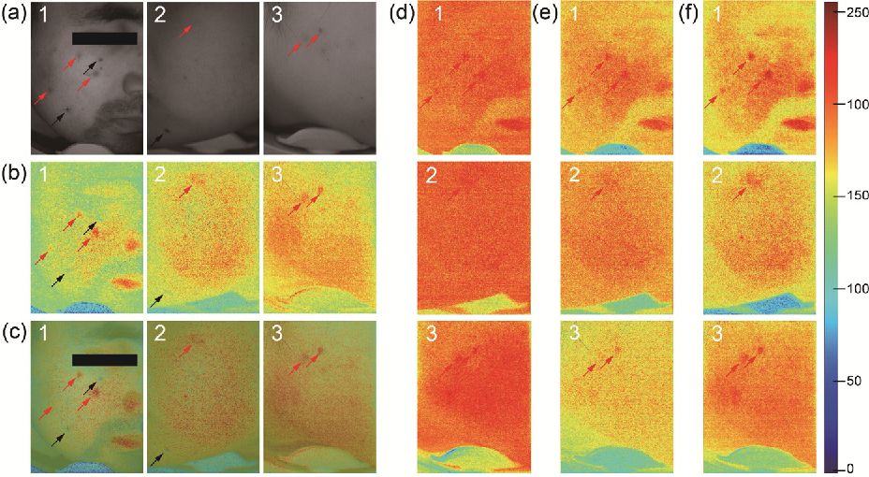
Analysis of Problem Statement (contd...)

Slide 9
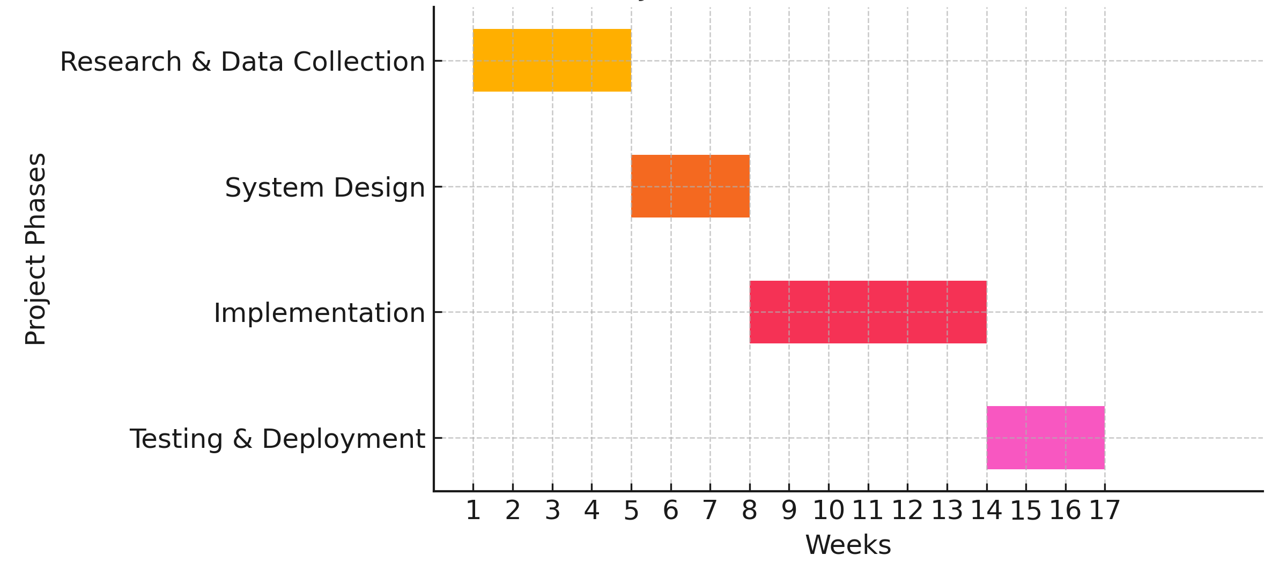
Timeline of the Project (Gantt Chart)

Slide 10
References (IEEE Paper format)
1.Esteva, A., Kuprel, B., Novoa, R. A., et al. — “Dermatologist-level classification of skin cancer with deep neural networks” (Nature, 2017). Landmark study showing CNNs can match dermatologists on image tasks (useful background even though not IEEE). Nature[2] M. Mekonnen and A. Hoekstra, “The green, blue and grey water footprint of crops and derived crop products,” Hydrology and Earth System Sciences, vol. 15, no. 5, pp. 1577–1600, May 2011.
2.Gutman, D., Codella, N. C. F., Celebi, M. E., et al. — “Skin Lesion Analysis toward Melanoma Detection: ISBI/ISIC challenge” (ISBI/ISIC challenge papers / datasets, 2016–2017). Key dataset / benchmark (ISIC). Essential if you need training/test data. arXivchallenge.isic-archive.com
3. AI-Based Classification for Skin Cancer (Goyal et al., 2019) | https://arxiv.org/abs/1911.11872(https://arxiv.org/abs/1911.11872)

Slide 11


