Slide 1
Employee Data Analysis using Excel
PUSHPALATHA. B
312200195/NM id F7D7359B806FE588B524F2FBD7E229E1
B. COM (GENERAL)
S. I. V. E. T. COLLEGE
STUDENT NAME:
REGISTER NO:
DEPARTMENT:
COLLEGE

Slide 2
PROJECT TITLE
Employee Performance Analysis using Excel

Slide 3


AGENDA
Problem Statement
Project Overview
End Users
Our Solution and Proposition
Dataset Description
Modelling Approach
Results and Discussion
Conclusion
3/21/2024 Annual Review

Slide 4

PROBLEM STATEMENT
Analysing performance of employees :
Analysing whether the employees are performing their job effectively or is there any challenges faced by them so they need training and if they are performing well incentives can be awarded.

Slide 5

PROJECT OVERVIEW
Performance Analysis :
A pivot table is created for analysing the performance of employees using their name, gender, business unit, and performance rating.

Slide 6

WHO ARE THE END USERS?
Organization
Employee
Employer
Manager
Different industries
It sector

Slide 7

OUR SOLUTION AND ITS VALUE PROPOSITION
Filtering - Used to remove missing values
Conditional formatting - To highlight blank values
Pivot table - Used for summarising and organising the datas
Graph - It is used for representing data and for better understanding

Slide 8
Dataset Description
Employee data set- Kaggle
26 features
Feature - 9 features
Employee id
Gender - male, female
Performace rating - numerical
Business unit
Name

Slide 9

THE "WOW" IN OUR SOLUTION
Delivers high quality results
3/21/2024 Annual Review
9

Slide 10
MODELLING
Data Collection - collecting the required datas and information.
Data cleaning - removing the unnecessary datas.
Techniques - Conditional formatting to highlight blank values.
Results and chart
Pivot table - To represent data in a understandable manner.
10

Slide 11
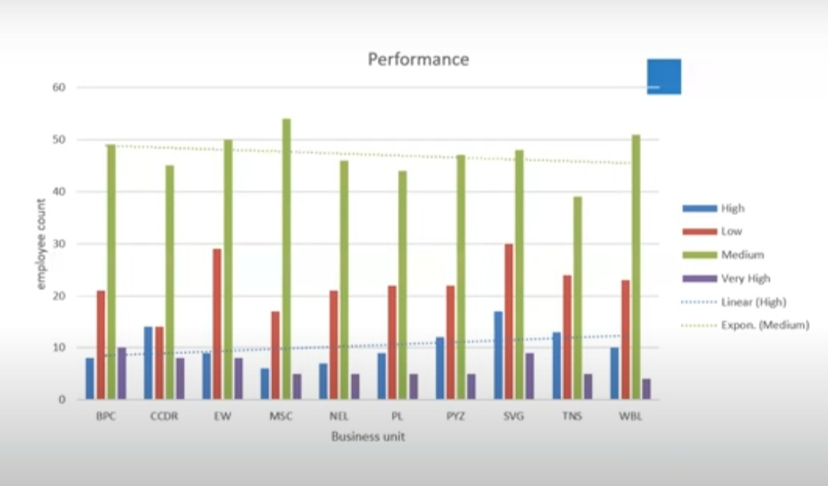
RESULTS
11

Slide 12
conclusion
With the help of this employee performance analysis, we came to know about the employee performance using excel. We also created pivot table for visualising and for better understanding purpose.

