Slide 1
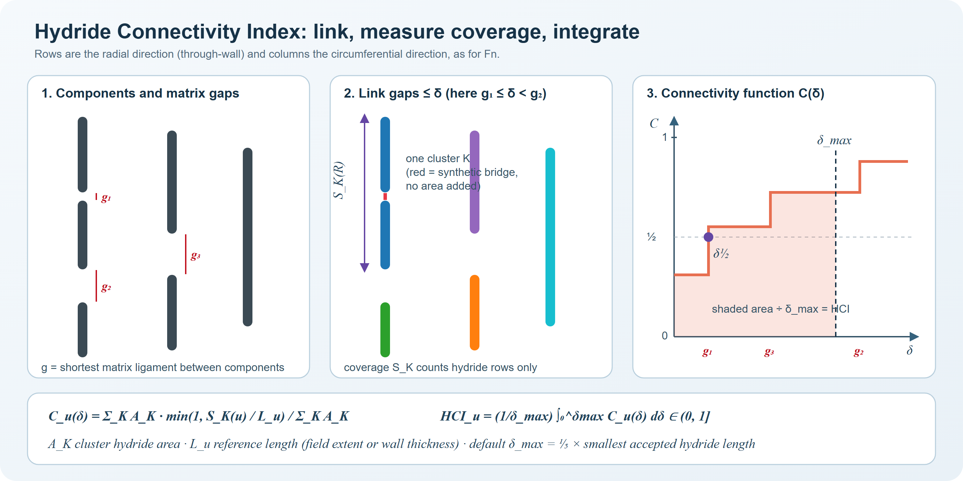
Hydride Connectivity Index (HCI) v1: problem, method, validation, results
MicroSeg 2.0.0 · formulation hci.v1 · review deck, 27 September 2026
A bounded, threshold-free connectivity index validated at constant area fraction (MicroSeg 2.0.0)
Notes:
Review deck for the HCI v1 formulation. It covers the problem, the intern prototype and why it was not adopted, the synthetic benchmark and its rationale, the algorithm step by step, validation evidence, the owner's delta_max rule and its consequences, results on the report's real micrographs, the implementation and the caveats.

Slide 2
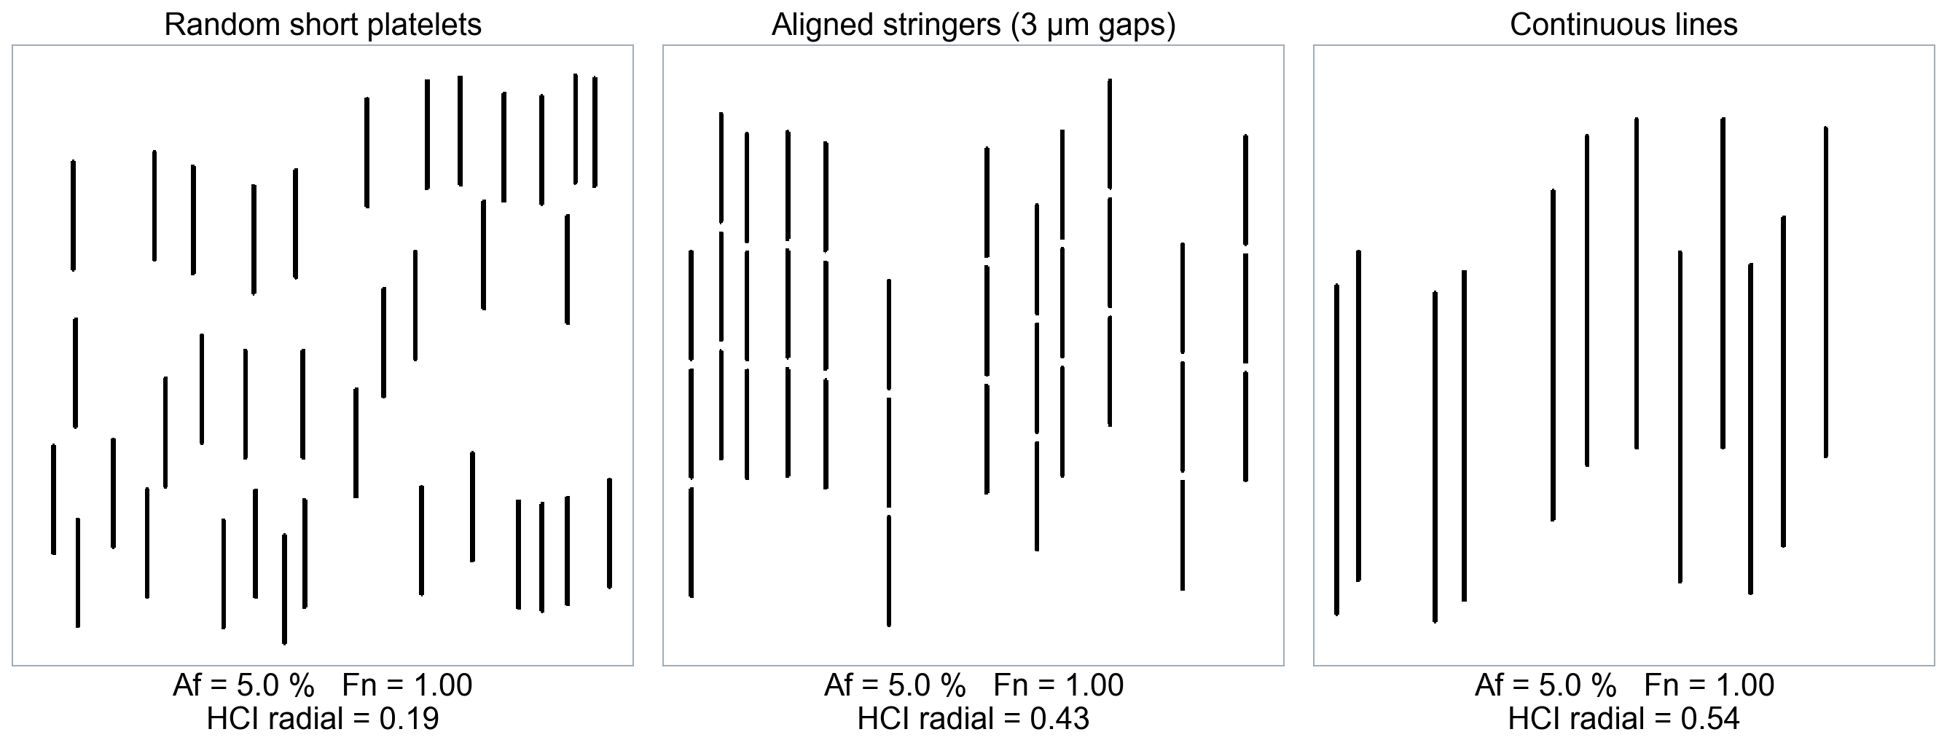
The problem: amount and orientation do not describe connectivity
Same area fraction, same Fn — very different connectivity: a new descriptor is needed
Notes:
All three synthetic masks have area fraction 5.0 % and length-weighted Fn = 1.00, because every hydride is radial. Yet a crack path through the continuous lines crosses far less matrix than one through isolated platelets. Area fraction and Fn cannot distinguish them; the HCI radial (fixed delta_max = 10 um) does: 0.20, 0.44, 0.55.

Slide 3
Existing hydride descriptors and where the HCI fits
Descriptor | What it measures | Limitation for connectivity
RHF / Fn | Share of radial hydrides | Orientation only; no linkage
HCC (Kim 2015) | Radial length of near-continuous hydrides in a band | Empirical band and closeness rules
RHCF (Billone 2013) | Max radial hydride length in an arc window | Window-based; one direction
RHCP (Simon 2021) | Optimal through-wall crack path (toughness-weighted) | Single weakest path; toughness ratio assumed
Intern HCI prototype | Topology × length / nearest-cluster distance | Unbounded, amount-driven, fails invariance
HCI v1 (this work) | Integrated single-linkage coverage, δ½, closure κ | Validated on synthetic axioms; field data pending
None separates connectivity from amount under controlled tests — that is the gap v1 fills
Notes:
RHCF: Billone, Burtseva, Einziger, J. Nucl. Mater. 433 (2013) 431. HCC: Kim et al., J. Nucl. Mater. 456 (2015) 235. RHCP: Simon et al., J. Nucl. Mater. 547 (2021) 152817; Dijkstra implementation PROPHET, J. Nucl. Mater. 567 (2022). Our companion path continuity Pi is explicitly RHCP-type; novelty is claimed for the integrated linkage HCI, the critical linking distance, the closure identity and the constant-Af benchmark with axioms.

Slide 4
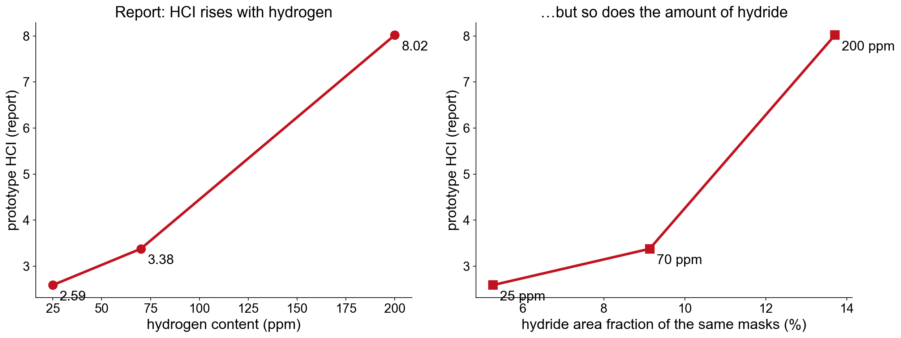
The intern prototype and what its results really show
Prototype formula
• w = (B+1)/N × L̄ / d_min
• HCI = Σ A·w / Σ A
• B junctions, N = ends + B
• d_min: nearest cluster
Reported (Table 2)
• 25 ppm: 2.59
• 70 ppm: 3.38
• 200 ppm: 8.02
But
• Area fraction 5 → 14 %
• Unbounded, px units
Prototype HCI rose with hydrogen — but so did the hydride amount: the trend is confounded
Notes:
Prototype: w_i = ((B_i+1)/N_i)(Lbar/d_min,i), HCI = sum(A_i w_i)/sum(A_i). Reported values 2.59, 3.38, 8.02 for 25, 70, 200 ppm. The report's own masks have area fractions 5.3, 9.1 and 13.7 %, so the rise cannot be attributed to connectivity. Re-running the unchanged prototype on the report masks gives 2.44, 3.12, 6.97 (figure resolution).

Slide 5
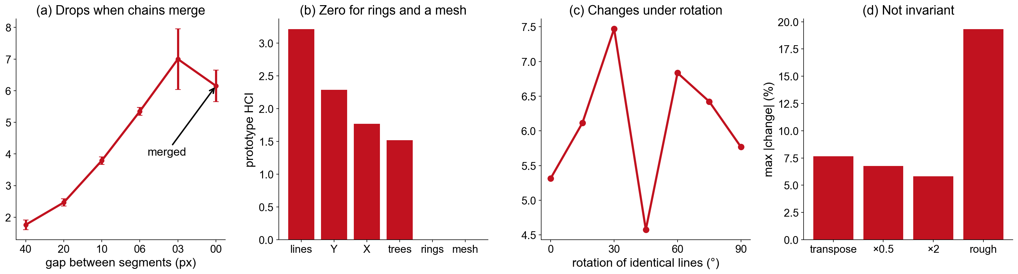
The prototype on the constant-area-fraction benchmark
Formulation-level failures, not just coding bugs — the prototype was not adopted
Notes:
All masks at Af = 5 %. (a) HCI falls when collinear chains finally merge. (b) A single connected cluster has no neighbour distance, so rings and the fully connected honeycomb mesh score 0. (c) Identical lines rotated vary by 15 % CV although the formula is isotropic. (d) Transpose changes it by 7.7 %, resolution by up to 6.8 %, roughness by 19 %. Also: two code paths disagree (6.05 vs 4.41), and six percolating masks exceeded 300 s.

Slide 6
Ten testable design axioms for any connectivity index
ID | Requirement | ID | Requirement
A1 | Ranks connectivity at constant Af | A6 | Exact symmetries (flip, transpose)
A2 | Bounded in (0, 1], interpretable | A7 | Resolution-consistent (µm thresholds)
A3 | Linking never lowers it | A8 | Robust to segmentation noise (≤ 5 %)
A4 | Fragmentation never raises it | A9 | Directional where declared
A5 | Defined for empty and single clusters | A10 | Deterministic, full provenance
Every axiom is checked automatically on the synthetic benchmark (tests/test_phase38_hci_core.py)
Notes:
The axioms turn the scientific intent into pass/fail tests. A1 is the key one: at constant area fraction the index must rank arrangements by connectivity.

Slide 7
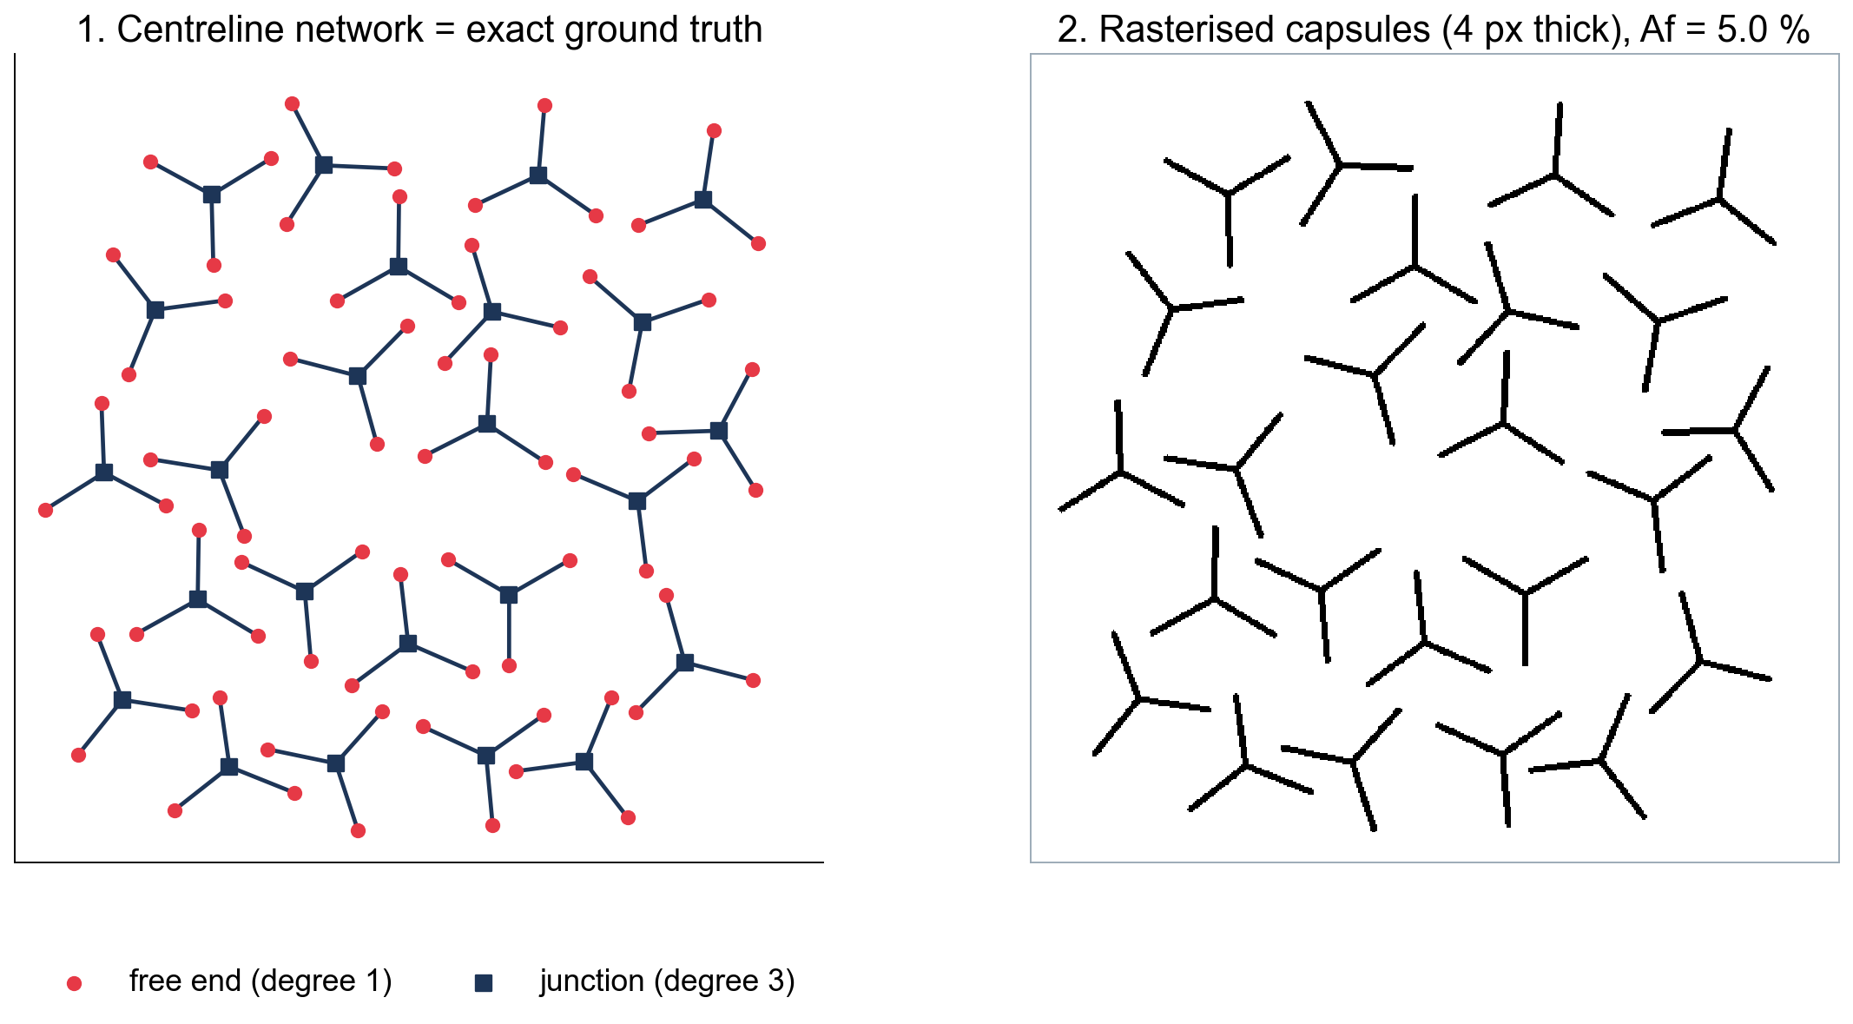
Synthetic benchmark: construction and rationale
Why synthetic?
• Real specimens change amount, orientation and spacing together
• One factor varied at a time
How
• Centreline graph → 4 px capsules
• Af fixed at 5.00 ± 0.05 %
• ≥ 6 µm clearance between objects
Ground truth
• Ends, junction degrees, loops
• 203 masks, bit-for-bit reproducible
Controlled masks with exact known answers make code and concept validation objective
Notes:
Each sample is a centreline graph (nodes, straight edges) rasterised as 4 px capsules. The graph gives exact ground truth: length, ends, junction degrees, loops, components and closure. A size parameter is solved so that the raster area fraction is 5.00 ± 0.05 %. Separate objects keep at least 12 px (6 um) of matrix. 203 masks regenerate bit-for-bit (tested).

Slide 8
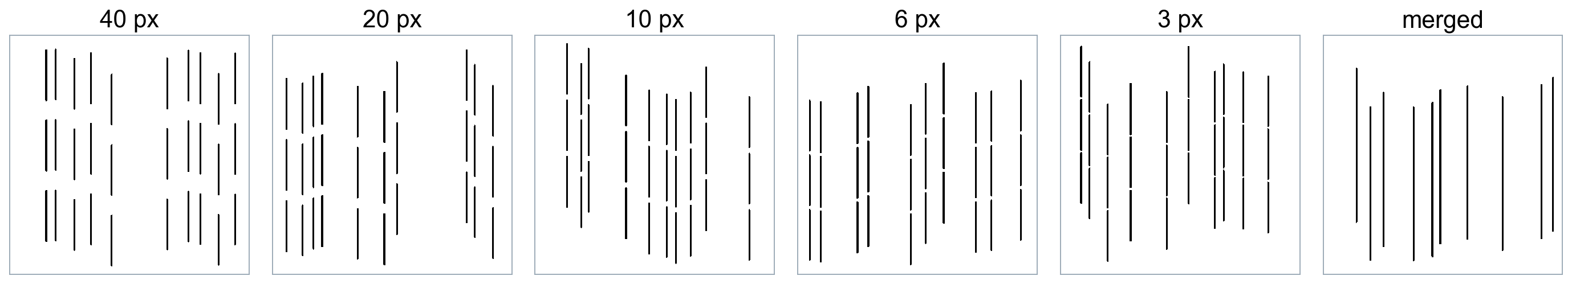
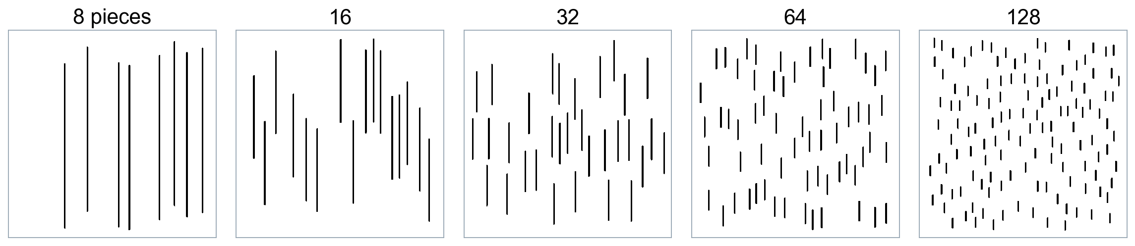
Benchmark families 1: gap and fragmentation (Af = 5 %)
Gap sweep
Only the gap between collinear hydrides changes
Fragmentation
Same hydride split into more, shorter pieces
Expected: closing gaps raises connectivity; splitting the same hydride lowers it
Notes:
Gap sweep: 10 chains of 3 collinear radial segments; surface gap 40, 20, 10, 6, 3 px, then merged. Isolates linking of collinear hydrides. Fragmentation: the same total length split into 8 to 128 radial pieces. Isolates fragment length at fixed amount.

Slide 9
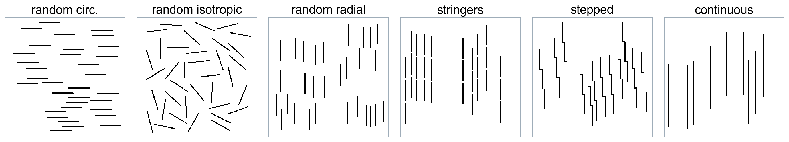
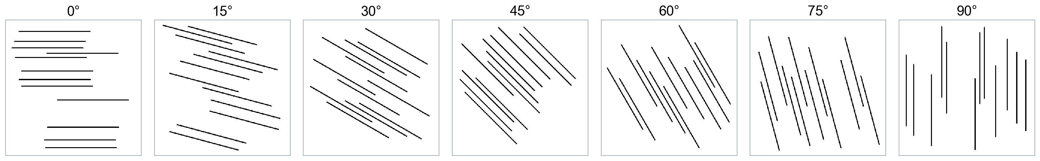
Benchmark families 2: arrangement and orientation
Arrangement
Same segments, different spatial organisation
Orientation
Identical lines, rotated 0–90°
Expected: aligned < stringers < stepped ≈ continuous; radial index follows angle, isotropic stays flat
Notes:
Arrangement: 36 equal segments placed randomly (circumferential, isotropic, radial), as stringers with 3 um gaps, as stepped linked staircases, or merged into continuous lines. Orientation: 12 identical lines rotated 0 to 90 degrees from the circumferential axis.

Slide 10
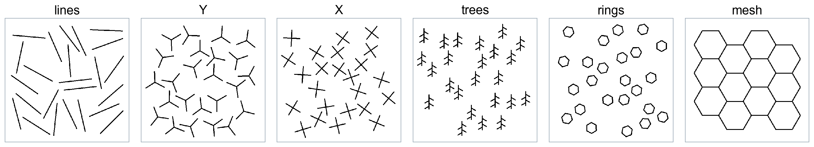
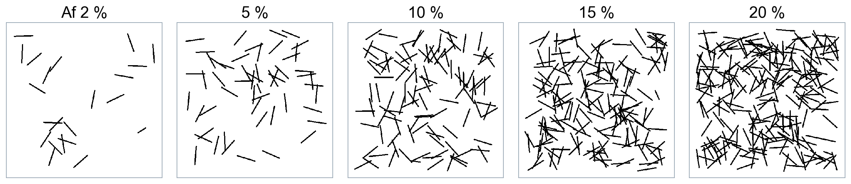
Benchmark families 3: topology and the percolation (Boolean) model
Topology
Ends, junctions, loops and one mesh
Boolean model
Af varied 2–20 %: percolation check
Expected: topology separates ends from loops; HCI rises with Af across the percolation transition
Notes:
Topology: equal total length as lines, Y (degree 3), X (degree 4), branched trees, hexagonal rings, and one honeycomb mesh; exact ends, junction degrees and loops known. Boolean model: overlapping random 60 px sticks at Af = 2 to 20 %, isotropic and radial, the classical continuum-percolation system; this family deliberately varies Af.

Slide 11
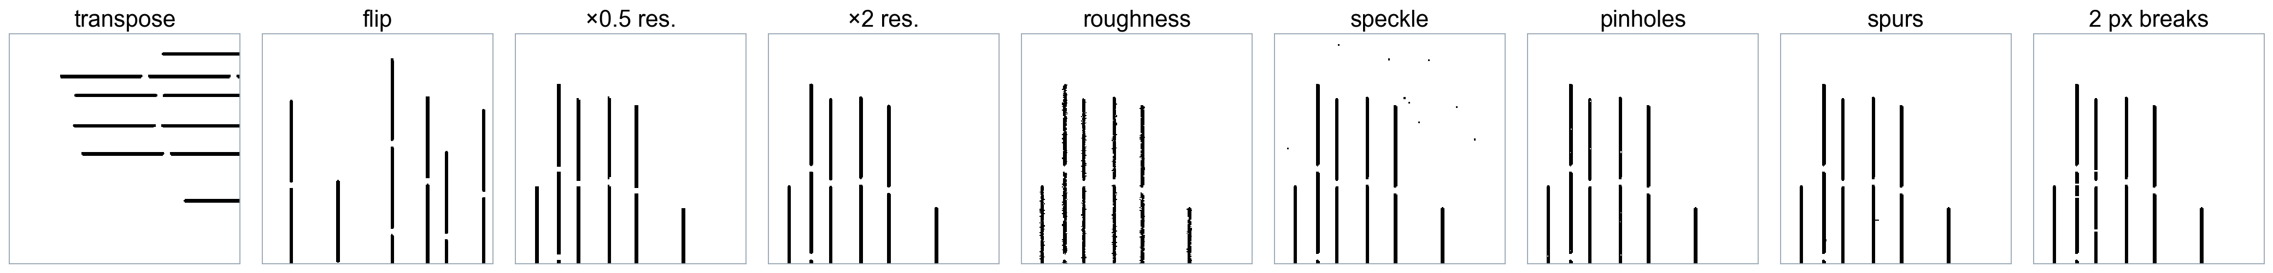
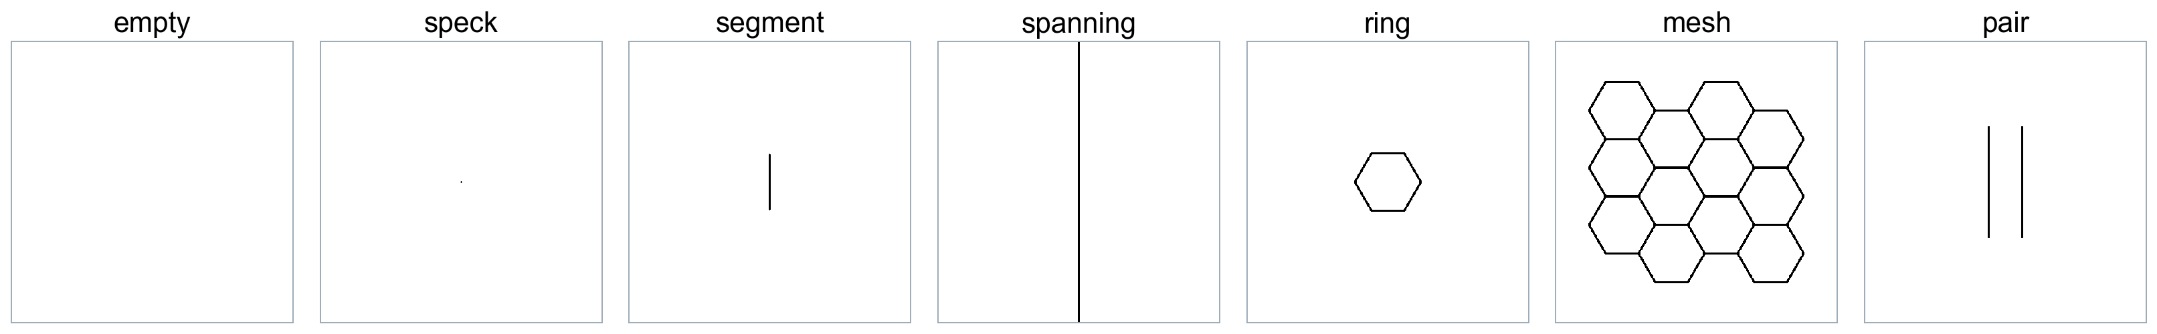
Benchmark families 4: invariance, noise and edge cases
Invariance
Symmetry, resolution and segmentation noise
Edge cases
Empty, speck, single clusters
Expected: exact symmetry, ≤ 5 % change under resolution or noise, explicit status for edge cases
Notes:
Invariance: transpose, flips, resolution x0.5 and x2 (pixel size recorded), boundary roughness (10 % boundary pixel flips), speckle below the clean-up size, pinholes, spurs and 2-px breaks. Degenerate: empty, sub-threshold speck, a single segment, a border-to-border line, a ring, a single mesh cluster and a pair of lines.

Slide 12
How the HCI works
Link hydrides across matrix gaps ≤ δ, measure covered length, average over δ up to δ_max
Notes:
Components are linked when the matrix ligament between them is at most delta (single linkage; bridges are synthetic and add no area). C(delta) is the area-weighted fraction of the reference length covered by the cluster each hydride belongs to, using projected coverage so gaps add no extent. The HCI is the mean of C over 0 to delta_max: bounded, monotone and threshold-free inside the range.

Slide 13
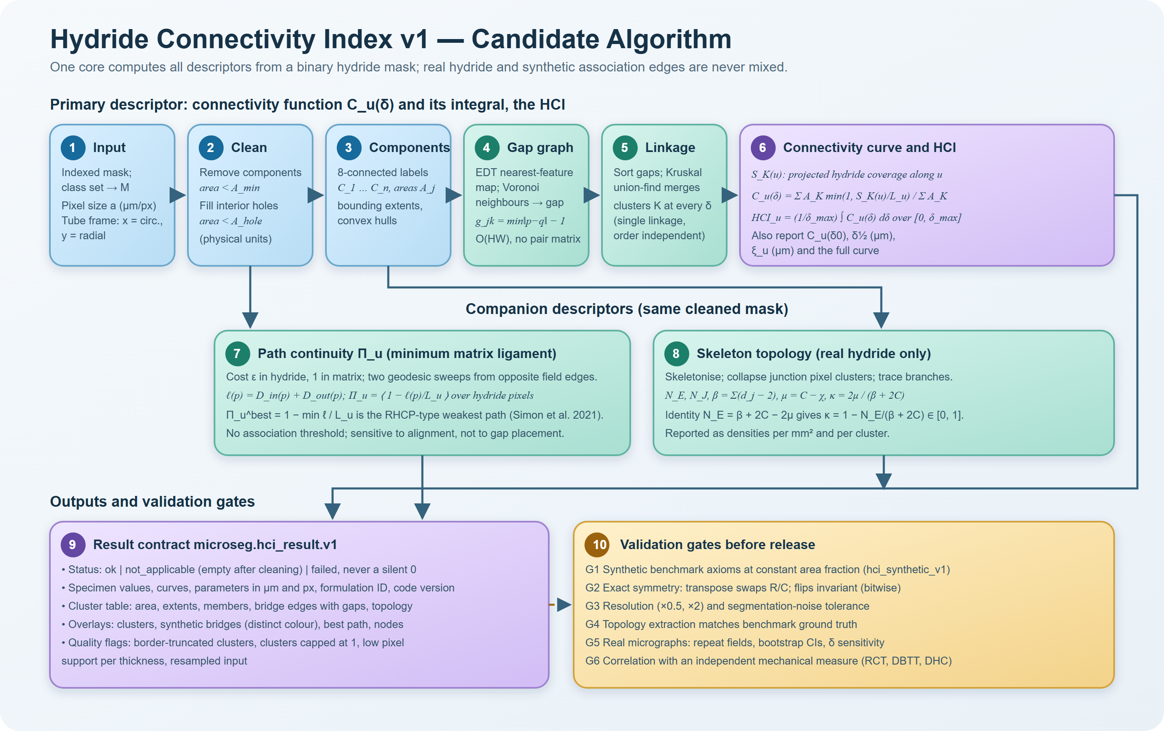
Algorithm flow sheet (same SVG as the code documentation)
One deterministic core for CLI, web and Python; real hydride and synthetic bridges never mixed
Notes:
Steps: binarise and clean (5 um2, 2x2 px floor); label 8-connected components; gap graph from the Euclidean distance transform (Voronoi neighbours contain the MST, so single linkage is exact); Kruskal merges give the exact step function C_u(delta); exact integral; companions path continuity and skeleton topology; quality flags; result schema microseg.hci_result.v1.

Slide 14
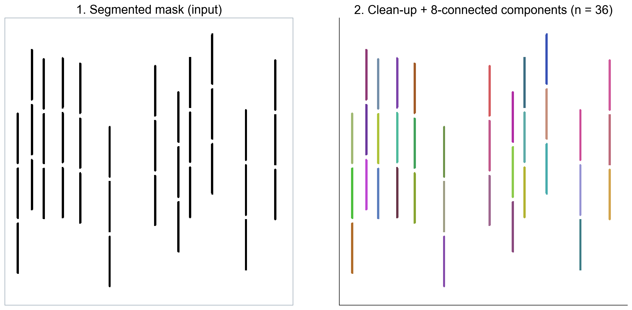
Step 1–2: clean-up and components
The mask is cleaned and split into 8-connected hydride components (36 platelets)
Notes:
Input: arrangement__radial_stringers__r00 (Af 5 %, 0.5 um/px). Components below 5 um2 would be removed; holes below 5 um2 filled; a 2x2 px floor applies at coarse resolution.

Slide 15
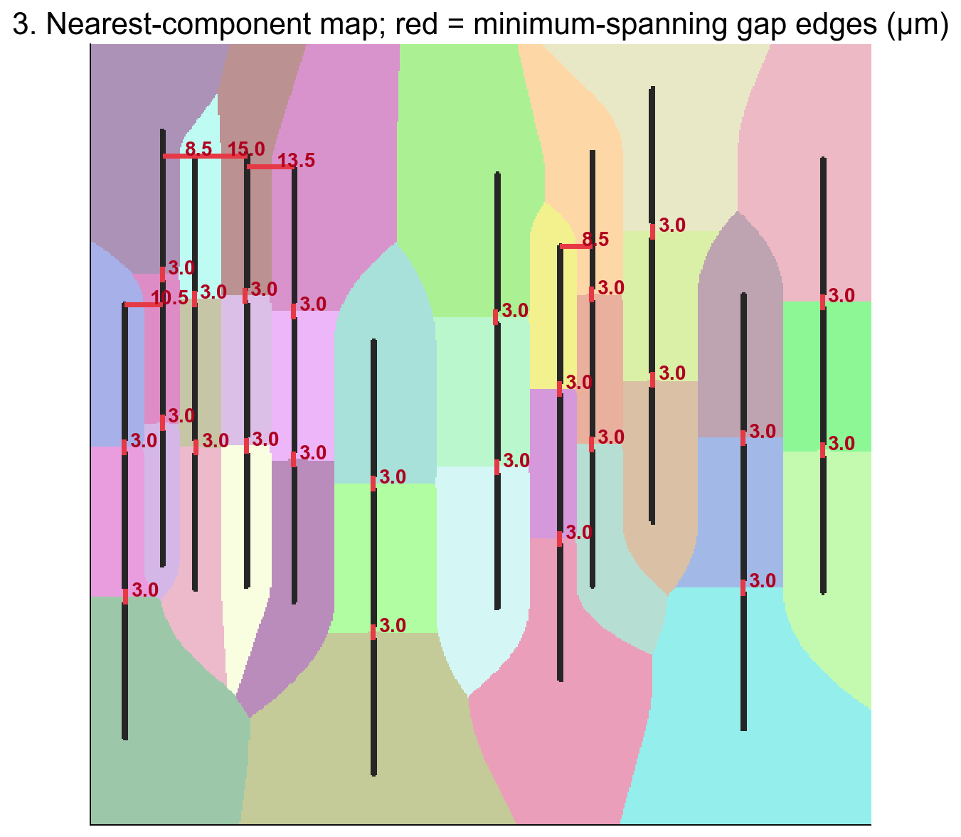
Step 3: gap graph from the distance transform
Only Voronoi-neighbour gaps are needed — they contain the minimum spanning tree (exact, O(pixels))
Notes:
Background colours show the nearest component of every matrix pixel. Red lines are minimum-spanning gap edges with their surface gap in um; the 3 um stringer gaps are the shortest.

Slide 16
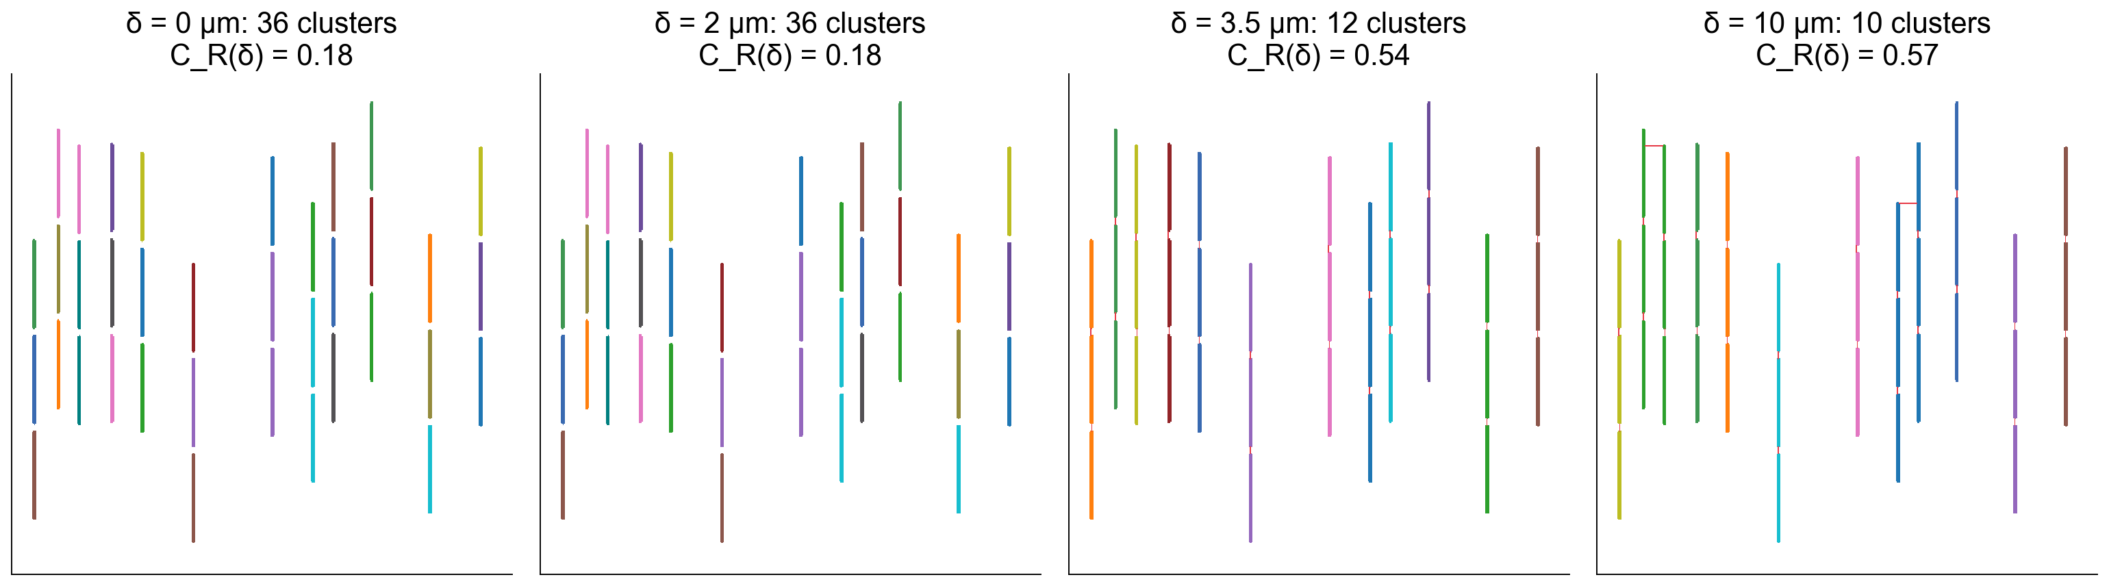
Step 4: clusters as the association distance δ grows
Stringer gaps (3 µm) bridge first: C_R jumps from 0.18 to 0.54 — red lines are synthetic bridges
Notes:
Clusters are single-linkage components at each delta. Bridges add no area and are drawn in red only in overlays.

Slide 17
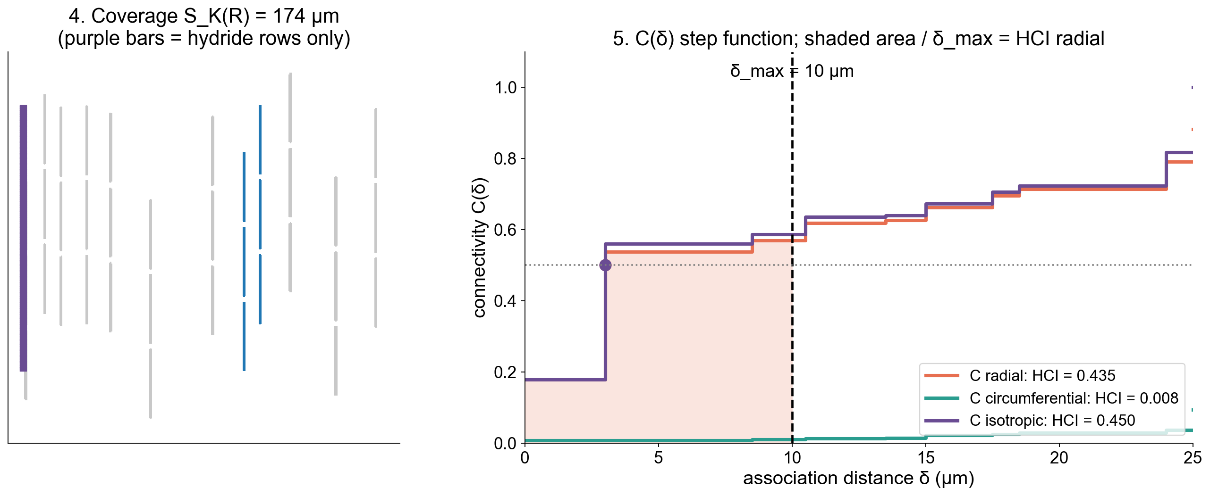
Step 5: coverage, connectivity function and the HCI
HCI = area under C(δ) ÷ δ_max = 0.44; δ½ = 3.2 µm recovers the designed gap
Notes:
Left: the largest cluster and the rows its hydride covers (bridged gaps add none). Right: exact step functions for three directions; the shaded area divided by delta_max is HCI radial; dots mark delta_half.

Slide 18
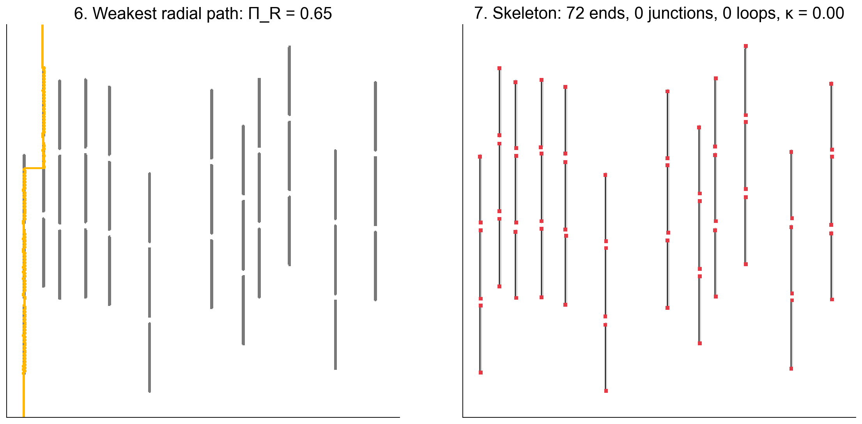
Companions: weakest path and skeleton topology
Π (RHCP-type path) and κ (network closure) are reported beside the HCI, never multiplied in
Notes:
Path continuity: two Dijkstra sweeps; ligament of the cheapest edge-to-edge path through each pixel. Topology: ends, collapsed junctions and loops from the Euler number; identity N_E = beta + 2C - 2mu holds exactly (kappa = 0 for these free-ended stringers).

Slide 19
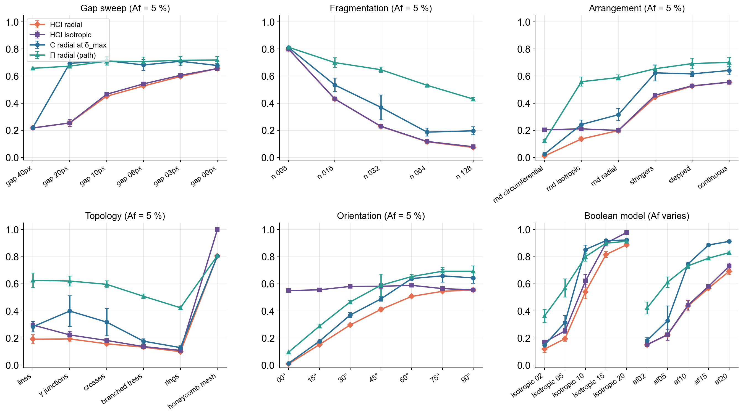
Validation on the benchmark: HCI v1 (fixed δ_max = 10 µm)
v1 meets every ordering axiom in every replicate at constant area fraction
Notes:
Mean +/- SD over replicates. HCI radial rises strictly as gaps close (0.22 to 0.66), falls with fragmentation, separates random (0.20), stringers (0.44), stepped (0.53) and continuous (0.55), follows orientation, and gives the mesh the maximum. The Boolean model shows the expected percolation rise with Af.

Slide 20
Scorecard: prototype versus HCI v1
Test | Prototype | HCI v1 (fixed 10 µm)
Gap sweep ordering | 1/5 | 5/5
Fragmentation ordering | 5/5 | 5/5
Arrangement ordering | 0/5 | 5/5
Orientation ordering | 0/3 (should be flat) | 3/3
Transpose / flips | 7.7 % | 0.0 %
Resolution ×0.5, ×2 | 6.8 % | 1.8 %
Speckle, pinholes, spurs, breaks | 1.9 % | 1.8 %
Boundary roughness (10 % flips) | 19.3 % | 5.2 %
Single cluster / mesh | 0 (undefined) | finite (iso 1.00)
v1 fixes ordering, symmetry, resolution and single-cluster failures; noise sensitivity is similar
Notes:
Prototype from the unchanged intern script (candidate study). v1 from the production library with fixed delta_max = 10 um. Ordering = replicates in the expected order (tolerance 0.01). Changes are maximum relative changes over the three invariance reference samples.

Slide 21
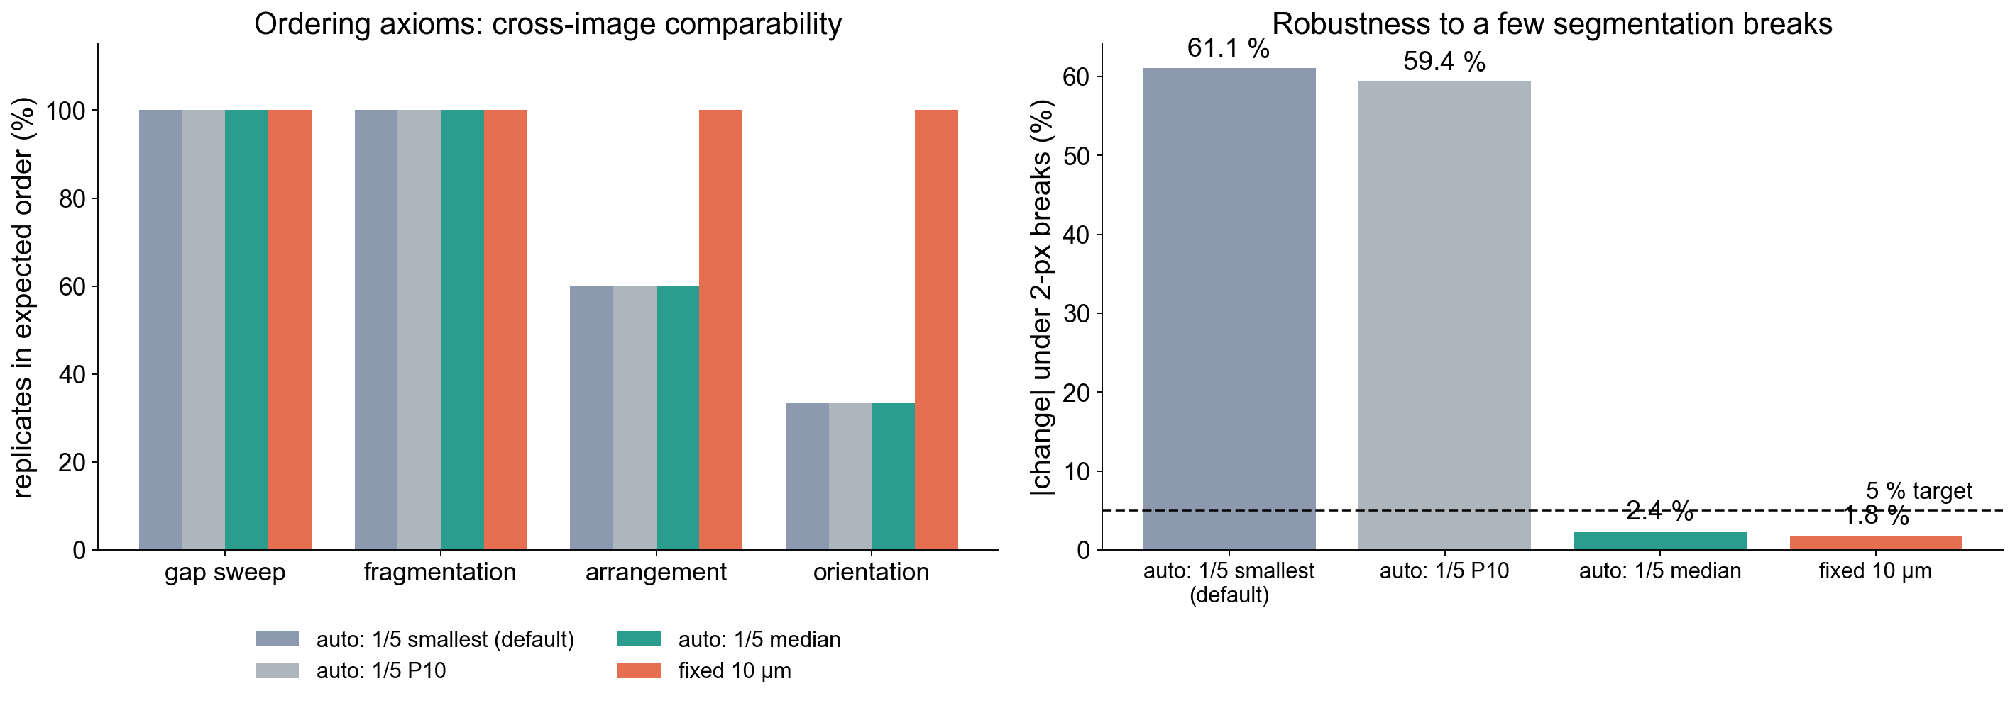
The δ_max rule: owner default versus alternatives
Default kept (1/5 of smallest hydride); compare specimens only with one fixed δ_max
Notes:
Owner decision: delta_max = 1/5 of the smallest accepted hydride. It is scale-free, but it is recomputed per image, so different images are integrated over different ranges (arrangement 3/5, orientation 1/3), and one small fragment sets the range for the whole image (-61 % under 2-px breaks). A median rule fixes the break sensitivity (2.4 %) but not comparability; fixed 10 um passes everything. The web UI offers all three; the Help and docs require a fixed value for comparisons.

Slide 22
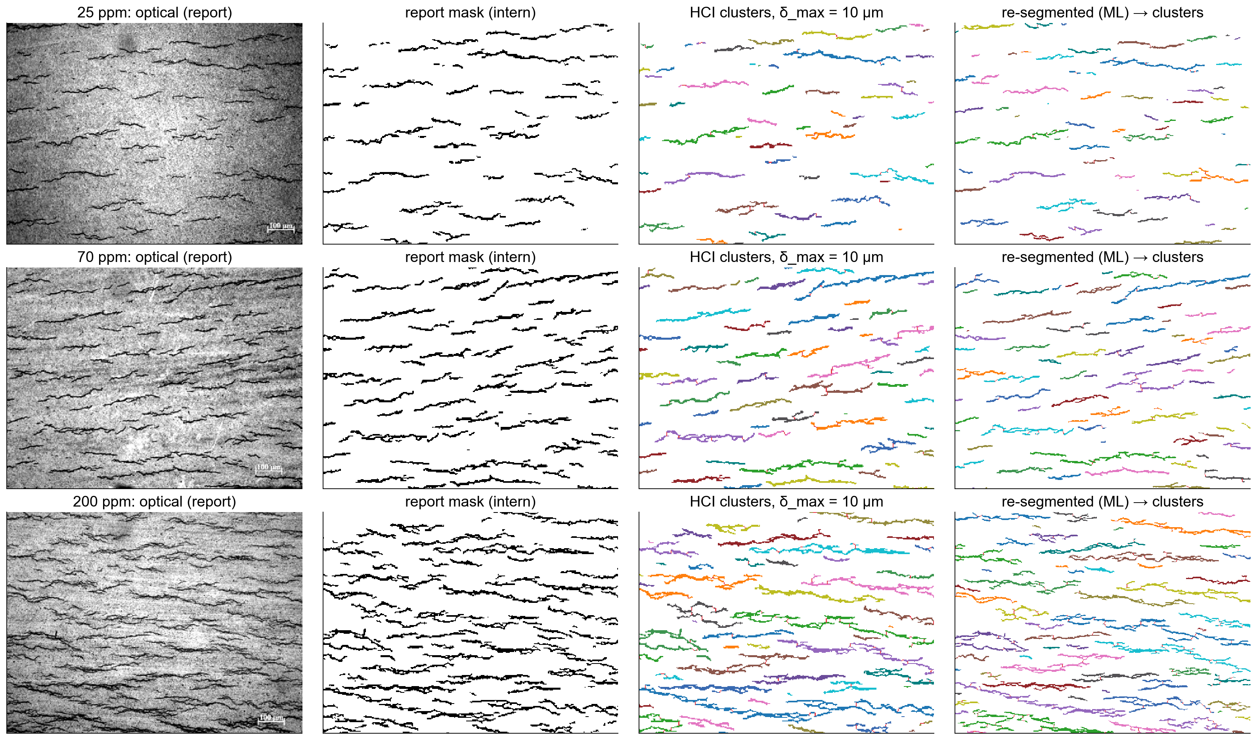
Real micrographs from the intern report (25, 70, 200 ppm)
The same pipeline runs on the report masks and on re-segmented micrographs (ML model)
Notes:
Images are the report's Table 2 figures: optical 513x384 (100 um bar = 46.5 px, 2.15 um/px) and the intern's masks 344x258 (3.21 um/px). Columns: optical micrograph; intern mask; HCI clusters at delta_max = 10 um (red = bridges); MicroSeg ML re-segmentation of the optical image with its clusters. Figure resolution only, so values are indicative.

Slide 23
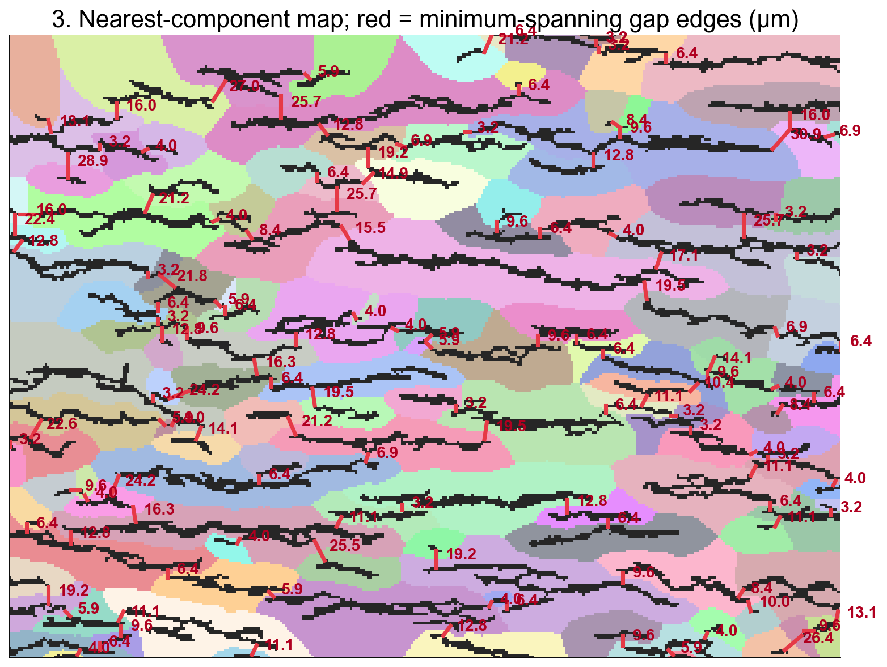
200 ppm, step 3: gap graph on a real mask
On real masks the gap graph is dense; each gap sets the δ at which two clusters merge
Notes:
Nearest-component map and minimum-spanning gap edges (um) for the 200 ppm report mask at 3.21 um/px.

Slide 24
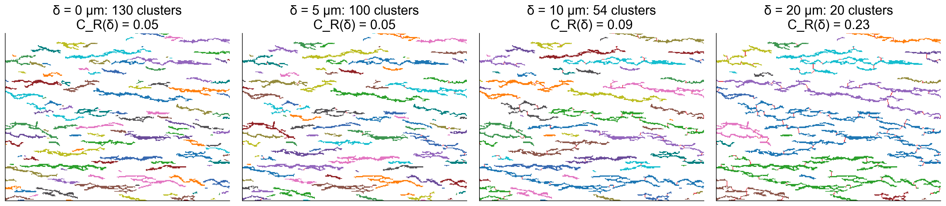
200 ppm, step 4: clusters as δ grows
Circumferential chains link first; radial linking needs much larger gaps
Notes:
Clusters at delta = 0, 5, 10 and 20 um; the number of clusters falls 130 → 20 while C_R stays low because the clusters run circumferentially.

Slide 25
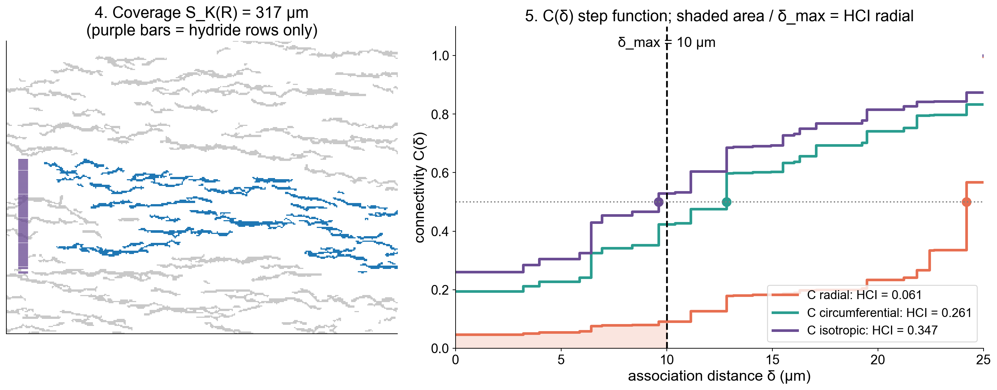
200 ppm, step 5: coverage and connectivity functions
Circumferential and isotropic connectivity are high; radial connectivity stays low (HCI R = 0.06)
Notes:
Largest cluster coverage and the three connectivity step functions for the 200 ppm mask; delta_max = 10 um.

Slide 26
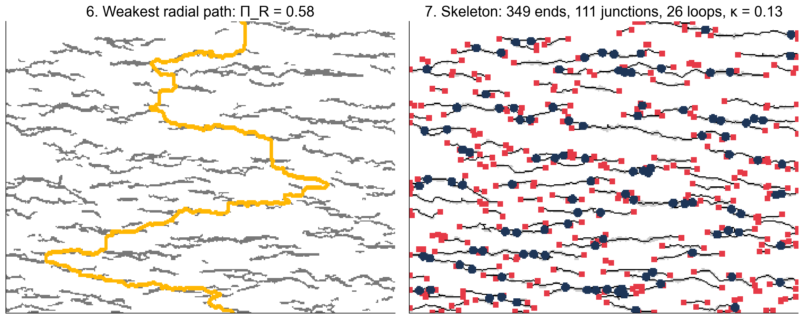
200 ppm, companions: weakest path and topology
The weakest radial path must cross mostly matrix; the network starts to close (κ = 0.13)
Notes:
Pi_R and skeleton topology for the 200 ppm mask; identity residual 0 after the resolution floor and bookkeeping fixes.

Slide 27
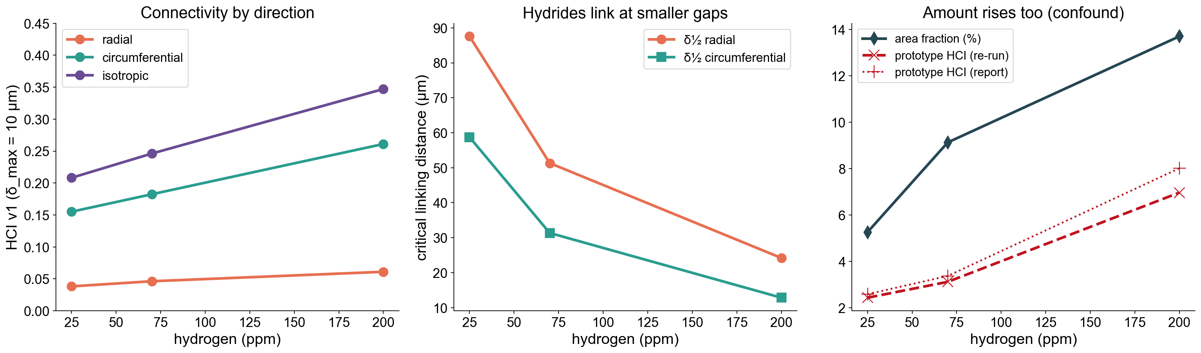
Real micrographs: results
Specimen | Af | Prototype (report / re-run) | HCI R | HCI C | HCI iso | δ½ R (µm) | κ
25 ppm | 5.3 % | 2.59 / 2.44 | 0.038 | 0.155 | 0.208 | 88 | 0.02
70 ppm | 9.1 % | 3.38 / 3.12 | 0.046 | 0.182 | 0.246 | 51 | 0.04
200 ppm | 13.7 % | 8.02 / 6.97 | 0.061 | 0.261 | 0.347 | 24 | 0.13
Circumferential connectivity and closure rise, δ½ falls 88 → 24 µm; through-wall connectivity stays low
Notes:
The v1 values separate effects the single prototype number merged. Area fraction also rises (5 to 14 %), so this series alone cannot separate amount from connectivity; the benchmark does. At 3.2 um/px the owner's auto rule floors delta_max to one pixel (smallest accepted hydride about 10 um long).

Slide 28
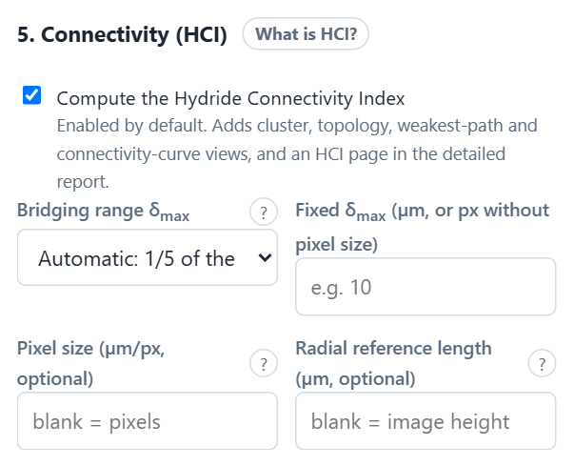
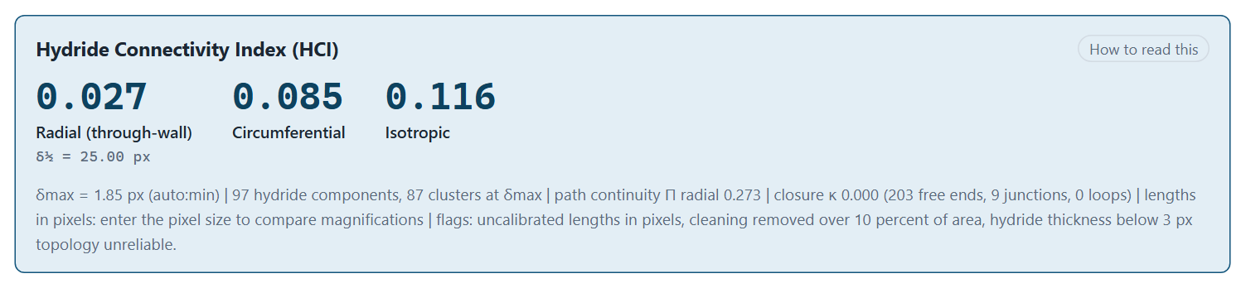
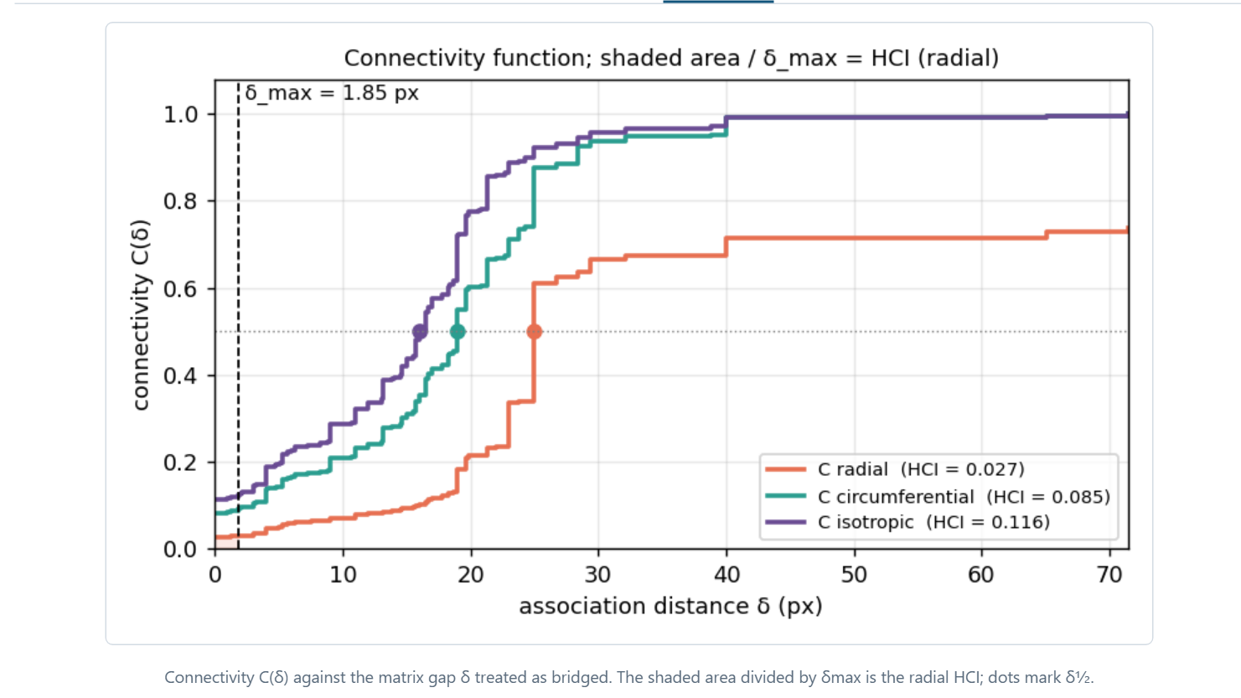
Implementation: enabled by default in the web UI
Also
• CLI: microseg_cli.py hci
• Python: analyze_continuity()
• PDF page + XLSX sheet
One library call behind the web UI, CLI and Python; results in JSON, PDF and XLSX
Notes:
Web: section 5 'Connectivity (HCI)' is ticked by default; delta_max mode (auto smallest / auto median / fixed), optional pixel size and radial reference length. Results panel shows HCI radial, circumferential and isotropic with delta_half, delta_max, counts and quality flags; views for clusters, curve, topology and path; a PDF page and an XLSX Connectivity sheet. CLI: microseg_cli.py hci. Python: analyze_continuity().

Slide 29
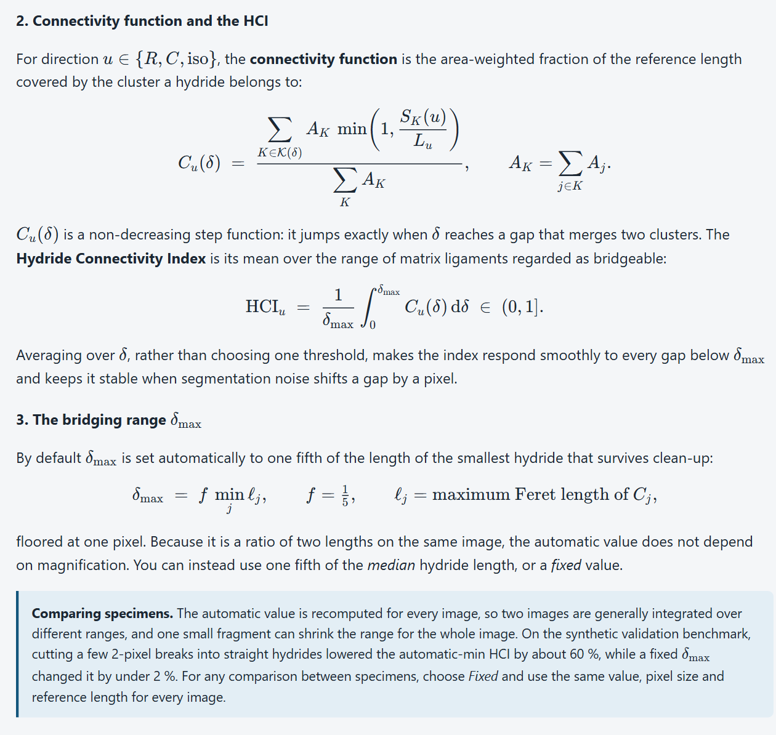
Documentation: theory and algorithm with typeset mathematics
Web Help
• Rendered offline with KaTeX
• Concept + flow SVGs
Sphinx
• hci_theory: proofs
• hci_user_guide
• hci_specification
• hci_synthetic_benchmark
Tests
• 40 HCI tests
• Axioms, topology, parity
The same equations appear in the web Help (KaTeX) and the Sphinx docs (MathJax), with proofs
Notes:
Web Help section 'Hydride Connectivity Index (HCI)': definitions, connectivity function, delta_max rule with the comparison warning, companions, properties, algorithm, settings and reporting rules. Sphinx: docs/hci_theory.md (propositions and proofs, closure identity, algorithm and complexity), docs/hci_user_guide.md, docs/hci_specification.md, docs/hci_synthetic_benchmark.md.

Slide 30
Caveats and limitations
Comparability
• Auto δ_max differs per image: fix δ_max to compare
• Same pixel size and reference length
Physics
• 2D section: out-of-plane links unseen
• Depends on Af across morphologies
• No mechanical correlation yet
Image quality
• Border clusters truncated (lower bound)
• Thin masks (< 3 px): topology unreliable
Performance
• 2048² mask ≈ 8 s on one core
HCI is experimental: validated on synthetic axioms, awaiting field data and property correlation
Notes:
Each caveat is also flagged in the result JSON where it can be detected automatically: uncalibrated lengths, largest cluster touching the border, extent capped at the reference length, hydride thickness below 3 px, clean-up thresholds raised to the resolution floor, topology identity residual non-zero. The web panel shows the flags (right).

Slide 31
Summary and next steps
Delivered
• Specification, theory, proofs
• 203-mask constant-Af benchmark
• Library, CLI, web (on by default)
• 40 tests; exact topology
• Report images analysed
Next
• Field-data validation
• Fixed-δ_max comparison protocol
• Desktop card; faster path solver
• Manuscript
HCI v1 is specified, validated on synthetic data, implemented, and ready for field-data validation
Notes:
Next: field-data validation by the owner's team (repeat fields, bootstrap CIs, predicted versus corrected masks, expert ranking, correlation with ring compression, DBTT or DHC), the desktop (Qt) card, and a faster path solver. Manuscript outline in docs/hci_implementation_plan.md.

