Slide 1
🌞Solar Power Generation Prediction using Machine Learning
(A Data Science Project for Renewable Energy Forecasting)
Tools & Technologies Used:
Python · Pandas · Scikit-learn · Matplotlib · XGBoost · Streamlit · GitHub
Deployed App:
🔗 https://solarpowerapp-fx6akuz7phlbpaspgm5pcn.streamlit.app/
Presented by:
Group 1
Data Science Trainee | ExcelR Institute

Slide 2
Table of Contents
  🌞 Introduction
  🎯 Project Goal & Workflow
  📊 Dataset Overview
  🔍 Exploratory Data Analysis (EDA)
  🧹 Data Preprocessing
  🤖 Modeling Overview & Results
  🌐 Deployment & Live Output
  🧩 Challenge
  📝 Conclusion
  🚀 Future Work

Slide 3
🌞 Introduction
  Solar power output depends heavily on weather conditions.
  Accurate prediction helps in energy planning and resource optimization.
  This project builds an end-to-end Machine Learning system to forecast solar power generation using real-world weather features.

Slide 4
🎯 Project Goal & Workflow
Goal
To predict solar power generation using weather-based parameters through machine learning,
identify key influencing features, and deploy a real-time Streamlit web app for prediction and analysis.
Workflow:
  Data Collection
  EDA & Visualization
  Preprocessing (Scaling)
  Model Training & Evaluation
  Best Model Selection
  Deployment on Streamlit Cloud

Slide 5
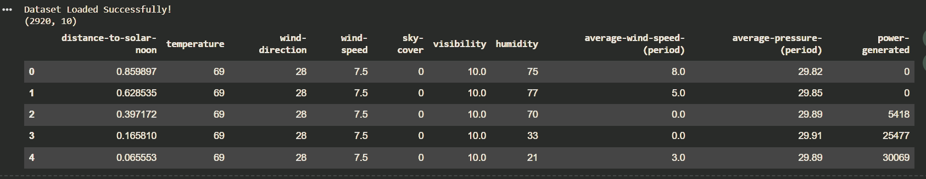
🗂️ Dataset Overview – Weather-Based Input Features
Sample Dataset (First 5 Rows)
  Dataset contains weather-based numerical features affecting solar power generation.
  Input features include:
    Temperature, humidity, visibility
    Wind-speed, sky-cover, wind-direction
    Distance-to-solar-noon
  Target variable: power_generated
  Summary:
    Clean numerical dataset
    Suitable for regression modeling
    Strong variability across features → useful for learning patterns

Slide 6
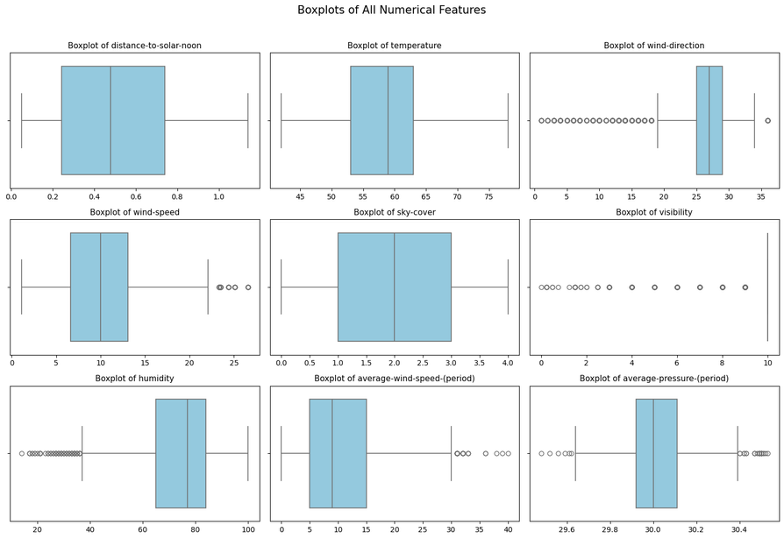
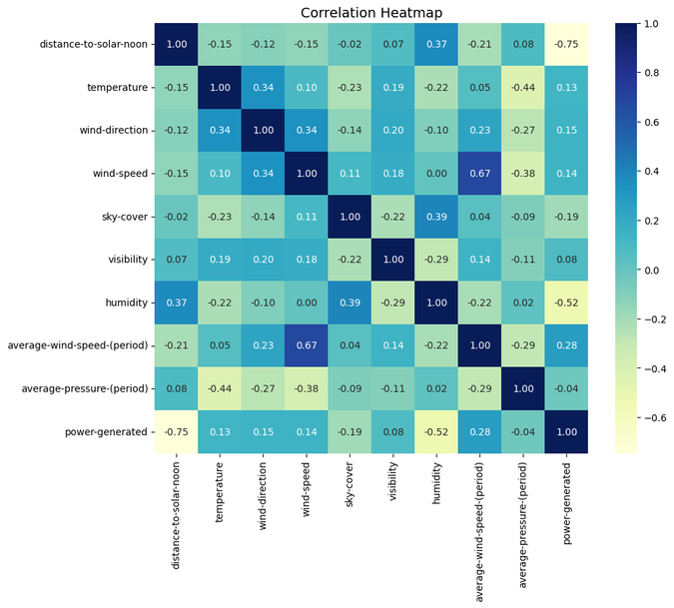
🔍 Exploratory Data Analysis (EDA)
To understand feature distribution, detect outliers, and explore relationships between variables affecting solar power generation.
Visuals: Feature Distribution (Boxplots) & Correlation Heatmap
🔍 Key Insights
  Most features (temperature, wind-speed, humidity) follow near-normal distributions.
  Outliers detected in humidity, wind-direction, and visibility.
  High correlation between temperature and power-generated (direct relationship).
  Sky-cover and humidity negatively influence power output.

Slide 7
🧹 Data Preprocessing
  All features scaled using StandardScaler for model stability.
  Train–test split performed (80/20).
  Saved model components:
    best_model.pkl
    scaler.pkl
  Feature order kept identical during deployment.

Slide 8
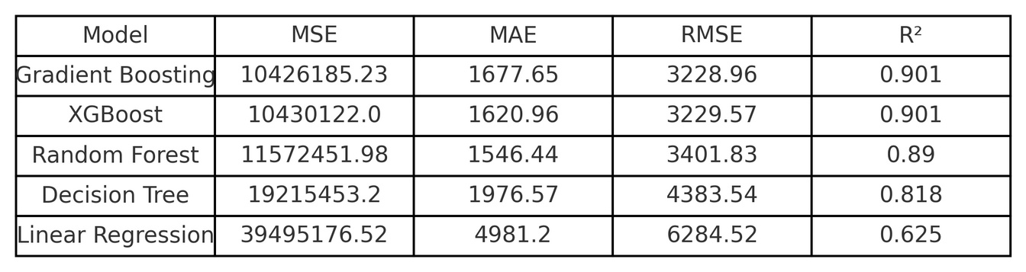
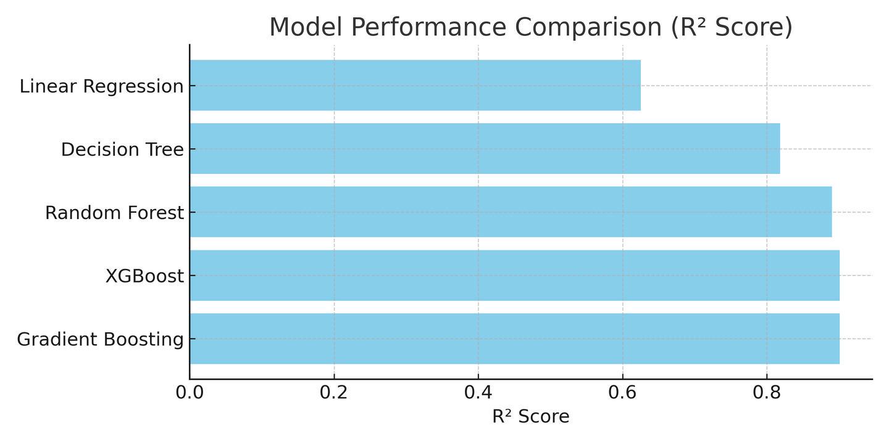
🤖 Modeling Overview & Results
To build and evaluate multiple regression models for predicting solar power generation.
Models Used
Linear Regression, Decision Tree, Random Forest , XGBoost ,Gradient Boosting Regressor
📊 Key Insights
  All models were trained using standardized data (StandardScaler).
  Gradient Boosting Regressor achieved the best accuracy among all models.
  Metrics evaluated:
    R² Score, MSE, MAE, RMSE
  Gradient Boosting showed the highest R² (~0.901) and lowest error values, making it the final selected model.
🧩 Best Model Selected: Gradient Boosting Regressor

Slide 9
🌐 Deployment & Live Output
To deploy the trained Gradient Boosting model with a Streamlit web interface, enabling real-time solar power prediction based on weather inputs.
⚙️ Tools & Platform
  Streamlit Cloud – to host and run the app online
  GitHub – for version control and integration
  Pickle (.pkl) – for saving and loading the trained model and scaler
💻 Deployment Workflow
  Upload files to GitHub → app.py, best_model.pkl, scaler.pkl, requirements.txt
  Connect GitHub repo to Streamlit Cloud
  App automatically builds and runs on cloud servers
  Share the public link for live prediction
👉 https://solarpowerapp-fx6akuz7phlbpaspgm5pcn.streamlit.app/

Slide 10
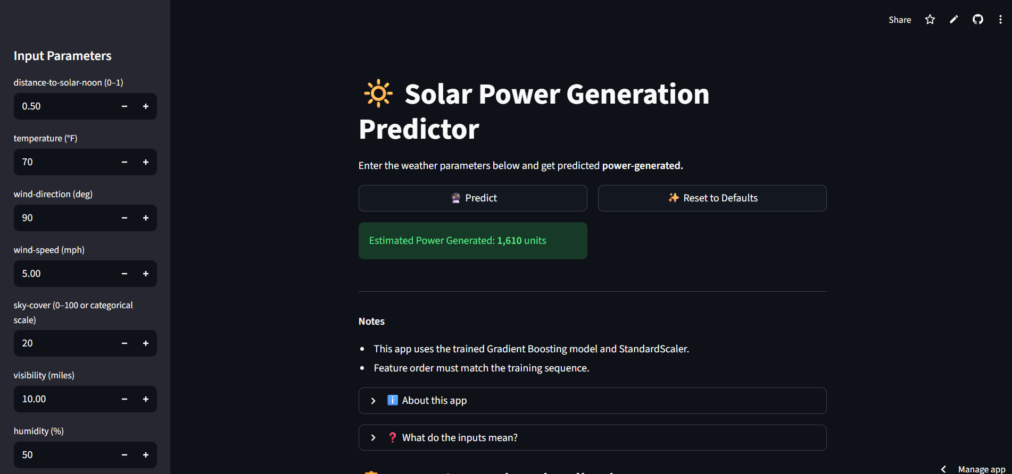
📊Live Streamlit App – Input Panel and Prediction Interface
User inputs parameters → Click Predict → Model generates real-time solar power output

Slide 11
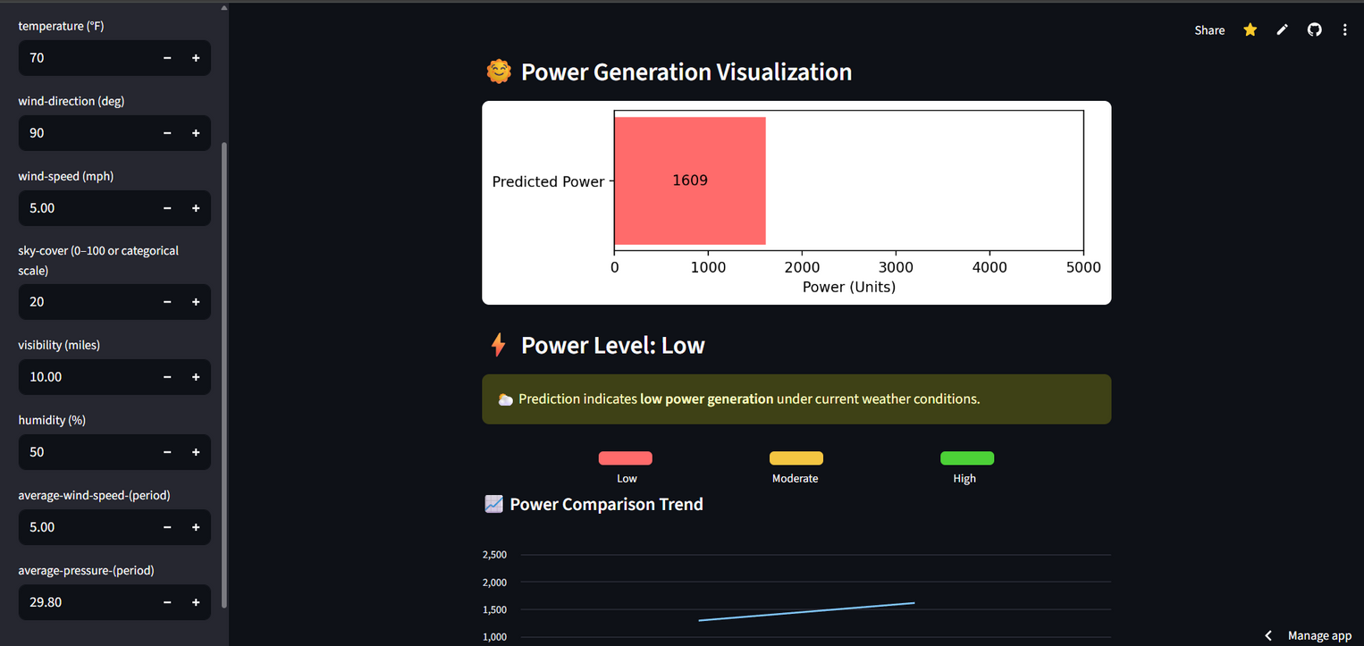
🎯 Key Insights
  Instant solar power prediction based on user inputs
  Dynamic visualization:
    🔴 Low 🟡 Moderate 🟢 High power generation
  Interactive sliders for temperature, humidity, visibility, etc.
  Uses same Gradient Boosting Regressor trained during modeling
Model predicted 1609 units of solar power — Low generation zone.

Slide 12
🧩 Challenges
  Data Quality Issues: Missing and inconsistent weather data required cleaning and scaling.
  Model Tuning: Achieving a balance between bias and variance during training.
  Deployment Integration: Ensuring .pkl model files loaded correctly on Streamlit Cloud.
  Limited Dataset Scope: Model performance could improve with more seasonal and regional data.

Slide 13
📝Conclusion
  The project successfully predicts solar power generation using weather parameters through machine learning.
  Among all tested models, the Gradient Boosting Regressor delivered the best accuracy (R² ≈ 0.90).
  Deployment on Streamlit Cloud enabled real-time predictions with an interactive web interface.
  Demonstrates how data science can support renewable energy optimization and efficient planning.

Slide 14
🚀Future Work
  Expand dataset with real-time satellite and IoT sensor inputs.
  Integrate forecast APIs (e.g., OpenWeatherMap) for dynamic prediction updates.
  Build a dashboard version with historical trends and live monitoring.
  Use deep learning models (LSTM / CNN) for more accurate long-term forecasting.
  Host on AWS or Azure for large-scale deployment with automated updates.

Slide 15
Thank
you!

