Slide 1


CSA1008- Software Engineering
SIMATS ENGINEERING
SAVEETHA INSTITUTE OF MEDICAL AND TECHNICAL SCIENCES
Capstone project presentation
Automated Exam Seating System: Intelligent Seat Allocation to Prevent Same-Branch Clustering
Presented by:
GONUGUNTA AJAY KUMAR (192372300)
MOHAN KRISHNA BALAJI (192324221)
JAGAN G (192421039)
PUSHPARAJ B (192421136)
PRIYAN A (192421181)
Guided By Dr. K. SHARMILI

Slide 2
INTRODUCTION
Examination seating is an important part of academic evaluation
Proper seating helps to maintain fairness in exams
Manual seating arrangement is still followed in many colleges
Manual methods take more time and effort
Same-branch students may sit close to each other
This can increase the chance of copying
Automation helps to improve accuracy and transparency

Slide 3
OBJECTIVES
To develop an automated system for exam seating arrangement
This system should reduce manual work and save preparation time
To prevent same-branch students from sitting in adjacent seats
This helps in reducing copying and other unfair practices
To save time during examination preparation
To generate seating arrangement automatically
To improve exam discipline

Slide 4
PROBLEM STATEMENT
Manual exam seating does not follow any strict rules for branch separation
As a result, students from the same branch may be seated close to each other
Handling seating for a large number of students becomes difficult Manual methods increase confusion and mistakes during allocation
Human involvement in every step increases the possibility of errors Last-minute changes make the process even more complicated
There is no intelligent system to ensure fair and balanced seating Hence, a better automated solution is required

Slide 5
Literature Review Overview
Existing systems focus mainly on random seat allocation
Some systems store student details in databases
Most systems do not consider branch separation
Manual checking is still required in many cases
Intelligent logic is not used in seat allocation
Automation level is limited
There is scope for improvement in exam seating systems

Slide 6
Identified Research Gaps
No proper system to prevent same-branch clustering
Lack of intelligent seat allocation algorithms
Poor handling of large student data
Manual intervention is still needed
Limited automation in report generation
Existing systems are not scalable
Need for a smarter seating solution

Slide 7
Proposed System / Framework Architecture
Student details like register number and branch are collected.
Data is stored in a centralized database
Branch information is used as a key constraint
Intelligent allocation logic is applied
Seats are assigned in a systematic manner
Adjacent seats are checked for branch conflict
Final seating plan is generated as output

Slide 8
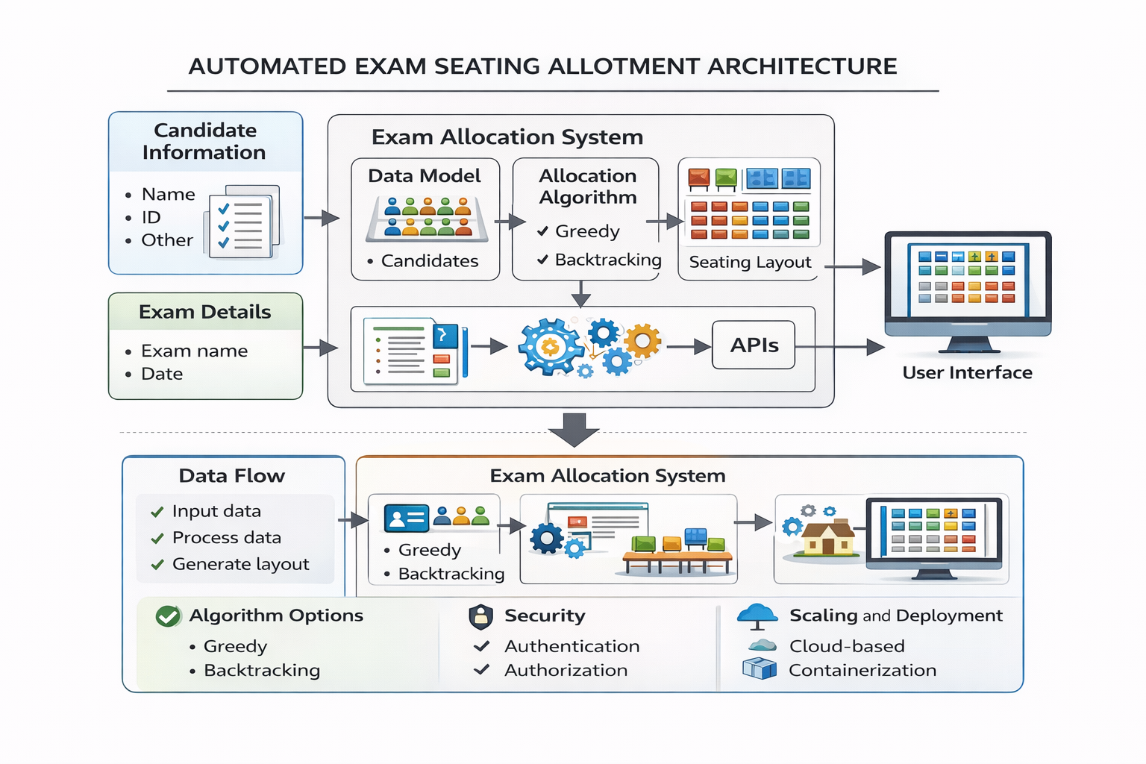
SYSTEM ARCHITECETURE

Slide 9
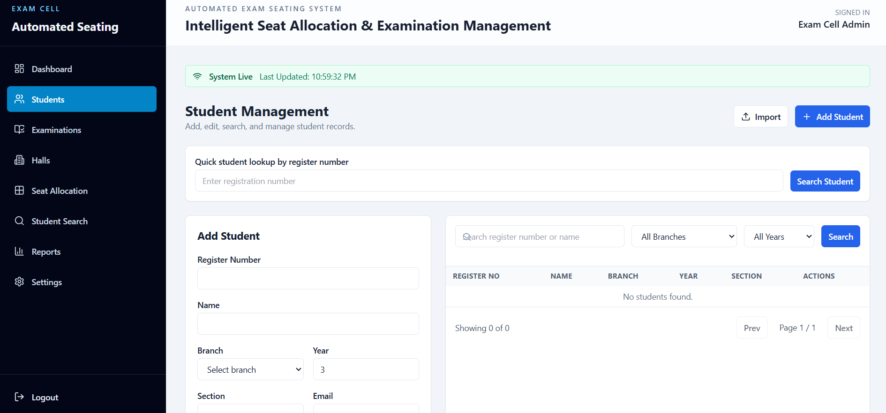
MODULE 1 : STUDENT INFORMATION MANAGEMENT SYSTEM
Collects student details such as Register Number, Name, and Branch
Stores student information in a centralized database
Allows adding, editing, and deleting records
Supports bulk upload through Excel/CSV
Maintains accurate data for seat allocation

Slide 10
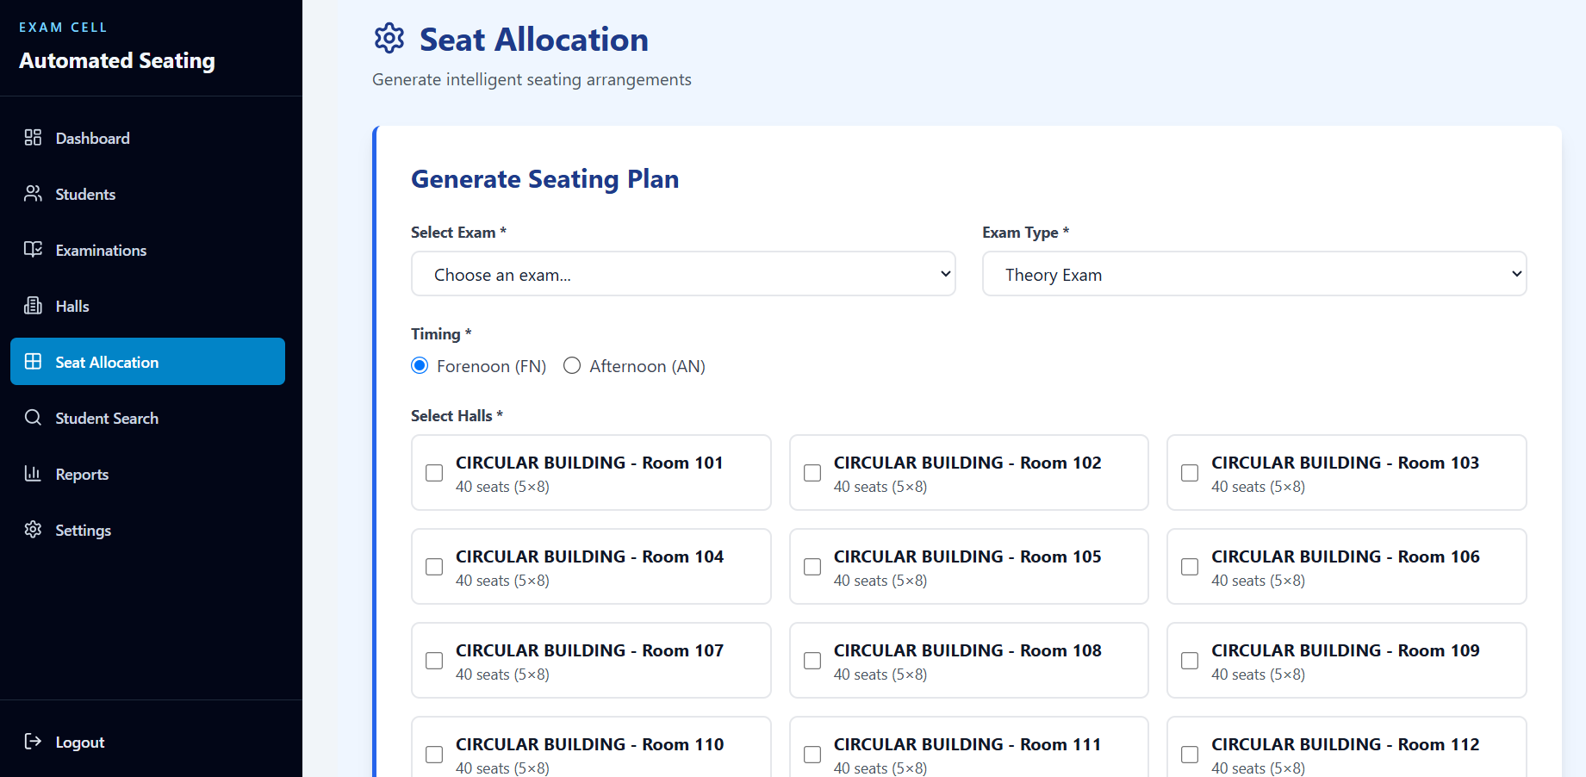
MODULE 2-Automated Examination Seat Allocation System
Automatically assigns seats to students
Uses branch as a constraint during allocation
Prevents same-branch students from sitting in adjacent seats
Distributes students evenly across exam halls
Reduces manual effort and allocation errors

Slide 11
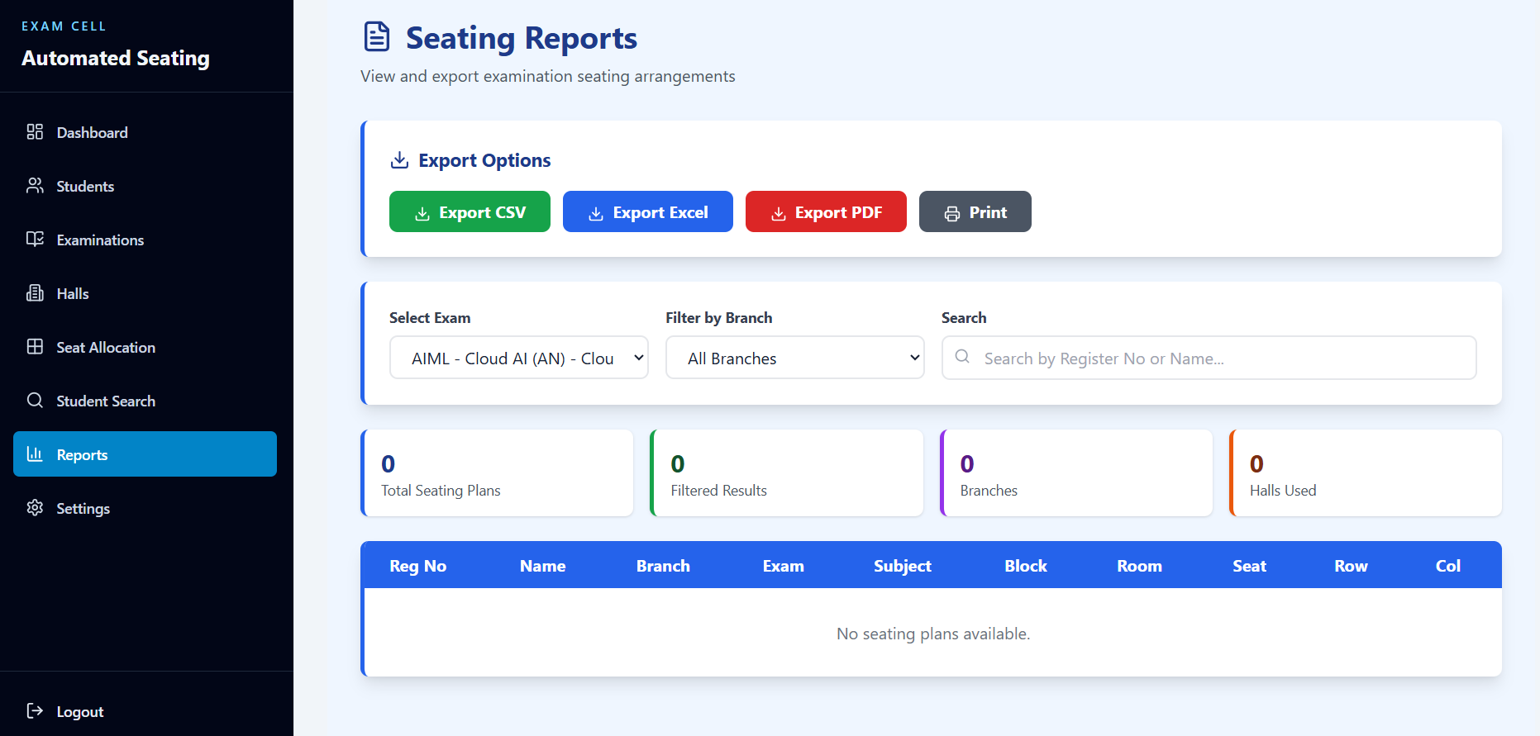
MODULE 3: Report Generation and Export System
Generates hall-wise seating arrangement reports
Displays student seat number and hall details
Provides printable seating charts
Exports reports in PDF or Excel format
Allows quick search of student seat allocation

Slide 12
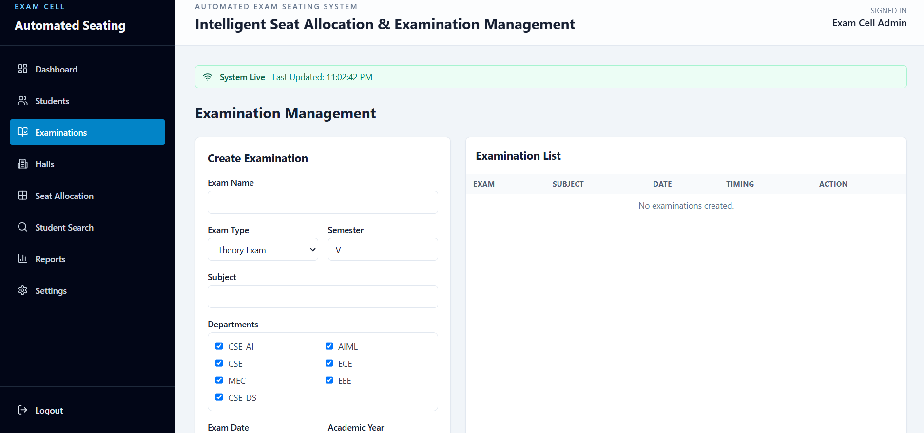
MODULE 4: ADMIN & EXAM MANAGEMENT SYSTEM
Allows authorized staff to manage examination details
Creates and updates exam schedules, halls, and seating capacity
Assigns students to the appropriate examination session
Maintains centralized exam and hall information
Reduces repeated manual data entry and administrative effort

Slide 13
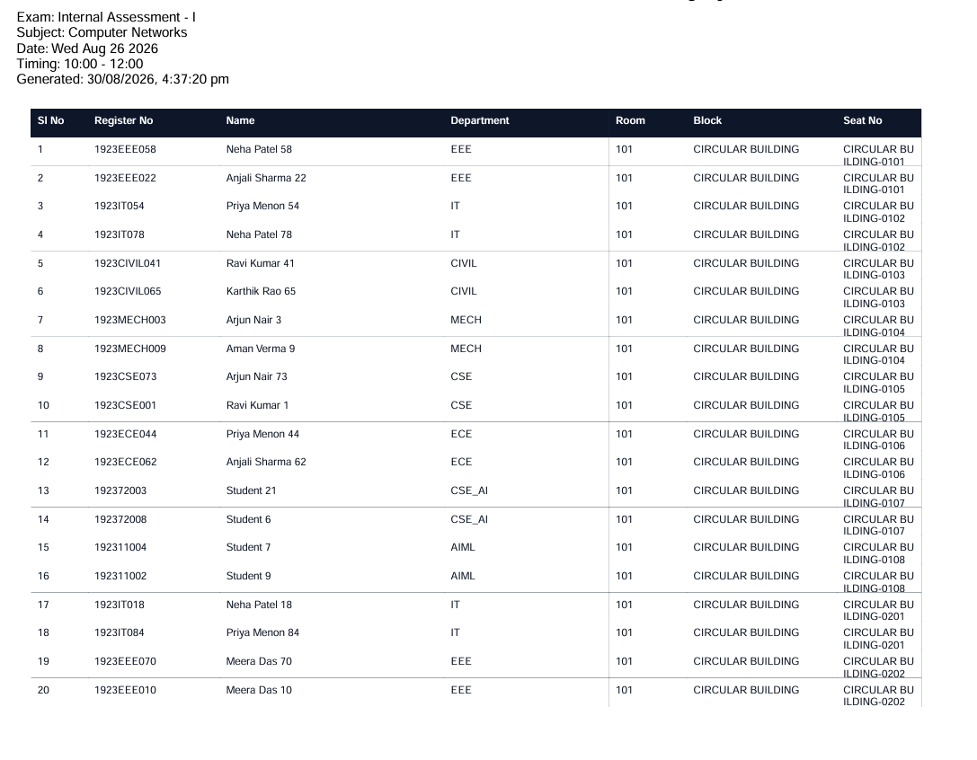
MODULE 5: SEAT VALIDATION & CONFLICT DETECTION SYSTEM
Validates the generated seating plan before finalizing allocation
Checks adjacent seats for same-branch conflicts
Detects duplicate or missing student seat assignments
Flags allocation conflicts for correction
Ensures the final seating plan is accurate, balanced, and ready for use

Slide 14
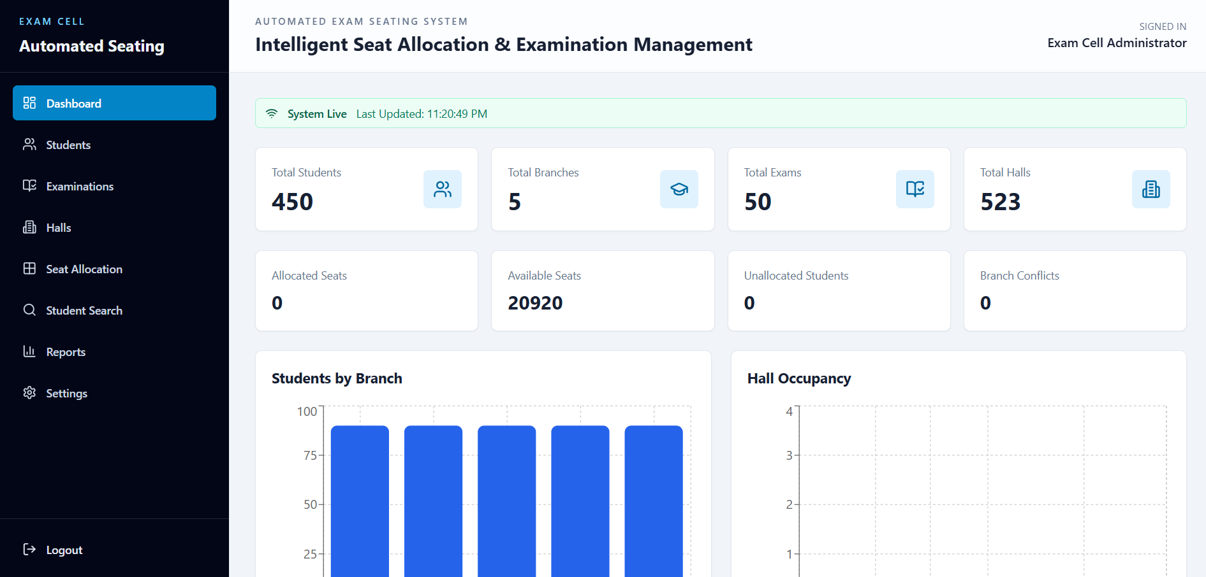
RESULTS

Slide 15
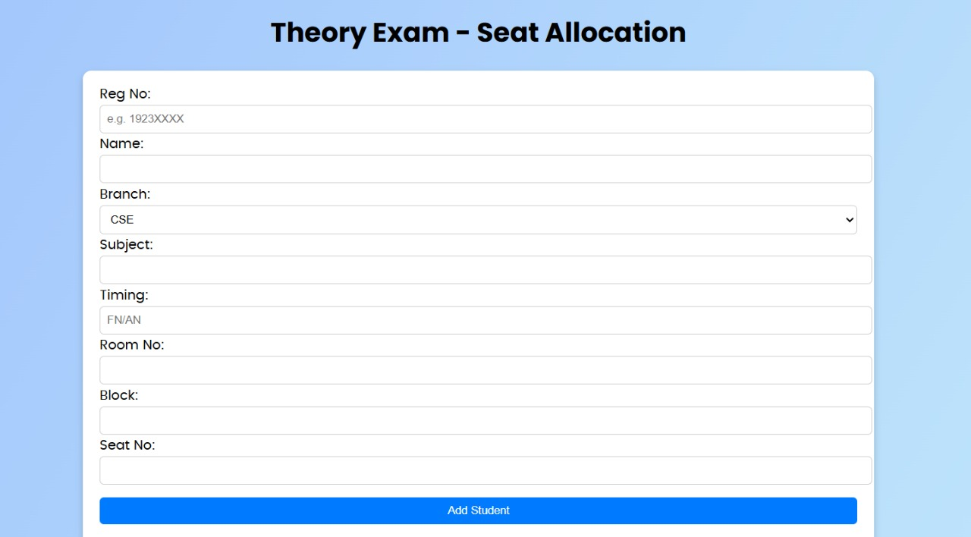
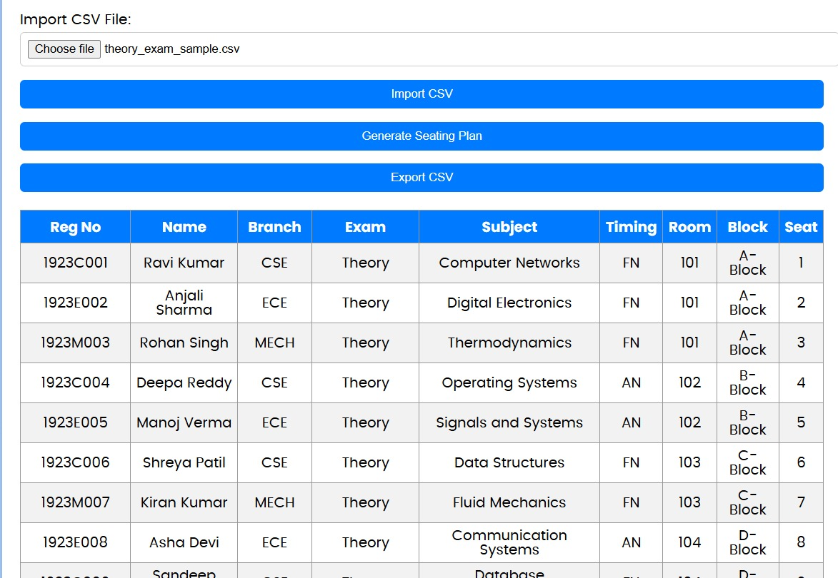

Slide 16
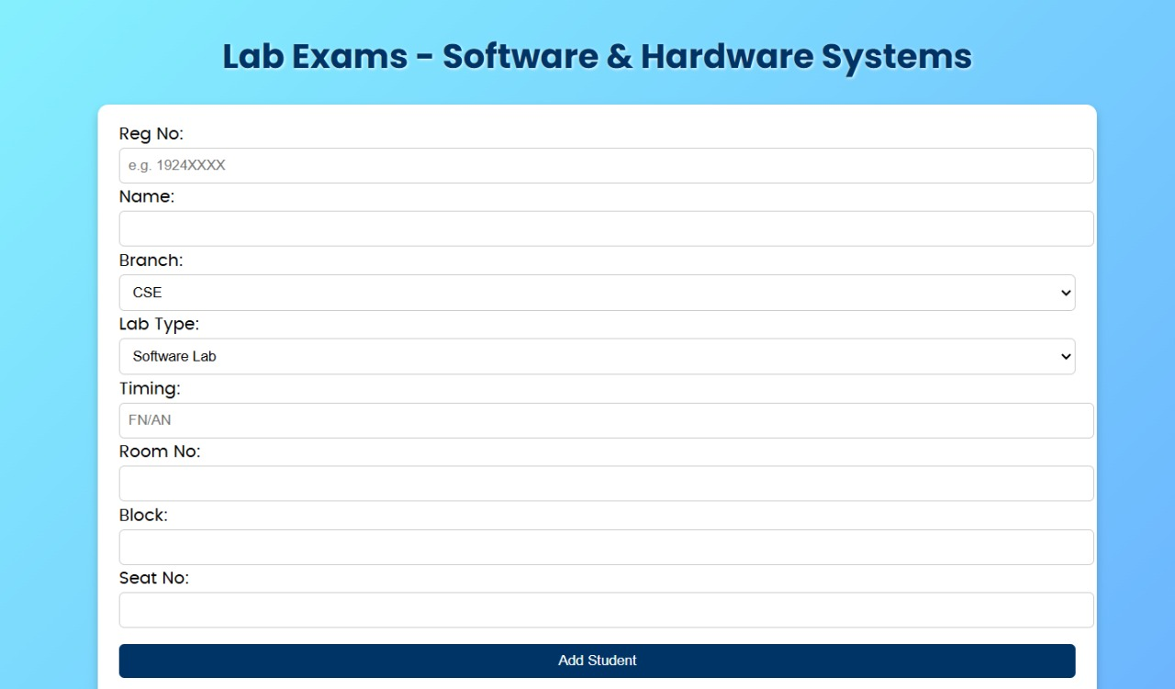
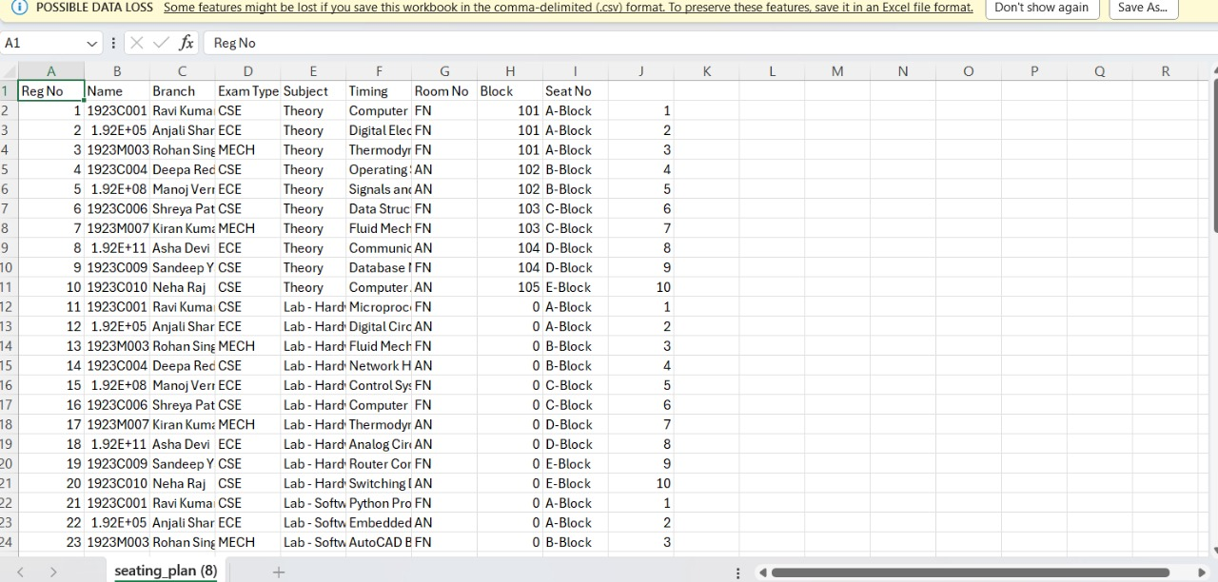

Slide 17
FUTURE ENHANCEMENT
Start & Fetch Data
Retrieve student details (registration number, name, branch, exam type, etc.) from the MySQL database or imported CSV file.
Random Shuffle & Branch Check
Randomly shuffle the student list and verify that no two consecutive students belong to the same branch.
If any repetition occurs, reshuffle or swap positions.
Room and Seat Allocation
Assign students sequentially to rooms (10 per room) and generate room numbers, block names, and seat numbers.
Generate & Export Seating Plan
Display the final seating plan on the web page and allow export to CSV or print options for exam use.

Slide 18
CONCLUSION
Automatically assigns seats to students without manual work.
Keeps students from the same branch seated separately.
Reduces cheating chances during exams.
Saves time and effort for staff.
Minimizes human errors in seating arrangement.
Creates a fair and well-organized exam environment.

Slide 19
REFERENCES
S. Kumar and R. Sharma, “Automated Examination Management System Using Database Technology,” International Journal of Computer Applications, vol. 178, no. 7, pp. 12–16, 2019.
P. Singh, A.Verma, and K. Patel,“Smart Seat Allocation System for Examination Using Automation,” International Journal of Engineering Research and Technology (IJERT),vol.9,no.6, pp. 845–849, 2020.
M. Johnson and L. Brown, “Design and Implementation of Automated Student Management Systems,” IEEE Access, vol. 8, pp. 112345–112353, 2020.
A. K. Gupta and N. Aggarwal, “Database-Driven Examination Hall Management System,” International Journal of Advanced Research in Computer Science, vol. 10, no. 3, pp. 45–49, 2019.
R. Mehta and S. Patel, “Rule-Based Algorithms for Resource Allocation in Educational Systems,” Proceedings of the IEEE International Conference on Smart Computing, pp. 210–215, 2021.

Slide 20


