Slide 1
Simple Travel Agency
Performance Testing

Slide 2
Agenda
01
Requirements
02
Configurations
03
Test Summary
04
Recommendations

Slide 3
Requirements
Scenario
CI/CD Integration
Create a script that load test flights for Route -> select one of the flights -> Fill any dummy details on the next page and click on submit.
Execute JMeter script as part of a DevOps solution
Concurrent Users
10, 50,100, 500

Slide 4
Runtime
10 Minutes
Configuration
Ramp up Period
Iterations
10 Users – 10 Seconds
50 Users – 50 Seconds
100 Users – 100 Seconds
500 Users – 200 Seconds

Slide 5
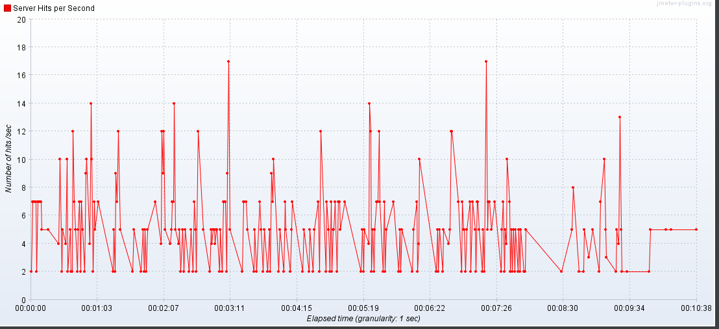
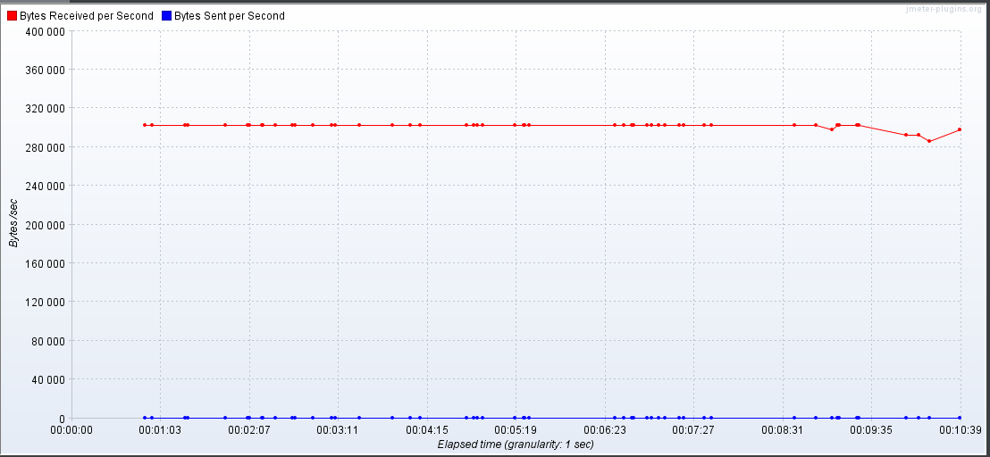
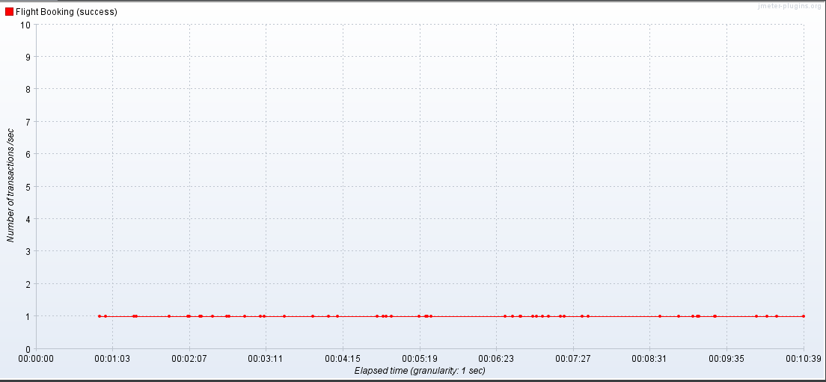
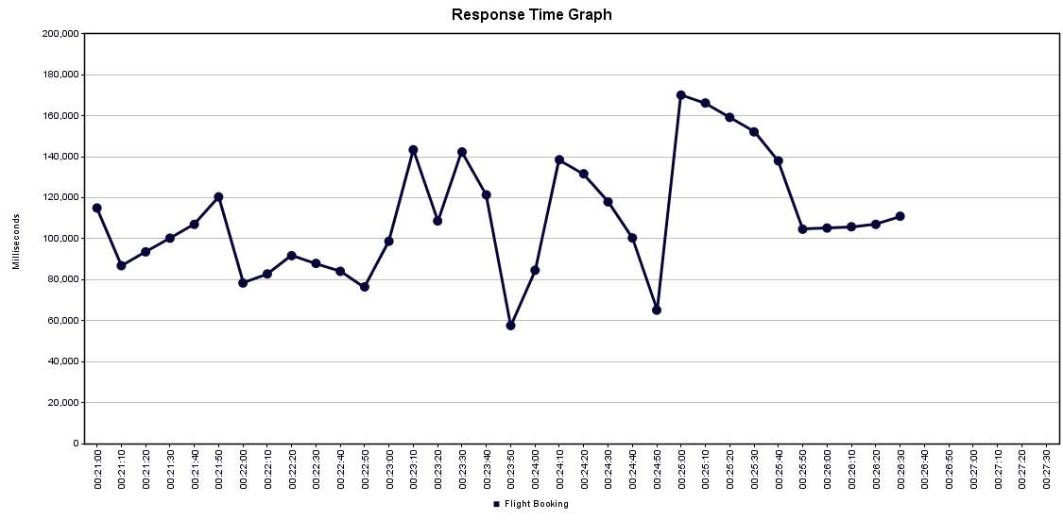
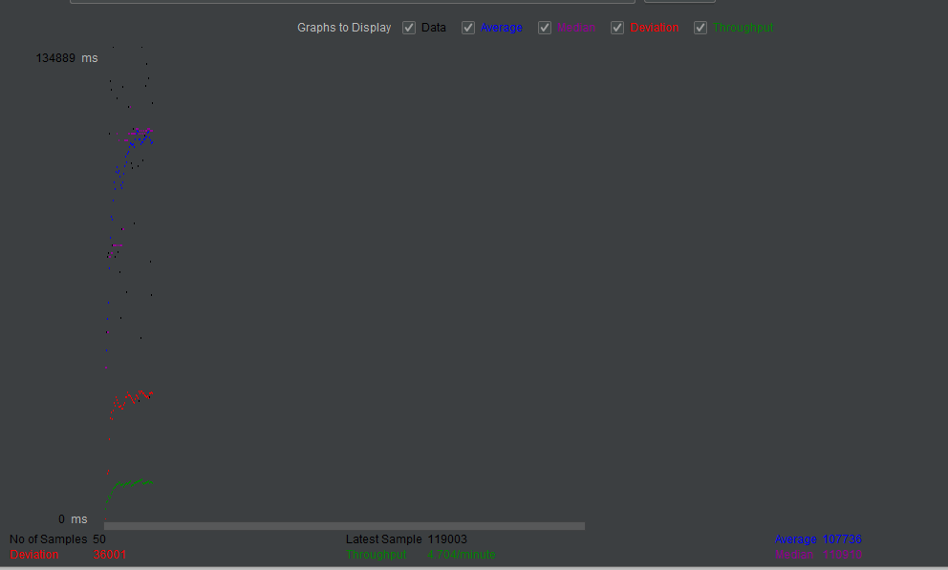
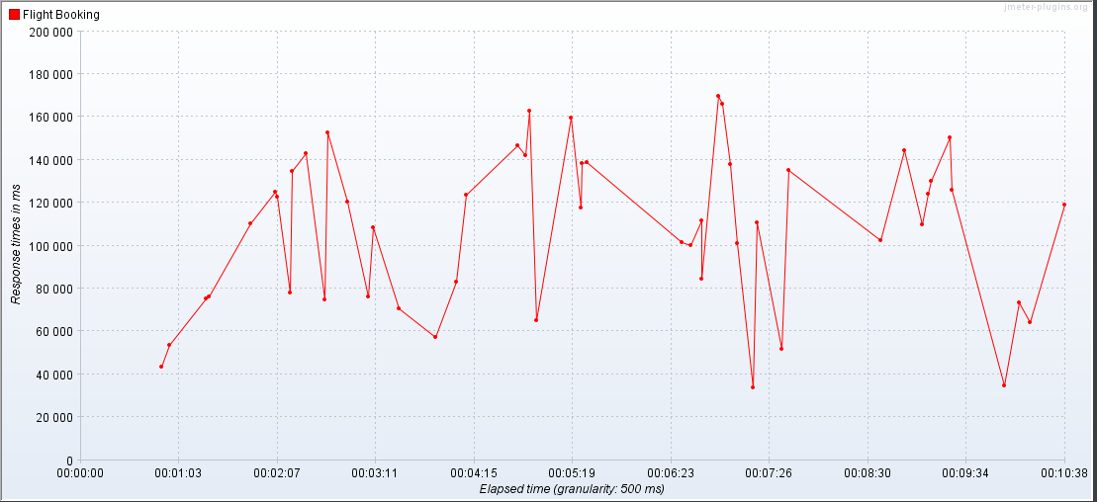
Test Summary (10 users)
Hits Per Second
Bytes Throughput Over Time
Transaction Per Second
Response Time
Deviation
Response Time Over Time
Summary Report

Slide 6
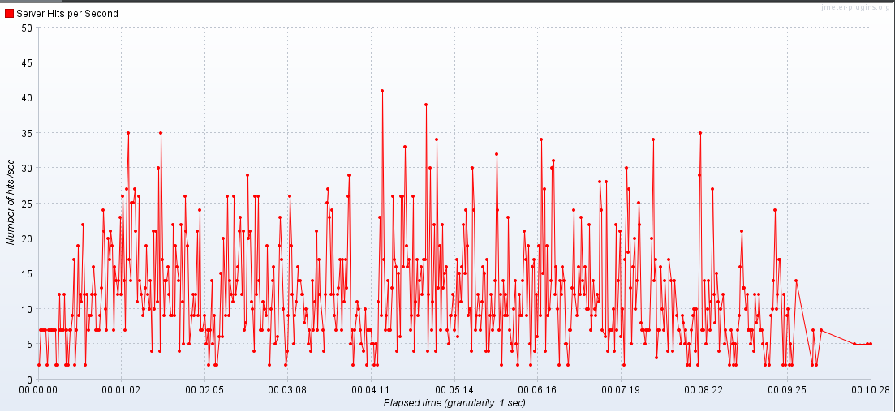
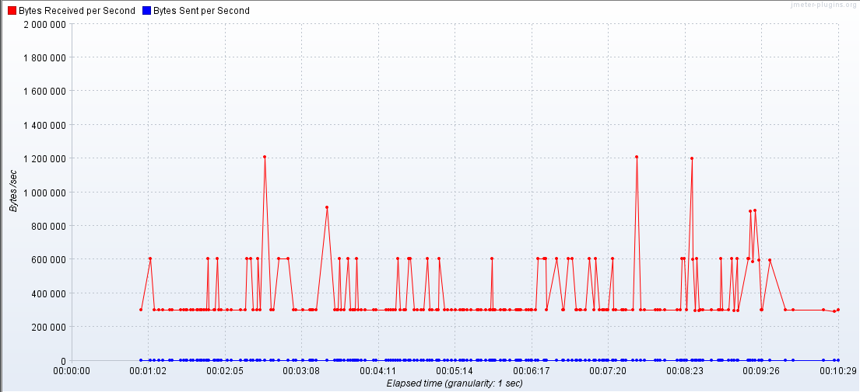
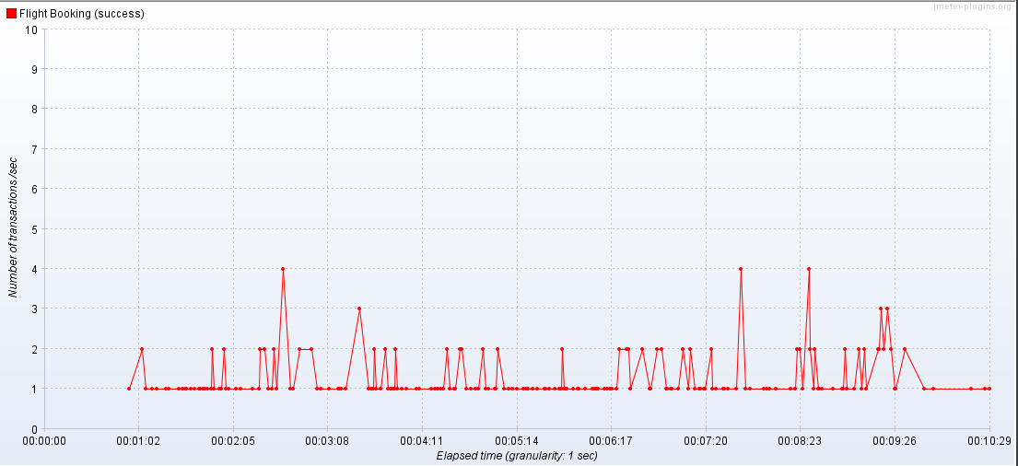
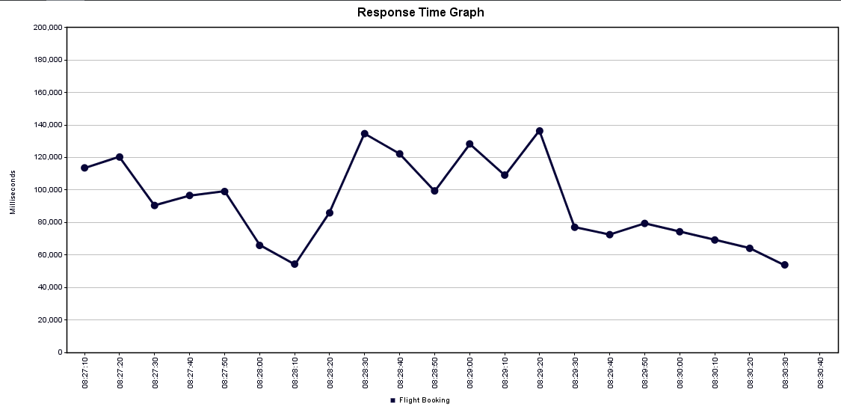
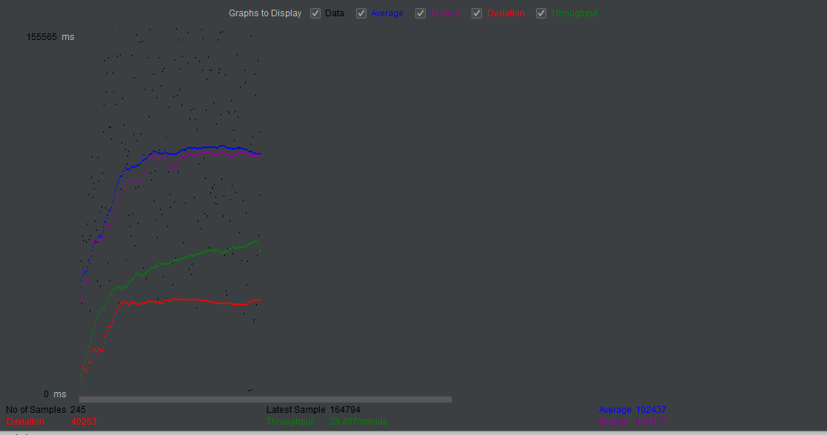
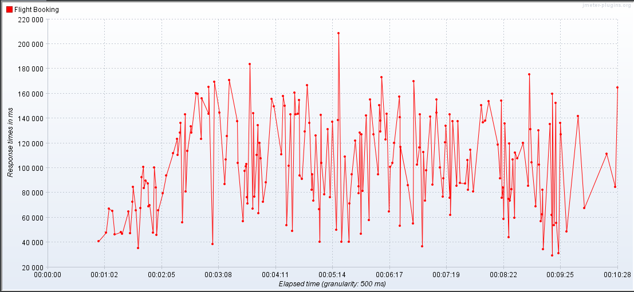
Test Summary (50 users)
Hits Per Second
Bytes Throughput Over Time
Transaction Per Second
Response Time
Deviation
Response Time Over Time
Summary Report

Slide 7
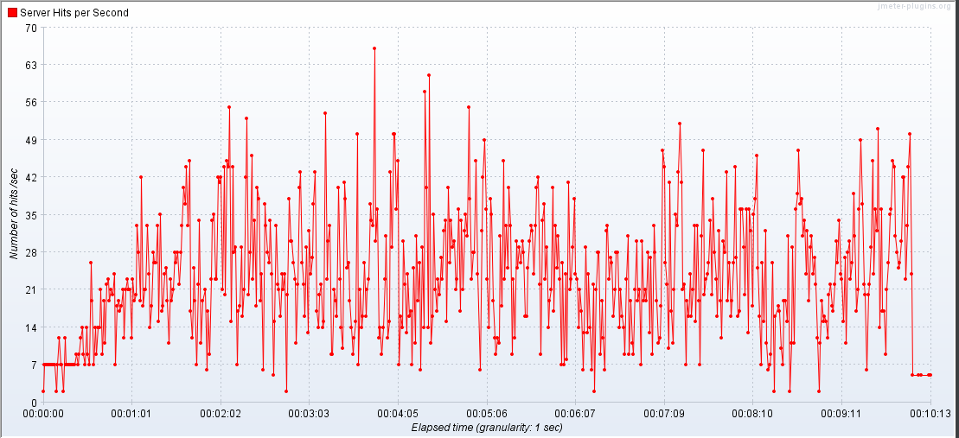
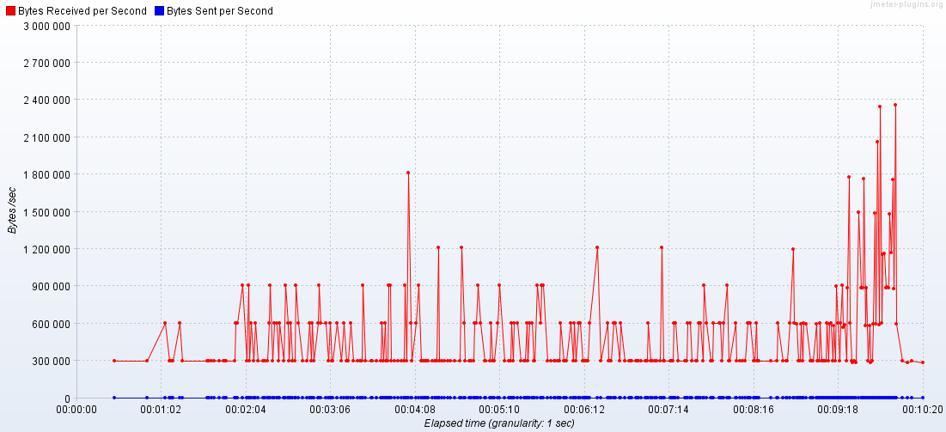
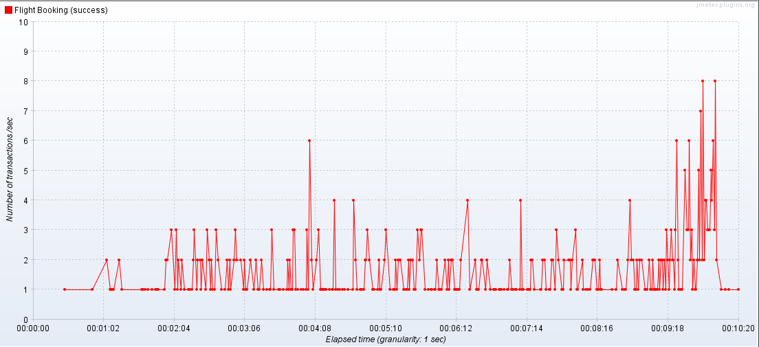
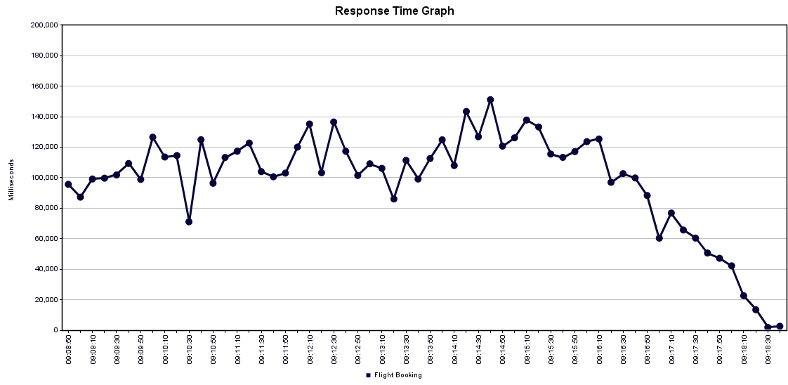
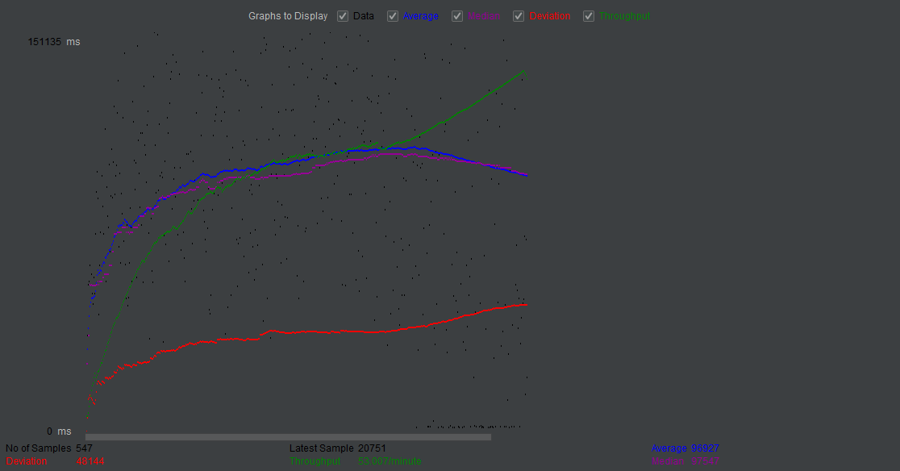
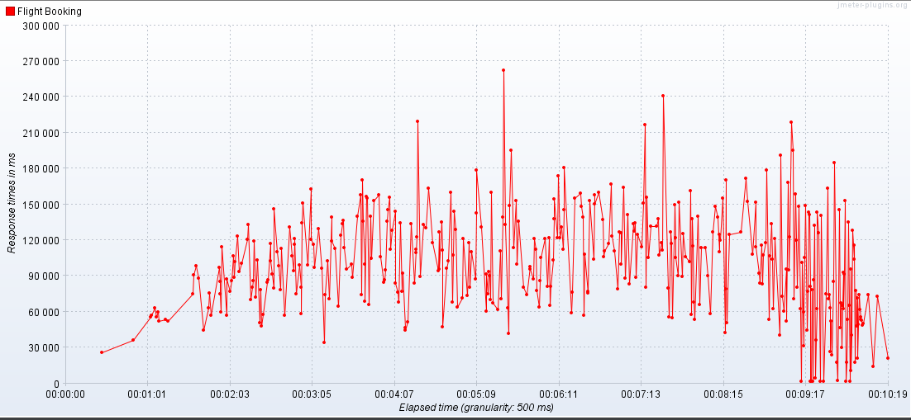
Test Summary (100 users)
Hits Per Second
Bytes Throughput Over Time
Transaction Per Second
Response Time
Deviation
Response Time Over Time
Summary Report

Slide 8
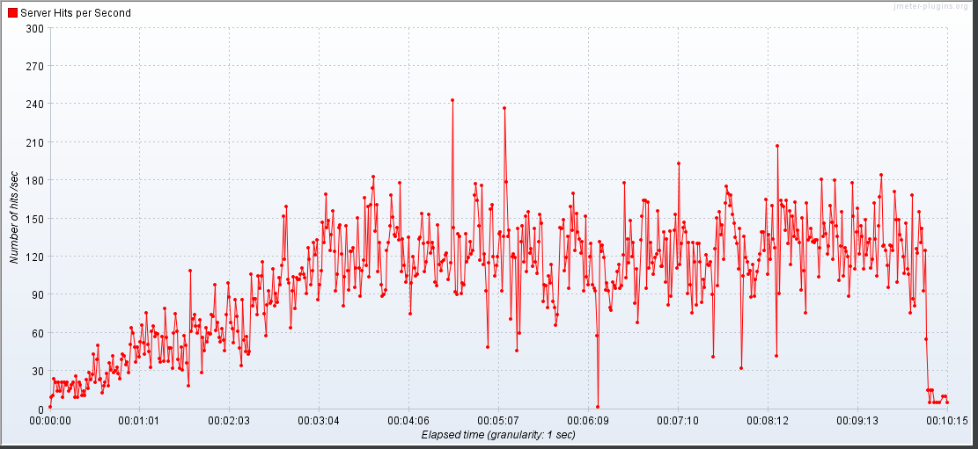
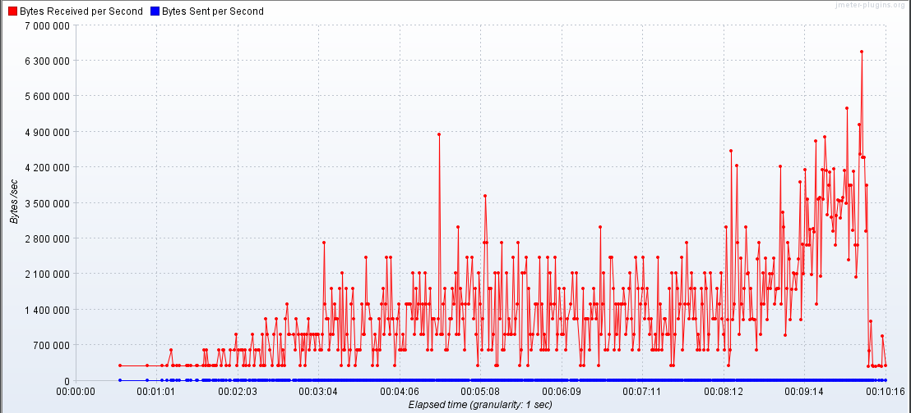
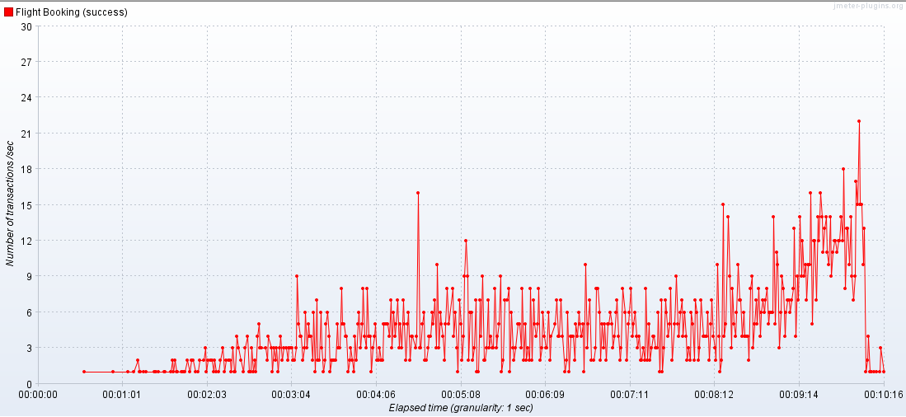
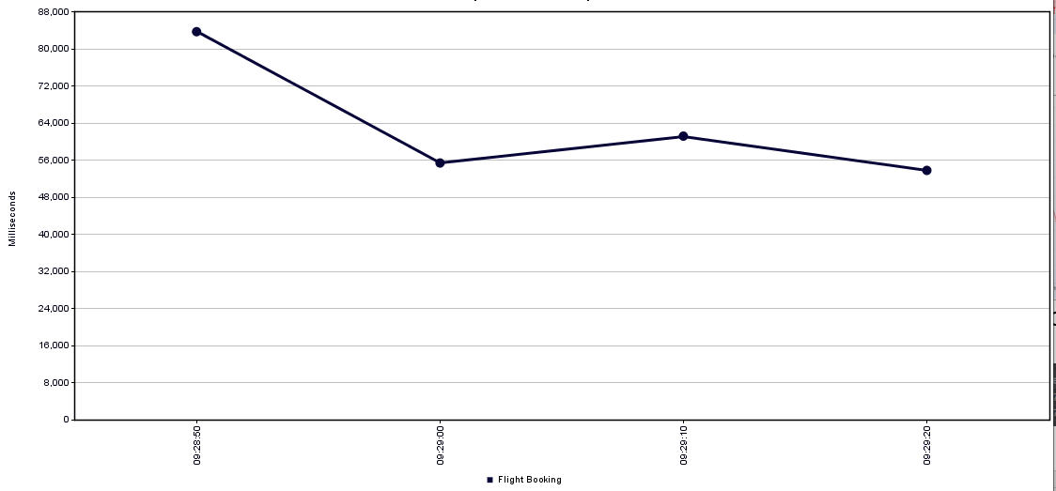
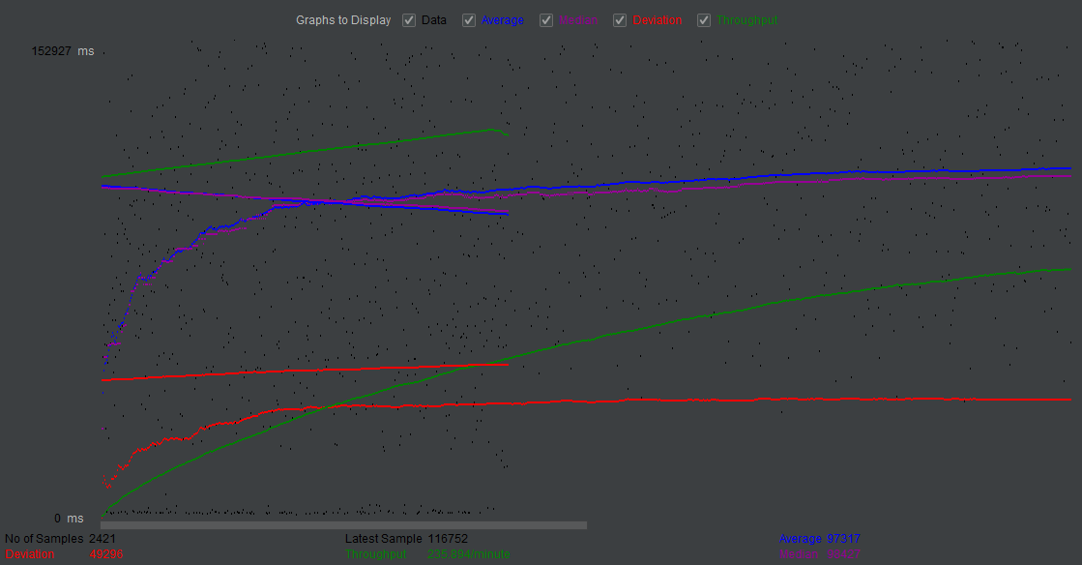
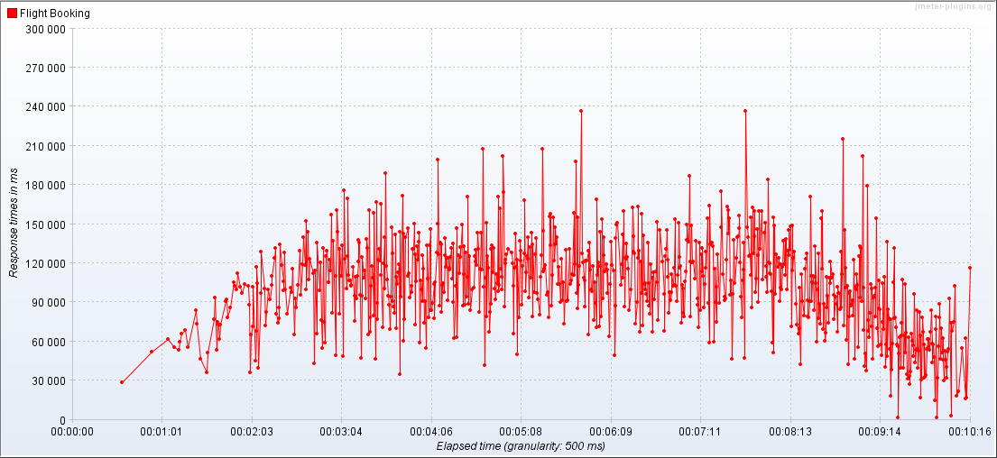
Test Summary (500 users)
Hits Per Second
Bytes Throughput Over Time
Transaction Per Second
Response Time
Deviation
Response Time Over Time
Summary Report

Slide 9
Results Comparison
Test 1
10
Concurrent Users
No major issues found
Avg Throughput – 4.7/min
Errors – 0%
Results
Test 2
50
Concurrent Users
No major issues found Throughput increases when number of concurrent users increases
Avg Throughput – 23.4/min
Errors – 0%
Results
Test 3
100
Concurrent Users
No major issues found Throughput increases when number of concurrent users increases
Avg Throughput – 53.0/min
Errors – 0%
Results
Test 4
500
Concurrent Users
No major issues found Throughput increases when number of concurrent users increases
Avg Throughput – 234.0/min
Errors - 0%
Results

Slide 10
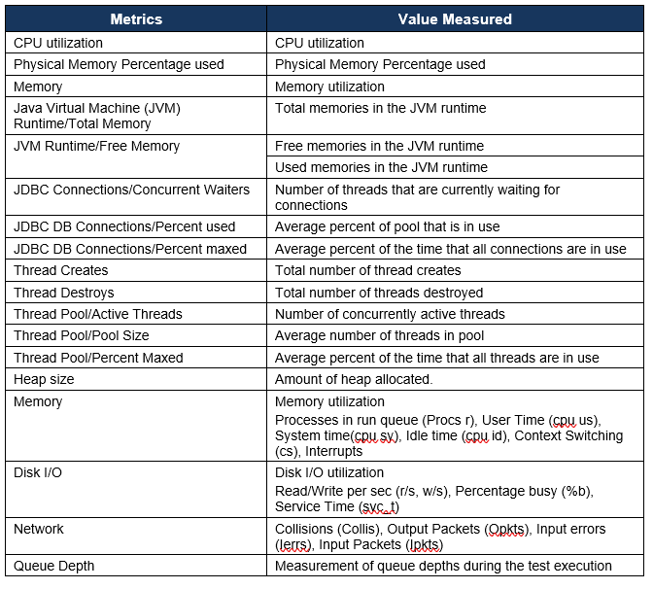
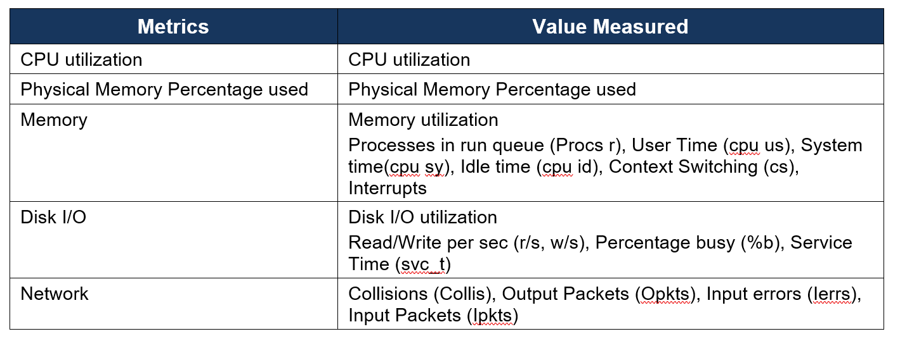
Recommendations
#1 Measure the Application Server Tier Metrics
#2 Measure the Database Server Tier Metrics
* Assumption – Application is built using java

Slide 11
Thank You

