Slide 1
CS217: Artificial Intelligence and Machine Learning (associated lab: CS240)
Nihar Ranjan Sahoo
PhD scholar under Prof. Pushpak Bhattacharyya CSE Dept., IIT Bombay
Week11 of 24mar25, Decision Trees, Intro Speech Recognition

Slide 2
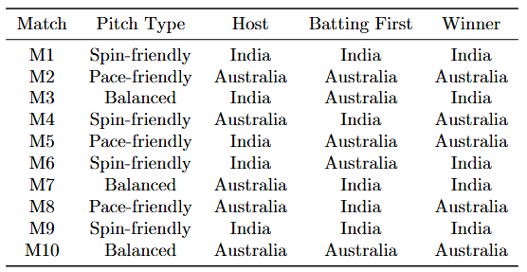
Decision Tree
Make decision to predict if India can beat Australia in the upcoming match?
Use Information Gain/Gain Ratio/Gini Index to build decision tree.

Slide 3
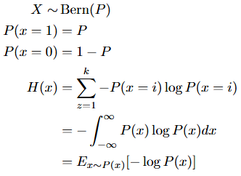
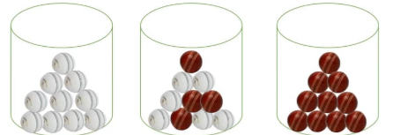
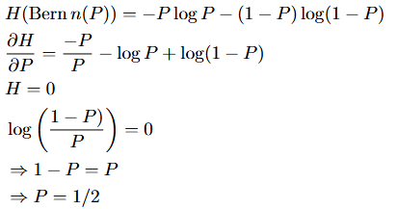
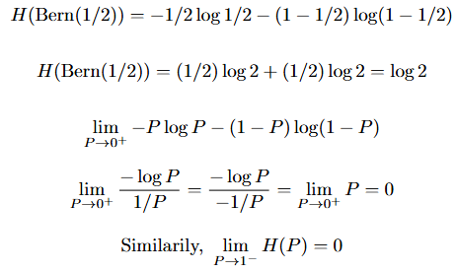
Decision Tree
Entropy == Randomness
Find P that maximizes the entropy for a Bern(P) => MLE

Slide 4
What needs to be decided on?
Split feature
based on Purity on feature
Split point
When to stop splitting
Purity:
how homogeneous a node is in terms of class labels
goal of splitting is to create child nodes that are purer than the parent node
meaning they contain more instances of a single class

Slide 5
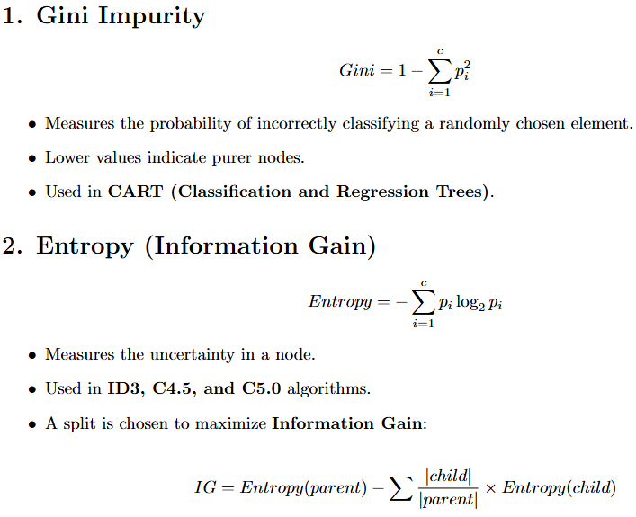
Different Purity measures?

Slide 6
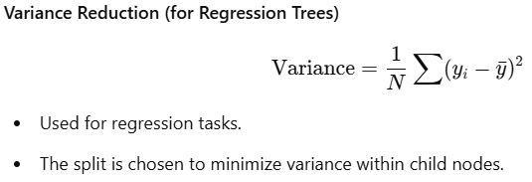
Different Purity measures?
Splitting Strategy- At each step, the algorithm:
Evaluates all possible splits.
Computes the purity measure for each split.
Selects the split that results in the highest improvement in purity.

Slide 7
Information Gain to construct Decision Tree

Slide 8
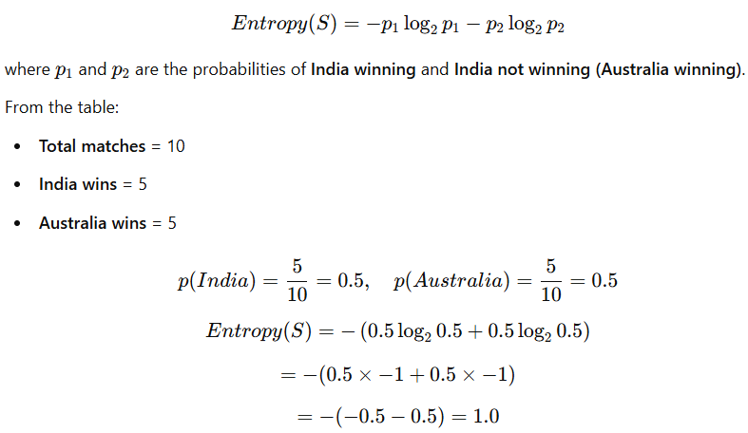
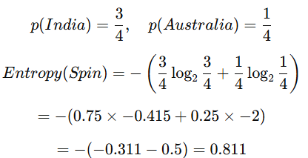
Information Gain to construct Decision Tree
Entropy for Spin

Slide 9

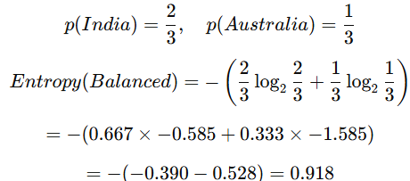

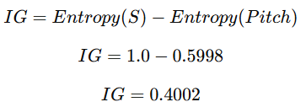
Information Gain to construct Decision Tree
Entropy for Pace
Entropy for Balanced
Weighted Entropy of Pitch
Information Gain
IG(Host)=1.0−0.971=0.029. | IG(Batting)=1.0−0.971=0.029

Slide 10
Stopping Criteria in Decision Tree
Pure Node
No significant IG
Minimum Samples in a node
Maximum tree depth
No features to split

Slide 11
Definition of a linear model
A linear model is considered linear because the model's predictions are a linear function of the parameters w.
Mathematically, a typical linear model takes the form:
y=w^{T}x+b
where:
x is the input feature vector,
w is the weight vector (parameters),
b is the bias term,
y is the predicted output.

Slide 12
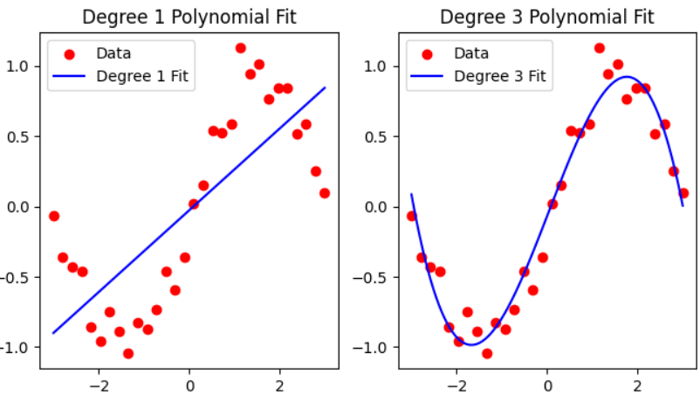
Bias-Variance Tradeoff: Overfitting and Underfitting
Overfitting: The model learns not only the underlying pattern but also the noise in the training data. It performs well on training data but poorly on unseen data.
Underfitting: The model is too simple to capture the underlying pattern in the data, leading to poor performance on both training and test data.

Slide 13
Bias-Variance Tradeoff: Overfitting and Underfitting
Overfitting: The model learns not only the underlying pattern but also the noise in the training data. It performs well on training data but poorly on unseen data.
Underfitting: The model is too simple to capture the underlying pattern in the data, leading to poor performance on both training and test data.

