Slide 1

Student Details
AP22110011231
LINGAM PUSHPESH

Slide 2
In-depth Study of the Car Dekho Dataset Patterns, Findings, and Irregularities
PROBLEM STATEMENT :
The car industry has a hard time predicting and managing how much cars lose value over time, which affects how cars are priced and what consumers decide to buy. Current methods often miss important details and don't use thorough data analysis to understand all the factors that cause cars to lose value. This project plans to solve these problems by using the Car Dekho dataset to find the main reasons cars lose value. By creating predictive models, the project aims to improve pricing strategies and make better predictions about resale values.

Slide 3
AGENDA/contents
Project Summary
Target Audience
Solution and Benefits
Project Tailoring
Model Development
Outcomes
Sources and References

Slide 4
PROJECT OVERVIEW
Purpose :
The goal of the project is to examine patterns in vehicle depreciation using the Car Dekho dataset. By applying data analytics, the project seeks to refine pricing strategies and gain deeper insights into market trends within the automotive sector.
Scope :
Study the Car Dekho dataset to understand how vehicle depreciation changes with factors like age, mileage, and brand.
Create models to predict how quickly vehicles lose value over time and help set better prices.
Offer useful insights to industry professionals to support better decisions about vehicle pricing and market strategies.

Slide 5
PROJECT OVERVIEW
Objectives :
Identify main factors that affect how quickly vehicles lose value, using past sales data.
Create models to predict depreciation rates and improve pricing strategies.
Give useful recommendations to industry stakeholders for better decision-making.
Improve understanding of market trends and consumer preferences regarding vehicle resale values.

Slide 6
who ARE THE END USERS of this project?
Automotive Dealerships and Manufacturers:
Characteristics: Engage in buying, selling, and making vehicles.
Needs: Need to understand vehicle depreciation to set optimal prices and manage inventory.
Benefits: Predictive models will help in setting competitive prices, adjusting stock levels, and boosting profitability.
2. Consumers (Buyers and Sellers of Used Vehicles):
Characteristics: Individuals and businesses looking to buy or sell used cars.
Needs: Desire clear pricing and reliable predictions for resale values.
Benefits: Insights will aid in making better decisions, negotiating deals, and achieving better financial outcomes.

Slide 7
who ARE THE END USERS of this project?
3. Market Analysts and Researchers:
Characteristics: Experts who analyze trends and conduct research in the automotive industry.
Needs: Need detailed data and analytical tools to derive meaningful insights.
Benefits: Insights from the project will help in understanding market trends, spotting emerging patterns, and creating industry reports.
4. Financial Institutions and Insurance Companies:
Characteristics: Entities that provide vehicle financing and insurance.
Needs: Require precise vehicle valuations for evaluating risk and making informed decisions.
Benefits: Predictive models will improve the accuracy of depreciation risk assessments and support better financial decision-making.

Slide 8
YOUR SOLUTION AND ITS VALUE PROPOSITION
Vehicle Dataset Overview: Key Insights and Trends:
Years Covered: The dataset spans vehicles from 2003 to 2017.
Price Range: Prices range from 0.10 lakhs (Bajaj Pulsar 150, 2008) to 35 lakhs (Land Cruiser, 2010), indicating a wide variety of market segments.
Model Variety: Includes 123 distinct vehicle models.
Alternative Fuel Vehicles: Features 2 CNG vehicles, highlighting the presence of alternative fuel options.
Seller Details: Data includes 106 individual sellers.
Depreciation Patterns: Shows significant variations in depreciation, particularly for high-value vehicles like the Land Cruiser and Fortuner.
Two-Wheeler Analysis: Provides insights into both low-cost and high-value two-wheelers.
Top-Selling Vehicles: The CITY car and Royal Enfield Classic 350 bike are the most frequently sold.
Impact of Mileage: Higher mileage is generally associated with lower selling prices and increased depreciation.

Slide 9
How did you customize the project and make it your own
Load Data: Imported the Car Dekho dataset from a CSV file using Python and Pandas.
Analyze Data: Used Pandas functions like min, max, info, head, and concat to explore and transform the data.
Create Visuals: Made Bar Charts, Pie Charts, Horizontal Line Charts, and Scatter Plots to show trends and insights.
Combine Datasets: Merged data from different sources and used displot for distribution analysis.
Extract Insights: Found patterns in pricing and depreciation, offering useful information for industry stakeholders.

Slide 10
MODELLING
I used Python with Pandas and NumPy to work with data from the Car Dekho CSV file.
I cleaned up and organized the data, and combined different datasets together.
To analyze trends and connections in how cars lose value over time, I used Seaborn and Matplotlib.
I created charts like bar graphs, scatter plots, and distribution plots to show these trends.
I predicted how fast cars lose value using machine learning techniques like linear regression and decision trees.
I split the data into parts, trained models to predict depreciation rates, and checked how accurate they were using different measures.
This work helped give clear advice to people in the car industry on how to set prices and manage stock better.

Slide 11
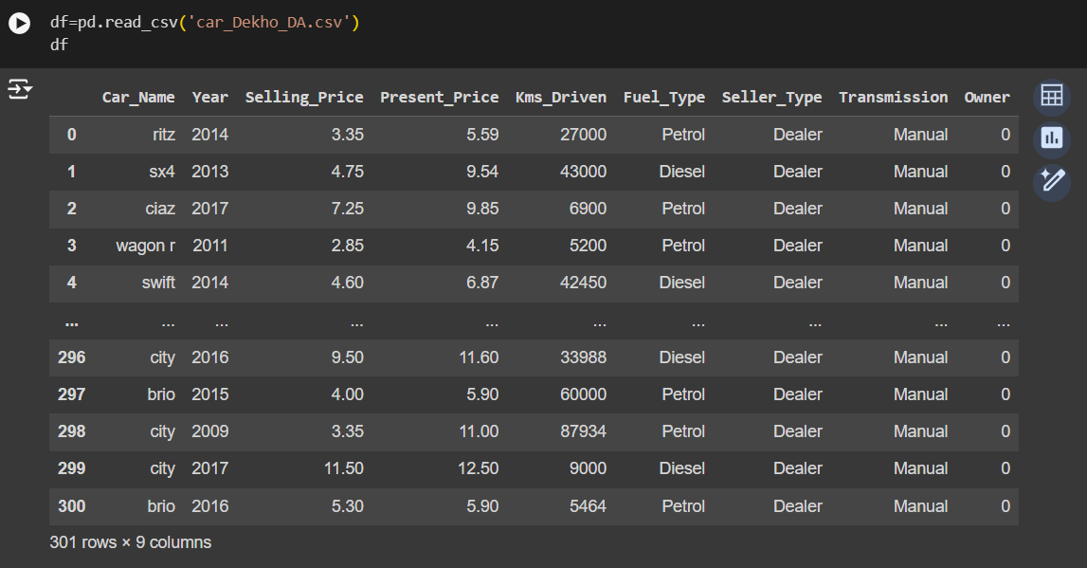
Results
Reading the Car Dekho DataSet(CSV File)

Slide 12
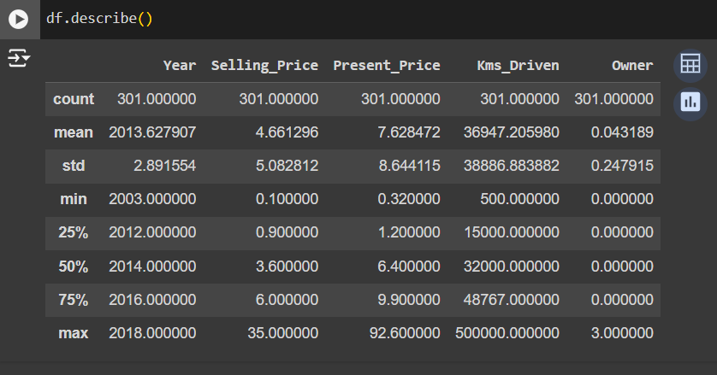
Results
Statistics of the DataSet using Describe Function

Slide 13
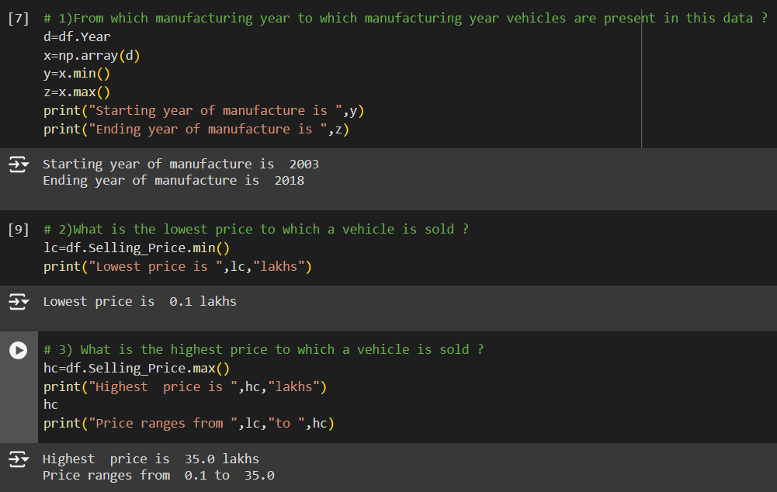
Results
Manufacturing Years and Price Ranges of Vehicles

Slide 14
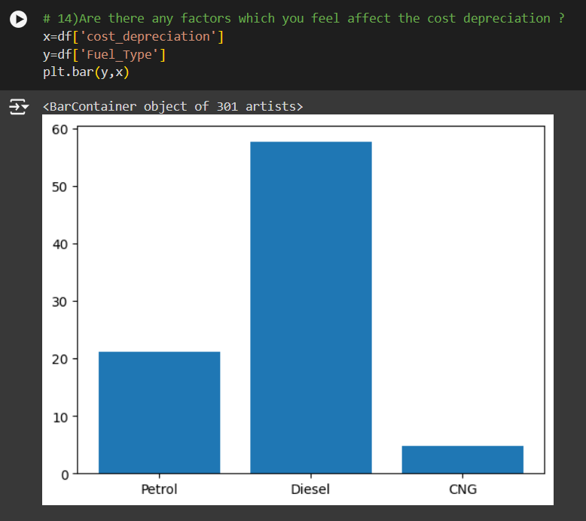
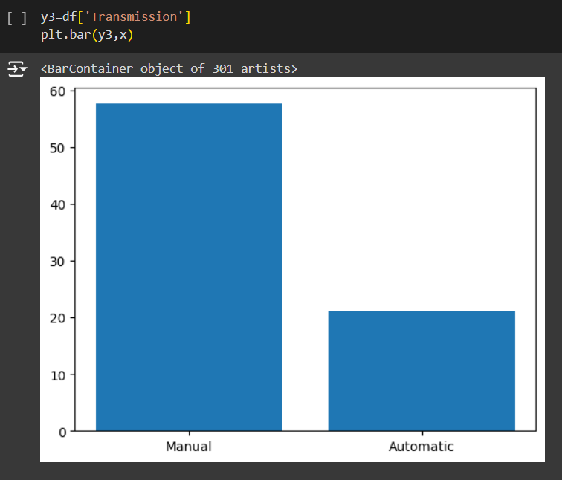
Results
Analysis of Depreciation Costs
Transmission Analysis

Slide 15
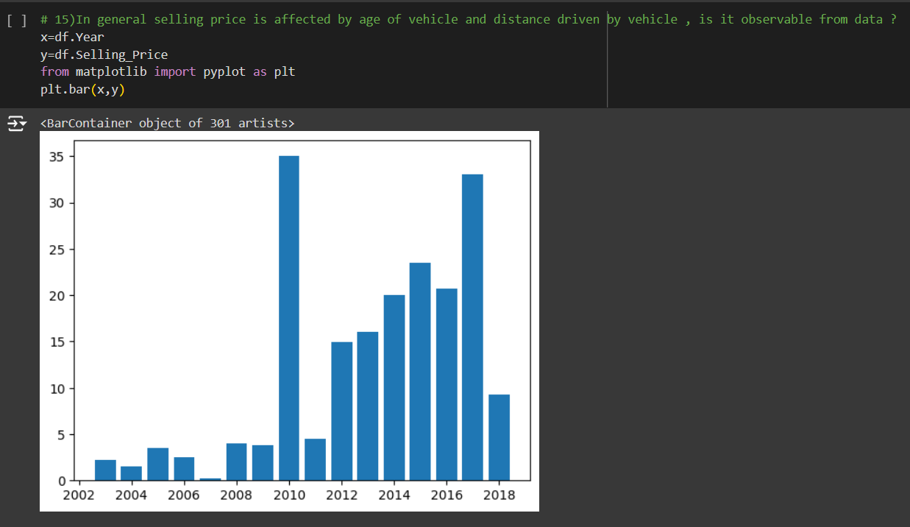
Results
Selling Price Analysis

Slide 16
Links
GIT HUB : https://github.com/Pushpeshlingam1407/Analysis_of_CarDekho_DataSet
Google drive:
https://drive.google.com/drive/folders/1659Bd-VXxXrIlZrHdOoE_NrB87fq9PuF?usp=drive_link
REFERENCES
Chat GPT – https://chatgpt.com/
IBM - https://skills.yourlearning.ibm.com/activity/PLAN-D0B733510535
W3Schools - https://www.w3schools.com/training/aws/data-analytics-fundamentals.php
geeksforgeeks - https://www.geeksforgeeks.org/data-analysis-tutorial/

