Slide 1
EcoOptimize AI
Intelligent Energy Management for Smart Buildings
Yuva Yodha Energy Tech Hackathon 2026

Slide 2
The Problem: Energy Waste
• Nearly 40% of global energy is consumed by buildings.
• Up to 30% of this energy is purely wasted.
• Modern commercial real estate relies on outdated heating and lighting schedules.

Slide 3
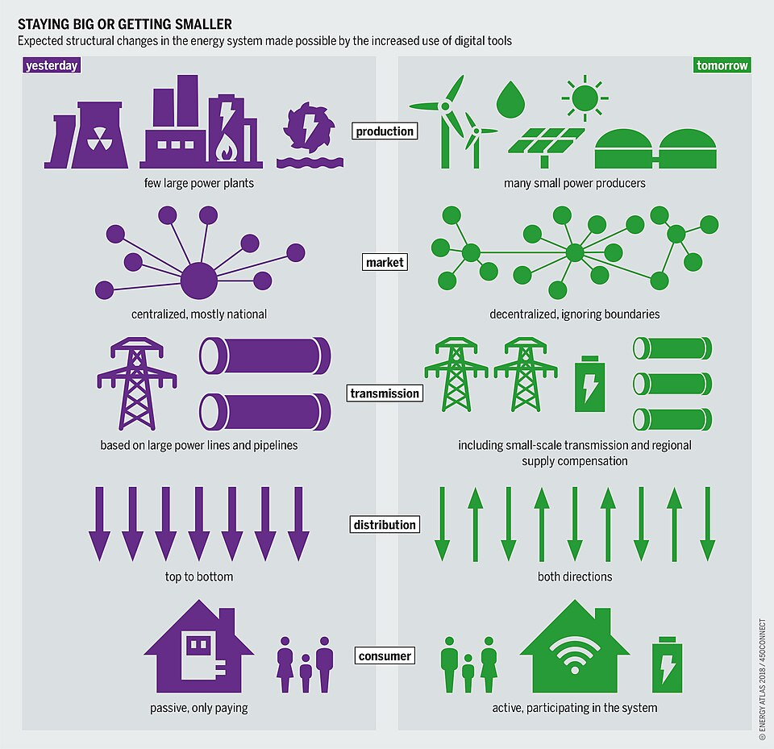
Why It Matters: The Global Cost
• Grid Strain: Peak loads threaten the stability of the power grid.
• Decarbonization: Scope 2 emissions must be cut to reach Net-Zero targets.
• Economic Burden: Operational costs are unnecessarily high for building owners.

Slide 4
The Solution: EcoOptimize AI
• An intelligent, ML-driven platform perfectly integrated with existing BMS.
• Dynamically adjusts HVAC and lighting based on actual, real-time data.
• Operates entirely without human micro-management.

Slide 5
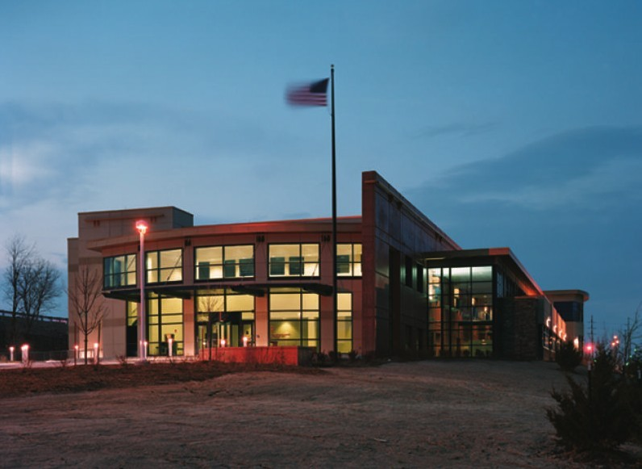
Alignment to Smart Buildings
• Transforms static infrastructure into responsive 'Smart' ecosystems.
• Uses cutting-edge sensor telemetry and algorithmic processing.
• Enhances tenant comfort while drastically lowering energy overhead.

Slide 6
Key Features & The User Journey
• Interactive Dashboard: Live tracking of energy savings and carbon reduction.
• Automated Controls: System autonomously commands HVAC set-points.
• Anomaly Detection: Sends automatic alerts for unusual power drain.

Slide 7
Technical Architecture
• Data Ingestion: IoT MQTT streams (occupancy) + REST APIs (weather forecasts).
• Machine Learning: Deep Time-Series forecasting and Reinforcement Learning.
• Interfaces: Standardized BACnet & Modbus communication protocols.

Slide 8
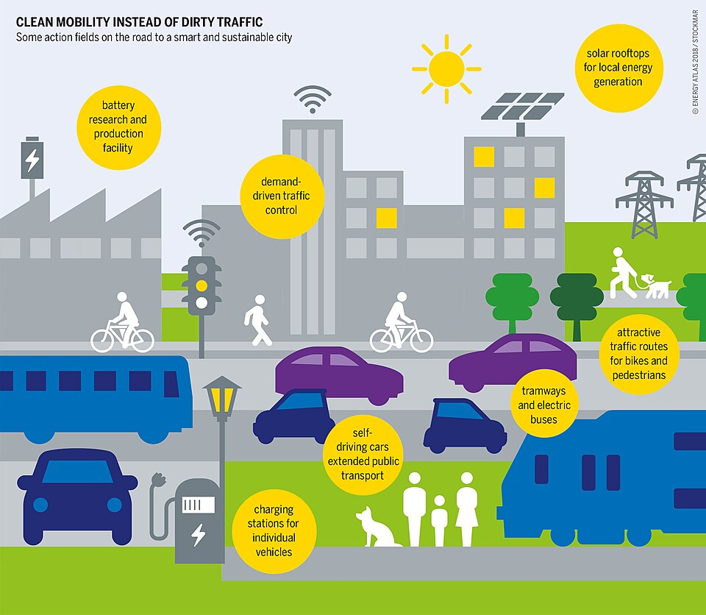
Innovation: Privacy-First Edge AI
• Processed Locally: Leverages NPUs (like Snapdragon) for localized inference.
• Zero Latency: Immediate set-point adjustment on the physical hardware.
• Peak Privacy: Data doesn't need to be pushed to an external cloud.

Slide 9
Expected Impact & Beneficiaries
• Projected 20% to 30% reduction in HVAC and lighting energy usage.
• Facility Managers: Reduced utility bills and lowered maintenance hours.
• Planet Earth: Significant decarbonization step in commercial environments.

Slide 10
Implementation Roadmap
• Phase 1: Prototype Mock Dashboard & Core ML Algorithm (Current).
• Phase 2: Internal Pilot in a single commercial office space.
• Phase 3: Hardware integration into legacy Building Management Systems.
• Phase 4: Full-Scale SaaS Commercial Rollout.

Slide 11
Team Introduction
• Pushyami Reddy
• Software Engineer | Data Engineering & AI Developer
• Email: pushyami.reddy@example.com (Edit this)
• Location: India

