Slide 1
EcoOptimize AI
Intelligent Energy Management for Smart Buildings
Yuva Yodha Energy Tech Hackathon 2026

Slide 2
The Problem: Energy Waste
Nearly 40% of global energy is consumed by buildings.
Up to 30% of this energy is purely wasted.
Modern commercial real estate relies on outdated heating
and lighting schedules.

Slide 3
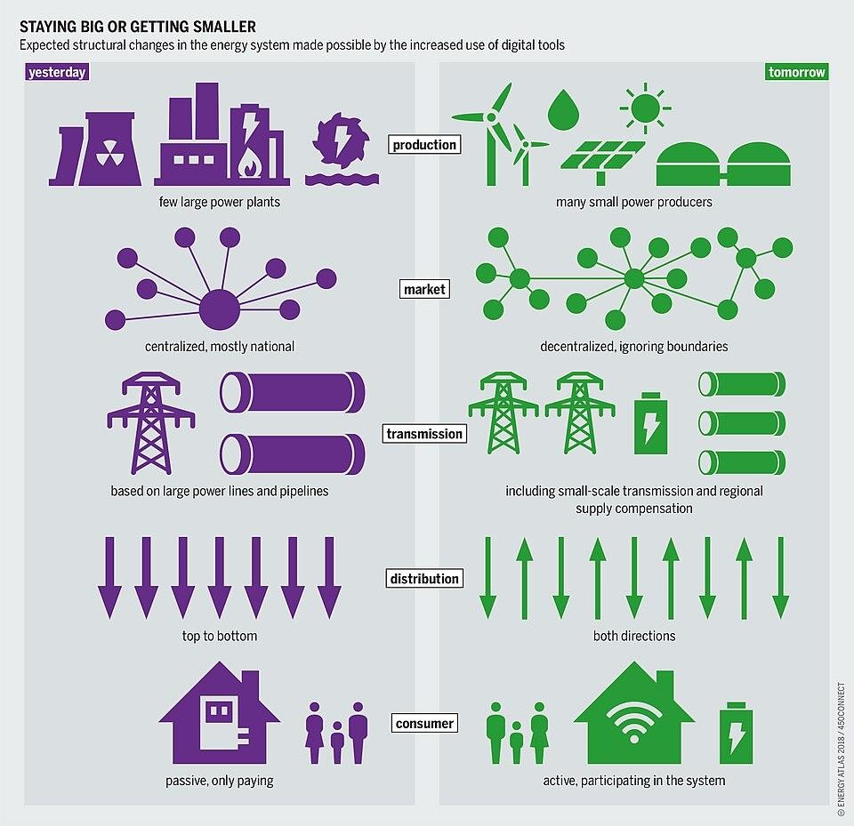
Why It Matters: The Global Cost
Grid Strain: Peak loads threaten the stability of the power grid.
Decarbonization: Scope 2 emissions must be cut to reach Net-Zero targets.
Economic Burden: Operational costs are unnecessarily high for building owners.

Slide 4
The Solution: EcoOptimize AI
An intelligent, ML-driven platform perfectly integrated
with existing BMS.
Dynamically adjusts HVAC and lighting based on actual,
real-time data.
Operates entirely without human micro-management.

Slide 5
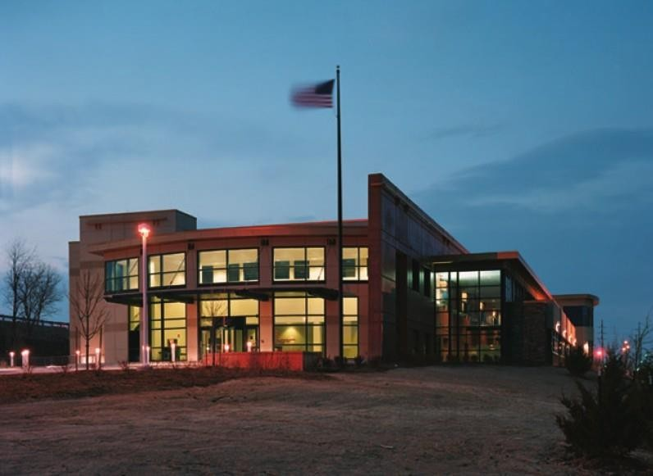
Alignment to Smart Buildings
Transforms static infrastructure into responsive 'Smart' ecosystems.
Uses cutting-edge sensor telemetry and algorithmic processing.
Enhances tenant comfort while drastically lowering energy overhead.

Slide 6
Key Features & The User Journey
Interactive Dashboard: Live tracking of energy savings and
carbon reduction.
Automated Controls: System autonomously commands
HVAC set-points.
Anomaly Detection: Sends automatic alerts for unusual
power drain.

Slide 7
Technical Architecture
Data Ingestion: IoT MQTT streams (occupancy) + REST
APIs (weather forecasts).
Machine Learning: Deep Time-Series forecasting and
Reinforcement Learning.
Interfaces: Standardized BACnet & Modbus
communication protocols.

Slide 8
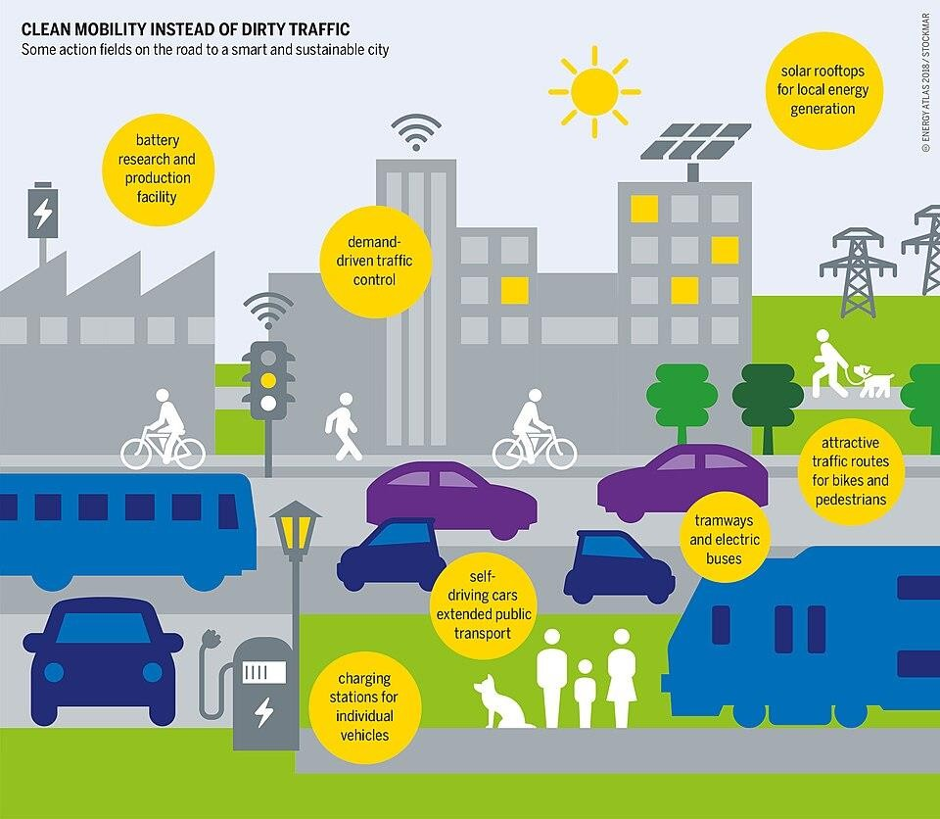
Innovation: Privacy-First Edge AI
Processed Locally: Leverages NPUs (like Snapdragon) for localized inference.
Zero Latency: Immediate set-point adjustment on the physical hardware.
Peak Privacy: Data doesn't need to be pushed to an external cloud.

Slide 9
Expected Impact & Beneficiaries
Projected 20% to 30% reduction in HVAC and lighting
energy usage.
Facility Managers: Reduced utility bills and lowered
maintenance hours.
Planet Earth: Significant decarbonization step in
commercial environments.

Slide 10
Implementation Roadmap
Phase 1: Prototype Mock Dashboard & Core ML
Algorithm (Current).
Phase 2: Internal Pilot in a single commercial office space.
Phase 3: Hardware integration into legacy Building
Management Systems.
Phase 4: Full-Scale SaaS Commercial Rollout.

Slide 11
Team Introduction
A V U Pushyami.
Software Engineer | Data Engineering & AI Developer
Email: pushyamireddy4533@gmail.com
Location: Bengaluru, India

