Slide 1
Recipe Preparation agent
CAPSTONE PROJECT
Presented By: Puskar
Student name: Puskar Das
College Name & Department: Meghnad Saha Institute of Technology
& Computer Science Engineering

Slide 2
OUTLINE
Problem Statement
Technology used
Wow factor
End users
Result
Conclusion
GitHub Link
Future scope
IBM Certifications

Slide 3
Problem Statement
Users often struggle to decide what to cook when they have limited available groceries. This leads to:
Food wastage
Time lost searching recipes
Ignoring dietary needs
Proposed Solution:
An AI-powered Recipe Preparation Agent using RAG (Retrieval-Augmented Generation) that:
Suggests recipes based on available ingredients
Offers substitutions and dietary alternatives
Provides step-by-step cooking instructions

Slide 4
Technology used
IBM Cloud Lite services
Natural Language Processing (NLP)
Retrieval Augmented Generation (RAG)
IBM Granite model

Slide 5
IBM cloud services used
IBM Cloud Watsonx AI Studio
IBM Cloud Watsonx AI runtime
IBM Cloud Agent Lab
IBM Granite foundation model

Slide 6
Wow factors
This agent:
Converts leftover ingredients into meals
Offers smart substitutions for unavailable items
Provides dietary adjustments (vegan, gluten-free)
Minimizes food waste
Makes cooking faster, smarter, and more sustainable

Slide 7
End users
Home Cooks
Students in hostels
Working professionals
Elderly users
Health-conscious individuals

Slide 8
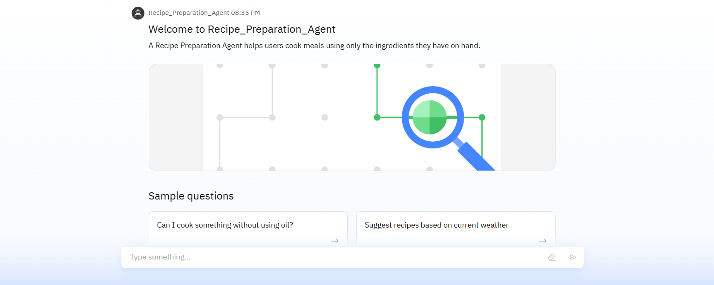
Results

Slide 9
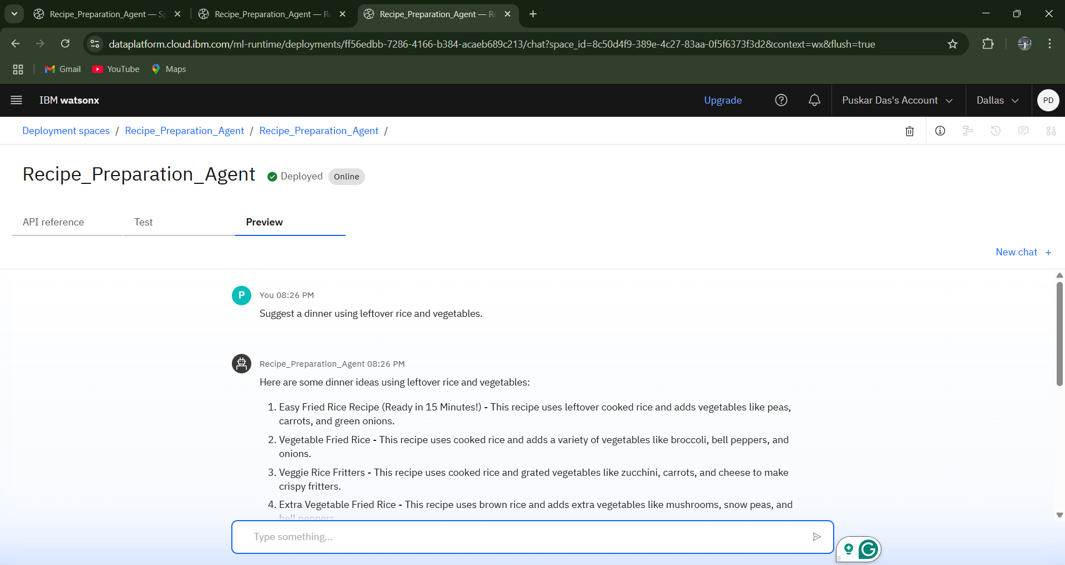
Results

Slide 10
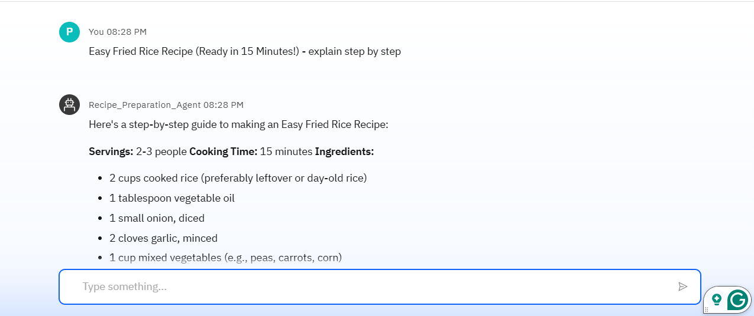
Results

Slide 11
Results
Deployed AI Agent

Slide 12
Conclusion
The Recipe Preparation Agent is a smart solution to everyday cooking challenges.
Simplifies meal planning
Respects dietary constraints
Promotes sustainability
It turns your pantry into a personal chef.

Slide 13
GitHub Link
Ctrl+Click on this text to Visit GitHub Repository of This Project

Slide 14
Future scope
Voice-controlled recipe assistant
Integration with grocery ordering apps
Multilingual support
Weekly meal planner feature
Calorie and nutrition tracking
IoT integration with kitchen appliances

Slide 15
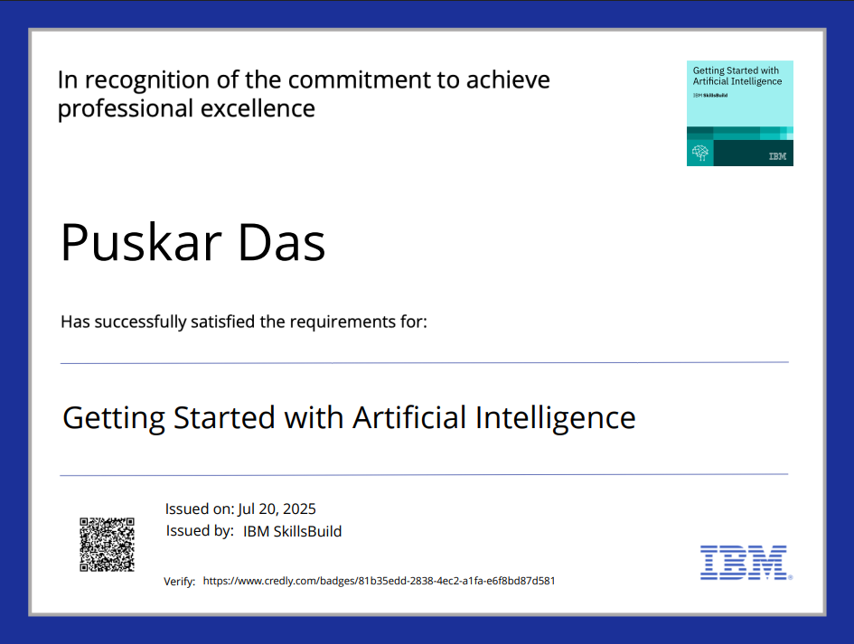
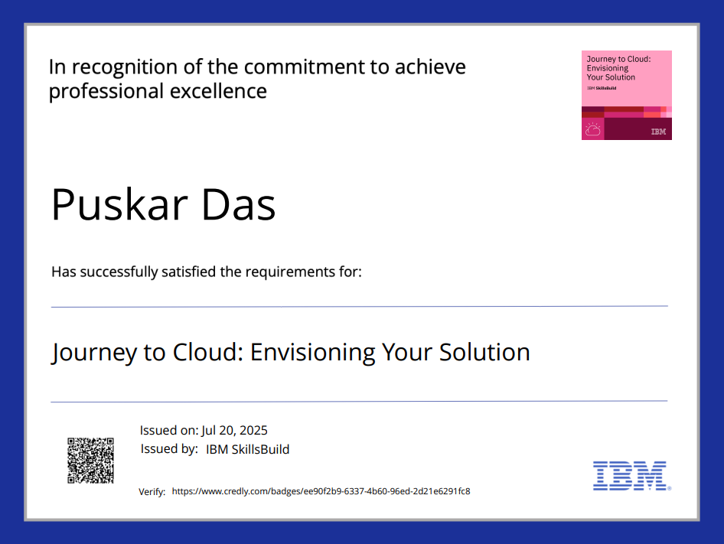
IBM Certifications

Slide 16
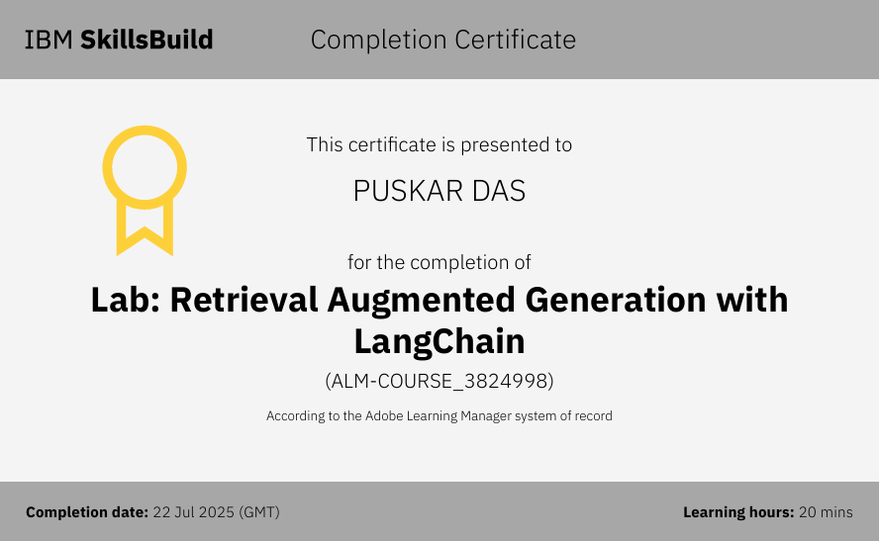

Slide 17
THANK YOU

