Slide 1


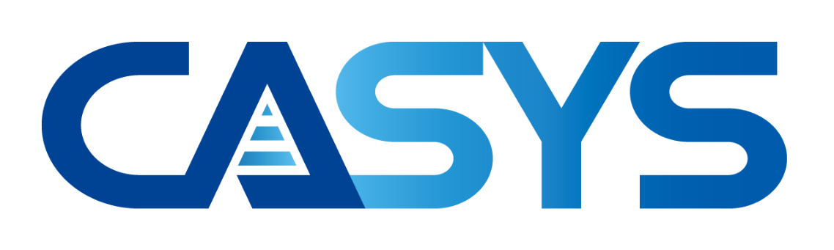
Adios to Busy-Waiting for Microsecond-scale Memory Disaggregation
Paper: https://yoon.ws/adios
Slides: https://yoon.ws/adios/slides
Code: https://yoon.ws/adios/src
Wonsup Yoon, Jisu Ok, Sue Moon, and Youngjin Kwon
Notes:
Hello everyone, I’m Wonsup Yoon, and I will present our work “Adios to Busy-Waiting for Microsecond-scale Memory Disaggregation”.
This is joint work with 옥지수, 문수복, 권영진 from KAIST.

Slide 2
Memory Disaggregation (MD)
Places computing and memory in physically separate nodes
Compute node's DRAM as local cache
Connected by fast interconnection (RDMA, CXL)
Advantages of memory disaggregation
Improving memory utilization
Mitigating memory capacity wall
Many systems utilizes paging for MD
Offering virtual memory transparency
Compute Node
Compute Node
Fast Interconnection
Memory Node
Memory Node
Memory disaggregation configuration
Notes:
For most of us here at EuroSys and ASPLOS memory disaggregation is a familiar term. But for those who might be new to it, let me give a real brief intro.
Memory disaggregation decouples memory from traditional servers and builds separate compute and memory nodes. This way compute nodes now have access to memory of size beyond a single server.
This design promotes better memory utilization and scalability in datacenters.
Memory disaggregation systems usually utilize paging to offer virtual memory for transparency.
-- backup
Memory disaggregation builds a pool of memory and separates it from compute nodes. Via fast interconnect compute nodes now have access to this big pool of memory on demand.

Slide 3
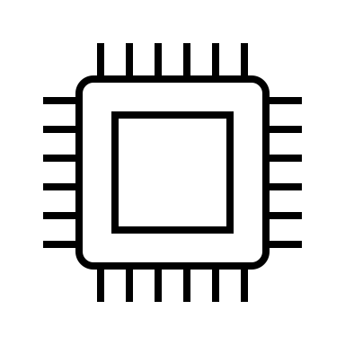
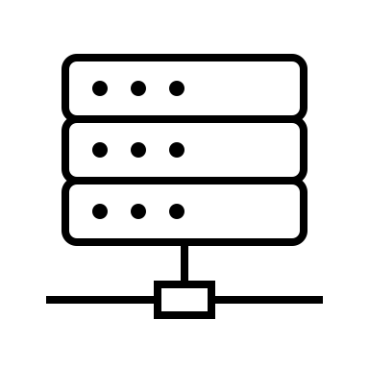
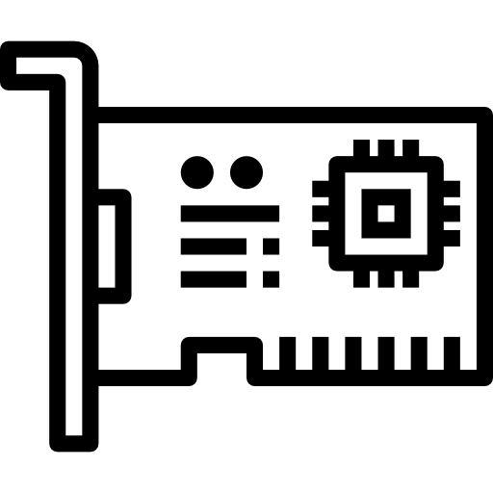




Busy-Waiting in Memory Disaggregation Systems*
Page Fault Occurs
Normal Execution
Pause Execution
Normal Execution
Page Fetch Request
RDMA READ
Busy-Waiting
Complete
PAGE
CPU
RNIC
Memory
Node
Busy-waiting reduces PF handling latency by removing context switching
*E.g., Fastswap (Eurosys20), Leap (ATC20), Hermit (NSDI23), and DiLOS (EuroSys23)
Notes:
In memory disaggregation systems, busy-waiting is a popular technique to reduce page fault handling latency. Let me show step-by-step where the busy-waiting takes place in page fault handling and how it reduces latency. Here on the left are the CPU and RNIC of the compute node.
During execution of an application, CPU may access remote memory.
When such remote memory access takes place, a page fault occurs (click) and CPU pauses execution, Then the page fault handler issues a page fetch request to RNIC.
Once the RNIC issues an RDMA read and until the page is fetched, CPU busy-waits for the completion of the page fetch request.
When the request completes (click) the application execution resumes.
CPU busy-waits for the request completion and does not context-switch to another application. This way page fault handling does not involve context switching and cause no overhead or in this case extra latency.

Slide 4
Handling Multiple Requests with Busy-Waiting
Observation #2: only 1 outstanding RDMA request (underutilized RDMA)
Page Fault Occurs
Normal Execution
Pause Execution
Normal Execution
#4
#3
#1
#2
Busy-Waiting
Queue
CPU
RNIC
Memory
Node
Observation #1: busy-waiting blocks processing requests in queue (head-of-line blocking)
Notes:
What happens if the CPU has to handle multiple requests at a time?
Let’s assume there is a queue for arriving requests.
A request No. 1 arrives (click) and CPU serves it. A page fault takes place, (click) CPU pauses execution (click) and sends a page fetch request to memory node as in we have seen the previous slide.
While CPU busy-waits for page fetching, (click) new requests arrive in the queue.
Because CPU is busy waiting, arriving requests remain in the queue and are not processed.
CPU’s busy waiting blocks processing other requests. This phenomenon is Head-of-line blocking.
When the page fetch completes. (click) CPU returns to normal execution.
Here we make one more observation. Even though RNIC can handle multiple requests, it handles only one outstating RDMA request at a time. The RDMA channel is underutilized.

Slide 5
Observation #1: Performance Impact of HoL Blocking
Busy-waiting increases queueing delay in tail
300
30
1.3
*Random array indirection workload. Local cache size is 20% of total working set (40GB).
Notes:
So how much impact does the head-of-line blocking have on performance?
On the left we plot the throughput on the x-axis and the 99percentile latency on the y-axis.
around 1.3MegaRPS, the system is saturated, and tail latency starts skyrocketing.
the latency breakdown at that point on the right
as you can see the queueing delays are dominant factors for such a high tail latency

Slide 6
Observation #2: Underutilized RDMA
Room for improvement
*Random array indirection workload. Local cache size is 20% of total working set (40GB).
Notes:
Let’s see RDMA utilization. 여기서 설명을 더 추가
this is load-throughput plot. As the load increases, the effective throughput of system is capped around 1.6 MRPS. you may think this is due to network saturation,
however, as you can see RDMA utilization is only about 50 percent even when the system is saturated
in other words, if we utilize the RDMA bandwidth, we can gain more throughput from that.

Slide 7
Revisiting Scheduling Approach
User-level
Infiniswap (NSDI’17) – yield-based page fault handling
Uses RDMA-connected remote memory as a swap device
Issues request asynchronously and scheduled out during I/O
However, 4KB page fetching latency is around 2 microseconds
Key idea: yield-based page fault handling with user-level scheduling
Eliminates busy-waiting
Minimizes overhead through fast lightweight context switching
Challenge: combining systems in two different spaces
Page fault handler in kernel and scheduler in userspace
Notes:
How do we make it possible? We began our research by revisiting traditional scheduling approaches.
Traditional systems rely on swap and do not perform busy-waiting. They use yield-based page fault handling. After issuing a page fetch request and CPU yields to other threads.
We point out here that yield-based page fault handling has a lot of scheduling overheads. Since page fetching only takes only 2 microseconds, context switching within the window is challenging for traditional scheduler.
Our key idea is to reduce such overhead. We build a high performance user-level scheduler and eliminate busy-waiting as well as high scheduling overhead.
The key challenge here is to combine systems in two different spaces. The page fault handler in the kernel and user-level scheduler in the user space.

Slide 8
Yield-based Page Fault Handling
Context Switch to #2
Pause Execution
Context Switch to #1
Normal Execution
Page Fault Occurs
Further utilizes RDMA
1
1
#4
#3
#1
#2
2
2
1
1
Queue
CPU
RNIC
Memory
Node
Eliminates busy-waiting and head-of-line blocking
Notes:
Let me show you how yield-based page fault handling improves performance
Like before, request arrives in the queue (click) it is handled in CPU
When page fault occurs,(click) pause execution (click) send a page fetch request
When new requests arrive at the queue, rather than busy-waiting, (click) CPU context-switches to the next request (click) and executes it
By doing so, yield-based page fault handling eliminates busy-waiting and head-of-line blocking
If another page fault occurs on the request, (click) the page fault handler issues a new page fetch request
And as you can see, yield-based page fault handling further utilizes RDMA
Later, when the first page fetch request completes, (click) CPU context switches back to the first request, (click) and resumes its execution

Slide 9
Key Insights – Efficient Co-design with Unikernel
Unikernel: single mode and one address space for application (scheduler) and kernel (page fault handler)
Kernel-level features
Paging for transparent virtual memory abstraction
Access to hardware information
User-level features
Lightweight context-switching
Customizable policy for microsecond-scale scheduling
Used by Lupine (EuroSys20), Seuss (EuroSys20), Unikraft (EuroSys21), UKL (EuroSys23), DiLOS (EuroSys23)
Unikernel
User-level Scheduler
Co-design
Page Fault Handler
VMM
Notes:
How do we perform the yield-based page fault handling efficiently?
We use unikernel and co-design user-level scheduler and page fault hander.
unikernel offers single mode and one address space for both application and kernel. So interaction between kernel and user part is just a normal function call, avoiding any expensive overheads Also, using unikernel, we can build a system that can use both the kernel-level features
and user-level features at the same time.
Due to these advantages, many systems adopt the unikernel design to make better operating systems, serverless platforms, and memory disaggregation systems. So many reasons for the Unikernel original paper to win the ASPLOS Influential Paper Award in Tue's award ceremony.

Slide 10
Unithread
Kernel Stack
Core of yield-based page fault handling
Kernel’s paging + user’s fast context switching
Universal stack design
Merges payload/app/kernel/IRQ stack into one
Minimizes context size of unithread
IRQ Stack
App Stack
Context
Request Payload
Mechanism | Context Size | Switching Cycles
Unithread | 80B | 40
Shinjuku* uthread | 968B | 191
Universal Stack
* Kaffes et al. “Shinjuku: Preemptive Scheduling for μsecond-scale Tail Latency” NSDI '19
Notes:
For efficient yield-based page fault handling, we devise a new thread abstraction called unithread.
It is our core data structure that supports kernel’s paging and user’s fast context switching It runs across all layers in OS, including application, user-level scheduler, and kernel page fault handler without any cost. So, it makes the yield-based page fault handling efficient.
Also it has the universal stack design which combines all data structures and stacks into one. In doing so it minimizes memory foot print In memory disaggregation, local DRAM is a valuable resource, so we need to reduce its footprint as much as possible. We minimized the footprint by minimizing context size of unithread.
As a result, unithreads have much smaller memory footprint while offering faster context switching performance.

Slide 11
More in the paper...
Page Fault Aware Dispatching
Mitigates tail latency increases due to temporary page fault imbalances
Polling Delegation to Dispatcher
No head-of-line blocking at the worker during packet transmissions
Eager and Streamlined Reclaimer
Prevents head-of-line blocking during page allocationd
Please refer to our paper!
Notes:
In addition to unithreads we have more features in our Adios. Here we outline 3 main features.
First, to deal with temporary page fault imbalances we adopt page-fault-aware dispatching. Since page faults occur randomly, some workers may have more page faults than others. Our scheduler keeps track of the number of page faults per worker and assigns more requests to workers with fewer outstanding page faults. This way we mitigate the increase in tail latency from page fault imbalances.
Second, we delegate polling to the dispatcher. Rather than workers busy-waiting for packet transmission, they delegate polling to the dispatcher and the dispatcher polls the completion of packet transmission. In doing so, the dispatcher polls for both packet reception and transmission at the same time, removing busy-waiting in workers.
And third, we have an eager reclaimer running in the background watching out for least commonly used pages. Our eager reclaimer secures free pages at any moment, but even when it fails to return free pages immediately, our reclaimer is free of mutex and thus quick to notify the workers.
Please refer to our paper for details.

Slide 12
Adios Implementation
Application
Unithreads
Unithreads
Unithreads
Application
Unithread abstraction
MD Scheduler
Single queueing
PF-aware dispatching
Memory Manager
Extended DiLOS*
Yield-based PF handling
Core LoC: 8,396
MD Scheduler
Workers
Workers
Dispatcher
PF-aware
Dispatch
Algorithm
Workers
Memory Manager
Reclaimer
Page Pool
PF Handler
* Yoon et al. “DiLOS: Do Not Trade Compatibility for Performance in Memory Disaggregation” EuroSys’23
Notes:
With these abstractions and features, we implement Adios, an efficient yield-based page fault handling system with user-level scheduling.
Our memory manager is an extension of our Eurosys 2023 work DiLOS.
DiLOS is built on top of unikernel Osv. It has page fault latency of only 3 microseconds. For Adios, we modify its page fault handler to support yield-based page fault handling.
On top of the memory manager, we have a memory disaggregation scheduler. It is a user-level scheduler for microsecond-scale latency and uses a single globally shared queue. It is well-known that a single queue reduces tail latency by removing load imbalances across workers.
Applications use unithread abstraction. Once an application uses the unithread abstraction, the rest are handled by the MD scheduler and the memory manager. Applications can use virtual memory semantic as before, sacrificing little compatibility for existing applications.
Its core part consists of about 8 thousand lines of C, C++ and assembly code

Slide 13
Evaluation
Q1: Does Adios prevent busy-waits and their HoLB?
Q2: Does Adios fully utilize RDMA?
Q3: Does Adios provide better performance in real-world applications? (Memcached, RocksDB, Silo, FAISS)
SotA systems for comparison
Hermit (NSDI’23): kernel + busy-waiting + single-queue FCFS
DiLOS (EuroSys’23): unikernel + busy-waiting + single-queue FCFS
Load Generator
Compute Node
Memory Node
100GbE
100GbE
Notes:
Let’s talk about evaluation
We conduct experiments to answer the three questions about head-of-line blocking, RDMA utilization, and real-world applications
We compare adiOs against two systems: a kernel-based system Hermit, and a unikernel-based system, DiLOS. Both systems use busy-waiting and single queue FCFS.
And we use a load generator which follows poisson process and 100Gbps links to connect the load generator, compute node, and memory node.

Slide 14
Q1: Does Adios prevent busy-waits and their HoLB?
DiLOS
10x lower P99.9 latency
Adios
30
37x lower queueing delay
Adios
(Zoomed)
30
Kcycles @ 1.3MRPS
*Random array indirection workload
Notes:
For the first question, we conduct performance breakdown again
These are latency breakdown of DiLOS and adiOs. The first plot is the breakdown of DiLOS, the second one is for adiOs.
In this experiment, adiOs has 10 times lower P99.9 tail latency overall.
If we zoom the second plot to around 30 kilo cycles, we can see more details in the plot.
As you can see, adiOs has 37 times lower queueing delay then DiLOS, and queueing delay is no longer dominant factor for tail latency at 1.3MRPS throughput.

Slide 15
Q2: Does Adios fully utilize RDMA?
1.6x
More
RDMA
Utilization
Better
*Random array indirection workload
Notes:
Now let's take a look at RDMA utilization
On the left we plot the thruput of both DiLOS and adiOs.
Compared to DiLOS whose thruput is capped at 1.6 MRPS, AdiOs thruput continues to grow linearly and reaches about 2.7MegaRPS.
On the right we plot the RDMA network utilization. With DiLOS the RDMA network was only 50% utilized. With adiOs, the utilization reaches about 80%.
Overall, adiOs processes more and better utilizes the RDMA network than DiLOS, getting close to the full network capacity.

Slide 16
Q3: Does Adios provide better performance in real-world applications? (KV Stores)
Better
Memcached (100% GET)
RocksDB (99% GET / 1% SCAN)
Notes:
For Real-world applications, we first conduct experiments with two key-value stores: Memcached and RocksDB.
For Memcached, we use 100 percent GET requests workload, and for rocksDB, we use a mixed workload of 99 percent of GET and one percent of SCAN requests.
In Memcached Adios keeps the 99.9 percentile latency under 40 microseconds and pushes the thruput far beyond 500Kilo RPS before the 99.9 percentile latency shoots up.
Hermit's 99.9 percentile latency starts to shoot up way early at about the thruput of 100~Kilo RPS and at the latency of above 50 microseconds.
In RocksDB, we observe the same performance advantage of Adios, but this time the gap between DiLOS and Adios is bigger than in Memcached.
In DiLOS,1 percent of SCAN requests block processing of GET requests. On the contrary, in Adios, if SCAN requests access remote memory, they yield to GET requests.

Slide 17
Q3: Does Adios provide better performance in real-world applications?
Adios outperforms DiLOS by 1.6x in throughput and by 11x in P99.9 latency
Better
Silo In-Memory Transaction DB [1]
FAISS Vector Search [2]
[1] Tu et al. “Speedy transactions in multicore in-memory databases” SOSP’13 [2] Douze et al. “The Faiss library” arXiv:2401.08281
Notes:
We also conduct two other experiments with complex applications
Silo In-Memory Transaction DB and FAISS vector search application. Adios also offers better throughput and tail latency
Overall, Adios outperforms DiLOS up to 1.6 times in throughput and 11 times in 99.9-percentile latency

Slide 18
Conclusion
We present Adios, an efficient yield-based page fault handling memory disaggregation system
Eliminates busy-waiting and head-of-line blocking
Further utilizes RDMA bandwidth to gain more throughput
Paper: https://yoon.ws/adios
Slides: https://yoon.ws/adios/slides
*NIC Icon: Flaticon.com
Notes:
In this talk, we have presented Adios, an efficient yield-based page fault handling memory disaggregation system. It eliminates busy-waiting and head-of-line blocking, which in turn results in higher thruput and better tail latency.
Our system has kept the tail latency low, while pushing the thruput far beyond DiLOS and Hermit's.
When we started this work, we coined the acronym for asynchronous disaggregation OS.
In this time of microsecond tail latency, we believe our yield-based approach is a promising direction in reducing queueing delay in I/O and communication. We plan to look further into other systems.
Our paper and slides are available at the links provided.
Thank you so much for listening to my presentation.
Now the work is done, we think our Adios leaves not much for memory disaggregation performance improvement.

Slide 19
Backup Slides
Notes:
입체감
Flat -> technicals

Slide 20
Tail Latency in Microsecond-scale Systems*
Queueing delay increases tail latency
#4
#2
#1
#3
#2
#1
NIC
Queue
CPU
What is the impact of memory disaggregation
on these systems?
*E.g., IX (OSDI14), ZygOS (SOSP17), Shinjuku (NSDI19), Persephone (SOSP21), Concord (SOSP23)
Notes:
At the same time, microsecond-scale systems for low tail latency are also popular in datacenters.
In these systems, NIC sends requests to CPU, and they are stored in a queue.
CPU picks a request from the queue and processes it
And more requests arrive in the queue
After handling the first requests, (click) CPU handles the next request in the queue
In these systems, queueing delay is important. Because it impacts the tail latency
Our question is the impact of memory disaggregation on these tail-sensitive systems.

Slide 21
Disaggregation Systems with Busy-Waiting
Busy-waiting reduces PF handling latency by removing scheduling
No context-switching overhead
No scheduler overhead
Busy-waiting is conventional way to use RDMA in kernel-based systems
Adopted by Fastswap (Eurosys ’20), Leap (ATC ’20), Hermit (NSDI ’23), DiLOS (EuroSys ’23)

Slide 22
Tail-Sensitive Applications
Popular in cloud (e.g., key-value store, RPC, microservices)
Usually serve requests in a few microseconds
Queueing delay impacts tail latency
# of queues btw NIC and CPU
Single queue: Shinjuku (NSDI ‘19), Persephone (SOSP ’21), Concord (SOSP ‘23)
Many queues (RSS): IX (OSDI ’14), ZygOS (SOSP ‘17)
What are the impact of memory disaggregation
on tail-sensitive applications?

Slide 23
Setup
Compute/memory node (Xeon 6330 2.0GHz, ConnectX-6 100GbE)
Compute node’s local cache size is 20% of total working set
Load generator (Xeon 6226R 2.9GHz, ConnectX-5 100GbE)
Generates loads based on poisson process
Nodes are back-to-back connected through 100GbE cables
Load Generator
Compute Node
Memory Node
100GbE
100GbE

Slide 24
Q1: Does Adios prevent busy-waits and their HoLB?
1.5x
higher
Better
65%
lower
*Random array indirection workload

Slide 25
Q1: Does Adios prevent busy-waits and their HoLB?
37x lower queueing delay
DiLOS
Adios
*Random array indirection workload

Slide 26
Notes
Please note that the talk sessions are 20 minutes pre paper.
To allow time for questions, please limit your presentation to 16-17 minutes.

