Slide 1

🌾 AgriVerse
FarmVerse Precision Agriculture Management Platform
Theme: Agriculture, Food Tech & Rural Development
Presented by: Team C
Guide: Ragul S

Slide 2
Problem Statement
Agriculture remains one of the most important sectors of the economy, yet many farmers continue to face challenges due to limited access to modern digital technologies and integrated farming solutions.
1
Lack of a unified platform for managing agricultural activities
2
Limited access to expert guidance for crop planning and disease management
3
Delayed pest identification resulting in reduced crop productivity
4
Insufficient access to real-time weather forecasts and market price information
5
Inefficient record management and decision-making processes

Slide 3
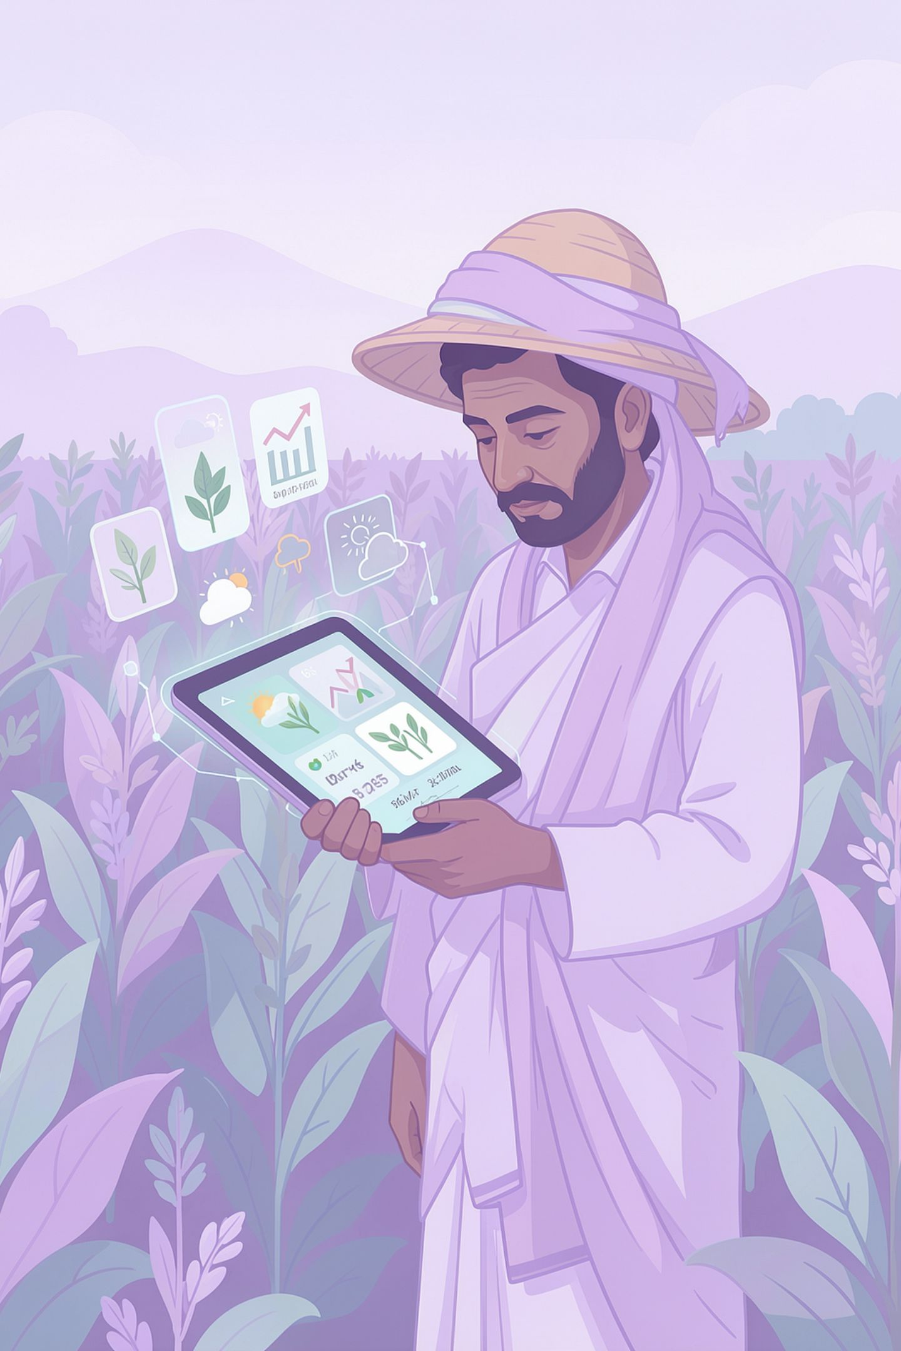
Proposed Solution & Objectives
AgriVerse is a Java Full Stack smart agriculture platform designed to simplify farm management by integrating crop advisory, weather insights, marketplace services, and expert consultation into a single secure application.
Objectives
Deliver a unified platform for modern farm management
Enable AI-driven crop advisory and early pest detection
Provide real-time weather updates and market price insights
Connect farmers with agricultural experts and buyers
Improve productivity through secure and data-driven decision making

Slide 4
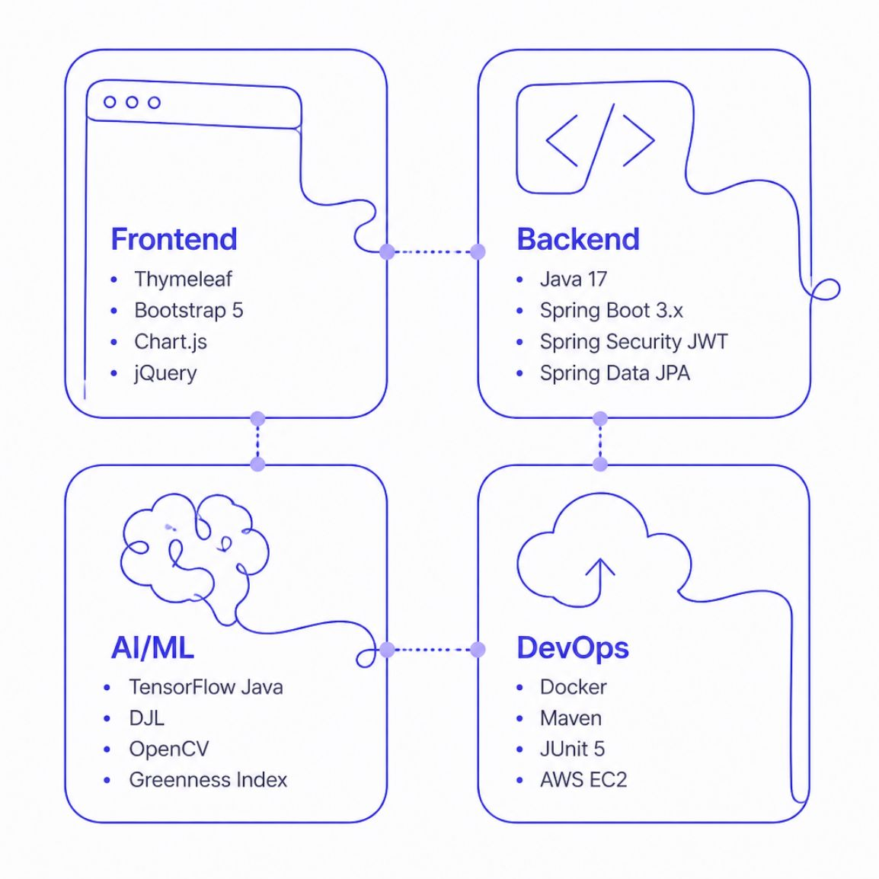
Technology Stack
Frontend
React.js, Bootstrap
Backend
Spring Boot
Security
Spring Security, JWT
Database
MONGODB
Build Tool
Maven
APIs
REST APIs
Version Control
Git & GitHub

Slide 5
System Architecture
Three-Tier Architecture
Data Flow
AI Pipeline
Database
Authentication & Authorization
Requests are meticulously processed: first authenticated by Spring Security, then routed through @RestController to interact with MySQL, before a response is delivered.
Our AI pipeline transforms raw images through OpenCV preprocessing, and performs advanced disease classification to provide precise agricultural insights.
Utilizes MONGODB with Spring Data JPA for robust production environments, while an H2 in-memory database facilitates seamless testing and demo functionalities.
Frontend connects to a robust Spring Boot API, which in turn integrates with a specialized Spring AI Microservice, ensuring a scalable and modular design.
Secure authentication is powered by Spring Security, JWT, implementing strict role-based access control for Farmers, Vets, and Admins.

Slide 6
Database Design
MySQL stores all application data using relational tables.
Users
Crops
Products
Orders
Authentication, roles, and profile details for farmers, buyers, and administrators.
Crop records with planting details, disease status, and cultivation metadata.
Marketplace product listings linked to crop inventory and availability.
Purchase transactions, order status, quantities, and delivery tracking.
Consultations
Weather
Marketplace
Expert advice sessions, diagnosis notes, and recommendations for users.
Location-based forecasts, alerts, and environmental conditions for decision-making.
Listings, pricing, categories, and buyer-seller interactions across the platform.

Slide 7
System Workflow & Security
AgriVerse ensures secure access through role-based authentication and controlled application workflow.
Workflow
Security
Spring Security
JWT Auth
Role-Based Access
User Login
Role Verification
Access Features
JWT Authentication
Personalized Dashboard

Slide 8
Core Features & Modules
AgriVerse provides a complete digital farming ecosystem by combining secure farm management, intelligent decision support, and role-based services on a single platform.
Core Features
Application Modules
AI & Smart Services
🔐 Secure Authentication
👨‍🌾 Farmer Portal
🌱 AI Crop Advisory
🌾 Crop Management
🩺 Expert Portal
🐛 Pest Detection
🌦️ Weather Insights
🛒 Marketplace
🌤️ Weather Analysis
🛍️ Digital Marketplace
📊 Admin Dashboard
📈 Market Price Insights
📊 Analytics Dashboard
🔑 Role-Based Access
🤖 Smart Recommendations

Slide 9
Key Innovations
AgriVerse combines modern Java Full Stack technologies with AI-powered services to deliver an intelligent and scalable digital farming solution.
💡 Innovation
Description
🤖 AI Advisory
Personalized crop recommendations based on farming data
🔐 Secure Access
JWT authentication with role-based authorization
🌦️ Smart Insights
Real-time weather and market price updates
🛒 Digital Marketplace
Direct farmer-to-buyer trading platform
📊 Analytics Dashboard
Visual reports for better decision-making

Slide 10
Competitive Analysis
Feature
Traditional Methods
AgriVerse
Crop Management
❌ Manual
✅ Digital
Expert Consultation
❌ Offline
✅ Online
Weather Insights
❌ Separate Apps
✅ Integrated
Marketplace
❌ Middlemen
✅ Direct Trading
AI Recommendations
❌ Not Available
✅ Intelligent Advisory
Secure Platform
❌ Limited
✅ JWT + Spring Security

Slide 11




Future Scope
IoT Sensor Integration
Drone Monitoring
AI Prediction Improvement
Seamlessly integrate data from soil, weather, and crop health sensors for real-time insights.
Utilize drones for aerial imaging, automated pest detection, and comprehensive crop analysis.
Enhance AI models for more accurate yield predictions, disease forecasting, and optimal resource management.
Mobile Application
Government Scheme Integration
Online Payments
Develop a dedicated mobile app for farmers to access AgriVerse features on-the-go.
Implement secure online payment gateways for marketplace transactions and expert consultations.
Integrate with government agricultural schemes and subsidies to provide farmers with relevant information and support.

Slide 12






Results & Benefits
Easy to use
Secure system
1
2
Centralized farm management
6
3
Better crop planning
Direct farmer-to-buyer connection
5
4
Faster decision making

Slide 13
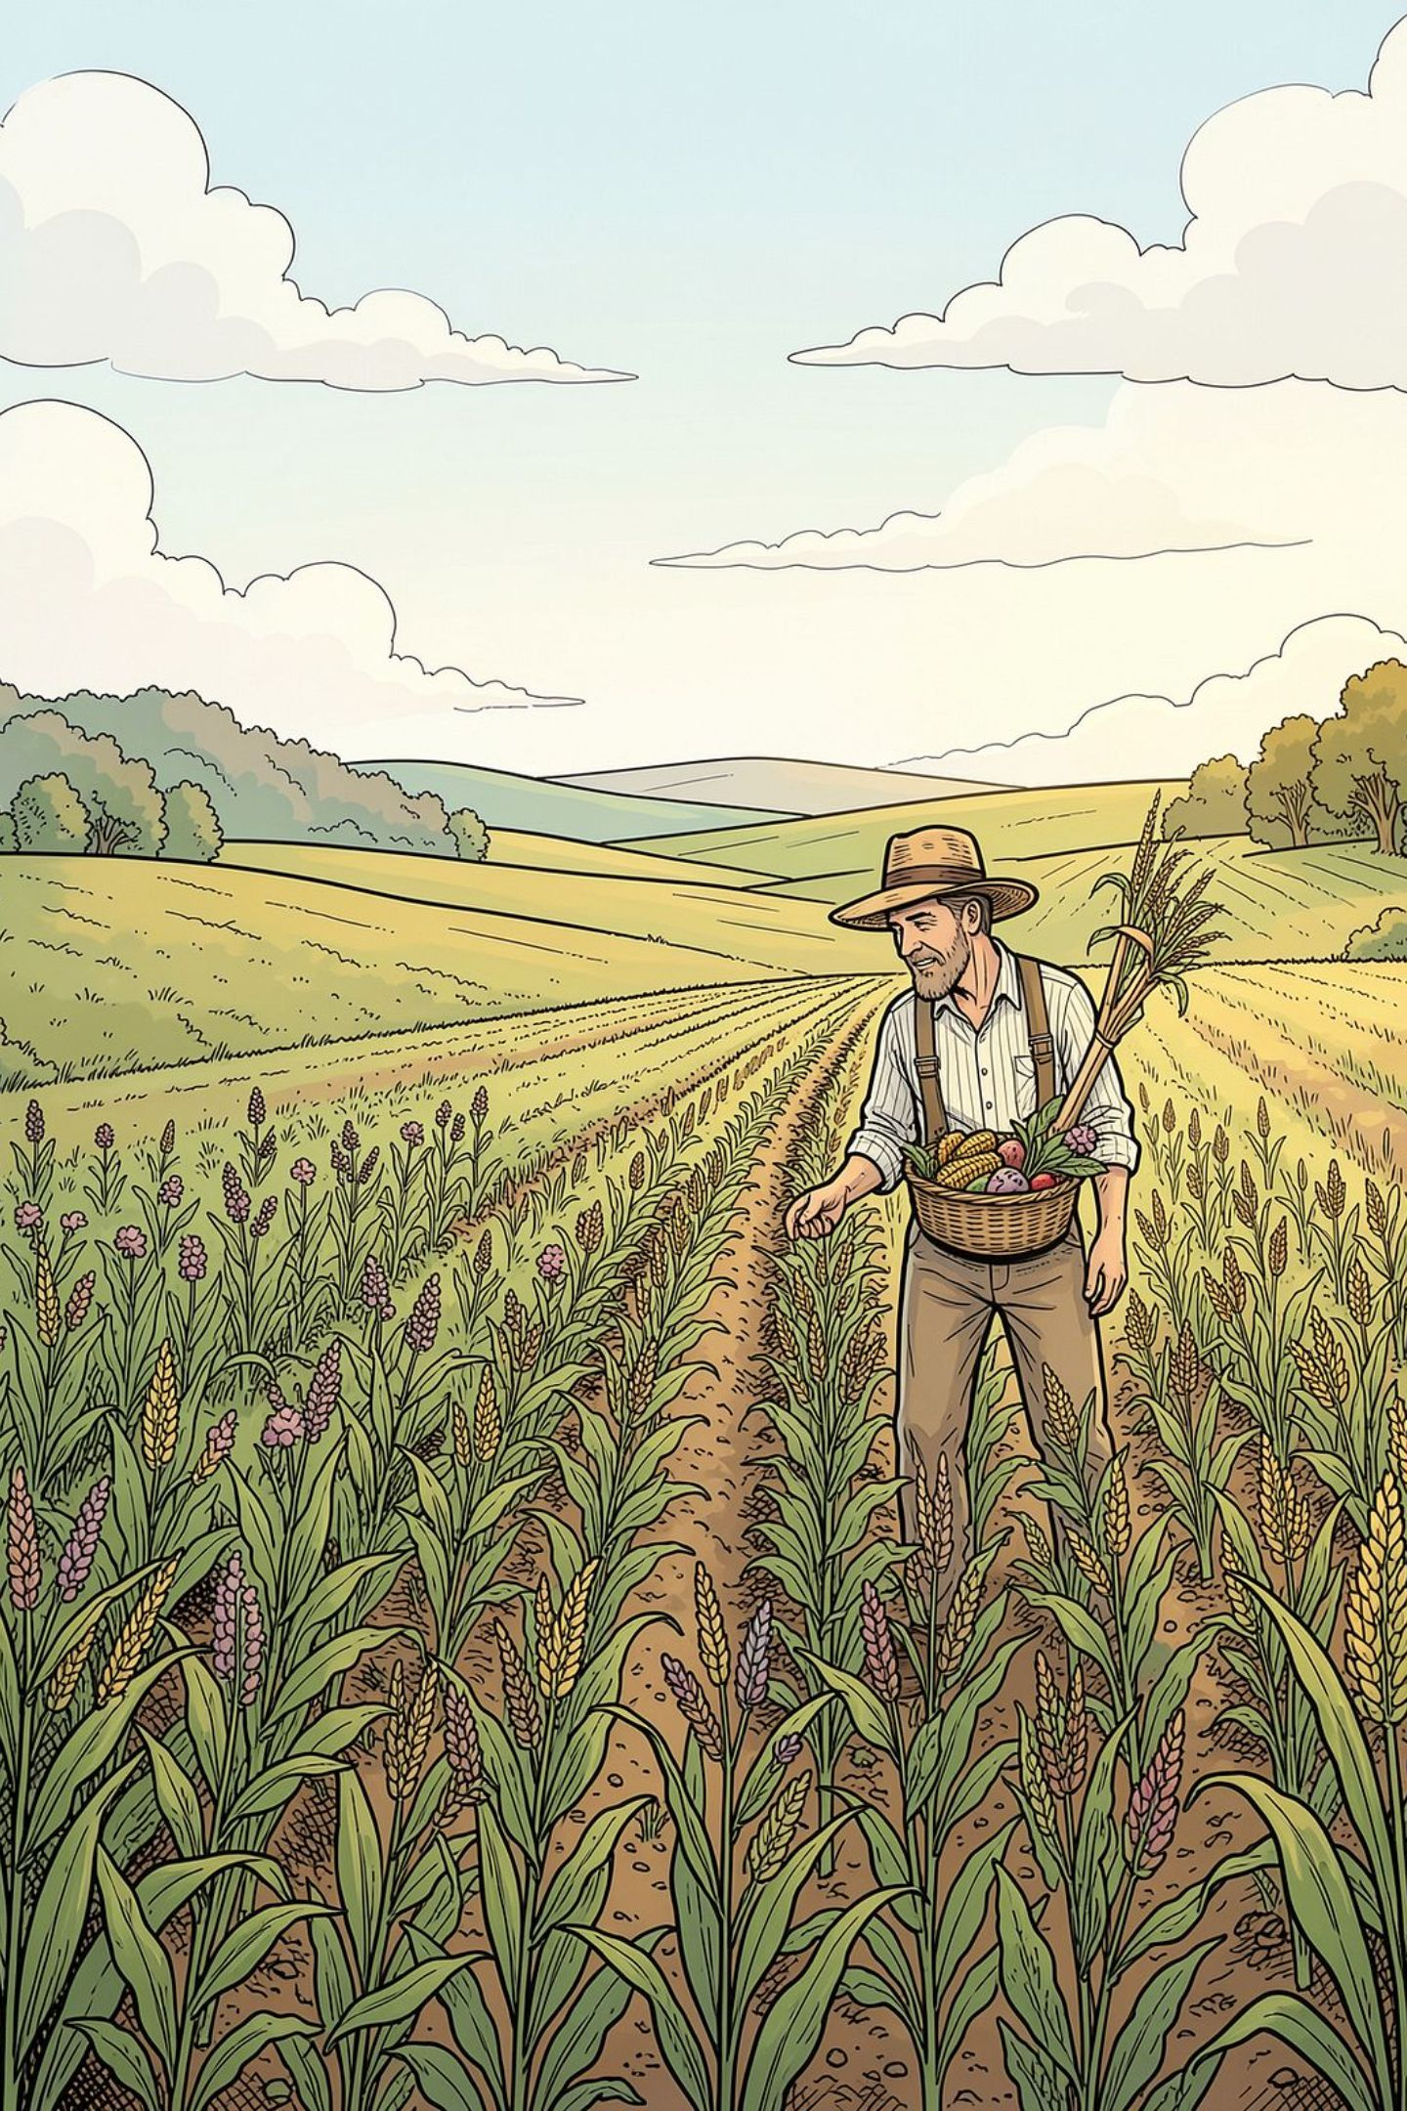
Thank You
Questions & Discussion
Presented by TEAM C

